Slide 1

MTPE
Machine Translation Post-Editing

Slide 2
Machine translation – what is this?
MT = translation automatically generated by computer software
FAMT - fully automatic MT
FAHQMT - fully automatic high quality MT
IMT - interactive machine translation
HAMT - human assisted machine translation
MAHT - machine assisted human translation
CAT - computer aided translation
Notes:
If the whole process of translation is performed with no human participation whatever, it is referred to as fully automatic machine translation (FAMT), nevertheless its output quality may frequently be questionable. Therefore, the application of FAMT is adequate when the purpose of the TK text does not require being flawlessly translated, i.e. it allows for certain inconsistencies in comparison with the SL input or stylistic shortcomings. In fact, such a rapidly achieved rough translation may also be very helpful, e.g. for a scientist who needs an immediate access to the content of a text within their domain written in a distant foreign language for which traditional human translation is not easily available, since he or she can employ their knowledge of the subject field in order to retrieve the actual intended meaning from the imperfect TL output. Despite the fact that the idea of accomplishing fully automatic high quality machine translation (FAHQMT) is essentially unfeasible on account of the inability of computers to reason in the same way humans do, a considerable reduction of mistakes and inaccuracies in a FAMT output is however possible.
Not only is it possible that human involvement in shaping the MT output can take place either before or after the MT proper, but the system may also allow for the user intervention during the process of translation, the phenomenon of which is known as interactive machine translation (IMT).

Slide 3
Short history of MT
1930s - George Artsrouni and Petr Smirnov-Troyanskii (idea of three stages)
1940 – First computers (Alan Turing’s team, code breaking operation); the Cold War period, Russian-English translation systems for the military
1954 - First trial (IBM & University of Georgetown)
1964 - ALPAC (Automatic Language Processing Advisory Committee); 1966 – critical report
1970s - Systran, Taum-météo (Canada, France, Germany)
1980s - Logos (German to French and vice versa), Pan-American Health Organization (from Spanish to English and vice versa), Japanese IT companies
1990s - Change from RBMT to SMT (e.g. Reverso)
1947 - Warren Weaver’s idea; 1949 - Memorandum
Notes:
Troyanskii – analysis by the editor – conversion into base forms according to syntactic functions, machine organizes base forms into equivalent sequences in the TL, and the rough version is corrected by a second editor (TL speaker). BUT The first real developments in Machine Translation took place after the Second World War, during which the first computers had been invented in the UK by Alan Turing’s team as part of the now famous code-breaking operation. The beginnings of the Cold War in the late 1940s prompted significant investment by the US government in automatic Russian-English translation systems for the military; France, Japan the UK and the USSR had smaller programs. These first-generation systems were known as “direct” systems since they were basically word based “direct replacement” systems; each ST word would be looked up and replaced by a corresponding TL term. (word for word is not a solid base for translation). Without significant progress, MT’s reputation fell very low in the 1960s following damning criticism by Yehoshua Bar-Hillel in his Report published in 1966 by the Automatic Language Processing Advisory Committee (ALPAC). Instead, the focus shifted to more basic questions of language processing, the field that became known as computational linguistics. The Weaver memorandum is probably the single most influential publication in the early days of machine translation, since it formulated goals and methods before most people had any idea of what computers might be capable of, and since it was the direct stimulus for the beginnings of research first in the United States and then later, indirectly, throughout the world (Hutchins 1997). Weaver had first mentioned the possibility of using the computer to translate in March 1947 in a letter to the cyberneticist Norbert Wiener and in a conversation with Andrew Booth, a British x-ray crystallographer, who was visiting various locations in the United States where computers were being built. In the following two years, he had been urged by his colleagues at the Rockefeller Foundation to elaborate on his ideas. The result was a memorandum, entitled simply “Translation,” which he wrote in July 1949 at Carlsbad, New Mexico (Weaver 1949).
MT is slower, less accurate and twice as expensive as human translation; and there is no immediate or predictable prospect of useful machine translation. It saw no need for further investment in MT research and instead recommended development of machine aids for translators (automatic dictionaires, and support for computational linguistics)

Slide 4
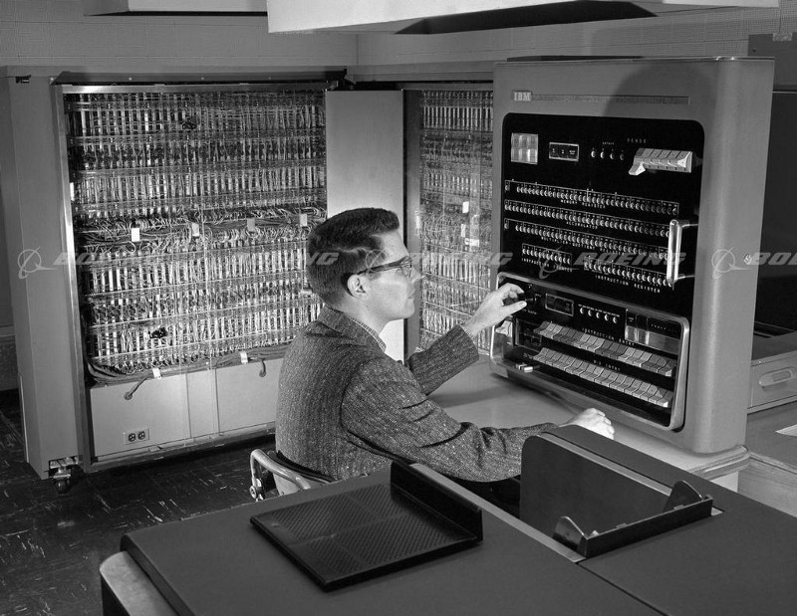
IBM
experiment
1954
Notes:
It was at the beginning of the Cold War. On January 7th 1954, at IBM headquarters in New York, the Georgetown–IBM experiment started. The IBM 701 computer automatically translated 60 Russian sentences into English for the first time in history.
“A girl who didn’t understand a word of the language of the Soviets punched out the Russian messages on IBM cards. The “brain” dashed off its English translations on an automatic printer at the breakneck speed of two and a half lines per second,” However, the triumphant headlines hid one little detail. No one mentioned the translated examples were carefully selected and tested to exclude any ambiguity. For everyday use, that system was no better than a pocket phrasebook. Nevertheless, this sort of arms race launched: Canada, Germany, France, and especially Japan, all joined the race for machine translation.

Slide 5
MT system types
Rule-based MT =RBMT
  predictable, consistent quality, in accordance with grammatical rules and dictionaries, good quality of controllable texts
  unnatural wording (no fluency), problems with exceptions, high development and adaptation costs
Statistical MT= SMT
  Based on bilingual corpora and frequency of given equivalents, fluency of translation, copes with exceptions, quickly developable - provided there is a large amount of data (= parallel texts - 2 million words for a specialised domain), easier in technical terms
  Inconsistent translation, unpredictable errors, inflection problems, high hardware requirements, poor quality for texts outside the corpus
Neural MT = NMT
  Uses machine learning (deep learning) - based on the creation of neural networks through which the system learns and acts autonomously, improving after each experience (like the human brain), predicting the probability of a given word sequence, requires less memory than SMT; smooth translation = sentence perceived as a complete unit
  All ambiguities and exceptions must be entered into the system, errors are difficult to detect, the system creates neologisms
Hybrid (variants) - integrates different existing methods, e.g. Rules Post-Processed by Statistics or Statistics Guided by Rules, or combining SMT and NMT – for maximum quality
Notes:
NMT uses deep learning techniques to directly translate source text into its target language. It works by understanding full sentences rather than individual words. This makes NMT more accurate than regular MT models when handling longer texts or phrases with multiple meanings – such as idiomatic expressions or slang

Slide 6
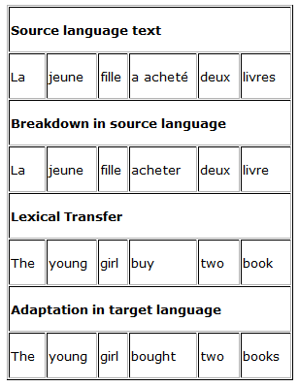
Direct Strategy (first TM systems)
Notes:
There are a number of systems that function on the same principle (SPANAM, used for Spanish-English translation since 1980, and SYSTRAN, developed in the US for military purposes to translate Russian into English. After modifications designed to improve its functioning, SYSTRAN was adopted by the European Community in 1976. At present it can be used to translate the following languages: SL : English, French, German, Spanish, Italian, Portuguese and Greek./ TL: English, French, German, Spanish, Italian, Portuguese, Greek, Dutch, Finnish and Swedish. In addition, programs are being created for other European languages, such as Hungarian, Polish and Serbo-Croatian.
Apart from being used by the European Commission, SYSTRAN is also used by NATO and by Aérospatiale, the French aeronautic company, which has played an active part in the development of the system by contributing its own terminology bank for French-English and English-French translation and by financing the specialized area related to aviation. Outside Europe, SYSTRAN is used by The United States Air Force because of its interest in Russian-English translation, by the XEROX Corporation, which adopted machine translation at the end of the 1970s and which is the private company that has contributed the most to the expansion of machine translation, and General Motors, which through a license from Peter Toma is allowed to develop and sell the applications of the system on its own account. It should be noted that in general the companies that develop direct machine translation systems do not claim that they are designed to produce good final translations, but rather to facilitate the translator's work in terms of efficiency and performance

Slide 7
RBMT vs. SMT
Encoding knowledge about the morphological, lexical, syntactic and functional structures of the source linguistic and target languages and the mappings between them
Providing enough aligned data to “train” it to “learn” the statistically most likely mappings between strings of characters in the two languages
Notes:
1) encode linguistic knowledge about the morphological, lexica, syntactic and functional structures of the source and target languages and the mappings between them
2) provide enough aligned data to “train” it to “learn” the statistically most likely mappings between strings of characters in the two languages. The first approach is that of rule-based MT (RBTM) and the second that of statistics-based MT (SMT). Nowadays there is a new enthusiasm about the potential of MT due to commercial and free online SMT (Language Weaver and Google) – thanks to the availability of very large corpora of aligned data, including TMs. SMT systems can be built in days or weeks rather than months or years, hence much of the excitement, even if the quality of the output has not necessarily improved.

Slide 8
RBMT | SMT
+ Consistent and predicatable quality | - Unpredictable translation quality
+ Out-of-domain translation quality | - Poor out-of-domain quality
+ Knows grammar rules | - Does not know grammar
+ High performance and robustness | - High CPU and disk space requirements
+ Consistency between versions | - Inconsistency between versions
- Lack of fluency | + Good fluency
- Hard to handle exceptions to rules | + Good for catching exceptions to rules
- High development and customization costs | + Rapid and cost-effective development costs provided the required corpus exists
Notes:
Given the overall requirements, there is a clear need for a third approach through which users would reach better translation quality and high performance (similar to rule-based MT), with less investment (similar to statistical MT).
SMT systems rely on two models of statistical probabilities, the translation model and the (target) language model, both calculated on the basis of a large bilingual corpus (preferably of millions of words). The translation model is “the set of probabilities for each word on the source side of the corpus that it corresponds to … each word on the target side of the corpus”. In this model, readily usable translation equivalents are expected to have a high statistical probability. The (target) language model is the set of probabilities of the relative ordering of a given set of TL words. These two models are then used in conjunction by a so-called decoder, whose task “consists of applying the translation model to a given sentence S to produce a set of probable (TL) words, and then applying the language model to these words to produce the target sentence T., such that the probability of T is the highest possible. Recent approaches include phrases in both models, with improved results.
The main challenge for RBMT is ambiguity at any linguistic level, hence the attraction of controlled languages.
For SMT the main challenge is data sparsity – words in the current source text which have been encountered only rarely (or even not at all) in the training data. Of course, the corrections made to SMT output by the translator are added to the TM so that the available training data constantly improves. The hunger for more data to train SMT systems has encouraged major content publishers, particularly in IT to pool their hitherto jealously guarded TM assets within the TAUS Data Association created by Translation Automation Users Society.
Yet, SMT systems are prone to run into difficulties when used on data different from that on which they were trained – to translate e mail correspondence rather than technical reports, for example. In these circumstances RBMT systems are judged more robust in maintaining their translation quality. While SMT errors may more often be unfathomable, the errors made by RBMT systems tend to be more consistent and as a result, easier for post-editors to find since they are the product of a rule-based process. For example, a given MT system might regularly insert the definite article before abstract nouns (“the love conquers all”) when translating from Romance languages. Similarly, instructional steps beginning You must in an English manual might be more appropriately translated into many languages by an impersonal construction such as it is necessary to. Specialized companies are already offering post-editing services to other LSPs. MT tools are rarely good at supporting the post-editing process but this new niche market may drive the development of better technologies.

Slide 9
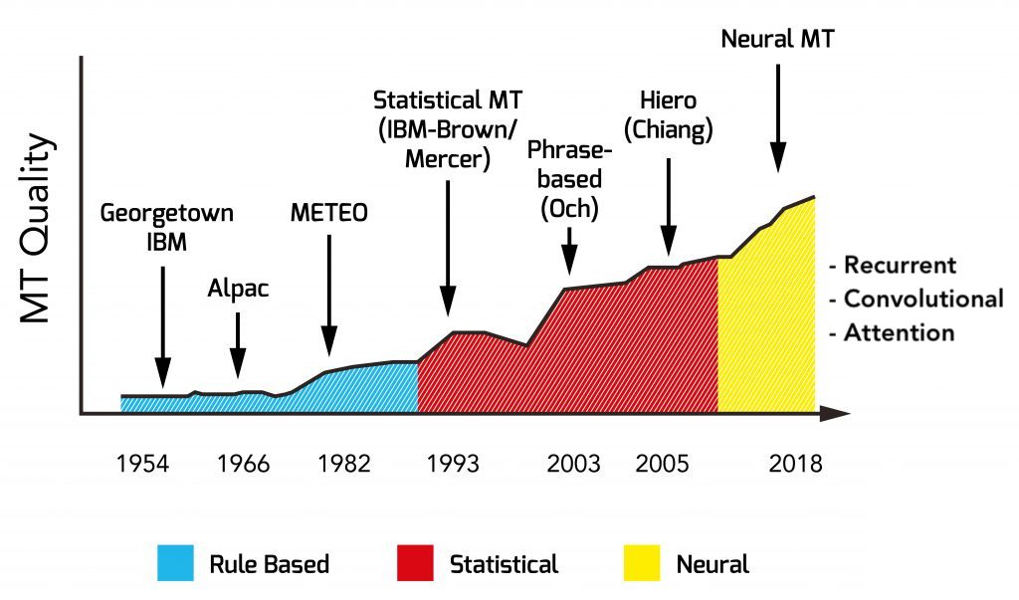
History of machine translation
DeepL 2017
Google Translate 2006,2016
Notes:
https://redokun.com/it/blog/machine-translation; MT on the web starts with Systran offering free translation of small texts (1996), followed by AltaVista Babelfish, which racked up 500,000 requests a day (1997). Franz-Josef Och (the future head of Translation Development at Google) wins DARPA’s speed MT competition (2003). More innovations during this time include MOSES, the open-source statistical MT engine (2007), a text/SMS translation service for mobiles in Japan (2008), and a mobile phone with built-in speech-to-speech translation functionality for English, Japanese and Chinese (2009). Recently, Google announced that Google Translate translates roughly enough text to fill 1 million books in one day (2012)

Slide 10
Google Translate
System initially based on SYSTRAN (just like Yahoo! Babel Fish, AOL)
In 2007 Google announced a new, proprietary algorithm, based on statistical models
Pattern detection + intelligent guess
Translations via English
UN documents as a corpus (6 official languages)
Supports 103 languages at various level
Used by more than 200 million people daily
Future development – addition of neural networks, a form of AI which continuously learns, understanding the structure and grammar
Notes:
January 2016 'Russian Federation' turns into Mordor, Sergei Lavrow as „sad little horse”, „Russian as „occupiers”. The error, which Google said is down to an automatic bug, appeared in the online tool when users converted the Ukranian language into Russian. A Google spokesman told Russia's state news agency RIA Novosti that the translating tool is fully automatic and solely uses algorithms. 'When Google Translate generates a translation, it looks for patterns in hundreds of millions of documents to help decide which definition is most correct,' he said. He added that automatic translation 'is a complex system because the meaning of a word depends on the context in which it is used‘. 'Therefore, there are mistakes and mistranslations, and we try to fix them as soon as possible after finding out about them,' the spokesman said. Although translations are managed automatically, it is possible for users to suggest alternative translations manually.
It is not the first time that politically charged mistranslations affect the Google Translate service between Ukrainian and Russian, which are linguistically similar. In November, the translating tool expressed 'all-Ukrainian' as 'All-Russian', according to RBK Ukraine.
Radio Free Europe also reports that in mid-2015, the 'Revolution of Dignity', another name for the Euromaidan revolution that ousted pro-Russian president Viktor Yanukovych, was translated into Russian as 'political crisis in Ukraine'.
so far, Google Translate is not capable of replacing human translators, a task that still looks far ahead. But due to its intricate algorithms, based on grounded statistical concepts, it is formally recognized as one of the greatest breakthroughs in machine translation. By relying on sophisticated analytical tools, Google changed the landscape of the translation business forever. Yet another field revolutionized thanks to statistics.
"Most state-of-the-art commercial machine translation systems in use today have been developed using a rules-based approach and require a lot of work by linguists to define vocabularies and grammars. Several research systems, including ours, take a different approach: we feed the computer with billions of words of text, both monolingual text in the target language, and aligned text consisting of examples of human translations between the languages. We then apply statistical learning techniques to build a translation model,"
The fact that Google Translate relies mostly on previously translated texts is also its weak point. Google does not directly translate from Language 1 to Language 2, at least not most of the time. Consider that many of the translation pairs offered, Korean to Urdu for instance, have no history of translation between them, and therefore no paired texts, neither on the web nor anywhere else. As a result, the algorithm usually translates the entered text to English, the language with the highest number of translation relationships. The text is then translated from English to any language you want [8]. In some cases, there's a fourth language involved. For instance, if you wish to translate a phrase in Catalan, the text would be first translated to Spanish, then to English and then to any language you may want. This intricate process is very prone to error, which explains why Google Translate is good with some languages, yet barely capable with others. The algorithms rely on the amount and quality of the translated documents that work as input for the process, the same way that the quality of raw data becomes key to the success of any model.

Slide 11
Neural Machine Translation
Neural machine translation (NMT) - the use of neural network models to learn a statistical model for machine translation.
A single system can be trained directly on source and target text
The strength of NMT lies in its ability to learn directly, in an end-to-end fashion, the mapping from input text to associated output text.

Slide 12
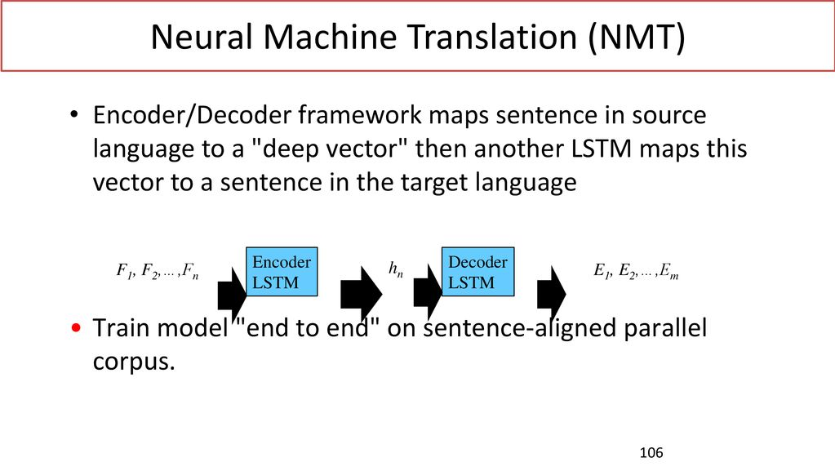
Notes:
Long short-term memory
Humans don’t start their thinking from scratch every second. As you read this essay, you understand each word based on your understanding of previous words. You don’t throw everything away and start thinking from scratch again. Your thoughts have persistence.
Long short-term memory (LSTM) is an artificial recurrent neural network (RNN) architecture^{[1]} used in the field of deep learning. Unlike standard feedforward neural networks, LSTM has feedback connections. It can not only process single data points (such as images), but also entire sequences of data (such as speech or video). For example, LSTM is applicable to tasks such as unsegmented, connected handwriting recognition,^{[2]} speech recognition^{[3][4]} and anomaly detection in network traffic or IDSs (intrusion detection systems). previous words. You don’t throw everything away and start thinking from scratch again. Your thoughts have persistence.

Slide 13
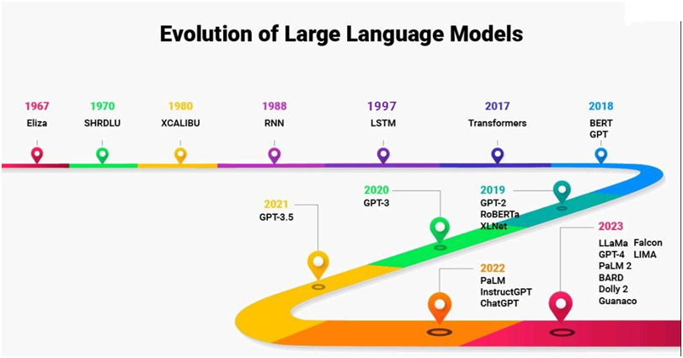
Machine translation and LLMs
Notes:
LLM-based translation differs from traditional machine translation in its ability to handle context, reasoning, and interaction. Traditional MT, including neural systems, primarily operates at the sentence level, optimizing for accuracy and fluency based on parallel data. The rise of Large Language Models (LLMs) marks the most significant evolution in translation technology since neural MT. Unlike traditional systems that translate sentence by sentence, purpose-built LLMs can reason across entire documents, enabling greater adaptability for complex enterprise content. Their key advantage is full-document context awareness. By considering terminology, tone, and intent holistically, purpose-built LLMs deliver stronger consistency and more natural, brand-aligned translations // https://www.kamarajiasacademy.com/current-affairs/large-language-model

Slide 14
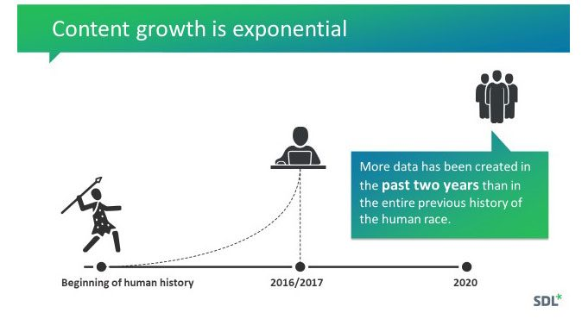
Notes:
https://www.cmswire.com/customer-experience/why-machine-translation-matters-in-the-modern-era/
Why Machine Translation Matters in the Modern Era - By Kirti Vashee JUNE 1, 2018

Slide 15
Pre-editing vs. Post-editing
Pre-editing is the process of adjusting text before it is automatically translated in order to improve the raw quality of the machine translation output and to reduce the amount of work required in the post-editing process
Post-editing is the examination and correction of the text resulting from an automatic or semi-automatic machine system to ensure it complies with the natural laws of grammar, punctuation, spelling and meaning, etc.
Notes:
Pre-editing is the process of adjusting text before it is automatically translated in order to improve the raw quality of the machine translation output and to reduce the amount of work required in the post-editing process. This process is most typically used when a document is going to be translated into more languages, which is when it becomes more cost-effective to invest time into pre-editing as opposed to more time into post-editing. Pre-editing can involve many different types of tasks. One such task is that in which the source text is written with fixed rules such as using short sentences, avoiding complex or ambiguous syntactic structures, term consistency etc. Other pre-editing tasks can involve spell checking the source text, format checking, and tagging elements in the source document that are not to be translated.
Post-editing is the “examination and correction of the text resulting from an automatic or semi-automatic machine system to ensure it complies with the natural laws of grammar, punctuation, spelling and meaning, etc.” (Draft of European Standard for Translation Services, Brussels, 2004)

Slide 16
Types of postedition
Light postedition – post-editing at a basic level (“sufficient quality")
Fully comprehensible text
Faithful rendering of the source text
No linguistic errors (but: syntax and grammar are not necessarily perfect)
Full postedition – comprehensible, accurate and stylistically correct text with coherent and correctly translated terminology
Modification of syntax
Taking cultural elements into account

Slide 17
Light post-edition
Obvious typos and errors
No stylistic corrections, no alteration of sentence structure
Comprehensible text - not necessarily natural
Checking that no relevant information has been omitted or erroneous information added
The objective is not to obtain a product comparable to a human translation
For internal purposes, to get a quick understanding of the content

Slide 18
Full postedition
To produce a grammatically, syntactically and semantically correct text in the target language
Check terminology for correctness and consistency, compare with reference documents
Rewriting the text according to the rules of the target language
Adaptation of cultural elements (idioms, proverbs, examples)
The aim is to produce a product comparable to a human translation

Slide 19
Light postedition
Automatic spell checking
Checking whether the entire text has been translated
General quality check - removal of ambiguous or incorrect translations within a given time limit
Check terminology against glossary, consistency, etc.
Checking proper names, names of institutions, titles, etc.
Making stylistic changes (unless the syntax causes misinterpretation)

Slide 20
Full postedition (=full proofreading)
Automatic spell-check + thorough checking of segments for grammar, spelling - within expected time limit
Checking that the entire text has been translated
Checking the translation of key terminology, proper names, institution names, titles, etc.
Checking stylistics and terminology against reference texts ( making modifications)
Cross-checks related to a subject matter specific tone of voice and terminology
Stylistic changes to increase the readability of the text and remove the „machine-translation feel”
Preparation of glossary (terminology extraction)

Slide 21
Standard postedition
Automatic spell-check + a manual spot-check to eliminate errors - within the expected time limit
Checking that the entire text has been translated
Overall sanity check to try to remove any ambiguous or incorrect translations – the expected time limit
Consistency checks of key terminology (product/brand names, names of insitutions, job titles, etc.)
Some stylistic corrections to increase the readability of the text and remove the „machine-translation feel”
Preparation of glossary (extraction of terms)

Slide 22
Postedition stages (light vs. full)
Lexical errors
Syntax error
Less obvious errors
Appropriate style
Fluency
Text comparable to human translation
Machine-generated text
Light postedition
Full postedition
Comprehensible text that is true to the original

Slide 23
Categories of errors in MT
Vocabulary / terminology
Literal translation of idioms
Lack of distinction between styles and registers
Errors in single words, references, structural errors (changing the sense)
Incorrect forms of verbs
Inconsistent translation of terms
- or - Translation of specific terms in the same way regardless of context
Syntactic errors
Punctuation errors
Omitted / added text
Compound words translated as single elements
Neologisms created by AI

Slide 24
Additional problems in MTPE
Different error categories from standard proofreading
Incorrect rendering of the sense of the source text at different levels
Time constraints - as few corrections as possible
Technical issues (interface, CAT tools)
Quick decision-making (whether to translate from scratch or revise)
High quality translation (fluency) makes the post-editor less alert - need to focus all the time
Psychological factor

Slide 25
Critical Errors in Machine Translation
(Al Sharou & Specia, 2022)
Critical errors occur when translation output significantly distorts the original meaning, leading to serious consequences such as misinformation, offense, or unsafe actions.
They arise through:
  Mistranslation (wrong meaning)
  Hallucination (adding content)
  Deletion (missing content)
Notes:
Al Sharou, Khetam & Specia, Lucia. (2022). A Taxonomy and Study of Critical Errors in Machine Translation. A Taxonomy and Study of Critical Errors in Machine Translation, June 2022, Conference: European Association for Machine Translation (EAMT), At: https://aclanthology.org/2022.eamt-1.20/

Slide 26
Types of Critical Errors
1. Toxicity Deviation (TOX)
Description:
The translation changes the level or type of toxicity (profanity, hate, aggression).
Example from the text:
Source (ST):
“Your killing the fucking planet.”
MT Output:
“May the damn planet kill you.”
Error Explanation:
  The original sentence criticizes someone’s actions.
  The translation reverses agency and turns it into a direct aggressive wish.
  This increases hostility and changes intent → critical toxicity distortion.

Slide 27
Types of Critical Errors
2. Health & Safety Risk (SAF)
Description:
Errors that introduce incorrect health or safety-related meaning, potentially misleading users.
Example from the text:
Source (ST):
“I know two teenagers that suffer from gerd it is a big problem for these people!”
MT Output:
“I know two teenagers that suffer from root disease it is a big problem for these people!”
Error Explanation:
  “GERD” (a medical condition) is mistranslated as “root disease.”
  This produces false medical information, which could mislead readers → health risk.

Slide 28
Types of Critical Errors
3. Named Entity Errors (NAM)
Description:
Incorrect handling of names, places, or entities, causing confusion or misinformation.
Example from the text:
Source (ST):
“Your fucking ass doesn’t know shit about it AT ALL. Rocky.”
MT Output:
“Your fucking ass doesn’t know shit about it AT ALL. rock.”
Error Explanation:
  “Rocky” (a proper name) is translated as “rock.”
  This leads to loss of identity and incorrect reference → entity distortion.

Slide 29
Types of Critical Errors
4. Sentiment or Negation Errors (SEN)
Description:
Errors that reverse polarity (positive ↔ negative) or remove negation.
Example:
Source (ST):
“Don’t the Yoshinoyasin Singapore and Indonesia ALSO not serve pork?”
MT Output:
“Don’t the Yoshinoyasin in Singapore and Indonesia ALSO serve pork?”
Error Explanation:
  The phrase “not serve pork” → “serve pork”
  Negation is dropped → meaning is reversed
  This could misinform users (e.g., dietary/religious context).
Notes:
Tenderloin / polędwica łososiowa / salmon

Slide 30
Types of Critical Errors
5. Numbers, Time, Units, Date Errors (NUM)
Description:
Incorrect translation of quantitative or temporal information.
Example:
Source (ST):
“Your signature is incredibly long. At 632 characters, it’s about two and a half times what the software allows.”
MT Output:
“Your signature is incredibly long. At 632 characters, it is double what the software allows.”
Error Explanation:
  “Two and a half times” → “double”
  Numerical meaning is changed and reduced. This could lead to misinterpretation of limits or requirements.

Slide 31
Types of Critical Errors
6. Instruction Errors (INS)
Description:
Errors that distort instructions, requests, or actions, leading to incorrect behavior.
Example:
Source (ST):
“The link to wikibooks doesn’t work and I don’t know how to fix it. Can anyone help?”
MT Output:
“The link to wikibooks doesn’t work and I don’t know how to fix it. Can I help you?”
Error Explanation:
  A request for help becomes an offer to help
  This reverses communicative intent → misleading interaction.

Slide 32
Types of Critical Errors
7. Other Critical Meaning Deviations (OTH)
Description:
Any critical meaning change not covered by other categories.
Example:
Source (ST):
“Admin’s beware of him.”
MT Output:
“Admin is aware of him.”
Error Explanation:
  Warning (“beware”) becomes neutral awareness
  The core intent (caution) is lost → serious meaning shift.
  .

Slide 33
Real-World Example (Al Sharou & Specia)
Source: “Good morning” (Arabic)
MT Output on social media: “Attack them” (Hebrew)
Impact: Led to real-world arrest
Shows how critical errors can have serious social/legal consequences
Notes:
The volume of content shared by users means that the MT-translated content cannot be manually post-edited. Therefore, users have to rely on MT as is and usually do not have the linguistic skills to identify the errors. As a consequence, users may be negatively affected if they misunderstand the intention or sentiment of the source text or could take inappropriate action if they act on critically corrupted translations. There are many instances where innocuous statements on social media have been translated by the machine to say something quite different, the opposite, or even turn a simple greeting into hate speech - translating ‘good morning’ in Arabic into ‘attack them’ in Hebrew by the machine, leading to the arrest of a Palestinian worker who posted it on his social media profile by Israeli police. Therefore, it is important that the issue of critical error is directly addressed.

Slide 34
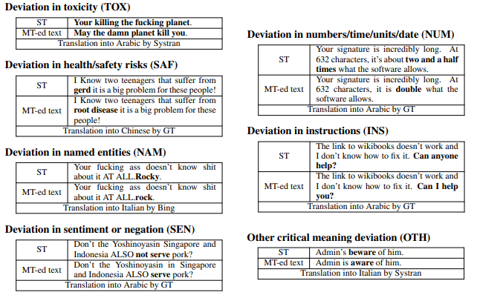

Slide 35
✓ Posteditor's tasks
✓ Using MT suggestions
Checking grammar, syntax, semantics and punctuation
Making sure nothing is missing or added to the text
Checking that all tags are correctly positioned
Retaining as much of the text generated by the machine translation as possible
If a large part of the sentence is correct
If the quality of the output text generated by MT is good and only minor corrections are required
If the quality of the output text generated by MT is of poorer quality, but the correction is faster than translating from scratch
If the meaning has been correctly rendered

Slide 36
✗ Posteditor should not
✗ MT suggestions should not be used
Thinking too long about an individual problem
Be reluctant to use repetition
Introduce stylistic changes if they are optional
If the output text generated by the MT does not make sense
If more than a few seconds are needed to understand the text generated by the MT
If there are errors that require significant changes to the structure of the text

Slide 37
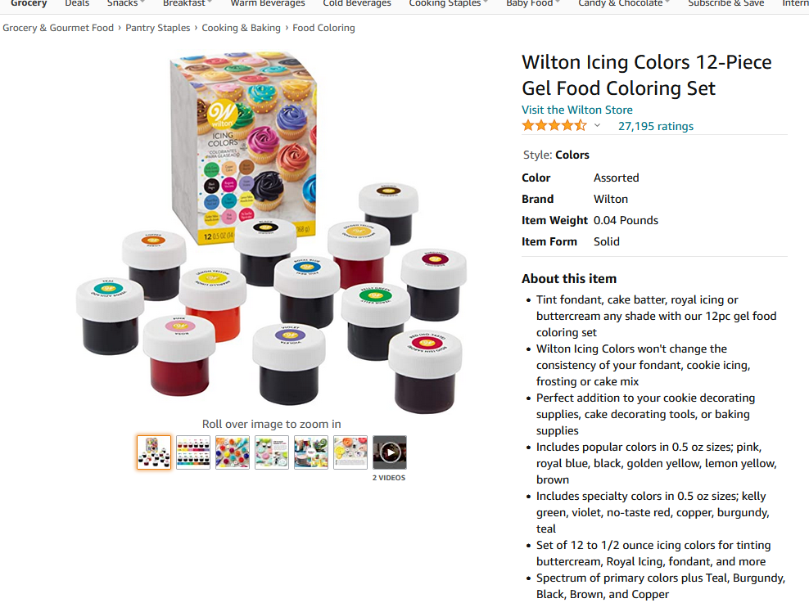

Slide 38
Examples – source text https://www.amazon.com/Wilton-Icing-Colors-12-Count-Gel-Based/dp/B0000CFN0Y?th=1
Wilton Icing Colors 12-Piece Gel Food Coloring Set
About this item
Tint fondant, cake batter, royal icing or buttercream any shade with our 12pc gel food coloring set
Wilton Icing Colors won't change the consistency of your fondant, cookie icing, frosting or cake mix
Perfect addition to your cookie decorating supplies, cake decorating tools, or baking supplies
Includes popular colors in 0.5 oz sizes; pink, royal blue, black, golden yellow, lemon yellow, brown
Includes specialty colors in 0.5 oz sizes; kelly green, violet, no-taste red, copper, burgundy, teal
Set of 12 to 1/2 ounce icing colors for tinting buttercream, Royal Icing, fondant, and more
Spectrum of primary colors plus Teal, Burgundy, Black, Brown, and Copper

Slide 39
Examples – target text (Google Translate)
Wilton Icing Colors 12-częściowy żelowy zestaw do kolorowania żywności
O tym przedmiocie
Odcień fondant, ciasto na ciasto, lukier królewski lub krem maślany w dowolnym odcieniu dzięki naszemu 12-częściowemu zestawowi do kolorowania żywności w żelu
Wilton Icing Colours nie zmieni konsystencji Twojej pomadki, lukru do ciastek, lukru lub mieszanki do ciast
Idealny dodatek do akcesoriów do dekorowania ciastek, narzędzi do dekorowania ciast lub materiałów do pieczenia
Zawiera popularne kolory w rozmiarach 0,5 uncji; różowy, królewski niebieski, czarny, złoty żółty, cytrynowożółty, brązowy
Zawiera kolory specjalne w rozmiarach 0,5 uncji; zielony kelly, fioletowy, bez smaku czerwony, miedziany, bordowy, turkusowy
Zestaw od 12 do 1/2 uncji kolorów lukru do barwienia kremu, Royal Icing, fondant i nie tylko
Spektrum kolorów podstawowych oraz turkusowy, bordowy, czarny, brązowy i miedziany

Slide 40
Examples – target text (DeepL)
Wilton Icing Colors 12-elementowy zestaw barwników spożywczych w żelu
O tym produkcie
Zabarw fondant, ciasto, lukier królewski lub krem maślany na dowolny kolor dzięki naszemu 12-częściowemu zestawowi barwników spożywczych w żelu.
Barwniki do lukru Wilton nie zmienią konsystencji pomady, lukru do ciasteczek, lukru ani masy do tortów.
Doskonały dodatek do artykułów do dekorowania ciasteczek, narzędzi do dekorowania tortów lub artykułów do pieczenia
Zawiera popularne kolory w rozmiarach 0,5 oz: różowy, błękit królewski, czarny, złoty żółty, cytrynowy żółty, brązowy
Specjalistyczne kolory w opakowaniach 0,5 oz: zielony, fioletowy, czerwony bezsmakowy, miedziany, bordowy, teal
Zestaw 12 kolorów do lukru o wadze 1/2 uncji do barwienia kremu maślanego, lukru królewskiego, pomady i innych produktów
Spektrum kolorów podstawowych oraz teal, burgund, czarny, brązowy i miedziany

Slide 41
Examples – target text in Italian (Google Translate)
Set di 12 coloranti alimentari in gel Wilton
Informazioni su questo articolo
Colora fondente, impasto per torte, glassa reale o crema al burro di qualsiasi tonalità con il nostro set di 12 coloranti alimentari in gelI coloranti alimentari
Wilton non alterano la consistenza del fondente, della glassa per biscotti, della crema o del preparato per torte
Un'aggiunta perfetta ai tuoi accessori per decorare biscotti, strumenti per decorare torte o accessori per la pasticceria
Include i colori più comuni in confezioni da 14 g: rosa, blu reale, nero, giallo oro, giallo limone, marrone
Include colori speciali in confezioni da 14 g: verde brillante, viola, rosso insapore, rame, bordeaux, verde acqua
Set di 12 coloranti alimentari in gel da 14 g per colorare crema al burro, glassa reale, fondente e altro ancora
Gamma di colori primari più verde acqua, bordeaux, nero, marrone e rame

Slide 42
Examples – target text in Italian (Google Translate)
Set di 12 coloranti alimentari in gel Wilton
Informazioni su questo articolo
Colora fondente, impasto per torte, glassa reale o crema al burro di qualsiasi tonalità con il nostro set di 12 coloranti alimentari in gelI coloranti alimentari
Wilton non alterano la consistenza del fondente, della glassa per biscotti, della crema o del preparato per torte
Un'aggiunta perfetta ai tuoi accessori per decorare biscotti, strumenti per decorare torte o accessori per la pasticceria
Include i colori più comuni in confezioni da 14 g: rosa, blu reale, nero, giallo oro, giallo limone, marrone
Include colori speciali in confezioni da 14 g: verde brillante, viola, rosso insapore, rame, bordeaux, verde acqua
Set di 12 coloranti alimentari in gel da 14 g per colorare crema al burro, glassa reale, fondente e altro ancora
Gamma di colori primari più verde acqua, bordeaux, nero, marrone e rame

Slide 43
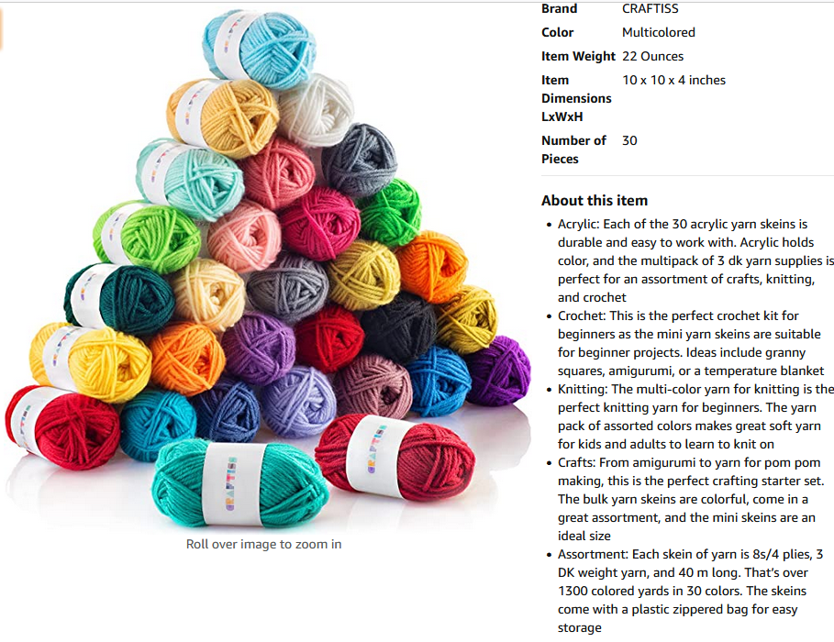

Slide 44
Examples – source text https://www.amazon.com/Craftiss-Acrylic-Perfect-Knitting-Crochet/dp/B07FS4P59J/ref=sr_1_6?crid=17UIZY3XHBT37&keywords=yarn&qid=1649325289&sprefix=yarn%2Caps%2C265&sr=8-6&th=1
Acrylic: Each of the 30 acrylic yarn skeins is durable and easy to work with. Acrylic holds color, and the multipack of 3 dk yarn supplies is perfect for an assortment of crafts, knitting, and crochet
Crochet: This is the perfect crochet kit for beginners as the mini yarn skeins are suitable for beginner projects. Ideas include granny squares, amigurumi, or a temperature blanket
Knitting: The multi-color yarn for knitting is the perfect knitting yarn for beginners. The yarn pack of assorted colors makes great soft yarn for kids and adults to learn to knit on
Crafts: From amigurumi to yarn for pom pom making, this is the perfect crafting starter set. The bulk yarn skeins are colorful, come in a great assortment, and the mini skeins are an ideal size

Slide 45
Examples – target text (Google Translate)
Akryl: Każdy z 30 motków przędzy akrylowej jest trwały i łatwy w obróbce. Akryl utrzymuje kolor, a opakowanie zbiorcze z przędzy 3 dk jest idealne do asortymentu wyrobów rękodzielniczych, dziewiarskich i szydełkowych
Szydełko: To idealny zestaw do szydełkowania dla początkujących, ponieważ mini motki włóczki są odpowiednie dla początkujących projektów. Pomysły obejmują kwadraty babci, amigurumi lub koc termiczny
Dzianie: Wielokolorowa włóczka do robótek na drutach to idealna włóczka dziewiarska dla początkujących. Zestaw włóczek w różnych kolorach to świetna miękka włóczka dla dzieci i dorosłych do nauki dziania
Rękodzieło: Od amigurumi po włóczkę do robienia pomponów, to idealny zestaw startowy do rękodzieła. Motki luzem są kolorowe, są w świetnym asortymencie, a motki mini są w idealnym rozmiarze

Slide 46
Examples – target text (DeepL)
Akryl: Każde z 30 motków włóczki akrylowej jest trwałe i łatwe w użyciu. Akryl zachowuje kolory, a wielopak 3 włóczek dk jest idealny do różnych prac rękodzielniczych, dziewiarskich i szydełkowania.
Szydełkowanie: Jest to idealny zestaw do szydełkowania dla początkujących, ponieważ mini motki włóczki są odpowiednie do początkujących projektów. Pomysły obejmują babcine kwadraty, amigurumi lub kocyk termiczny.
Dzierganie: Wielokolorowa włóczka do robótek na drutach to idealna włóczka dla początkujących. Zestaw włóczek w różnych kolorach to świetna, miękka włóczka dla dzieci i dorosłych do nauki robienia na drutach.
Robótki ręczne: Od amigurumi po włóczkę do robienia pomponów - ten zestaw to idealny zestaw dla początkujących rękodzielników. Duże motki włóczki są kolorowe i mają duży wybór kolorów, a mini motki mają idealny rozmiar.

Slide 47
Examples – target text in Italian (Google Translate)
Acrilico: Ognuna delle 30 matasse di filato acrilico è resistente e facile da lavorare. L'acrilico mantiene il colore e la confezione multipla di 3 gomitoli di filato DK è perfetta per un assortimento di lavori creativi, maglia e uncinetto.
Uncinetto: Questo è il kit perfetto per l'uncinetto per principianti, poiché le mini matasse di filato sono adatte a progetti per principianti. Le idee includono piastrelle all'uncinetto, amigurumi o una coperta termica.
Maglia: Il filato multicolore per maglia è il filato perfetto per i principianti. La confezione di filati in colori assortiti è un ottimo filato morbido per bambini e adulti che vogliono imparare a lavorare a maglia.
Lavoretti creativi: Dagli amigurumi al filato per realizzare pon pon, questo è il set perfetto per iniziare a creare. Le matasse di filato sono colorate, disponibili in un ottimo assortimento e le mini matasse hanno le dimensioni ideali.

Slide 48

Dziękuję za uwagę
Thank you for your attention

