Slide 1


Orchestrating AI
as Tool, Mediator, and Environment:
Towards Inclusive Learning Ecosystems
S. M. Pagliara, G. Bonavolontà, A. Mura
Università di Cagliari
silviom.pagliara@unica.it

Slide 2
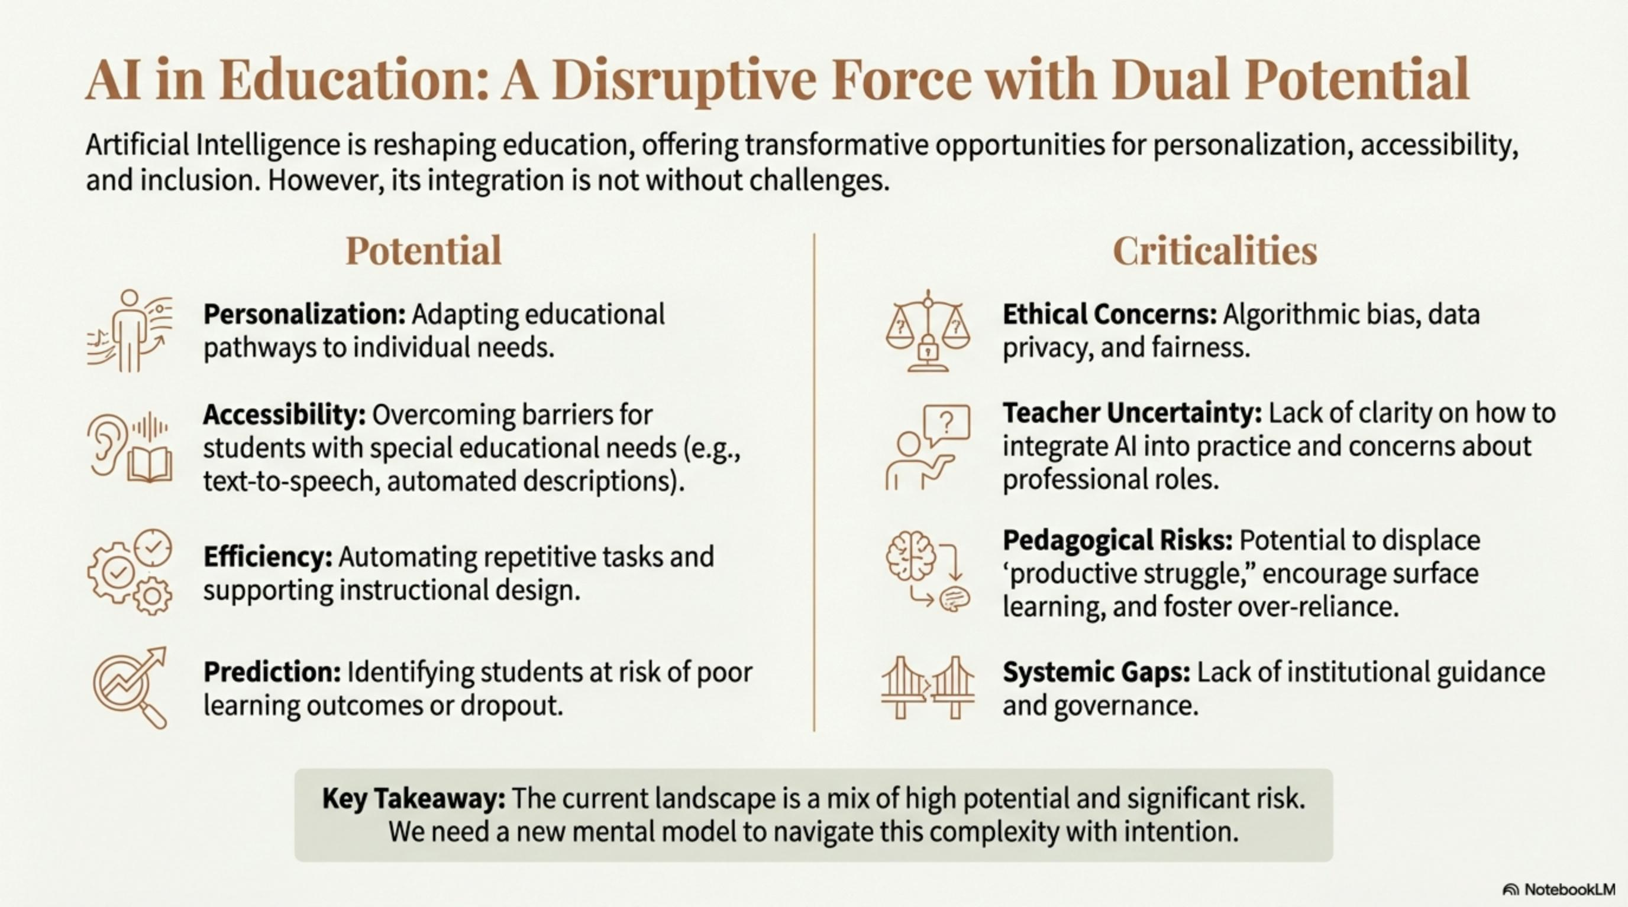
Notes:
Why orchestration now?
AI differs in kind; simultaneous tool/mediator/environment.
Teacher professionalism is pivotal (models, data, limits, affordances, neurodiversity).
Promise (personalisation, accessibility) and risks (bias, opacity, workload, governance).
Non-solutionist stance: align theory, design, evaluation in context.

Slide 3
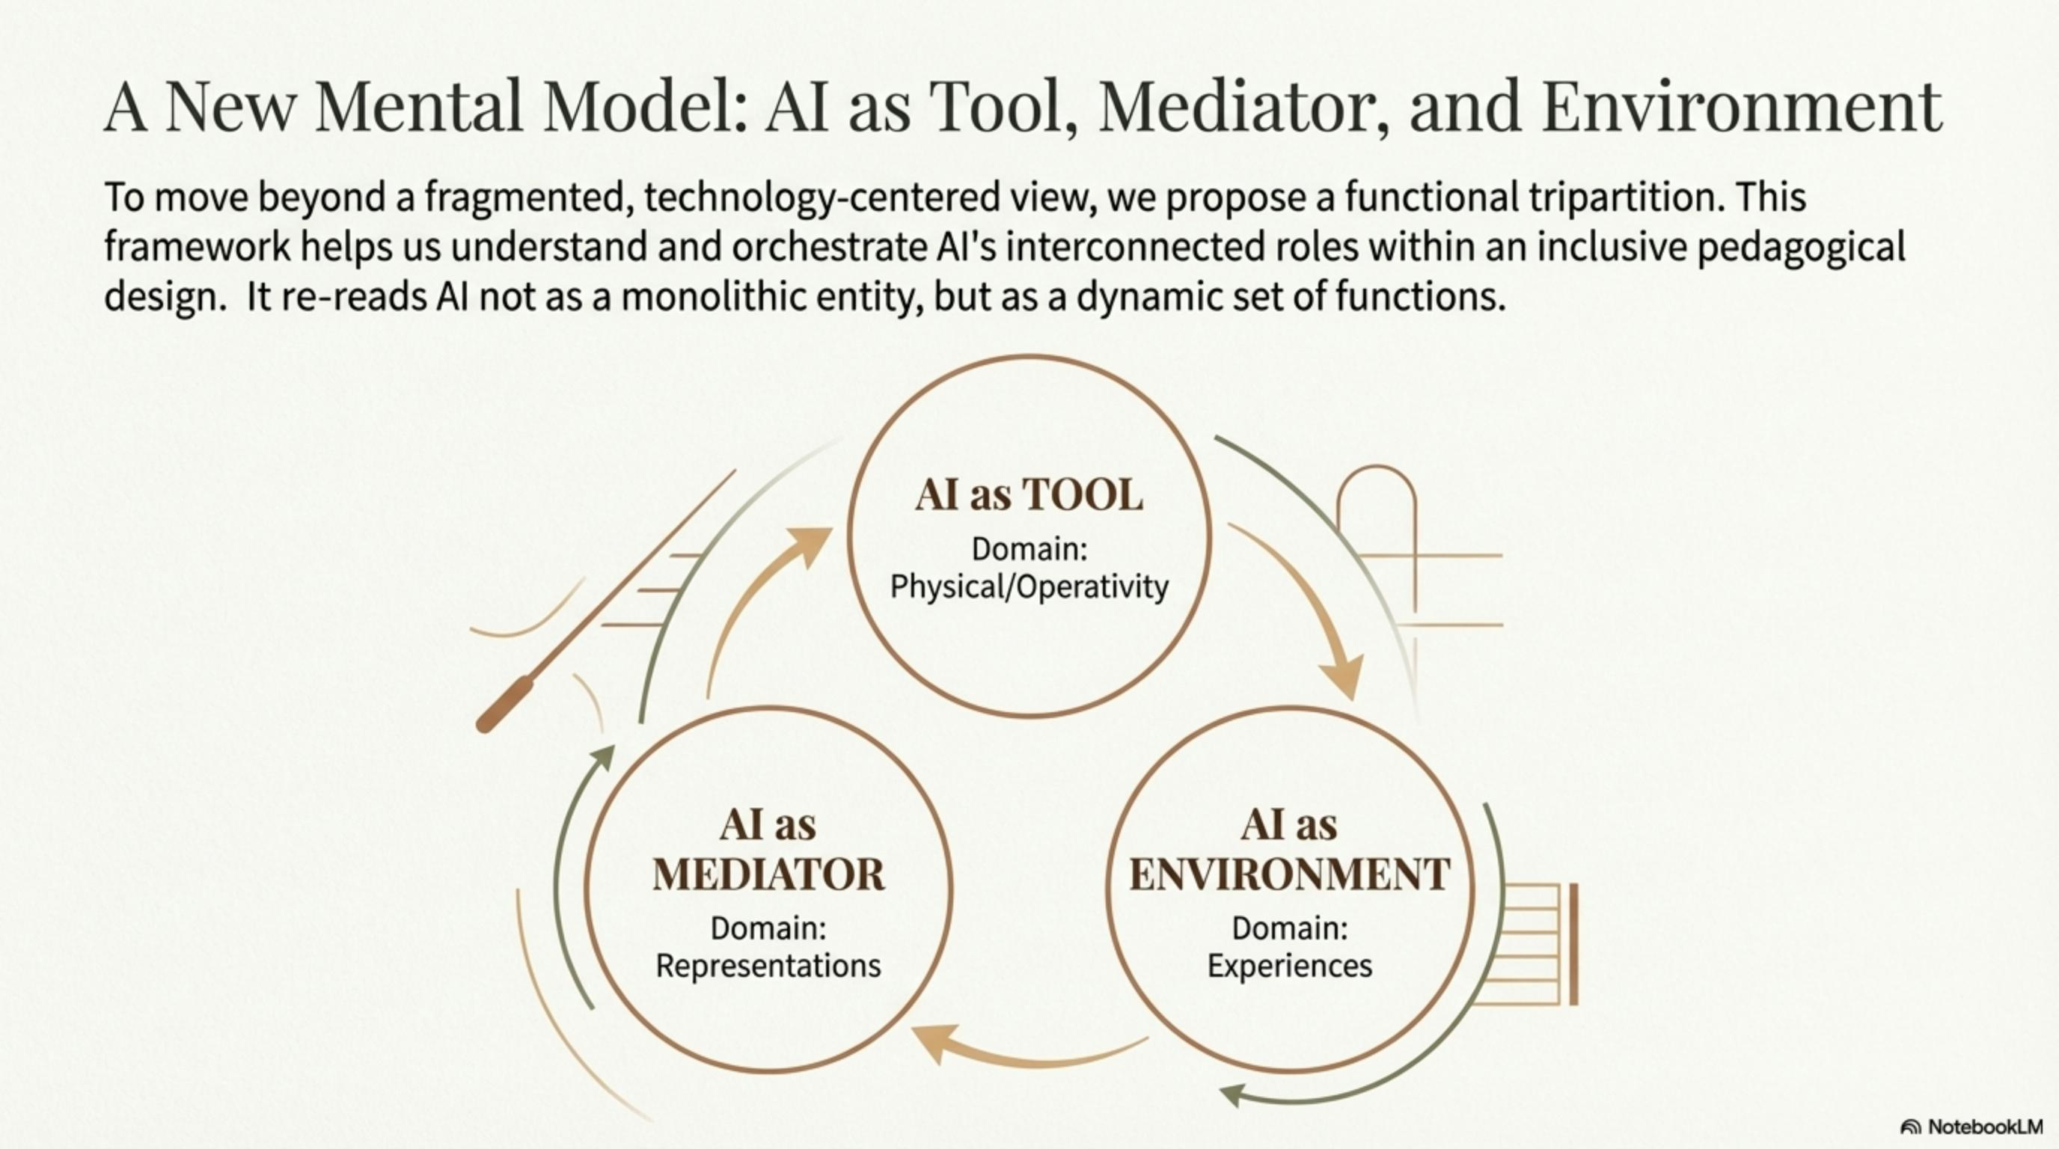
Notes:
≈60s: Link three roles to three design dimensions central to inclusion.
Conceptual framing
Tripartition aligned with inclusive design and UDL.
Three roles: Tool, Mediator, Environment (ecosystem).
Design across: Neurocognitive, Technological, Methodological–didactic (UDL).
Teacher as orchestrator; governance/regulation are enabling conditions.

Slide 4
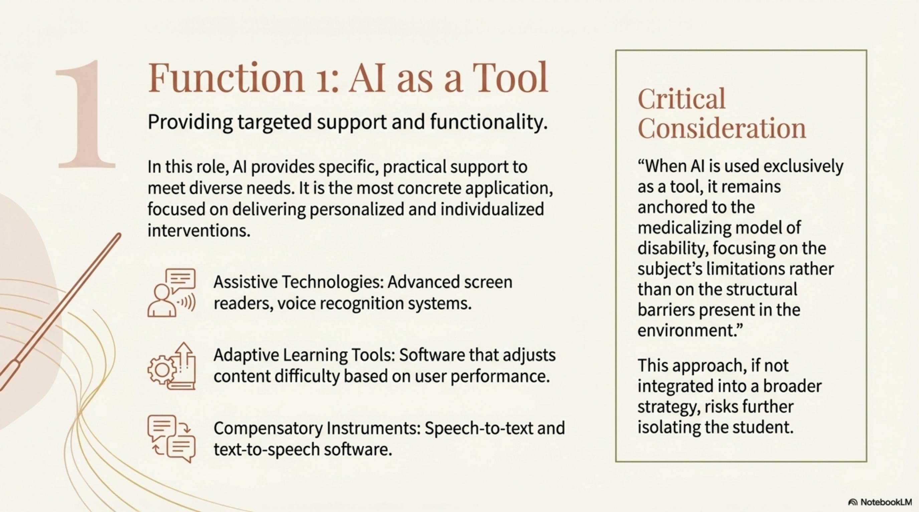

Slide 5
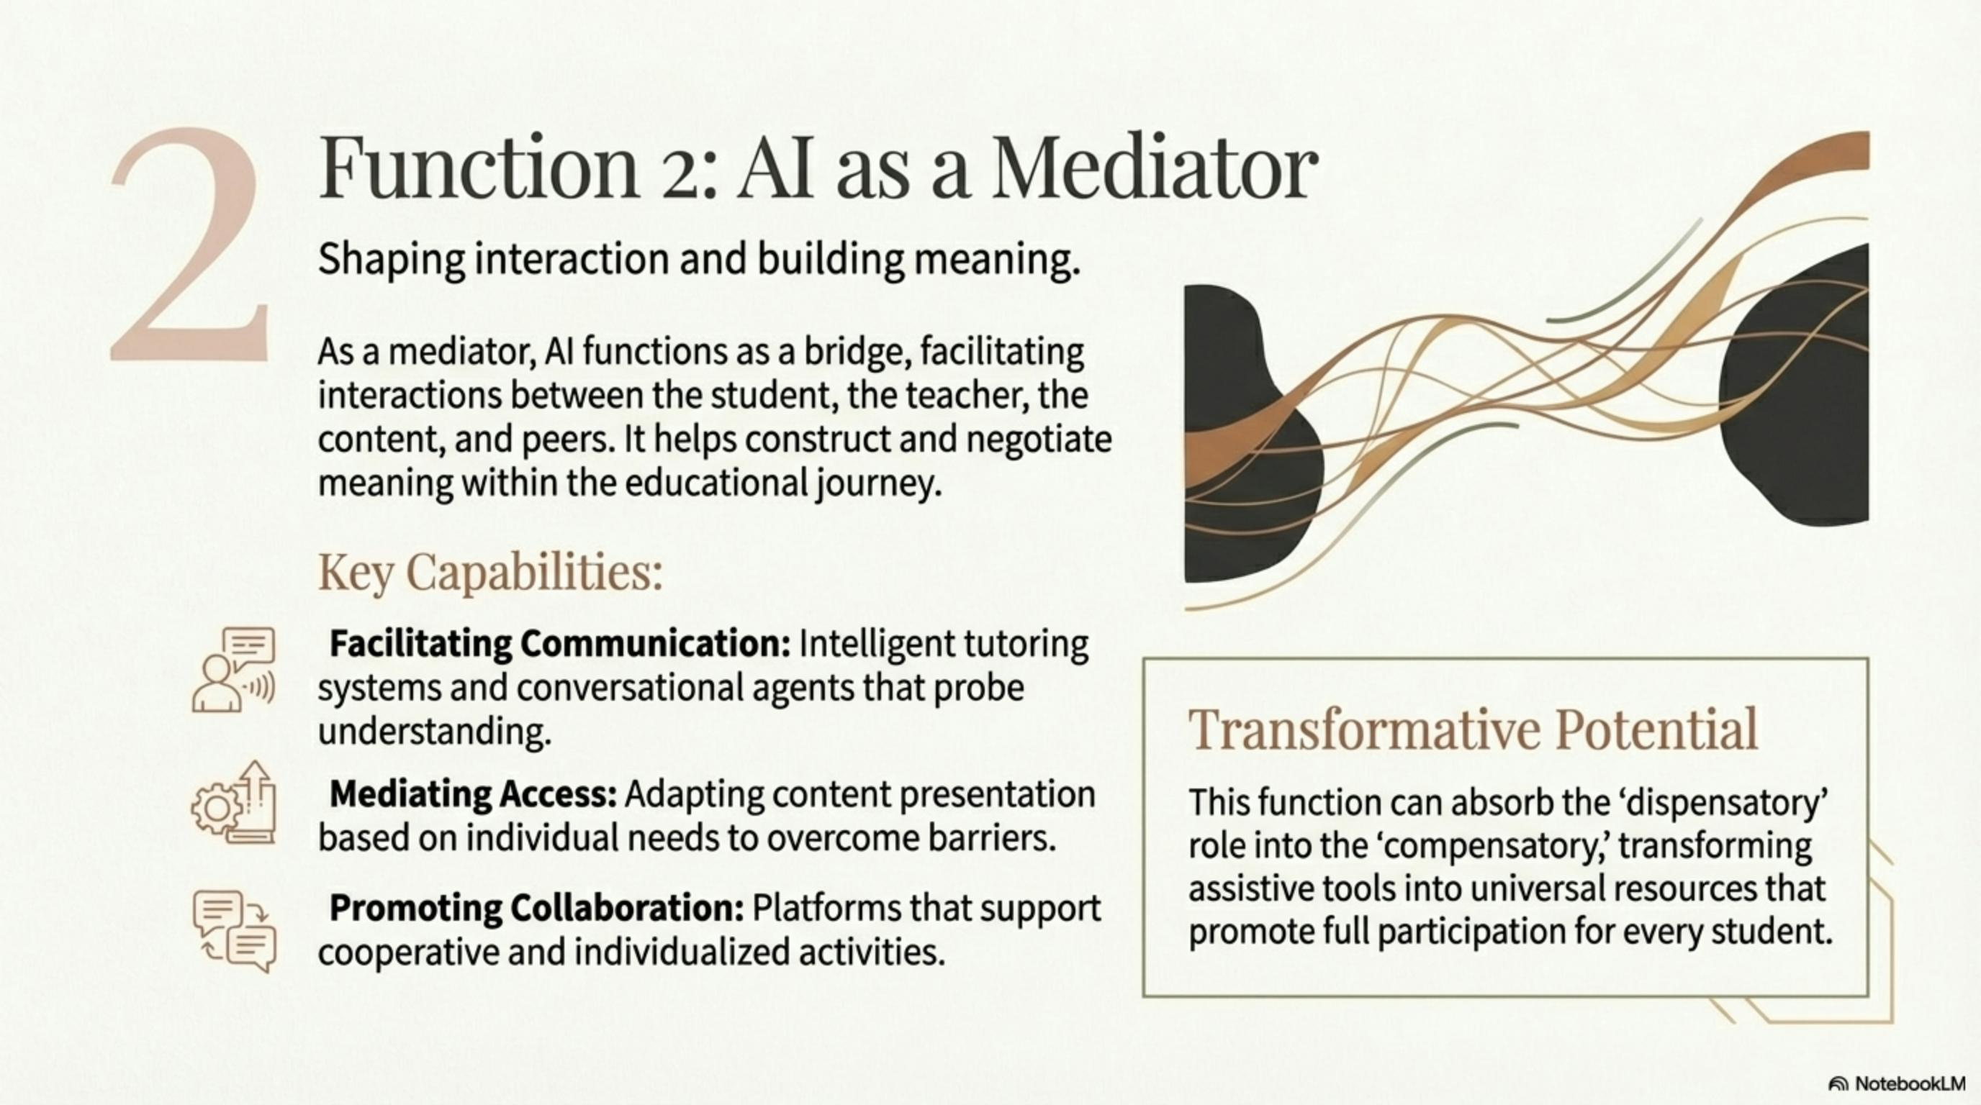

Slide 6
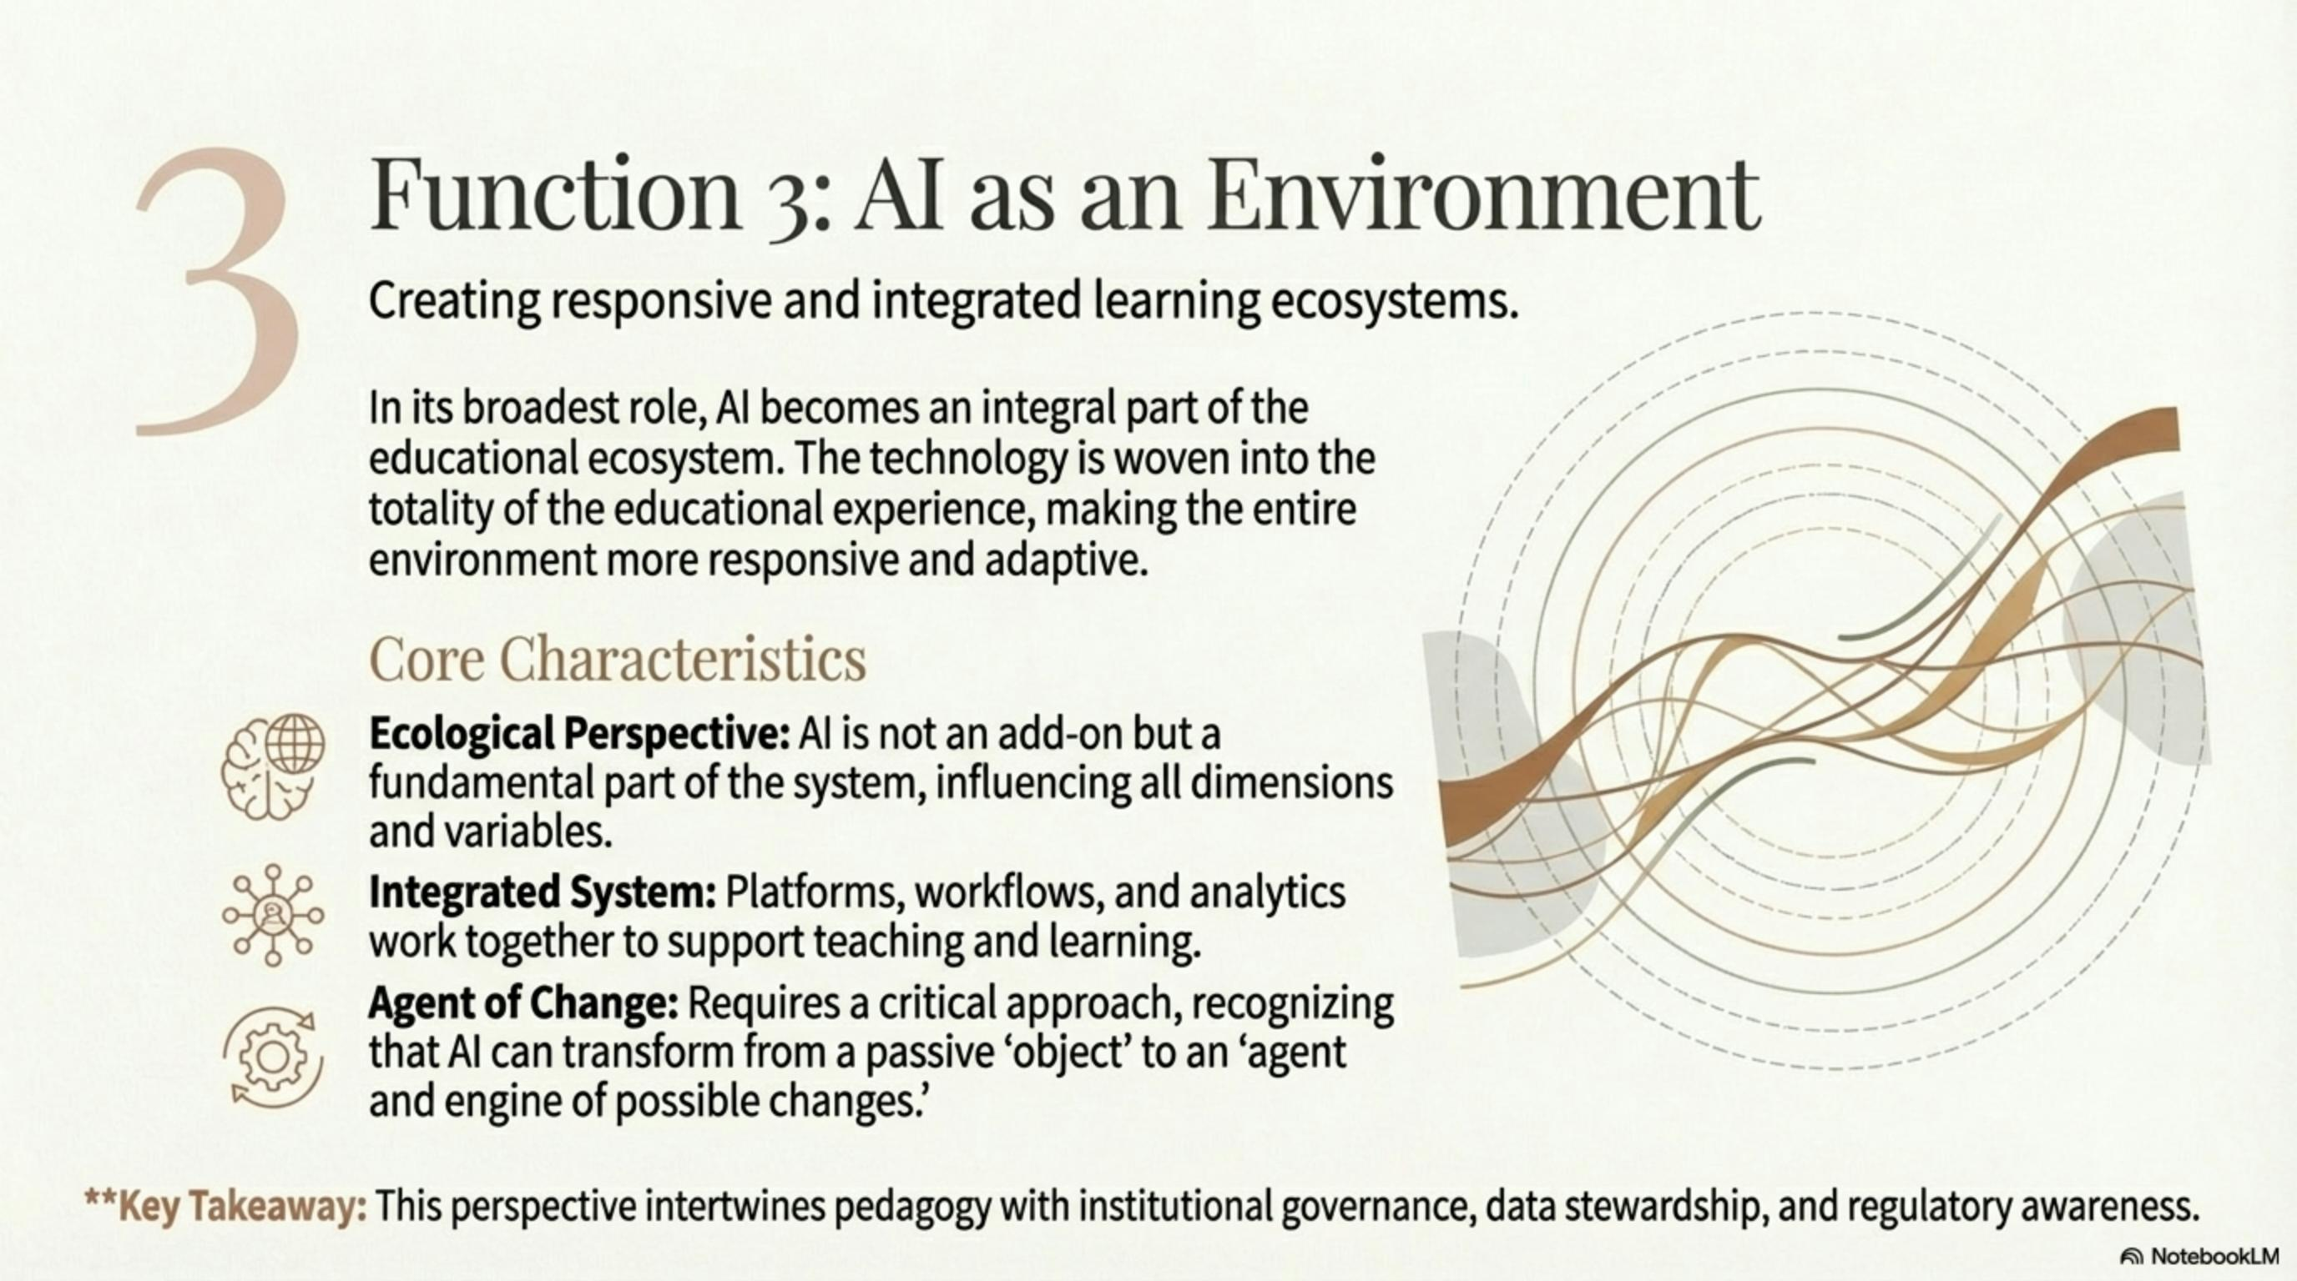

Slide 7
Orchestration heuristic (practice)
Neurocognitive: tune scaffolds for self-regulation.
Technological: close reading of affordances + human-in-the-loop.
Methodological–didactic: intentions first; transparent AI roles.
Tool→fit/universalise; Mediator→productive struggle; Environment→governance/transparency.
Notes:
≈60s: Keep focus on learning while embedding ethics and governance.

Slide 8
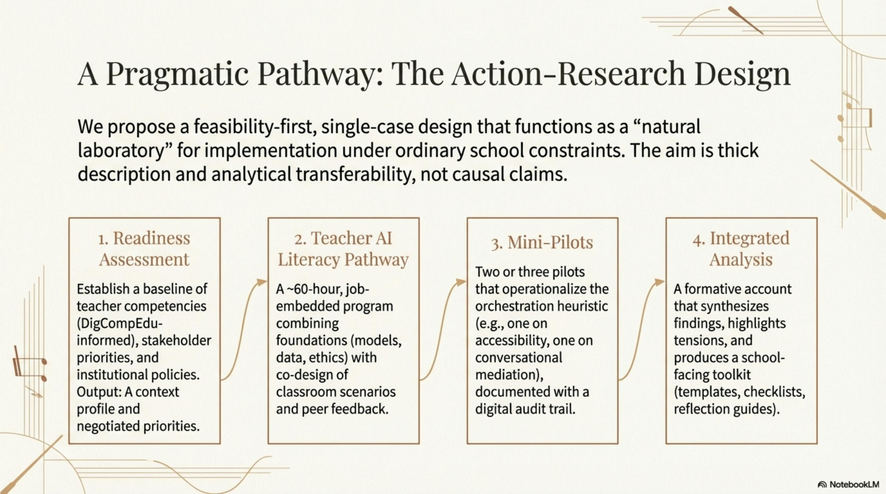
Notes:
≈60s: Instrumental case—surface mechanisms, barriers, enablers; thick description.
Readiness: UNESCO - DigCompEdu 3.0 interviews; policy/data registers → context profile + priorities.
AI-literacy (~60h): foundations, ethics & DP, co-design, micro-teaching, peer feedback.
Mini-pilots (2–3): accessibility/personalisation + conversational mediation; audit trail.
Integrated analysis: school-facing toolkit (templates, checklists, prompts, reflections).

Slide 9
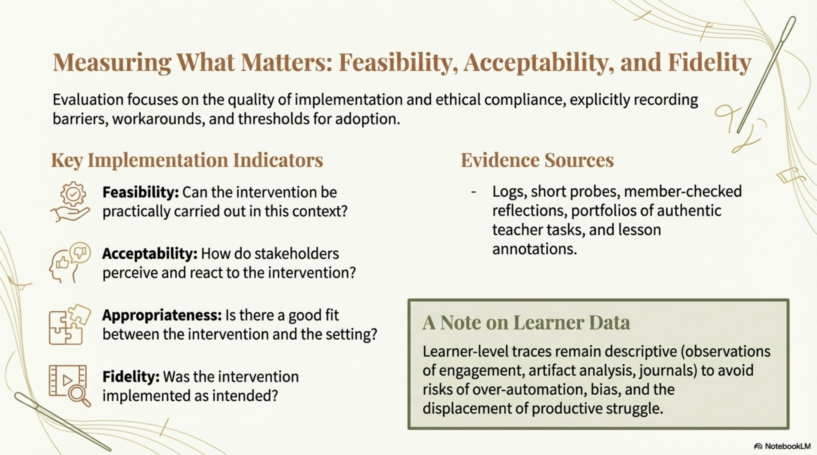
Notes:
Teacher AI-literacy: self-assessment, authentic portfolios, assessor judgements.
Implementation: feasibility, acceptability, appropriateness, fidelity; logs and member checks.
Learner traces: descriptive (engagement, time on task, artefacts, journals).

Slide 10
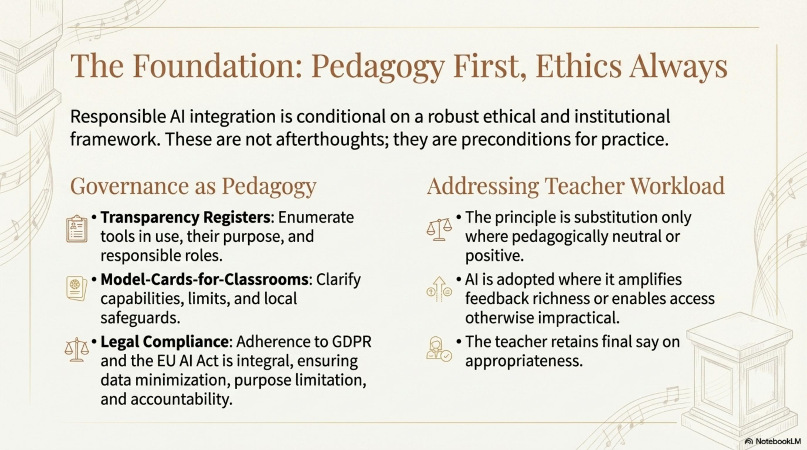
Notes:
Ethics-by-design: minimisation, least-privilege, transparency registers, age-appropriate explainability.

Slide 11
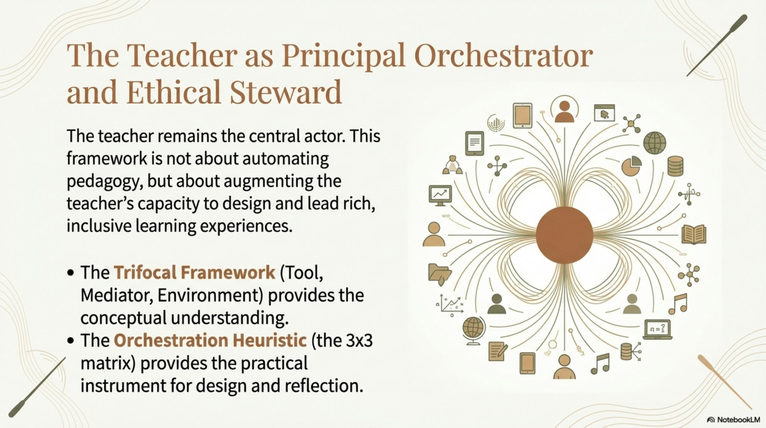
Notes:
Now: orchestration framework + draft measurement toolkit.
Not yet: causal claims (single-case trades external for ecological validity).
Next: replication (multi-case), meta-synthesis, follow-ups; AI literacy scale-up.
Take-home: AI needs orchestration—pedagogy, ethics, governance in the lead.

Slide 12

Contribution & next steps
Now: orchestration framework + draft measurement toolkit.
Not yet: causal claims (single-case trades external for ecological validity).
Next: replication (multi-case), meta-synthesis, follow-ups; AI literacy scale-up.
Take-home: AI needs orchestration—pedagogy, ethics, governance in the lead.
Notes:
≈55s: Invitation to refine and test under ordinary school constraints.

Slide 13
References (excerpt)
Agrusti, F., & Bonavolontà, G. (2021). Intelligenza Artificiale e Educazione: Le percezioni degli studenti del Dipartimento di Scienze dell’Educazione dell’Università Roma Tre sul concetto di Intelligenza Artificiale. Q‐Times Webmagazine, XIII(1), , 130–145.
Bonavolontà, G., Pagliara, S.M., & Mura, A. (2025). Verso un Ecosistema Educativo Universale: una proposta di valorizzazione multifunzionale dell’IA per l’inclusione. Italian Journal of Special Education for Inclusion, XIII, 1, 59‐68. https://doi.org/10.7346/sipes-01-2025-04
Bond, M., Khosravi, H., De Laat, M., Bergdahl, N., Negrea, V., Oxley, E., & Pham, P., et al. (2024). A meta systematic review of artificial intelligence in higher education: A call for increased ethics, collaboration, and rigour. International Journal of Educational Technology in Higher Education, XXI(1): 4.
European Parliament and Council of the European Union, Regulation (EU) 2024/1689 of the European Parliament and of the Council of 13 June 2024 laying down harmonised rules on artificial intelligence and amending Regulations (EC) No 300/2008, (EU) No 167/2013, (EU) No 168/2013, (EU) 2018/858, (EU) 2018/1139 and (EU) 2019/2144 and Directives 2014/90/EU, (EU) 2016/797 and (EU) 2020/1828 (Artificial Intelligence Act), Bruxelles, Oﬃcial Journal of the European Union, L 327, 2024.
Fiorucci, A., & Bevilacqua, A. (2024a). Un matrimonio quasi felice... L’intelligenza artificiale nell’ambito della pedagogia e della didattica speciale: Opportunità e rischi. Italian Journal Of Special Education For Inclusion, XII(2): 73–83.
Mura, A. (2016). Diversità e Inclusione. Diversità e inclusione: percorsi e strumenti, 1a edizione 2016. Milano: Franco Angeli, 2022 (ristampa).
Pagliara, S. M., Bonavolontà, G., Pia, M., Falchi, S., Zurru, A. L., Fenu, G., & Mura, A. (2024). The Integration of Artificial Intelligence in Inclusive Education: A Scoping Review. Information, XV(12): 774.
Ranieri, M. (2024). Intelligenza artificiale a scuola. Una lettura pedagogico‐didattica delle sfide e delle opportunità.
UNESCO (2024). AI competency framework for students, Parigi, UNESCO.
UNESCO (2024). AI competency framework for teachers, Parigi, UNESCO.

Slide 14
Orchestrating AI as Tool, Mediator, and Environment:
Towards Inclusive Learning Ecosystems
S. M. Pagliara, G. Bonavolontà, A. Mura
Università di Cagliari
silviom.pagliara@unica.it

