Slide 1
Mass spectrometry applied to the analysis of mixtures of proteins = MS-based proteomic analysis

Slide 2
What happens if I inject into ESI-ION TRAP MS a complex mixture of proteins (from biological fluids, cellular or tissue extracts...)?
overlapping of all m/z spectra of each protein in the sample.
impossible to obtain a deconvolution for each spectrum
#
1890-1939
RT:
43.71-44.79
AV:
12
NL:
3.26E4
Crowded spectrum!!
F:
FTMS + p ESI Full ms [300.00-2000.00]
1295.432
100
z=9
95
1165.991
90
z=?
85
1410.821
80
846.962
z=9
z=?
1585.987
75
1111.018
z=9
z=1
1231.657
1457.232
70
907.462
1023.304
z=?
1377.591
z=8
65
z=1
z=?
z=?
60
1667.046
55
829.203
z=?
Relative Abundance
z=1
1765.141
1876.931
50
366.140
z=?
z=?
45
z=?
449.155
603.361
810.335
z=?
z=?
z=?
1917.715
40
748.708
z=?
35
z=?
30
515.308
25
z=?
20
15
10
5
0
400
600
800
1000
1200
1400
1600
1800
2000
m/z

Slide 3
FIRST STEP FOR PROTEOMIC ANALYSIS: SAMPLE PREPARATION
IT MUST BE USEFUL TO REDUCE THE COMPLEXITY, TO SIMPLIFY THE SAMPLE
Several methods for sample preparation there exist, depending on:
Type of biological sample (tissue, cells, bio-fluids, cytoplasmatic organelles)
Type of proteomic approach (DIRECT ANALYSIS OF INTACT PROTEINS or ANALYSIS OF THEIR PROTEOLITIC FRAGMENTS)
Type of separative technique coupled to MS detection (gel-free or gel-based)

Slide 4
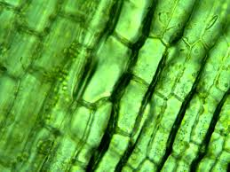
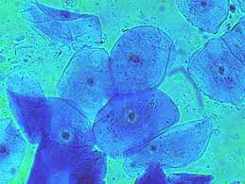
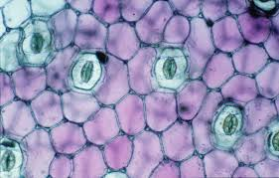
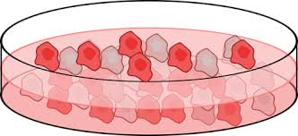
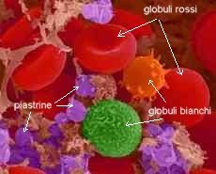
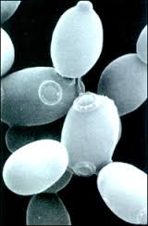
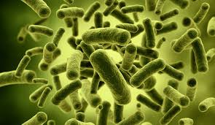
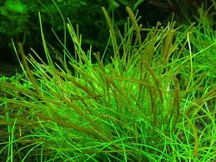

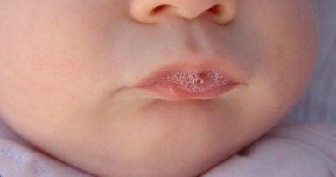
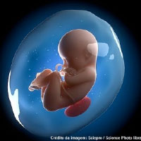
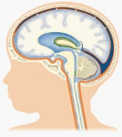
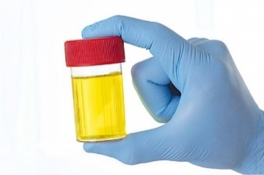
STARTING BIOLOGICAL SAMPLES
TISSUES, ORGANS
CELLS
ORGANISMS
BIOLOGICAL FLUIDS
Saliva
Blood
Urine
Cephalo-rachidian fluid
Amniotic fluid

Slide 5
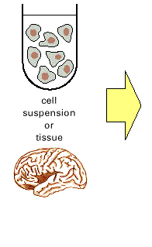
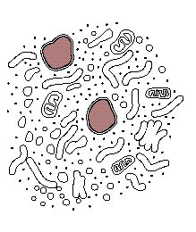
SAMPLE PREPARATION:EXTRACTION OF PROTEINS FROM CELL CULTURES OR TISSUES
To extract proteins, you must firstly destroy the cells
Cellular culture
or tissue
HOMOGENIZATION OF CELLS OR TISSUES IN AN APPROPRIATE EXTRACTION BUFFER
The HOMOGENIZATION procedure can use different enzymatic, mechanical or chemical methods depending on the type of cell that needs to be treated or the type of cell organelle that needs to be isolated
Several protocols exist

Slide 6
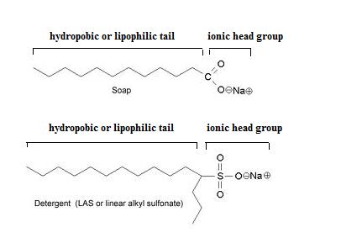
used at low temperature, ~ 4°C
Extraction buffer composition
  pH near to 7.0 (to inhibit lysosomal proteases and simulate the cellular environment)
  Low Ionic strength 0.15-0.20 M (salting-in: to increase the protein solubility)
  it contains stabilizing agents: reducent agents (thiolic compounds such as dithiotreitol) to reduce the disulfide bonds in the proteins.
  it contains inhibitor of proteases (to inhibit endogenous proteases)
  It can contain chelant agents: Etilendiamminotetracetic acid (EDTA) to remove cations and inhibit the metallo-proteinases.
  It may contain detergents (ionic or non-ionic): SDS, triton…

Slide 7
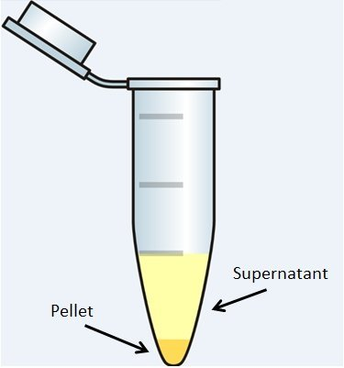
Cells or tissue
Biofluid
Treatment with acidic or hydro-organic solution or with an extraction buffer
Homogenization/rupture of membranes, organelles and cell walls
Raw extract: soluble proteins and molecules and insoluble particles
Inhibition of endogenous proteases with enzyme inhibitors
CENTRIFUGE
Monitor protein presence and concentration in each step using analytical techniques:
Spectrophotometry
Chromatography
Electrophoresis…
PELLET
SURNATANT
PROTEIN FRACTIONATION to simplify the protein mixture)
PROTEIN PURIFICATION
DIRECT ANALYSIS BY MS
PROTEIN MIXTURES TO ANALYZE BY MS
PURE PROTEINS TO ANALYZE BY MS
Notes:
BREAK OF THE CELLS RELEASES ALSO NUCLEIC ACIDS, LIPIDS, SUGARS, METABOLITES…
Fractionation tecniques are basic biochemical techniques

Slide 8
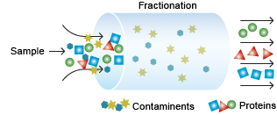
Some information about PROTEIN FRACTIONATION techniques.
They simplify the complex protein extract by separating it into simpler fractions of proteins
ULTRAFILTRATION
FRACTIONAL PRECIPITATION
CHROMATOGRAPHIC TECHNIQUES
ELECTROPHORETIC TECHNIQUES

Slide 9
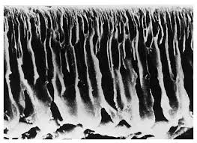

TO SEPARATE PROTEINS PRESENT IN COMPLEX MIXTURES:
FRACTIONATION BY ULTRAFILTRATION
THE PROTEIN EXTRACT can be FRACTIONATED according to the size of the proteins
It is possible to separate fractions that contain proteins with different molecular weight using filter membranes (there have different molecular cut-off: from 3 KDa to 100 Kda).
i.e. MW cut-off =10 KDa
Molecules < 10 KDa
Molecules > 10 KDa

Slide 10
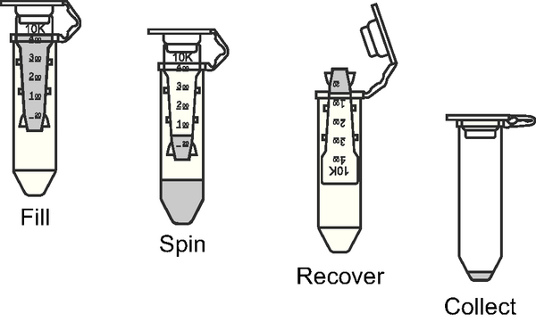
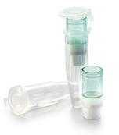
Protein extract: mixture of different proteins with different sizes
Centrifuge filter devices
Membrane filter 10 KDa cut-off
Proteins with molecular weight greater than 10 kDa: they are retained by the filter and recovered in a smaller volume of solution =concentrated
Proteins with molecular weight less than 10 kDa: they pass through the filter and are collected at the bottom of the tube

Slide 11
SEPARATE PROTEINS PRESENT IN COMPLEX MIXTURES:
FRACTIONAL PRECIPITATION
It is based on the different solubility that the different proteins have as a function of several parameters:
pH,
Ionic strength, concentration of salts dissolved in solution
Temperature
Solvent polarity
Example: by treating the whole saliva with an acidic solution (pH 3.0-3.5) of trifluoroacetic acid or formic acid 0.1-0.2%, and then, spin the sample at low temperature, two protein fractions may be separated:
Soluble fraction of peptides and protein with molecular weight up to 70-100 kDa
Insoluble fraction of big proteins

Slide 12
FIRST STEP FOR PROTEOMIC ANALYSIS: SAMPLE PREPARATION
IT MUST BE USEFUL TO REDUCE THE COMPLEXITY, TO SIMPLIFY THE SAMPLE
Several methods for sample preparation there exist, depending on:
Type of biological sample (tissue, cells, bio-fluids, cytoplasmatic organelles)
Type of proteomic approach (DIRECT ANALYSIS OF INTACT PROTEINS or ANALYSIS OF THEIR PROTEOLITIC FRAGMENTS)
Type of separative technique coupled to MS detection (gel-free or gel-based)

Slide 13

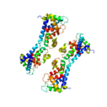
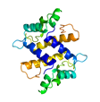
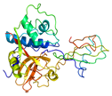
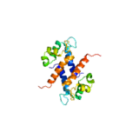




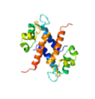

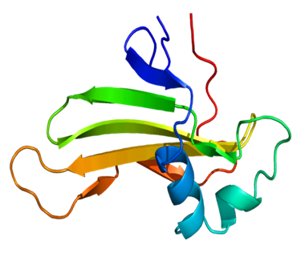
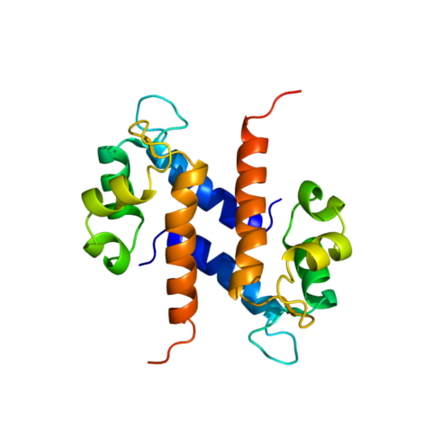
Type of proteomic approach to analyze complex PROTEIN extract from biological sample
Analysis of simplified fractions: proteomic platform mass spectrometry-based
Analysis of a complex mixtureafter its proteolytic digestion in small fragments by a proteomic platform mass spectrometry-based,
1
2
PROTEIN FRACTIONS
1a
1b
They can be analyzed intact, “as they are” by mass spectrometry
They can be submitted to proteolytic digestion and the mixture of fragments analyzed by mass spectrometry

Slide 14
1a) When a direct MS analysis of intact proteins is performed, it is necessary a complete removal of contaminants including detergents, lipids, and salts prior to MS analysis
1b and 2) When the proteolytic digestion precedes the MS analysis, it is necessary the complete reduction of disulfide bonds, selective alkylation of cysteines without non-specific modification of other amino acids, reproducible proteolysis, and complete removal of contaminants including detergents, lipids, and salts prior to MS analysis.

Slide 15
FIRST STEP FOR PROTEOMIC ANALYSIS: SAMPLE PREPARATION
IT MUST BE USEFUL TO REDUCE THE COMPLEXITY, TO SIMPLIFY THE SAMPLE
Several methods for sample preparation there exist, depending on:
Type of biological sample (tissue, cells, bio-fluids, cytoplasmatic organelle)
Type of proteomic approach (DIRECT ANALYSIS OF INTACT PROTEINS or ANALYSIS OF THEIR PROTEOLITIC FRAGMENTS)
Type of separative technique coupled to MS detection (gel-free or gel-based)

Slide 16
Gel-free and gel-based proteomics are two distinct approaches to analyzing proteins
Gel-free proteomics
Description: Proteins are digested into peptides and separated using liquid chromatography (LC), which is then directly analyzed by mass spectrometry.
Methodology: proteins are digested, and the resulting peptides are separated by LC and analyzed by tandem mass spectrometry (MS/MS).
Advantages: Higher throughput, deeper proteome coverage, and improved sensitivity compared to gel-based methods. It is also well-suited for quantitative comparisons.
Disadvantages: Does not provide the same visual output as gel-based methods and may not be as effective at retaining PTMs without specific enrichment strategies.
Gel-based proteomics
Description: Proteins are separated and visualized as spots on a gel before being extracted for further analysis.
Traditional method: Two-dimensional gel electrophoresis (2-DE) separates proteins first by isoelectric point and then by molecular weight.
Advantages: Visual representation of protein spots and their relative abundance, useful for identifying post-translational modifications (PTMs).
Disadvantages: Can be time-consuming and labor-intensive, may have limited sensitivity and dynamic range.

Slide 17
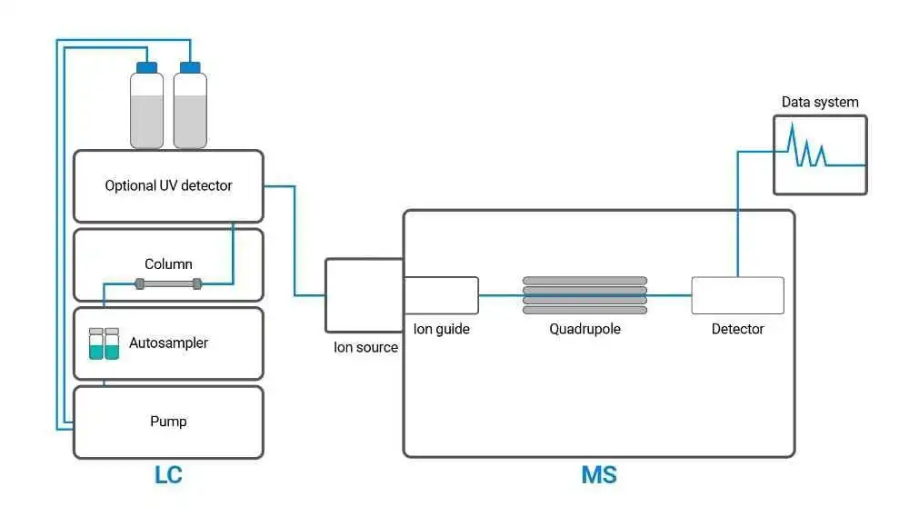
GEL-FREE SEPARATION TECHNIQUE COMBINED WITH MS DETECTION
Liquid Chromatographic separation combined with Mass Spectrometer detection (LC-MS platform).
High Pressure Liquid Chromatography – MS (HPLC-MS)
SPECIFIC INFORMATION THAT CAN BE OBTAINED FOR EACH PROTEIN: Elution times, Mass, Structure
LC-MS IS A PROTEOMIC PLATFORM WITH HIGH SENSITIVITY
Ability to detect quantities in the order of femtograms (depends on the type of MS)

Slide 18
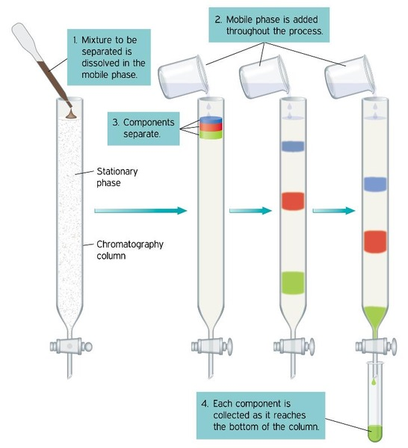
Chromatography is a process for separating components of a mixture. To get the process started, the mixture is dissolved in a solvent called the mobile phase, which carries it through a second substance called the stationary phase.
Liquid chromatography
The mobile phase is the liquid that dissolves the target compound.
The stationary phase is the part of a column that interacts with the target compound.
Example: green component has a strong affinity with the mobile phase and moves quickly through the column, while the blue component has a strong affinity with the stationary phase and moves through slowly.
The elution speed in the column depends on the affinity between the compound and the stationary phase.

Slide 19
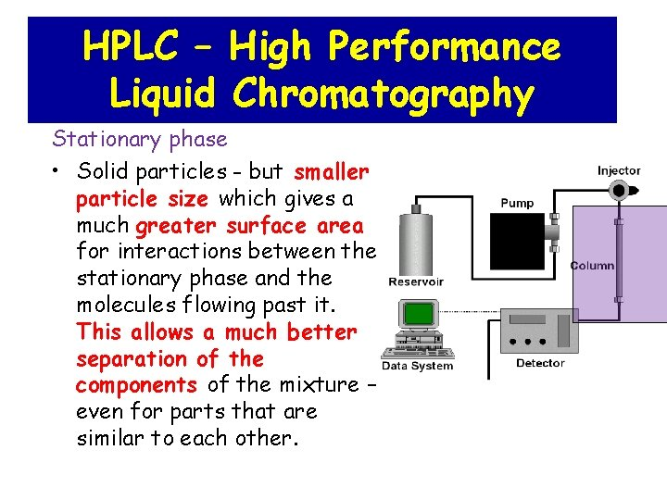

Slide 20
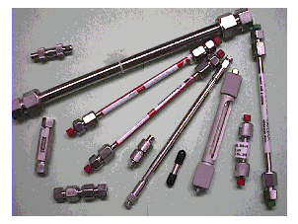
Stationary phase is composed by very small diameter particles (3-10 μm) that ensure:
Larger available surface for separation
Higher System Resolution
The mobile phase has to flow through a stationary phase where is high the resistance to mobile phase flow.
In an HPLC system, pumps are used to generate a HIGH PRESSURE (up to 500 bar) of the mobile phase flow, so that this is pushed through the stationary phase
Chromatographic column for HPLC:
The stationary phase is packed in a stainless steel column (must contain high pressures)

Slide 21
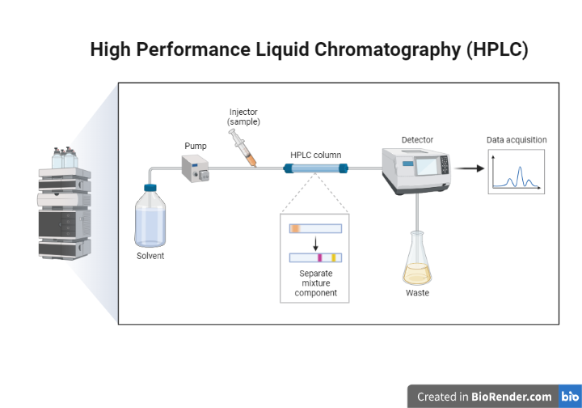
HIGH PRESSURE CHROMATOGRAPHIC SYSTEM
HPLC = HIGH PRESSURE/PERFORMANCE LIQUID CROMATOGRAPHY
UHPLC = ULTRA HIGH PERFORMANCE LIQUID CROMATOGRAPHY (high speed analysis)
Overview of the HPLC process
https://www.shimadzu.com/an/service-support/technical-support/analysis-basics/basic/what_is_hplc.html
In the Chromatogram: peaks correspond to separated proteins
Notes:
The solvent used to separate components in a liquid sample for HPLC analysis is called the mobile phase.
The mobile phase is delivered to a separation column, containing the stationary phase, and then to the detector at a stable flow rate controlled by the solvent delivery pump.
A certain amount of sample is injected into the column and the compounds contained in the sample are separated.
The compounds separated in the column are detected by a detector downstream of the column
and each compound is identified and quantified.

Slide 22
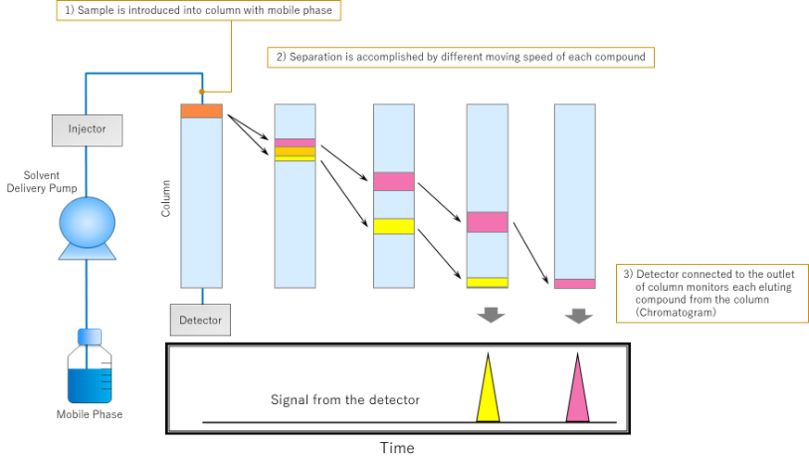
https://www.shimadzu.com/an/service-support/technical-support/analysis-basics/basic/what_is_hplc.html
https://www.youtube.com/watch?v=jwks-ov7bEE
Notes:
HPLC can separate and detect each compound by the difference of each compound's speed through the column. There are two phases for HPLC: the mobile phase and the stationary phase. The mobile phase is the liquid that dissolves the target compound. The stationary phase is the part of a column that interacts with the target compound.
example in which the yellow component has a strong affinity with the mobile phase and moves quickly through the column, while the pink component has a strong affinity with the stationary phase and moves through slowly. The elution speed in the column depends on the affinity between the compound and the stationary phase.

Slide 23
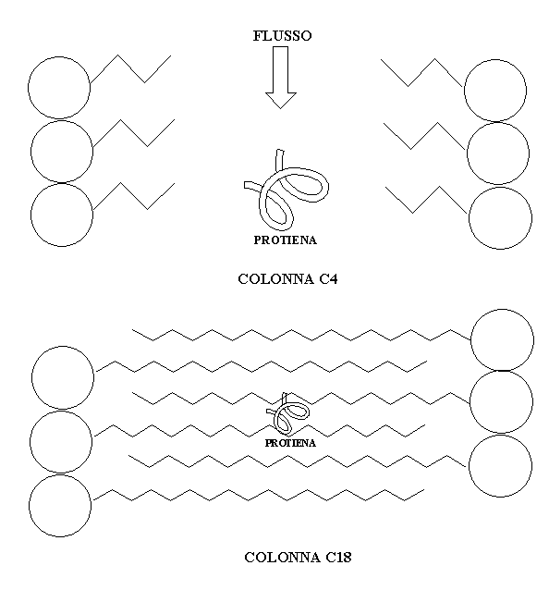
REVERSE PHASE CHROMATOGRAPHIC COLUMN (RP-HPLC):
Stationary phase (non Polar): silica particles functionalized with hydrophobic carbon chains with n carbon atoms(C4, C8, C18)
The longer the hydrocarbon chains, the greater the ability of the stationary phase to retain proteins
flow
C4 column
2 MOBILE PHASES (polar) are used in gradient way.
Gradient elution is established between a mobile phase (A) AQUEOUS/ACIDIC and a mobile phase (B) HYDRO-ORGANIC (WATER/ACETONITRILE-20/80)
Gradient starts from 100% phase A (0%B) to 100% phase B (0%A).
C18 column
Peptides and proteins in acidic solution (pH < 3.0-3.5) are mainly PROTONATED,
1) Most POLAR peptides/proteins ELUTE FIRST with phase A,
2) HYDROPHOBIC peptides/proteins interact with the stationary phase and are delayed in their elution. They ELUTE LATER by THE INCREASING of the percentage of the organic phase B

Slide 24
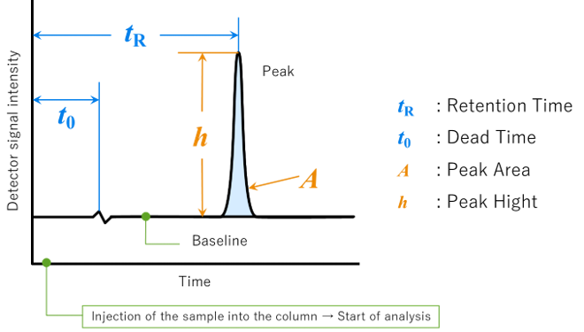
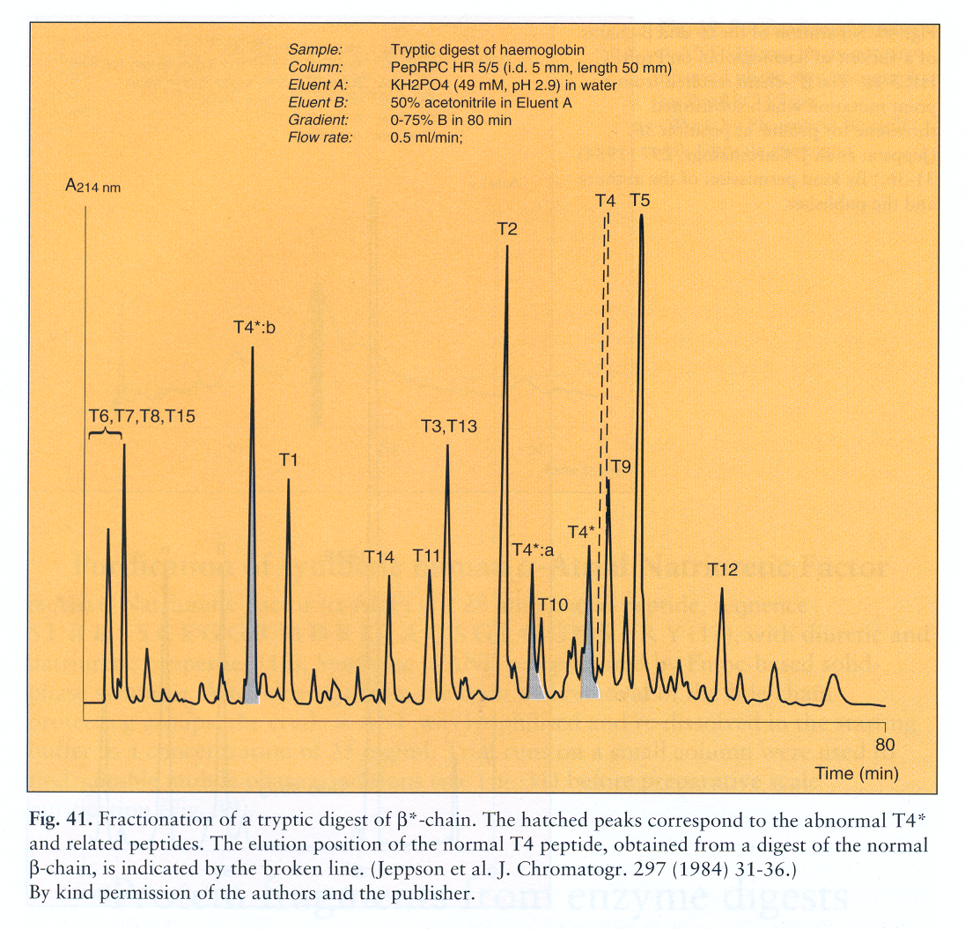
UV CHROMATOGRAM: plot of “Detector signal intensity” and “elution time”
is time interval between sample injection and the maximum of the peak.
Absorption of UV light by side chains (280nm) and peptide bonds (214nm) of a protein.
GENERAL CHARACTERISTICS OF HPLC
High resolution
Ability to perform analysis in a short time
Chromatographic columns reusable several times
Adaptability to all types of chromatography
High reproducibility
High efficiency (Very tight peaks)
Automated instrumentation
Notes:
The word "chromatogram" means a plot obtained via chromatography. Fig.4 shows an example of a chromatogram. The chromatogram is a two-dimensional plot with the vertical axis showing concentration in terms of the detector signal intensity and the horizontal axis representing the analysis time. When no compounds are eluted from the column, a line parallel to the horizontal axis is plotted. This is called the baseline. The detector responds based on the concentration of the target compound in the elution band. The obtained plot is more like the shape of a bell rather than a triangle. This shape is called a “peak”.
Retention time (tR) is the time interval between sample injection point and the apex of the peak. The required time for non-retained compounds (compounds with no interaction for the stationary phase) to go from the injector to the detector is called the dead time (t0).
The peak height (h) is the vertical distance between a peak's apex and the baseline, and the peak area (A) colored in light blue is the area enclosed by the peak and baseline. These results will be used for the qualitative and quantitative analysis of a sample's components.

Slide 25
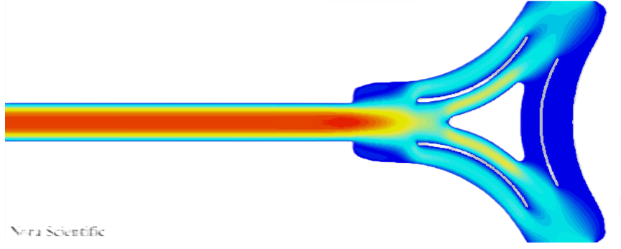
Separated proteins or fragments of proteins are eluted from the HPLC and addressed to the detector
LC-MS platform
HPLC
UV detector
UV chromatogram (peaks generated by the UV absorption of each protein, 214/280 nm)
Flow splitter
Chromatographic separation of proteins and peptides present in mixture
ESI-Ion trap MS detector
ION chromatogram (TIC) (peaks generated by the ionic current of the multiply-charged ions produced by each protein)
Mass of each protein.
Average or exact mass
Quantity, type and location of post-translational modifications
Study of the amino acid sequence (IDENTIFICATION)
Quantification of each protein
Detection, identification, structural characterization

Slide 26
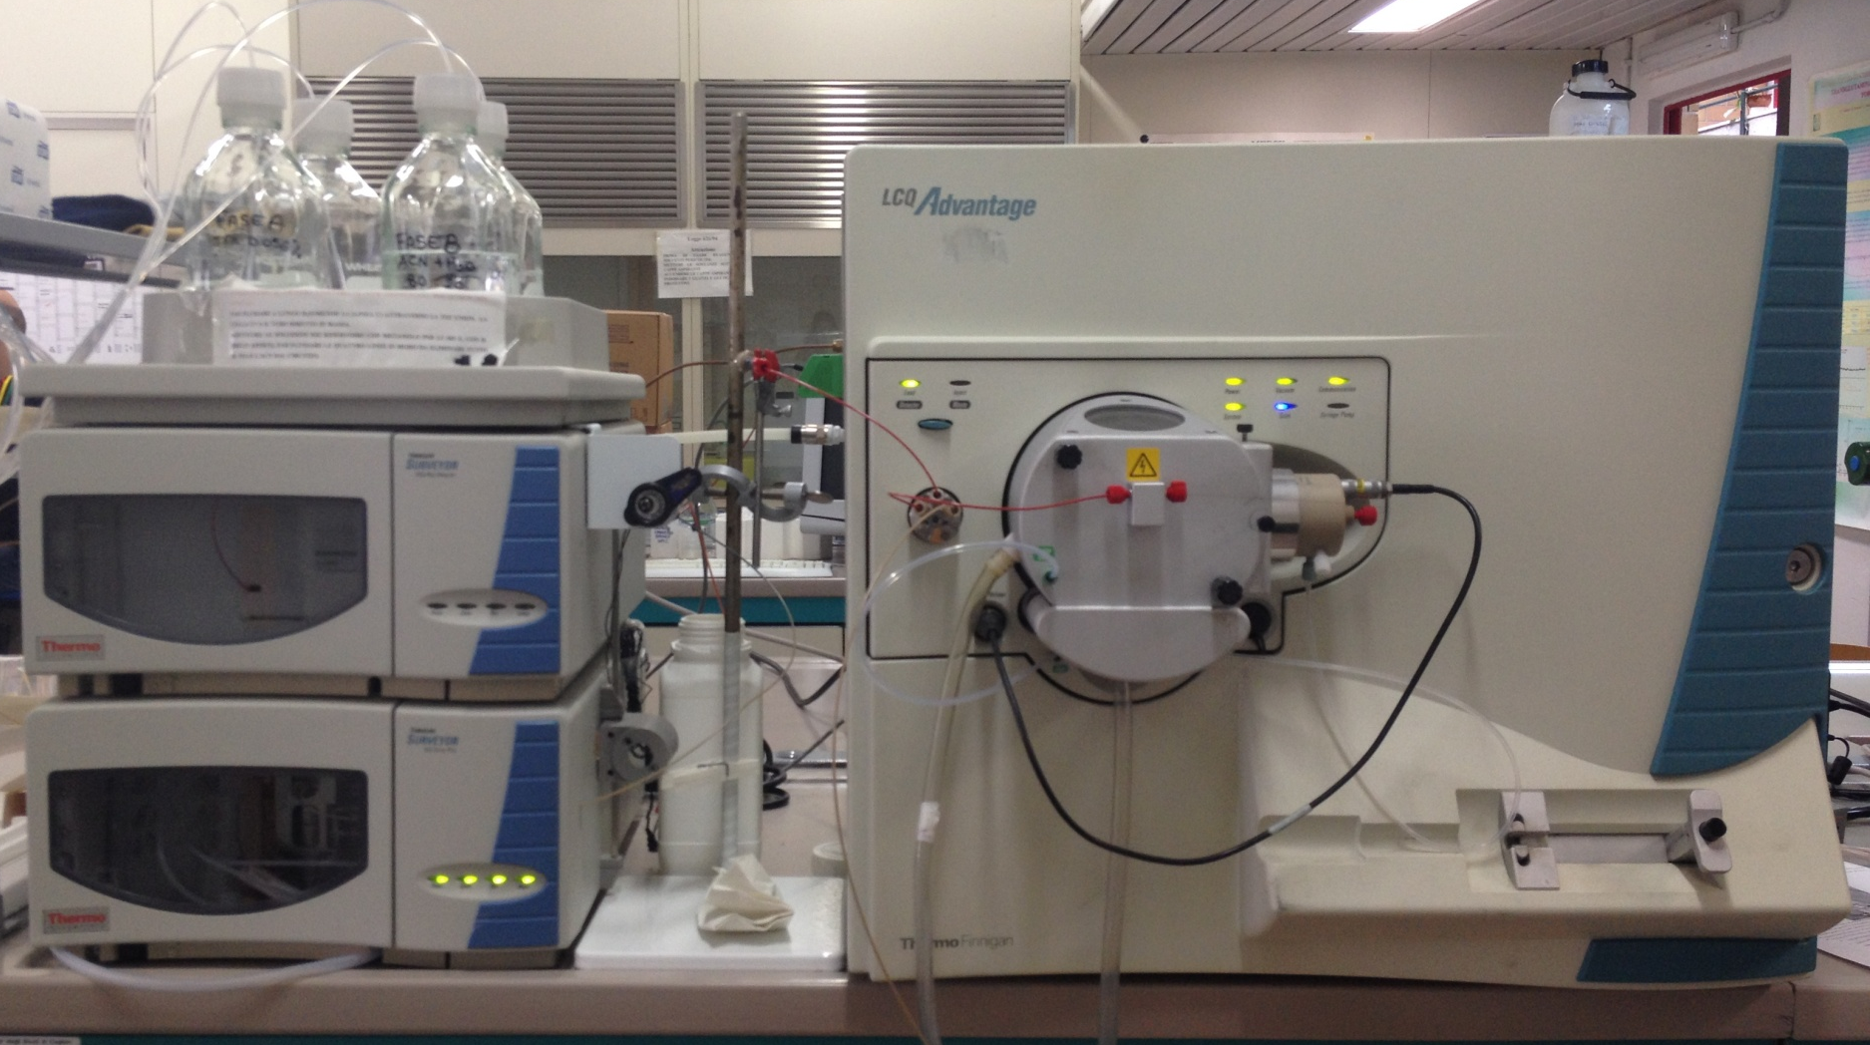
Coupling HPLC with Ion trap MS by Electrospray Source (ESI)
Reverse phase (RP) column (C8 or C18)
Gradient chromatography with Phase A, aqueous solution of formic acid (FA), acetic acid (AA) or trifluoroacetic acid (TFA) (pH 2.5-4.5) to detect positive ions or basic buffers (pH 8) to detect negative ions
Phase B, hydro-organic mixture of water and acetonitrile or methanol and FA or TFA or AA
HPLC
Electrospray Source (ESI)
Mass spectrometer (Ion trap)
The eluate leaving the column is delivered to the ESI source, or split between a UV detector and the MS, where the ionization takes place. The ions are transferred to the IT analyzer to be separated according to the m/z ratio and then detected.

Slide 27
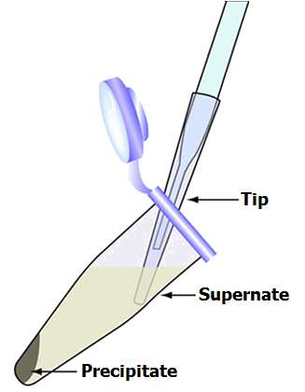
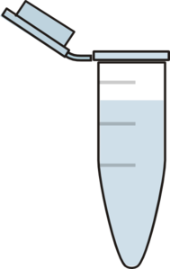
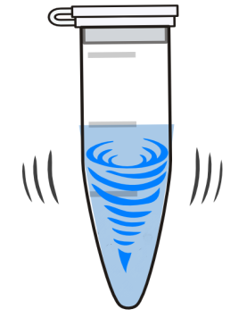
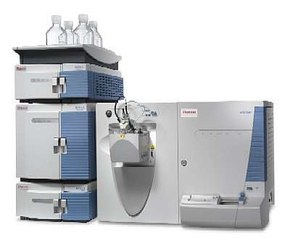
Example: HPLC-ESI-IT-MS analysis of a human salivary sample.
The sample is prepared with the following procedure:
Saliva
TFA 0.2%
Tip
Supernatant
Saliva treated with 0.2% of trifluoroacetic acid
1:1 v/v ratio
Centrifugation
15 min. at 20.000g at 4°C
Precipitate
Separation of acid supernatant from the pellet
RP-HPLC-ESI-MS analysis

Slide 28
HPLC-ESI-IT-MS analysis of ACID SOLUBLE FRACTION of a human salivary proteins
Peptides and proteins present in the sample are separated by RP-HPLC, according to their different ability to interact with the stationary and mobile phases.
Most POLAR PEPTIDES/PROTEINS ELUTE FIRST,
more HYDROPHOBIC Peptides/proteins ELUTE LATER
Histatins
TIC MS: Total Ion current chromatogram generated by the current produced by each protein when arrive to the detector
100
Acidic PRPs
80
Thymosins
α-defensins
60
Basic PRPs
Statherin
40
PB peptide
S-100 proteins
Cystatins
20
0
0.8
Relative Abundance
UV 214 nm
UV Chromatogram
0.6
0.4
0.2
0.0
1.2
1.0
0.8
UV 276 nm
UV Chromatogram
0.6
0.4
0.2
0.0
0
5
10
15
20
25
30
35
40
45
50
Time (min)

Slide 29
For each chromatographic peak, which has been separated by RP-HPLC, the MASS SPECTRUM is recorded: it is produced by the multiply-charged ions of the protein eluting in the peak (or proteins co-eluting).
100
22.30
80
RT:
0.00 - 54.99
TIC MS
60
22.90
NL:
3.81E9
Relative Abundance
16.23
28.36
28.88
40
12.70
15.35
18.09
33.63
49.15
18.86
35.63
20
37.03
43.12
47.11
11.01
27.00
0
0
10
20
Time (min)
30
40
50
100
+ c ESI Full ms [ 300.00-2000.00]
It is possible to obtain the mass spectrum of each individual analyte even if the analytes elute in the same chromatographic peak.
A4
RT:
17.91-18.39
A5
1522.7
1903.0
80
AV:22
Relative Abundance
NL:
5.72E7
60
A6
40
A9
A8
A7
1269.1
B5
846.6
952.2
B10
1088.0
1919.8
A10
B12
B11
860.5
B9
B8
B7
B6
20
762.0
800.6
873.2
1067.0
1200.2
1371.5
1599.8
0
400
600
800
1000
m/z
1200
1400
1600
1800
A. 7608.0
From the mass spectrum we can derive the value of the average mass through the process of deconvolution
100
PEPTIDE II-2
80
Spectrum of deconvolution (Mav)
PEPTIDE IB-1
60
Relative Abundance
A. 9593.8
40
NL:
1.68E8
II-2, (K⁺ form)
20
7646.0
IB-1, (K⁺ form)
9631.9
0
7000
7500
8000
8500
9000
9500
mass

