Slide 1

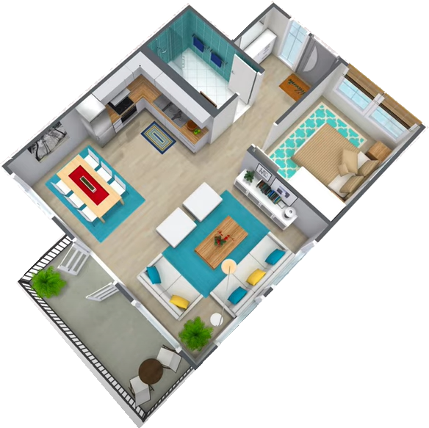
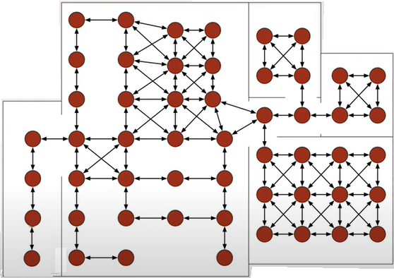


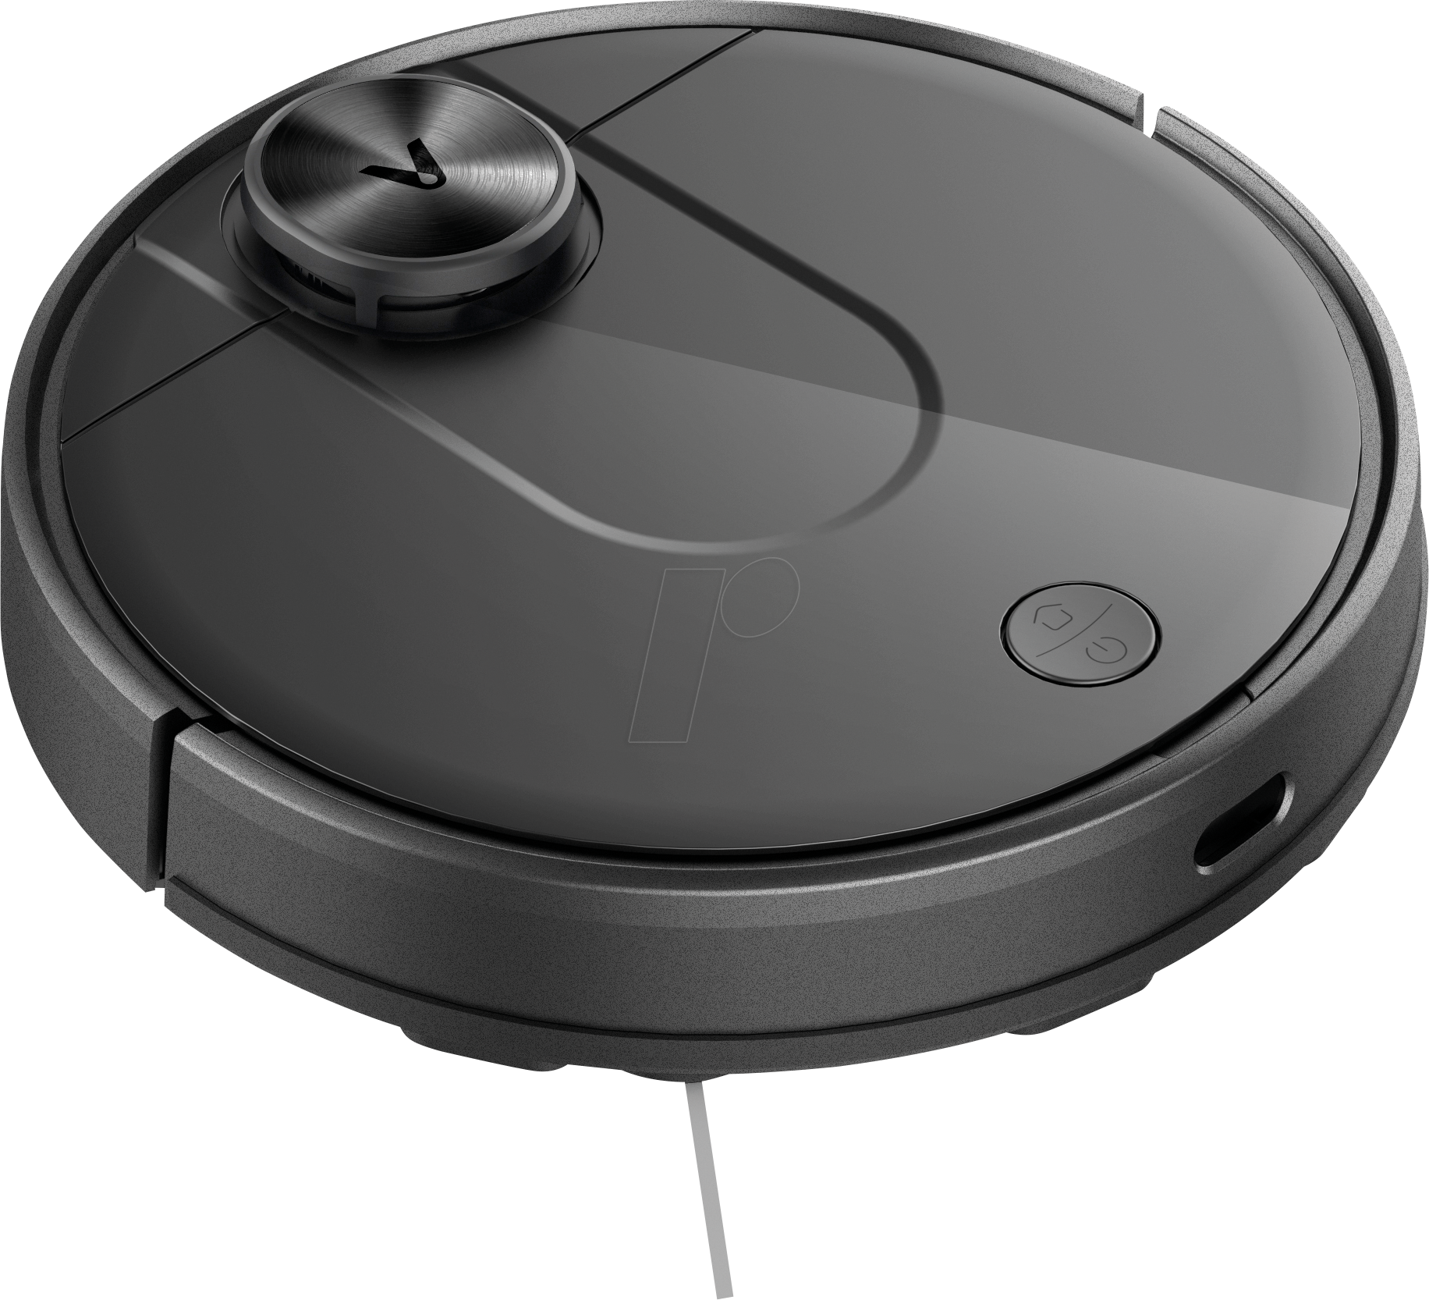

STOCHASTIC MODELS
-
Hidden Markov Model
1
Notes:
So today we gonna present the last module of this course that it is about queuieing networks….namely systems in which a number of queues are connected to each other by what it is called as... customer routing….
…where…for costumer routing we mean the path that costumers can follows among the queues of the network.
Just to give an idea on what we are going to talk…by refering to the network in the picture…. Here we have a multi-layer client-server architecture ….. requests come from outside…and are taken in charge and elaborated by the first set of queues…than if the request is accomplished that job leaves the system following one of the possible leaving-path.
Otherwise…If that request requires other operations…related messages are delivered to the layer 1 and if necessary from layer 1 to layer 2….
Let us further note that sometimes it may also occur that an operation need a cross check…. and thus the costumer routing can also consider the presence of loops like this….or this…
In general we have that when a customer is serviced at one node…then… it can join another node and queue for service, or simply leave the system.
Ah…notice that in this contest… we will often refer to the queues that constitute the network as nodes…

Slide 2
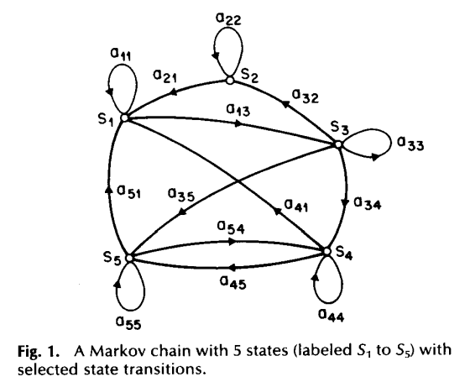
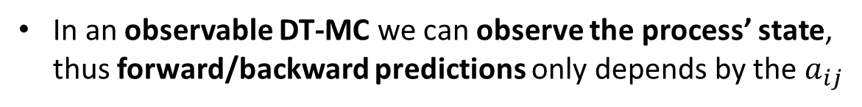
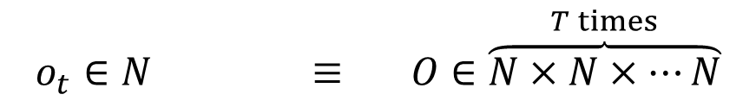
Observable discrete-time markov models
Let $O=\left\{o_{1},o_{2}, …{,o}_{T}\right\}$ be a vector of observation and let our DT-MC be
$$Model=\left(N,P,Π\left(0\right)\right)$$
In an observable DT-MC what we may observe is the state of the process, thus
$$o_{t}∈N ≡ O∈\overset{T times}{\overbrace{N×N×⋯N}}$$
Thus, let $O=\left\{o_{1},o_{2},…,o_{6}\right\}=\left\{S_{3},S_{4},S_{5},S_{4},S_{1},S_{1}\right\}$ results
$$\operatorname{Pr}\left(O|Model,q_{0}=S_{3}\right)=a_{34}a_{45}a_{54}a_{41}a_{11}$$
In an observable DT-MC we can observe the process’ state, thus forward/backward predictions only depends by the $a_{ij}$
In many applications we cannot observe the true state we are interested in.
What we can measure is the effect of being in a state/or a combination of them.
The observable effects can also be random due to noise or uncertainties.
Notes:
Here just to remark the importance of queuing networks in telecommunication systems we have another example…for instance…the Internet… that….as you know…. It works by means of a complex architecture where packets flows are processed by many routers, each modeled by a queue.
In particular we have that packets enter in the network because generated from different sources…. and with different destinations…
Then…. they arrive to nodes in a stochastic fashion…and then…each router asynchronously elaborates them…
Of course notice that.. if the traffic intensity exceed some given quantities …well some traffic is lost due to buffer overflows…
Let us further note that queuing networks are successfully used not only to solve resource allocation problems in telecommunication but…. Of course….whenever a flow of jobs need to be processed, independently by the fact that their arrivals and services are either synchronous or asynchronous, or either stochastic or deterministic.
In particular we have that all the results we are going to see are useful to determines in an easy way the system performance…and also to evaluate…. for resource allocation purposes…. the resources need such that a complex client-server architecture works while satisfying some QoS specifications.
Specification that could be expressed in term of time spent in the system…or in term of the buffer capacity … and that of course depends on the allocated resources…that means the number of servers per queue, their service rate… the buffer capacity … furthermore it is easy understand that all those quantities are further influenced by the costumer routing that express…in terms or probability….all the possible paths that a costumer can follows within the network.

Slide 3




Hidden Markov Models: Motivating example
A person is flipping a coin behind a curtain.
Each result is called out by an observer and it becomes our observation $o_{t}$.
Thus, what we are now observing is not the state of the coin $q_{t}$, but what the person behind the curtain is calling out.
$$O=\left\{o_{1},o_{2}…,o_{T}\right\}=\left\{𝒯,ℋ,𝒯,ℋ,ℋ,…,𝒯\right\}$$
$$o_{t}$$
How do we model this situation?
Should we assume 1 fair coin is being flipped? (even if they could be more and unfair)
Should we assume the caller is accurate? (even if it can be inaccurate/malicius)
These additional layers of ambiguity makes our problem non trivial and more realistic!
Notes:
Here just to remark the importance of queuing networks in telecommunication systems we have another example…for instance…the Internet… that….as you know…. It works by means of a complex architecture where packets flows are processed by many routers, each modeled by a queue.
In particular we have that packets enter in the network because generated from different sources…. and with different destinations…
Then…. they arrive to nodes in a stochastic fashion…and then…each router asynchronously elaborates them…
Of course notice that.. if the traffic intensity exceed some given quantities …well some traffic is lost due to buffer overflows…
Let us further note that queuing networks are successfully used not only to solve resource allocation problems in telecommunication but…. Of course….whenever a flow of jobs need to be processed, independently by the fact that their arrivals and services are either synchronous or asynchronous, or either stochastic or deterministic.
In particular we have that all the results we are going to see are useful to determines in an easy way the system performance…and also to evaluate…. for resource allocation purposes…. the resources need such that a complex client-server architecture works while satisfying some QoS specifications.
Specification that could be expressed in term of time spent in the system…or in term of the buffer capacity … and that of course depends on the allocated resources…that means the number of servers per queue, their service rate… the buffer capacity … furthermore it is easy understand that all those quantities are further influenced by the costumer routing that express…in terms or probability….all the possible paths that a costumer can follows within the network.

Slide 4
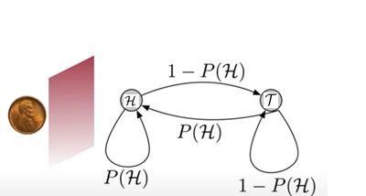
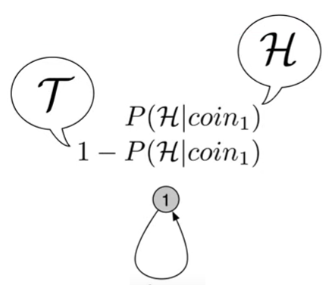
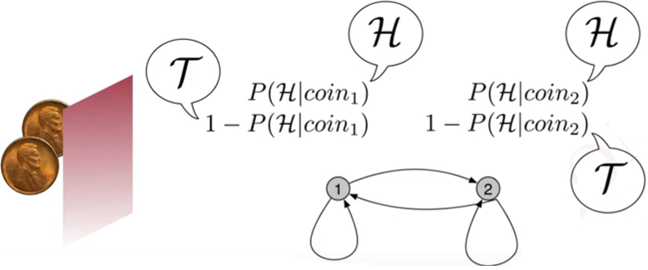
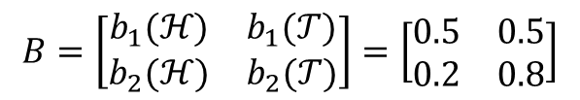








Motivating example
$$O=\left\{o_{1},o_{2}…,o_{T}\right\}=\left\{ℋ,𝒯,ℋ,ℋ,…,𝒯\right\}$$
$$=\left\{S_{1},S_{2},S_{1},S_{1},…,S_{2}\right\}$$
If we know there is 1 coin this process could be also modelled as $→$
where $S_{1}=1$ stays for a 1 coin with given emission probabilities
$$1$$
However, behind the curtain there could be 2 coins, possibly unfair, and following a non-uniform tossing policy (see below)
Prob. To Flip coin 1 or 2
$$A=\left[\begin{matrix}a_{11} & a_{12} \\ a_{21} & a_{22}\end{matrix}\right]=\left[\begin{matrix}0.5 & 0.5 \\ 0.2 & 0.8\end{matrix}\right]$$
$$a_{12}$$
Prob. To call
$ℋ$or $𝒯$for coin 1 or 2
$$B=\left[\begin{matrix}b_{1}(ℋ) & b_{1}(𝒯) \\ b_{2}(ℋ) & b_{2}(𝒯)\end{matrix}\right]=\left[\begin{matrix}0.5 & 0.5 \\ 0.2 & 0.8\end{matrix}\right]$$
$$a_{11}$$
$$a_{21}$$
$$a_{22}$$
Notes:
Here just to remark the importance of queuing networks in telecommunication systems we have another example…for instance…the Internet… that….as you know…. It works by means of a complex architecture where packets flows are processed by many routers, each modeled by a queue.
In particular we have that packets enter in the network because generated from different sources…. and with different destinations…
Then…. they arrive to nodes in a stochastic fashion…and then…each router asynchronously elaborates them…
Of course notice that.. if the traffic intensity exceed some given quantities …well some traffic is lost due to buffer overflows…
Let us further note that queuing networks are successfully used not only to solve resource allocation problems in telecommunication but…. Of course….whenever a flow of jobs need to be processed, independently by the fact that their arrivals and services are either synchronous or asynchronous, or either stochastic or deterministic.
In particular we have that all the results we are going to see are useful to determines in an easy way the system performance…and also to evaluate…. for resource allocation purposes…. the resources need such that a complex client-server architecture works while satisfying some QoS specifications.
Specification that could be expressed in term of time spent in the system…or in term of the buffer capacity … and that of course depends on the allocated resources…that means the number of servers per queue, their service rate… the buffer capacity … furthermore it is easy understand that all those quantities are further influenced by the costumer routing that express…in terms or probability….all the possible paths that a costumer can follows within the network.

Slide 5
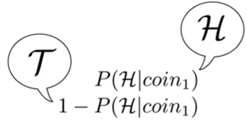

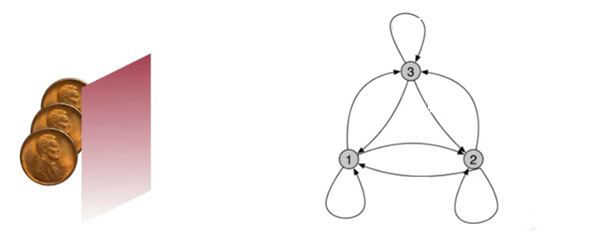







Motivating example (cont’d)
What if behind the curtain there could be more than two coins?
$$1$$
$$a_{12}$$
Which of the three models should we choose?
$$a_{11}$$
$$a_{21}$$
$$a_{22}$$
Model 1 has 1 unknown parameters
$⇒$ Easiest to learn
Model 2 has 4 unknown parameters
If there is only one coin the model training will be much longer, and at the end it will degenerate to Model 1
$⇒$
Model 3 has 9 unknown parameters
On the contrary coins are more than 1
Notes:
Here just to remark the importance of queuing networks in telecommunication systems we have another example…for instance…the Internet… that….as you know…. It works by means of a complex architecture where packets flows are processed by many routers, each modeled by a queue.
In particular we have that packets enter in the network because generated from different sources…. and with different destinations…
Then…. they arrive to nodes in a stochastic fashion…and then…each router asynchronously elaborates them…
Of course notice that.. if the traffic intensity exceed some given quantities …well some traffic is lost due to buffer overflows…
Let us further note that queuing networks are successfully used not only to solve resource allocation problems in telecommunication but…. Of course….whenever a flow of jobs need to be processed, independently by the fact that their arrivals and services are either synchronous or asynchronous, or either stochastic or deterministic.
In particular we have that all the results we are going to see are useful to determines in an easy way the system performance…and also to evaluate…. for resource allocation purposes…. the resources need such that a complex client-server architecture works while satisfying some QoS specifications.
Specification that could be expressed in term of time spent in the system…or in term of the buffer capacity … and that of course depends on the allocated resources…that means the number of servers per queue, their service rate… the buffer capacity … furthermore it is easy understand that all those quantities are further influenced by the costumer routing that express…in terms or probability….all the possible paths that a costumer can follows within the network.

Slide 6
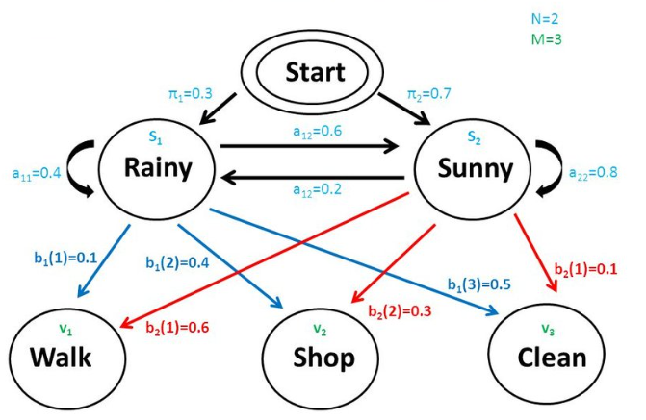






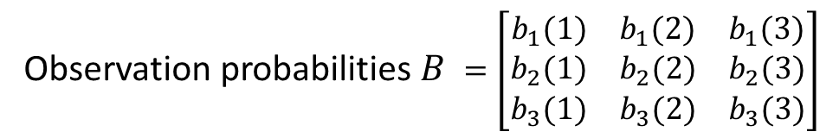



Hidden Markov Models
In a Hidden Markov Model (HMM) the process states $N$are generally «hidden»
States : $N=\left\{S_{1},S_{2},…,S_{N}\right\}$
with
$$a_{ij}=\operatorname{Pr}\left(q_{t+1}=S_{j}|q_{t}=S_{i}\right)$$
From each state $S_{i}$ observations take values from a set of events called
Emissions : $M=\left\{m_{1},m_{2},…,m_{M}\right\}$
with
$$b_{i}\left(k\right)=\operatorname{Pr}\left(o_{t}=m_{k}|q_{t}=S_{i}\right)$$
Thus, a HMM is fully characterized by
$$HMM≡(N,M,A,B,Π(0))$$
Example:
$$N=\left\{Rainy,Sunny\right\}$$
$$M=\left\{Walk,Shop,Clean \right\}$$
Initial probabilities $Π\left(0\right)=\left[π_{1},π_{2}\right]=[0.3,0.7]$
Transition probabilities $A$ $=\left[\begin{matrix}a_{11} & a_{12} \\ a_{21} & a_{22}\end{matrix}\right]$
Observation probabilities $B$ $=\left[\begin{aligned}\begin{matrix}b_{1}(1) & b_{1}(2) & b_{1}(3)\end{matrix} \\ \begin{matrix}b_{2}(1) & b_{2}(2) & b_{2}(3)\end{matrix} \\ \begin{matrix}b_{3}(1) & b_{3}(2) & b_{3}(3)\end{matrix}\end{aligned}\right]$
Notes:
Here just to remark the importance of queuing networks in telecommunication systems we have another example…for instance…the Internet… that….as you know…. It works by means of a complex architecture where packets flows are processed by many routers, each modeled by a queue.
In particular we have that packets enter in the network because generated from different sources…. and with different destinations…
Then…. they arrive to nodes in a stochastic fashion…and then…each router asynchronously elaborates them…
Of course notice that.. if the traffic intensity exceed some given quantities …well some traffic is lost due to buffer overflows…
Let us further note that queuing networks are successfully used not only to solve resource allocation problems in telecommunication but…. Of course….whenever a flow of jobs need to be processed, independently by the fact that their arrivals and services are either synchronous or asynchronous, or either stochastic or deterministic.
In particular we have that all the results we are going to see are useful to determines in an easy way the system performance…and also to evaluate…. for resource allocation purposes…. the resources need such that a complex client-server architecture works while satisfying some QoS specifications.
Specification that could be expressed in term of time spent in the system…or in term of the buffer capacity … and that of course depends on the allocated resources…that means the number of servers per queue, their service rate… the buffer capacity … furthermore it is easy understand that all those quantities are further influenced by the costumer routing that express…in terms or probability….all the possible paths that a costumer can follows within the network.

Slide 7

Hidden Markov Models
HMM is a statistical model-based method used in Machine Learning to capture the underlying patterns or structures in sequential data
It is known for its applications to:
Thermodynamics, Physics, chemistry, Economics, finance
Signal processing, Information theory, Pattern recognition
speech, handwriting, gesture recognition
text, handwriting, position forecasting
musical score following, part-of-speech tagging
bioinformatics, dna sequence classifications
Etc…
It is straightforward noticing that a DT-MC is a special case of HMM
where $B=[b_{j}(k)]$ is such that $b_{j}\left(j\right)=1,b_{j}\left(k\right)=0 ∀ k≠j$
Notes:
Here just to remark the importance of queuing networks in telecommunication systems we have another example…for instance…the Internet… that….as you know…. It works by means of a complex architecture where packets flows are processed by many routers, each modeled by a queue.
In particular we have that packets enter in the network because generated from different sources…. and with different destinations…
Then…. they arrive to nodes in a stochastic fashion…and then…each router asynchronously elaborates them…
Of course notice that.. if the traffic intensity exceed some given quantities …well some traffic is lost due to buffer overflows…
Let us further note that queuing networks are successfully used not only to solve resource allocation problems in telecommunication but…. Of course….whenever a flow of jobs need to be processed, independently by the fact that their arrivals and services are either synchronous or asynchronous, or either stochastic or deterministic.
In particular we have that all the results we are going to see are useful to determines in an easy way the system performance…and also to evaluate…. for resource allocation purposes…. the resources need such that a complex client-server architecture works while satisfying some QoS specifications.
Specification that could be expressed in term of time spent in the system…or in term of the buffer capacity … and that of course depends on the allocated resources…that means the number of servers per queue, their service rate… the buffer capacity … furthermore it is easy understand that all those quantities are further influenced by the costumer routing that express…in terms or probability….all the possible paths that a costumer can follows within the network.

Slide 8

Motivating example
Consider an “in-door” robot for cleaning purposes (thus with no GPS)
The robot may reason about the world by means of a HMM
Cleaning robot generally has noisy sonar sensor and a compass to learn a raw room layout, while identifying new obstacles, or estimating its location based on observation
Observations generally consist in what sensors returns w.r.t. the known room layout, e.g. “obstacles in the direction North-West, after 2 movements from the charging station”
Here, to simplify the discussion, we assume observations are provided by a camera, reading the floor patterns
$$O=\left\{o_{1},o_{2}…,o_{T}\right\}$$
in place the compass aimed at reading obstacles directions
On the basis of the Markov property we are going to show the robot will be able to:
learn the house layout (training phase)
estimate its location in the map at every time $t$
All could be done by exploiting the so-called Forward-Backward algorithm
Notes:
Here just to remark the importance of queuing networks in telecommunication systems we have another example…for instance…the Internet… that….as you know…. It works by means of a complex architecture where packets flows are processed by many routers, each modeled by a queue.
In particular we have that packets enter in the network because generated from different sources…. and with different destinations…
Then…. they arrive to nodes in a stochastic fashion…and then…each router asynchronously elaborates them…
Of course notice that.. if the traffic intensity exceed some given quantities …well some traffic is lost due to buffer overflows…
Let us further note that queuing networks are successfully used not only to solve resource allocation problems in telecommunication but…. Of course….whenever a flow of jobs need to be processed, independently by the fact that their arrivals and services are either synchronous or asynchronous, or either stochastic or deterministic.
In particular we have that all the results we are going to see are useful to determines in an easy way the system performance…and also to evaluate…. for resource allocation purposes…. the resources need such that a complex client-server architecture works while satisfying some QoS specifications.
Specification that could be expressed in term of time spent in the system…or in term of the buffer capacity … and that of course depends on the allocated resources…that means the number of servers per queue, their service rate… the buffer capacity … furthermore it is easy understand that all those quantities are further influenced by the costumer routing that express…in terms or probability….all the possible paths that a costumer can follows within the network.

Slide 9




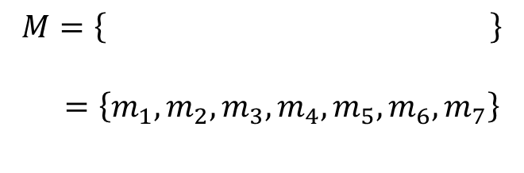
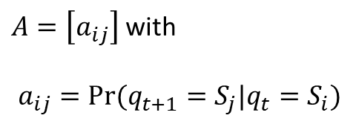







Motivating example
At the moment let us assume the HMM be known
$$HMM≡(N,M,A,B,Π(0))$$
$$N=\left\{0,1,2,…,52\right\}$$
$A=\left[a_{ij}\right]$ with
$a_{ij}=Pr(q_{t+1}=S_{j}|q_{t}=S_{i})$
$$5$$
$$0:Charging Station$$
$$Π\left(0\right)=\left[π_{0},π_{1},…,π_{N}\right]=\left[1,0,…,0\right]$$
$$π_{0}=1$$
$$0$$
$B=\left[b_{i}(k)\right]$ with $b_i(k)=Pr(o_{t}=m_{k}|q_{t}=S_{i})$
$5$ :
$$M=\left\{ \right\}$$
$=\left\{m_{1},m_{2}, m_{3},m_{4},m_{5},m_{6},m_{7}\right\}$
$$b_{5}\left(k\right) :$$
$\frac{1}{5} \frac{3}{5} 0 0 \frac{1}{5} 0 0$
Notes:
Here just to remark the importance of queuing networks in telecommunication systems we have another example…for instance…the Internet… that….as you know…. It works by means of a complex architecture where packets flows are processed by many routers, each modeled by a queue.
In particular we have that packets enter in the network because generated from different sources…. and with different destinations…
Then…. they arrive to nodes in a stochastic fashion…and then…each router asynchronously elaborates them…
Of course notice that.. if the traffic intensity exceed some given quantities …well some traffic is lost due to buffer overflows…
Let us further note that queuing networks are successfully used not only to solve resource allocation problems in telecommunication but…. Of course….whenever a flow of jobs need to be processed, independently by the fact that their arrivals and services are either synchronous or asynchronous, or either stochastic or deterministic.
In particular we have that all the results we are going to see are useful to determines in an easy way the system performance…and also to evaluate…. for resource allocation purposes…. the resources need such that a complex client-server architecture works while satisfying some QoS specifications.
Specification that could be expressed in term of time spent in the system…or in term of the buffer capacity … and that of course depends on the allocated resources…that means the number of servers per queue, their service rate… the buffer capacity … furthermore it is easy understand that all those quantities are further influenced by the costumer routing that express…in terms or probability….all the possible paths that a costumer can follows within the network.

Slide 10
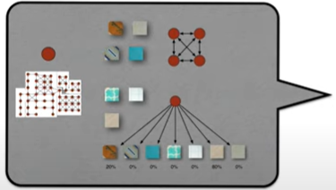






Three key HMM problems
$$HMM≡(N,M,A,B,Π(0))$$
Consider a HMM:
1. What is the probability that a model generates a sequence?
$$O=\left\{o_{1},o_{2},o_{3},…,o_{T}\right\}$$
$⇒ Pr{(O|λ)}$ ?
Model : $λ=\{A,B,Π(0)\}$
2. What sequence of states best explain a sequence of observations?
$$O=\left\{o_{1},o_{2},o_{3},…,o_{T}\right\} ⇒ Q=\left\{q_{1},q_{2},q_{3},…,q_{T}\right\} ?$$
3. Given a sequences of observations how to learn the model probabilities that would generate them?
$$O=\left\{o_{1},o_{2},o_{3},…,o_{T}\right\}$$
$⇒\text{Model}\text{ : }λ=\{A,B,Π(0)\}$ ?
Notes:
Here just to remark the importance of queuing networks in telecommunication systems we have another example…for instance…the Internet… that….as you know…. It works by means of a complex architecture where packets flows are processed by many routers, each modeled by a queue.
In particular we have that packets enter in the network because generated from different sources…. and with different destinations…
Then…. they arrive to nodes in a stochastic fashion…and then…each router asynchronously elaborates them…
Of course notice that.. if the traffic intensity exceed some given quantities …well some traffic is lost due to buffer overflows…
Let us further note that queuing networks are successfully used not only to solve resource allocation problems in telecommunication but…. Of course….whenever a flow of jobs need to be processed, independently by the fact that their arrivals and services are either synchronous or asynchronous, or either stochastic or deterministic.
In particular we have that all the results we are going to see are useful to determines in an easy way the system performance…and also to evaluate…. for resource allocation purposes…. the resources need such that a complex client-server architecture works while satisfying some QoS specifications.
Specification that could be expressed in term of time spent in the system…or in term of the buffer capacity … and that of course depends on the allocated resources…that means the number of servers per queue, their service rate… the buffer capacity … furthermore it is easy understand that all those quantities are further influenced by the costumer routing that express…in terms or probability….all the possible paths that a costumer can follows within the network.

Slide 11


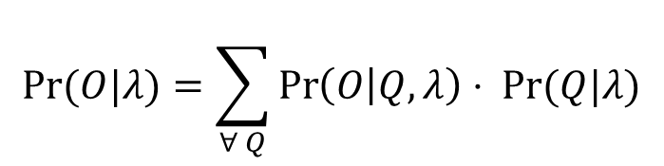





Problem 1: Determine $\operatorname{Pr}{(O|λ)}$
1. What is the probability that a model generates a sequence?
$$O=\left\{o_{1},o_{2},o_{3},…,o_{T}\right\}$$
$⇒ Pr{(O|λ)}$ ?
Model : $λ=\{A,B,Π(0)\}$
Notice that Problem 1 is related also to Problem 3 in the sense that it is equivalent to find the best apartment model among many apartment models $λ_{i}$, i.e,
Which $λ_{i}$ best explain $O$?
Looking for $\operatorname{Pr}{(O|λ)} ≡$
$λ_{i} : \max_{i}{\operatorname{Pr}{(O|λ_{i})}}$ ?
To find $\operatorname{Pr}{(O|λ)}$, we can consider all possible states sequences
$$Q=\left\{q_{1},q_{2},q_{3},…,q_{T}\right\}$$
and
$$\operatorname{Pr}{(O|Q,λ)}$$
$$\operatorname{Pr}{(O|λ)}=\sum_{∀ Q}{\operatorname{Pr}\left(O | Q,λ\right)⋅ \operatorname{Pr}{(Q|λ)}}$$
Now, note that
Notes:
Here just to remark the importance of queuing networks in telecommunication systems we have another example…for instance…the Internet… that….as you know…. It works by means of a complex architecture where packets flows are processed by many routers, each modeled by a queue.
In particular we have that packets enter in the network because generated from different sources…. and with different destinations…
Then…. they arrive to nodes in a stochastic fashion…and then…each router asynchronously elaborates them…
Of course notice that.. if the traffic intensity exceed some given quantities …well some traffic is lost due to buffer overflows…
Let us further note that queuing networks are successfully used not only to solve resource allocation problems in telecommunication but…. Of course….whenever a flow of jobs need to be processed, independently by the fact that their arrivals and services are either synchronous or asynchronous, or either stochastic or deterministic.
In particular we have that all the results we are going to see are useful to determines in an easy way the system performance…and also to evaluate…. for resource allocation purposes…. the resources need such that a complex client-server architecture works while satisfying some QoS specifications.
Specification that could be expressed in term of time spent in the system…or in term of the buffer capacity … and that of course depends on the allocated resources…that means the number of servers per queue, their service rate… the buffer capacity … furthermore it is easy understand that all those quantities are further influenced by the costumer routing that express…in terms or probability….all the possible paths that a costumer can follows within the network.

Slide 12
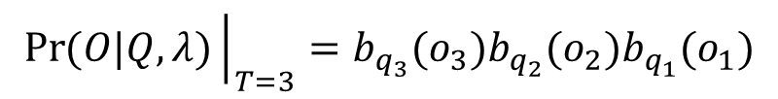
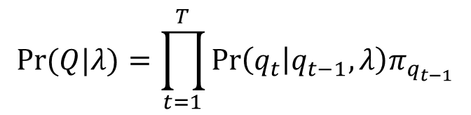
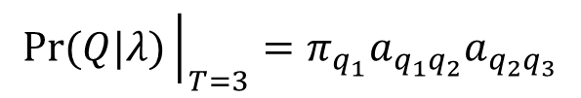
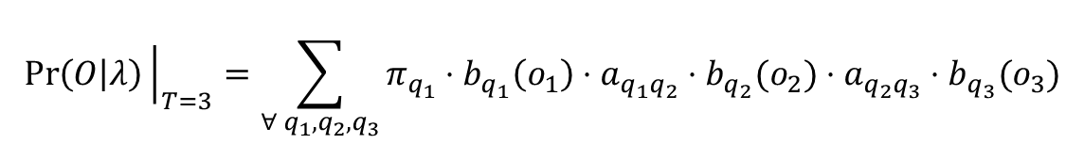
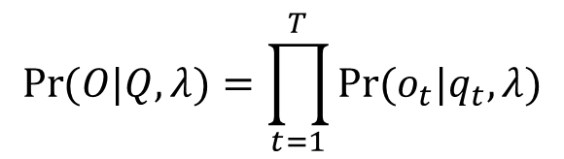
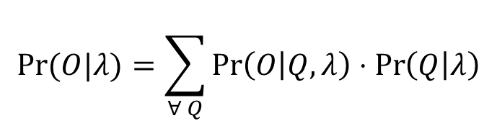
Problem 1: Determine $\operatorname{Pr}{(O|λ)}$
The probability of seeing observation given the state sequence $Q$ and $λ$ is
$$\operatorname{Pr}{(O|Q,λ)}=\prod_{t=1}^{T}{\operatorname{Pr}{(o_{t}|q_{t},λ)}}$$
$$\operatorname{Pr}{(O|Q,λ)}{\left.​\right|}_{T=3}=b_{q_{3}}(o_{3})b_{q_{2}}(o_{2})b_{q_{1}}(o_{1})$$
The probability of seeing that state sequence is
$$\operatorname{Pr}{(Q|λ)}=\prod_{t=1}^{T}{\operatorname{Pr}\left(q_{t} | q_{t−1},λ\right)π_{q_{t−1}}}$$
$$\operatorname{Pr}{(Q|λ)}{\left.​\right|}_{T=3}=π_{q_{1}}a_{q_{1}q_{2}}a_{q_{2}q_{3}}$$
Thus, one derives
$$\operatorname{Pr}{(O|λ)}=\sum_{∀ Q}{\operatorname{Pr}\left(O | Q,λ\right)⋅\operatorname{Pr}\left(Q | λ\right)}$$
$$\operatorname{Pr}\left(O | λ\right){\left.​\right|}_{T=3}=\sum_{∀ q_{1},q_{2},q_{3}}{π_{q_{1}}⋅b_{q_{1}}\left(o_{1}\right)⋅a_{q_{1}q_{2}}⋅b_{q_{2}}(o_{2})⋅{a_{q_{2}q_{3}}⋅b}_{q_{3}}(o_{3})}$$
12
Notes:
Here just to remark the importance of queuing networks in telecommunication systems we have another example…for instance…the Internet… that….as you know…. It works by means of a complex architecture where packets flows are processed by many routers, each modeled by a queue.
In particular we have that packets enter in the network because generated from different sources…. and with different destinations…
Then…. they arrive to nodes in a stochastic fashion…and then…each router asynchronously elaborates them…
Of course notice that.. if the traffic intensity exceed some given quantities …well some traffic is lost due to buffer overflows…
Let us further note that queuing networks are successfully used not only to solve resource allocation problems in telecommunication but…. Of course….whenever a flow of jobs need to be processed, independently by the fact that their arrivals and services are either synchronous or asynchronous, or either stochastic or deterministic.
In particular we have that all the results we are going to see are useful to determines in an easy way the system performance…and also to evaluate…. for resource allocation purposes…. the resources need such that a complex client-server architecture works while satisfying some QoS specifications.
Specification that could be expressed in term of time spent in the system…or in term of the buffer capacity … and that of course depends on the allocated resources…that means the number of servers per queue, their service rate… the buffer capacity … furthermore it is easy understand that all those quantities are further influenced by the costumer routing that express…in terms or probability….all the possible paths that a costumer can follows within the network.

Slide 13



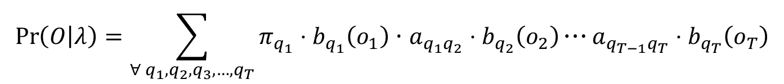


Problem 1: Determine $\operatorname{Pr}{(O|λ)}$
Unfortunately, calculating this directly is infeasible in practice
$$\operatorname{Pr}\left(O | λ\right)=\sum_{∀ q_{1},q_{2},q_{3},…,q_{T}}{π_{q_{1}}⋅b_{q_{1}}\left(o_{1}\right)⋅a_{q_{1}q_{2}}⋅b_{q_{2}}\left(o_{2}\right)⋯a_{q_{T−1}q_{T}}⋅b_{q_{T}}\left(o_{T}\right)}$$
How many possible state sequences $Q$are there?
$N^{T}$ combinations
How many multiplications per state sequences
$$2T−1$$
$$\left(2T−1\right)N^{T}+\left(N^{T}−1\right)$$
Total number of operations?
Let $N=5$ and $T=100$ one obtains
$$\left(2T−1\right)N^{T}+\left(N^{T}−1\right)=\left(2⋅100−1\right)5^{100}+\left(5^{100}−1\right)$$
$$=200⋅5^{100}−1≈5^{3.3}⋅5^{100}$$
$$≈5^{103}≈{10}^{72}$$
We need a better way to compute it!
Notes:
Here just to remark the importance of queuing networks in telecommunication systems we have another example…for instance…the Internet… that….as you know…. It works by means of a complex architecture where packets flows are processed by many routers, each modeled by a queue.
In particular we have that packets enter in the network because generated from different sources…. and with different destinations…
Then…. they arrive to nodes in a stochastic fashion…and then…each router asynchronously elaborates them…
Of course notice that.. if the traffic intensity exceed some given quantities …well some traffic is lost due to buffer overflows…
Let us further note that queuing networks are successfully used not only to solve resource allocation problems in telecommunication but…. Of course….whenever a flow of jobs need to be processed, independently by the fact that their arrivals and services are either synchronous or asynchronous, or either stochastic or deterministic.
In particular we have that all the results we are going to see are useful to determines in an easy way the system performance…and also to evaluate…. for resource allocation purposes…. the resources need such that a complex client-server architecture works while satisfying some QoS specifications.
Specification that could be expressed in term of time spent in the system…or in term of the buffer capacity … and that of course depends on the allocated resources…that means the number of servers per queue, their service rate… the buffer capacity … furthermore it is easy understand that all those quantities are further influenced by the costumer routing that express…in terms or probability….all the possible paths that a costumer can follows within the network.

Slide 14
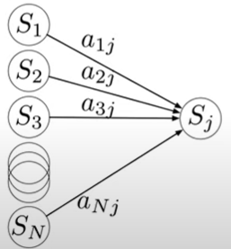


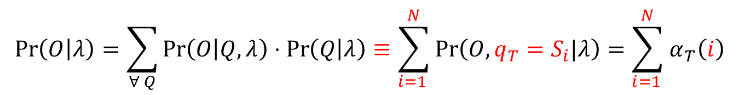

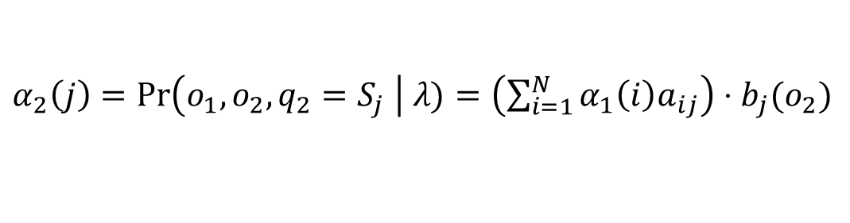

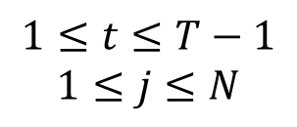


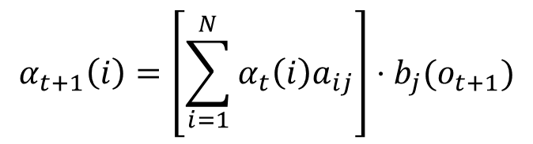



The forward algorithm
$$α_{t}(i)=\operatorname{Pr}\left(o_{1},o_{2},…,o_{t},q_{t}=S_{i} \right| λ)$$
Let us introduce the forward helper function
By solving it inductively
Base case $t=1$:
$α_{1}\left(i\right)=\operatorname{Pr}\left(o_{1},q_{1}=S_{i} \right| λ)=π_{i}⋅b_{i}(o_{1})$ $1≤i≤N$
$t=2$:
$α_{2}\left(j\right)=\operatorname{Pr}\left(o_{1},o_{2},q_{2}=S_{j} \right| λ)=\left(\sum_{i=1}^{N}{α_{1}\left(i\right)a_{ij}}\right)$ $⋅$ $b_{j}(o_{2})$
$$α_{t}(1)$$
Inductive step:
$$α_{t}(2)$$
$$α_{t+1}\left(i\right)=\left[\sum_{i=1}^{N}{α_{t}\left(i\right)a_{ij}}\right]⋅b_{j}(o_{t+1})$$
$$α_{t}(3)$$
$$1≤t≤T−1$$
$$1≤j≤N$$
$$⋮$$
$$α_{t+1}\left(j\right)$$
$$α_{t}(N)$$
By means of that, and by marginalizing w.r.t. the final state $q_{T}$:
$$\operatorname{Pr}\left(O | λ\right)=\sum_{∀ Q}{\operatorname{Pr}\left(O | Q,λ\right)⋅\operatorname{Pr}\left(Q | λ\right)}≡\sum_{i=1 }^{N}{\operatorname{Pr}\left(O,q_{T}=S_{i}|λ\right)}=\sum_{i=1 }^{N}{α_{T}\left(i\right)}$$
Notes:
Here just to remark the importance of queuing networks in telecommunication systems we have another example…for instance…the Internet… that….as you know…. It works by means of a complex architecture where packets flows are processed by many routers, each modeled by a queue.
In particular we have that packets enter in the network because generated from different sources…. and with different destinations…
Then…. they arrive to nodes in a stochastic fashion…and then…each router asynchronously elaborates them…
Of course notice that.. if the traffic intensity exceed some given quantities …well some traffic is lost due to buffer overflows…
Let us further note that queuing networks are successfully used not only to solve resource allocation problems in telecommunication but…. Of course….whenever a flow of jobs need to be processed, independently by the fact that their arrivals and services are either synchronous or asynchronous, or either stochastic or deterministic.
In particular we have that all the results we are going to see are useful to determines in an easy way the system performance…and also to evaluate…. for resource allocation purposes…. the resources need such that a complex client-server architecture works while satisfying some QoS specifications.
Specification that could be expressed in term of time spent in the system…or in term of the buffer capacity … and that of course depends on the allocated resources…that means the number of servers per queue, their service rate… the buffer capacity … furthermore it is easy understand that all those quantities are further influenced by the costumer routing that express…in terms or probability….all the possible paths that a costumer can follows within the network.

Slide 15
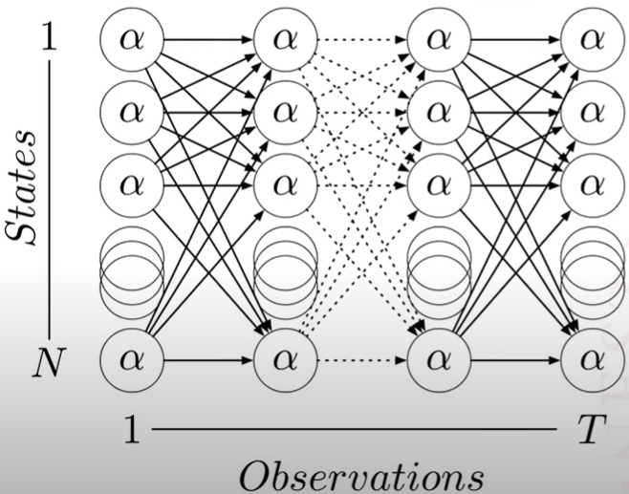
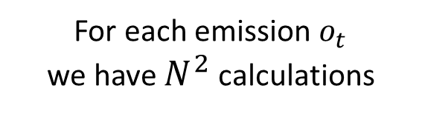
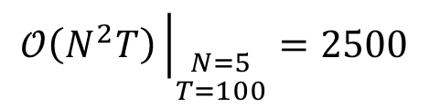
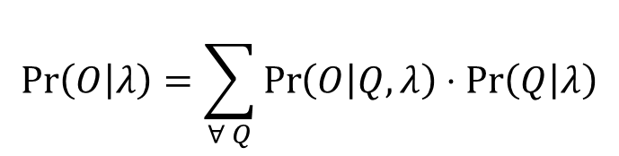
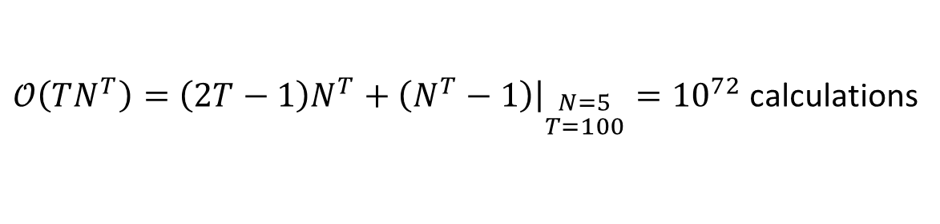

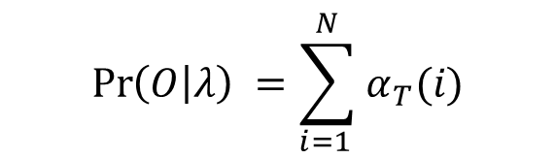

The forward algorithm
$$\operatorname{Pr}\left(O | λ\right)=\sum_{∀ Q}{\operatorname{Pr}\left(O | Q,λ\right)⋅\operatorname{Pr}\left(Q | λ\right)}$$
$𝒪\left(TN^{T}\right)=\left(2T−1\right)N^{T}+\left(N^{T}−1\right){\left.​\right|}_{\begin{aligned}N=5 \\ T=100\end{aligned}}={10}^{72}$ calculations
$$\operatorname{Pr}\left(O | λ\right) =\sum_{i=1 }^{N}{α_{T}(i)}$$
$N^{2}$ calculations $×T$
$$α_{T}(i)=\operatorname{Pr}\left(o_{1},o_{2},…, q_{T}=S_{i} \right| λ)$$
For each emission $o_{t}$
we have $N^{2}$ calculations
$$𝒪\left(N^{2}T\right){\left.​\right|}_{\begin{aligned}N=5 \\ T=100\end{aligned}}=2500$$
Notes:
Here just to remark the importance of queuing networks in telecommunication systems we have another example…for instance…the Internet… that….as you know…. It works by means of a complex architecture where packets flows are processed by many routers, each modeled by a queue.
In particular we have that packets enter in the network because generated from different sources…. and with different destinations…
Then…. they arrive to nodes in a stochastic fashion…and then…each router asynchronously elaborates them…
Of course notice that.. if the traffic intensity exceed some given quantities …well some traffic is lost due to buffer overflows…
Let us further note that queuing networks are successfully used not only to solve resource allocation problems in telecommunication but…. Of course….whenever a flow of jobs need to be processed, independently by the fact that their arrivals and services are either synchronous or asynchronous, or either stochastic or deterministic.
In particular we have that all the results we are going to see are useful to determines in an easy way the system performance…and also to evaluate…. for resource allocation purposes…. the resources need such that a complex client-server architecture works while satisfying some QoS specifications.
Specification that could be expressed in term of time spent in the system…or in term of the buffer capacity … and that of course depends on the allocated resources…that means the number of servers per queue, their service rate… the buffer capacity … furthermore it is easy understand that all those quantities are further influenced by the costumer routing that express…in terms or probability….all the possible paths that a costumer can follows within the network.

Slide 16
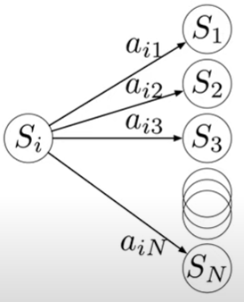
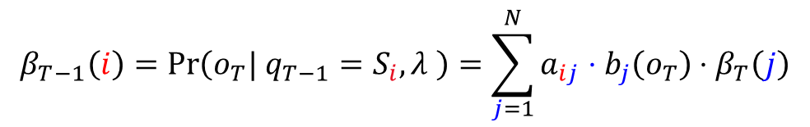








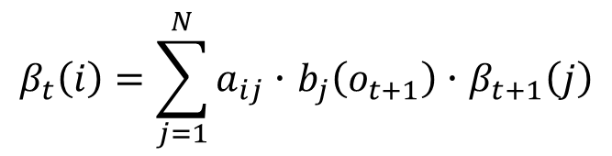



The backward algorithm
The forward function is all I need to solve Problem 1, but let us make the same analysis also “backward” because it will help us to solve the Problem 2 and 3
$$β_{t}\left(i\right)=\operatorname{Pr}\left(o_{t+1},o_{t+2},…,o_{T}| q_{t}=S_{i},λ \right), t<T$$
Backward helper function:
Interpretation: Given that the robot crossed the door right now $\left(q_{t}=5\right)$.
What is the probability I will see the sequence of camera shots I know where coming?
Base case $t=T$:
$$β_{T}(i)=1$$
$$1≤j≤N$$
$$β_{T−1}\left(i\right)=\operatorname{Pr}\left(o_{T}| q_{T−1}=S_{i},λ \right)=\sum_{j=1}^{N}{a_{ij}⋅b_{j}\left(o_{T}\right)⋅β_{T}\left(j\right)}$$
$t=T−1$:
Inductive step:
$$t=T−1,T−2,…,1$$
$$β_{t+1}(1)$$
$$⋮$$
$$β_{t+1}(2)$$
$$β_{t}\left(i\right)=\sum_{j=1}^{N}{a_{ij}⋅b_{j}\left(o_{t+1}\right)⋅β_{t+1}\left(j\right)}$$
$$β_{t+1}(3)$$
$$β_{t}\left(j\right)$$
$$⋮$$
$$⋮$$
$$β_{t+1}(N)$$
Notes:
Here just to remark the importance of queuing networks in telecommunication systems we have another example…for instance…the Internet… that….as you know…. It works by means of a complex architecture where packets flows are processed by many routers, each modeled by a queue.
In particular we have that packets enter in the network because generated from different sources…. and with different destinations…
Then…. they arrive to nodes in a stochastic fashion…and then…each router asynchronously elaborates them…
Of course notice that.. if the traffic intensity exceed some given quantities …well some traffic is lost due to buffer overflows…
Let us further note that queuing networks are successfully used not only to solve resource allocation problems in telecommunication but…. Of course….whenever a flow of jobs need to be processed, independently by the fact that their arrivals and services are either synchronous or asynchronous, or either stochastic or deterministic.
In particular we have that all the results we are going to see are useful to determines in an easy way the system performance…and also to evaluate…. for resource allocation purposes…. the resources need such that a complex client-server architecture works while satisfying some QoS specifications.
Specification that could be expressed in term of time spent in the system…or in term of the buffer capacity … and that of course depends on the allocated resources…that means the number of servers per queue, their service rate… the buffer capacity … furthermore it is easy understand that all those quantities are further influenced by the costumer routing that express…in terms or probability….all the possible paths that a costumer can follows within the network.

Slide 17


Three key HMM problems
$$HMM≡(N,M,A,B,Π(0))$$
Consider a HMM:
1. What is the probability that a model generates a sequence?
$$O=\left\{o_{1},o_{2},o_{3},…,o_{T}\right\}$$
OK
$⇒ Pr{(O|λ)}$ ?
Model : $λ=\{A,B,Π(0)\}$
2. What sequence of states best explain a sequence of observations?
$$O=\left\{o_{1},o_{2},o_{3},…,o_{T}\right\} ⇒ Q=\left\{q_{1},q_{2},q_{3},…,q_{T}\right\} ?$$
3. Given a sequences of observations how to learn the model probabilities that would generate them?
$$O=\left\{o_{1},o_{2},o_{3},…,o_{T}\right\}$$
$⇒\text{Model}\text{ : }λ=\{A,B,Π(0)\}$ ?
Notes:
Here just to remark the importance of queuing networks in telecommunication systems we have another example…for instance…the Internet… that….as you know…. It works by means of a complex architecture where packets flows are processed by many routers, each modeled by a queue.
In particular we have that packets enter in the network because generated from different sources…. and with different destinations…
Then…. they arrive to nodes in a stochastic fashion…and then…each router asynchronously elaborates them…
Of course notice that.. if the traffic intensity exceed some given quantities …well some traffic is lost due to buffer overflows…
Let us further note that queuing networks are successfully used not only to solve resource allocation problems in telecommunication but…. Of course….whenever a flow of jobs need to be processed, independently by the fact that their arrivals and services are either synchronous or asynchronous, or either stochastic or deterministic.
In particular we have that all the results we are going to see are useful to determines in an easy way the system performance…and also to evaluate…. for resource allocation purposes…. the resources need such that a complex client-server architecture works while satisfying some QoS specifications.
Specification that could be expressed in term of time spent in the system…or in term of the buffer capacity … and that of course depends on the allocated resources…that means the number of servers per queue, their service rate… the buffer capacity … furthermore it is easy understand that all those quantities are further influenced by the costumer routing that express…in terms or probability….all the possible paths that a costumer can follows within the network.

Slide 18

Problem 2: Estimate the best $Q$ explaining $O$
2. What sequence of states best explain observations?
$$O=\left\{o_{1},o_{2},o_{3},…,o_{T}\right\}⇒ Q=\left\{q_{1},q_{2},q_{3},…,q_{T}\right\} ?$$
Example 1: Given a floor covering sequence, which path did the robot follow?
Example 2: Given a sequence of sounds, which phonemes or words correspond?
What does “best” mean?
Example of the true path
Notes:
Here just to remark the importance of queuing networks in telecommunication systems we have another example…for instance…the Internet… that….as you know…. It works by means of a complex architecture where packets flows are processed by many routers, each modeled by a queue.
In particular we have that packets enter in the network because generated from different sources…. and with different destinations…
Then…. they arrive to nodes in a stochastic fashion…and then…each router asynchronously elaborates them…
Of course notice that.. if the traffic intensity exceed some given quantities …well some traffic is lost due to buffer overflows…
Let us further note that queuing networks are successfully used not only to solve resource allocation problems in telecommunication but…. Of course….whenever a flow of jobs need to be processed, independently by the fact that their arrivals and services are either synchronous or asynchronous, or either stochastic or deterministic.
In particular we have that all the results we are going to see are useful to determines in an easy way the system performance…and also to evaluate…. for resource allocation purposes…. the resources need such that a complex client-server architecture works while satisfying some QoS specifications.
Specification that could be expressed in term of time spent in the system…or in term of the buffer capacity … and that of course depends on the allocated resources…that means the number of servers per queue, their service rate… the buffer capacity … furthermore it is easy understand that all those quantities are further influenced by the costumer routing that express…in terms or probability….all the possible paths that a costumer can follows within the network.

Slide 19
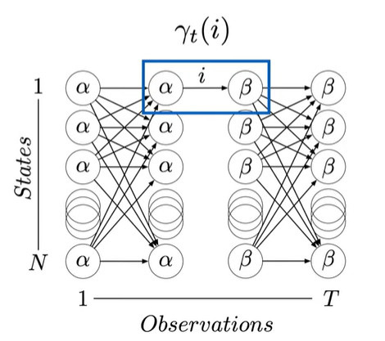
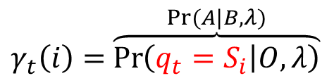
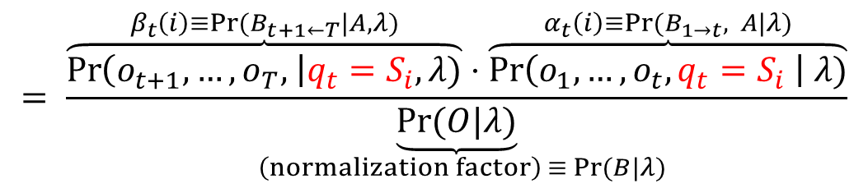
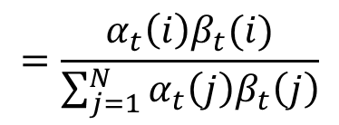
Problem 2 through a Maximum Likelihood Criteria
Approach 1. Choose states that are individually most likely
$$q_{t}^{∗}=\arg{\max_{1≤i≤N}{\operatorname{Pr}\left( q_{t}=S_{i } \right| O,λ)} ∀ t=1,2,…,T}$$
$$= \frac{\overset{β_{t}\left(i\right)≡\operatorname{Pr}{(B_{t+1←T}|A,λ)}}{\overbrace{\operatorname{Pr}\left(o_{t+1}, …,o_{T}, \right|q_{t}=S_{i},λ)}}⋅\overset{α_{t}\left(i\right)≡\operatorname{Pr}{(B_{1→t}, A|λ)}}{\overbrace{\operatorname{Pr}\left(o_{1},…,o_{t},q_{t}=S_{i} \right| λ)}}}{\underset{ \left(normalization factor\right) ≡\operatorname{Pr}{(B|λ)}}{\underbrace{\operatorname{Pr}{(O|λ)}}}}$$
$γ_{t}\left(i\right)=$ $\overset{\operatorname{Pr}{(A|B,λ)}}{\overbrace{\operatorname{Pr}\left(q_{t}=S_{i} | O,λ\right)}}$
$$=\frac{α_{t}\left(i\right)β_{t}(i)}{\sum_{j=1}^{N}{α_{t}\left(j\right)β_{t}\left(j\right)}}$$
This criteria returns the most expected states, but it may provide not feasible sequences…
Notes:
Here just to remark the importance of queuing networks in telecommunication systems we have another example…for instance…the Internet… that….as you know…. It works by means of a complex architecture where packets flows are processed by many routers, each modeled by a queue.
In particular we have that packets enter in the network because generated from different sources…. and with different destinations…
Then…. they arrive to nodes in a stochastic fashion…and then…each router asynchronously elaborates them…
Of course notice that.. if the traffic intensity exceed some given quantities …well some traffic is lost due to buffer overflows…
Let us further note that queuing networks are successfully used not only to solve resource allocation problems in telecommunication but…. Of course….whenever a flow of jobs need to be processed, independently by the fact that their arrivals and services are either synchronous or asynchronous, or either stochastic or deterministic.
In particular we have that all the results we are going to see are useful to determines in an easy way the system performance…and also to evaluate…. for resource allocation purposes…. the resources need such that a complex client-server architecture works while satisfying some QoS specifications.
Specification that could be expressed in term of time spent in the system…or in term of the buffer capacity … and that of course depends on the allocated resources…that means the number of servers per queue, their service rate… the buffer capacity … furthermore it is easy understand that all those quantities are further influenced by the costumer routing that express…in terms or probability….all the possible paths that a costumer can follows within the network.

Slide 20










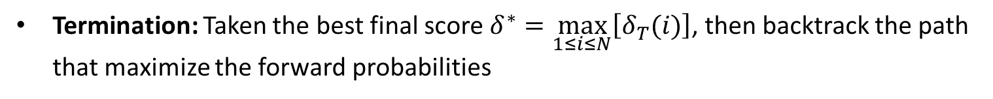
Problem 2 through the Viterbi Algorithm
Approach 2. Choose a path sequence $Q=\{q_{1},q_{2},…,q_{T} \}$ that maximize $\operatorname{Pr}\left(Q|O,λ\right)$
Since $\operatorname{Pr}\left(Q|O,λ\right)=\frac{Pr\left(Q,O | λ\right)}{\operatorname{Pr}{(O|λ)}} ⇒ max\operatorname{Pr}\left(Q|O,λ\right)≡\max{\operatorname{Pr}\left(Q,O| λ\right)}$
where $\max{\operatorname{Pr}\left(\left\{q_{1},q_{2},..q_{T}\right\},\{o_{1},o_{2},..o_{T}\}| λ\right)}$ is solvable by the Viterbi Algorithm
Let us introduce a helper function to capture this
$$δ_{t}\left(i\right)=\max_{q_{1},q_{2},…,q_{t−1}}{\operatorname{Pr}\left(\left\{q_{1},q_{2},..q_{t−1},q_{t}=S_{i}\right\},\{o_{1},o_{2},..o_{t}\}| λ\right)} ∀ t=1,…,T$$
Base step $t=1$:
$$δ_{1}\left(i\right)=\operatorname{Pr}\left(q_{1}=S_{i},o_{1}| λ\right)=π_{i}⋅b_{i}(o_{1})$$
$$ψ_{1}\left(i\right)=0 , ∀ i$$
Induction step:
$$δ_{t}\left(j\right)=\max_{1≤i≤N}\left[δ_{t−1}\left(i\right)a_{ij}\right]⋅b_{j}\left(o_{t}\right)$$
$$ψ_{t}\left(j\right)=\arg{\max_{1≤i≤N}\left[δ_{t−1}\left(i\right)a_{ij}\right]}$$
$$2≤t≤T, 1≤j≤N$$
(it stores the best $i$ at each time $t$)
Termination: Taken the best final score $δ^{∗}=\max_{1≤i≤N}\left[δ_{T}(i)\right]$, then backtrack the path that maximize the forward probabilities
$$q_{T}^{∗}=\arg{\max_{1≤i≤N}\left[δ_{T}\left(i\right)\right]}$$
$$q_{t}^{∗}=ψ_{t+1}\left(q_{t+1}^{∗}\right)$$
$$1≤t≤T−1$$
Notes:
Here just to remark the importance of queuing networks in telecommunication systems we have another example…for instance…the Internet… that….as you know…. It works by means of a complex architecture where packets flows are processed by many routers, each modeled by a queue.
In particular we have that packets enter in the network because generated from different sources…. and with different destinations…
Then…. they arrive to nodes in a stochastic fashion…and then…each router asynchronously elaborates them…
Of course notice that.. if the traffic intensity exceed some given quantities …well some traffic is lost due to buffer overflows…
Let us further note that queuing networks are successfully used not only to solve resource allocation problems in telecommunication but…. Of course….whenever a flow of jobs need to be processed, independently by the fact that their arrivals and services are either synchronous or asynchronous, or either stochastic or deterministic.
In particular we have that all the results we are going to see are useful to determines in an easy way the system performance…and also to evaluate…. for resource allocation purposes…. the resources need such that a complex client-server architecture works while satisfying some QoS specifications.
Specification that could be expressed in term of time spent in the system…or in term of the buffer capacity … and that of course depends on the allocated resources…that means the number of servers per queue, their service rate… the buffer capacity … furthermore it is easy understand that all those quantities are further influenced by the costumer routing that express…in terms or probability….all the possible paths that a costumer can follows within the network.

Slide 21

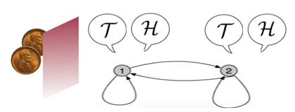



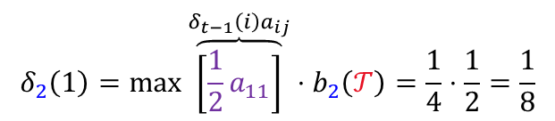











































The Viterbi algorithm
Assume
$$π_{1}=1$$
$$δ_{1}\left(1\right)=π_{1}b_{1}\left(ℋ\right)=1⋅\frac{1}{2}=\frac{1}{2}$$
$$\frac{1}{2}$$
$$\frac{1}{2}$$
$$\frac{2}{10}$$
$$\frac{8}{10}$$
$ψ_{1}\left(1\right)=$0
$$δ_{2}\left(1\right)=\max{\overset{δ_{t−1}\left(i\right)a_{ij}}{\overbrace{\left[\frac{1}{2}a_{11}\right]}}⋅b_{2}\left(𝒯\right)}=\frac{1}{4}⋅\frac{1}{2}=\frac{1}{8}$$
$$a_{12}=\frac{1}{2}$$
$$ψ_{2}(1)=1$$
$$δ_{2}\left(2\right)=\max\left[\frac{1}{2}a_{12}\right]b_{2}\left(𝒯\right)=\frac{1}{4}⋅\frac{2}{10}=\frac{1}{20}$$
$$a_{11}=\frac{1}{2}$$
$$a_{21}=\frac{2}{10}$$
$$a_{22}=\frac{8}{10}$$
$$ψ_{2}(2)=1$$
$$δ_{3}\left(1\right)=\max\left[δ_{2}\left(1\right)a_{11},δ_{2}\left(2\right)a_{21}\right]b_{3}\left(ℋ\right)=\frac{1}{32}$$
$$o_{1}=ℋ$$
$$o_{2}=𝒯$$
$$o_{3}=ℋ$$
$$o_{4}=ℋ$$
$$ψ_{3}(1)=1$$
$$δ_{3}(2)=\max\left[δ_{2}\left(1\right)a_{11},δ_{2}\left(2\right)a_{21}\right]b_{3}\left(ℋ\right)=\frac{1}{20}$$
$$1/2$$
$$1/8$$
$$1/32$$
$$1/128$$
$$1$$
$$ψ_{3}(2)=1$$
$$1/20$$
$$δ_{4}\left(1\right)=\max\left[δ_{3}\left(1\right)a_{11},δ_{3}\left(2\right)a_{21}\right]b_{4}\left(ℋ\right)=\frac{1}{128}$$
$$1/20$$
$$4/125$$
$$2$$
$$ψ_{4}(1)=1$$
Best score
$$δ_{4}(2)=\max\left[δ_{3}\left(1\right)a_{12},δ_{3}\left(2\right)a_{22}\right]b_{4}\left(ℋ\right)=\frac{4}{125}$$
Backward estimation:
$$ψ_{4}(2)=2$$
$q_{T}^{∗}=q_{4}^{∗}=$ $\arg{\max\left[δ_{4}\left(1\right),δ_{4}(2)\right]}=2$
$$q_{t}^{∗}=ψ_{t+1}\left(q_{t+1}^{∗}\right)$$
$$q_{3}^{∗}=ψ_{4}\left(2\right)=2$$
$$q_{2}^{∗}=ψ_{3}\left(2\right)=1$$
$$q_{1}^{∗}=ψ_{2}\left(1\right)=1$$
Notes:
Here just to remark the importance of queuing networks in telecommunication systems we have another example…for instance…the Internet… that….as you know…. It works by means of a complex architecture where packets flows are processed by many routers, each modeled by a queue.
In particular we have that packets enter in the network because generated from different sources…. and with different destinations…
Then…. they arrive to nodes in a stochastic fashion…and then…each router asynchronously elaborates them…
Of course notice that.. if the traffic intensity exceed some given quantities …well some traffic is lost due to buffer overflows…
Let us further note that queuing networks are successfully used not only to solve resource allocation problems in telecommunication but…. Of course….whenever a flow of jobs need to be processed, independently by the fact that their arrivals and services are either synchronous or asynchronous, or either stochastic or deterministic.
In particular we have that all the results we are going to see are useful to determines in an easy way the system performance…and also to evaluate…. for resource allocation purposes…. the resources need such that a complex client-server architecture works while satisfying some QoS specifications.
Specification that could be expressed in term of time spent in the system…or in term of the buffer capacity … and that of course depends on the allocated resources…that means the number of servers per queue, their service rate… the buffer capacity … furthermore it is easy understand that all those quantities are further influenced by the costumer routing that express…in terms or probability….all the possible paths that a costumer can follows within the network.

Slide 22


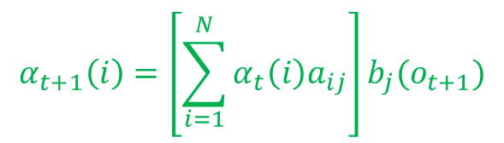
Viterbi Algorithm VS Forward-Backward algorithm
The Viterbi algorithm solutions are similar with the Forward-Backward algorithm
$$α_{t+1}\left(i\right)=\left[\sum_{i=1}^{N}{α_{t}\left(i\right)a_{ij}}\right]b_{j}(o_{t+1})$$
$$δ_{t}\left(j\right)=\max_{1≤i≤N}\left[δ_{t−1}\left(i\right)a_{ij}\right]⋅b_{j}\left(o_{t}\right)$$
$$VS$$
$$q_{T}^{∗}=\arg{\max_{1≤i≤N}\left[δ_{T}\left(i\right)\right]}$$
Both are computationally treatable with a complexity of $𝒪\left(N^{2}T+T\right) VS 𝒪(N^{2}T)$
The major difference are instead:
It perform a maximization of the previous state in place of “sum” procedure
It further consider also a backtracking part to determine its best $q_{t}^{∗}$
The Viterbi algorithm finds application also to “not-probabilistic” fields
See: shortest path planning on maps, minimum spanning three problems on graphs, etc…
Notes:
Here just to remark the importance of queuing networks in telecommunication systems we have another example…for instance…the Internet… that….as you know…. It works by means of a complex architecture where packets flows are processed by many routers, each modeled by a queue.
In particular we have that packets enter in the network because generated from different sources…. and with different destinations…
Then…. they arrive to nodes in a stochastic fashion…and then…each router asynchronously elaborates them…
Of course notice that.. if the traffic intensity exceed some given quantities …well some traffic is lost due to buffer overflows…
Let us further note that queuing networks are successfully used not only to solve resource allocation problems in telecommunication but…. Of course….whenever a flow of jobs need to be processed, independently by the fact that their arrivals and services are either synchronous or asynchronous, or either stochastic or deterministic.
In particular we have that all the results we are going to see are useful to determines in an easy way the system performance…and also to evaluate…. for resource allocation purposes…. the resources need such that a complex client-server architecture works while satisfying some QoS specifications.
Specification that could be expressed in term of time spent in the system…or in term of the buffer capacity … and that of course depends on the allocated resources…that means the number of servers per queue, their service rate… the buffer capacity … furthermore it is easy understand that all those quantities are further influenced by the costumer routing that express…in terms or probability….all the possible paths that a costumer can follows within the network.

Slide 23
Three key HMM problems
$$HMM≡(N,M,A,B,Π(0))$$
Consider a HMM:
1. What is the probability that a model generates a sequence?
$$O=\left\{o_{1},o_{2},o_{3},…,o_{T}\right\}$$
OK
$⇒ Pr{(O|λ)}$ ?
Model : $λ=\{A,B,Π(0)\}$
2. What sequence of states best explain a sequence of observations?
OK
$$O=\left\{o_{1},o_{2},o_{3},…,o_{T}\right\} ⇒ Q=\left\{q_{1},q_{2},q_{3},…,q_{T}\right\} ?$$
3. Given a set of observations sequences hot to learn the model probabilities that would generate them?
$$O=\left\{o_{1},o_{2},o_{3},…,o_{T}\right\}$$
$⇒\text{Model}\text{ : }λ=\{A,B,Π(0)\}$ ?
Notes:
Here just to remark the importance of queuing networks in telecommunication systems we have another example…for instance…the Internet… that….as you know…. It works by means of a complex architecture where packets flows are processed by many routers, each modeled by a queue.
In particular we have that packets enter in the network because generated from different sources…. and with different destinations…
Then…. they arrive to nodes in a stochastic fashion…and then…each router asynchronously elaborates them…
Of course notice that.. if the traffic intensity exceed some given quantities …well some traffic is lost due to buffer overflows…
Let us further note that queuing networks are successfully used not only to solve resource allocation problems in telecommunication but…. Of course….whenever a flow of jobs need to be processed, independently by the fact that their arrivals and services are either synchronous or asynchronous, or either stochastic or deterministic.
In particular we have that all the results we are going to see are useful to determines in an easy way the system performance…and also to evaluate…. for resource allocation purposes…. the resources need such that a complex client-server architecture works while satisfying some QoS specifications.
Specification that could be expressed in term of time spent in the system…or in term of the buffer capacity … and that of course depends on the allocated resources…that means the number of servers per queue, their service rate… the buffer capacity … furthermore it is easy understand that all those quantities are further influenced by the costumer routing that express…in terms or probability….all the possible paths that a costumer can follows within the network.

Slide 24
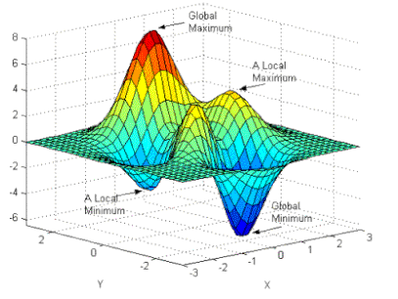






Problem 3: Model training
3. Given the observations how to learn the model probabilities that would generate them?
$$O=\left\{o_{1},o_{2},o_{3},…,o_{T}\right\}$$
$⇒ \text{Model}\text{ : }λ=\{A,B,Π(0)\}$ ?
The answer is not unique and it depends on the considered optimal criteria
In general, it is used the BAUM-WELCH Algorithm that is an “Expectation Maximization method”, i.e., it maximize the likelihood that $λ$ generates $O$
$$\overline{λ}=\underset{λ}{arg max}\left\{\operatorname{Pr}\left(O|λ\right)\right\}$$
However, the mixed-integer nature of the decision variables involved, makes the problem not convex and only a local optimum can be found
Not-convex solvers use the gradient descent method as well, however the solution goodness depends on the decision variable initialization
The BAUM-WELCH Algorithm at each iteration makes use of
$$α_{t}(i)=\operatorname{Pr}\left(o_{1},…,o_{t},q_{t}=S_{i} \right| λ)$$
$$γ_{t}\left(i\right)=\operatorname{Pr}{(q_{t}=S_{i}|O,λ)}=\frac{α_{t}\left(i\right)β_{t}(i)}{\sum_{j=1}^{N}{α_{t}\left(j\right)β_{t}\left(j\right)}}$$
$$β_{t}\left(i\right)=\operatorname{Pr}\left(o_{t+1},…, o_{T}| q_{t}=S_{i},λ \right)$$
Then, it computes $\operatorname{Pr}\left(O|λ\right)$ and modify $λ→λ^{′}$ to the direction $\operatorname{Pr}\left(O|λ\right)$ increases, then it checks $\operatorname{Pr}\left(O|λ^{′}\right)>\operatorname{Pr}\left(O|λ\right)$. Once it detect no more improvements it terminates.
Notes:
Here just to remark the importance of queuing networks in telecommunication systems we have another example…for instance…the Internet… that….as you know…. It works by means of a complex architecture where packets flows are processed by many routers, each modeled by a queue.
In particular we have that packets enter in the network because generated from different sources…. and with different destinations…
Then…. they arrive to nodes in a stochastic fashion…and then…each router asynchronously elaborates them…
Of course notice that.. if the traffic intensity exceed some given quantities …well some traffic is lost due to buffer overflows…
Let us further note that queuing networks are successfully used not only to solve resource allocation problems in telecommunication but…. Of course….whenever a flow of jobs need to be processed, independently by the fact that their arrivals and services are either synchronous or asynchronous, or either stochastic or deterministic.
In particular we have that all the results we are going to see are useful to determines in an easy way the system performance…and also to evaluate…. for resource allocation purposes…. the resources need such that a complex client-server architecture works while satisfying some QoS specifications.
Specification that could be expressed in term of time spent in the system…or in term of the buffer capacity … and that of course depends on the allocated resources…that means the number of servers per queue, their service rate… the buffer capacity … furthermore it is easy understand that all those quantities are further influenced by the costumer routing that express…in terms or probability….all the possible paths that a costumer can follows within the network.

Slide 25










The BAUM-WELCH Algorithm
Let us give an idea on how it works by introducing the following helper function
$$ξ_{t}\left(i,j\right)=\operatorname{Pr}\left(q_{t}=S_{i},q_{t+1}=S_{j}|O,λ\right)=\frac{α_{t}\left(i\right)⋅\left(a_{ij}⋅b_{j}\left(o_{t+1}\right)\right)⋅β_{t+1}(j)}{\operatorname{Pr}{(O|λ)}}$$
$$=\frac{α_{t}\left(i\right)⋅\left(a_{ij}⋅b_{j}\left(o_{t+1}\right)\right)⋅β_{t+1}(j)}{\sum_{i=1}^{N}{α_{t}\left(i\right)\sum_{j=1}^{N}{a_{ij}}}b_{j}\left(o_{t+1}\right)β_{t+1}\left(j\right)}$$
Note that, by marginalizing w.r.t. $j,$it results:
$$\sum_{j=1}^{N}{ξ_{t}\left(i,j\right) }=\operatorname{Pr}\left(q_{t}=S_{i}|O,λ\right) ≡ γ_{t}\left(i\right)$$
$ξ_{t}(i,j)≡$ Probability of transitioning from $S_{i}$ at time $t$ to $S_{j}|O,λ$
Note:
$γ_{t}\left(i\right)≡$ Probability of being in $S_{i}$ at time $t$ $| O,λ$
By marginalizing w.r.t. time $t$
$\sum_{t=1}^{T−1}{ξ_{t}\left(i,j\right)}≡$Expected #transitions from $S_{i}$ to $S_{j}| O,λ$
$\sum_{t=1}^{T−1}{γ_{t}\left(i\right)≡}$Exp. #times $S_{i}$ is visited (#transitions from) $|O,λ$
Notes:
Here just to remark the importance of queuing networks in telecommunication systems we have another example…for instance…the Internet… that….as you know…. It works by means of a complex architecture where packets flows are processed by many routers, each modeled by a queue.
In particular we have that packets enter in the network because generated from different sources…. and with different destinations…
Then…. they arrive to nodes in a stochastic fashion…and then…each router asynchronously elaborates them…
Of course notice that.. if the traffic intensity exceed some given quantities …well some traffic is lost due to buffer overflows…
Let us further note that queuing networks are successfully used not only to solve resource allocation problems in telecommunication but…. Of course….whenever a flow of jobs need to be processed, independently by the fact that their arrivals and services are either synchronous or asynchronous, or either stochastic or deterministic.
In particular we have that all the results we are going to see are useful to determines in an easy way the system performance…and also to evaluate…. for resource allocation purposes…. the resources need such that a complex client-server architecture works while satisfying some QoS specifications.
Specification that could be expressed in term of time spent in the system…or in term of the buffer capacity … and that of course depends on the allocated resources…that means the number of servers per queue, their service rate… the buffer capacity … furthermore it is easy understand that all those quantities are further influenced by the costumer routing that express…in terms or probability….all the possible paths that a costumer can follows within the network.

Slide 26









The BAUM-WELCH Algorithm
Let us recap the information we have:
We have an idea of model structure $λ=\{A,B,Π(0)\}$ (…at least a raw guess)
We have a set of observations $O=\left\{o_{1},o_{2},…,o_{T}\right\}$ (measurements)
We have a set of tools: $α_{t}\left(i\right),β_{t}\left(i\right),γ_{t}\left(i\right),ξ_{t}(i,j)$
How do we use these info to improve (train) our model guess?
$$\overline{λ}=\left\{\overline{A},\overline{B},\overline{Π}\left(0\right)\right\}$$
Note that we have the ability to compute the following updates:
$γ_{1}\left(i\right)=\operatorname{Pr}\left(q_{1}=S_{i}|O,λ\right)≡$
Expected frequency in $S_{i}$ at time $t=1$, i.e., ${\overline{π}}_{i}\left(0\right)$
$$\frac{Expected \#transitions from S_{i} to S_{j}}{Expected \#transitions from S_{i}}$$
$$=\frac{\sum_{t=1}^{T−1}{ξ_{t}\left(i,j\right)}}{\sum_{t=1}^{T−1}{γ_{t}\left(i\right)}}$$
${\overline{a}}_{ij}≡$
$$=\frac{\sum_{\begin{aligned}t=1 \\ with o_{t}=m_{k}\end{aligned}}^{T}{ξ_{t}\left(i,j\right)}}{\sum_{t=1}^{T}{γ_{t}\left(i\right)}}$$
${\overline{b}}_{i}(k)≡$
$$\frac{Expected \#times in state S_{i} and observing m_{k}}{Expected \#times in S_{i}}$$
If $R$-many realizations are available, we can averaging among them $⇒\frac{\sum_{k=1}^{R}{\left\{{\overline{π}}_{i}^{k}\left(0\right), {\overline{A}}^{k}, {\overline{B}}^{k}\right\}}}{R}$
Notes:
Here just to remark the importance of queuing networks in telecommunication systems we have another example…for instance…the Internet… that….as you know…. It works by means of a complex architecture where packets flows are processed by many routers, each modeled by a queue.
In particular we have that packets enter in the network because generated from different sources…. and with different destinations…
Then…. they arrive to nodes in a stochastic fashion…and then…each router asynchronously elaborates them…
Of course notice that.. if the traffic intensity exceed some given quantities …well some traffic is lost due to buffer overflows…
Let us further note that queuing networks are successfully used not only to solve resource allocation problems in telecommunication but…. Of course….whenever a flow of jobs need to be processed, independently by the fact that their arrivals and services are either synchronous or asynchronous, or either stochastic or deterministic.
In particular we have that all the results we are going to see are useful to determines in an easy way the system performance…and also to evaluate…. for resource allocation purposes…. the resources need such that a complex client-server architecture works while satisfying some QoS specifications.
Specification that could be expressed in term of time spent in the system…or in term of the buffer capacity … and that of course depends on the allocated resources…that means the number of servers per queue, their service rate… the buffer capacity … furthermore it is easy understand that all those quantities are further influenced by the costumer routing that express…in terms or probability….all the possible paths that a costumer can follows within the network.

Slide 27











The BAUM-WELCH Algorithm
So…
Given a model guess $λ=\{A,B,Π(0)\}$ and $O$, produce $α_{t}\left(i\right),β_{t}\left(i\right),γ_{t}\left(i\right),ξ_{t}(i,j)$
Given $α_{t}\left(i\right),β_{t}\left(i\right),γ_{t}\left(i\right),ξ_{t}(i,j)$, produce $\overline{λ}=\left\{\overline{A},\overline{B},\overline{Π}\left(0\right)\right\}$
$$Re−Estimate$$
$$Paramters$$
$λ=\{A,B,Π(0)\}$
$$\overline{λ}=\underset{λ}{arg max}\left\{\operatorname{Pr}\left(O|λ\right)\right\}$$
$\overline{λ}=\left\{\overline{A},\overline{B},\overline{Π}\left(0\right)\right\}$
$\overline{λ}=\left\{\overline{A},\overline{B},\overline{Π}\left(0\right)\right\}$
$$local optimun$$
$$α_{t}\left(i\right),β_{t}\left(i\right),γ_{t}\left(i\right),ξ_{t}(i,j)$$
$$Expectation$$
$$Maximization$$
$$α_{t}\left(i\right),β_{t}\left(i\right),γ_{t}\left(i\right),ξ_{t}(i,j)$$
$$\max_{λ}\left\{\operatorname{Pr}\left(O|λ\right)\right\}$$
$$α_{t}\left(i\right),β_{t}\left(i\right),γ_{t}\left(i\right),ξ_{t}(i,j)$$
Notes:
Here just to remark the importance of queuing networks in telecommunication systems we have another example…for instance…the Internet… that….as you know…. It works by means of a complex architecture where packets flows are processed by many routers, each modeled by a queue.
In particular we have that packets enter in the network because generated from different sources…. and with different destinations…
Then…. they arrive to nodes in a stochastic fashion…and then…each router asynchronously elaborates them…
Of course notice that.. if the traffic intensity exceed some given quantities …well some traffic is lost due to buffer overflows…
Let us further note that queuing networks are successfully used not only to solve resource allocation problems in telecommunication but…. Of course….whenever a flow of jobs need to be processed, independently by the fact that their arrivals and services are either synchronous or asynchronous, or either stochastic or deterministic.
In particular we have that all the results we are going to see are useful to determines in an easy way the system performance…and also to evaluate…. for resource allocation purposes…. the resources need such that a complex client-server architecture works while satisfying some QoS specifications.
Specification that could be expressed in term of time spent in the system…or in term of the buffer capacity … and that of course depends on the allocated resources…that means the number of servers per queue, their service rate… the buffer capacity … furthermore it is easy understand that all those quantities are further influenced by the costumer routing that express…in terms or probability….all the possible paths that a costumer can follows within the network.

Slide 28
Three key HMM problems
$$HMM≡(N,M,A,B,Π(0))$$
Consider a HMM:
1. What is the probability that a model generates a sequence?
$$O=\left\{o_{1},o_{2},o_{3},…,o_{T}\right\}$$
OK
$⇒ Pr{(O|λ)}$ ?
Model : $λ=\{A,B,Π(0)\}$
2. What sequence of states best explain a sequence of observations?
OK
$$O=\left\{o_{1},o_{2},o_{3},…,o_{T}\right\} ⇒ Q=\left\{q_{1},q_{2},q_{3},…,q_{T}\right\} ?$$
3. Given a sequences of observations how to learn the model probabilities that would generate them?
OK
$$O=\left\{o_{1},o_{2},o_{3},…,o_{T}\right\}$$
$⇒\text{Model}\text{ : }λ=\{A,B,Π(0)\}$ ?
Notes:
Here just to remark the importance of queuing networks in telecommunication systems we have another example…for instance…the Internet… that….as you know…. It works by means of a complex architecture where packets flows are processed by many routers, each modeled by a queue.
In particular we have that packets enter in the network because generated from different sources…. and with different destinations…
Then…. they arrive to nodes in a stochastic fashion…and then…each router asynchronously elaborates them…
Of course notice that.. if the traffic intensity exceed some given quantities …well some traffic is lost due to buffer overflows…
Let us further note that queuing networks are successfully used not only to solve resource allocation problems in telecommunication but…. Of course….whenever a flow of jobs need to be processed, independently by the fact that their arrivals and services are either synchronous or asynchronous, or either stochastic or deterministic.
In particular we have that all the results we are going to see are useful to determines in an easy way the system performance…and also to evaluate…. for resource allocation purposes…. the resources need such that a complex client-server architecture works while satisfying some QoS specifications.
Specification that could be expressed in term of time spent in the system…or in term of the buffer capacity … and that of course depends on the allocated resources…that means the number of servers per queue, their service rate… the buffer capacity … furthermore it is easy understand that all those quantities are further influenced by the costumer routing that express…in terms or probability….all the possible paths that a costumer can follows within the network.

Slide 29
Hidden Markov Models on Matlab: Two coins example
Define our true HMM and generate a realization of observations and states from it
rng(0) % to fix the random seed
A=[0.5 0.5; 0.1 0.9], B=[0.5 0.5; 0.1 0.9]
% In this way the process starts in state 1. If Pi(0) is not [1 0] an additional START state is needed
simu_lenght=100000;
[seq, states] = hmmgenerate(simu_lenght, A, B); % generate sequence seq
Estimate the best state sequence given a sequence of observation
% Solution Problem 2: Viterbi Algorithm
likelystates = hmmviterbi(seq, A, B);
% If we suppose to now thre true sequence of states then it results
% the Accuracy solution = percentage of the time that the true sequence of states
% agrees with the sequence of likely states provided by the the Viterbi Algorithm
sum(states==likelystates)/simu_lenght % 71%
To compute Forward and Backwards probabilities
% See "doc hmmdecode".
[PSTATES, logpseq, FORWARD, BACKWARD, S] = hmmdecode(seq,A,B)
% It returns forward and backward probabilities of the sequence.

Slide 30
Hidden Markov Models on Matlab: Two coins example
To estimate the hidden Markov model from a sequence
% Solution Problem 3:
A_guess1=[0.5 0.5;0.5 0.5]; B_guess1=[0.5 0.5; 0.5 0.5] % A raw guess for A and B
% This command call the Baum-Welch algorithm for 100 interation,
[A_est1, B_est1] = hmmtrain(seq, A_guess1, B_guess1, 'maxiterations', 100)
likelystates = hmmviterbi(seq, A_est1, B_est1); % evaluate goodness by the Viterbi
sum(states==likelystates)/simu_lenght % 20.0% -> poor estimation
%% Let’s try to explore more this solution to see if it can be improved
[A_est2, B_est2] = hmmtrain(seq, A_est1, B_est1, 'maxiterations', 100)
likelystates = hmmviterbi(seq, A_est2, B_est2);
sum(states==likelystates)/simu_lenght % 20.0% -> no improvement (stable local optimum)
%% Since poor, let’s move a bit manually from the previous guess (let’s change the initialization)
A_guess3=[0.5 0.5;0.4 0.6]
B_guess3=[0.5 0.5; 0.4 0.6]
[A_est3, B_est3] = hmmtrain(seq, A_guess3, B_guess3, 'maxiterations', 100)
likelystates = hmmviterbi(seq, A_est3, B_est3);
sum(states==likelystates)/simu_lenght % 80.1% -> good model
%% Let’s try to explore more this solution to see if it can be improved
[A_est4, B_est4] = hmmtrain(seq, A_est3, B_est3, 'maxiterations', 100)
likelystates = hmmviterbi(seq, A_est4, B_est4);
sum(states==likelystates)/simu_lenght % 81.4% -> improvement

Slide 31


Hidden Markov Models on Matlab: Two coins example
%% and again…
[A_est5, B_est5] = hmmtrain(seq, A_est4, B_est4, 'maxiterations', 100)
likelystates = hmmviterbi(seq, A_est5, A_est5);
sum(states==likelystates)/simu_lenght % 82.2% -> improvement
%% and again…
[A_est6, B_est6] = hmmtrain(seq, A_est5, B_est5, 'maxiterations', 100)
likelystates = hmmviterbi(seq, A_est6, A_est6);
sum(states==likelystates)/simu_lenght % 82.2% -> no improvement
%% and again…
[A_est7, B_est7] = hmmtrain(seq, A_est6, B_est6, 'maxiterations', 100)
likelystates = hmmviterbi(seq, A_est7, A_est7);
sum(states==likelystates)/simu_lenght % 83.5% -> improvement
%% and again…
[A_est8, B_est8] = hmmtrain(seq, A_est7, B_est7, 'maxiterations', 100)
likelystates = hmmviterbi(seq, A_est8, A_est8);
sum(states==likelystates)/simu_lenght % 83.5% (maybe it’s good enought)
%% Accept the solution or try to change manually a bit the last best estimation
%% Alternatively try to explore a different “decision variable” initialization
%% Also sequences of observation can be used to improve the training
%% hmmtrain([seq1;…; seqn], A_guess, B_guess, 'maxiterations', 100)

Slide 32
Hidden Markov Models on Matlab: Two coins example
For an observable Markov chain because the sequence of states is now observable (not hidden), namely $O≡Q$, we can call the following istruction
%% To estimate a A on an observable DT-MC
%% Notice that B is now an identity matrix with a proper size
[A_est, B_est] = hmmtrain(states, A_guess, eye(size(A_guess)), 'maxiterations', 100)
To estimate the HMM from a sequence of observations and the corresponding sequence of state, and without using any guess for $A$ and $B$ it can be used
%% To estimate a A and B given a sequence of observations and states
% [A, B] = hmmestimate(seq, states)
Further details on Hidden Markov Models and related applications can be found in:
[1] Rabiner, Lawrence R. "A tutorial on hidden Markov models and selected applications in speech recognition." Proceedings of the IEEE 77.2 (1989): 257-286.
[2] Statistical Toolbox for Use with Matlab. cda.psych.uiuc.edu/matlab_pdf/stats.pdf
[3] Wright, Charles V., et al. "Spot me if you can: Uncovering spoken phrases in encrypted voip conversations." 2008 IEEE Symposium on Security and Privacy (sp 2008). IEEE, 2008.
[4] Alshamaa, Daniel, et al. "A hidden markov model for indoor trajectory tracking of elderly people." IEEE Sensors Applications Symposium (SAS). IEEE, 2019.

