Slide 1

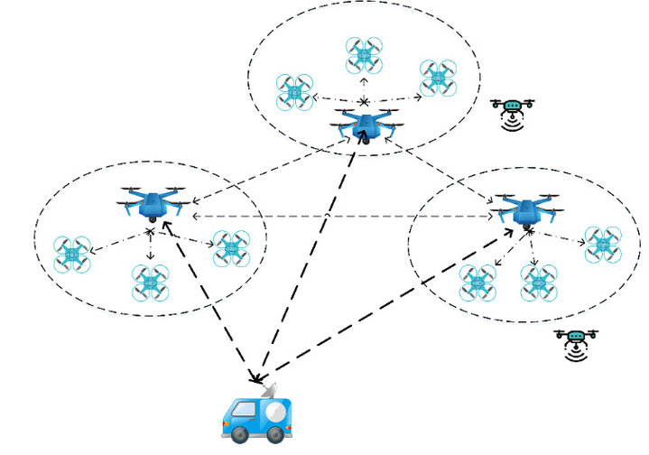
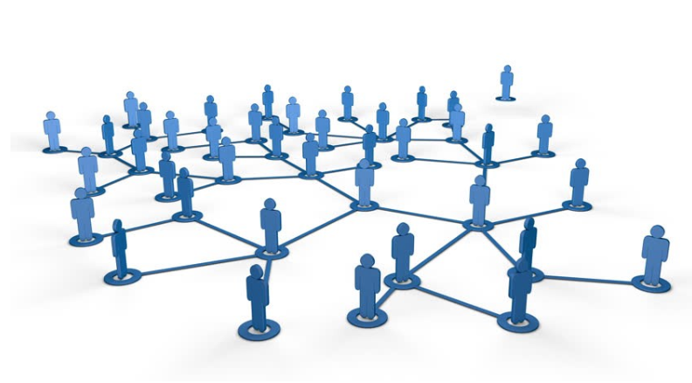
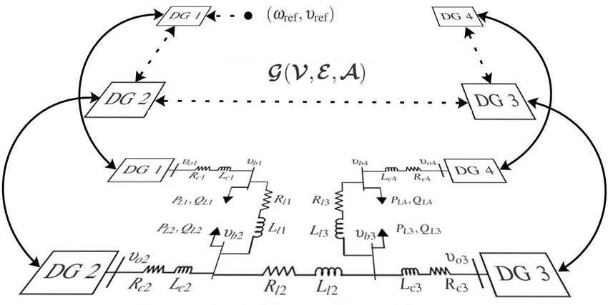

STOCHASTIC MODELS
-
Convex optimization over
Distributed Networks
1
Notes:
So today we gonna present the last module of this course that it is about queuieing networks….namely systems in which a number of queues are connected to each other by what it is called as... customer routing….
…where…for costumer routing we mean the path that costumers can follows among the queues of the network.
Just to give an idea on what we are going to talk…by refering to the network in the picture…. Here we have a multi-layer client-server architecture ….. requests come from outside…and are taken in charge and elaborated by the first set of queues…than if the request is accomplished that job leaves the system following one of the possible leaving-path.
Otherwise…If that request requires other operations…related messages are delivered to the layer 1 and if necessary from layer 1 to layer 2….
Let us further note that sometimes it may also occur that an operation need a cross check…. and thus the costumer routing can also consider the presence of loops like this….or this…
In general we have that when a customer is serviced at one node…then… it can join another node and queue for service, or simply leave the system.
Ah…notice that in this contest… we will often refer to the queues that constitute the network as nodes…

Slide 2
Motivating considerations
In recent years, there has been a renewed research interest towards ﬁnding efﬁcient algorithms for solving convex optimization problems in parallel or distributed fashion
This is mainly motivated by the explosion in size and complexity of data sets used in statistical machine learning, where optimization is used for parameter training, and for applications in Large-Scale Systems decision making problems
Convex optimization has practical applications for the following:
Network Utility Maximization problems
Electricity generation optimization
Load balancing optimization
Machine learning (multi-class classifiers & unsupervised learning)
Distributed localization using wireless signals
Distributed coordination of multi-robot platoon
and all those applications implemented over a network and/or on a IoT-based control infrastructure where nodes with limited capabilities have to perform decision-making tasks beyond their “local” environment knowledge
In the following basic notions on centralized and distributed convex optimization algorithms are discussed by exploiting results on System Theory analysis
Notes:
Here just to remark the importance of queuing networks in telecommunication systems we have another example…for instance…the Internet… that….as you know…. It works by means of a complex architecture where packets flows are processed by many routers, each modeled by a queue.
In particular we have that packets enter in the network because generated from different sources…. and with different destinations…
Then…. they arrive to nodes in a stochastic fashion…and then…each router asynchronously elaborates them…
Of course notice that.. if the traffic intensity exceed some given quantities …well some traffic is lost due to buffer overflows…
Let us further note that queuing networks are successfully used not only to solve resource allocation problems in telecommunication but…. Of course….whenever a flow of jobs need to be processed, independently by the fact that their arrivals and services are either synchronous or asynchronous, or either stochastic or deterministic.
In particular we have that all the results we are going to see are useful to determines in an easy way the system performance…and also to evaluate…. for resource allocation purposes…. the resources need such that a complex client-server architecture works while satisfying some QoS specifications.
Specification that could be expressed in term of time spent in the system…or in term of the buffer capacity … and that of course depends on the allocated resources…that means the number of servers per queue, their service rate… the buffer capacity … furthermore it is easy understand that all those quantities are further influenced by the costumer routing that express…in terms or probability….all the possible paths that a costumer can follows within the network.

Slide 3
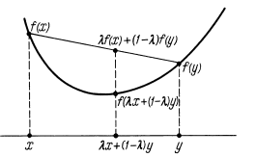
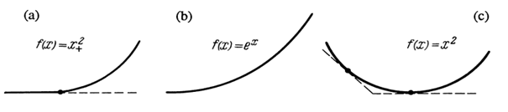
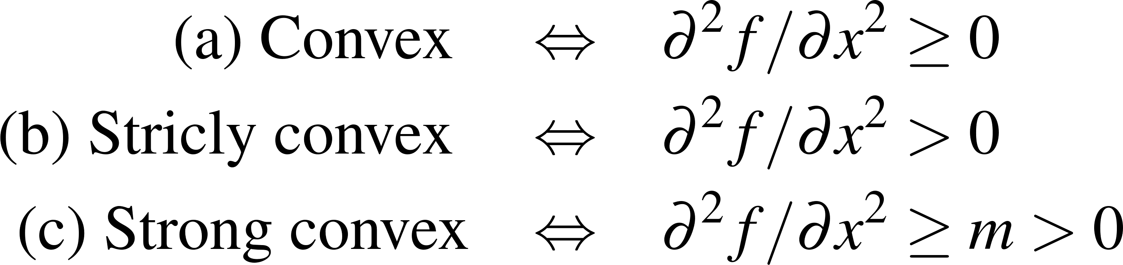

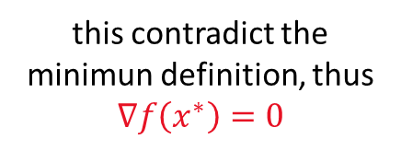
Some notion on convexity
A scalar function $f\left(x\right):ℝ^{n}→ℝ$ is called convex if
If the inequality holds strictly is called strictly convex, thus it has unique minimun
Example 1: $f={\left(x+5\right)}^{2}=x^{2}+10x+25→∇f\left(x\right)=2x+10=0⇒x^{∗}=−5$ (unique min.)
Lemma 1: If $f\left(x\right)$ is differentiable ($∀ x ∃ ∇f\left(x\right)$), convexity is equivalent to
Example 1 (cont’d): $f\left(x+y\right)={(x}^{2}+10x+25)+\left(2x+10\right)y+y^{2}≥f\left(x\right)+∇f{\left(x\right)}^{T}⋅y$
Theorem (Fermat): Let $f(x)$ differentiable, and $x^{∗}$ be a local minimum of $f(x)$. Then $∇f\left(x^{∗}\right)=0$
Proof: Let $y=−τ∇f\left(x^{∗}\right)$ and suppose $∇f\left(x^{∗}\right)≠0$, with $τ→0$
this contradict the minimun definition, thus $∇f\left(x^{∗}\right)=0$
Notes:
Here just to remark the importance of queuing networks in telecommunication systems we have another example…for instance…the Internet… that….as you know…. It works by means of a complex architecture where packets flows are processed by many routers, each modeled by a queue.
In particular we have that packets enter in the network because generated from different sources…. and with different destinations…
Then…. they arrive to nodes in a stochastic fashion…and then…each router asynchronously elaborates them…
Of course notice that.. if the traffic intensity exceed some given quantities …well some traffic is lost due to buffer overflows…
Let us further note that queuing networks are successfully used not only to solve resource allocation problems in telecommunication but…. Of course….whenever a flow of jobs need to be processed, independently by the fact that their arrivals and services are either synchronous or asynchronous, or either stochastic or deterministic.
In particular we have that all the results we are going to see are useful to determines in an easy way the system performance…and also to evaluate…. for resource allocation purposes…. the resources need such that a complex client-server architecture works while satisfying some QoS specifications.
Specification that could be expressed in term of time spent in the system…or in term of the buffer capacity … and that of course depends on the allocated resources…that means the number of servers per queue, their service rate… the buffer capacity … furthermore it is easy understand that all those quantities are further influenced by the costumer routing that express…in terms or probability….all the possible paths that a costumer can follows within the network.

Slide 4
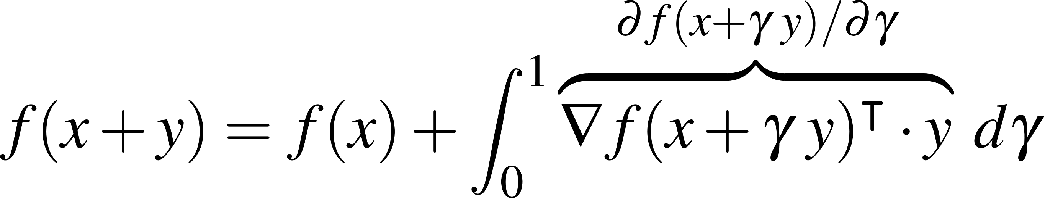
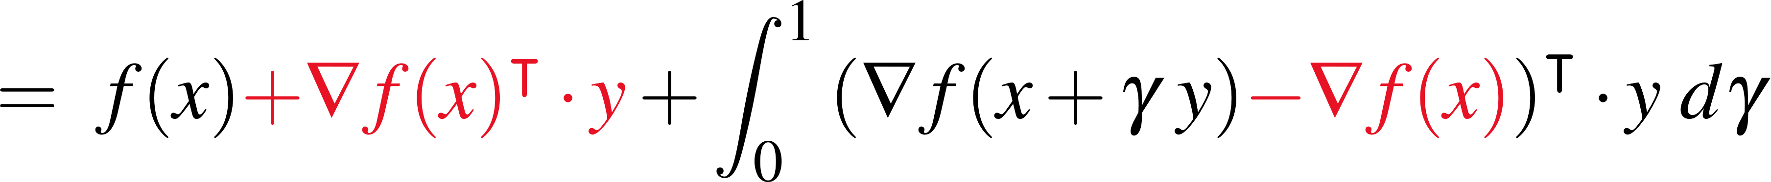
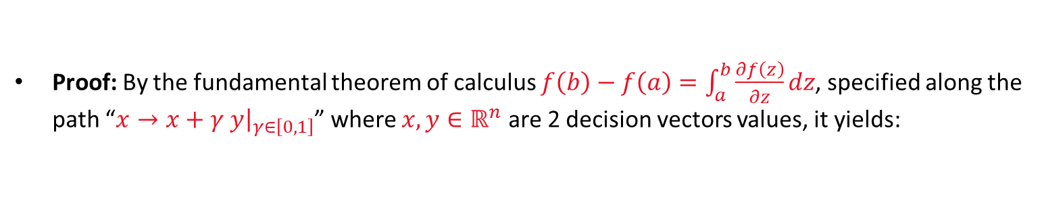
Unconstrained convex optimization: The Gradient Method
Let $f\left(x\right)$ be convex, differentiable and bounded from below $f\left(x\right)≥f\left(x^{∗}\right)≻−∞$, to solve
the simplest way, since $∇f\left(x^{∗}\right)=0$, is by minimizing its gradient, which, due to convexity, is an increasing function ($∇f\left(x\right)≥∇f\left(x^{∗}\right) ∀ x≠x^{∗}$). Thus, one may construct the iteration sequence as
Theorem: Let $f\left(x\right):ℝ^{n}→ℝ$ be a convex function, bounded from below, with the gradient satisfying
Let $0<τ<\frac{2}{L}$ then $\lim_{k→∞}{∇f(x(k))}=0$, and $f(x)$ monotonically decrease to $f\left(x^{∗}\right)⇒x\left(k\right)→x^{∗}$
Proof: By the fundamental theorem of calculus $f\left(b\right)−f\left(a\right)=\int_{a}^{b}{\frac{∂f\left(z\right)}{∂z}dz}$, specified along the path “$x→x+γ y{\left.​\right|}_{γ∈\left[0,1\right]}$” where $x,y∈ℝ^{n}$ are 2 decision vectors values, it yields:
Then, letting $x=x(k)$ and $y=−τ∇f(x(k))$, it yields
Notes:
Here just to remark the importance of queuing networks in telecommunication systems we have another example…for instance…the Internet… that….as you know…. It works by means of a complex architecture where packets flows are processed by many routers, each modeled by a queue.
In particular we have that packets enter in the network because generated from different sources…. and with different destinations…
Then…. they arrive to nodes in a stochastic fashion…and then…each router asynchronously elaborates them…
Of course notice that.. if the traffic intensity exceed some given quantities …well some traffic is lost due to buffer overflows…
Let us further note that queuing networks are successfully used not only to solve resource allocation problems in telecommunication but…. Of course….whenever a flow of jobs need to be processed, independently by the fact that their arrivals and services are either synchronous or asynchronous, or either stochastic or deterministic.
In particular we have that all the results we are going to see are useful to determines in an easy way the system performance…and also to evaluate…. for resource allocation purposes…. the resources need such that a complex client-server architecture works while satisfying some QoS specifications.
Specification that could be expressed in term of time spent in the system…or in term of the buffer capacity … and that of course depends on the allocated resources…that means the number of servers per queue, their service rate… the buffer capacity … furthermore it is easy understand that all those quantities are further influenced by the costumer routing that express…in terms or probability….all the possible paths that a costumer can follows within the network.

Slide 5
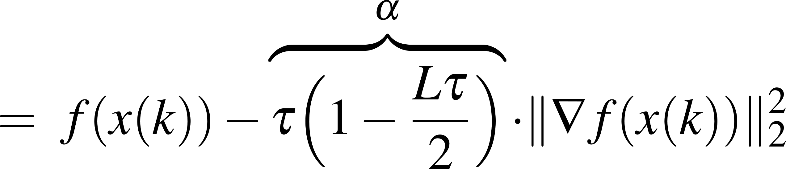
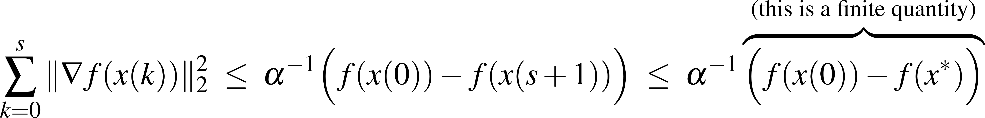
Unconstrained convex optimization: The Gradient descent Method
Then, by exploting (3), i.e. , it yields
By summing the inequalities from $0$ to $s$ over $k$, we obtain
From which, it is easy note
Thus, the series is summable:
Corollary: If $τ→0$, a CT gradient descent is implemented. Moreover, if $f\left(x\right)$ is strictly convex, $x^{∗}$ correspond to the unique stable equilibrium of $\dot{x}=−∇f(x)$.
Example 1 (con’t): Consider $\dot{x}=−\left(2x−10\right) ⇒ x^{∗} :\dot{x}=0 ⇒ x^{∗}=−5$.
Further $\left|∇f\left(x\right)−∇f\left(y\right)\right|=\left|\left(2x−10\right)−\left(2y−10\right)\right|≤2|x−y|⇒L=2⇒τ<\left(\frac{2}{L}\right)=1$.
Remark: Let $ρ>1$, the convergence can be speed-up as $\dot{x}=−ρ⋅∇f\left(x\right)$, where now $τ<$ $\frac{2}{ρL}$
Notes:
Here just to remark the importance of queuing networks in telecommunication systems we have another example…for instance…the Internet… that….as you know…. It works by means of a complex architecture where packets flows are processed by many routers, each modeled by a queue.
In particular we have that packets enter in the network because generated from different sources…. and with different destinations…
Then…. they arrive to nodes in a stochastic fashion…and then…each router asynchronously elaborates them…
Of course notice that.. if the traffic intensity exceed some given quantities …well some traffic is lost due to buffer overflows…
Let us further note that queuing networks are successfully used not only to solve resource allocation problems in telecommunication but…. Of course….whenever a flow of jobs need to be processed, independently by the fact that their arrivals and services are either synchronous or asynchronous, or either stochastic or deterministic.
In particular we have that all the results we are going to see are useful to determines in an easy way the system performance…and also to evaluate…. for resource allocation purposes…. the resources need such that a complex client-server architecture works while satisfying some QoS specifications.
Specification that could be expressed in term of time spent in the system…or in term of the buffer capacity … and that of course depends on the allocated resources…that means the number of servers per queue, their service rate… the buffer capacity … furthermore it is easy understand that all those quantities are further influenced by the costumer routing that express…in terms or probability….all the possible paths that a costumer can follows within the network.

Slide 6
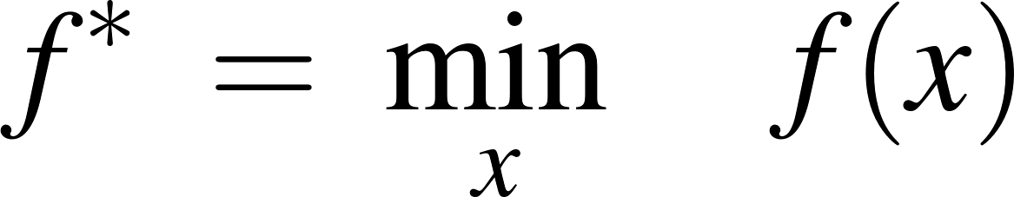
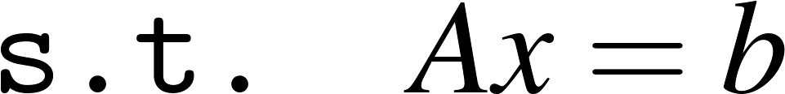
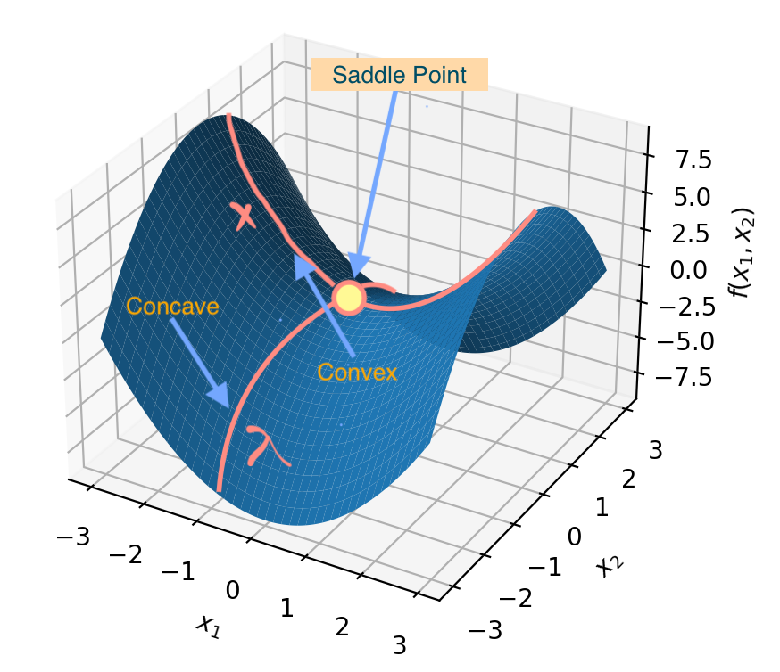
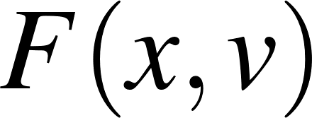


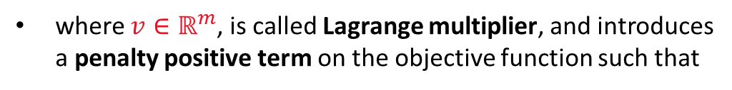
Convex optimization with equality constraints
Consider the following constrained optimization problem.
To provide the main idea and simplifying derivations, we assume: a) $rank\left\{A\right\}=m$ (full row-rank); b) $f$ differentiable and strictly-convex; c) optimization is made in continuous-time $τ→0$
Lagrange Multiplier theory allows to convert (4) into the “Unconstrained Lagrangian Dual Problem”
where $v∈ℝ^{m}$, is called Lagrange multiplier, and introduces a penalty positive term on the objective function such that
If $Ax−b$ is mets $F\left(x,v\right){=f(x)}∀ v$, thus $x^{∗}$ can be reached following $−∇f(x)$
If not, since $v$is maximized, small deviations on $Ax−b$ leads $F\left(x,v\right)$ to increase a lot. This implies (5) give more priority to the constrain satisfaction rather than $\min_{x}{f(x)}$.
Note: Lagrange Multipliers Theory cause the critical point $(x^{∗},v^{∗})$ to occur at a saddle point. Indeed, $F\left(x,v\right)$results convex w.r.t. to $x$ and concave w.r.t. $v$.
Notes:
Here just to remark the importance of queuing networks in telecommunication systems we have another example…for instance…the Internet… that….as you know…. It works by means of a complex architecture where packets flows are processed by many routers, each modeled by a queue.
In particular we have that packets enter in the network because generated from different sources…. and with different destinations…
Then…. they arrive to nodes in a stochastic fashion…and then…each router asynchronously elaborates them…
Of course notice that.. if the traffic intensity exceed some given quantities …well some traffic is lost due to buffer overflows…
Let us further note that queuing networks are successfully used not only to solve resource allocation problems in telecommunication but…. Of course….whenever a flow of jobs need to be processed, independently by the fact that their arrivals and services are either synchronous or asynchronous, or either stochastic or deterministic.
In particular we have that all the results we are going to see are useful to determines in an easy way the system performance…and also to evaluate…. for resource allocation purposes…. the resources need such that a complex client-server architecture works while satisfying some QoS specifications.
Specification that could be expressed in term of time spent in the system…or in term of the buffer capacity … and that of course depends on the allocated resources…that means the number of servers per queue, their service rate… the buffer capacity … furthermore it is easy understand that all those quantities are further influenced by the costumer routing that express…in terms or probability….all the possible paths that a costumer can follows within the network.

Slide 7
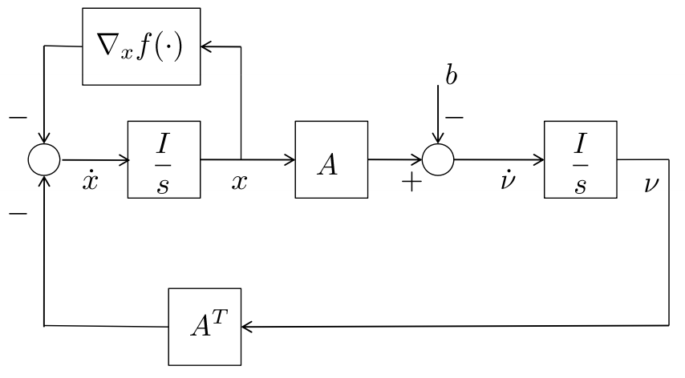
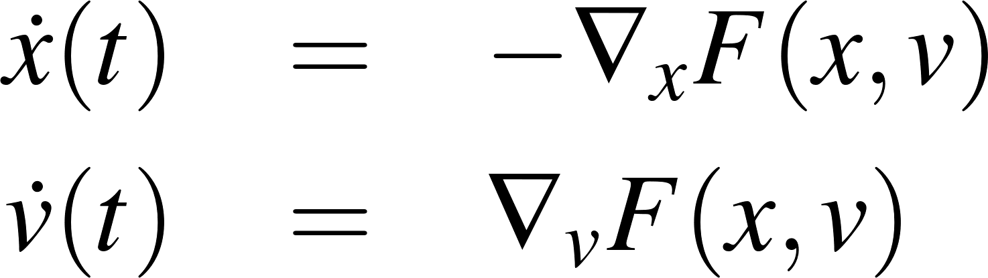
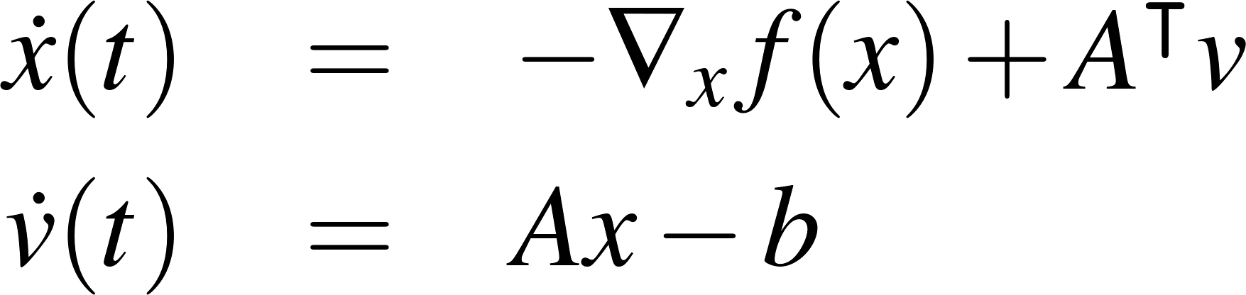
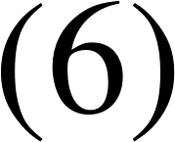

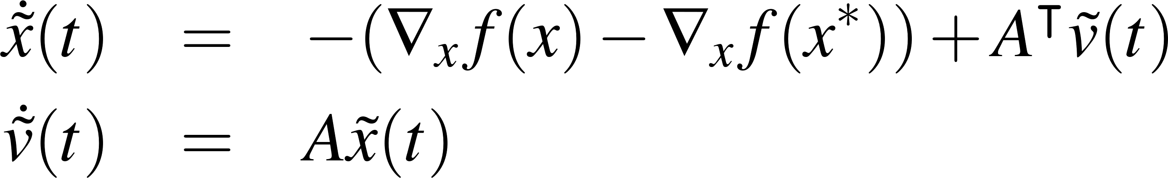
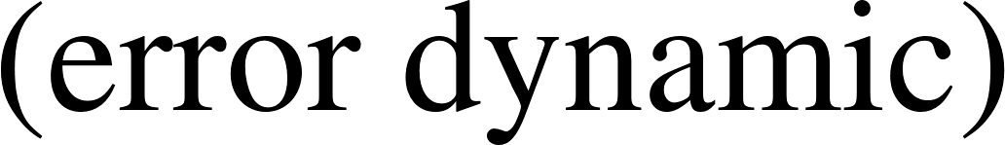
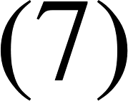
Convex optimization with equality constraints
To solve the problem
A CT solver may follow $−∇_{x}F$ w.r.t. $x$ and $+∇_{v}F$w.r.t. $v$, as:
Theorem: Consider (6), for any initial values $x(0)$ and $v(0)$, we have $\lim_{t→+∞}{x(t)}=x^{∗}$
Proof: Let $(\overline{x},\overline{v})$ be a stazionary point of (6), it satisfies $\dot{x}=0$ and $\dot{v}=0$. Moreover, under the current assumptions such equilibrium is unique, and corresponds to the solution $(x^{∗},v^{∗})$ of (5).
To study the solver’s convergence, it is convenient study the dynamic of $\left(\tilde{x},\tilde{v}\right)=\left(x−x^{∗},{v−v}^{∗}\right)$, namely
Equilibrum stability of nonlin. dyn. systems $\dot{e}=h(e)$ is studied through the Lyapunov direct method
Lyap. Theorem: Let $0$ be an equilibrium of $\dot{e}=h(e)$. If $∃V\left(e\right)>0 ∀ e≠0$ and $V\left(0\right)=0$ (pos. def. $≻$) such that $\dot{V}≤0$ $∀ e$ (neg. semi-def. $≼$), $0$is stable. If $\dot{V}<0 ∀ e≠0$ (neg. def. $≺$), $z_{eq}$ is asympt. stable
LaSalle’s Invariance Principle: Let $\dot{V}\left(z\right)≼0$ (i.e. $\dot{V}=0$ also for some $z≠0$). If the Invariant Set $ℐ$ satisyfing $\dot{V}=0$ contains no other trajectories except $0$, then $0$is asympt. stable.
Notes:
Here just to remark the importance of queuing networks in telecommunication systems we have another example…for instance…the Internet… that….as you know…. It works by means of a complex architecture where packets flows are processed by many routers, each modeled by a queue.
In particular we have that packets enter in the network because generated from different sources…. and with different destinations…
Then…. they arrive to nodes in a stochastic fashion…and then…each router asynchronously elaborates them…
Of course notice that.. if the traffic intensity exceed some given quantities …well some traffic is lost due to buffer overflows…
Let us further note that queuing networks are successfully used not only to solve resource allocation problems in telecommunication but…. Of course….whenever a flow of jobs need to be processed, independently by the fact that their arrivals and services are either synchronous or asynchronous, or either stochastic or deterministic.
In particular we have that all the results we are going to see are useful to determines in an easy way the system performance…and also to evaluate…. for resource allocation purposes…. the resources need such that a complex client-server architecture works while satisfying some QoS specifications.
Specification that could be expressed in term of time spent in the system…or in term of the buffer capacity … and that of course depends on the allocated resources…that means the number of servers per queue, their service rate… the buffer capacity … furthermore it is easy understand that all those quantities are further influenced by the costumer routing that express…in terms or probability….all the possible paths that a costumer can follows within the network.

Slide 8
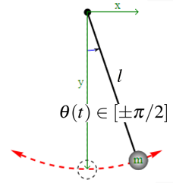
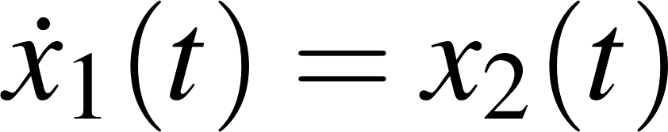
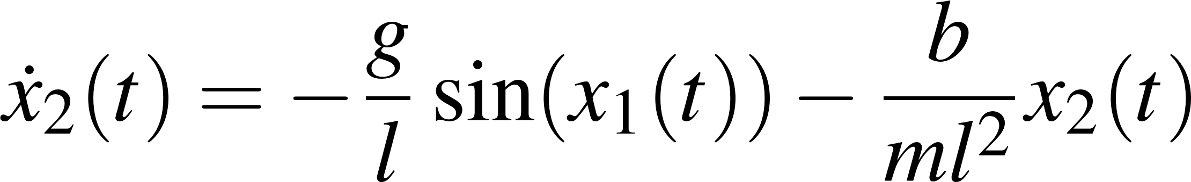
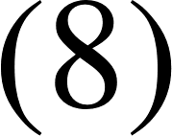
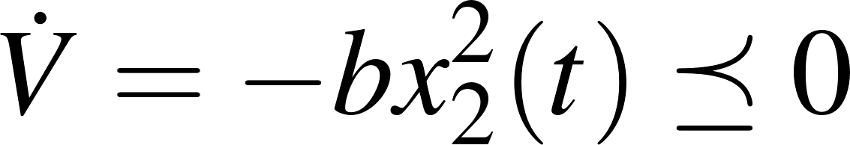
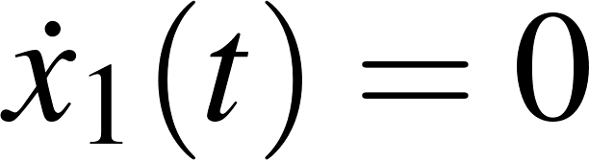
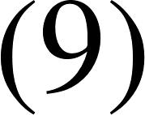
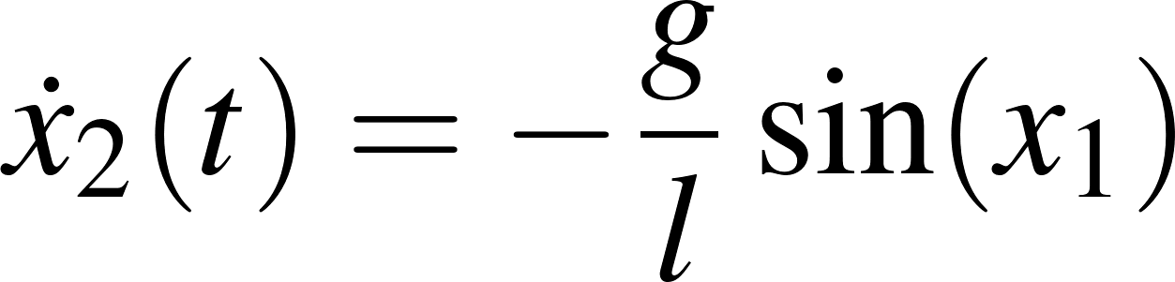
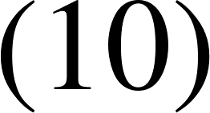
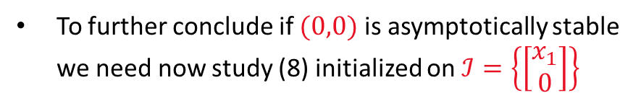
Physical-based stability understanding example
Example: Consider a pendolum with friction
Let $x_{1}=θ$, by simple manipulations
Equilibrium points are the solutions of $\begin{aligned}{\dot{x}}_{1}=0 \\ {\dot{x}}_{2}=0\end{aligned}$ , if we assume $x_{1}∈\left[±\frac{π}{2}\right]⇒ x_{eq}=\left[\begin{aligned}0 \\ 0\end{aligned}\right]$
To study $x_{eq}$, ‘energetic’ or ‘arbitrarily chosen’ positive def. functions (e.g. norms) of $x$ can be used:
Note: Thus $x_{eq}$is simply stable, and the invariant set $ℐ=\left\{\left[\begin{aligned}x_{1} \\ 0\end{aligned}\right]\right\}$ solution of $\dot{V}=0$will be reached.
To further conclude if $(0,0)$ is asymptotically stable we need now study (8) initialized on $ℐ=\left\{\left[\begin{aligned}x_{1} \\ 0\end{aligned}\right]\right\}$
Note: Since $x_{2}=0$ implies both ${\dot{x}}_{2}=0$ and ${\dot{x}}_{1}=x_{2}=0$ then $x_{1}=cost$. Moreover, since only $x_{1}=0$ satisfies the invariance of $ℐ$, then $ℐ=\left\{x_{eq}\right\}≡\left\{\left[\begin{aligned}0 \\ 0\end{aligned}\right]\right\}$. Thus, $x_{eq}$is asymp. stable.
Notes:
Here just to remark the importance of queuing networks in telecommunication systems we have another example…for instance…the Internet… that….as you know…. It works by means of a complex architecture where packets flows are processed by many routers, each modeled by a queue.
In particular we have that packets enter in the network because generated from different sources…. and with different destinations…
Then…. they arrive to nodes in a stochastic fashion…and then…each router asynchronously elaborates them…
Of course notice that.. if the traffic intensity exceed some given quantities …well some traffic is lost due to buffer overflows…
Let us further note that queuing networks are successfully used not only to solve resource allocation problems in telecommunication but…. Of course….whenever a flow of jobs need to be processed, independently by the fact that their arrivals and services are either synchronous or asynchronous, or either stochastic or deterministic.
In particular we have that all the results we are going to see are useful to determines in an easy way the system performance…and also to evaluate…. for resource allocation purposes…. the resources need such that a complex client-server architecture works while satisfying some QoS specifications.
Specification that could be expressed in term of time spent in the system…or in term of the buffer capacity … and that of course depends on the allocated resources…that means the number of servers per queue, their service rate… the buffer capacity … furthermore it is easy understand that all those quantities are further influenced by the costumer routing that express…in terms or probability….all the possible paths that a costumer can follows within the network.

Slide 9
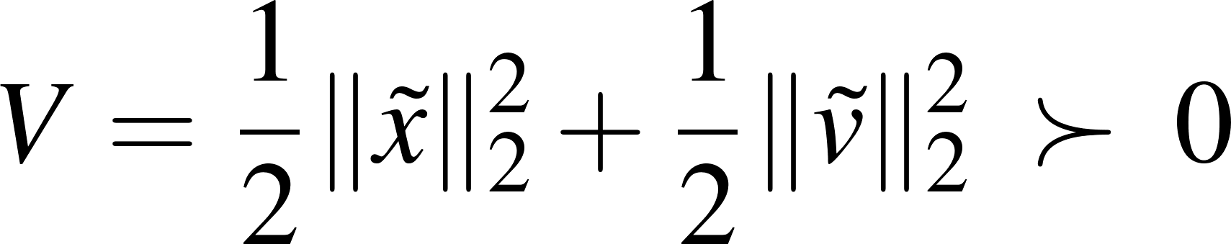


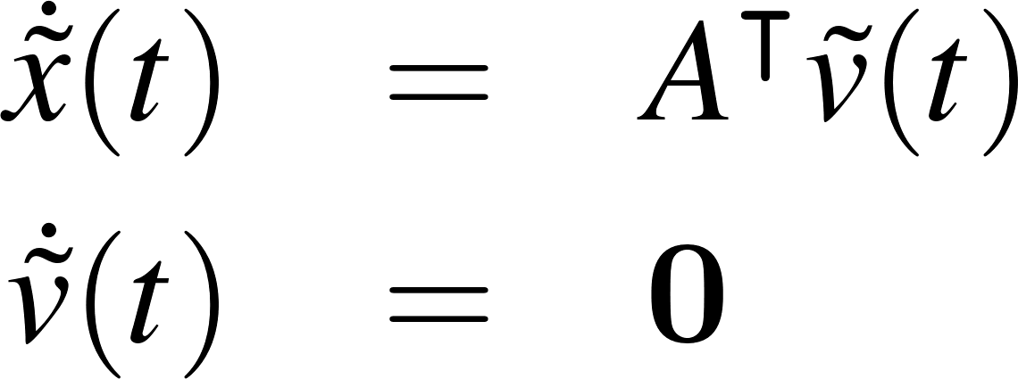
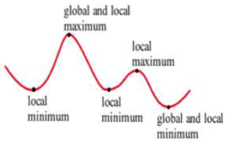
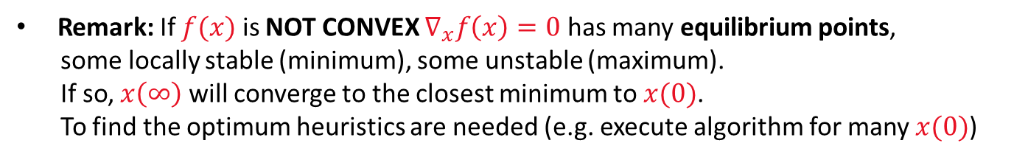
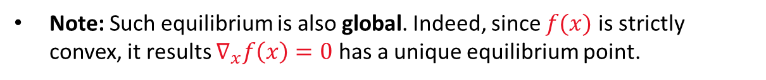
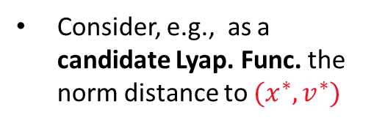
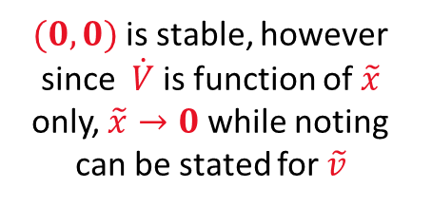
Constrained convex optimization with equality constraints
Consider, e.g., as a candidate Lyap. Func. the norm distance to $(x^{∗},v^{∗})$
By differentiating it, and thanks to Lemma 1:
$(0,0)$is stable, however since $\dot{V}$ is function of $\tilde{x}$
only, $\tilde{x}→0$ while noting can be stated for $\tilde{v}$
To say more, let’s study what happen after the Invariant Set $ℐ=\{0,\tilde{v}\}$ is reached
By intializing (11) on $ℐ=\left\{\left(\tilde{x},\tilde{v}\right) \right| \tilde{x}=0\}$, it yields:
Since $\tilde{x}=0$implies $\dot{\tilde{x}}=0$ and $\dot{\tilde{v}}=0$, this further implies $\tilde{v}=cost.$Thus, since the only constant $\tilde{v}$ satisfying $\dot{\tilde{x}}=0$is $\tilde{v}=0$. It results $\left(\tilde{x},\tilde{v}\right)=(0,0)$is asym. stable and thus $(x^{∗},v^{∗})$ will be reached
Note: Such equilibrium is also global. Indeed, since $f(x)$ is strictly convex, it results $∇_{x}f\left(x\right)=0$ has a unique equilibrium point.
Remark: If $f(x)$ is NOT CONVEX $∇_{x}f\left(x\right)=0$ has many equilibrium points,
some locally stable (minimum), some unstable (maximum).
If so, $x\left(∞\right)$ will converge to the closest minimum to $x(0)$.
To find the optimum heuristics are needed (e.g. execute algorithm for many $x(0)$)
Note: By discretizing (6) the results can be extended to the DT setting, for small enough $τ>0$.
Notes:
Here just to remark the importance of queuing networks in telecommunication systems we have another example…for instance…the Internet… that….as you know…. It works by means of a complex architecture where packets flows are processed by many routers, each modeled by a queue.
In particular we have that packets enter in the network because generated from different sources…. and with different destinations…
Then…. they arrive to nodes in a stochastic fashion…and then…each router asynchronously elaborates them…
Of course notice that.. if the traffic intensity exceed some given quantities …well some traffic is lost due to buffer overflows…
Let us further note that queuing networks are successfully used not only to solve resource allocation problems in telecommunication but…. Of course….whenever a flow of jobs need to be processed, independently by the fact that their arrivals and services are either synchronous or asynchronous, or either stochastic or deterministic.
In particular we have that all the results we are going to see are useful to determines in an easy way the system performance…and also to evaluate…. for resource allocation purposes…. the resources need such that a complex client-server architecture works while satisfying some QoS specifications.
Specification that could be expressed in term of time spent in the system…or in term of the buffer capacity … and that of course depends on the allocated resources…that means the number of servers per queue, their service rate… the buffer capacity … furthermore it is easy understand that all those quantities are further influenced by the costumer routing that express…in terms or probability….all the possible paths that a costumer can follows within the network.

Slide 10
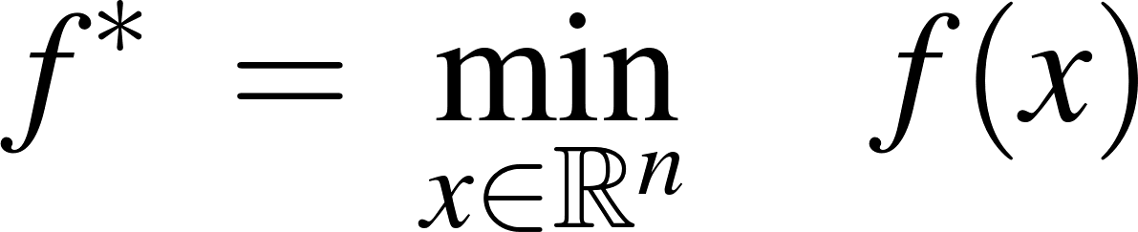

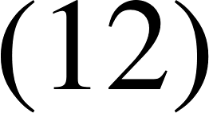

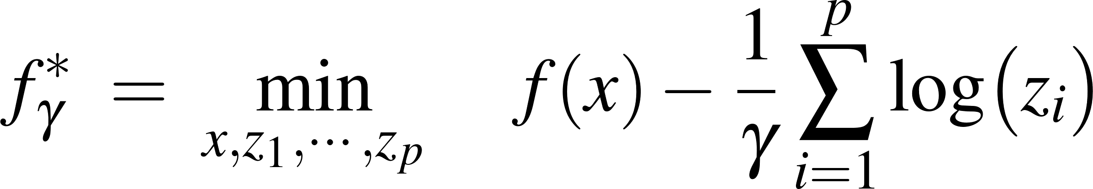
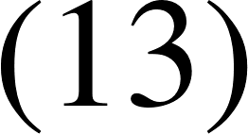
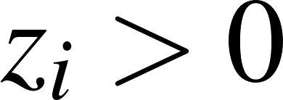
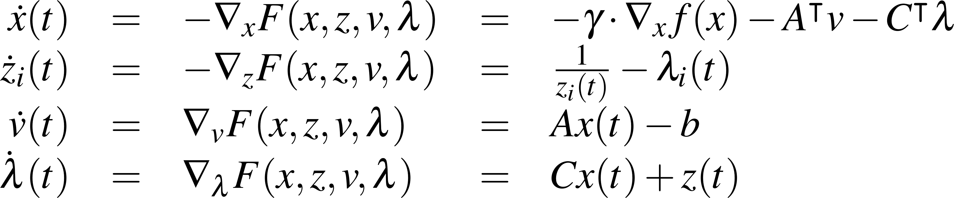

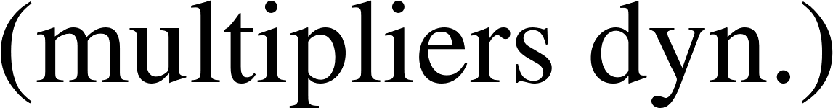
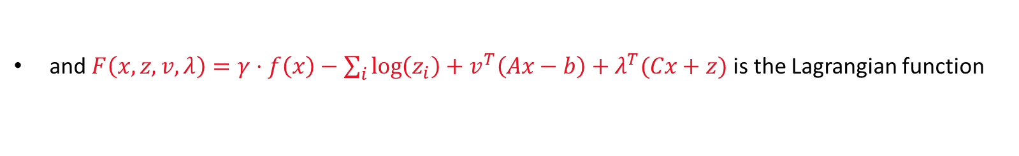

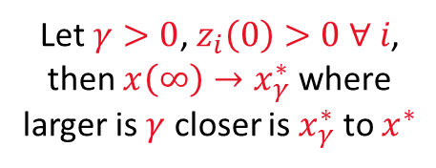
Convex optimization with inequality constraints
Consider the following constrained optimization problem.
Requirement: These constraints, even not linear (e.g. $g_{i}\left(x\right)≤0$), must satisfy the Slater's condition i.e. $∃ x^{∗} :g_{i}\left(x^{∗}\right)<0$ ($x^{∗}$ must be interior to the domain identified by the intersection constraints).
From (12), let $γ>0$ large enough, then the solution of (12) can be approximated by:
$f_{γ}^{∗}→f^{∗}$ as $γ→∞$
Note: Inequalities in (12) are replaced by a barrier cost function depending by the slack variables $z_{i}$aimed at penalizing the optimization, e.g., as $z_{i}→0^{+}$ then $−\log{z_{i}}→+∞$.
Note: Because $log\left(z_{i}\right)∈ℝ$ then $z_{i}>0$ is intrinsecally verified, and (13) plays as an optimization with equality constraints it can solved as the unconstrained Lagrangian dual problem, where:
Let $γ>0$, $z_{i}\left(0\right)>0 ∀ i$, then $x\left(∞\right)→x_{γ}^{∗}$ where larger is $γ$ closer is $x_{γ}^{∗}$ to $x^{∗}$
and $F\left(x,z,v,λ\right)=γ⋅f\left(x\right)−\sum_{i}{\log\left(z_{i}\right)+v^{T}\left(Ax−b\right)+λ^{T}(Cx+z)}$ is the Lagrangian function
Notes:
Here just to remark the importance of queuing networks in telecommunication systems we have another example…for instance…the Internet… that….as you know…. It works by means of a complex architecture where packets flows are processed by many routers, each modeled by a queue.
In particular we have that packets enter in the network because generated from different sources…. and with different destinations…
Then…. they arrive to nodes in a stochastic fashion…and then…each router asynchronously elaborates them…
Of course notice that.. if the traffic intensity exceed some given quantities …well some traffic is lost due to buffer overflows…
Let us further note that queuing networks are successfully used not only to solve resource allocation problems in telecommunication but…. Of course….whenever a flow of jobs need to be processed, independently by the fact that their arrivals and services are either synchronous or asynchronous, or either stochastic or deterministic.
In particular we have that all the results we are going to see are useful to determines in an easy way the system performance…and also to evaluate…. for resource allocation purposes…. the resources need such that a complex client-server architecture works while satisfying some QoS specifications.
Specification that could be expressed in term of time spent in the system…or in term of the buffer capacity … and that of course depends on the allocated resources…that means the number of servers per queue, their service rate… the buffer capacity … furthermore it is easy understand that all those quantities are further influenced by the costumer routing that express…in terms or probability….all the possible paths that a costumer can follows within the network.

Slide 11





Distributed convex optimization
Consider an undirected network $𝒢$ of $n$ agents aimed at solving the decision making problem
where $f(x)$ is a common objective function, and $f_{i}(x_{i})$ are private and strictly convex functions
Examples: a) $x^{∗}$ can be viewed as the optimal power, a set of controllable loads are planned to absorbe to avoid peaks; b) or the optimal power a set generator should inject to meet some demand.
Remark: Since agent $i$ knows only $f_{i}$ they need to collaborate over $𝒢$ to solve (13), i.e. they need to find a consensus over $𝒢$on a common value $c^{∗}$such that $x_{i}=c^{∗} ∀ i$
Note: If $f_{i}$ depends only by $x_{i}$ as in (13), we say (13) is separable (i.e. solve (13) is equivalent to solve separately $\min_{x_{i}}{f_{i}(x_{i})} ∀ i$, $s.t. : x_{i}=x_{j}∀ j$). IF NOT, suboptimal heuristics needs to be devised.
Note: Assume $𝒢$ undirected is not restrictive, especially, if gossip interactions are implemented.
Thus, solve the unconstrained problem (13) in a distributed way, and under the communication constraints over $𝒢$, is equivalent to solve the next problem with the equality constraints:
Thus, (14) can be solved by the Lagrange multipl. methods, where $x^{∗}$ must satisfy $𝓛x^{∗}=0$
Notes:
Here just to remark the importance of queuing networks in telecommunication systems we have another example…for instance…the Internet… that….as you know…. It works by means of a complex architecture where packets flows are processed by many routers, each modeled by a queue.
In particular we have that packets enter in the network because generated from different sources…. and with different destinations…
Then…. they arrive to nodes in a stochastic fashion…and then…each router asynchronously elaborates them…
Of course notice that.. if the traffic intensity exceed some given quantities …well some traffic is lost due to buffer overflows…
Let us further note that queuing networks are successfully used not only to solve resource allocation problems in telecommunication but…. Of course….whenever a flow of jobs need to be processed, independently by the fact that their arrivals and services are either synchronous or asynchronous, or either stochastic or deterministic.
In particular we have that all the results we are going to see are useful to determines in an easy way the system performance…and also to evaluate…. for resource allocation purposes…. the resources need such that a complex client-server architecture works while satisfying some QoS specifications.
Specification that could be expressed in term of time spent in the system…or in term of the buffer capacity … and that of course depends on the allocated resources…that means the number of servers per queue, their service rate… the buffer capacity … furthermore it is easy understand that all those quantities are further influenced by the costumer routing that express…in terms or probability….all the possible paths that a costumer can follows within the network.

Slide 12









Distributed CT convex optimization
Thus, (14) can be solved by:
From which the next dynamical solver can be derived
Note: Since the original problem is separable, (16) can easily be implemented in a distributed fashion over the multi-agents system framework.
Thus, let the agent dynamic be as:
Let $𝒩_{i}=\left\{j∈𝒱 :\left(i,j\right)∈ℰ\right\}$ be the neighbours set of agent $i$, the next agent control solves (16):
Note: The block diagram shows $v$ can be viewed as an integral control which argument is the consensus term $𝓛x$
Notes:
Here just to remark the importance of queuing networks in telecommunication systems we have another example…for instance…the Internet… that….as you know…. It works by means of a complex architecture where packets flows are processed by many routers, each modeled by a queue.
In particular we have that packets enter in the network because generated from different sources…. and with different destinations…
Then…. they arrive to nodes in a stochastic fashion…and then…each router asynchronously elaborates them…
Of course notice that.. if the traffic intensity exceed some given quantities …well some traffic is lost due to buffer overflows…
Let us further note that queuing networks are successfully used not only to solve resource allocation problems in telecommunication but…. Of course….whenever a flow of jobs need to be processed, independently by the fact that their arrivals and services are either synchronous or asynchronous, or either stochastic or deterministic.
In particular we have that all the results we are going to see are useful to determines in an easy way the system performance…and also to evaluate…. for resource allocation purposes…. the resources need such that a complex client-server architecture works while satisfying some QoS specifications.
Specification that could be expressed in term of time spent in the system…or in term of the buffer capacity … and that of course depends on the allocated resources…that means the number of servers per queue, their service rate… the buffer capacity … furthermore it is easy understand that all those quantities are further influenced by the costumer routing that express…in terms or probability….all the possible paths that a costumer can follows within the network.

Slide 13








The Augmented Lagrangian and Control Interpretation
Let us now note that the solution of (15), reported also below
is also equivalent to the solution of the next augment Lagrangian problem
Indeed, it is easy note that, if the constraint is satisfied $x : ℒx=0 ⇒$ $f_{aug}(x)=f(x)$
Thus, by straightforward considerations, the next solver is derived:
Note: It is interesting note solver (18) has a proportional-integral (PI) term w.r.t. the consenus error $𝓛x$
Note: The extra dampling term provides better stability and convergence properties, and allows relaxing the assumption $f_{i}$ is strictly convex to just convex
Notes:
Here just to remark the importance of queuing networks in telecommunication systems we have another example…for instance…the Internet… that….as you know…. It works by means of a complex architecture where packets flows are processed by many routers, each modeled by a queue.
In particular we have that packets enter in the network because generated from different sources…. and with different destinations…
Then…. they arrive to nodes in a stochastic fashion…and then…each router asynchronously elaborates them…
Of course notice that.. if the traffic intensity exceed some given quantities …well some traffic is lost due to buffer overflows…
Let us further note that queuing networks are successfully used not only to solve resource allocation problems in telecommunication but…. Of course….whenever a flow of jobs need to be processed, independently by the fact that their arrivals and services are either synchronous or asynchronous, or either stochastic or deterministic.
In particular we have that all the results we are going to see are useful to determines in an easy way the system performance…and also to evaluate…. for resource allocation purposes…. the resources need such that a complex client-server architecture works while satisfying some QoS specifications.
Specification that could be expressed in term of time spent in the system…or in term of the buffer capacity … and that of course depends on the allocated resources…that means the number of servers per queue, their service rate… the buffer capacity … furthermore it is easy understand that all those quantities are further influenced by the costumer routing that express…in terms or probability….all the possible paths that a costumer can follows within the network.

Slide 14










CT distributed Convex optimization: Simulink Simulation
Note: Least square opt. converges to $x^{∗}=x_{ave}$
Notes:
Here just to remark the importance of queuing networks in telecommunication systems we have another example…for instance…the Internet… that….as you know…. It works by means of a complex architecture where packets flows are processed by many routers, each modeled by a queue.
In particular we have that packets enter in the network because generated from different sources…. and with different destinations…
Then…. they arrive to nodes in a stochastic fashion…and then…each router asynchronously elaborates them…
Of course notice that.. if the traffic intensity exceed some given quantities …well some traffic is lost due to buffer overflows…
Let us further note that queuing networks are successfully used not only to solve resource allocation problems in telecommunication but…. Of course….whenever a flow of jobs need to be processed, independently by the fact that their arrivals and services are either synchronous or asynchronous, or either stochastic or deterministic.
In particular we have that all the results we are going to see are useful to determines in an easy way the system performance…and also to evaluate…. for resource allocation purposes…. the resources need such that a complex client-server architecture works while satisfying some QoS specifications.
Specification that could be expressed in term of time spent in the system…or in term of the buffer capacity … and that of course depends on the allocated resources…that means the number of servers per queue, their service rate… the buffer capacity … furthermore it is easy understand that all those quantities are further influenced by the costumer routing that express…in terms or probability….all the possible paths that a costumer can follows within the network.

Slide 15





Distributed DT convex optimization
For simplicity in the analysis, we considered solvers performing the minimization in CT
However, results can easily be extended in the DT setting by means of Euler-discretization, e.g.:
Then, by looking for a Lyapunov function such that $V\left(x\left(k\right)\right)≻0 :V\left(x\left(k+1\right)\right)−V\left(x\left(k\right)\right)<0$), upper-bounds for $τ$, which will depends also by $f_{i}$could be found.
Example: Let $f_{i}$ be quadratic, $∇f_{i}=2x_{i}$, then following a simpler eigenvalue analisys it results $\left|eig\left(I_{n}−τ2I_{n}−τℒ)\right)\right|<1$ (i.e. condition for contraction) holds for all $τ<{\left(2+\max{eig\left\{ℒ\right\}}\right)}^{−1}$.
Notes:
Here just to remark the importance of queuing networks in telecommunication systems we have another example…for instance…the Internet… that….as you know…. It works by means of a complex architecture where packets flows are processed by many routers, each modeled by a queue.
In particular we have that packets enter in the network because generated from different sources…. and with different destinations…
Then…. they arrive to nodes in a stochastic fashion…and then…each router asynchronously elaborates them…
Of course notice that.. if the traffic intensity exceed some given quantities …well some traffic is lost due to buffer overflows…
Let us further note that queuing networks are successfully used not only to solve resource allocation problems in telecommunication but…. Of course….whenever a flow of jobs need to be processed, independently by the fact that their arrivals and services are either synchronous or asynchronous, or either stochastic or deterministic.
In particular we have that all the results we are going to see are useful to determines in an easy way the system performance…and also to evaluate…. for resource allocation purposes…. the resources need such that a complex client-server architecture works while satisfying some QoS specifications.
Specification that could be expressed in term of time spent in the system…or in term of the buffer capacity … and that of course depends on the allocated resources…that means the number of servers per queue, their service rate… the buffer capacity … furthermore it is easy understand that all those quantities are further influenced by the costumer routing that express…in terms or probability….all the possible paths that a costumer can follows within the network.

Slide 16












Asynchronous Gossip-based Optimization
To account gossip-based asynchronous communications the DT consensus algorithm
has been rewritten as
node $I_{k}$ denotes the node is randomly waked-up at $t_{k}$ with probability $1/n$
where
node $J_{k}∈𝒩_{i}$ denotes a neighbor of $I_{k}$ taken random with probability $p_{ij}$
Similarly, the DT optimization solver on the right can be rewritten in gossip fashion as
Due to (*.1), one note that achieves the consensus on the $v_{i}(k)$ implies also $x_{i}(k)$ makes consensus.
Thus, a simpler and elegant version of (*) is:
Proof idea: First we need to show $x(k)$ reachs a consensus $c\left(k\right)1_{n}$ (see gossip consensus proof). Then, that $c\left(k\right)→c^{∗}≡x^{∗}$ by descending the gradient direction. See: [Nedic & Veeravalli (2009). IEEE CDC]
Note: If $τ_{k}=τ=cost.>0$ this lead $x\left(∞\right)→x^{∗}±𝒪(τ)$ (zig-zag motion around $x^{∗}$), thus consider a vanishing step-size $τ_{k}$ may improve the solver accuracy since $𝒪\left(τ_{k}\right){\left.​\right|}_{k→∞}→0$.
For instance let $Γ_{k}\left(i\right)$ be the #times agent $i$ updated its state because of either $I_{k}=i$ or $J_{k}=i$, then consider $τ_{i,k}=\frac{1}{Γ_{k}\left(i\right)}$ is vanishing and it improves the accuracy since $τ_{i,k}{\left.​\right|}_{k→∞}→0$
Notes:
Here just to remark the importance of queuing networks in telecommunication systems we have another example…for instance…the Internet… that….as you know…. It works by means of a complex architecture where packets flows are processed by many routers, each modeled by a queue.
In particular we have that packets enter in the network because generated from different sources…. and with different destinations…
Then…. they arrive to nodes in a stochastic fashion…and then…each router asynchronously elaborates them…
Of course notice that.. if the traffic intensity exceed some given quantities …well some traffic is lost due to buffer overflows…
Let us further note that queuing networks are successfully used not only to solve resource allocation problems in telecommunication but…. Of course….whenever a flow of jobs need to be processed, independently by the fact that their arrivals and services are either synchronous or asynchronous, or either stochastic or deterministic.
In particular we have that all the results we are going to see are useful to determines in an easy way the system performance…and also to evaluate…. for resource allocation purposes…. the resources need such that a complex client-server architecture works while satisfying some QoS specifications.
Specification that could be expressed in term of time spent in the system…or in term of the buffer capacity … and that of course depends on the allocated resources…that means the number of servers per queue, their service rate… the buffer capacity … furthermore it is easy understand that all those quantities are further influenced by the costumer routing that express…in terms or probability….all the possible paths that a costumer can follows within the network.

Slide 17

Asynchronous Gossip-based Convex Optimization
clc, clear all, close all, rng(0)
% Problem: min_x sum_i (x_i(t)-x_i(0))^2 s.t. Lx=0 in a gossip fashion
% The graph G is complete for simplicity in the simulation’s implementation.
% However, if G is arbitrary, it is must be undirected and connected
N=10 % Number of agents
% Set the number of iterations
num_iters = 2000;
% Support vector to store data at each iteration
x_sol=zeros(num_iters,N);
v_sol=zeros(num_iters,N);
counter=zeros(num_iters,N);
t = 0; % Interaction time
% Initialize the agents states, i.e., set x(0)
x0=[1 2 3 4 5 6 7 8 9 50]
x_sol(1,:)=x0;
Notes:
Here just to remark the importance of queuing networks in telecommunication systems we have another example…for instance…the Internet… that….as you know…. It works by means of a complex architecture where packets flows are processed by many routers, each modeled by a queue.
In particular we have that packets enter in the network because generated from different sources…. and with different destinations…
Then…. they arrive to nodes in a stochastic fashion…and then…each router asynchronously elaborates them…
Of course notice that.. if the traffic intensity exceed some given quantities …well some traffic is lost due to buffer overflows…
Let us further note that queuing networks are successfully used not only to solve resource allocation problems in telecommunication but…. Of course….whenever a flow of jobs need to be processed, independently by the fact that their arrivals and services are either synchronous or asynchronous, or either stochastic or deterministic.
In particular we have that all the results we are going to see are useful to determines in an easy way the system performance…and also to evaluate…. for resource allocation purposes…. the resources need such that a complex client-server architecture works while satisfying some QoS specifications.
Specification that could be expressed in term of time spent in the system…or in term of the buffer capacity … and that of course depends on the allocated resources…that means the number of servers per queue, their service rate… the buffer capacity … furthermore it is easy understand that all those quantities are further influenced by the costumer routing that express…in terms or probability….all the possible paths that a costumer can follows within the network.

Slide 18
Asynchronous Gossip-based Convex Optimization
for i = 2:num_iters
  % Randomly select two nodes to communicate
  node_indices = randperm(N, 2);
  node1 = node_indices(1);
  node2 = node_indices(2);
  % Update the counter counting how many times each node is called
  counter(i,node1)=counter(i-1,node1)+1;
  counter(i,node2)=counter(i-1,node2)+1;
  % Update the Langrange multiplier in a gossip fashion
  v_sol(i,node1) = (x_sol(i-1,node1) + x_sol(i-1, node2)) / 2;
  v_sol(i,node2) = (x_sol(i-1,node1) + x_sol(i-1, node2)) / 2;
  % Update the decision variables along the gradient-descent direction using a vanishing step-size
  x_sol(i,node1) = v_sol(i,node1) - 2*(x_sol(i-1,node1) - x0(node1))/counter(i,node1);
  x_sol(i,node2) = v_sol(i,node2) - 2*(x_sol(i-1,node1) - x0(node2))/counter(i,node2);
  for k=1:N
    if k~=node1 && k ~= node2
      v_sol(i,k)=v_sol(i-1,k);
      x_sol(i,k)=x_sol(i-1,k);
      counter(i,k)=counter(i-1,k);
  end
  end
  t = [t;t(end) + exprnd(1/N)]; % Update the interaction time as Exp. Inter-event random time
end
Notes:
Here just to remark the importance of queuing networks in telecommunication systems we have another example…for instance…the Internet… that….as you know…. It works by means of a complex architecture where packets flows are processed by many routers, each modeled by a queue.
In particular we have that packets enter in the network because generated from different sources…. and with different destinations…
Then…. they arrive to nodes in a stochastic fashion…and then…each router asynchronously elaborates them…
Of course notice that.. if the traffic intensity exceed some given quantities …well some traffic is lost due to buffer overflows…
Let us further note that queuing networks are successfully used not only to solve resource allocation problems in telecommunication but…. Of course….whenever a flow of jobs need to be processed, independently by the fact that their arrivals and services are either synchronous or asynchronous, or either stochastic or deterministic.
In particular we have that all the results we are going to see are useful to determines in an easy way the system performance…and also to evaluate…. for resource allocation purposes…. the resources need such that a complex client-server architecture works while satisfying some QoS specifications.
Specification that could be expressed in term of time spent in the system…or in term of the buffer capacity … and that of course depends on the allocated resources…that means the number of servers per queue, their service rate… the buffer capacity … furthermore it is easy understand that all those quantities are further influenced by the costumer routing that express…in terms or probability….all the possible paths that a costumer can follows within the network.

Slide 19
Gossip-based implementation
% Print the final node values
figure(1)
subplot(121)
  stairs(t,x_sol)
  title('Agents convergence $x^*=9.5\cdot 1_n$')
  xlabel('$t$')
  ylabel('$x_i(t)$')
  axis([0 150 -50 50])
  yticks([-50:10:50])
  grid
subplot(122)
  stairs(t,x_sol)
  title('Zoom')
  xlabel('$t$')
  axis([150 200 9 11])
  grid
Notes:
Here just to remark the importance of queuing networks in telecommunication systems we have another example…for instance…the Internet… that….as you know…. It works by means of a complex architecture where packets flows are processed by many routers, each modeled by a queue.
In particular we have that packets enter in the network because generated from different sources…. and with different destinations…
Then…. they arrive to nodes in a stochastic fashion…and then…each router asynchronously elaborates them…
Of course notice that.. if the traffic intensity exceed some given quantities …well some traffic is lost due to buffer overflows…
Let us further note that queuing networks are successfully used not only to solve resource allocation problems in telecommunication but…. Of course….whenever a flow of jobs need to be processed, independently by the fact that their arrivals and services are either synchronous or asynchronous, or either stochastic or deterministic.
In particular we have that all the results we are going to see are useful to determines in an easy way the system performance…and also to evaluate…. for resource allocation purposes…. the resources need such that a complex client-server architecture works while satisfying some QoS specifications.
Specification that could be expressed in term of time spent in the system…or in term of the buffer capacity … and that of course depends on the allocated resources…that means the number of servers per queue, their service rate… the buffer capacity … furthermore it is easy understand that all those quantities are further influenced by the costumer routing that express…in terms or probability….all the possible paths that a costumer can follows within the network.

Slide 20

Asynchronous Gossip-based Convex Optimization
Notes:
Here just to remark the importance of queuing networks in telecommunication systems we have another example…for instance…the Internet… that….as you know…. It works by means of a complex architecture where packets flows are processed by many routers, each modeled by a queue.
In particular we have that packets enter in the network because generated from different sources…. and with different destinations…
Then…. they arrive to nodes in a stochastic fashion…and then…each router asynchronously elaborates them…
Of course notice that.. if the traffic intensity exceed some given quantities …well some traffic is lost due to buffer overflows…
Let us further note that queuing networks are successfully used not only to solve resource allocation problems in telecommunication but…. Of course….whenever a flow of jobs need to be processed, independently by the fact that their arrivals and services are either synchronous or asynchronous, or either stochastic or deterministic.
In particular we have that all the results we are going to see are useful to determines in an easy way the system performance…and also to evaluate…. for resource allocation purposes…. the resources need such that a complex client-server architecture works while satisfying some QoS specifications.
Specification that could be expressed in term of time spent in the system…or in term of the buffer capacity … and that of course depends on the allocated resources…that means the number of servers per queue, their service rate… the buffer capacity … furthermore it is easy understand that all those quantities are further influenced by the costumer routing that express…in terms or probability….all the possible paths that a costumer can follows within the network.

Slide 21
References
Polyak (1987). Introduction to optimization. optimization software." Inc., Pub. Div., NY (USA)
Wang & Elia (2011). A control perspective for centralized and distributed convex optimization. IEEE Conf. Decision and Control.
Nedic & Veeravalli (2009). Asynchronous gossip algorithms for stochastic optimization. IEEE Conf. on Decision and Control, pp. 3581-3586.
Gharesifard, Bahman, and Jorge Cortés. "Distributed continuous-time convex optimization on weight-balanced digraphs." IEEE Transactions on Automatic Control 59.3 (2013): 781-786.
Related results & research activities developed at the “AutoLab” Research Group
Robust consensus and optimizations problems using nonlinear discontinuous algorithms
Pilloni, Pisano, Franceschelli, Usai (2016). A discontinuous algorithm for distributed convex optimization. In: Int. Workshop on Variable Structure Systems, pp. 22-27.
Pilloni, Pisano, Franceschelli, Usai (2023) “On the variable structure control approach with sliding modes to robust finite-time consensus problems: A methodological overview based on nonsmooth analysis”. In: Annual Reviews in Control.
Pilloni, Callia, Pisano, Usai (2024) “Strict Lyapunov Functions for Second-Order Sliding Mode Robust Consensus with the Super-Twisting Algorithm”. In: 17th Int. Workshop on Variable Structure Systems (under review).
Energy Communities Demand-side management optimization problems over IoT infrastructures
Franceschelli, Pilloni, Gasparri (2020). Multi-agent coordination of thermostatically controlled loads by smart power sockets for electric demand-side management. IEEE Transaction on Control Systems Technology, 29.2 (2020): 731-743.
Kaheni, Pilloni, Ruda, Usai, Franceschelli (2022). Distributed Asynchronous Greedy Control of Large Networks of Thermostatically Controlled Loads for Electric Demand Response. IEEE Control Systems Letters, 7, pp. 169-174.
Moré, Deplano, Pilloni, Pisano, Franceschelli (2024). Online Coordination of BESS and Thermostatically Control Loads for Shared Energy Optimization in Energy Communities. IEEE Int. Conf. on Automation Science and Engineering (CASE), pp. 2738-2744.
Notes:
Here just to remark the importance of queuing networks in telecommunication systems we have another example…for instance…the Internet… that….as you know…. It works by means of a complex architecture where packets flows are processed by many routers, each modeled by a queue.
In particular we have that packets enter in the network because generated from different sources…. and with different destinations…
Then…. they arrive to nodes in a stochastic fashion…and then…each router asynchronously elaborates them…
Of course notice that.. if the traffic intensity exceed some given quantities …well some traffic is lost due to buffer overflows…
Let us further note that queuing networks are successfully used not only to solve resource allocation problems in telecommunication but…. Of course….whenever a flow of jobs need to be processed, independently by the fact that their arrivals and services are either synchronous or asynchronous, or either stochastic or deterministic.
In particular we have that all the results we are going to see are useful to determines in an easy way the system performance…and also to evaluate…. for resource allocation purposes…. the resources need such that a complex client-server architecture works while satisfying some QoS specifications.
Specification that could be expressed in term of time spent in the system…or in term of the buffer capacity … and that of course depends on the allocated resources…that means the number of servers per queue, their service rate… the buffer capacity … furthermore it is easy understand that all those quantities are further influenced by the costumer routing that express…in terms or probability….all the possible paths that a costumer can follows within the network.

