Slide 1

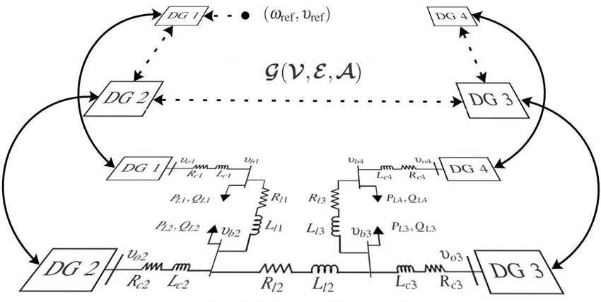
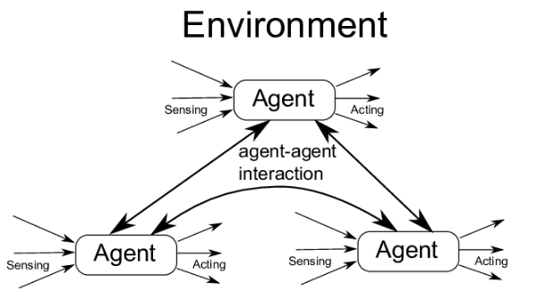
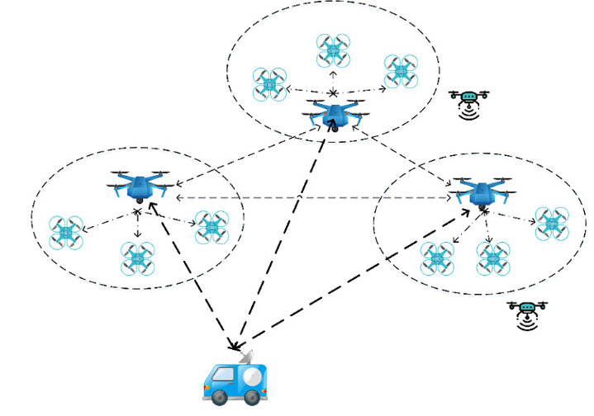

STOCHASTIC MODELS
- Advanced seminars -
The Consensus Problem
1
Notes:
So today we gonna present the last module of this course that it is about queuieing networks….namely systems in which a number of queues are connected to each other by what it is called as... customer routing….
…where…for costumer routing we mean the path that costumers can follows among the queues of the network.
Just to give an idea on what we are going to talk…by refering to the network in the picture…. Here we have a multi-layer client-server architecture ….. requests come from outside…and are taken in charge and elaborated by the first set of queues…than if the request is accomplished that job leaves the system following one of the possible leaving-path.
Otherwise…If that request requires other operations…related messages are delivered to the layer 1 and if necessary from layer 1 to layer 2….
Let us further note that sometimes it may also occur that an operation need a cross check…. and thus the costumer routing can also consider the presence of loops like this….or this…
In general we have that when a customer is serviced at one node…then… it can join another node and queue for service, or simply leave the system.
Ah…notice that in this contest… we will often refer to the queues that constitute the network as nodes…

Slide 2
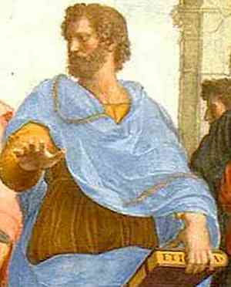

Background on Multi-Agents Systems (MAS)
Definition: A MAS consists of a set of entities (agents) sharing a common environment and tasked to exhibit emergent behavior beyond their capabilities, through interactions
“The whole is greater than the sum of its parts”. Aristotele (384-322 a.C.)
Interpretation: The behavior of a complex system cannot be understood by analyzing only their constituent parts individually
Originating from biological observations, the MAS paradigm referred to software entities tasked to reduce the computational burden of large-scale algorithms by distributing the computations and the decision-making
The MAS paradigm allows decentralization, flexibility, and resilience to central node faults while minimizing computational and traffic burden compared to centralized schemes
Todays MAS applications are various and often involve geographically distr. cyber-physical systems
Examples: a) Distributed Estimation & Optimization over networks; b) power balancing in microgrids;
c) cloud load-balancing; d) Demand-side Management coordination; e) MANET & FANET control;
f) other decision-making problems over IOT infrastructures…
Notes:
Here just to remark the importance of queuing networks in telecommunication systems we have another example…for instance…the Internet… that….as you know…. It works by means of a complex architecture where packets flows are processed by many routers, each modeled by a queue.
In particular we have that packets enter in the network because generated from different sources…. and with different destinations…
Then…. they arrive to nodes in a stochastic fashion…and then…each router asynchronously elaborates them…
Of course notice that.. if the traffic intensity exceed some given quantities …well some traffic is lost due to buffer overflows…
Let us further note that queuing networks are successfully used not only to solve resource allocation problems in telecommunication but…. Of course….whenever a flow of jobs need to be processed, independently by the fact that their arrivals and services are either synchronous or asynchronous, or either stochastic or deterministic.
In particular we have that all the results we are going to see are useful to determines in an easy way the system performance…and also to evaluate…. for resource allocation purposes…. the resources need such that a complex client-server architecture works while satisfying some QoS specifications.
Specification that could be expressed in term of time spent in the system…or in term of the buffer capacity … and that of course depends on the allocated resources…that means the number of servers per queue, their service rate… the buffer capacity … furthermore it is easy understand that all those quantities are further influenced by the costumer routing that express…in terms or probability….all the possible paths that a costumer can follows within the network.

Slide 3
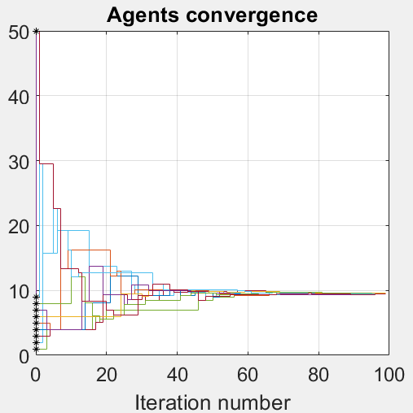
The consensus problem
In team working, the problem is always that of finding an agreement among the team members
In MAS the objective is to reach an opinion agreement (consensus) to the solution of a task, even in the presence of uncertainties/delays/disturbances at either the physical or communication levels.
Definition: The consensus problem refers to the problem of coordinating the agents states to agree on a common quantity (e.g. a measure/setpoint/decision) by interacting with each other
This problem is more complex than spreading a rumor since it involves the need for coordinated actions, e.g.,
  the estimation of unknown to all quantity
  the optimization of cost function under node’s privacy constraints limiting the information spreading
The consensus problem can be formulated in either
  A discrete- (DT) or continuous-time (CT) setting
  A deterministic or randomized fashion
Notes:
Here just to remark the importance of queuing networks in telecommunication systems we have another example…for instance…the Internet… that….as you know…. It works by means of a complex architecture where packets flows are processed by many routers, each modeled by a queue.
In particular we have that packets enter in the network because generated from different sources…. and with different destinations…
Then…. they arrive to nodes in a stochastic fashion…and then…each router asynchronously elaborates them…
Of course notice that.. if the traffic intensity exceed some given quantities …well some traffic is lost due to buffer overflows…
Let us further note that queuing networks are successfully used not only to solve resource allocation problems in telecommunication but…. Of course….whenever a flow of jobs need to be processed, independently by the fact that their arrivals and services are either synchronous or asynchronous, or either stochastic or deterministic.
In particular we have that all the results we are going to see are useful to determines in an easy way the system performance…and also to evaluate…. for resource allocation purposes…. the resources need such that a complex client-server architecture works while satisfying some QoS specifications.
Specification that could be expressed in term of time spent in the system…or in term of the buffer capacity … and that of course depends on the allocated resources…that means the number of servers per queue, their service rate… the buffer capacity … furthermore it is easy understand that all those quantities are further influenced by the costumer routing that express…in terms or probability….all the possible paths that a costumer can follows within the network.

Slide 4
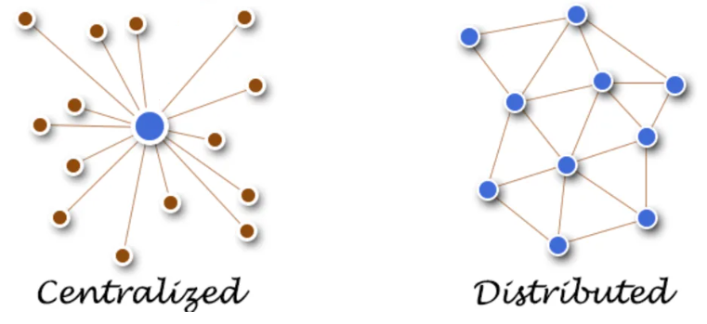
Consensus algorithms over Networks
Distributed computing allows, among other, for reducing the computation and communication burden compared with centralized schemes, while avoiding central-point failure situations due to fault/cyber-attacks
Although deterministic synchronous approaches are simpler to be studied, since they requires synchronous and safe communications, except to critical problems, they approximate the reality because of agents generally interact in a stochastic setting!
For instance: in most of the IoT, or Wifi-based decision-making architecture, communications are asynchronous, pair-wise, and possibly either lossy or noisy.
Thus, fault-tolerant decision-making algorithms are needed because:
It may be impractical/costly having centralized units dedicated either to perform the task, or to facilitating synchronization among communications
Often the network topology itself is time-varying and not completely known
For instance: nodes may join or leave the network, or even expire, due to the limited power resources
To warm-up let’s start studying the deterministic consensus problem
Notes:
Here just to remark the importance of queuing networks in telecommunication systems we have another example…for instance…the Internet… that….as you know…. It works by means of a complex architecture where packets flows are processed by many routers, each modeled by a queue.
In particular we have that packets enter in the network because generated from different sources…. and with different destinations…
Then…. they arrive to nodes in a stochastic fashion…and then…each router asynchronously elaborates them…
Of course notice that.. if the traffic intensity exceed some given quantities …well some traffic is lost due to buffer overflows…
Let us further note that queuing networks are successfully used not only to solve resource allocation problems in telecommunication but…. Of course….whenever a flow of jobs need to be processed, independently by the fact that their arrivals and services are either synchronous or asynchronous, or either stochastic or deterministic.
In particular we have that all the results we are going to see are useful to determines in an easy way the system performance…and also to evaluate…. for resource allocation purposes…. the resources need such that a complex client-server architecture works while satisfying some QoS specifications.
Specification that could be expressed in term of time spent in the system…or in term of the buffer capacity … and that of course depends on the allocated resources…that means the number of servers per queue, their service rate… the buffer capacity … furthermore it is easy understand that all those quantities are further influenced by the costumer routing that express…in terms or probability….all the possible paths that a costumer can follows within the network.

Slide 5
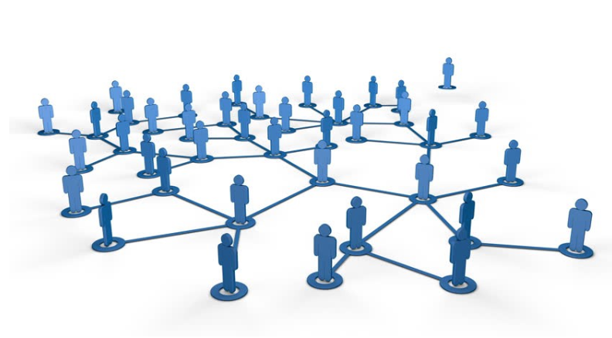
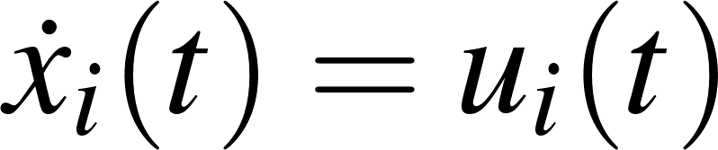
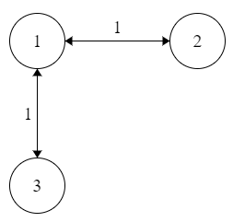
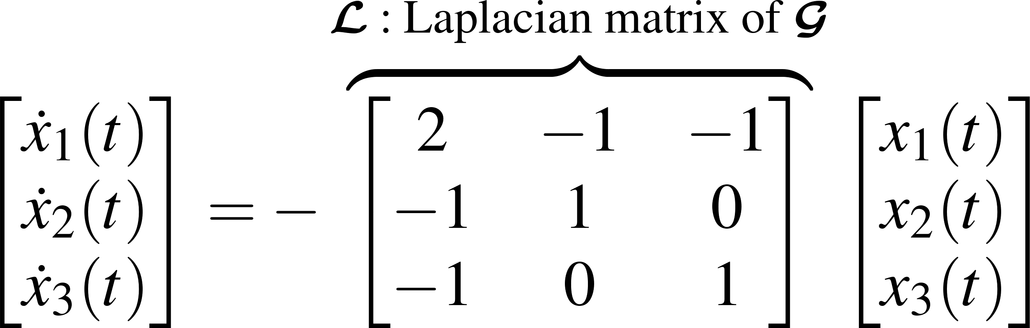

The determistic CT consensus problem
Problem formulation: Consider a set of $n$CT scalar agents
where $x_{i}(t)$is the agent state (opinion), $x_{i}(0)$its initial preference, and $u_{i}(t)$the interaction protocol
Assume: Agents operates on a strongly connected undirect network $𝒢(𝒱,ℰ)$, i.e. $\left(j,i\right)∈ℰ⇒∃\left(j,i\right)$
Seeking a consensus implies the design of a control $u_{i}(t)$to drive the relative error $e_{ik}\left(t\right)→0$
From the Control System Theory, since we want to drive such error to zero, one may think design a feedback rule of the form $u_{i}\left(t\right)=\sum_{j∈𝒩_{i}}{\left(x_{j}\left(t\right)−x_{i}\left(t\right)\right)}$ would provide interesting results!
Example: For the a given communication graph $𝒢(𝒱,ℰ)$ the MAS dynamic takes the expression
Notes:
Here just to remark the importance of queuing networks in telecommunication systems we have another example…for instance…the Internet… that….as you know…. It works by means of a complex architecture where packets flows are processed by many routers, each modeled by a queue.
In particular we have that packets enter in the network because generated from different sources…. and with different destinations…
Then…. they arrive to nodes in a stochastic fashion…and then…each router asynchronously elaborates them…
Of course notice that.. if the traffic intensity exceed some given quantities …well some traffic is lost due to buffer overflows…
Let us further note that queuing networks are successfully used not only to solve resource allocation problems in telecommunication but…. Of course….whenever a flow of jobs need to be processed, independently by the fact that their arrivals and services are either synchronous or asynchronous, or either stochastic or deterministic.
In particular we have that all the results we are going to see are useful to determines in an easy way the system performance…and also to evaluate…. for resource allocation purposes…. the resources need such that a complex client-server architecture works while satisfying some QoS specifications.
Specification that could be expressed in term of time spent in the system…or in term of the buffer capacity … and that of course depends on the allocated resources…that means the number of servers per queue, their service rate… the buffer capacity … furthermore it is easy understand that all those quantities are further influenced by the costumer routing that express…in terms or probability….all the possible paths that a costumer can follows within the network.

Slide 6
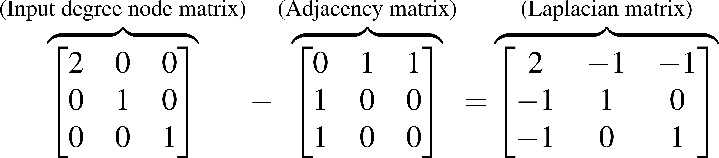
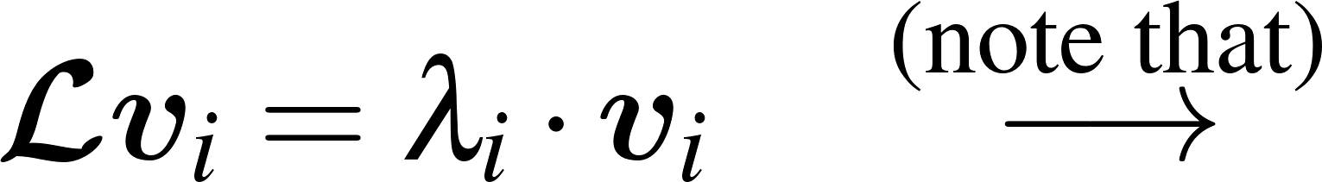
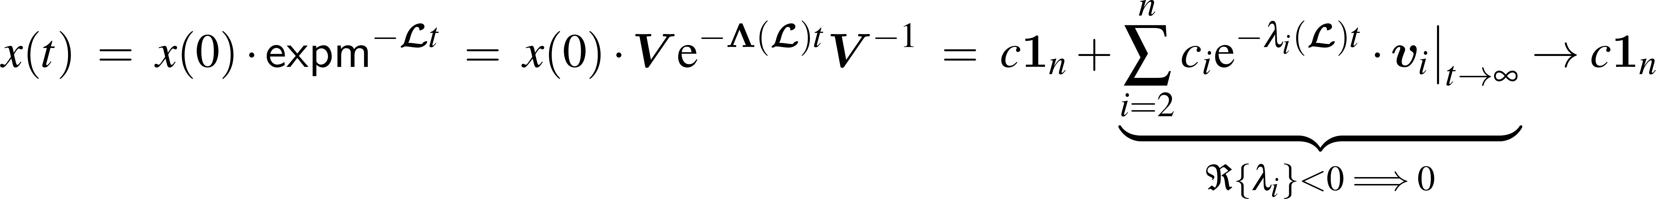

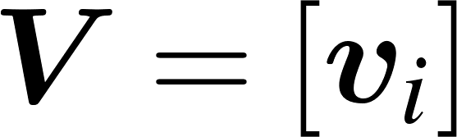
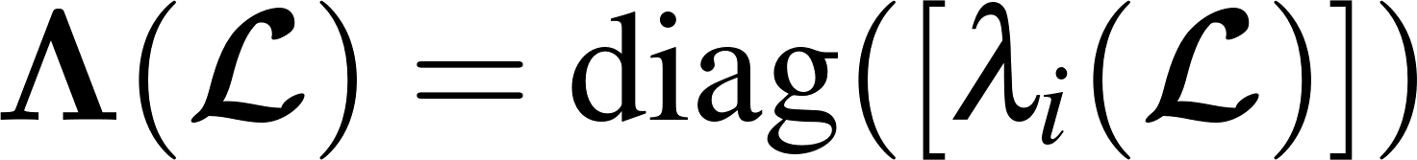

The determistic CT consensus problem
Definition: The Laplacian matrix encodes the pattern of information flows in $𝒢(𝒱,ℰ)$ where
If $𝓖$ is strongly connected then “$−𝓛$“ is a feasible transition rate matrix $Q$ of an irreducible CT-MC described by the same graph $𝓖$, thus:
From (1) and by exploiting modal diagonalization one may notes $u_{i}(t)$ achieves a consensus
Note $\dot{x}=−𝓛x$as a unique invariant distribution $Π𝓛=0$, moreover since $𝓛=𝓛^{T}$ the correspond-ding CT-MC is reversible, thus $Π=\frac{1_{n}^{T}}{n}$ and $1_{n}^{T}𝓛=0_{n}^{T}$. Now consider $y\left(t\right)=Π⋅x\left(t\right)$, and note that
Notes:
Here just to remark the importance of queuing networks in telecommunication systems we have another example…for instance…the Internet… that….as you know…. It works by means of a complex architecture where packets flows are processed by many routers, each modeled by a queue.
In particular we have that packets enter in the network because generated from different sources…. and with different destinations…
Then…. they arrive to nodes in a stochastic fashion…and then…each router asynchronously elaborates them…
Of course notice that.. if the traffic intensity exceed some given quantities …well some traffic is lost due to buffer overflows…
Let us further note that queuing networks are successfully used not only to solve resource allocation problems in telecommunication but…. Of course….whenever a flow of jobs need to be processed, independently by the fact that their arrivals and services are either synchronous or asynchronous, or either stochastic or deterministic.
In particular we have that all the results we are going to see are useful to determines in an easy way the system performance…and also to evaluate…. for resource allocation purposes…. the resources need such that a complex client-server architecture works while satisfying some QoS specifications.
Specification that could be expressed in term of time spent in the system…or in term of the buffer capacity … and that of course depends on the allocated resources…that means the number of servers per queue, their service rate… the buffer capacity … furthermore it is easy understand that all those quantities are further influenced by the costumer routing that express…in terms or probability….all the possible paths that a costumer can follows within the network.

Slide 7
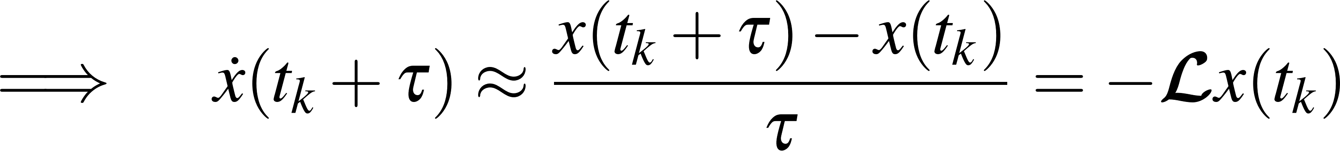
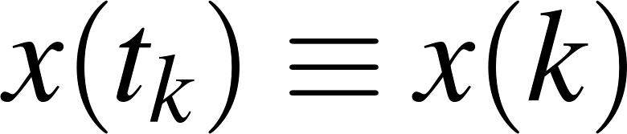
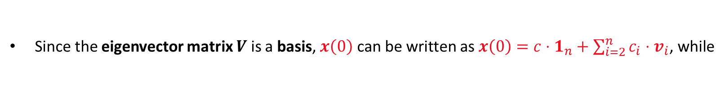
The determistic DT consensus problem
We showed the Laplacian flow protocol $u_{i}\left(t\right)$ achieves consensus on the agent’s initial preferences barycenter if interactions occurs deterministically and continuously as time passes
The results can also easily be extended to DT communications, by Euler forward discretizing the control protocol, with a sufficiently small sampling-time, e.g., $τ<{\left(\max\left\{eig\left(𝓛\right)\right\}\right)}^{−1}$,
If so, note that $𝓛=𝓛^{T}⇒P=P^{T}$, where $P$is a feasible probability matrix of a reversible DT-MC
Thus, $λ_{1}=1$, $v_{1}=1_{n}$, $0<\left|λ_{i}\right|<1 ∀ i>1$, and $Π=\frac{1_{n}^{T}}{n}$ solves $Π=ΠP$
Since the eigenvector matrix $V$ is a basis, $x\left(0\right)$ can be written as $x\left(0\right)=c⋅1_{n}+\sum_{i=2}^{n}{c_{i}⋅v_{i}}$, while
Then, by studying $y\left(k\right)=Π⋅x(k)$, it yields
Notes:
Here just to remark the importance of queuing networks in telecommunication systems we have another example…for instance…the Internet… that….as you know…. It works by means of a complex architecture where packets flows are processed by many routers, each modeled by a queue.
In particular we have that packets enter in the network because generated from different sources…. and with different destinations…
Then…. they arrive to nodes in a stochastic fashion…and then…each router asynchronously elaborates them…
Of course notice that.. if the traffic intensity exceed some given quantities …well some traffic is lost due to buffer overflows…
Let us further note that queuing networks are successfully used not only to solve resource allocation problems in telecommunication but…. Of course….whenever a flow of jobs need to be processed, independently by the fact that their arrivals and services are either synchronous or asynchronous, or either stochastic or deterministic.
In particular we have that all the results we are going to see are useful to determines in an easy way the system performance…and also to evaluate…. for resource allocation purposes…. the resources need such that a complex client-server architecture works while satisfying some QoS specifications.
Specification that could be expressed in term of time spent in the system…or in term of the buffer capacity … and that of course depends on the allocated resources…that means the number of servers per queue, their service rate… the buffer capacity … furthermore it is easy understand that all those quantities are further influenced by the costumer routing that express…in terms or probability….all the possible paths that a costumer can follows within the network.

Slide 8

Consensus on directed graphs: f-consensus
If $𝒢(𝒱,ℰ)$ is simply a directed strongly connected graph, then $P≠P^{T}⇒Π≠\frac{1_{n}^{T}}{n}$, however even in this case the Laplacian flow protocol
$$u_{i}\left(t\right)=\sum_{j∈𝒩_{i}}{a_{ij}\left(x_{j}\left(t\right)−x_{i}\left(t\right)\right)}$$
where $a_{ij}>0$, denotes how much a neighbor information is weighted, achieve the consensus, where the only difference it that now it achieves the so-called f-consensus
Specifically, with a similar analysis, agents are shown converging to linear function of the agents’ initial state weighted by the stationary distribution $Π$of either the matrix $𝓛$ or $P$, namely:
This implies $𝒢$ affect the consensus value through $Π$
The convergence rate of the algorithms are insted related to the second smallest eigenvalue of the Laplacian matrix (corresponding to its slowest time-costant), namely
The $λ_{2}(ℒ)$ is known as algebraic connectivity of $𝒢$, and, if $𝒢$ is connected, $λ_{2}\left(ℒ\right)≥\frac{1}{n⋅\max_{i}\left\{𝒟(𝒢)\right\}}>0$
Notes:
Here just to remark the importance of queuing networks in telecommunication systems we have another example…for instance…the Internet… that….as you know…. It works by means of a complex architecture where packets flows are processed by many routers, each modeled by a queue.
In particular we have that packets enter in the network because generated from different sources…. and with different destinations…
Then…. they arrive to nodes in a stochastic fashion…and then…each router asynchronously elaborates them…
Of course notice that.. if the traffic intensity exceed some given quantities …well some traffic is lost due to buffer overflows…
Let us further note that queuing networks are successfully used not only to solve resource allocation problems in telecommunication but…. Of course….whenever a flow of jobs need to be processed, independently by the fact that their arrivals and services are either synchronous or asynchronous, or either stochastic or deterministic.
In particular we have that all the results we are going to see are useful to determines in an easy way the system performance…and also to evaluate…. for resource allocation purposes…. the resources need such that a complex client-server architecture works while satisfying some QoS specifications.
Specification that could be expressed in term of time spent in the system…or in term of the buffer capacity … and that of course depends on the allocated resources…that means the number of servers per queue, their service rate… the buffer capacity … furthermore it is easy understand that all those quantities are further influenced by the costumer routing that express…in terms or probability….all the possible paths that a costumer can follows within the network.

Slide 9
Randomized consensus problem
The goal is to design a fault-tolerant computation & information exchange algorithm so that
the desired decision-making consensus problem is solved
regardless:
The presence of asynchronous and possibly lossy interactions
Example: Agents do not necessarily update their states “all at the same time”, and some communications may sometimes fail
To consider a worst-case realistic scenario, we suppose agents perform the interaction in a gossip-based fashion, as it is in ad-hoc Wi-Fi networks, namely:
Each node communicates with no more than one neighbor in each time slot
Operating assumptions: We choose to work in the asynchronous CT setting because it is somewhat easier to analyze (results can be concluded also in DT). Here, we have:
Each node $i$ has a local clock ticking at the times of a rate 1 Poisson process $C_{i}(t)$
When there is a jump on $C_{i}(t)$, node $i$ pick-up a $j∈𝒩_{i}$, randomly and uniformly, establish a communication, then nodes $i$ and $j$ update their states accordingly
Notes:
Here just to remark the importance of queuing networks in telecommunication systems we have another example…for instance…the Internet… that….as you know…. It works by means of a complex architecture where packets flows are processed by many routers, each modeled by a queue.
In particular we have that packets enter in the network because generated from different sources…. and with different destinations…
Then…. they arrive to nodes in a stochastic fashion…and then…each router asynchronously elaborates them…
Of course notice that.. if the traffic intensity exceed some given quantities …well some traffic is lost due to buffer overflows…
Let us further note that queuing networks are successfully used not only to solve resource allocation problems in telecommunication but…. Of course….whenever a flow of jobs need to be processed, independently by the fact that their arrivals and services are either synchronous or asynchronous, or either stochastic or deterministic.
In particular we have that all the results we are going to see are useful to determines in an easy way the system performance…and also to evaluate…. for resource allocation purposes…. the resources need such that a complex client-server architecture works while satisfying some QoS specifications.
Specification that could be expressed in term of time spent in the system…or in term of the buffer capacity … and that of course depends on the allocated resources…that means the number of servers per queue, their service rate… the buffer capacity … furthermore it is easy understand that all those quantities are further influenced by the costumer routing that express…in terms or probability….all the possible paths that a costumer can follows within the network.

Slide 10
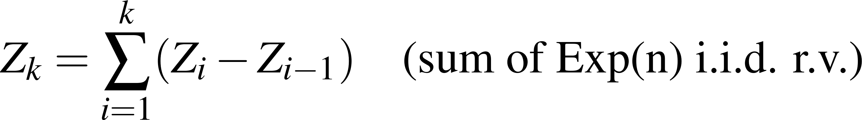
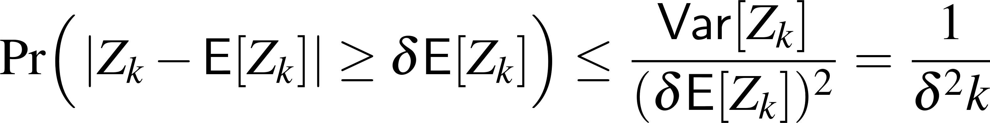
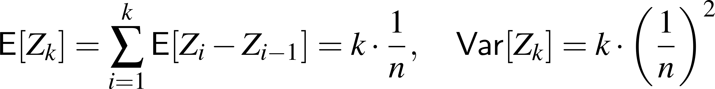


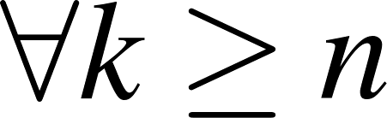
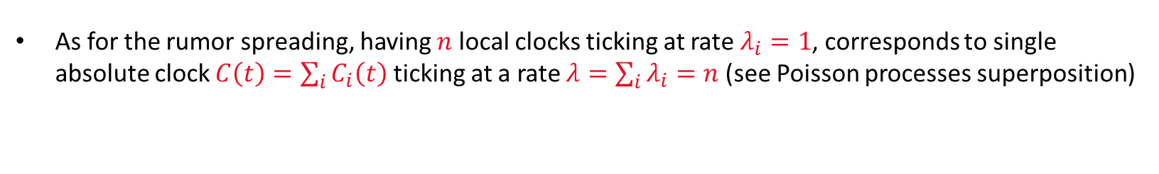
Considerations on Clock Ticks and the Absolute Time
As for the rumor spreading, having $n$ local clocks ticking at rate $λ_{i}=1$, corresponds to single absolute clock $C\left(t\right)=\sum_{i}{C_{i}\left(t\right)}$ ticking at a rate $λ=\sum_{i}{λ_{i}}=n$ (see Poisson processes superposition)
Then, let $Z_{k}$ the $k$-th random tick time of $C\left(t_{k}\right)$, then $\left\{Z_{k}−Z_{k−1}\right\}∼Exp\left(n\right)$, thus
However, if $n$ is large (many nodes) and $k≥n$ $⇒$ $Z_{k}∼N\left(μ,σ^{2}\right)$ and a stronger result holds
Theorem (Gaussian tail bound): Let $Z_{k}$ be a Gaussian (or sub-Gaussian) r.v., then $|Z_{k}−μ|∼N\left(0,σ^{2}\right)$is normal, and satisfies
Thus, with a very high probability $Z_{k}∈\frac{k}{n}⋅\left(1±δ\right)≈\frac{k}{n}$ implying that conclusions in terms of #clock ticks $k$, if scaled by $n$, gives exact corrispondence in the absolute time because $Z_{k}≈k/n$ $∀ k≥n$.
Notes:
Here just to remark the importance of queuing networks in telecommunication systems we have another example…for instance…the Internet… that….as you know…. It works by means of a complex architecture where packets flows are processed by many routers, each modeled by a queue.
In particular we have that packets enter in the network because generated from different sources…. and with different destinations…
Then…. they arrive to nodes in a stochastic fashion…and then…each router asynchronously elaborates them…
Of course notice that.. if the traffic intensity exceed some given quantities …well some traffic is lost due to buffer overflows…
Let us further note that queuing networks are successfully used not only to solve resource allocation problems in telecommunication but…. Of course….whenever a flow of jobs need to be processed, independently by the fact that their arrivals and services are either synchronous or asynchronous, or either stochastic or deterministic.
In particular we have that all the results we are going to see are useful to determines in an easy way the system performance…and also to evaluate…. for resource allocation purposes…. the resources need such that a complex client-server architecture works while satisfying some QoS specifications.
Specification that could be expressed in term of time spent in the system…or in term of the buffer capacity … and that of course depends on the allocated resources…that means the number of servers per queue, their service rate… the buffer capacity … furthermore it is easy understand that all those quantities are further influenced by the costumer routing that express…in terms or probability….all the possible paths that a costumer can follows within the network.

Slide 11
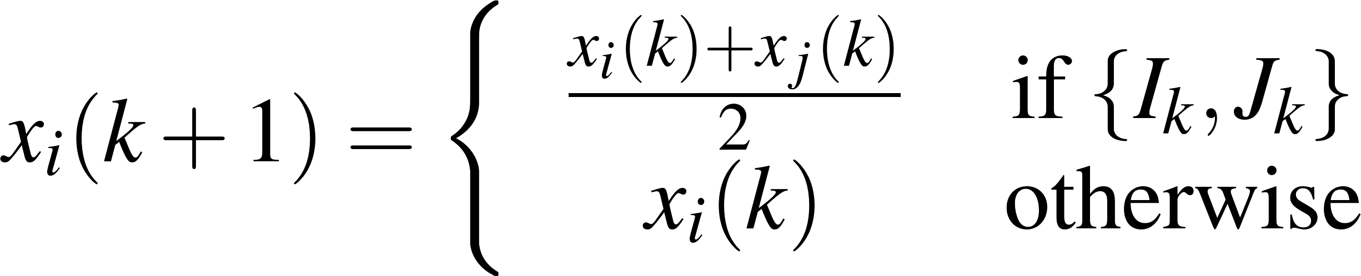
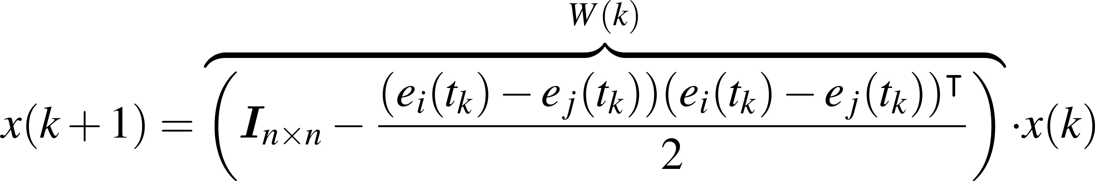
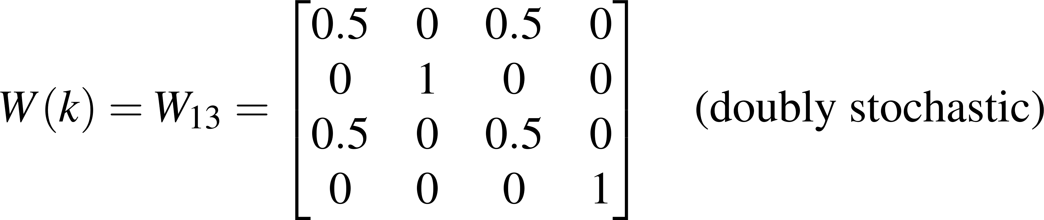
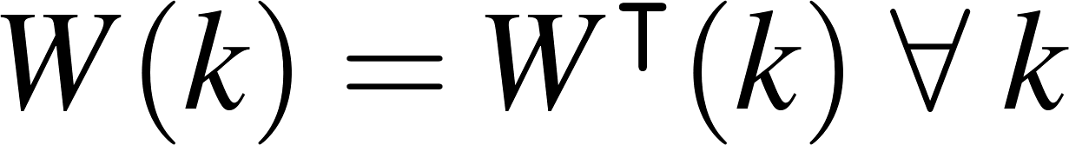

The Gossip-based consensus protocol
Let us now focus on the on the gossip algorithm. We said $𝒢$ can be arbitrary but strongly connected.
This implies every node has it own neighbor set $𝒩_{i}=\left\{ j∈𝒱 :\left(i,j\right)∈ℰ \right\}$
At the time $t_{k}$ the clock $C\left(t_{k}\right)$ ticked, 1 local clock ticked, thus let $I_{k}$ be r.v. associated to that node.
At that time $t_{k}$, the $k$-th algorithm iteraction occurs, such that:
node $I_{k}$ pick-up one of its neighbor $J_{k}∈𝒩_{i}$ with probability $p_{ij}$ and establish a link;
both nodes $\left\{I_{k},J_{k}\right\}$ set their values equal to their current state average;
We used only pairwise communications
Let $x={\left[x_{1}⋯x_{n}\right]}^{T}$, then with probability $Pr\left(I_{k}=i,J_{k}=j\right)=\frac{1}{n}⋅p_{ij}$ the network updated its state as next:
Example for $n=4$, and ${\{I}_{k},J_{k}\}=\{1,3\}$
where $e_{i}=\left[0,⋯0, 1,0, ⋯0\right]∈ℝ^{n}$ as $1$ only at the the $i$-th component, $0$ otherwise, whereas $W(k)$ is a doubly-stochastic random matrix.
Notes:
Here just to remark the importance of queuing networks in telecommunication systems we have another example…for instance…the Internet… that….as you know…. It works by means of a complex architecture where packets flows are processed by many routers, each modeled by a queue.
In particular we have that packets enter in the network because generated from different sources…. and with different destinations…
Then…. they arrive to nodes in a stochastic fashion…and then…each router asynchronously elaborates them…
Of course notice that.. if the traffic intensity exceed some given quantities …well some traffic is lost due to buffer overflows…
Let us further note that queuing networks are successfully used not only to solve resource allocation problems in telecommunication but…. Of course….whenever a flow of jobs need to be processed, independently by the fact that their arrivals and services are either synchronous or asynchronous, or either stochastic or deterministic.
In particular we have that all the results we are going to see are useful to determines in an easy way the system performance…and also to evaluate…. for resource allocation purposes…. the resources need such that a complex client-server architecture works while satisfying some QoS specifications.
Specification that could be expressed in term of time spent in the system…or in term of the buffer capacity … and that of course depends on the allocated resources…that means the number of servers per queue, their service rate… the buffer capacity … furthermore it is easy understand that all those quantities are further influenced by the costumer routing that express…in terms or probability….all the possible paths that a costumer can follows within the network.

Slide 12
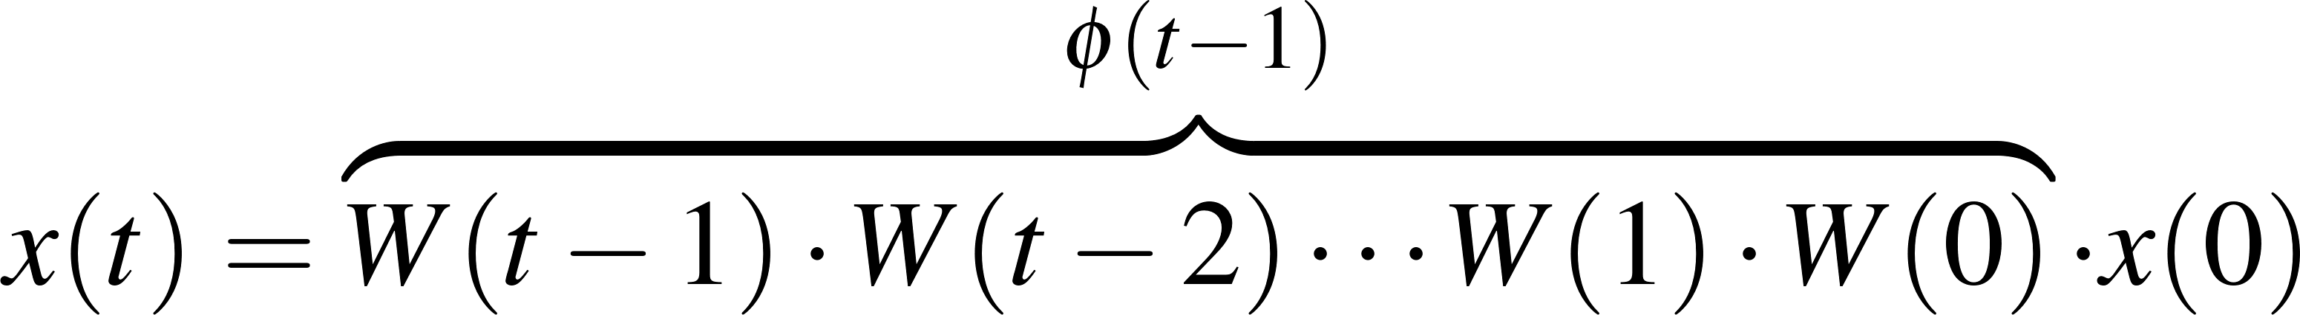
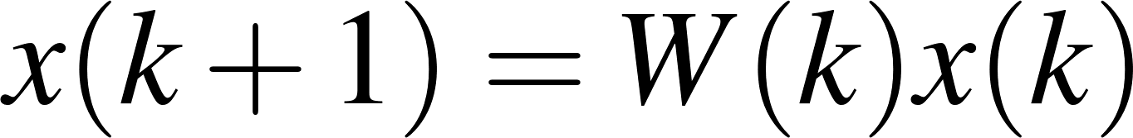
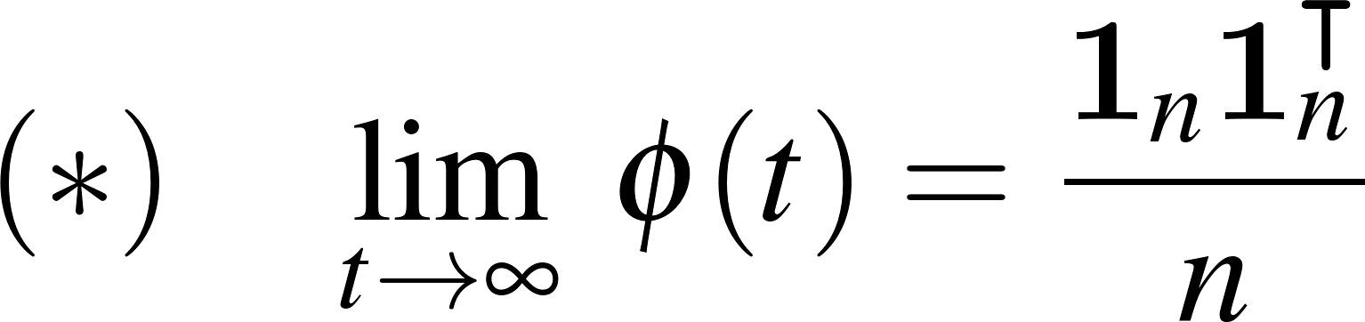

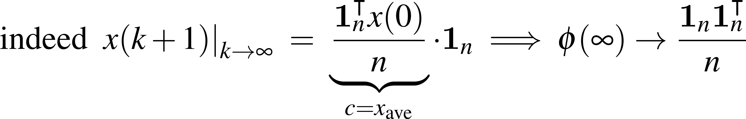
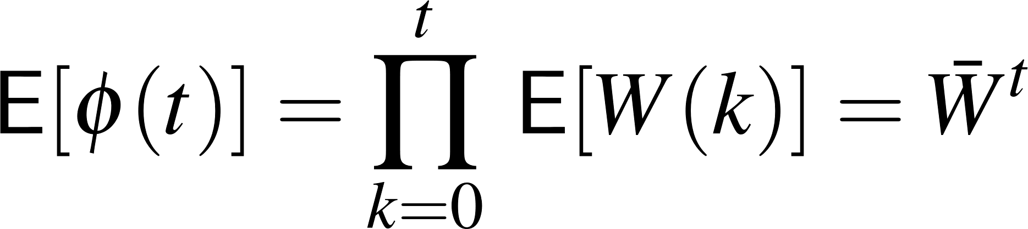
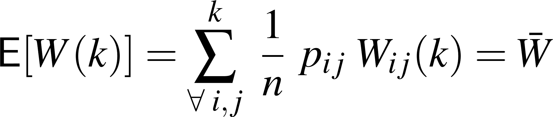

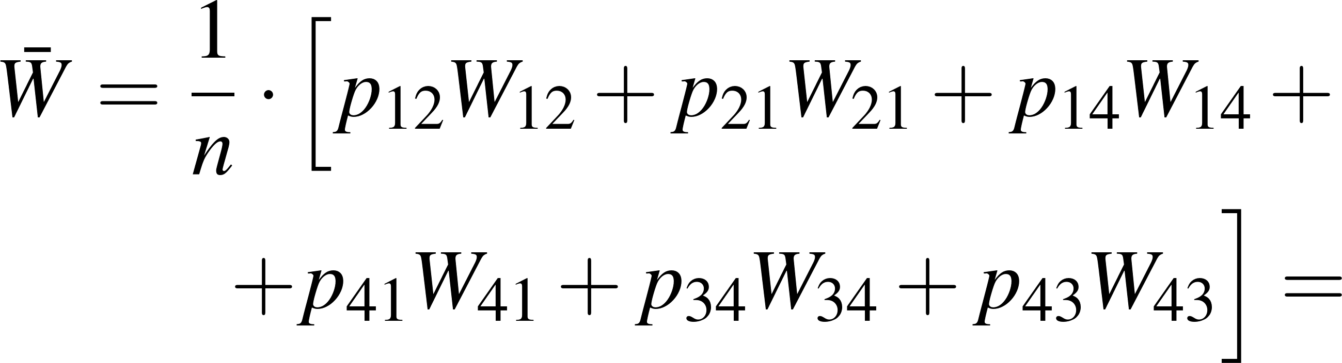
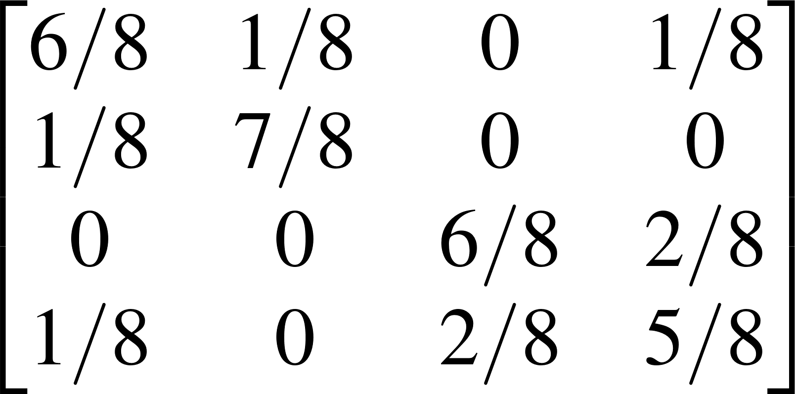
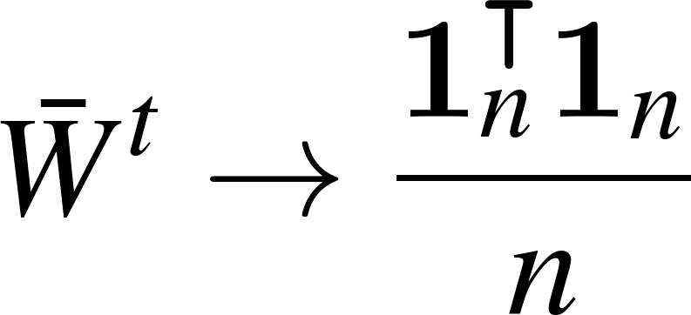
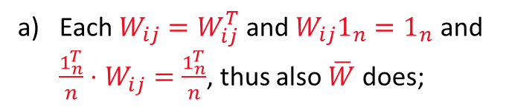
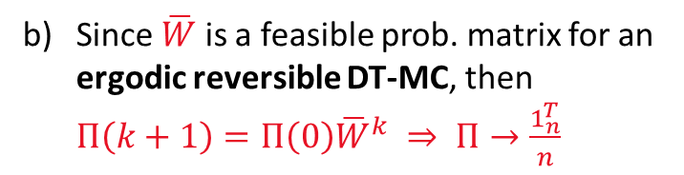
Convergence analysis: Convergence in Expectaion
Given the stochastic process $\{W\left(k\right)\}$, then the MAS updates its state as
Further notice that, to reach consensus on the average initial state, the following must hold:
a) Let’s start with the Expectation analsys of matrix $φ(t)$: First, since $W(k)$ are i.i.d., then
with
Each $W_{ij}=W_{ij}^{T}$ and $W_{ij}1_{n}=1_{n}$ and $\frac{1_{n}^{T}}{n}⋅W_{ij}=\frac{1_{n}^{T}}{n}$, thus also $\overline{W}$ does;
Example: Consider
with $n=4, p_{12}=p_{14}=p_{41}=p_{43}=0.5$, $p_{21}=p_{34}=1$
Since $\overline{W}$ is a feasible prob. matrix for an ergodic reversible DT-MC, then $Π\left(k+1\right)=Π\left(0\right){\overline{W}}^{k} ⇒ Π→\frac{1_{n}^{T}}{n}$
From b), and by analogies with DT-MC
Notes:
Here just to remark the importance of queuing networks in telecommunication systems we have another example…for instance…the Internet… that….as you know…. It works by means of a complex architecture where packets flows are processed by many routers, each modeled by a queue.
In particular we have that packets enter in the network because generated from different sources…. and with different destinations…
Then…. they arrive to nodes in a stochastic fashion…and then…each router asynchronously elaborates them…
Of course notice that.. if the traffic intensity exceed some given quantities …well some traffic is lost due to buffer overflows…
Let us further note that queuing networks are successfully used not only to solve resource allocation problems in telecommunication but…. Of course….whenever a flow of jobs need to be processed, independently by the fact that their arrivals and services are either synchronous or asynchronous, or either stochastic or deterministic.
In particular we have that all the results we are going to see are useful to determines in an easy way the system performance…and also to evaluate…. for resource allocation purposes…. the resources need such that a complex client-server architecture works while satisfying some QoS specifications.
Specification that could be expressed in term of time spent in the system…or in term of the buffer capacity … and that of course depends on the allocated resources…that means the number of servers per queue, their service rate… the buffer capacity … furthermore it is easy understand that all those quantities are further influenced by the costumer routing that express…in terms or probability….all the possible paths that a costumer can follows within the network.

Slide 13
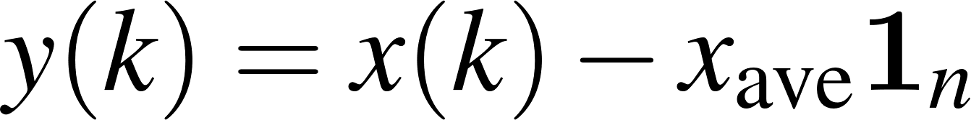
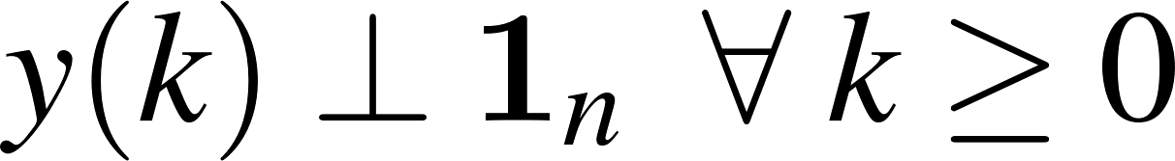


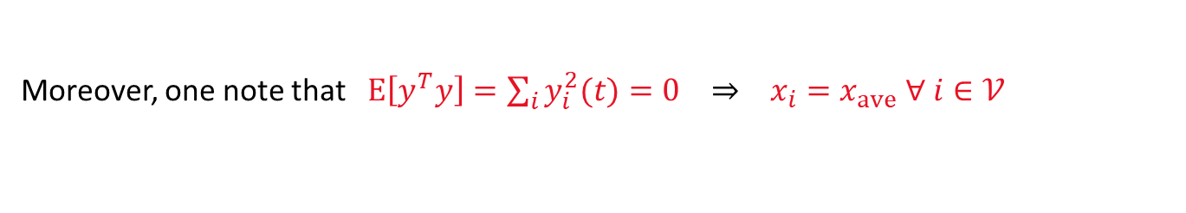
Convergence analysis: Convergence in 2nd –order moment
We proved $E\left[x(t)\right]=x_{ave}1_{n}$. However, this does not exclude arbitrarily large fluctuation!
b) Let’s prove that $Var\left[x(t)\right]=E\left[y{\left(t\right)}^{2}\right]→0$ where satisfies
Moreover: $W\left(k\right)1_{n}=1_{n} ⇒$
Thus, the update rule of $y\left(k\right)$ follows the same rule of $x\left(k\right)$
Then: Since $y\left(k+1\right)=W\left(k\right)y(k)$:
Finally, since $W(k)$ is doubly-stochastic, and $𝒢$ is connected, and $E\left[W^{T}\left(k\right)W\left(k\right)\right]={\overline{W}}^{2} (cost.)$
and because
Thus: by repeatedly conditioning, we obtain
Since $λ_{2}∈(0,1)$than $E\left[y^{T}y\right]=Var\left[x−x_{ave}1_{n}\right]→0$as $t→∞$ at a rate depending by $λ_{2}$.
Moreover, one note that $E\left[y^{T}y\right]=\sum_{i}{y_{i}^{2}(t)}=0 ⇒ x_{i}=x_{ave} ∀ i∈𝒱$
Intepretation: This means any gossip protocol if $𝒢$is connected, thus $W\left(k\right) :0<λ_{2}\left(W\left(k\right)\right)<1$, converges in the 2nd –order moment (cf. with DT deterministic consensus where $P$ plays as $W$).
Notes:
Here just to remark the importance of queuing networks in telecommunication systems we have another example…for instance…the Internet… that….as you know…. It works by means of a complex architecture where packets flows are processed by many routers, each modeled by a queue.
In particular we have that packets enter in the network because generated from different sources…. and with different destinations…
Then…. they arrive to nodes in a stochastic fashion…and then…each router asynchronously elaborates them…
Of course notice that.. if the traffic intensity exceed some given quantities …well some traffic is lost due to buffer overflows…
Let us further note that queuing networks are successfully used not only to solve resource allocation problems in telecommunication but…. Of course….whenever a flow of jobs need to be processed, independently by the fact that their arrivals and services are either synchronous or asynchronous, or either stochastic or deterministic.
In particular we have that all the results we are going to see are useful to determines in an easy way the system performance…and also to evaluate…. for resource allocation purposes…. the resources need such that a complex client-server architecture works while satisfying some QoS specifications.
Specification that could be expressed in term of time spent in the system…or in term of the buffer capacity … and that of course depends on the allocated resources…that means the number of servers per queue, their service rate… the buffer capacity … furthermore it is easy understand that all those quantities are further influenced by the costumer routing that express…in terms or probability….all the possible paths that a costumer can follows within the network.

Slide 14
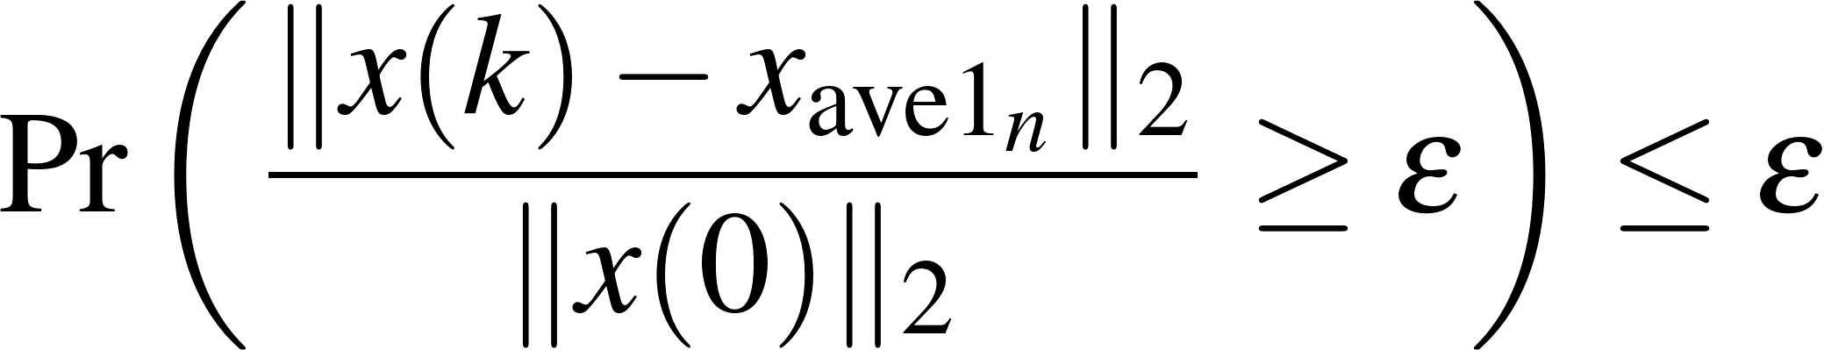
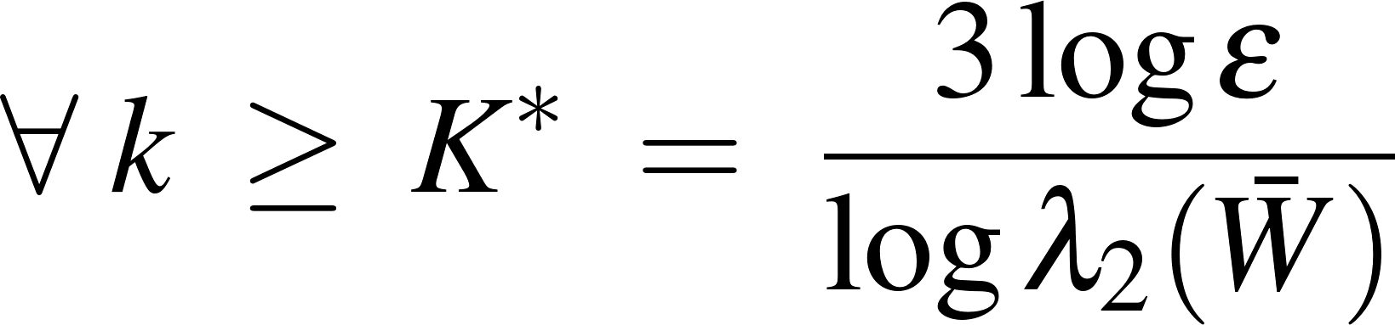
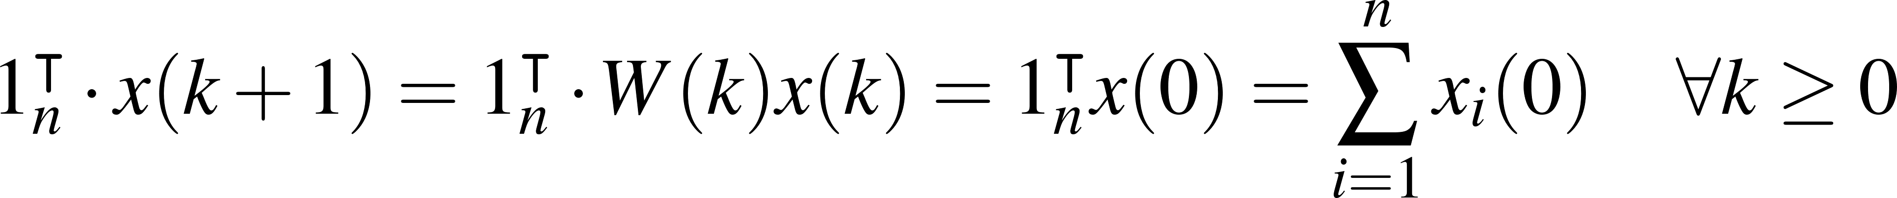
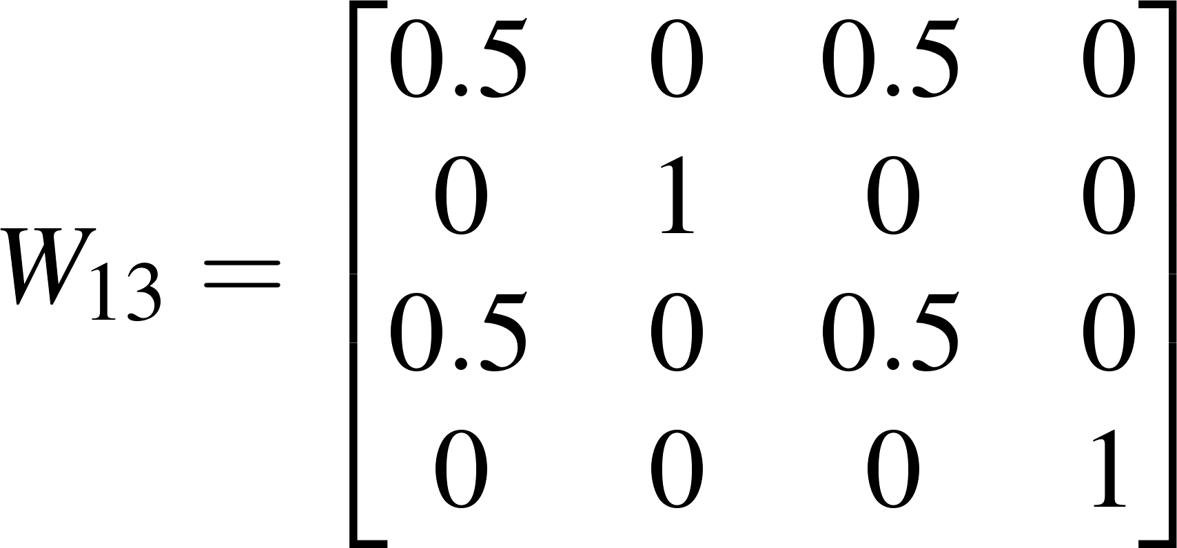
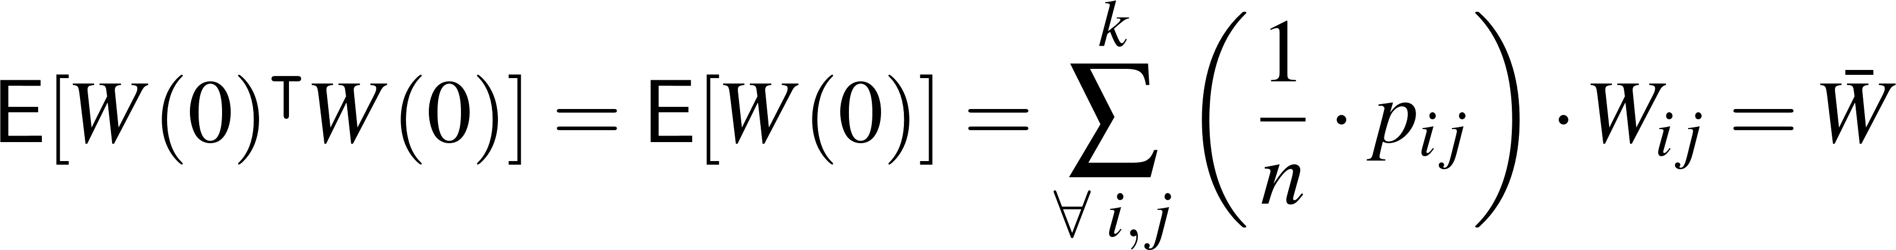
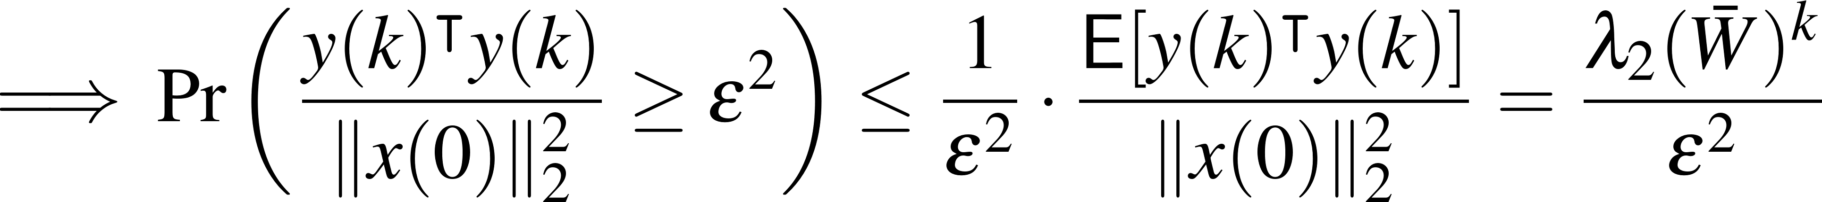
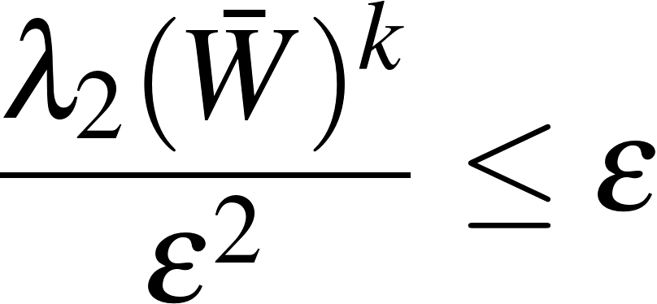
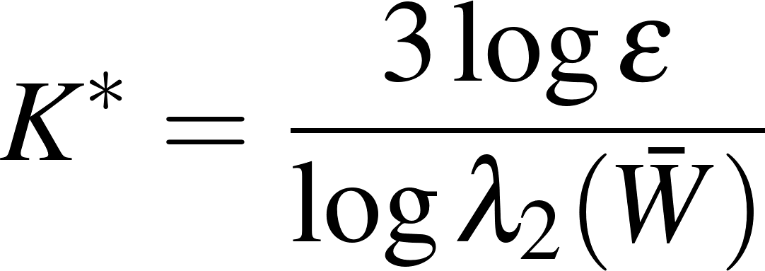
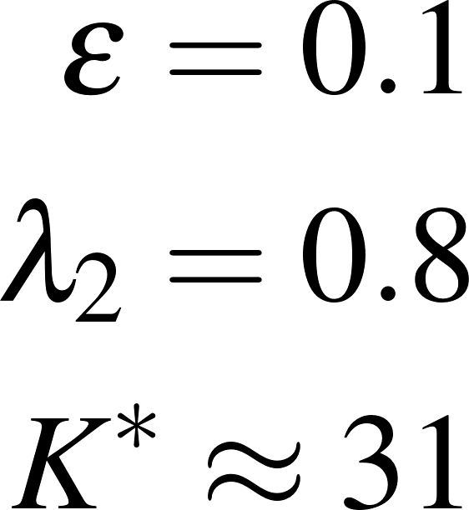


High probability bound on Averaging Time
Lemma: The given gossip-based consensus protocol, for any initial condition $x\left(0\right)$, and after a #clock-ticks $k≥K^{∗}$, allows agents to estimate $x_{ave}$ with high probability
Proof: Since $W(k)$ is doubly-stochastic $1_{n}^{T}W\left(k\right)=1_{n}^{T}$, then, the next function is time-invariant
Moreover, since $W(k)$ is symmetric, and idempotent ($W{\left(k\right)}^{T}W\left(k\right)=W\left(k\right)$) (because it is a «projection matrix»), then also $\overline{W}$ does, i.e.,
Then, by diagonalizing $\overline{W}$:
By the Markov Inequality and (**)
From that, and by solving
with respect to $k$ it yields
Notes:
Here just to remark the importance of queuing networks in telecommunication systems we have another example…for instance…the Internet… that….as you know…. It works by means of a complex architecture where packets flows are processed by many routers, each modeled by a queue.
In particular we have that packets enter in the network because generated from different sources…. and with different destinations…
Then…. they arrive to nodes in a stochastic fashion…and then…each router asynchronously elaborates them…
Of course notice that.. if the traffic intensity exceed some given quantities …well some traffic is lost due to buffer overflows…
Let us further note that queuing networks are successfully used not only to solve resource allocation problems in telecommunication but…. Of course….whenever a flow of jobs need to be processed, independently by the fact that their arrivals and services are either synchronous or asynchronous, or either stochastic or deterministic.
In particular we have that all the results we are going to see are useful to determines in an easy way the system performance…and also to evaluate…. for resource allocation purposes…. the resources need such that a complex client-server architecture works while satisfying some QoS specifications.
Specification that could be expressed in term of time spent in the system…or in term of the buffer capacity … and that of course depends on the allocated resources…that means the number of servers per queue, their service rate… the buffer capacity … furthermore it is easy understand that all those quantities are further influenced by the costumer routing that express…in terms or probability….all the possible paths that a costumer can follows within the network.

Slide 15








High probability bound on Averaging Time
Corollary: Let the accuracy $ε>0$ be given. For $n$ large and a symmetric communication probability matrix $P=\left[p_{ij}\right]$, then $K^{∗}≤T_{ave}$ is upper-bounded by
Note: If $𝒢$ is undirected with uniform communication probabilities, then $P$ is symmetric.
E.g.
Proof: First note
Because of $P$ is symmetric
Interpretation: This result means the averaging time scale in accordance with an accuracy value $ε$, the network size $n$, and the 2nd largest eigenvalues of the “communication graph probability matrix” $λ_{2}\left(P\right)$, thus it depends by $𝒢$ through the Laplacian matrix $ℒ$.
Notes:
Here just to remark the importance of queuing networks in telecommunication systems we have another example…for instance…the Internet… that….as you know…. It works by means of a complex architecture where packets flows are processed by many routers, each modeled by a queue.
In particular we have that packets enter in the network because generated from different sources…. and with different destinations…
Then…. they arrive to nodes in a stochastic fashion…and then…each router asynchronously elaborates them…
Of course notice that.. if the traffic intensity exceed some given quantities …well some traffic is lost due to buffer overflows…
Let us further note that queuing networks are successfully used not only to solve resource allocation problems in telecommunication but…. Of course….whenever a flow of jobs need to be processed, independently by the fact that their arrivals and services are either synchronous or asynchronous, or either stochastic or deterministic.
In particular we have that all the results we are going to see are useful to determines in an easy way the system performance…and also to evaluate…. for resource allocation purposes…. the resources need such that a complex client-server architecture works while satisfying some QoS specifications.
Specification that could be expressed in term of time spent in the system…or in term of the buffer capacity … and that of course depends on the allocated resources…that means the number of servers per queue, their service rate… the buffer capacity … furthermore it is easy understand that all those quantities are further influenced by the costumer routing that express…in terms or probability….all the possible paths that a costumer can follows within the network.

Slide 16
Matlab implementation
rng(0);
% Number of nodes, and initialization
n=10; x = 1:n; x(end)=50
% Solution vector:
num_iters = 100; x_sol=zeros(num_iters,n); x_sol(1,:)=x
A = ones(4) - eye(4); % Graph adiangency matrix,
P=(1/(n))*ones(n,n) % Uniform probability communication matrix
% Run the randomized gossip algorithm
for i = 2:num_iters
  % Randomly select two nodes to communicate
  node_indices = randperm(n, 2)
  node1 = node_indices(1); node2 = node_indices(2);
  % Update the node values using gossip update rule
  x_sol(i,node1) = (x_sol(i-1,node1) + x_sol(i-1, node2)) / 2
  x_sol(i,node2) = x_sol(i,node1);
    for k=1:n
      if k~=node1 && k ~= node2
      x_sol(i,k)=x_sol(i-1,k);
      end
    end
end
Notes:
Here just to remark the importance of queuing networks in telecommunication systems we have another example…for instance…the Internet… that….as you know…. It works by means of a complex architecture where packets flows are processed by many routers, each modeled by a queue.
In particular we have that packets enter in the network because generated from different sources…. and with different destinations…
Then…. they arrive to nodes in a stochastic fashion…and then…each router asynchronously elaborates them…
Of course notice that.. if the traffic intensity exceed some given quantities …well some traffic is lost due to buffer overflows…
Let us further note that queuing networks are successfully used not only to solve resource allocation problems in telecommunication but…. Of course….whenever a flow of jobs need to be processed, independently by the fact that their arrivals and services are either synchronous or asynchronous, or either stochastic or deterministic.
In particular we have that all the results we are going to see are useful to determines in an easy way the system performance…and also to evaluate…. for resource allocation purposes…. the resources need such that a complex client-server architecture works while satisfying some QoS specifications.
Specification that could be expressed in term of time spent in the system…or in term of the buffer capacity … and that of course depends on the allocated resources…that means the number of servers per queue, their service rate… the buffer capacity … furthermore it is easy understand that all those quantities are further influenced by the costumer routing that express…in terms or probability….all the possible paths that a costumer can follows within the network.

Slide 17


Matlab implementation
Tave_max= 3*n*log(1/0.1)/(1-0)
eps=0.2;
x_ave=mean(x);
x_sol-x_ave*ones(size(x_sol))
% Notice that this probability evaluated experimentally approaches eps=0.2
pr_abs_x_to_xave_greater_eps= sum( sqrt(sum( (x_sol-x_ave.*ones(size(x_sol))).^2,2)) /norm(x) > eps)/(num_iters-1)
% Print the final node values
figure(1)
stairs([0:num_iters-1],x_sol)
hold on
title('Agents convergence')
xlabel('Iteration number')
grid
stairs(zeros(size(x_sol(1,:))),x_sol(1,:),'*k')
Notes:
Here just to remark the importance of queuing networks in telecommunication systems we have another example…for instance…the Internet… that….as you know…. It works by means of a complex architecture where packets flows are processed by many routers, each modeled by a queue.
In particular we have that packets enter in the network because generated from different sources…. and with different destinations…
Then…. they arrive to nodes in a stochastic fashion…and then…each router asynchronously elaborates them…
Of course notice that.. if the traffic intensity exceed some given quantities …well some traffic is lost due to buffer overflows…
Let us further note that queuing networks are successfully used not only to solve resource allocation problems in telecommunication but…. Of course….whenever a flow of jobs need to be processed, independently by the fact that their arrivals and services are either synchronous or asynchronous, or either stochastic or deterministic.
In particular we have that all the results we are going to see are useful to determines in an easy way the system performance…and also to evaluate…. for resource allocation purposes…. the resources need such that a complex client-server architecture works while satisfying some QoS specifications.
Specification that could be expressed in term of time spent in the system…or in term of the buffer capacity … and that of course depends on the allocated resources…that means the number of servers per queue, their service rate… the buffer capacity … furthermore it is easy understand that all those quantities are further influenced by the costumer routing that express…in terms or probability….all the possible paths that a costumer can follows within the network.

Slide 18






Consensus problem extension
The averaging problem on MAS network comes up in many applications such as: rendezvous problems among mobile robots, distributed estimation, data fusion, and optimization
Consensus problems over networks can also be extended to nonlinear functions, such as:
Example: Temperature estimation in WSN
The Median preference
The Midrange preference (average of the largest and smallest data points)
The Max or Min preference
Leader tracking over $𝒢$
Note: The average consensus problem itself can also be viewed as the root-mean-square minimization the agent’s initial preferences
where $𝒢$ has to be connected and undirected.
Distributed optimizations problems subjected to communication constraints
Notes:
Here just to remark the importance of queuing networks in telecommunication systems we have another example…for instance…the Internet… that….as you know…. It works by means of a complex architecture where packets flows are processed by many routers, each modeled by a queue.
In particular we have that packets enter in the network because generated from different sources…. and with different destinations…
Then…. they arrive to nodes in a stochastic fashion…and then…each router asynchronously elaborates them…
Of course notice that.. if the traffic intensity exceed some given quantities …well some traffic is lost due to buffer overflows…
Let us further note that queuing networks are successfully used not only to solve resource allocation problems in telecommunication but…. Of course….whenever a flow of jobs need to be processed, independently by the fact that their arrivals and services are either synchronous or asynchronous, or either stochastic or deterministic.
In particular we have that all the results we are going to see are useful to determines in an easy way the system performance…and also to evaluate…. for resource allocation purposes…. the resources need such that a complex client-server architecture works while satisfying some QoS specifications.
Specification that could be expressed in term of time spent in the system…or in term of the buffer capacity … and that of course depends on the allocated resources…that means the number of servers per queue, their service rate… the buffer capacity … furthermore it is easy understand that all those quantities are further influenced by the costumer routing that express…in terms or probability….all the possible paths that a costumer can follows within the network.

Slide 19
References
DeGroot, M. H. (1974). Reaching a consensus. Journal of the American Statistical association, 69(345), 118-121.
Olfati-Saber, R., Fax, J. A., & Murray, R. M. (2007). Consensus and cooperation in networked multi-agent systems. Proceedings of the IEEE, 95(1), 215-233.
Boyd, S., Ghosh, A., Prabhakar, B., & Shah, D. (2006). Randomized gossip algorithms. IEEE transactions on information theory, 52(6), 2508-2530.
Notes:
Here just to remark the importance of queuing networks in telecommunication systems we have another example…for instance…the Internet… that….as you know…. It works by means of a complex architecture where packets flows are processed by many routers, each modeled by a queue.
In particular we have that packets enter in the network because generated from different sources…. and with different destinations…
Then…. they arrive to nodes in a stochastic fashion…and then…each router asynchronously elaborates them…
Of course notice that.. if the traffic intensity exceed some given quantities …well some traffic is lost due to buffer overflows…
Let us further note that queuing networks are successfully used not only to solve resource allocation problems in telecommunication but…. Of course….whenever a flow of jobs need to be processed, independently by the fact that their arrivals and services are either synchronous or asynchronous, or either stochastic or deterministic.
In particular we have that all the results we are going to see are useful to determines in an easy way the system performance…and also to evaluate…. for resource allocation purposes…. the resources need such that a complex client-server architecture works while satisfying some QoS specifications.
Specification that could be expressed in term of time spent in the system…or in term of the buffer capacity … and that of course depends on the allocated resources…that means the number of servers per queue, their service rate… the buffer capacity … furthermore it is easy understand that all those quantities are further influenced by the costumer routing that express…in terms or probability….all the possible paths that a costumer can follows within the network.

