Slide 1

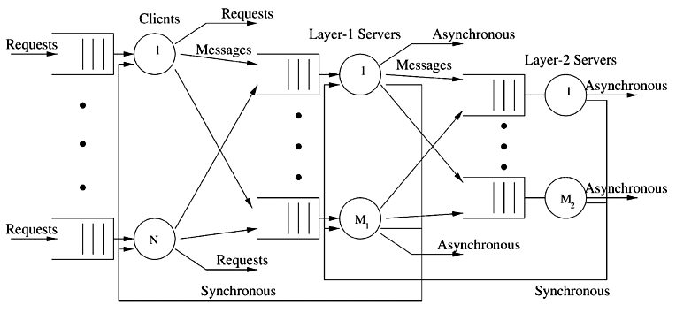


STOCHASTIC MODELS
-
Queueing Networks
1
Notes:
So today we gonna present the last module of this course that it is about queuieing networks….namely systems in which a number of queues are connected to each other by what it is called as... customer routing….
…where…for costumer routing we mean the path that costumers can follows among the queues of the network.
Just to give an idea on what we are going to talk…by refering to the network in the picture…. Here we have a multi-layer client-server architecture ….. requests come from outside…and are taken in charge and elaborated by the first set of queues…than if the request is accomplished that job leaves the system following one of the possible leaving-path.
Otherwise…If that request requires other operations…related messages are delivered to the layer 1 and if necessary from layer 1 to layer 2….
Let us further note that sometimes it may also occur that an operation need a cross check…. and thus the costumer routing can also consider the presence of loops like this….or this…
In general we have that when a customer is serviced at one node…then… it can join another node and queue for service, or simply leave the system.
Ah…notice that in this contest… we will often refer to the queues that constitute the network as nodes…

Slide 2
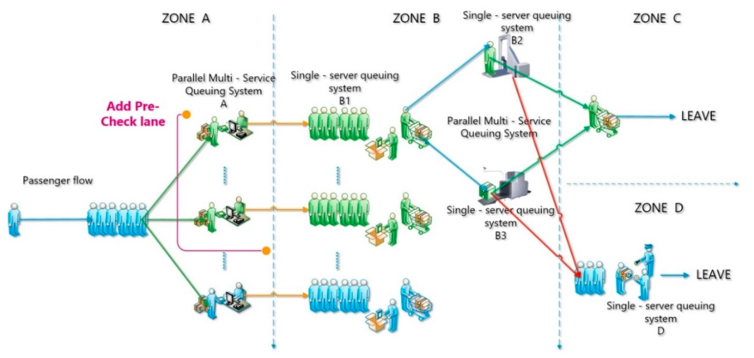
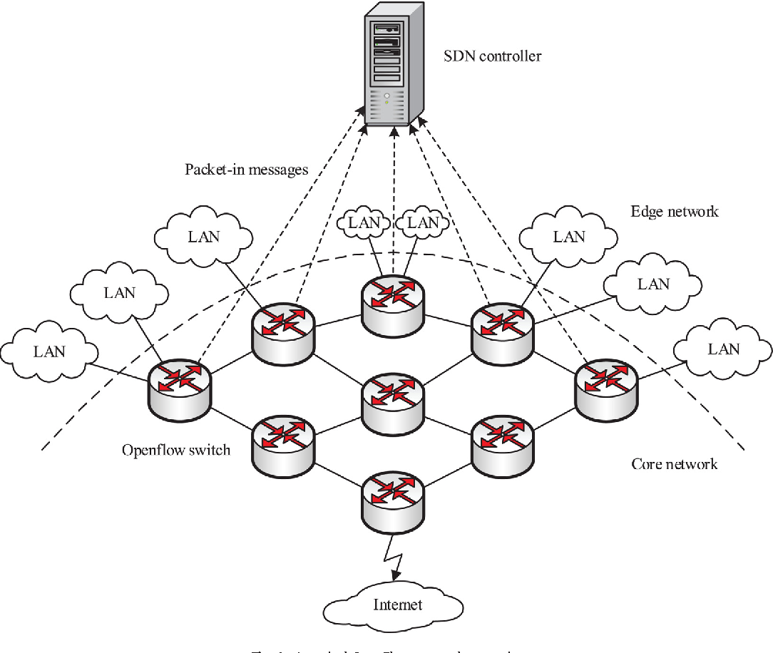
Queueing networks
In many real-world systems and applications, jobs/customers are served asynchronously in more than one server station arranged as a network
Each network node consists of a queue, and jobs flow through some paths
Queueing networks are successfully used for resource allocation purposes in
  telecommunications & computing networks
  manufacturing processes
  transportation systems
  management problems
  etc..
Airport Security system
Manufactory system
Upon completing their service at a server, customers move to another for additional services or leave the system according to some routing disciplines (either deterministics or stochastics).
Internet networks
Notes:
Here just to remark the importance of queuing networks in telecommunication systems we have another example…for instance…the Internet… that….as you know…. It works by means of a complex architecture where packets flows are processed by many routers, each modeled by a queue.
In particular we have that packets enter in the network because generated from different sources…. and with different destinations…
Then…. they arrive to nodes in a stochastic fashion…and then…each router asynchronously elaborates them…
Of course notice that.. if the traffic intensity exceed some given quantities …well some traffic is lost due to buffer overflows…
Let us further note that queuing networks are successfully used not only to solve resource allocation problems in telecommunication but…. Of course….whenever a flow of jobs need to be processed, independently by the fact that their arrivals and services are either synchronous or asynchronous, or either stochastic or deterministic.
In particular we have that all the results we are going to see are useful to determines in an easy way the system performance…and also to evaluate…. for resource allocation purposes…. the resources need such that a complex client-server architecture works while satisfying some QoS specifications.
Specification that could be expressed in term of time spent in the system…or in term of the buffer capacity … and that of course depends on the allocated resources…that means the number of servers per queue, their service rate… the buffer capacity … furthermore it is easy understand that all those quantities are further influenced by the costumer routing that express…in terms or probability….all the possible paths that a costumer can follows within the network.

Slide 3

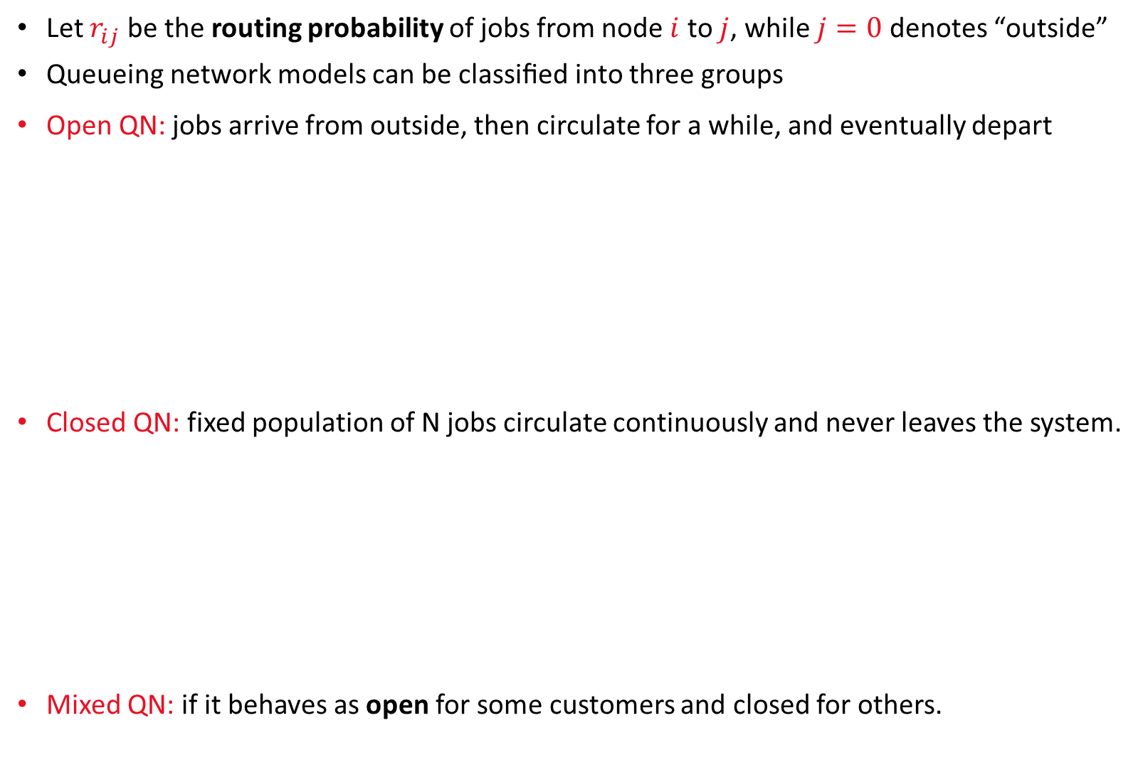








Open & Closed Queueing Networks
AA24_25
Let $r_{ij}$ be the routing probability of jobs from node $i$ to $j$, while $j=0$ denotes “outside”
Queueing network models can be classiﬁed into three groups
Open QN: jobs arrive from outside, then circulate for a while, and eventually depart
Closed QN: fixed population of N jobs circulate continuously and never leaves the system.
Mixed QN: if it behaves as open for some customers and closed for others.
$$r_{10}=0.5$$
$$r_{20}=0.5$$
λ₁^{in}
$$r_{12}=0.5$$
μ₁
$$r_{23}$$
$$r_{31}=0.5$$
λ₁
λ₂
μ₂
λ₃
μ₃
λ₂^{in}
$$r_{33}=0.5$$
$$r_{22}=(1−p)$$
$$r_{12}=1$$
AA24_25
μ₁
μ₂
The system is isolated
with N costumers within
N costumers
$$r_{21}=p$$
Notes:
Well…from a practical point of view queueing network can be classified in three types….
Open networks, as this….where costumers arrive from outside, circulate, and eventually depart…
Then…. we have the Closed networks, that can be seen as isolated system. Well…in closed network we have that the population of costumer within the system is, at any time, fixed and constant…look at the figure…there are no arrivals from outside… but in the system we still have n costumers within ….that can circulate continuously and that cannot never leave the system….or equivalently if a costumer at a time “t” leave the system then…. it is immediately replaced by another….so that in the system we constantly count N costumer at each time instant.
Then…. we have the mixed networks that can be seen as a combination of the previous two, namely it behaves as it was open …for some types of customers…whereas it behaves as closed network for some other type of jobs…that are instead always confined within the system. This is the case of system where there are multiple classes of customers and jobs and various service disciplines as well

Slide 4
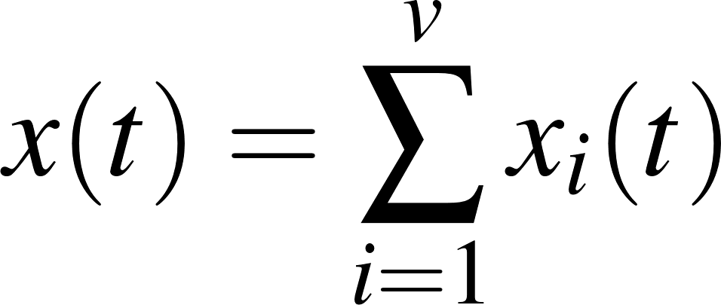

Open network & Closed network (cont’d)
Consider a QN with $v$ queues, refferred as nodes
Let $x_{i}(t)$ be the number of customers at time $t$in node $i=1,2,…,v$
The total number of customers in the network is
In Open QNs: External customers are allowed to join the system ($x(t)$ is time-varying)
In Closed QN: the number of customers in the system is constant ($x(t)$ is time-invariant)
Remark 1: If the arrival rate from outside and the departure rate are approximately the
same, the QN can be modeled as a closed network without sacriﬁcing too much.
Example 1: Every social service during the CoVid-19 pandemy worked as a closed QN. Indeed, only a limited number of people may access the service at the same time, and, as soon as one leave the system, only one external costumer may access the system.
AA24_25
Notes:
In particular we have that for a network with v queues …or service station….or simply nodes… we denote by x_i of t…. The the number of customers on node $i$ at time $t$ and that ….. Thus we have that in an open QNs customers from outside are allowed to join the system… which implies that the total number of costumers…. denoted by $x(t)$ and consisting in the summation of all the costumer w.r.t to each node is clearly time-varying.
On the other hand…in a closed QN that number is clearly constant.
Notice that also open network which arrival rate into and the departure rate out of the network are the same…. or approximately the same….. can be modeled as a closed network without sacriﬁcing too much accuracy.
The important thing is that at any time n is mantained constant.
For instance think about a car service center supporting a ﬁxed number of cars…well this is a closed QN.

Slide 5
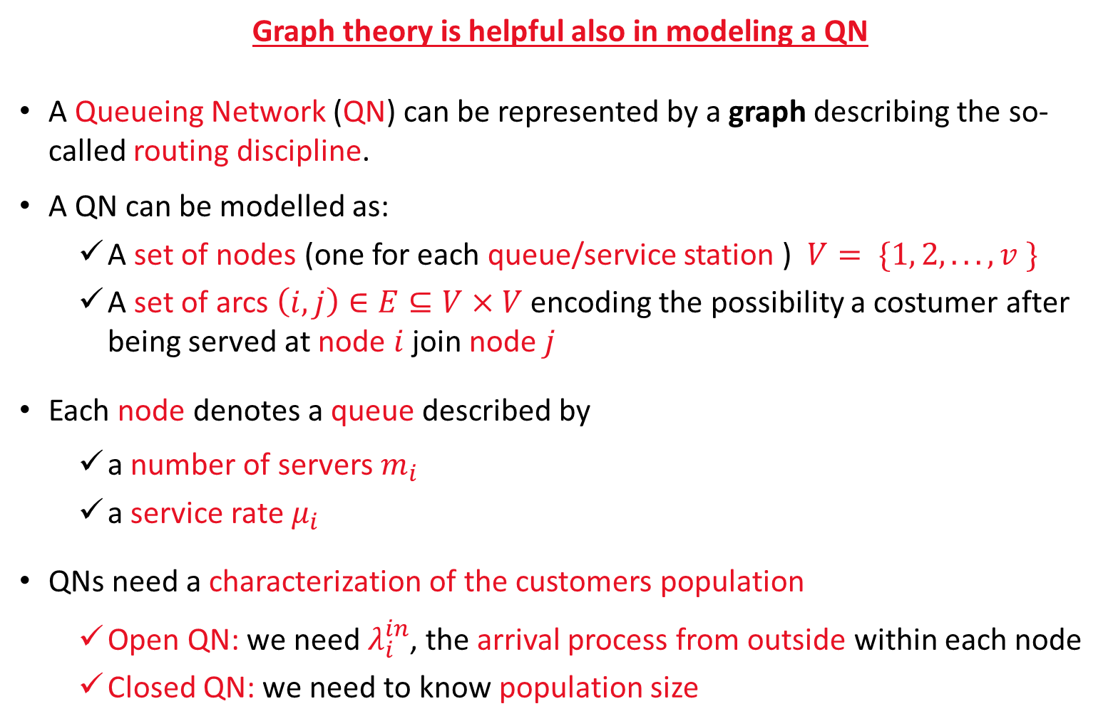
Queueing network’s characterization
Graph theory is helpful also in modeling a QN
A Queueing Network (QN) can be represented by a graph describing the so-called routing discipline.
A QN can be modelled as:
  A set of nodes (one for each queue/service station ) $V= \{1, 2,. . . ,v \}$
  A set of arcs $\left(i,j\right)∈E⊆V×V$encoding the possibility a costumer after being served at node $i$ join node $j$
Each node denotes a queue described by
  a number of servers $m_{i}$
  a service rate $μ_{i}$
QNs need a characterization of the customers population
  Open QN: we need $λ_{i}^{in}$, the arrival process from outside within each node
  Closed QN: we need to know population size
Notes:
So ...roughly speaking we have that a queuing network can be described by a graph that describe the so-called routing discipline of costumers… namely we have a set of nodes one for each queue in the system…. And a set of arcs that represent the possibility that a costumer after being served at node “i” join the queue of node “j”…
Then each node is deﬁned in accordance by its Kendal notation by its number of servers m_i …its service rate mu_i ….that can be either constant for all the servers…. or dependent on the actual state of the station….for instance…if you remember what we have said during the last lectures ….in a mulit-servers queues…the death rate of the associated BDP changes accordingly with number of costumer within the queue.
Moreover QNs need of a characterization of the customers population. If it is in constant within the system as in a close network we have to now n, whereas if arrivals from outside are allowed we have to now the lambda_i^in

Slide 6




Particular types of QNs
Tandem QN: It is the simplest Open QN. It consists of many queues in series.
Applications: Assembly lines, sequential computations, are some obvious instances of Tandem QNs
Open QNs with feedback
Interpretation: The 1st station provides a service. The 2nd verify the service quality. If it is acceptable, the piece leaves the system with a given probability
arrivals
departures
$$μ_{1}$$
$$μ_{v}$$
arrivals
departures
$$μ_{1}$$
$$μ_{2}$$
feedback
Notes:
Here we have a list of particular QN topologies of interest.
For instance the first is the so called Tandem QN that is the simplest open network….this is the case of an assembly line or a sequential process where each costumer that comes from outside is subject to many operations in sequence … one after another…
Another type of queue is instead the open network with a feedback …. This is the case of a manufactory system costing of two stations….the 1st provides a service…and the second verify the service quality. If a given specification is satisfied….then the piece leaves the system otherwise the piece return back to the fist station.

Slide 7







Particular types of QNs
Cyclic QN: The simplest closed QN. It consists of a loop of many queues in series.
Otherwise, we refer to generic QNs.
Under the assumption of Markovian nodes, in the following
we will learn how perform a steady state analysis of a QN
$$μ_{1}$$
$$μ_{2}$$
It’s the closed counterpart of the tandem QN for open QN
N jobs
$$μ_{1}$$
$$μ_{2}$$
$$μ_{3}$$
$$μ_{1}$$
$$μ_{2}$$
Generic Markovian open QN
Generic Markovian closed QN
Notes:
So…. we have said that the tandem network is the simplest open network….well its closed counterpart is the so-called ….cyclic network…that consists on a loop of queues… with of course N costumers within…
In general we refer to other topologies as generic open or closed networks….
Given that… in the following…. Under the assumption of considering network of markovian queues we will learn how perform a steady state analysis of a generic markovian network either open or closed network

Slide 8

Queuing Network Notation
Consider a QN of $v$ nodes (queues).
Let $X_{i}$ be the r.v. associated with #costumers in the $i$-th station
Let $x_{i}$ be the #costumer in the $i$-th station
We define the following row vectors
Then the probability of having a given deployment of costumes within the system is denoted by the next joint probability distribution function
Notes:
So … let us first introduce a bit of notation….so we have v nodes in the network…then we denote the discrete random variable associated with the number of costumers in node “i” as capitol X_i….whereas small x_i is a the possible number of costumers allowed to stay in that node.
We also define the vectors Capitol X vector an small x… respectively…. The row vector that collect all the r.v. associated with the number of costumers within each node…
and a generic feasible distribution of costumers within the system….
Then the state probability of having any given particular distribution of costumes ….that is denoted by small x …. within the system is denoted by the following joint probability distribution

Slide 9
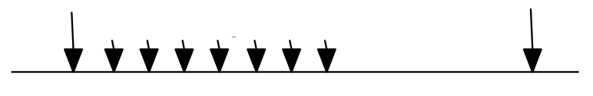


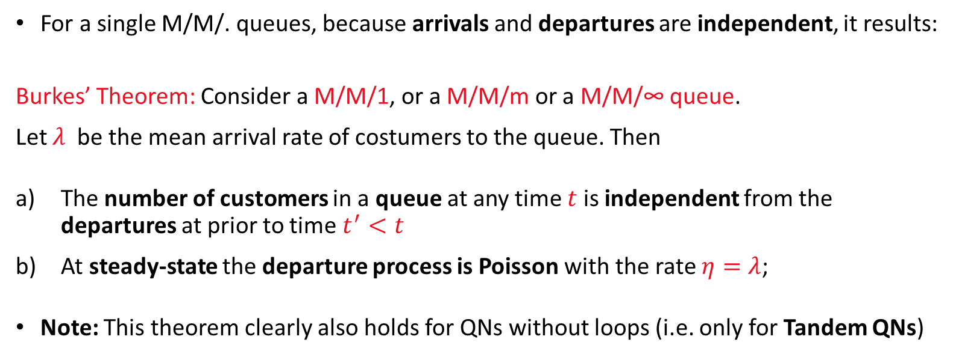






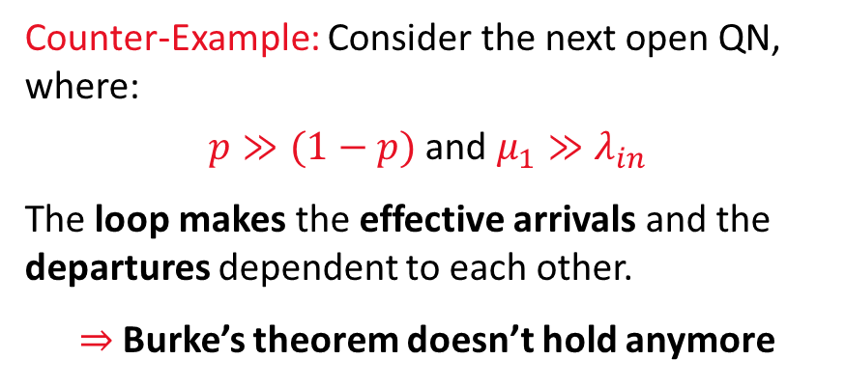

Analysis of QNs
For a single M/M/. queues, because arrivals and departures are independent, it results:
Burkes’ Theorem: Consider a M/M/1, or a M/M/m or a M/M/∞ queue.
Let $λ$ be the mean arrival rate of costumers to the queue. Then
The number of customers in a queue at any time $t$ is independent from the departures at prior to time $t^{′}<t$
At steady-state the departure process is Poisson with the rate $η=λ$;
Note: This theorem clearly also holds for QNs without loops (i.e. only for Tandem QNs)
Counter-Example: Consider the next open QN, where:
$p≫(1−p)$ and $μ_{1}≫λ_{in}$
The loop makes the effective arrivals and the departures dependent to each other.
$⇒$ Burke’s theorem doesn’t hold anymore
$$λ^{in}$$
$$x_{1}\left(t\right)=7$$
$$\left(1−p\right)$$
$λ_{1}=λ^{in}+pλ_{1}$
$$μ_{1}$$
$$η_{1}≡λ_{1}$$
$$p$$
Ext. arr. due to $λ^{in}$
Ext. arr.
Internal arrival due to $p$
Mixture of exponential arrivals
Notes:
Let us now discuss some results that are useful to study the behaviour a markovian QN at steady state…….well… the first result that need to be mentioned is the so called Burke’s Theorem…. if you remember we used a lot this theorem during the last lectures to evaluate the throughput of queues… in particular this theorem say that in a generic ergodic markovian queue at steady state departure and arrivals are balanced…and such that the departure process eta (the is the throughput of the node) is equal to the arrival rate….
Moreover we further states that… at any time t…. the number of customers in the queue is independent from the departure process…
Well…from that… it thus follows that this theorem holds not only for isolated queues…but also for those network where arrivals and departures are indepedents …this the case for instance of the Tandem Queue….
But unfortunately this is not the case a generic QN with loops or feedbacks….in fact in this case we may have that the arrival process to a queue may…result to be….how to say…corrupted…. By some departures…in a such a way that the total arrival process is no more poissonian at each time instant….
Let us consider for instance Example 1. Here some costumers comes from outside in a poisson fashion with mean rate lambda_in…Then after the service….with probability p …. costumers may return back to the buffer input or leave the system….we also call as lambda 1 the effective input rate of this network…
well it is obvious that if the service rate \mu is much faster than \lambda_in …. And p is large….then we have that after the service a costumers goes back very quickly to the queue input …well…now we have that lambda 1 is completely different from lambda_1^in and of course it is no more poissonian…
In fact….although arrivals form outside in this point are poisson…and also departure in this point are poisson…because services are exponential….well if we observer lambda_1…we find that between to two external arrivals we may found burst of…how to say….internal arrivals …. That makes lambda 1 no more poissonian.
So this speech was to explain why the burkes theorem do not works in general…however it helps us to say something on the stedy state of a Tandem queue…

Slide 10
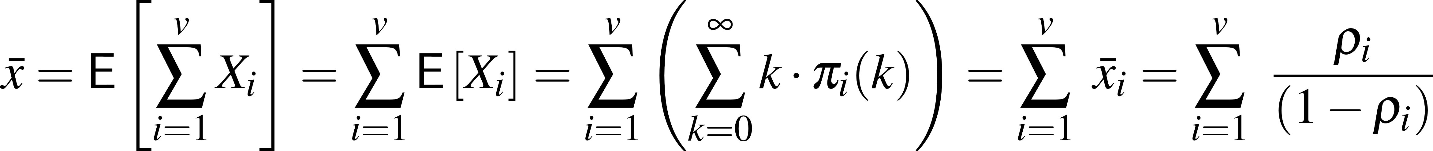

Tandem QN analysis
For a Tandem QN arrivals and the service are independent, thus the Burke’s Theorem holds. Then each queue can be studied separately.
Theorem: Consider QN with $v$ M/M/1 nodes in series. External arrivals are Poisson with rate $λ$. Service times are exponential with rate $μ_{i}$, $i=1,2,…,v$.
Let $λ_{i}$ be the arrivals to node $i$from node $i−1$, and let $X_{i}$ be the r.v. associated with the #costumers in the $i$-th node, and $π_{i}\left(x_{i}\right)=\operatorname{Pr}{(X_{i}(∞)=x_{i})}$
Due to the absence of loops, nodes are independent, then if queues are ergodic, $λ/μ_{i}<1$, the joint stationary probability takes the product form
As an example, it follows, e.g., the mean number of costumers in the QN is given by
Notes:
So given that we have that for Tandem queues consisting of ergodic nodes…with poisson external arrivals and exponential service times the burks theorem holds and the steady state probability of having a given distribution of costumers in the system…like x1 in node 1, xe in node 2 ans so…is simply expressed by the product of the stationary probabilities of each node. For instance if we consider a tendem queue of M/M/1 nodes this joint probability is the product of the probabilities of having x_i costumers in each queue i….
Thus it straighforwardly results that also the mean number of costumers in the system is the sum of the mean number of costumers in the system.

Slide 11
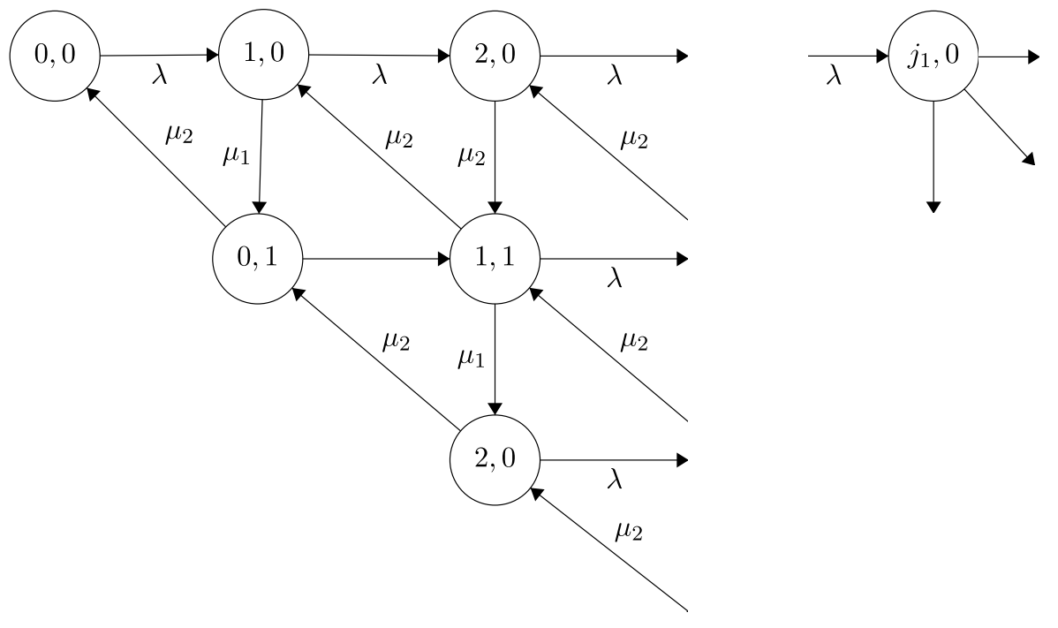




Molling of a Tandem QN as a CT-MC
Example 2: Consider a Tandem QN of two M/M/1 stations
This QN can be modelled by an infinite-state CT-MC which states consist of the pair of r.v. $\left(X_{1},X_{2}\right)∈ℕ_{0}×ℕ_{0}$ counting all the costumers deploiments in the two nodes
$λ_{1}$
$λ_{2}$
$λ$
μ₁
μ₂
Notes:
Well…notice now that… although this result is trivial….it dispense us to very huge amount of counts…. In fact just for the clarity sake imagine to consider the easiest tandem queue…that consisting in only two M/M/1 nodes.
Well…of course…we have that this stochastic process can for sure be modelled by means of a CT-MC….however now…because of we are interested on the number of costumers in node 1 and that in node 2….each state of this MC consider the pair X1 X_2….thus we have that (00) indicates no costumers in both the queues….1,0 one costumer in node 1 and zero in node 2…. Then…look at here…
from (1,0) I can moved to (20) is an arrival occurs or to (0,1) is the service complete for first…and in fact I move to (10) to (01) with a rate mu1… that means that the costumers is moved from the first to the second queue….
Then form (0,1) with a rate \mu2 the system could become empty and then I return to (00)…or I can moved to (11) and so on….
Maybe you could imaging how complex is solving this markov chain….but if note in the next slide we have the counts

Slide 12
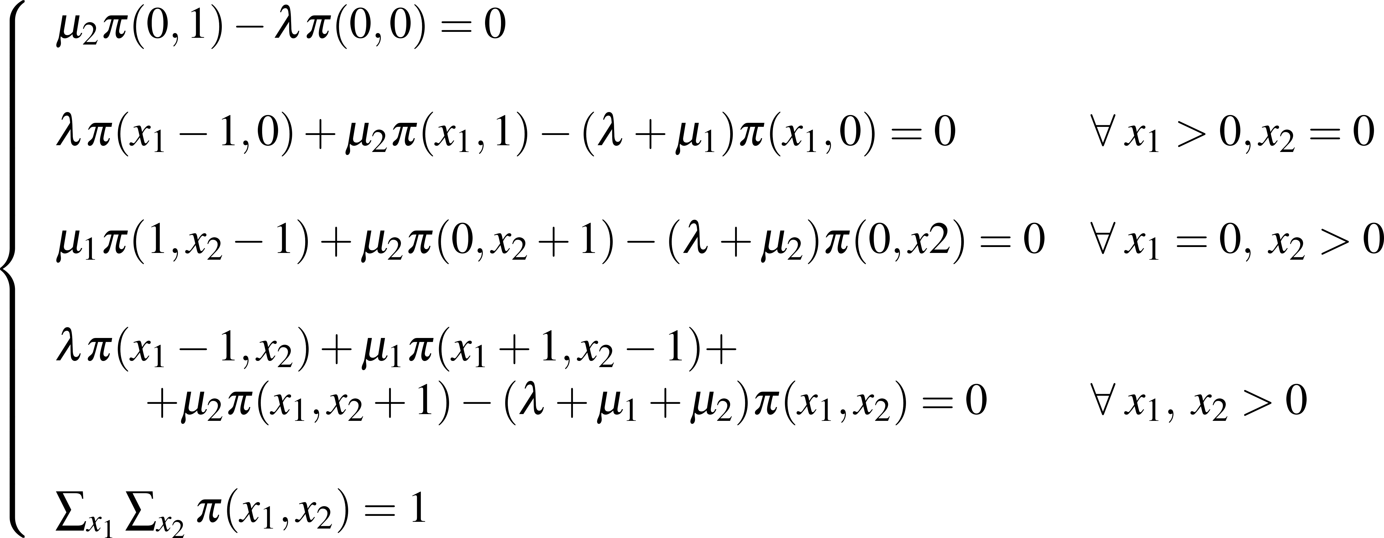
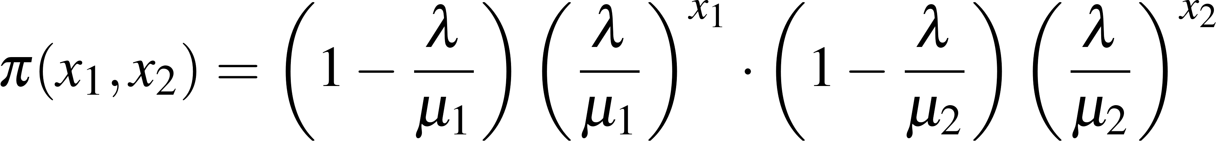
Examples (cont’d)
If the QN is ergodic (i.e. each queue is ergodic as well), the stationary probabilities can be found by solving the resulting balancing equations
After manipulations, the mentioned
product form takes place
Notes:
You could verify this count as an exercise….however look at….
The steady state joint probability of having x_1 costumers in the first queue and x_2 in the second is the product of their probabilities …this is because the two queues can be studied as independent…thus the joint probability is the product of their single probabilities…

Slide 13
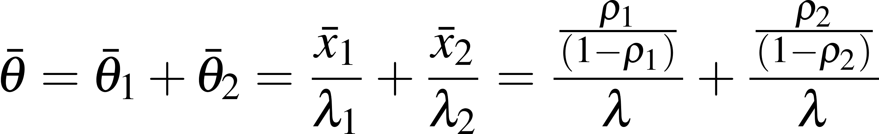
Examples (cont’d)
Example 2: Consider the following Tandem QN of two M/M/1 stations
Since the services are independent, from the Burke’s Theorem the throughput of the first resource at steady state is
Therefore, it further results that
Thus, by means of the Little’s Law, we can further conclude that the mean time spent in the QN is
$λ_{1}$
$λ_{2}$
$λ$
μ₁
μ₂
Notes:
Of course because of the two queues are independent…thus we have that throughout at steady of node 1 is equal to lambda…and also that of node two….and that of course the total mean time to cross the network is the sum of the two times…bat thete_1 and bar theta_2….where each can be derived by means of the littles law.

Slide 14
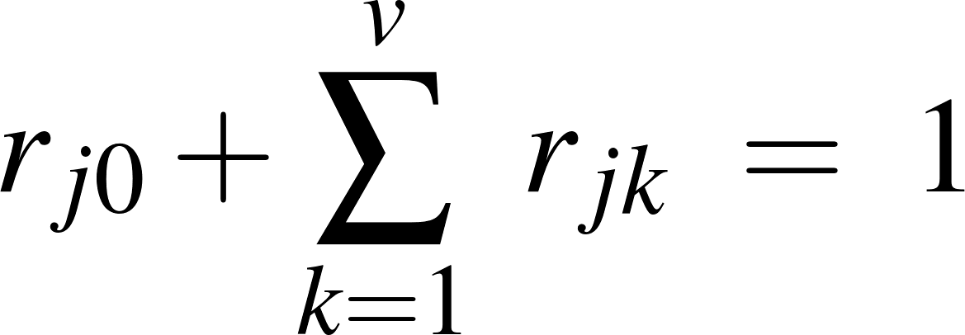
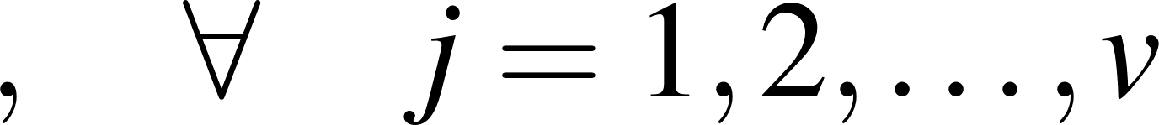
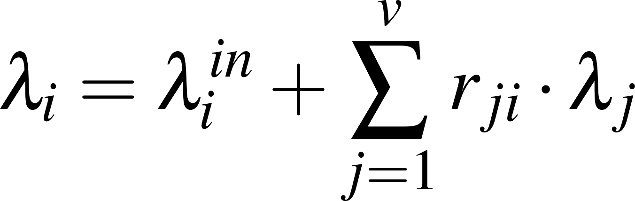
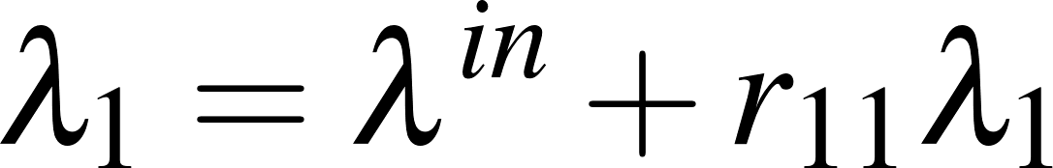
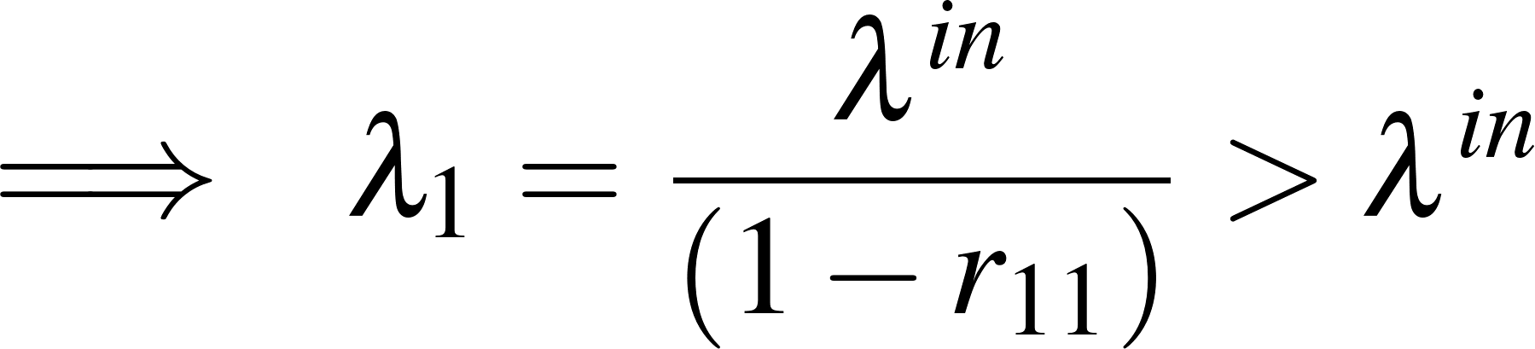






Markovian Open QNs (or Jackson Networks)
Consider an open QN of M/M/m nodes where arrivals at node $i$from outside are Poisson with rate $λ_{i}^{in}$ and the services are exponential with mean service times $\frac{1}{μ_{i}}$
Let $r_{jk}$ be routing probability that a customer after being served at node $j$ requests a service from node $k$, and $r_{j0}$ be the probability that leaves the QN after service at node $j$
Due to the composition of Poisson SPs, if a steady-state exists (i.e. if the QN is ergodic), it will be such that it satisfies to the so-called
Example 1:
Routing probabilities satisfy
Traffic equation for node $i$
(mean flow through node i)
Traffic equation for this M/M/1:
$$λ^{in}$$
$$r_{10}=\left(1−p\right)$$
$λ_{1}=λ^{in}+r_{11}λ_{1}$
$$μ_{1}$$
$$r_{11}=p$$
Notes:
Well…What about if we consider a generic open QN consisting of Markovian queues…..thus…each with poisson arrivals form outside lambda_i^in and exponential service time with mean rate mu…
Well…in this case we have that …. a costumers may leave node j and reach to node k with a probability r_jk…. This is called routing probability…otherwise it may leave the system with a probability that is denoted by rj0….and such that the sum of all the routing probabilities makes 1
So…given that we have that at each time t each node satisfy the so-called traffic equation…. That is this…
Namely by the composition of processes…. we have that the total traffic to node i…that is lambda i is equal to the sum between the external and internal arrivals weigted by means of the routing probabilities….
So… for instance for Example 1 we have that lambda_1=lambda_in+p\times \lambda_1….from that we have this…. Which shows that in this case…lambda_1 is clearly larger than lambda_in because of it is augmented by the flow of costumers from this path.

Slide 15
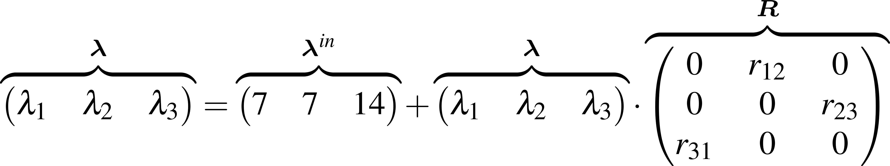
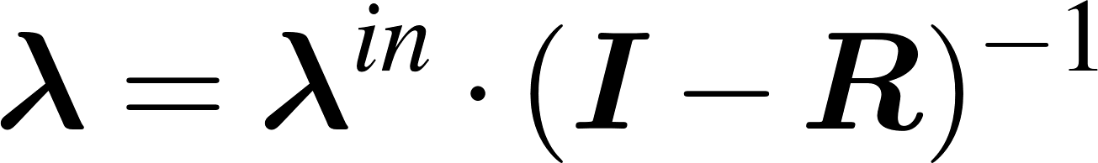









Examples (cont’d)
Example 3: Consider the following Open Network of 3 M/M/1
If the QN is ergodic the steady-state mean arrival/departure rates are the solution of the above linear system, namely
Problem: The previous result does not depend by the service rates, this make one think
having is only a necessary condition
$$r_{10}=0.5$$
$$r_{20}=0.5$$
$$r_{30}=0.5$$
$$r_{12}=0.5$$
$$r_{23}=0.5$$
λ₁
μ₁
λ₂
μ₂
λ₃
μ₃
$$λ_{1}^{in}=7$$
$$λ_{2}^{in}=7$$
$$λ_{3}^{in}=14$$
$$r_{31}=0.5$$
Notes:
Here we have another example…. a QN of three M/M/1 nodes… so not the traffic equations can be rewritten in terms of matrices….so….by solving with respect to lambda we get that the vector of arrivals depends of the inverse of this matrix I minus R….where R is the so called routing probability matrix.
So we observe that for sure necessary condition for the ergodicity is that the matrix I-R is invertible as it is written here…. (GIRAAAAAA EVIDENZIAAAA)

Slide 16
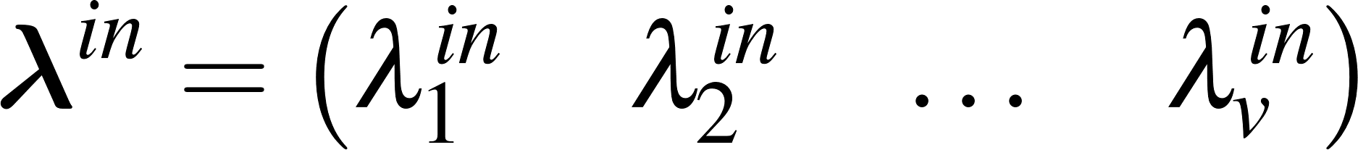
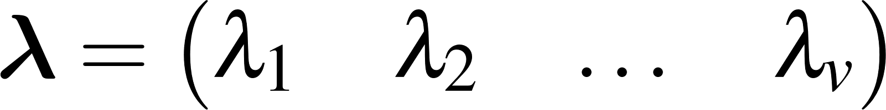
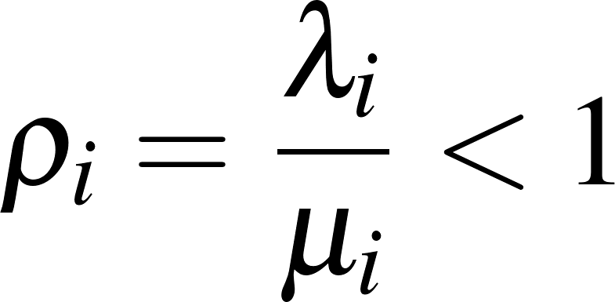
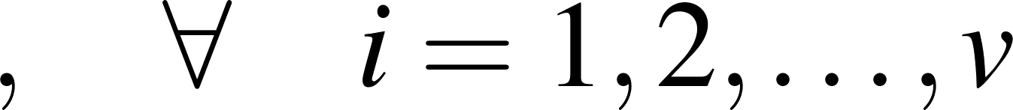


Ergodic condition for Open Networks
Ergodicity Theorem for Open QNs: Consider an Open Network. Let $λ_{i}^{in}$ and $λ_{i}$ be the mean arrivals rate from outside, and the mean flows of costumer flowing along the $i$-th resource.
Then let
An Open Network is ergodic iff, each node is ergodic as well, namely
Interpretation: If the QN is ergodic each node is flowed by a steady constant flow of customers at the steady-state regime
IMPORTANT: Notice that
is necessary but not sufficient condition for having an Open Network ergodic.
In addition is it need also that $ρ_{i}=\frac{λ_{i}}{μ_{i}}<1 ∀ i=1,2,…,v$ (nec. & suff. condition)
Notes:
However this is not enough …. in fact as we have seen… the traffic equation depends only by lambda not by mu….thus it can be proved that necessary and sufficient condition for an open network to be ergodic is that… not only this matrix is invertible but also that \lambda_i are such that lambda_i over mu_i are strictly lower than 1.
That means that an open QN is ergodic if and only, each queue is ergodic as well.

Slide 17
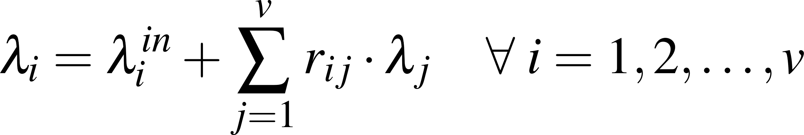

Stationary distribution of Open Networks
Jackson Theorem: Consider an ergodic open QN of $v$M/M/m nodes
Let $λ_{i}^{in}$ be rate of arrivals at node $i$from outside, $μ_{i}$ its mean service rate, and $λ_{i}$ its mean rate of arrivals satisfying
Then at the steady state the number of costumers in different nodes are independent. Thus, arrivals/departures to each node behaves as $Pois(λ_{i})$.
INTERPRETATION: This implies that, at steady state, each station behaves as an isolated queue despite the presence of both loops and connections.
Thus, the QN joint probabilities have the product form below
where
Notes:
Finally here we have the most important result of queuing networks that is called Jackson Theorem….In particular it says that in open ergodic QN of $v$Markovian nodes….at steady steady state we observes that arrivals are independent to each other. Then it follows that each queue behaves like an isolated queue with Poisson with rate $λ_{i}$
So…by this results implies that…. We have that although the flow lambda_i are not poissonian in general….at steady state they becomes poissonian….so the arrivals to each queue are independent as well….and thus due to the mentioned independence the joint probability of having a given distribution of costumers in the queue takes again the product form.

Slide 18
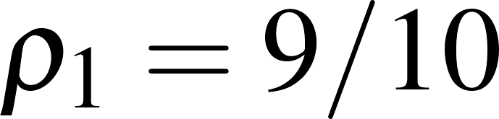
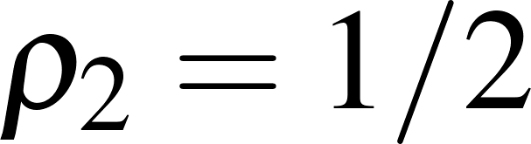
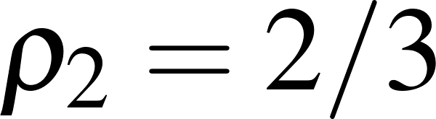
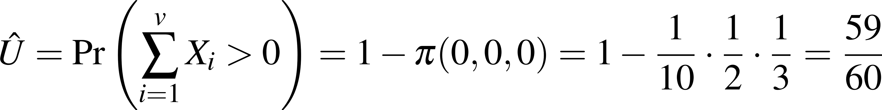


Examples (cont’d)
Example 5: Consider the open Jackson network of Example 3
where
In Example 3 we found that , then
Since the QN is ergodic from the Jackson Theorem one has
From that we can thus compute the QN utilization factor as
$$r_{10}=0.5$$
$$r_{20}=0.5$$
$$r_{30}=0.5$$
$$r_{12}=0.5$$
$$r_{23}=0.5$$
λ₁
μ₁
λ₂
μ₂
λ₃
μ₃
$$λ_{1}^{in}=7$$
$$λ_{2}^{in}=7$$
$$λ_{3}^{in}=14$$
$$r_{31}=0.5$$
Notes:
Here is just an application of the Jackson theorem where we first observe if the the network is ergodic and then we apply that theorem…..Look at here…. It is evident that the joint probability is the product between the three stationary probabilities associated with each queue.

Slide 19
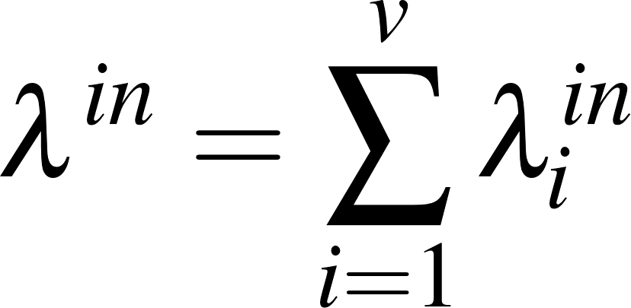
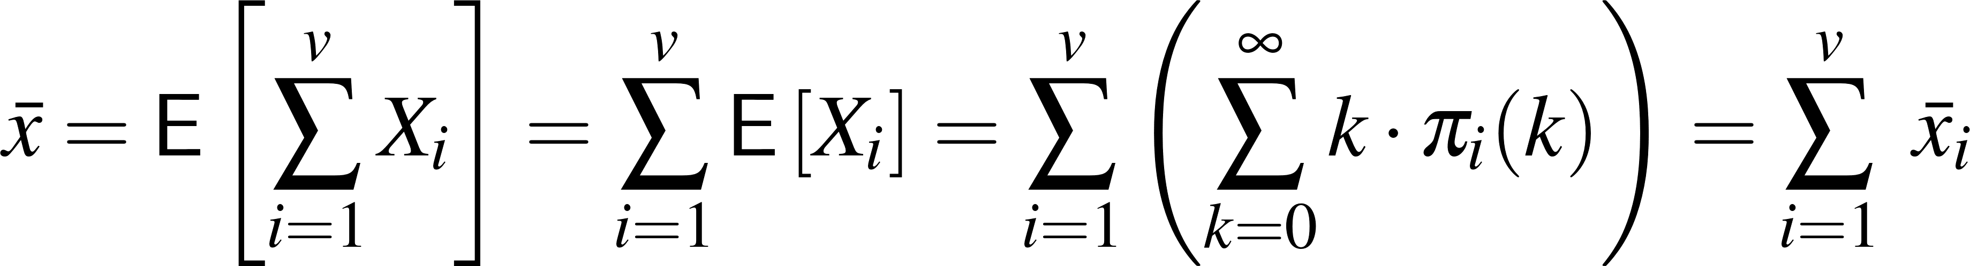
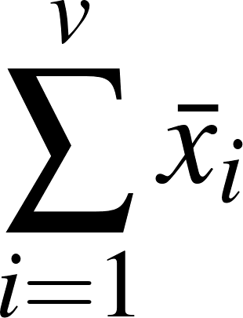
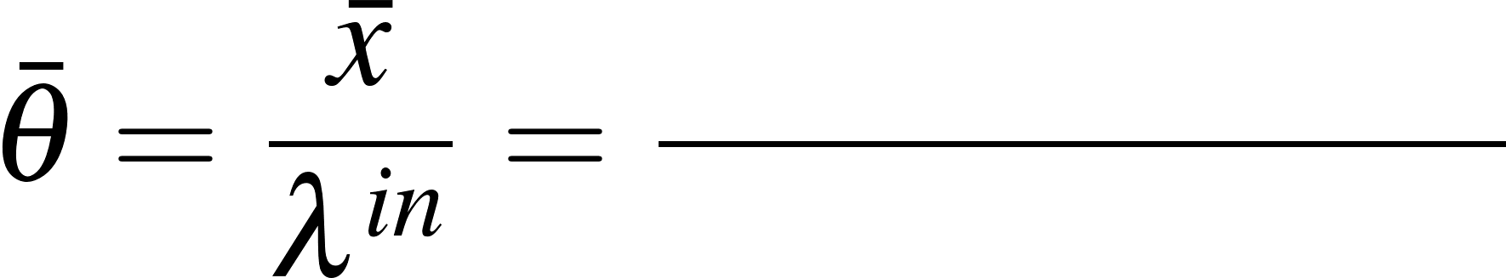
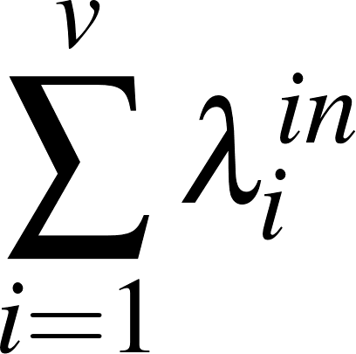

Little’s Law for Queuing Networks
Let us consider any arbitrarily complex Jackson network
If the QN is ergodic, then the Little’s Law holds in a wider-sense, namely:
Let $λ^{in}$ be the total rate of arrivals for outside to the network:
Let $\overline{x}$ be the mean number of costumer in the QN at the steady-state
Then the mean time spent by a costumer is QN is
Notes:
So….suppose that our network is open, and ergodic with a total arrival rate from outside equal to the sum of all the lambda_i ^in….
And because of at steady state queues are independent to each other…and thus the mean number of costumers in the network is equal to the mean number of costumers in each node…. Well in this case…. it results that the Littles law olds again…in accordance with this formulation….
So….at steady we have that the mean time spent by costumer to cross the network is equal to the ratio between the total arrival rate and the mean number of costumers in the system.

Slide 20
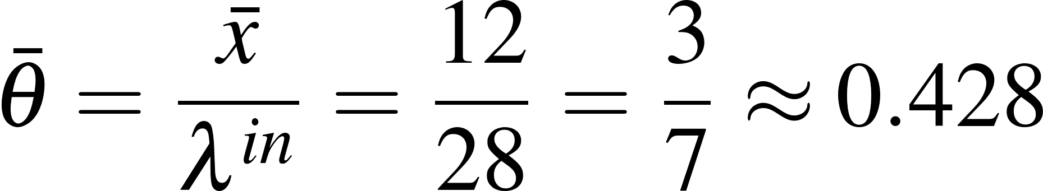



Examples (cont’d)
Example 6: Consider the Open QN of Example 3
where
Then
Then, the mean time spent by a customer to cross the network is
$$r_{10}=0.5$$
$$r_{20}=0.5$$
$$r_{30}=0.5$$
$$r_{12}=0.5$$
$$r_{23}=0.5$$
λ₁
μ₁
λ₂
μ₂
λ₃
μ₃
$$λ_{1}^{in}=7$$
$$λ_{2}^{in}=7$$
$$λ_{3}^{in}=14$$
$$r_{31}=0.5$$
Notes:
So here we have just an application of that law…in particular after having calculated the mean total number of costumers in the system that is 12…and the total arrival rate that is 28… well from the Little’s Law for QN we have that the mean time spent by a costumer to cross the network is bar x over \lambda_in

Slide 21
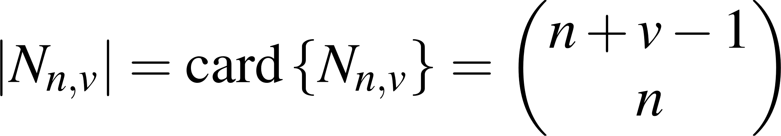


Markovian Closed QNs (or Gordon–Newell Networks)
Consider an Open Network, where costumers cannot enter or leave the system, thus
$$λ_{i}^{in}=0 , r_{i0}=0 , ∀ i$$
This is a:
Closed QNs are used to model a QN in which the #customers in the QN is time-invariant
Let $n$be #costumers. Let $v$ be the #nodes. Let $N_{n,v}$ be state-space of the QN.
$N_{n,v}$ considers all the possible arrangements of the $n$costumers into the $v$ nodes
The cardinality $N_{n,v}$ can be derived by the formula #combination with repetition
Closed Queuing Network (or Gordon-Newell Networks)
State space $N_{n,v}$of a closed QN
Notes:
So let us now focus our attention back to the closed networks we have mentioned in the first part of the lecture….well….
It results that open Jackson Network, where costumers cannot enter or leave in the system….that means a network where that both the $λ_{i}^{in}$ and the routing probabilities $r_{i0}$ are zero…. Well this a closed Jackson Networks…..
Let us further note that some books to closed jackoson network also as Gordon-Newell network, where Gordon a newell are the name of the researches that formalize the foundamental theorem for this class of closed networks.
Let us now mention the aspects that makes the analysis of closed network much more complicated w.r.t. that of open newtorks…the first aspect is that….because of the finite number of costumers in the system…to study this type of queues we always have to evaluate all the possible combination of costumers in each queue…that represents the state space of the associated MC…
Fortunatelly we have that…at least the number of combination is of easy computation by means of the formula that counts all the possible arrangement of n items over v box….that is also known as the formula for the number of combination of with repetition….that is this….
Let me do an example…..

Slide 22
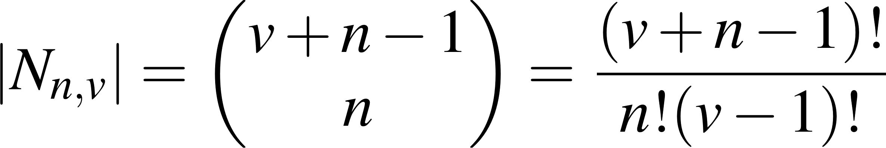
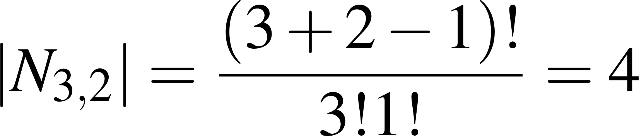

Examples (cont’d)
Example 7: Consider a closed QN with $v=2$ stations and $n=3$costumers
The state space of this closed QN counts all the possible customer arrangements where $n=3$, over $v=2$ stations/nodes
Then, it results that
Notes:
Consider, for instance, a closed QN with $2$ nodes $3$costumers…so the state space of this stochastic system is:…. 3 costumer in the first or three in the second…or two in the first and one in the second…or the vice-versa….
Well look at….by letting v equal to 2 and n equal 3 here …we correctly obtain 4.

Slide 23
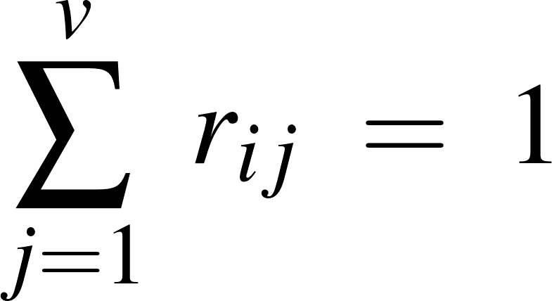

Markovian Closed QNs (cont’d)
A Gordon-Newell Network is a closed QN of $v$ M/M/m resources where:
The node’s service-times are independent and Exponentially distr. with mean $1/μ_{i}$
The routing probabilities satisfies that
  where $r_{ij}$ is probability a customer after completing a service at node $i$ requests a service to node $j$, while it always results $r_{i0}=0$ (i.e. no jobs can leave the QN)
IMPORTANT: The node’s costumer flows $λ_{i}$ are not independent (thus not Poisson) because arrivals and departures to each node depend to the actual costumer's deployment
Remark: For open QNs we seen that if each queue is ergodic, at least at the steady-state (i.e. as $t→∞$) they behave as independent. This is not true for closed QNs
Indeed, since $\sum_{i}{x_{i}(t)}=n ∀ t≥0$, the probability to have an arrival in node $j$ is non-zero if and only there are costumers in one of the queues $i$with a non zero $r_{ij}$
Notes:
The second aspect that makes the the study of this queue harder is that now the state probabilities are always not independent….in fact because of no arrivals form outside are allowed…then the probabilities of having some arrivals to a queue clearly depends on the actual costumer distribution.
Let me do an example…for instance …imagine a cyclic network with three queues…(DISEGNALA)…and assume three costumers here and zero here and here….well…the probability of having 1 costumer in the midle queue is 0…but…of course… once some costumers arrives in the first queue…well the same probability will become nonzero

Slide 24






CT-MC modelling of Closed QNs
Example: Consider the 2 arrangement of customers on a closed QN
Example: Suppose only the 20% of departures from node $k$ may reach node $j$ ($r_{kj}=0.2$)
Suppose node $k$ is a M/M/$3$ queue with service rate $μ_{k}$, and that $x_{k}=5$,
It results: $γ_{kj}=3⋅μ_{k}$
It is easy understand that every generic closed QN can be modelled by means of a finite-state CT-MC which transition rates can properly be evaluated by means of:
$r_{kj}$ be the routing probability from node $k$ to node $j$
and let
$γ_{k,x_{k}}$ be the departure rate from $k$| (given that) it contains $x_{k}$ costumers
the routing probabilities $r_{kj}$
the node’s service rate $μ_{k}$
the actual #costumers in the node $x_{k}$
the node’s #servers $m_{k}$
Notes:
So….how to study a Gordon–Newell Networks? Of course by means of CT-MCs… In particular we have that…
Let x \prime like here….be a generic arrangement of costumers among the $v$ stations and such that its sum is clearly equal to n…. So in a closed network transition probabilities are evaluated in accordance with this picture if$r_{kj}≠0$ it means that costumers after having recived the service in node k can join the queue of node j….let us forther note that x prime and x second differes only by one costumer that now is moved to state k to state j….
In particular we that if we denoted the total throughput from station $k$as $γ_{k,x_{k}}$…well the rate for this arc is r_kj times $γ_{k,x_{k}}$

Slide 25
















Examples (cont’d)
Example 9: Consider a closed QN with an M/M/$m_{1}$ and an M/M/ $m_{2}$ node
Since $v=2$ and $n=3$its sample-space $N_{3,2}$ is the same of Example 8
Due to the given routing probabilities the following ergodic CT-MC takes place
$$r_{22}=1−p$$
$$μ_{2}$$
$$μ_{1}$$
$$r_{12}=1$$
$$r_{21}=p$$
$$n=3$$
Notes:
So here we consider a closed network consisting of a M/M/1 and an M/M/2 station….so here we have its sample space ….and its routing probability matrix….look at…from node 1 we can move only to node 2 whereas from node 2 we can move either to node one with probability p…or follows this loop with probability 1-p
Here is the transition graph associated with the resulting CT-MC…this MC is clearly ergodic because the graph is strongly connected and has a finite number of states…let us further note that form state 03 we can move to state 12 with a rate that is p times 2mu …because p is the routing probability r21 whereas… the 2 is because node 2 has 2 servers an more then 1 costumers…in the same way we mode also with transition….whereas from 21 to 30 the rate is only p times mu2 because here we have only costumer….on the bottom we have only mu1 because the first station has only 1 server….and also because r12=1.
Given that we have that the stationary probability distribution for this system can be easialy solved by evaluating the usual linear system…where Q is here….whereas this is is resulting distribution.

Slide 26
















Ergodic Gordon–Newell Networks
If $n$ is large, verify if a closed QN is ergodic passing through its CT-MC may become a computationally inefficient (the $Q$ size may be large)
An easier way to determine if the closed QN is ergodic is by means on consideration on the traffic equations, and/or on its graphical representation.
Theorem: A closed QN is ergodic if and only if the routing probability matrix $R$ has a single eigenvalue in $λ_{1}=1$.
Remark 1: For a closed QN $R$ is row-stochastic
If the multiplicity of $λ_{1}=1$ is $≥2$, this means there 2 or more absorbing node, e.g.:
Example:
2 abs. nodes
$2n$ many absorbing states in the resulting
CT-MC model $\left\{\begin{aligned}(0,0,0, a) \\ (0,0,n−a,0)\end{aligned}\right\} ∀ a=0,1,2…n$
$$0.2$$
$$μ_{3}$$
$$0.3$$
$$μ_{1}$$
$$μ_{2}$$
$$1$$
$$0.3$$
$$μ_{4}$$
$$0.2$$
$$n=cost.$$
Notes:
Ok…so…we have seen that after having draw the transition graph associated with the MC that model the considered closed network…we have all the tools to study this system….in particular we have by invoking the graphical or the eigenvalue criteria the ergodicity of the system can easily studied….
However….notice that similarly with the open networks where the ergodicity can be studied by means of R……well we can write also for a closed network the traffic equations…
Well in this case it results that necessary and sufficient condition for a closed Gordon-Newell Network to be ergodic is that the routing probability matrix $R$ has a single eigenvalue in 1
Well in this case we have that the advantage to study the network erogodicity by means of matrix R…instead of by means of matrix Q of the associated MC is that matrix R has a size equal to the number of nodes…whereas matrix Q…even if the the considered network has a few nodes and a small population …well…the size of the transition rate matrix $Q$ is much larger then the size of $R$ that is instead equalt to $v$.

Slide 27










Examples (cont’d)
Example 9: Consider a closed QN with an M/M/$m_{1}$ and an M/M/ $m_{2}$ node
The same result can be derived by the criteria for finite CT-MCs
$$r_{22}=1−p$$
$$μ_{1}$$
$$μ_{2}$$
$$n=3$$
$$r_{21}=p$$
This QN is ergodic because $R$ has a single eigenvalue in 1
$Q$has a single eigenvalue in 0
Notes:
So here we shows that the eigenvalue criteria on matrix Q…and that on matrix R provided the same result….in particular we have that the network is ergodic because Q has a single 0 eigenvalue….however look at R…as expected it has only a single eigenvalue on 1.

Slide 28



Stationary distribution of Closed Networks
The steady-state joint probabilities of a closed QN can be derived by passing through the analysis of its associated finite-state CT-MC
Here, differently to open QNs the steady-state probabilities do not take a product form
However, despite the node’s dependence, if the closed QN is ergodic, the joint steady-state probabilities takes as well product-like form
$$μ_{1}$$
$$μ_{2}$$
$$n=3$$
$$r_{21}=p$$
(nodes are not independent)
(see GN Theor.)

Slide 29










Stationary distribution of Closed Networks
Gordon-Newell Theorem: Consider an ergodic closed QN of $v$ $⋅$/M/$m_{i}$ node.
Its joint steady-state probability distribution takes the following product-like form
where $κ$ is a normalization constant that is derived by the next constraint
while let
then $β_{i}(x_{i})$ are
let
let
If the $i$-th node is a $⋅$/M/1
If the $i$-th node is a $⋅$/M/$m_{i}$
Notes:
If so…we are now in position to present the so-called Gordon-Newell Theorem…That is the theorem that allows to derive the steady state probabilities of a generic ergodic closed markovian Network…
Well.. In particular it results that… the probability of having a particular distribution….like….x_1 costumers in node 1…x_2 in node 2…and so on takes the following product form….. where we can note that…except to a normalization constant denoted by \kappa, the functions \beta_i we seen before give us an information on the probability of having a particular distribution of costumers in the system.
In particular it results that…although the now the nodes of the network cannot behaves as independent….their stationary probability has a product form.
Let us further note that the constant kappa is derived by the following costraints that simply states that the sum of probabilities of each arrangement of costumer in the network must be 1.
....whereas here…we can see again the functions beta presented in the previous slide…
Ah…just for information I’ve included the this theorem in the famous table that you could you use to solve the assignment.

Slide 30


Stationary distribution of closed QN
To evaluate the limiting distribution of a closed QN by means of the GN Theorem we need:
The steady-state departure rates by solving the QN traffic equations, i.e,
Then, for each node $i$ we must determine its own steady-state traffic intensity
Finally, we must determine the functions $β_{i}(x_{i})$, $∀ x_{i}≤n$, as follows:
If the $i$-th resource is a $⋅$/M/1
If the $i$-th resource is a $⋅$/M/$m_{i}$
Notes:
Let us now focus our attention to the evaluation of the Stationary distribution of a Gordon-Newell Network.
However…before that…let us first solve the linear system associated with the traffic equations….look at here…now the term lambda_in that used to appear on an open network now is identially zero….
…..after that let us derive the traffic intensity within each node …that is rho_i that is equal, as usual, to lambda_i over mu_i….
Then…by denoting x_i as the number of costumers in the $i$-th node, where of course x_i il smaller or equal to n….that is total number of costumers available in the system….we can now to derive the following functions beta….which meaing will be more clear later.
In particular we have that if a node has a single server we use this formula…whereas if a node has many servers we use this formula…. Wheres beta is equal to this…. if x_i is smaller or equal to the number of servers….otherwise ….we use this alternative formala…

Slide 31








Examples (cont’d)
Example 9: Consider a closed network with a M/M/1 and a M/M/2 station
By selecting for simplicity $α=2$ then
$$r_{22}=1−p$$
$$μ_{1}$$
$$μ_{2}$$
$$n=3$$
$$r_{21}=p$$
Since $R$ is row stochastic, there are infinite many solutions in the form
Notes:
So here we are going to verify if the stationary probabilities derived during the last lecture and associated with this closed network coud be also derived by means of the GN theorem.
So….the first step is to derive a solution for the traffic equation…notice that because of R is row stochastic we have that its solution is in general undermined.
However for our purposes we can simply take one of the possible feasible solutions, for instance the one that simplify our counts…. I mean …for instance by letting alpha=2 we have that lamnda is (1,2)
.
Then we can now compute the rho….notice that now the fact that rho is smalle or larger then one is no more a problem becuyase of a closed network have a finite number of states.

Slide 32


Examples (cont’d)
Example 9: Consider a closed network with a M/M/1 and a M/M/2 station
The first queue is an M/M/1 thus
The second queue is an M/M/2 thus
$$r_{22}=1−p$$
$$μ_{1}$$
$$μ_{2}$$
$$n=3$$
$$r_{21}=p$$
Notes:
After that we can compute our the beta functions...
Take care here…. For node one we use the formala for M/M/1 queues
whereas we use that for M/M/2 nodes for beta 2……because node to has 2 servers…. So…if in the node there are less than 2 costumers we get this…otherwise by means of this formula we obtain this…

Slide 33







Examples (cont’d)
Example 9: Consider a closed network with a M/M/1 and a M/M/2 station
From the product form of stationary probabilities for Gordon-Newell QNs on has that
$$r_{22}=1−p$$
$$μ_{1}$$
$$μ_{2}$$
$$n=3$$
$$r_{21}=p$$
Notes:
Then…. From the beta functions that are reported here for the sake of completeness…. And by means of product form for the stationary probabilities of a closed network we derive these probabilities where the normalization factor kappa is still unknown…..however…as I told you…because the the sum of all the probabilities must be one…..so by means of this equation ….GIRAAAA

Slide 34







Examples (cont’d)
Example 9: Consider a closed network with a M/M/1 and a M/M/2 station
From the $κ$ definition, one has that
Then by substituting on $κ$ one derives
Remark: The GN-Theorem’s advantage is that it allows to determine the QN’s steady-state probability by means of an efficient recursive algorithm and without passing through its CT-MC modellization, which can be very hard, for large QNs
$$r_{22}=1−p$$
$$μ_{1}$$
$$μ_{2}$$
$$n=3$$
$$r_{21}=p$$
(which corresponds to what obtained
by solving its balancing equations)
Notes:
We derive the actual value of \kappa and thus also the stationary probabilities which value is the same that we derived by means of the associated CT-MC…..

Slide 35
Extension to not markovian networks
Attempts to extend these results to more general QNs, are currently under study.
However, due to the problem complexity, at the moment, the most general and worth to mention result comes from the 1975
The BCMP theorem extends the class of QN solvable by a product-like form to:
Resource allocation problems or QoS comparisons involving other types of Queues or Network of Queues are instead solved by means of simulations
Baskett, F., Chandy M., Muntz R., Palacios J., “Open, closed, and mixed networks with different classes of customers”, Journal of ACM, Vol. 22, pp. 248-260, 1975.
Nodes with arbitrarily distributed service times (not only Exponentials)
Costumers belonging to different classes (i.e. needs, behaviours, or priorities)
Different service policies then the conventional FIFO discipline
To this end see, e.g., the SimEvents® Matlab/SIMULINK Toolbox
Url: https://it.mathworks.com/discovery/queuing-theory.html
Notes:
Finally we conclude this module…and the lectures of this course by saying that in the case were the network is markovian its study becomes much harder…….
In particular among the several results available in the literature one of the most powerfull if the BCMP theorem…that provided a different product form for the stationary probabilities of QN either open…closed or mixed in which:
Fisrt the service time can be arbitrarily distributed …thus not necessarily exponential….
Sencod, we have that costumers may belongs with different classis and priorities…
And the BCMP theorem also consider the possibility to have different discipline with the respect to the classical FIFO policy
Lastly …if instead we face off with queues or network of queues that are neither markovian nor such that the BCPM theorem can be applied…well the use of intensive MONTE-CARLO simulation is mandatory.
To this end I would like to concluded this module by mentioning that for our purposes, and of course for those that are interested…. In most recent version of Matlab it is available the SimEvents tools that allows to simulate queues and network of queues very easily in Simulink.

Slide 36



