Slide 1
Reményi Péter, PhD
University of Pécs
Hungary
remko@gamma.ttk.pte.hu

Slide 2
About me
Master of geography and history
2009 PhD – geography. Title: Political Geographical Consequences of the Break-up of Yugoslavia and it’s Impact on the Settlement System of the Region
Associate professor at the University of Pécs, head of Department of Political Geography, Regional and Development Studies
Researcher at HUN-REN Center for Economic and Regional Studies
Main area of research&education: political geography, geopolitics, border studies, geography of Central and Southeastern Europe

Slide 3
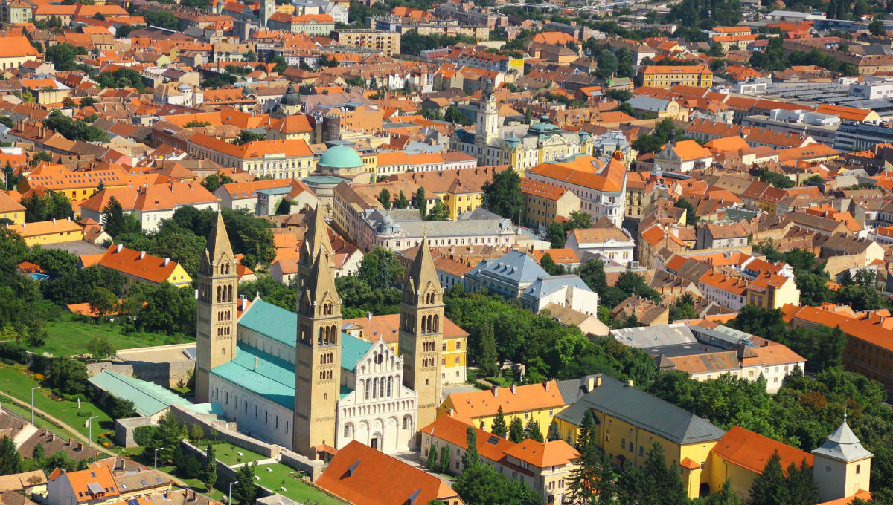
My town – Pécs
(Pečuh/Pečuj, Fünfkirchen)
The fifth largest in Hungary ~ 150.000
At the foothills of Mecsek (coal&uranium – mining heritage)
University town
Diverse ethnic/cultural background
UNESCO WH site
2010 European capital of culture

Slide 4
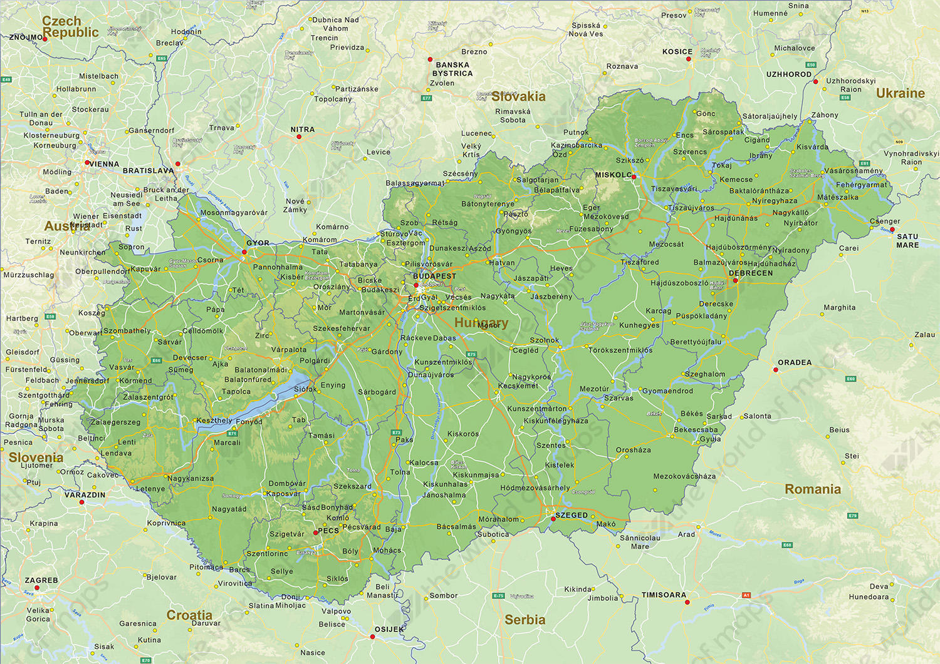

Slide 5
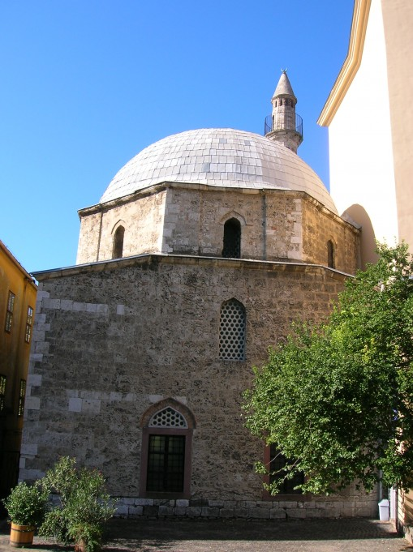
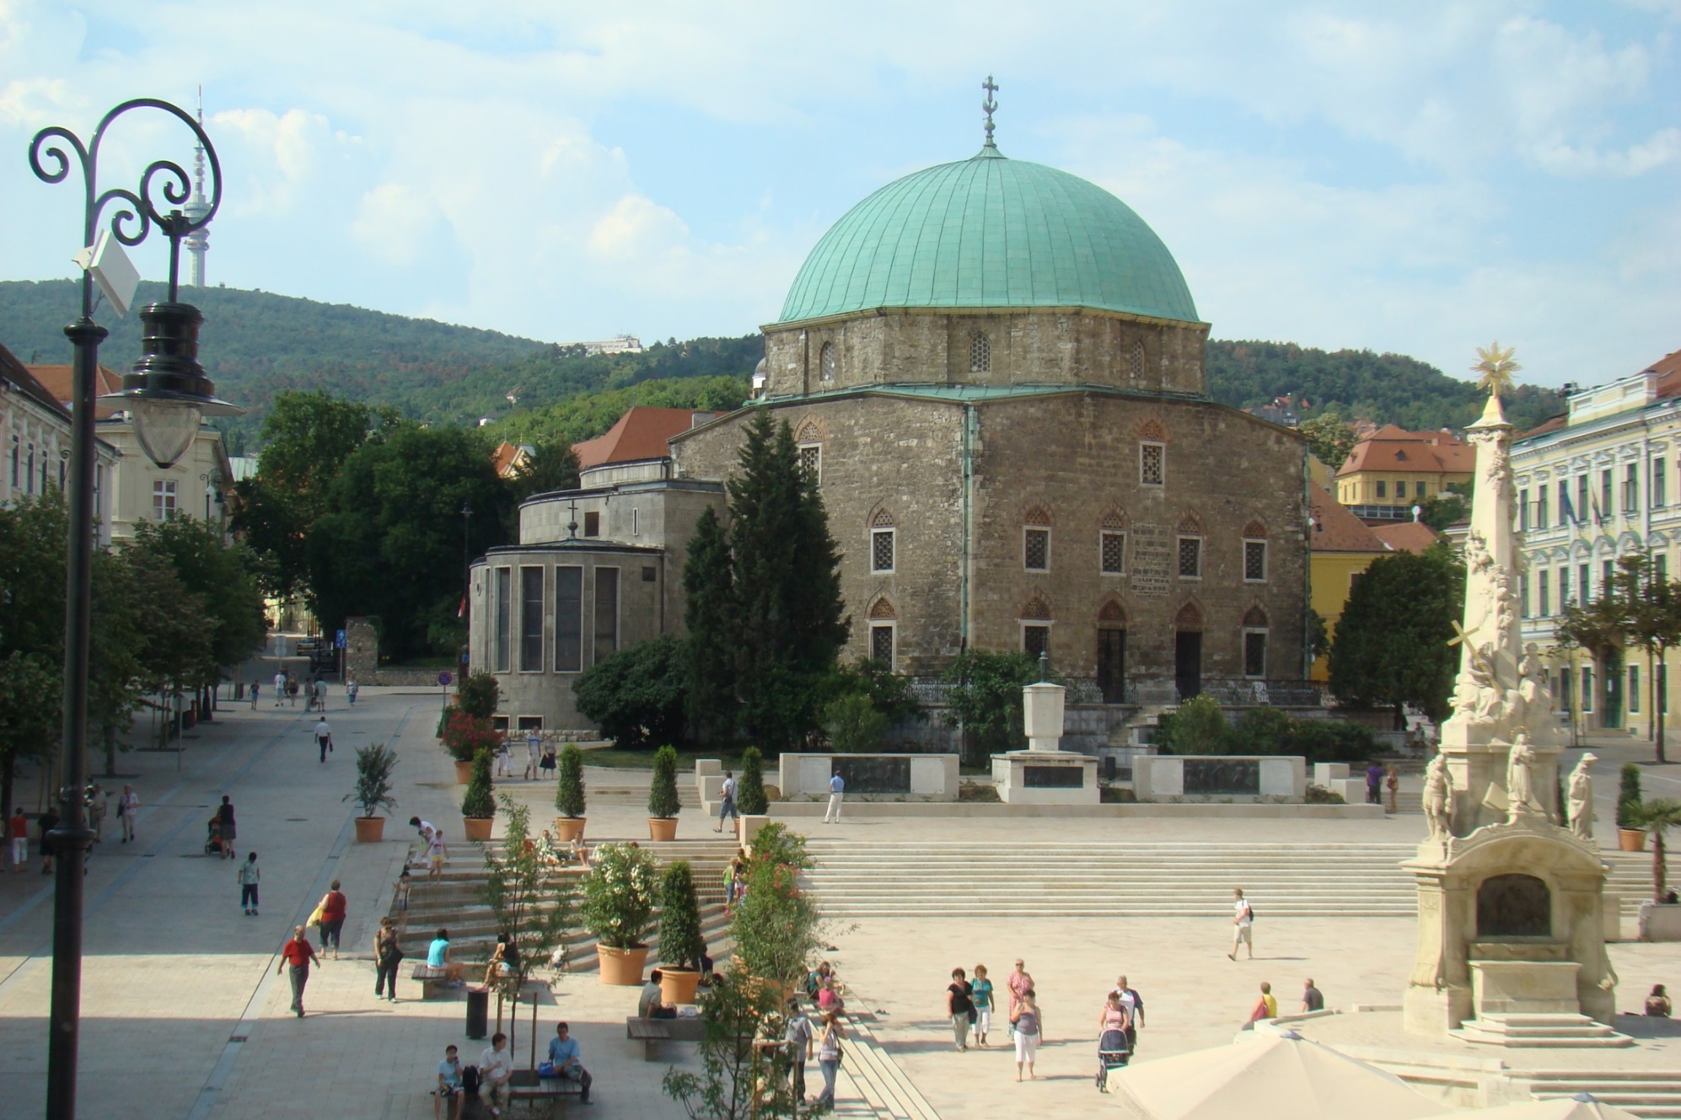
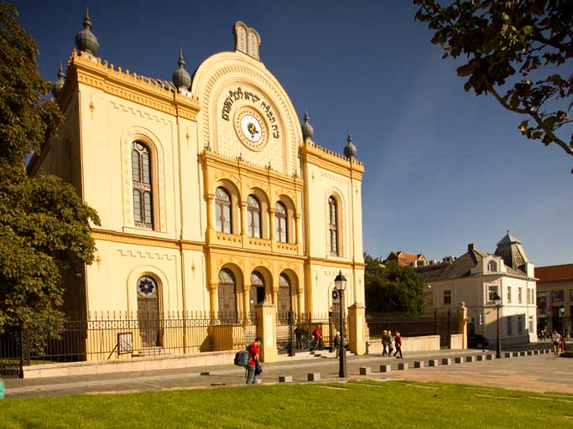
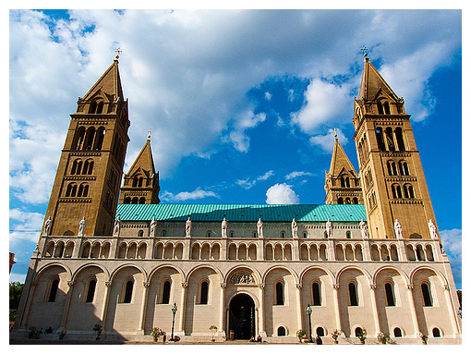
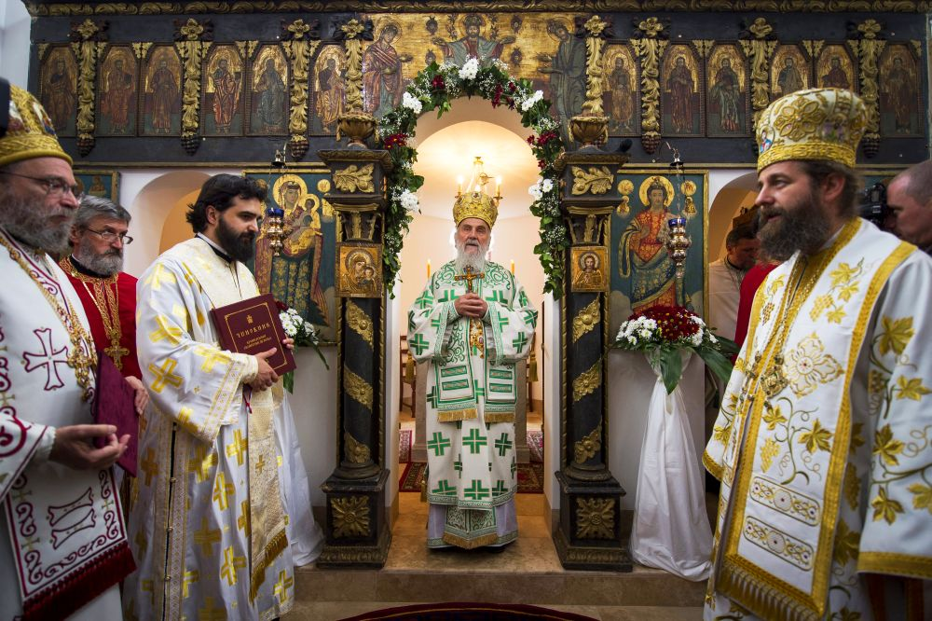
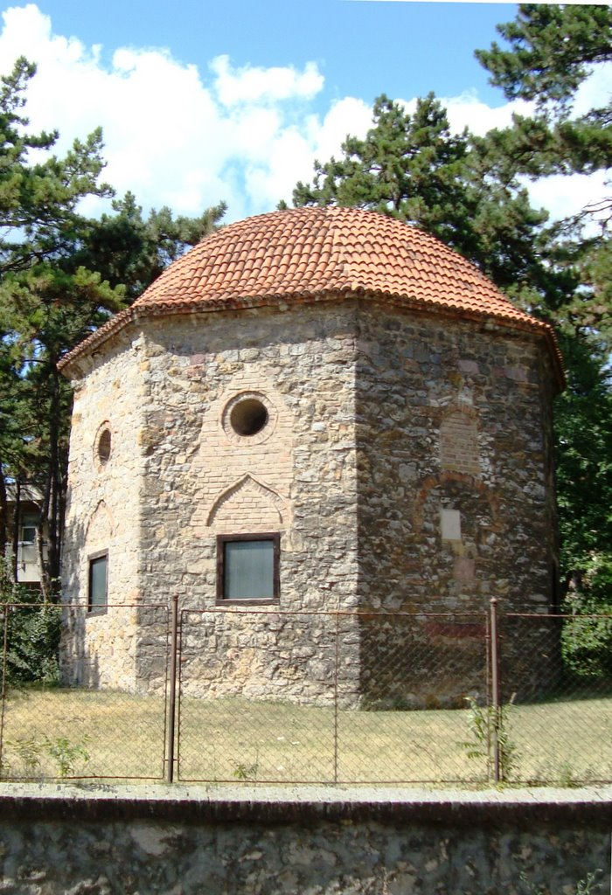
Diverse cultural heritage

Slide 6
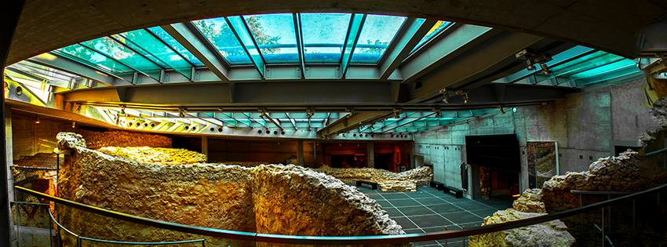
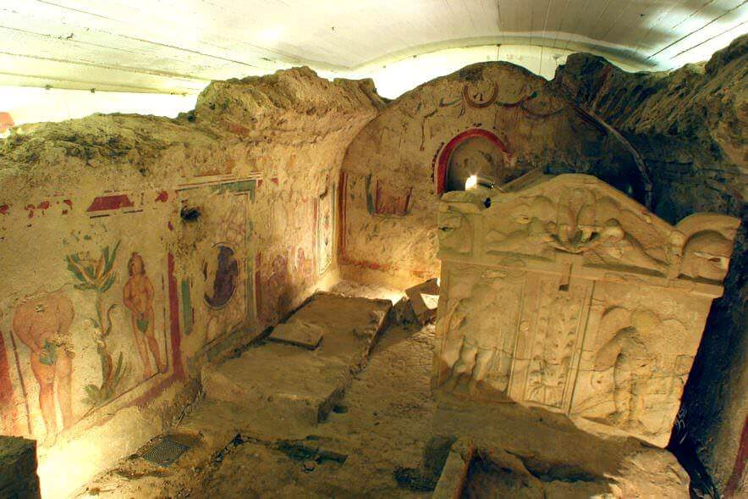
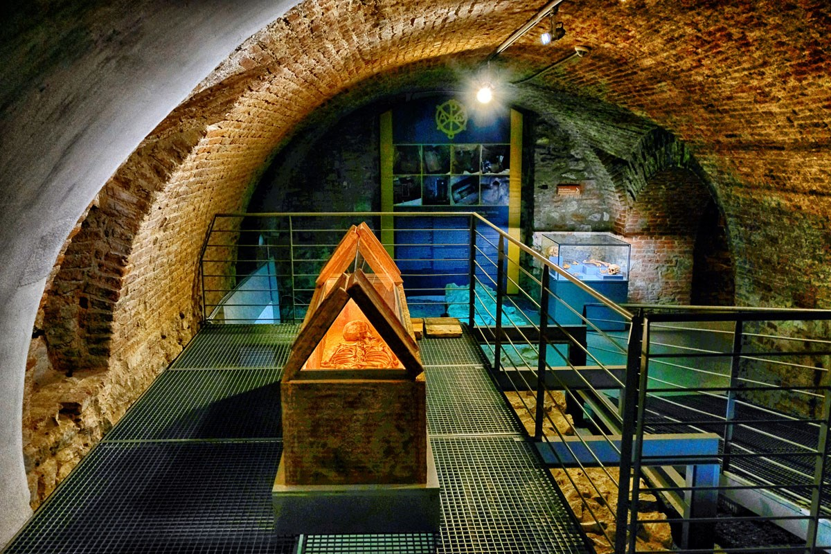
UNESCO WH

Slide 7
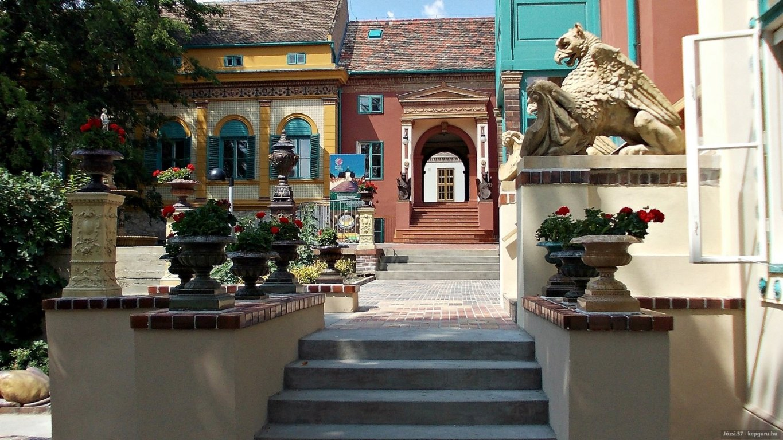
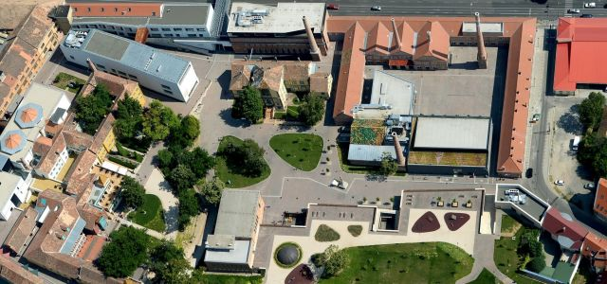
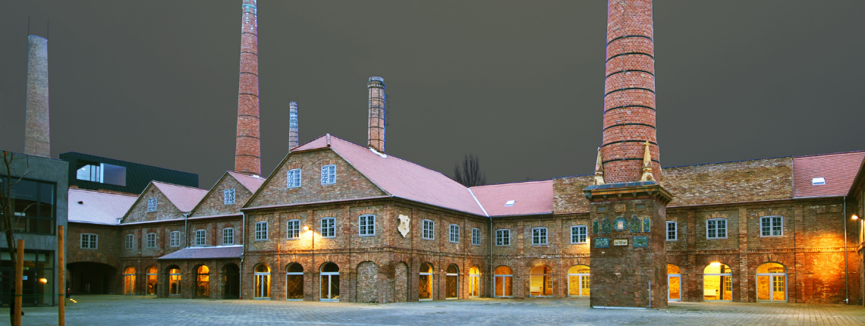
Zsolnay quarter – brown field rehabilitation

Slide 8
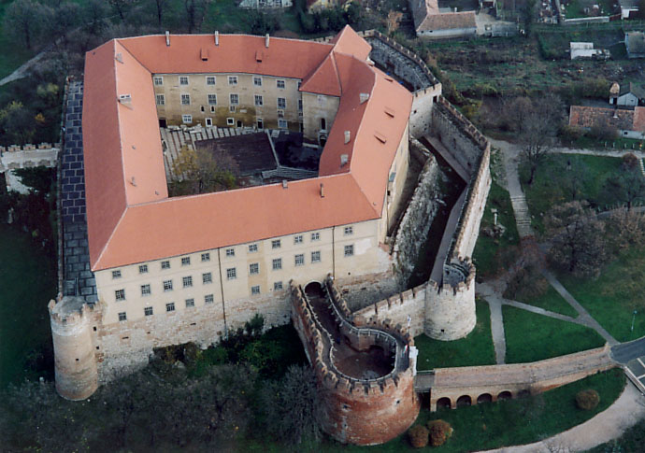
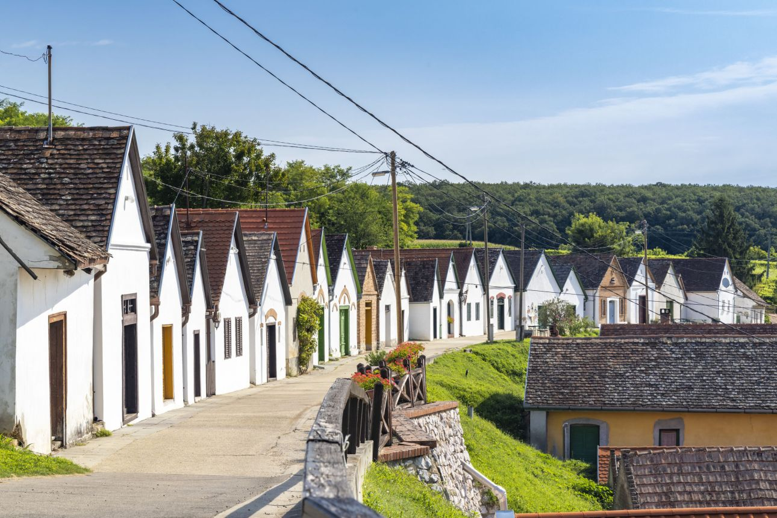
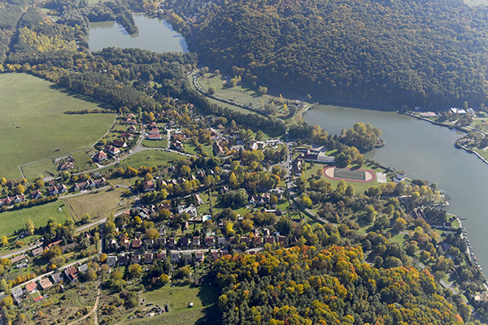
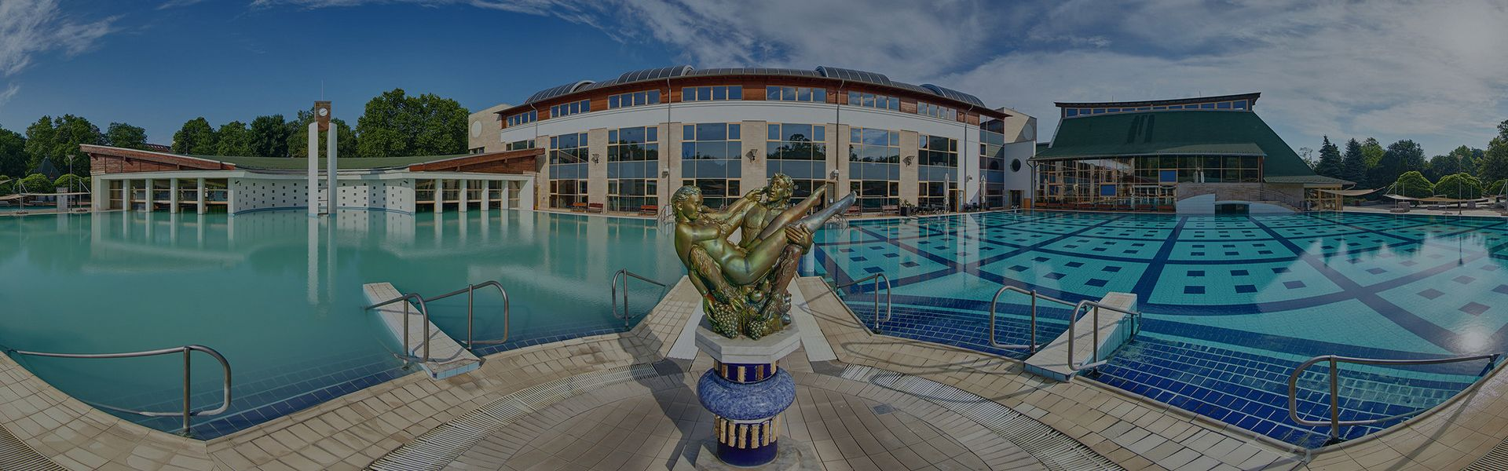
Around Pécs
Villány – wine
Harkány – spa
Szigetvár, Siklós – castles
Orfű – nature

Slide 9

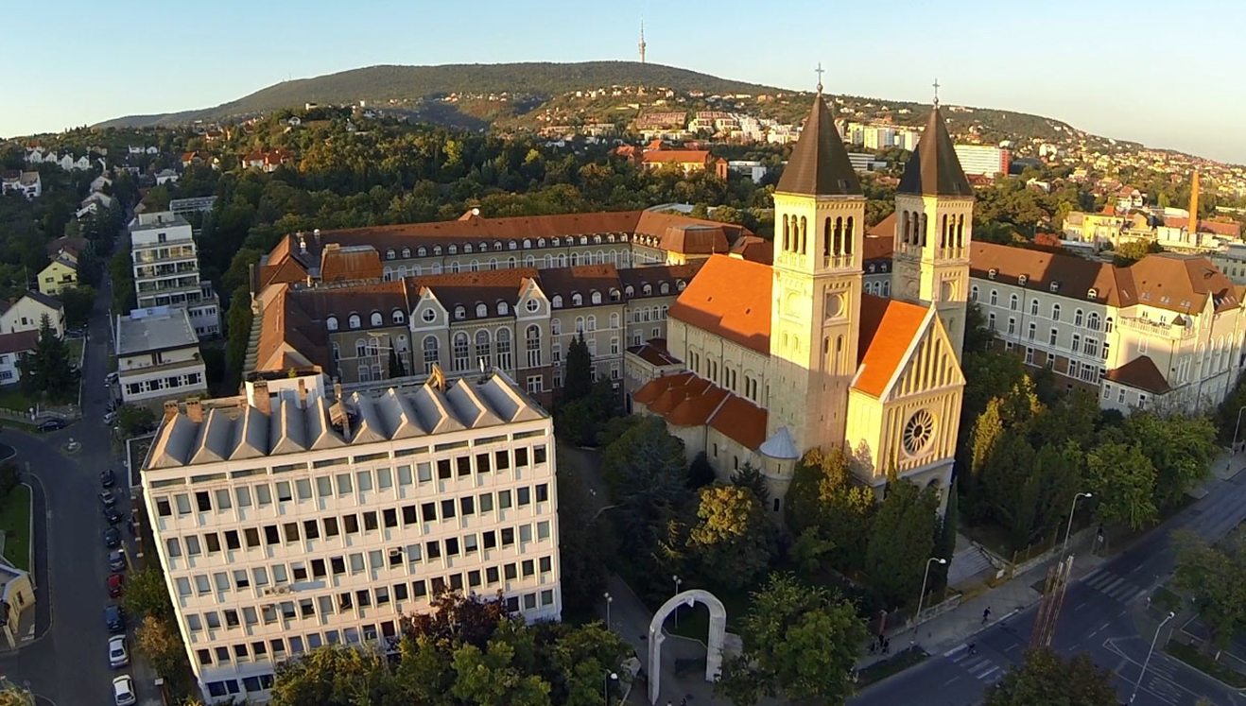
My university
The oldest in Hungary – 1367
One of the largest universities in Hungary
10 faculties, 1400 lecturers, 20.000 students
of which around 5000 international

Slide 10
Geopolitics in Central and Eastern Europe

Slide 11
Where is Central Europe?

Slide 12
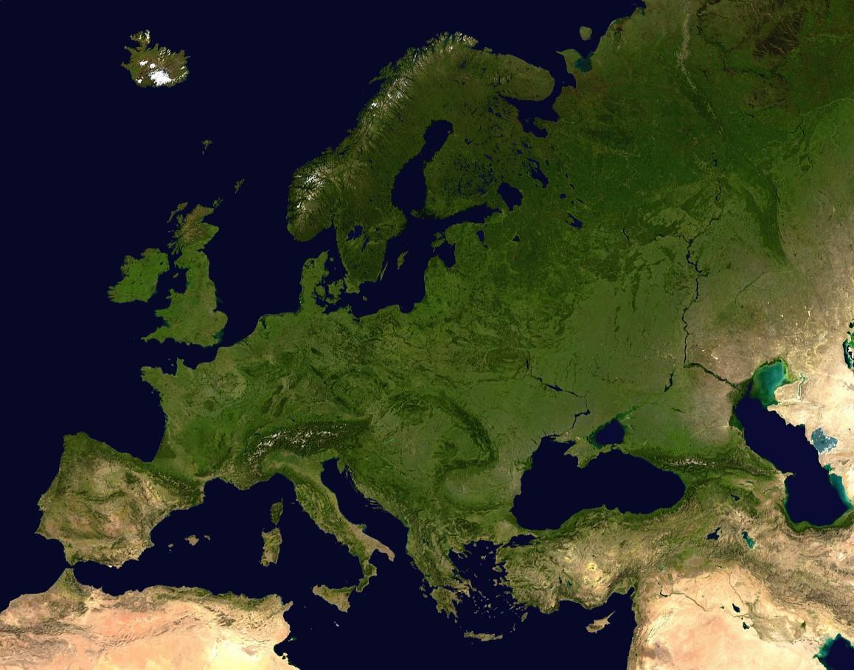
What category it is?
Geographical?
Historical?
Cultural?
Political?
Else?

Slide 13
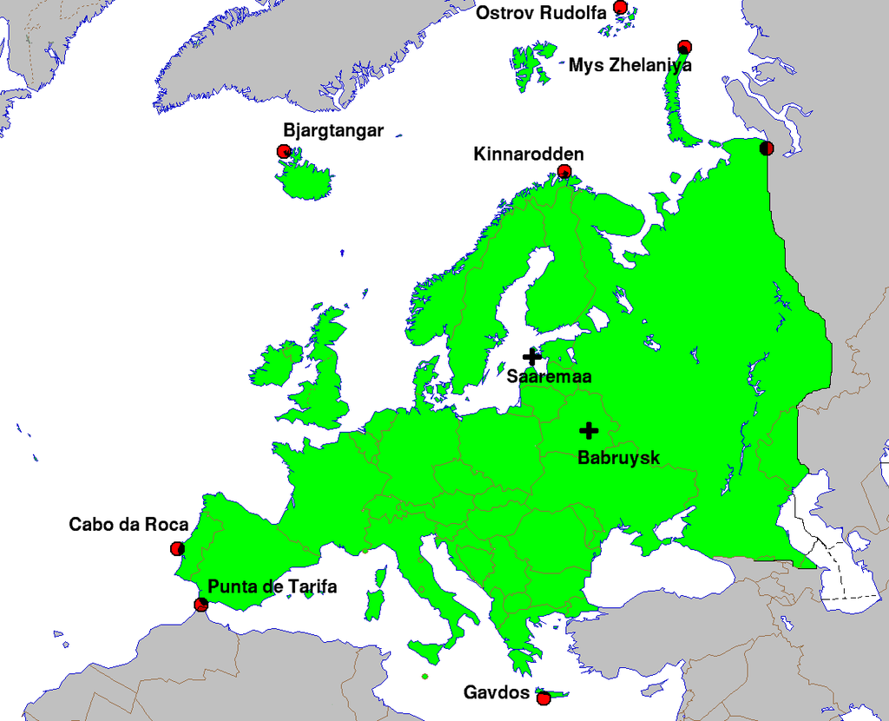
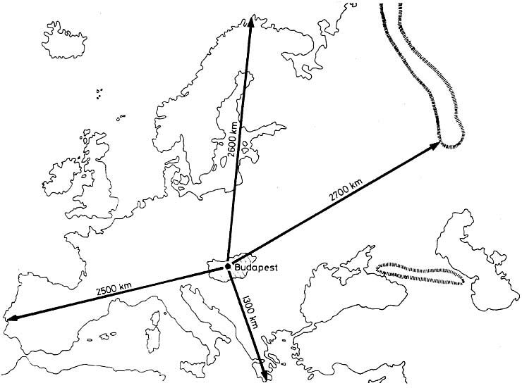
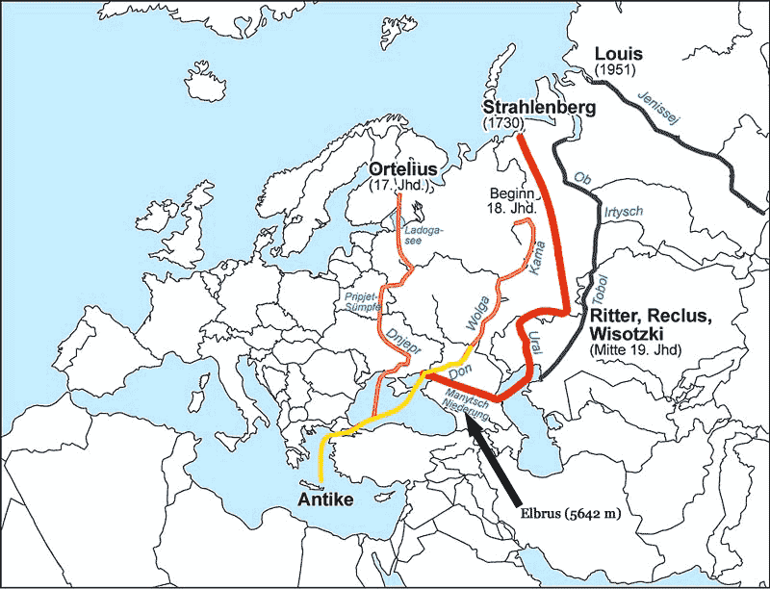
Where are Europe’s boundaries?

Slide 14
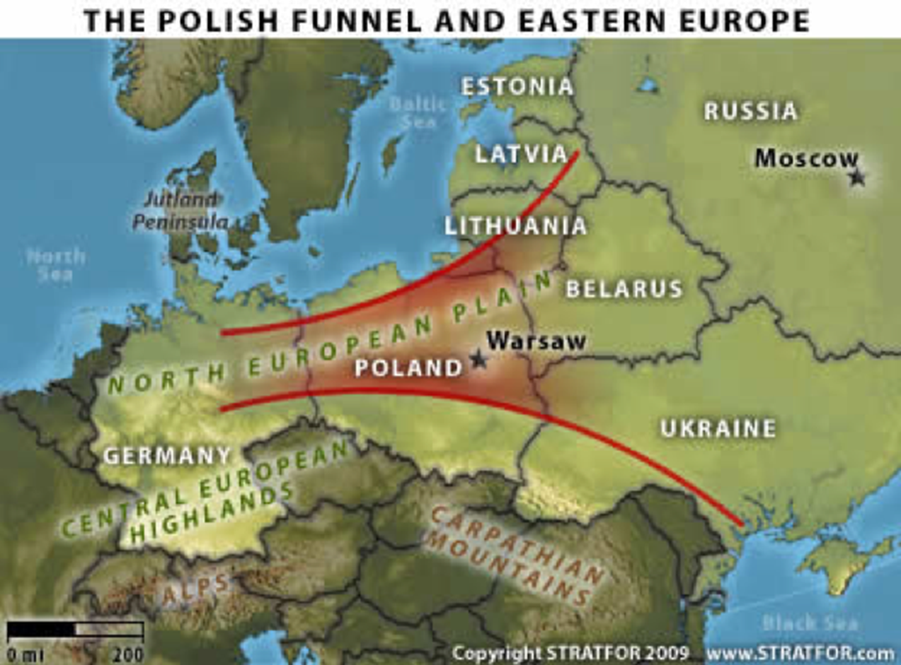
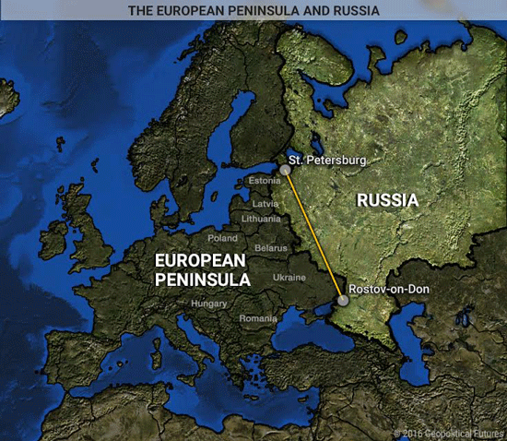
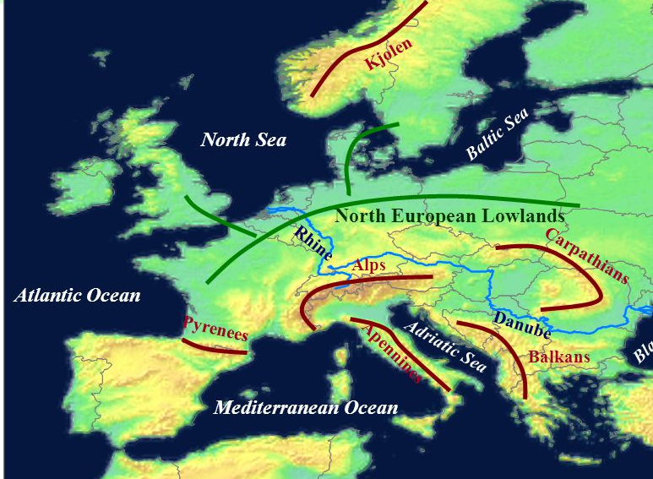
The geopolitical boundary

Slide 15
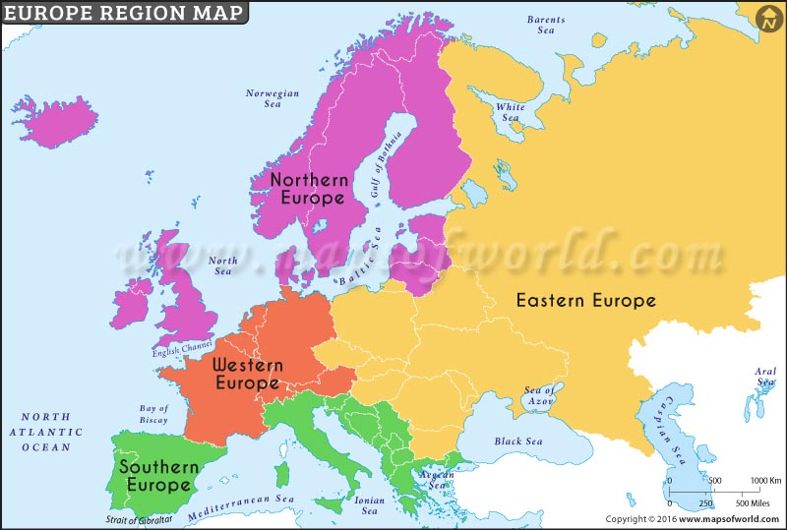
According to directions

Slide 16
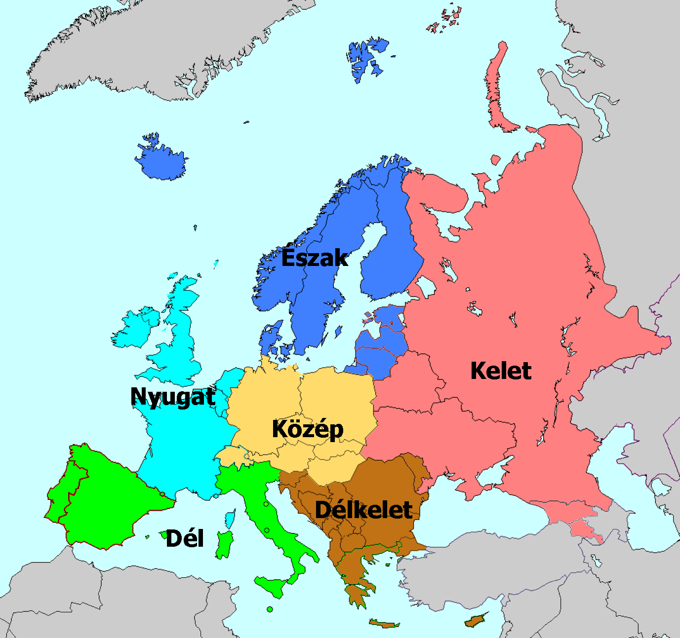
Perhaps the most precise
EE ->WE
EE ->NE
ECE=V4
WCE=German EU
SEE-new

Slide 17
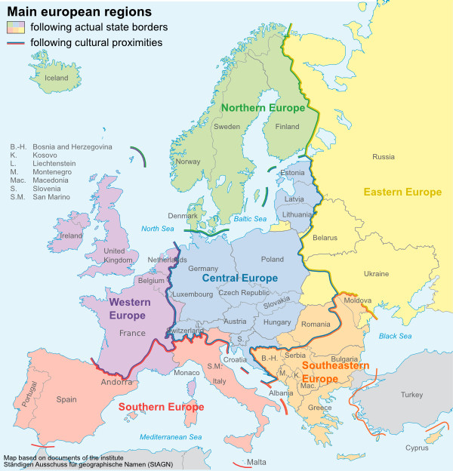
State border vs. Cultural boundary

Slide 18
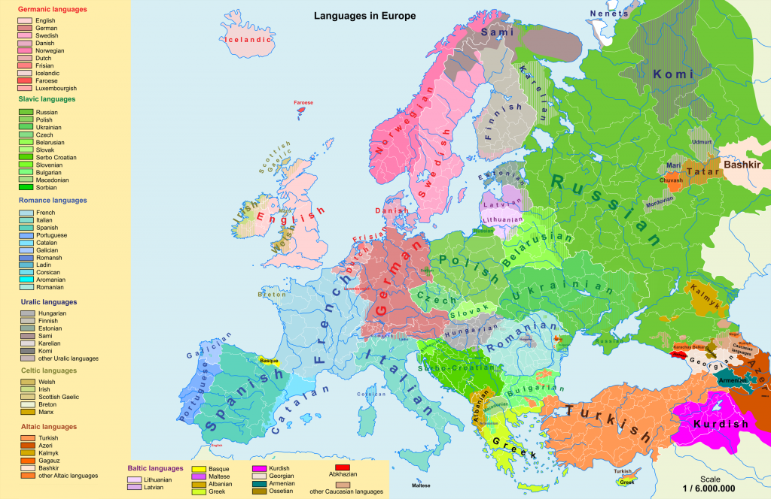

Slide 19
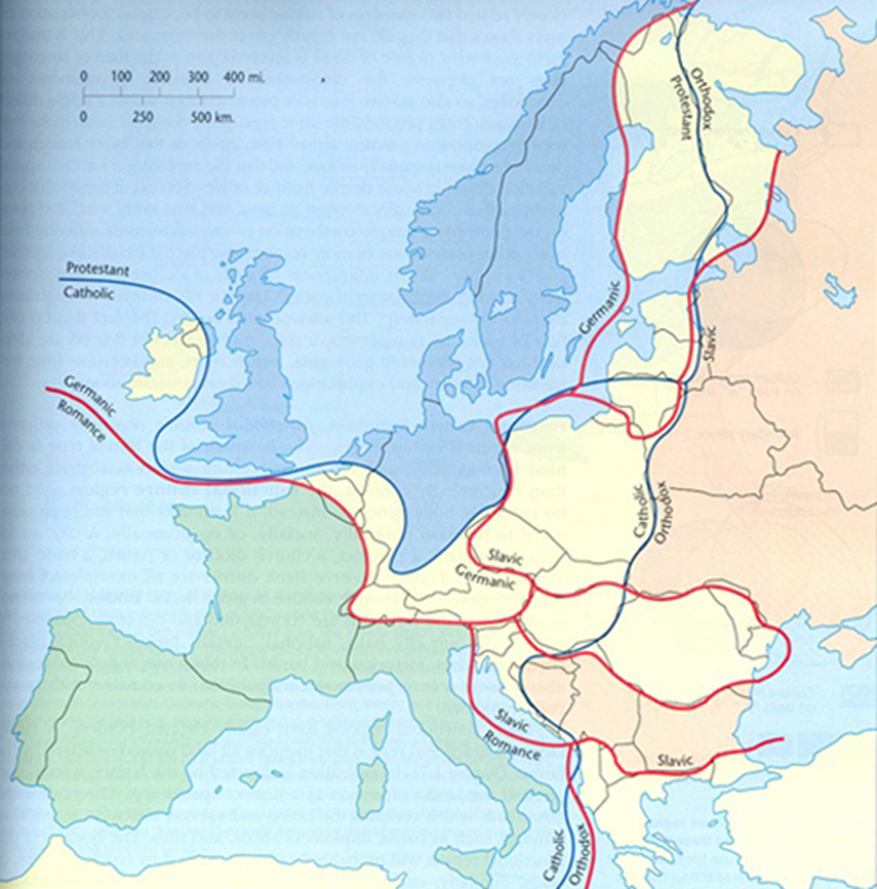
Religious/cultural faultlines

Slide 20
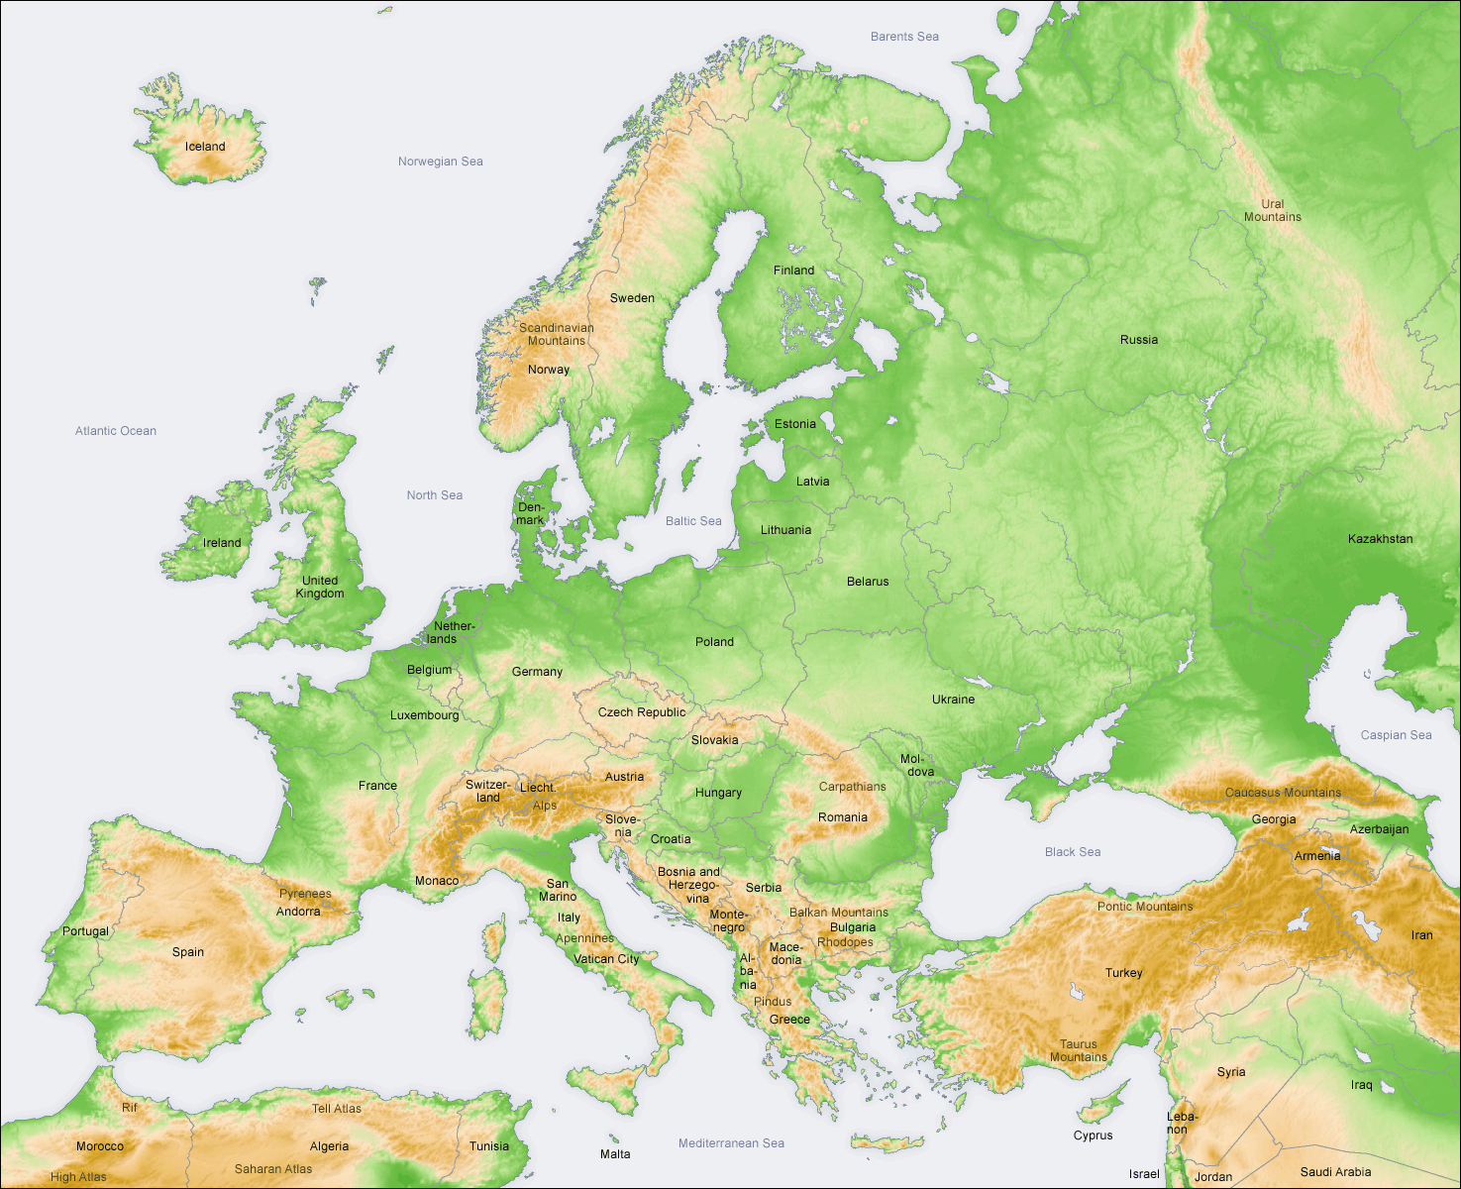
Physical geography
CEU does not exist
Danube basin?
Carpathian/Pannonian basin?
German hills?
Polish hills?
Polish-German plains?
East European plains?
Balkans?

Slide 21
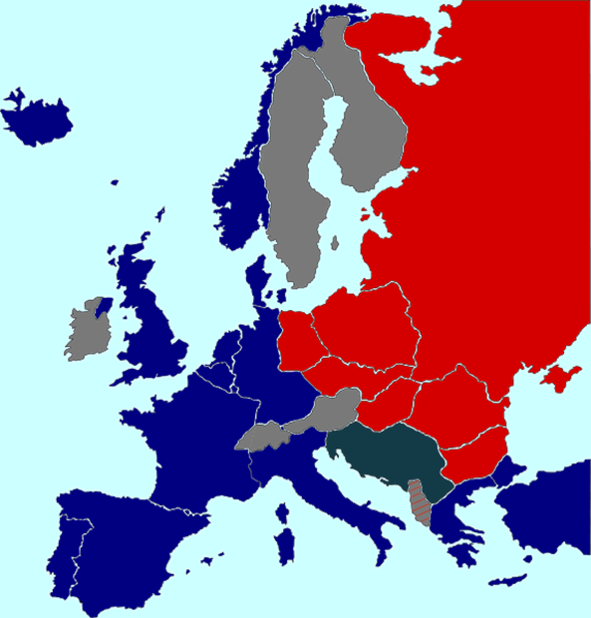
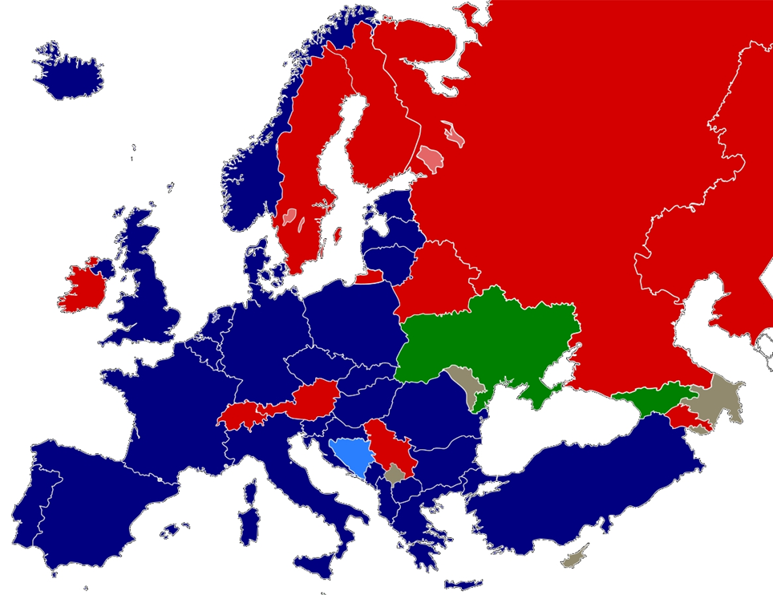
CE does not always exist politically either
Not a permanent category
Cold war: East vs. West – no room for CE
NATO enlargement – militarily East EU=postSoviet

Slide 22
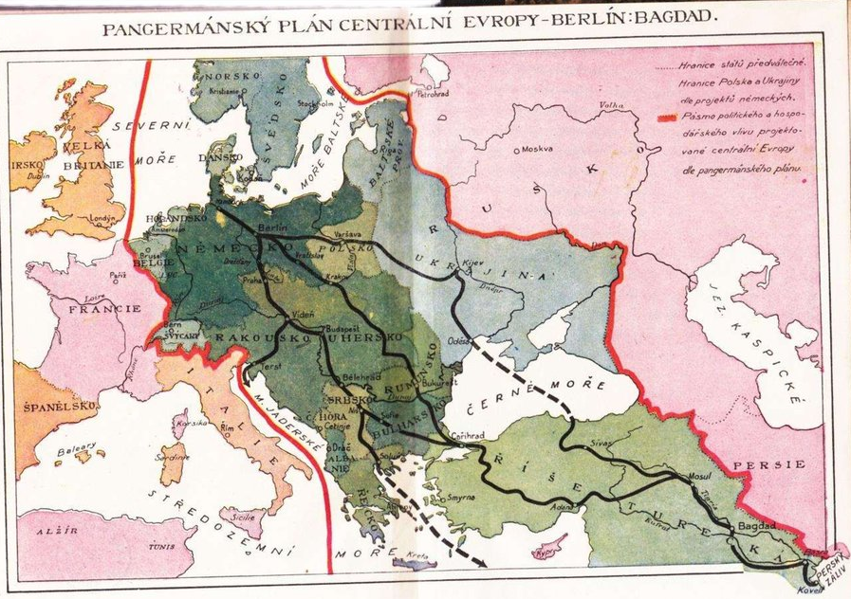
It can mean sg totally different

Slide 23
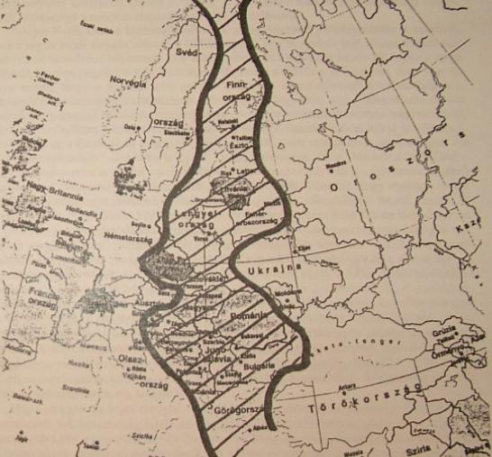
Zwischeneuropa – Europe in between
Small nations from Finland to Greece between German Europe and Russian Europe

Slide 24
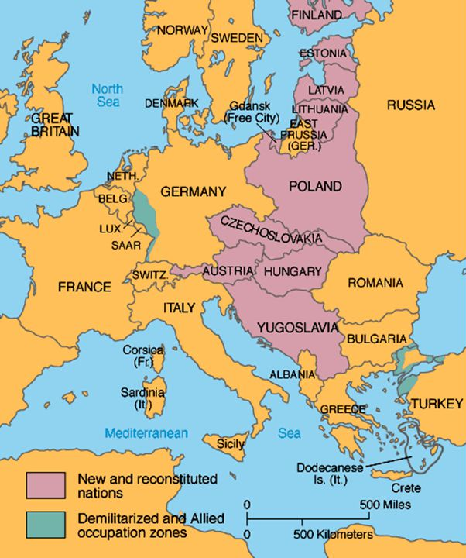
Europe in between: playground for Germany and Russia
Post WW1
Fall of three multinational empires
Independent small multinational states
Conflictual relations w/ each other
Cordon sanitaire

Slide 25
Central and Eastern Europe – V4 states
Central and Eastern Europe (CEE)?
Eastern edge of the Western world vs. buffer zone:
  Culturally (Oskar Halecki, Milan Kundera, Samuel Huntington)
  Historically (Michael Howard, Helmut Juros, Bibó István)
  Geopolitically (Rudolf Holsti, Norman Davies)
EU eastern enlargement(s)
Space of intensive bordering processes
Space of block building in the EU (V4)
Souce: Heinrich Boell Stiftung

Slide 26
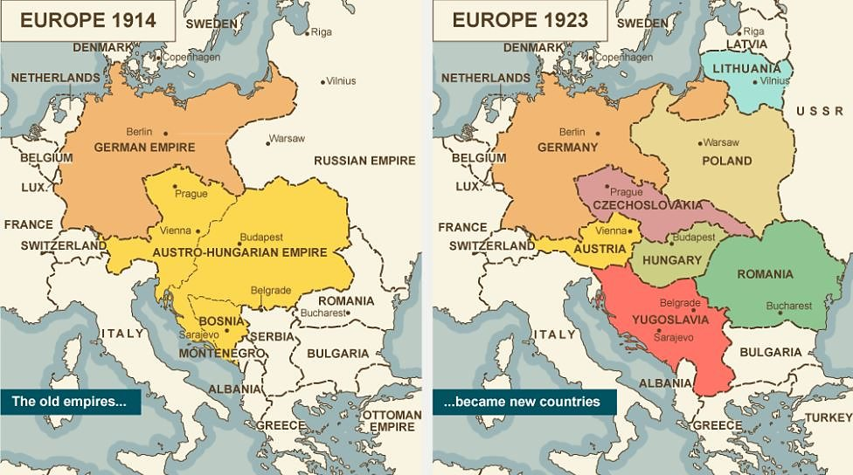
  Space of intensive bordering processes
World War I
Borders as
a product of
the past (O’Dowd
Wilson, 2002)

Slide 27
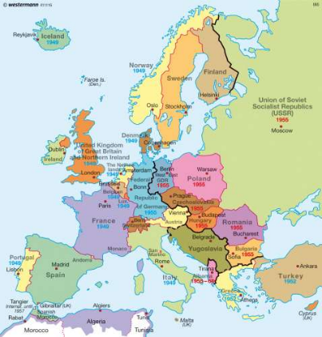
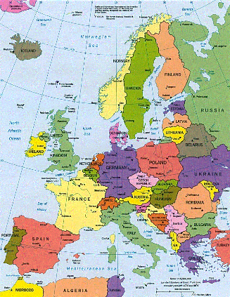
  Space of intensive bordering processes
World War II and the Cold War
Source: Dierckte International Atlas Source: www.gif-map.com/

Slide 28
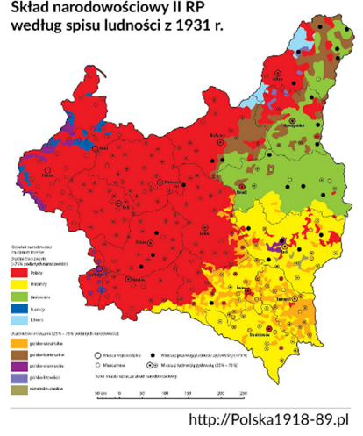
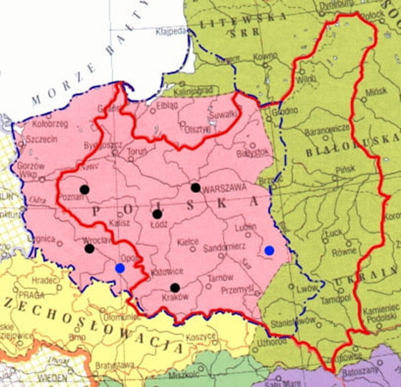
  Space of intensive bordering processes

Slide 29
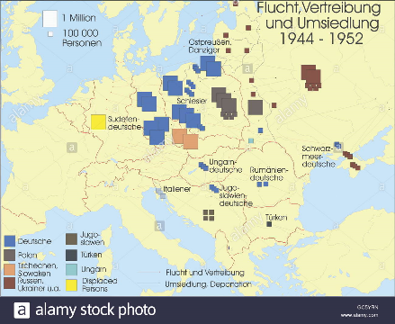
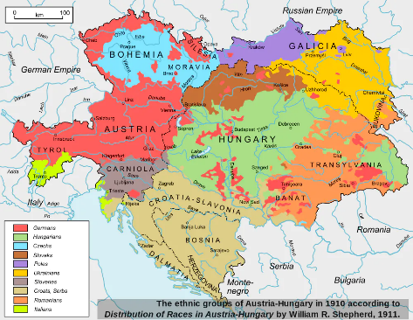

  Space of intensive bordering processes
Expellees, refugees, settlers
Ethnic homogenization
Border isolation

Slide 30
Small states
Multicultural empires – ethnic diversity
Turning theory
Ferry-states
Disrupted modernizations

Slide 31
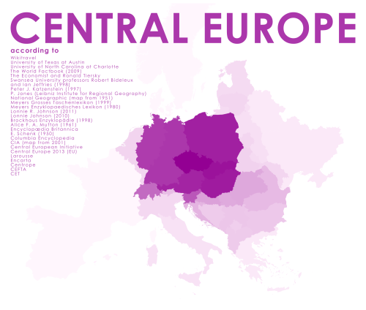
https://mapsontheweb.zoom-maps.com/

Slide 32
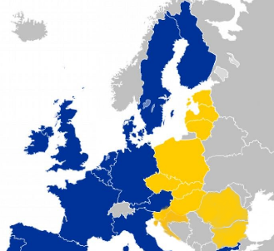
  EU eastern enlargement(s)
Borders as key denominators of sovereignty and relations with the EU (O’Dowd and Wilson, 2002)

Slide 33
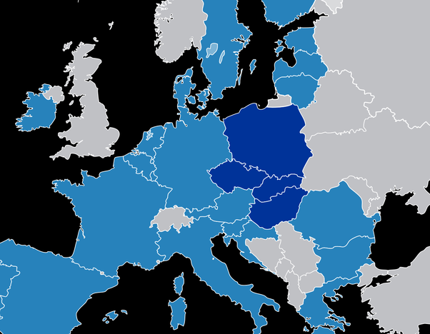
  Space of block building in the EU (V4)
Source: Quora

Slide 34
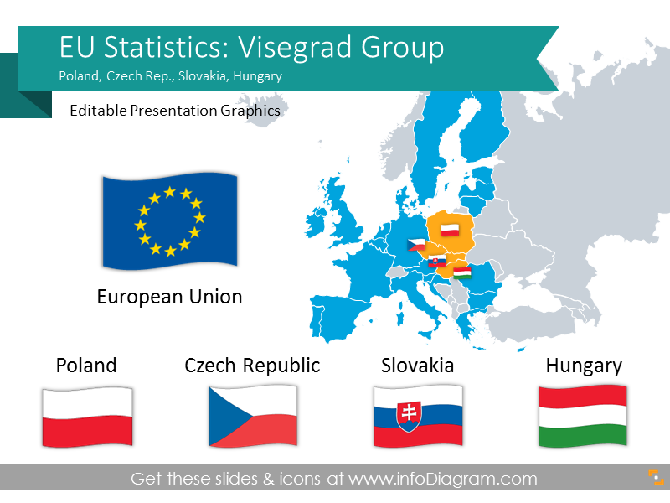
The Visegrad 4 – political substance
initiated in 1991
intensification 2000-2003
reactivation 2015
splitting again 2023/24

Slide 35
Central Europe without central europeans?
The V4 is an existing organization in CE, but only partly covers CE, and it is interstate/intergovernmental
No (political) geographical entity covers CE. V4 is fine but exclusive
Factors of cultural cohesion exist but ‚central europeanness’ is fading. Do we identify ourselves as central european? Or is this just an intellectual category?

Slide 36
CEE today

Slide 37
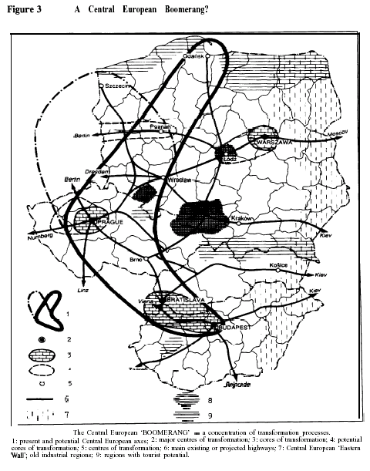
Regime change: CEE catching up
Gorzelak, G. 1995: „Central European bumerang”
Economy: dynamic growth
Politics: integrating – V4
Spatial structure:
  Fast growth of metropolitan regions (urban-rural dichotomy)
  W-E slope

Slide 38
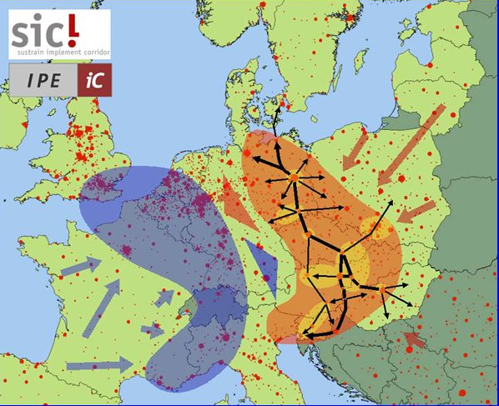

Slide 39

Old Europe – New Europe

Slide 40


Slide 41

Semi-periphery
Target area for WEU trade and FDI (from 5 largest investor (20) of individual V4 states only 2 non-WEU)
Already a dominant partner at the periphery FDI – HUN->WB, PL->UKR
Trade – HUN top5 in Serbia PL in UKR and BEL

Slide 42





Slide 43



Slide 44
  Do we need it?
Source: Koziarski 2020

Slide 45




Divided we stand…

Slide 46

And the winner is...

Slide 47
The War in Ukraine and CE

Slide 48

“It cannot be stressed enough that without Ukraine, Russia ceases to be an empire, but with Ukraine suborned and then subordinated, Russia automatically becomes an empire” (Brzezinski, 1995)

Slide 49

Centuries old objectives:
Warm water ports

Slide 50

Centuries old objectives:
Western buffer zone
Post 2WW maximum
1990 collapse

Slide 51


Slide 52


Slide 54


Slide 55

Immediate effect on CE
Bipolarisation of Europe (E-W) – no room for CE or Europe-in-between, the West closes its ranks
V4&other CE cooperation cease – Hungary and recently Slovakia pro-Russian POL&CZ pro-Ukrainian
EU&NATO powers focus on cooperation with the latter (+RO, Baltics etc)
HUN(&SK) isolating – serious blow on V4 coop., on CE as a whole

Slide 56
Ambivalent HUN moves
Unfriendly to UKR
  Not supplying arms
  Not allowing arms to pass through Hungary
  Blocking EU financial aid to UKR
  Blocking FIN&SWE NATO accession
  Vetoing sanctions against some individuals
BUT
  Condemnig Russian agression
  Accepting all refugees
  Sending non-military aid
  Exporting huge volumes of oil&gas to UKR
  Allowing third countries to fly arms over HUN
  Voting for all sanctions
  Finally voting for NATO enlargement as well, as EU financial aid

Slide 58
Why?
Official explanations
  Hungarian minority (~150.000)
  Hungarian companies (e.g. OTP)
  Dependency on Russian energy
  Russia can not be defeated on the battleground
  Keeping HUN outside of the war
  War is wrong
Critical narratives – no one sees clearly
  Blackmailing
  Financing
  Revisionism
  Autocratism
  Or even worse….

Slide 59



CE after the war
Under threat (at least perceived) – esp. Baltics, Poland, Romania, Moldova
Growing importance (military, political)
Other narrative: the end of CE – return to cold war E-W

Slide 60


Slide 61




Three seas initiative
Geopolitical role
A new cordon sanitaire?
Polish middle power?
Europe-in-between again
With US interests

Slide 62
Major consequences
Long frozen conflict in the neighborhood
Increasing great power competition (economic, political, intelligence…) in the region (EU/USA vs. Russia&China)
Growing importance (no matter who wins)
Poland&Romania rise
If Poland is smart enough EU leadership can also shift eastwards (Paris-Berlin-Warsaw axis)
With UKR victory ->CE may also move eastwaed

Slide 63
“If Ukraine is to survive as an independent state, it will have to become part of Central Europe rather than Eurasia, and if it is to be a part of Central Europe, then it will have to partake fully of Central Europe’s links to NATO and the European Union” Z. Brzezinski 1997

Slide 64
ergo
CE is an interest driven spatial category
Changes over time
Spatial changes (who’s in, who’s out)
disappears
Re-emerges
Plans to make it great and important, but its problem remains the same:
  In between more powerful neighbors without internal cohesion – a buffer zone used to contain the ‚enemy’

