Slide 1
Bosnia and Herzegovina
Ethnocratic regimes

Slide 2
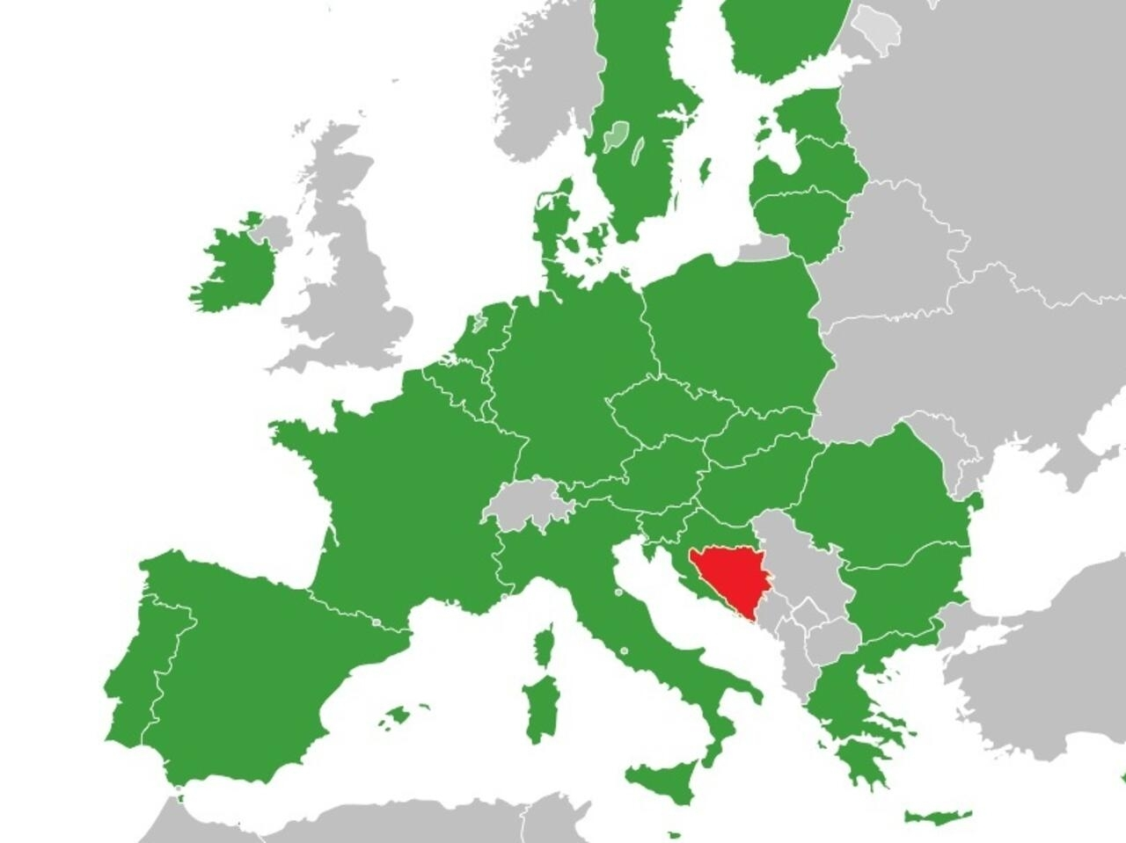
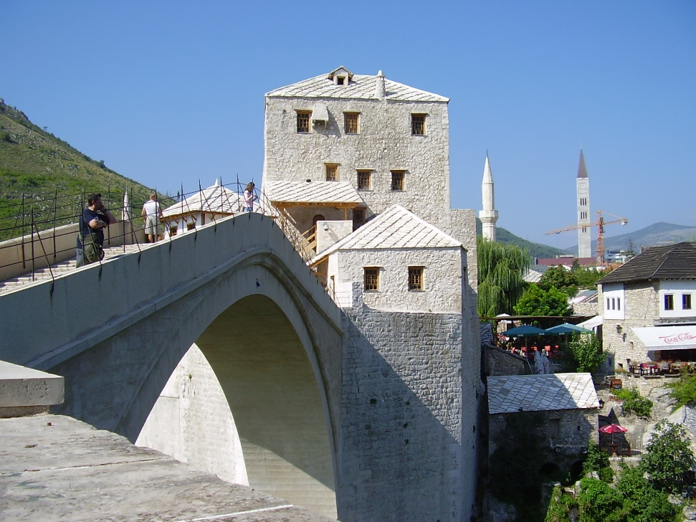
Some facts
SEEurope (a.k.a. Balkans)
Republic of former Yugoslavia
Capital: Sarajevo
51,209 sqkm
3.4 million (est.) last census in 2013
  51% Bosniak (pred. Muslim)
  31% Serbs (pred. Orthodox)
  15% Croats (pred Catholic)
Long history of multiculturality

Slide 3
What is an ethnocratic regime? according to O. Yiftachel and A. Ghanem 2004
Ethnicity instead of citizenship matters in accessing public goods and benefits
One ethnic group dominates politics and institutions
Control over territory – main issue
  Structural segregation
  Minorities perceived as threat to the nationalistic project
  Ethnocratic spatial control (land tenure, planning, transportation…)
In BiH the sub-national units run the ethnocratic regimes creating unfriendly environment for ‘others’
Ethnic parties, ethnicized education, ethnic differentiation in the public sphere (jobs, subsidies…) and everyday life
Examples are Israel, Bangladesh, Estonia, etc.

Slide 4
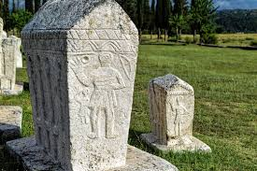
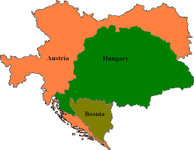
Some turning points
Old Bosnian church
Short-lived medieval semi-independence
Islamization during Ottoman times (Islamized Croats vs. Islamized Serbs)
AH annexation – attempt to develop a Bosnian identity
AH colonialism
Yugoslavia (1st&2nd)
In between: fascist Croat state

Slide 5
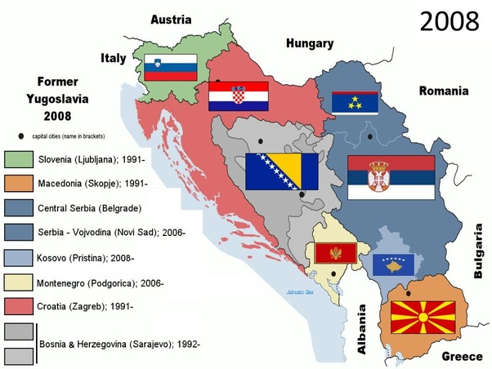
Dissolution of SFRJ
Change in external context
  End of cold war
  No enemy
Growing internal tensions
  Ethno-religious
  Development
  Historical
  Socio-economic transition
  Generational change…

Slide 6
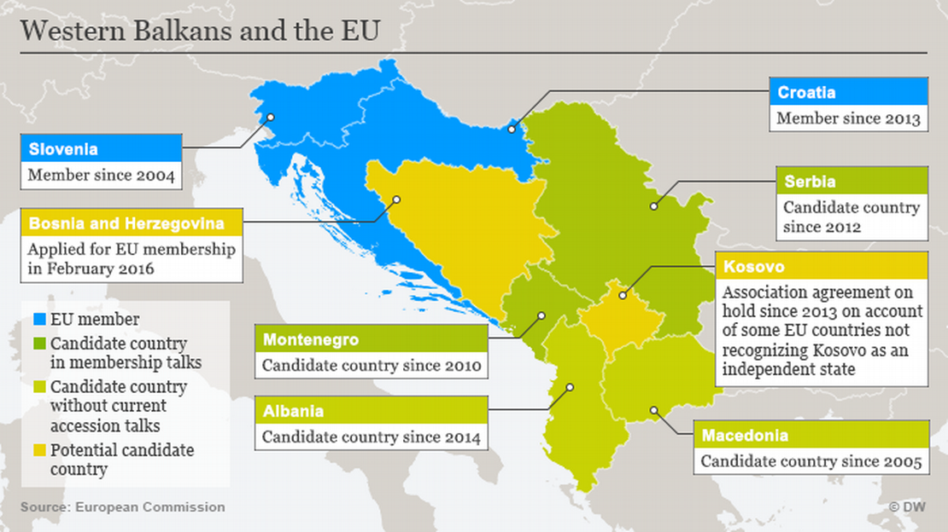
The result is the Western Balkans – EU term for the region
EU integration objectives for all, but different stages

Slide 7
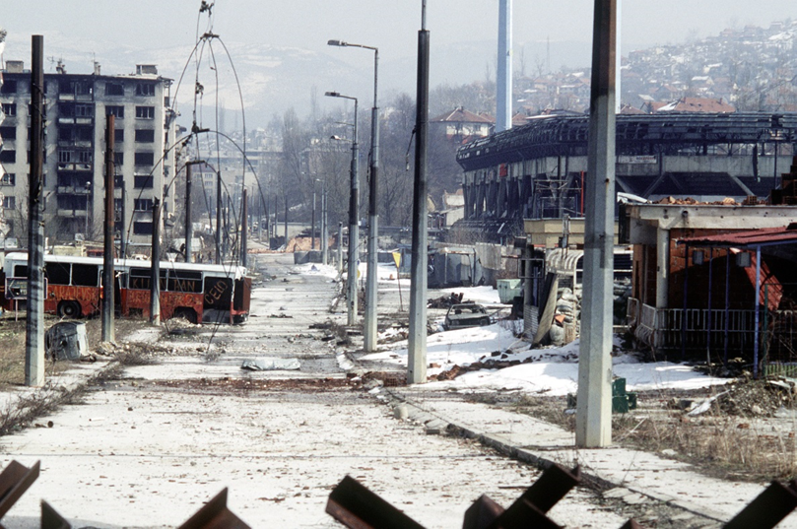

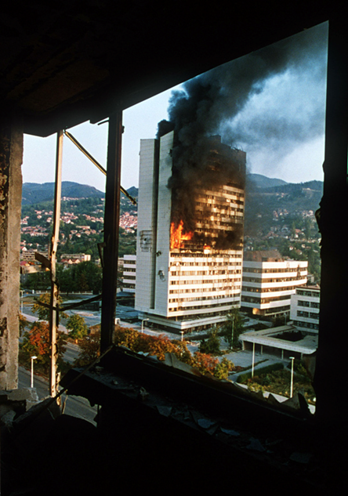
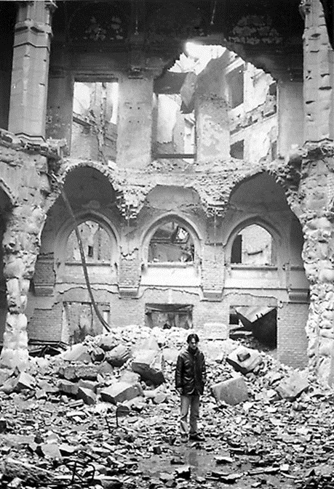
The war in BiH
1992-1995, longest among YU wars
Mainly along ethnic lines (B. vs. B.)
homogenization aims – ethnic cleansing
Genocide/ethnocide (e.g. Srebrenica)
Deliberate destruction of built heritage
Siege of Sarajevo
Stopped by int’l forces

Slide 8
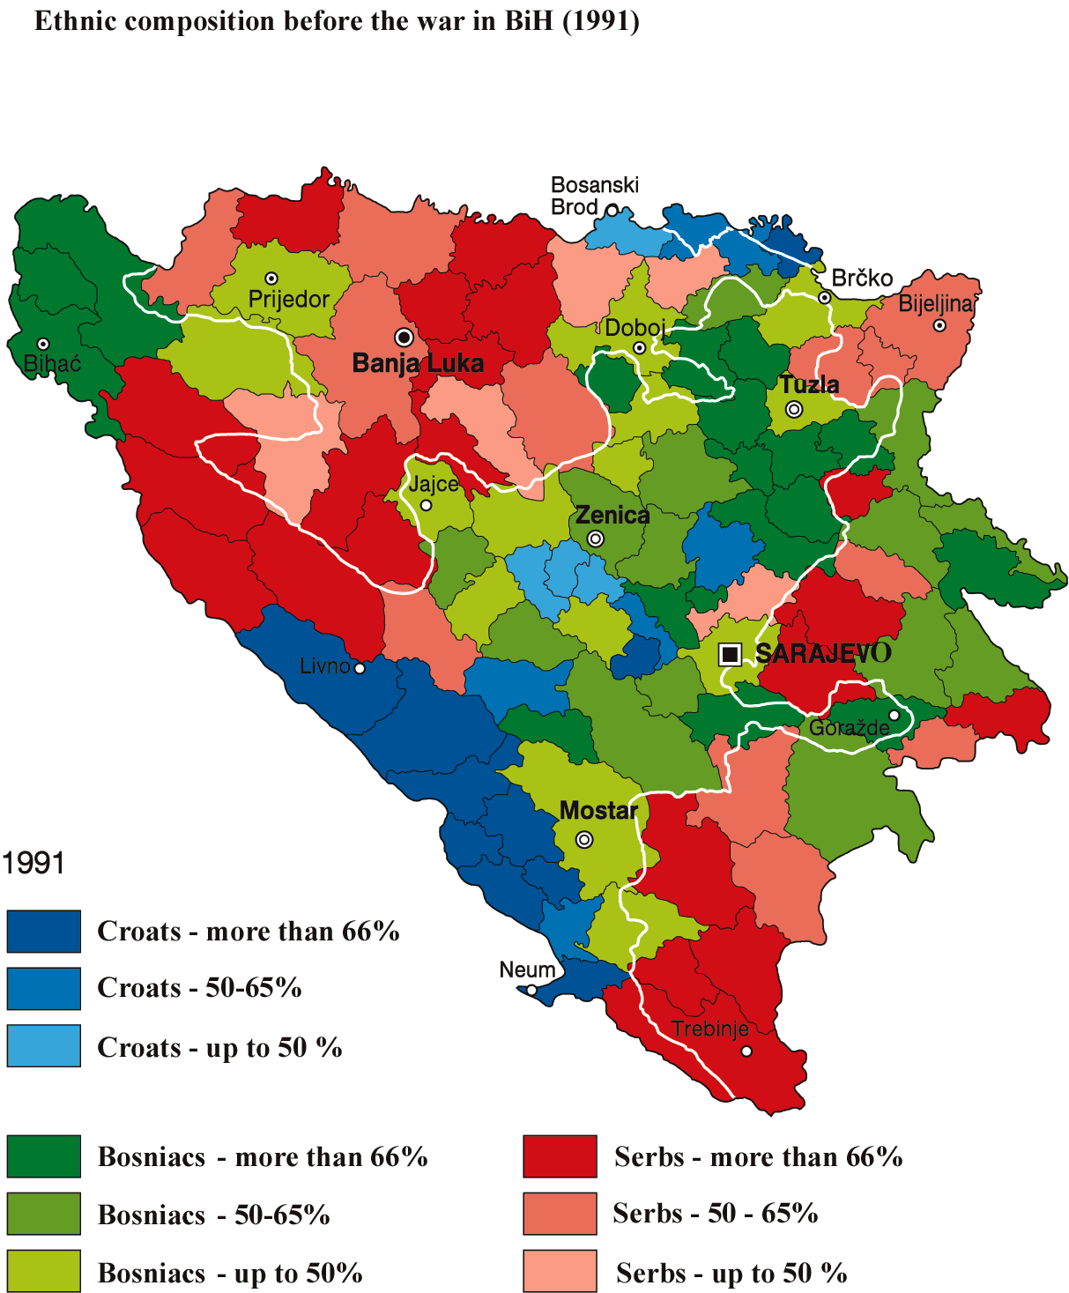
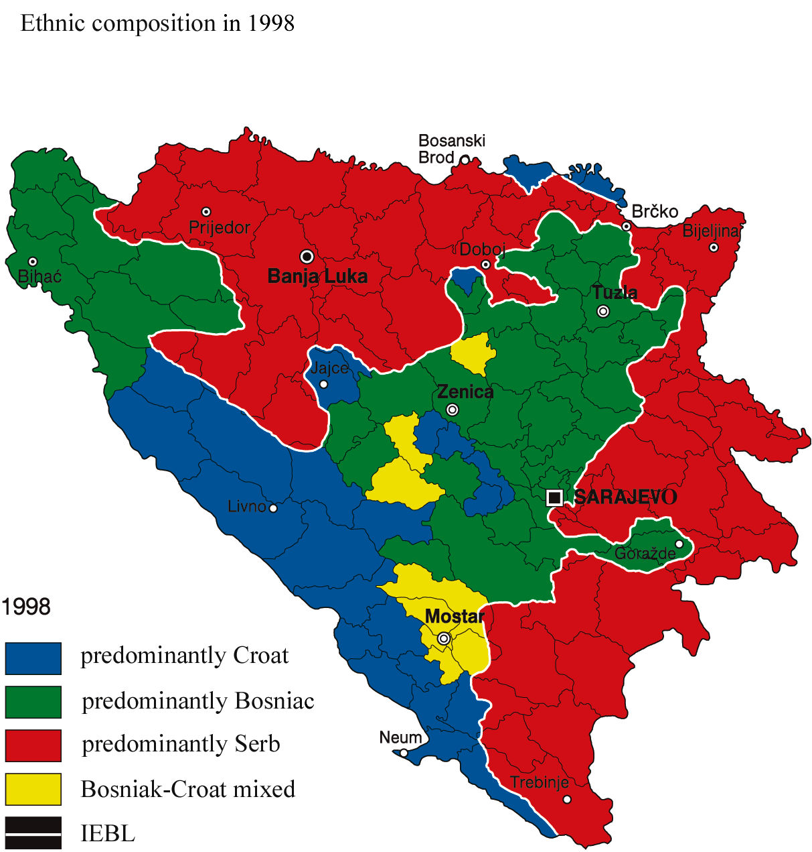
Ethnic homogenization

Slide 9
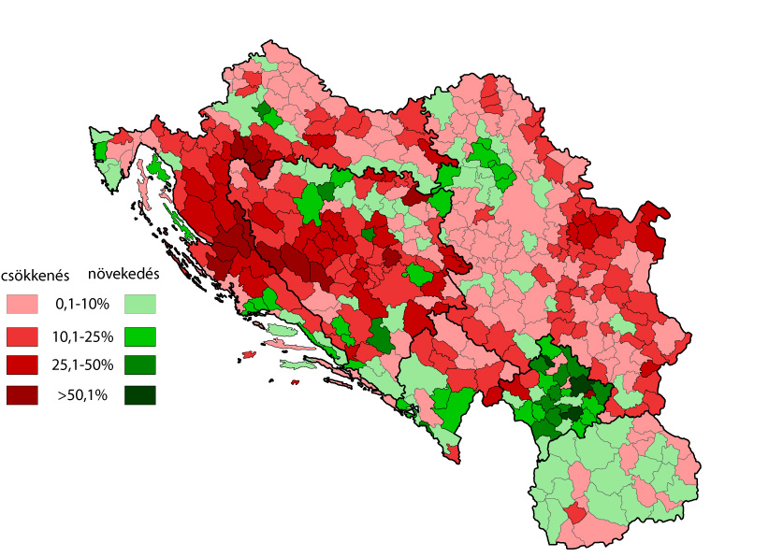

Slide 10
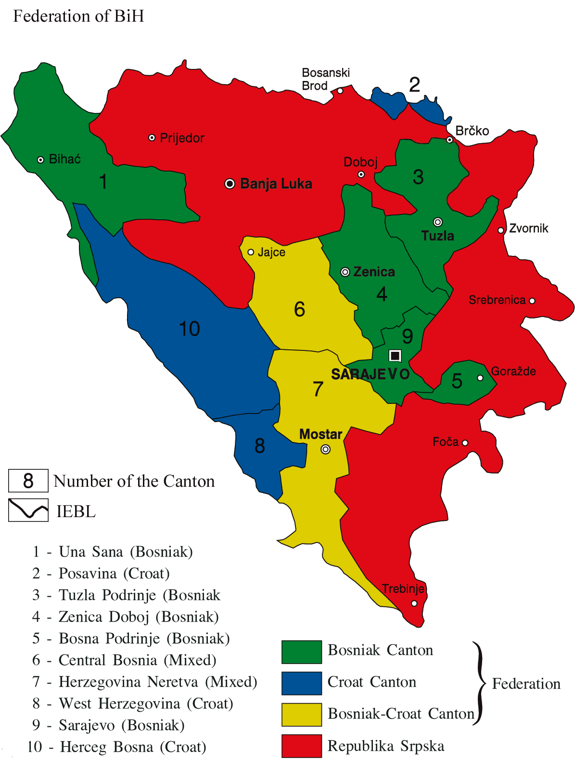
The state
DPA ended the war but no sustainable development has been achieved – political stalemate
War-time territorial gains are legitimized
DPA needs ethnic based territorial decentralization
Majority of political groups (parties) are also organized along ethnic lines
Ethnic affiliation in many cases overrules loyalty to the state
Different demographic dynamics create different strategies
Self caging vs expansionism

Slide 11
The political system
Practically a form of internationl protectorate with limited sovereignity (High Representative)
Two entities a special district and ten cantons
All with its own legislative, executive and jurisdictional bodies
Huge bureaucracy
Collective presidency
Ethnic quotas
Ethnic veto
IEBL – along the frontlines
The result is an overcomplicated, very expensive system

Slide 12
Ethnic based politics
Major parties are ethnic-based since 1990
Client relations with constituencies
Access to resources through the ethnic elites
Only members of the three constituent peoples can be elected to MP
Only residents of FBiH can vote for the Croat and Bosniak candidates and residents of RS for Serbian candidates
Unlikely to change anytime soon

Slide 13
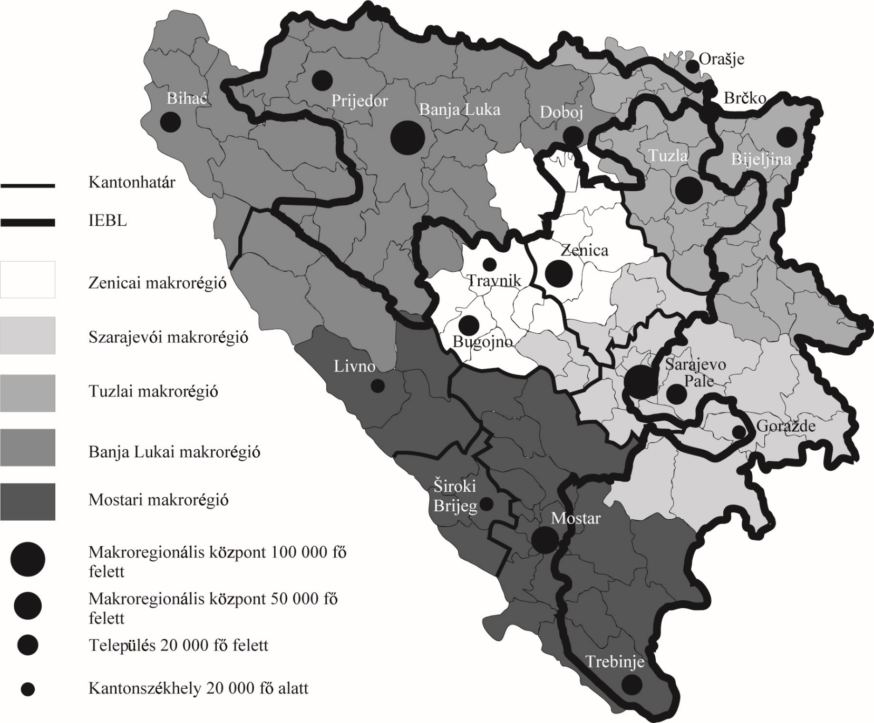

Slide 14
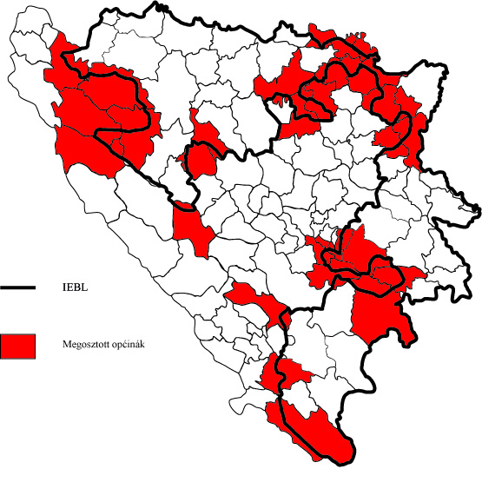

Slide 15
Ethnic composition
 | 1991 (census) | 1995 (est.) source: Praso, M. 1996 | 2000 (CIA est.) | 2013 (census)
Bosniak | 1 902 956 | 1 275 000 | 1 932 232 | 1 769 592
Serb | 1 366 104 | 987 000 | 1 493 451 | 1 086 733
Croat | 760 852 | 468 000 | 575 643 | 544 780
Yugoslav | 242 682 | 116 000 | 0 | 2570
others | 104 439 | 52 000 | 24 150 | 127 000
total | 4 377 033 | 2 898 000 | 4 025 476 | 3 531 159

Slide 16
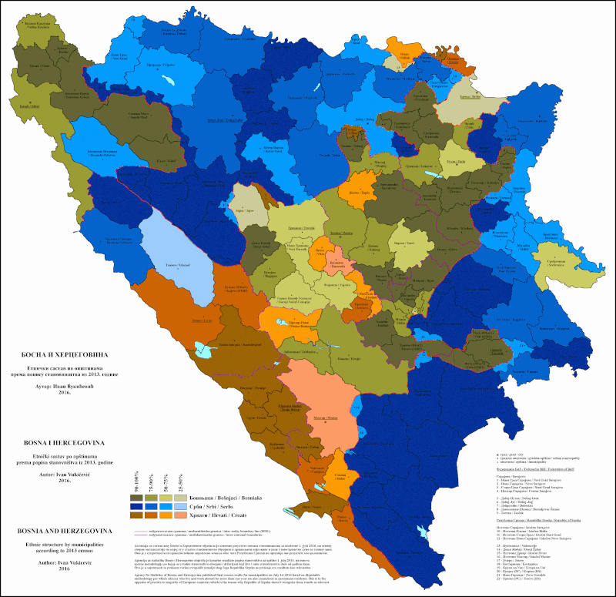

Slide 17
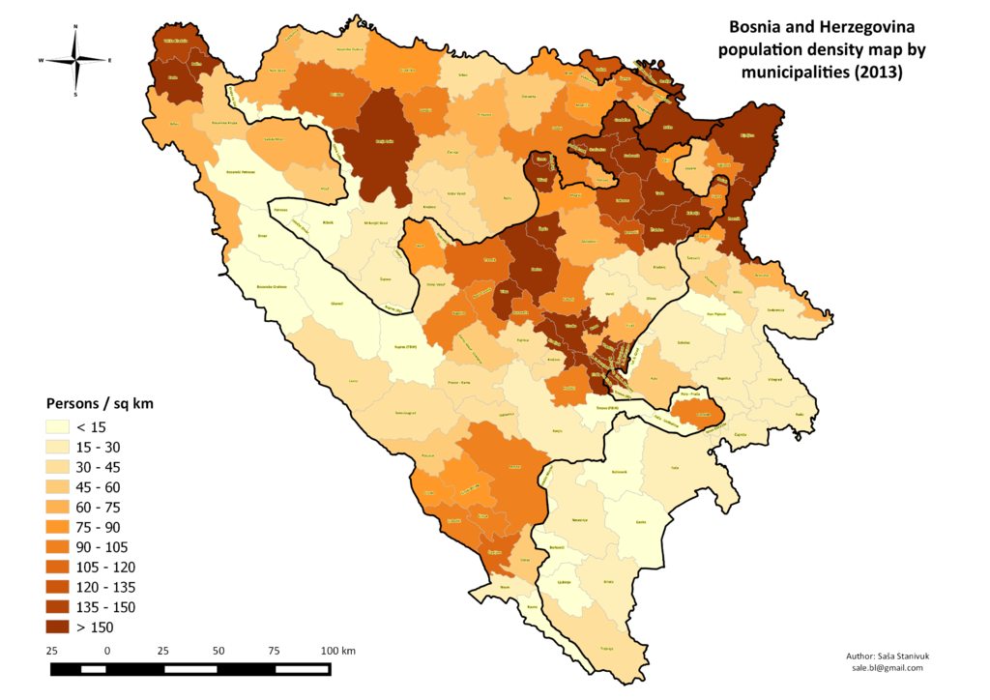

Slide 18
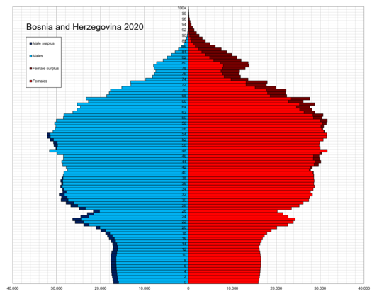

Slide 19
Natural change

Slide 20
Top-down vs. bottom-up state-building
Parallel state building in BiH following ethnic logic
Top-down in BiH, with the help of western states from 1995 (statute, HR, institution & capacity building, neighborhood policy, financial help, etc.)
In the RS bottom-up, driven by internal forces with the ‘covert’ help of Russia, China and Serbia. (regional development, economic policy/privatisation, education, ethnocratic structures)
The first is a centripetal while the second is a centrifugal force regarding integrity of BiH

Slide 21
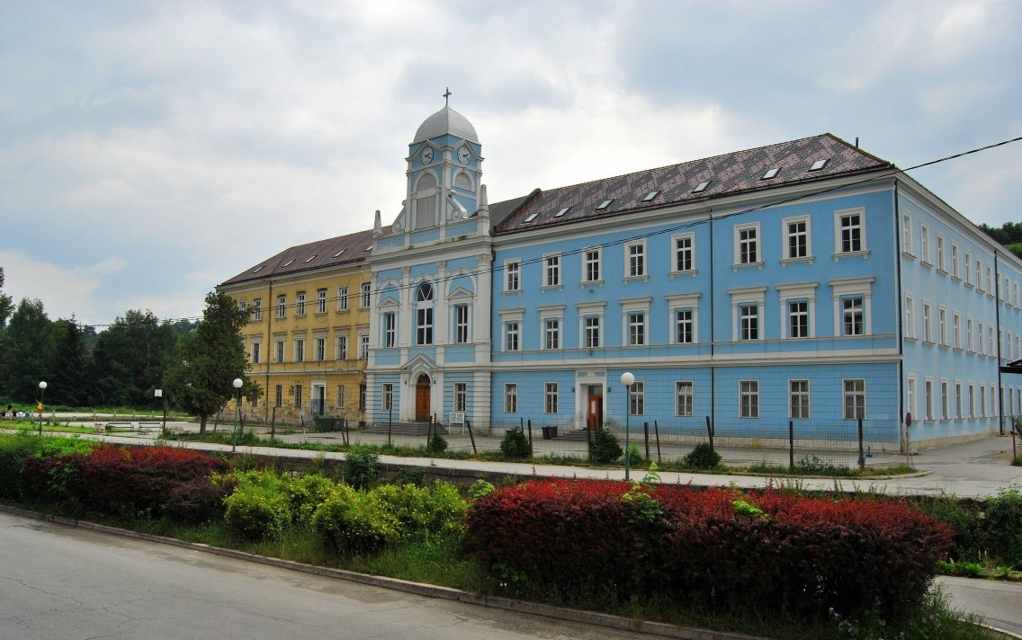
education
Entities have different educational systems
Curriculas, textbooks from Serbia and Croatia
Two schools under one roof in Federation
Three different histories, geographies, literatures etc. entrenches divisions
Create different national narratives
By Krešimir Bikić - http://picasaweb.google.com/kresimirbikic/
TravnikBosna#, CC BY-SA 3.0, https://commons.wikimedia.org/w
/index.php?curid=12740502

Slide 22
Transportation development
Regional development and transportation development are major tools in state building
However it is definitely not transportation infrastructure, or the state of communication which is the greatest problem of BiH
  The economy is not dynamic
  High unemployment rates
  Low export figures
  Not a real transit region – except CE tourists to C and S Dalmatia
All contribute to the fact that the existing infrastructure is generally not overused (though sometimes at some places it may be crowded)
Due to the ethnoterritorial structures talking about the infrastructure in BiH is rather a political question and not economic

Slide 23
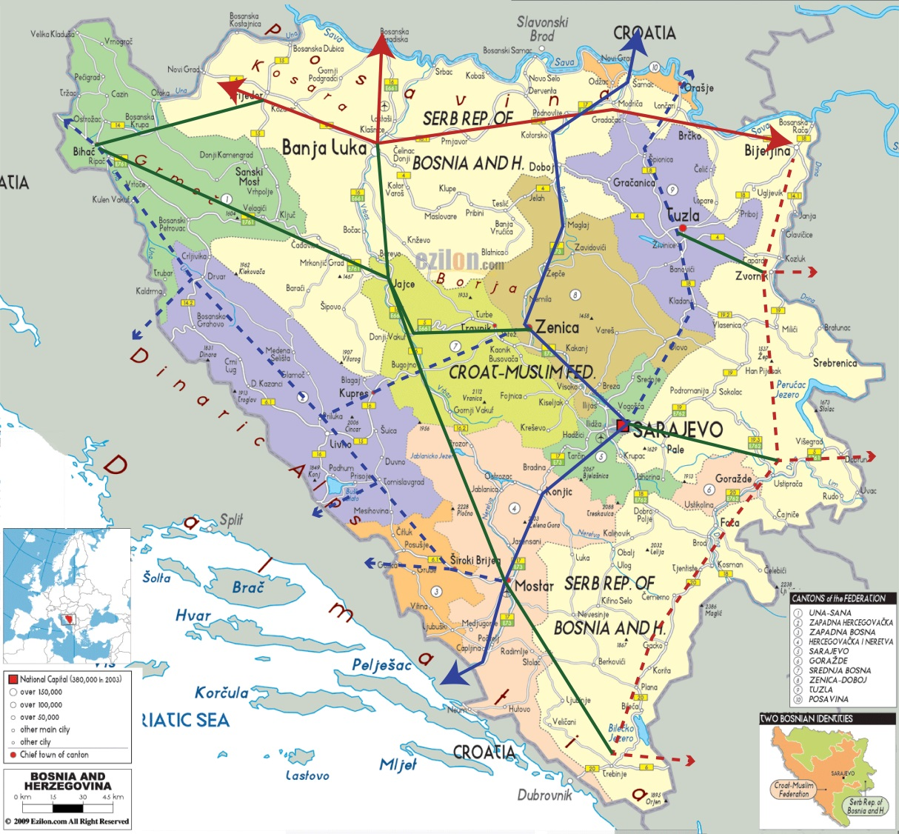
Major axes
As many other, transportation is also ethnicized in BiH
The main axis of RS is E-W along Posavina the secondary is N-S along the Drina
The main axis of FBiH is N-S along the Bosna-Neretva the secondary is NW-SE along the poljes
Since the planning, maintaining and control of the roads and traffic is an entity business particular ethnic/entity interests rule

Slide 24
Who’s interest?

Slide 25
Transportation development and regional development in general are entity business
Who controls the land?
All would like to have crucial lines running uninterruptedly in „their” territory
What is good for RS of BiH is also suitable for an independent RS
A major characteristic of ethnocratic regimes
Due to long-term demographic changes Bosniaks are interested in centralized transportation development as well but not always
Regional development plans clearly reflect this

Slide 26
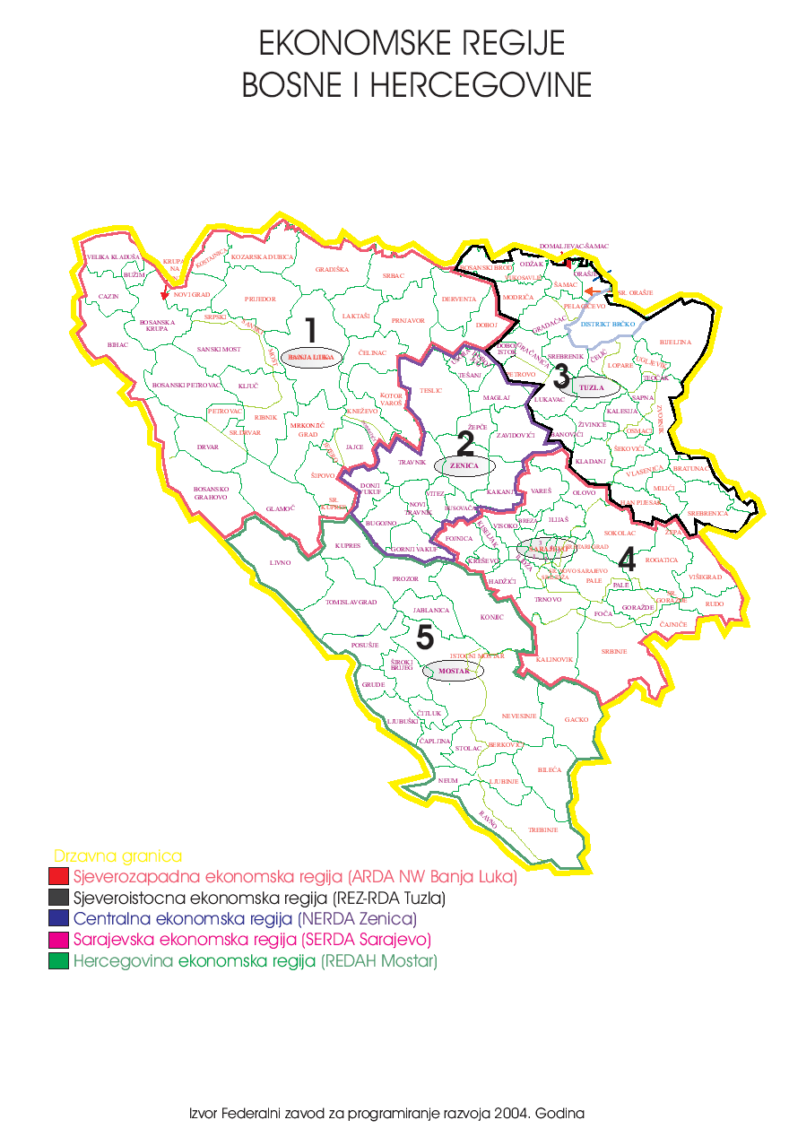
Different perception of IEBL
Planning documents of RS do not care about the territory of FBiH.
Planning objectives are decreasing territorial weaknesses and vulnerability of RS
and increasing territorial cohesion, competitiveness, identity etc.
Strategy of FBiH on the contrary eviews spatial planning and implementation
of plans as if there were no entities and cantons.

Slide 27
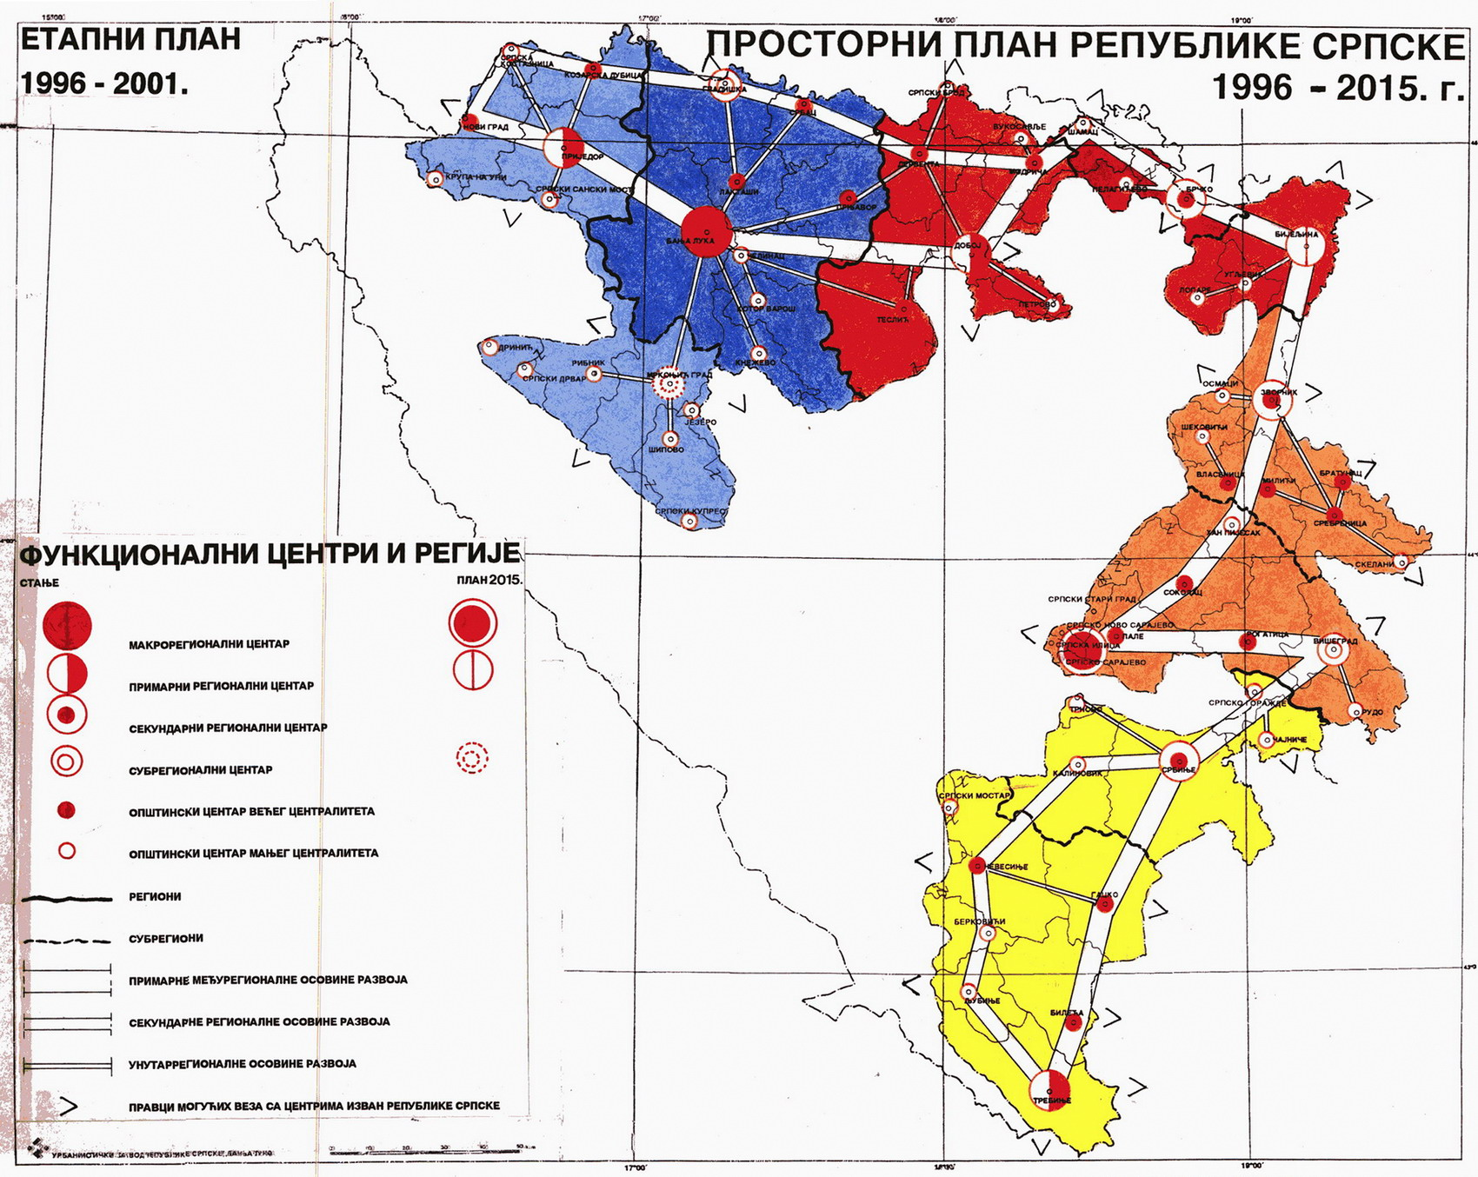

Slide 29
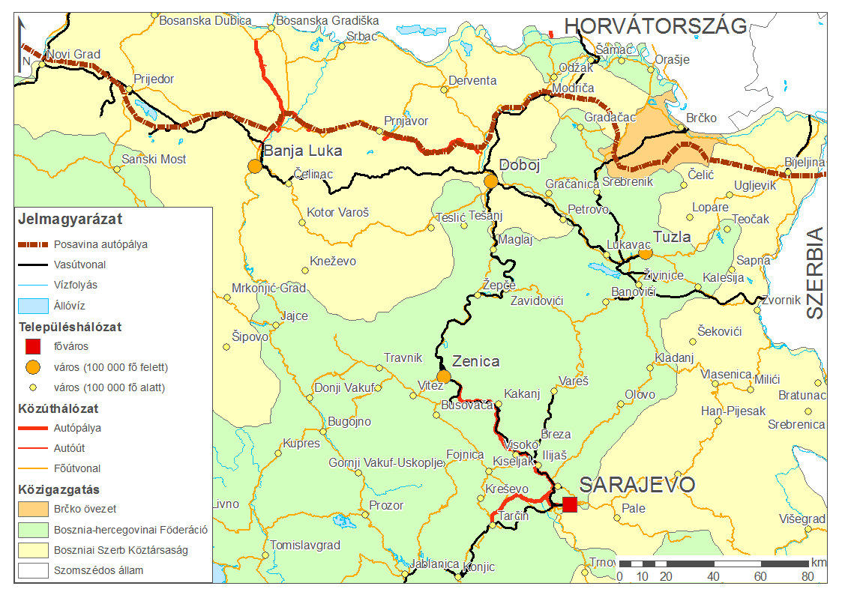
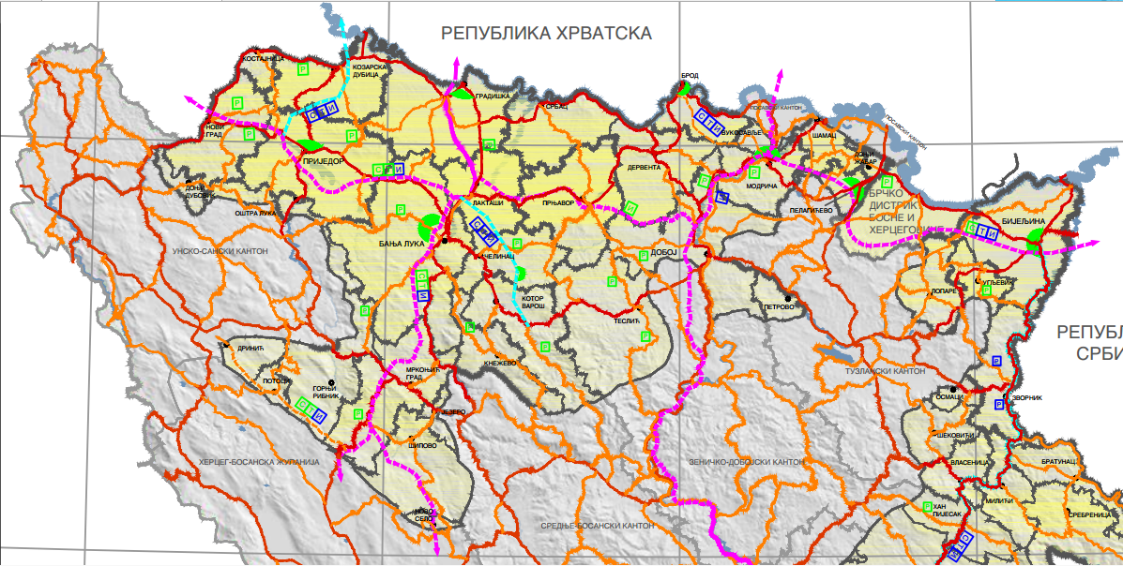
Serbian corridor of Posavina

Slide 30
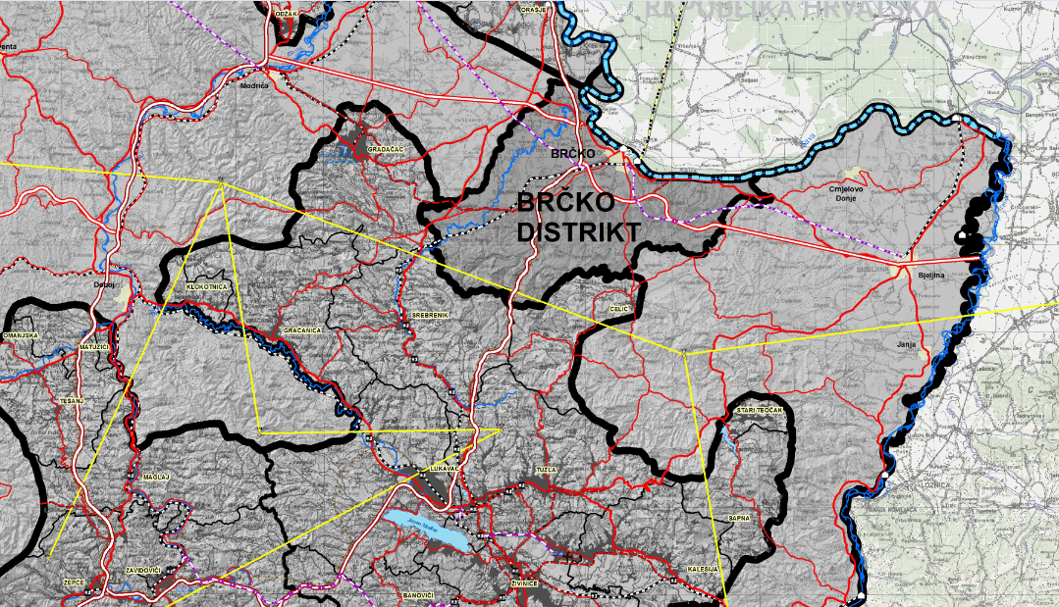
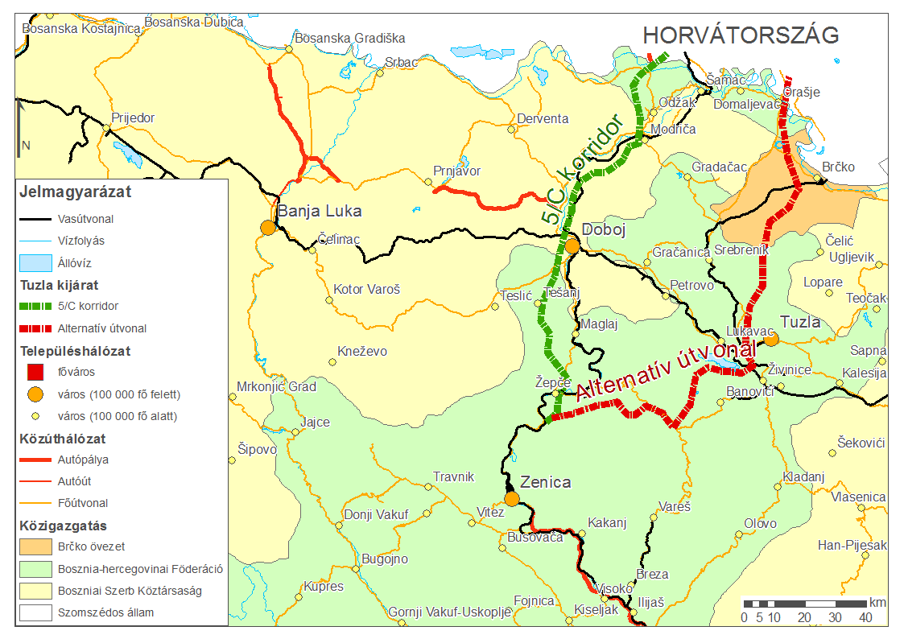
Bosniak exit to Sava

Slide 31
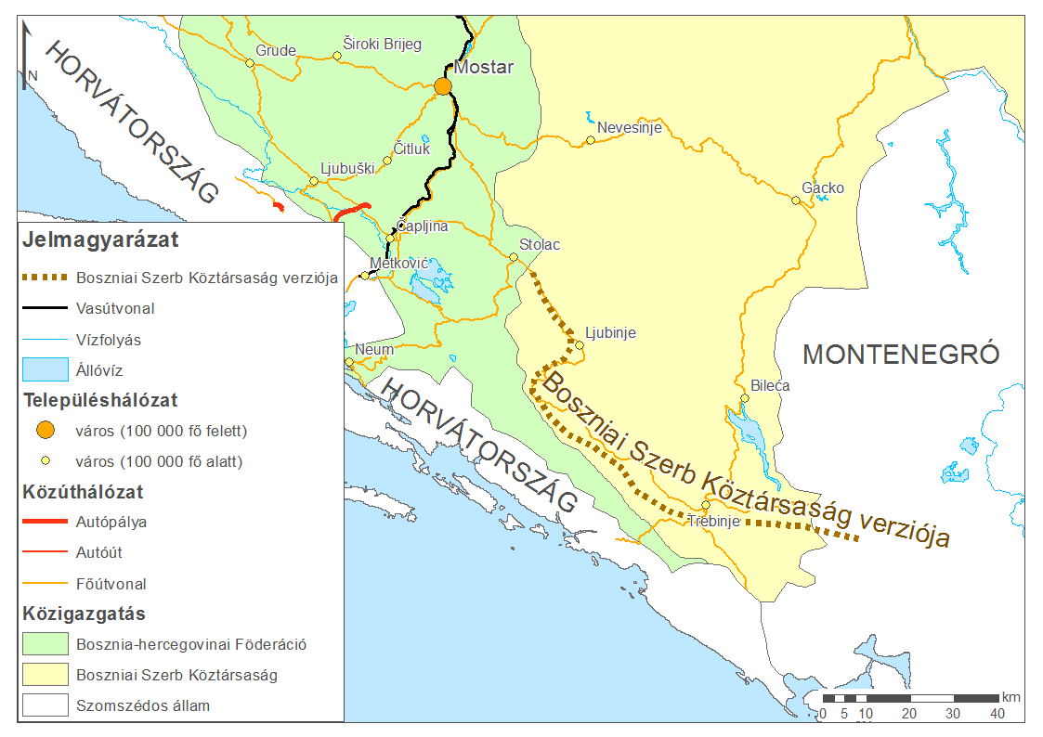
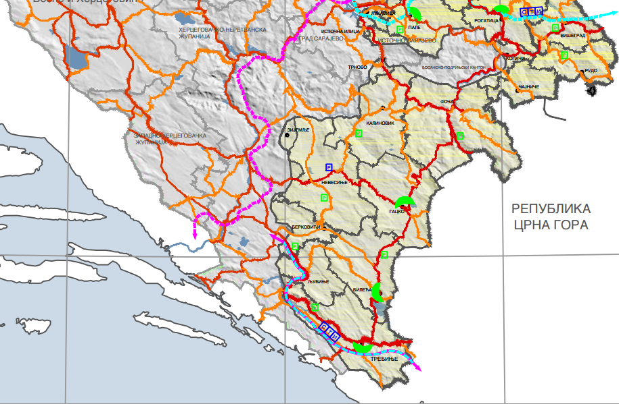
Serbian version of Herzegovina highway

Slide 32
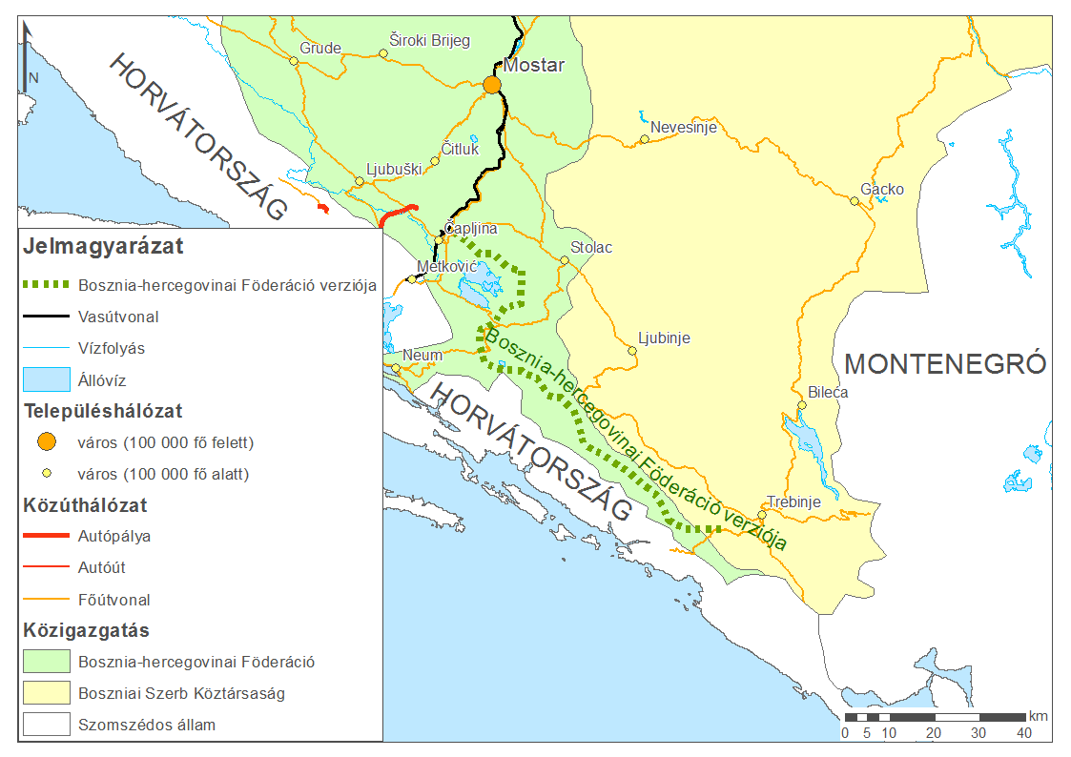
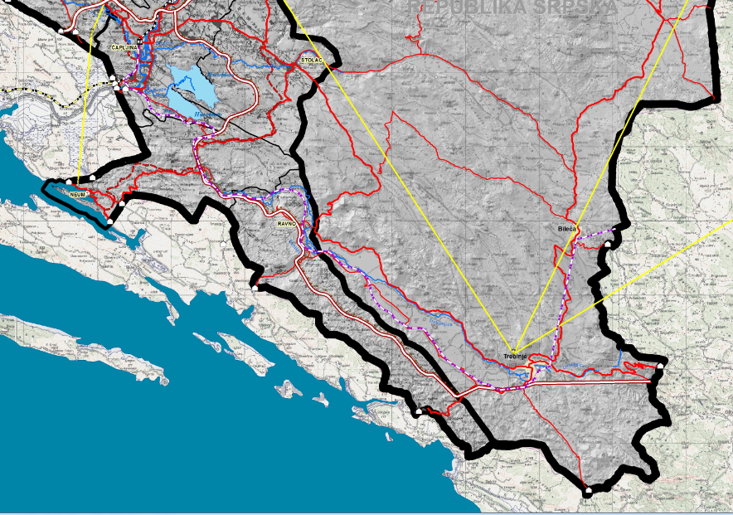
The same in the Federation

Slide 33
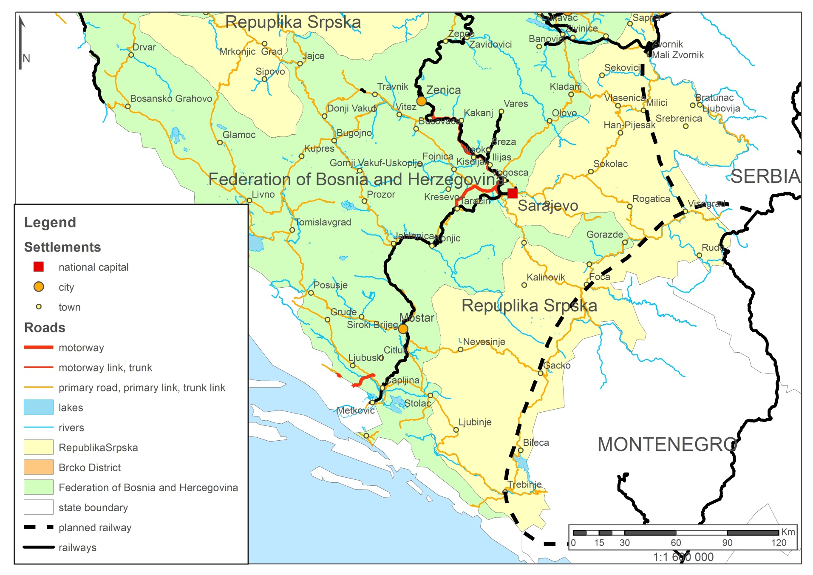
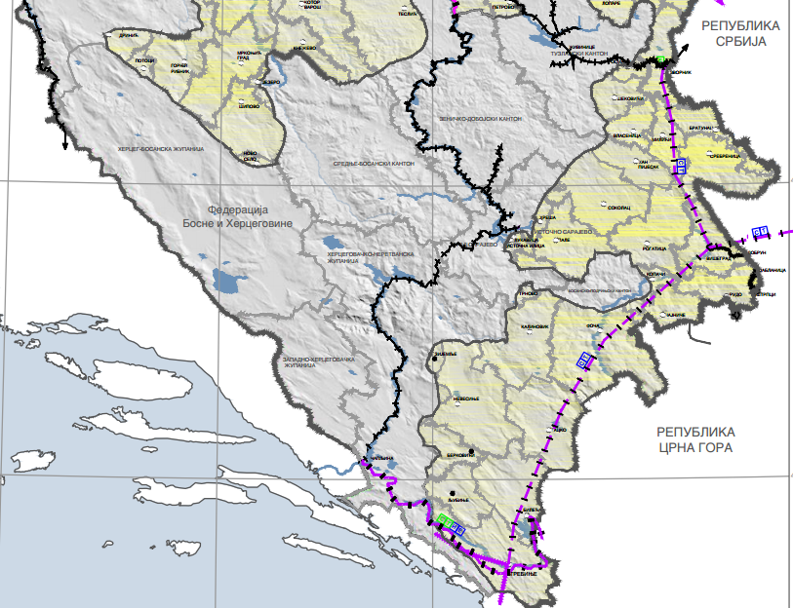
The „Drina-railway”

Slide 34
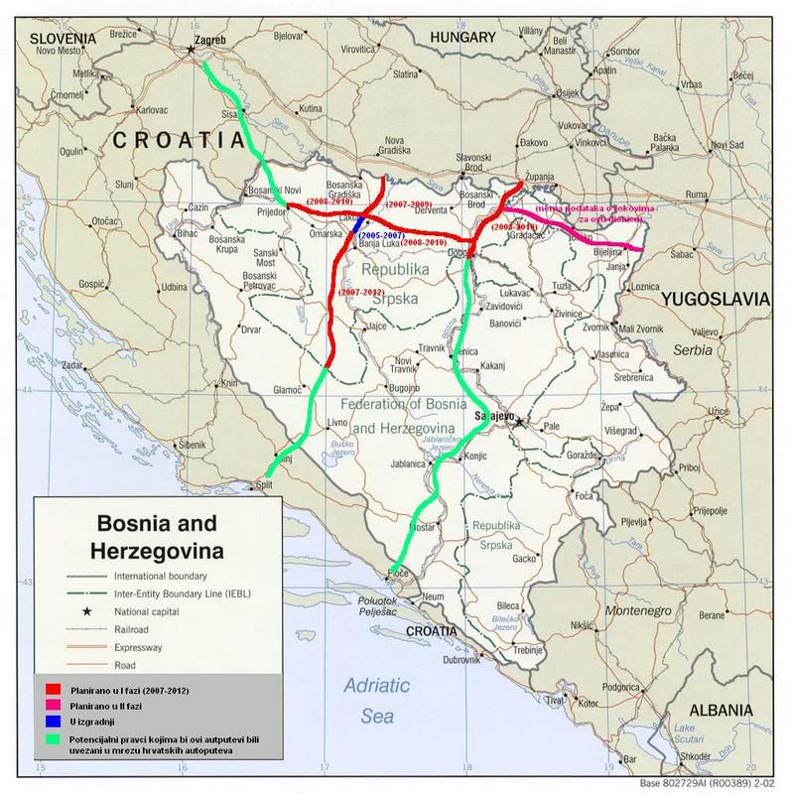

Slide 35
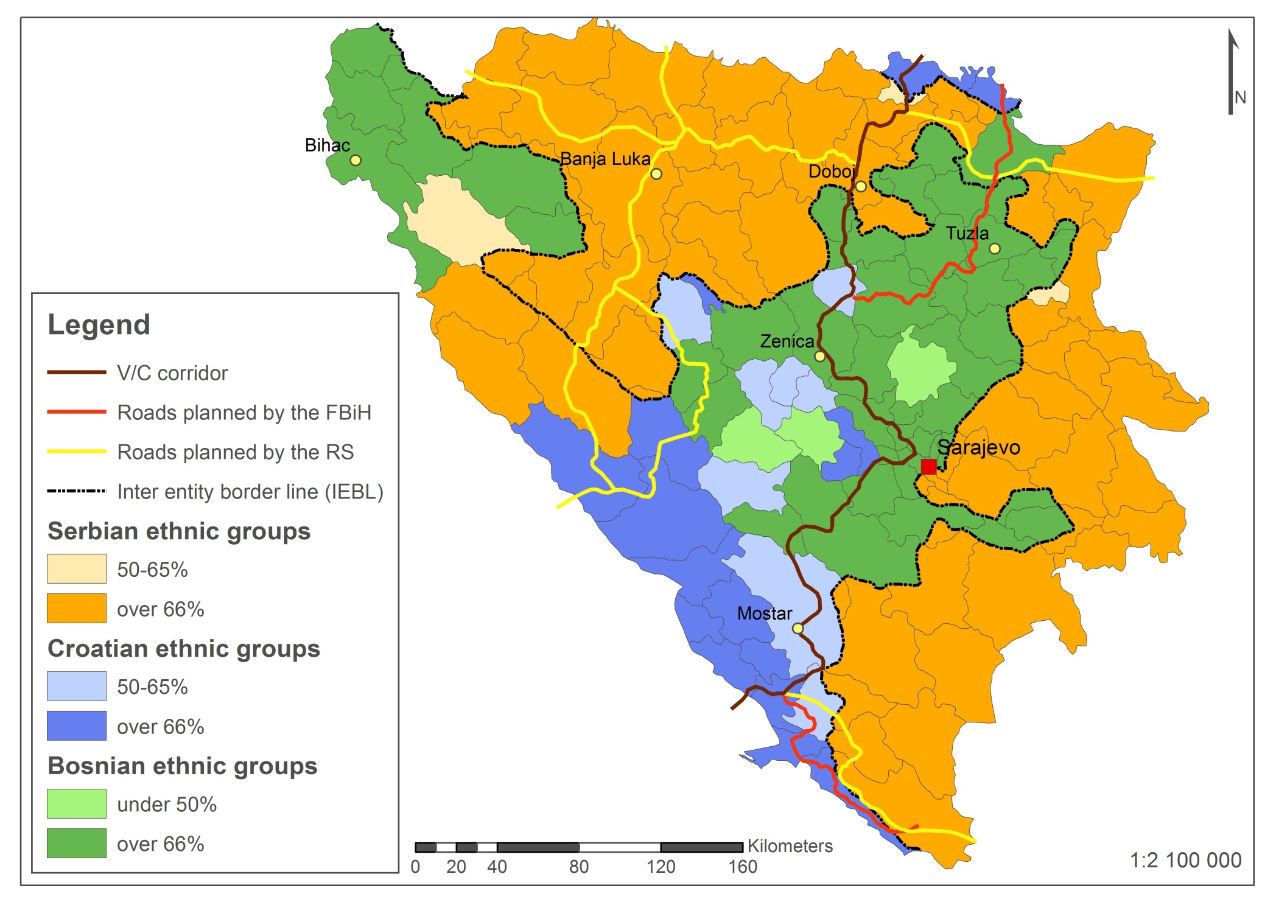

Slide 36
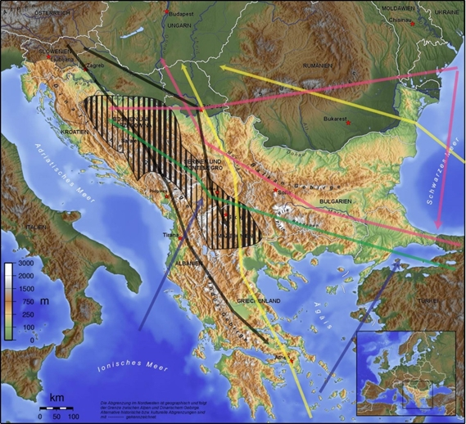
A divided Balkans
small and weak states at the margin – great arena for building influence
„In-betweenness”: multiple spheres of interests
exists for centuries but increased by the EU political crisis
EU is still the most influential but the financial and institutional crisis, BREXIT, the enlargement fatigue, COVID etc. opens up space for other external powers
Renewed geopolitical competition from the late 2000’s – China’s&Russia’s global strategies, Turkey’s regional power games, USA new cold war&containment
No clear hegemonic power in the region.
The competition for power creates opportunities for smaller states to assert their own interests

Slide 37

A divided BiH
A divided BiH makes increasing influence even easier
Two entities, three constituent nations, complex political structure, ethnocratic regimes…
External actors have been interfering Bosnian politics for a while (even constitually legalized right for interference)
Political stalemate – no clear hegemony – similar to WB

Slide 38
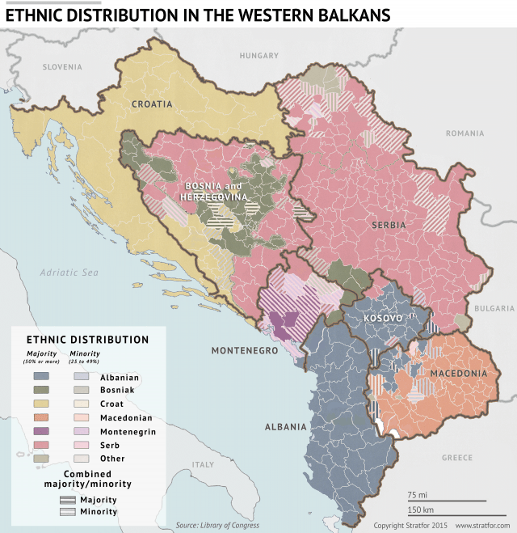
Foreign influence
Serbs and Croats have a kin state in the neighborhood
Double citizenships
RS leader Dodik – secessionist threats
Croatia’s influence in Herzegovina
Turkish&Gulf states’ influence in Bosniak cantons
Economy, culture, education, etc.

Slide 39
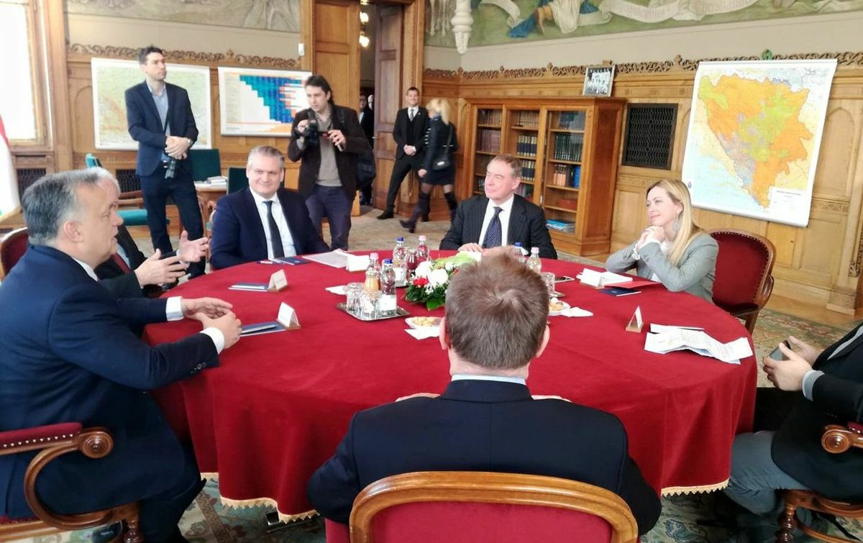
Hungary in the region
Hungary’s renewed interest towards the Western Balkans from the 2010’s (Reményi et al. 2021)
After Croatia and Serbia BiH appears more often in the news
At the end of 2018 many news outlets reported that the ethnic map of BiH is hanging in PM Orbán’s office.
Several other (often controversial) moves towards BiH followed

Slide 40
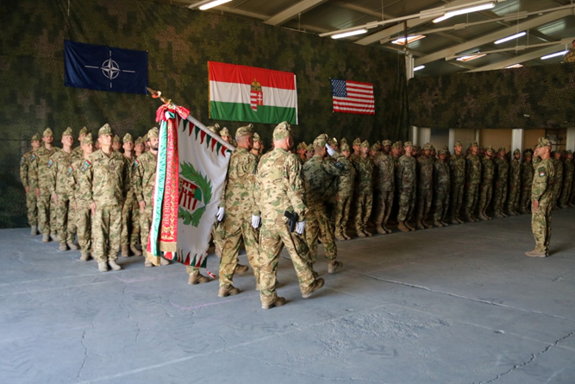
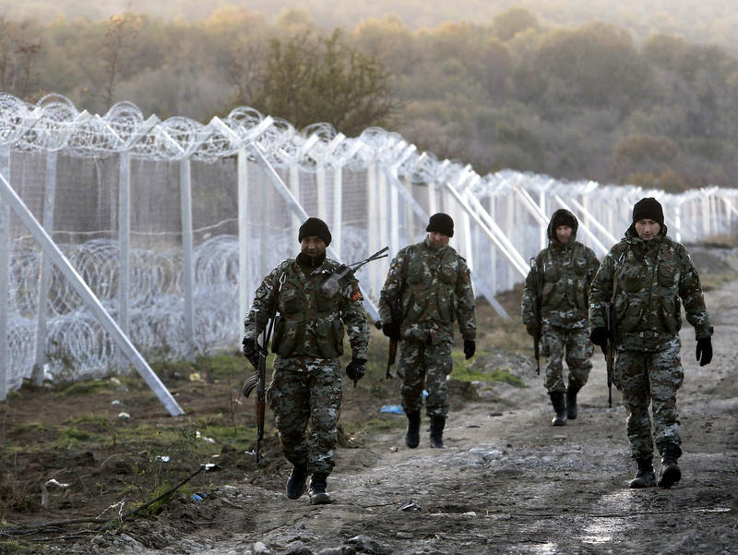
Hungary in the WB - security
Hungary is not a major military power but,
  both in BiH and in KOS Hungary has a significant military presence
  NATO liaison office in Banja Luka,
  3rd largest force in KFOR,
  1/3 of soldiers in BiH
  Commander of KFOR (oct. 2021-22)
  Commander of EUFOR-ALTHEA (2024-)
supporting likeminded politicians in border securitization
  providing razor wire to Macedonia,
  joint border patrol in Macedonia and Serbia
Hungarian soldiers in Pristina – promenade.hu
Macedonia border barrier - AP/Bornis Grdanoski

Slide 41
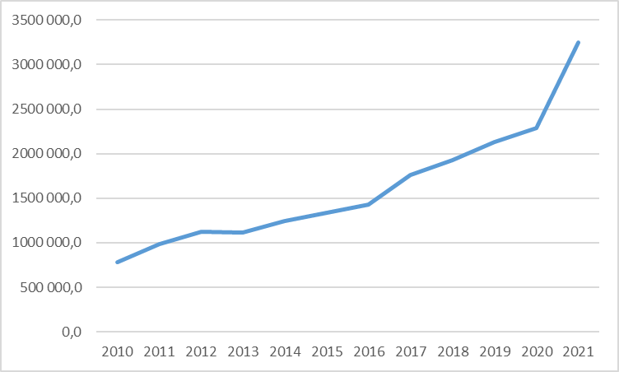
Hungary in the WB - Economic relations
  2010-2021 the export doubled, total trade increased 2.5 fold (5.5bn euro - if Croatia is included 4 fold to 9bn) – same size as Turkey
  FDI increased by more than 60% to 1.5bn euro (2010-21)
  WB would be the 13th largest trade partner in 2021 (same size as Russia – 10th if HR is included=France) but massively positive balance (7th largest surplus, 3rd if Hr is included)
HU-WB trade incl. Croatia
in million HUF
Institutional developments
  Hungarian Export Promotion Agency – Belgrade office 2018 (Istanbul, Moscow, Shanghai, Tokyo, Toronto)
  Western Balkans Investment Support Programme 2019 (25million euro), etc.
Investment in strategic sectors (banking, energy) as well as SMEs

Slide 42
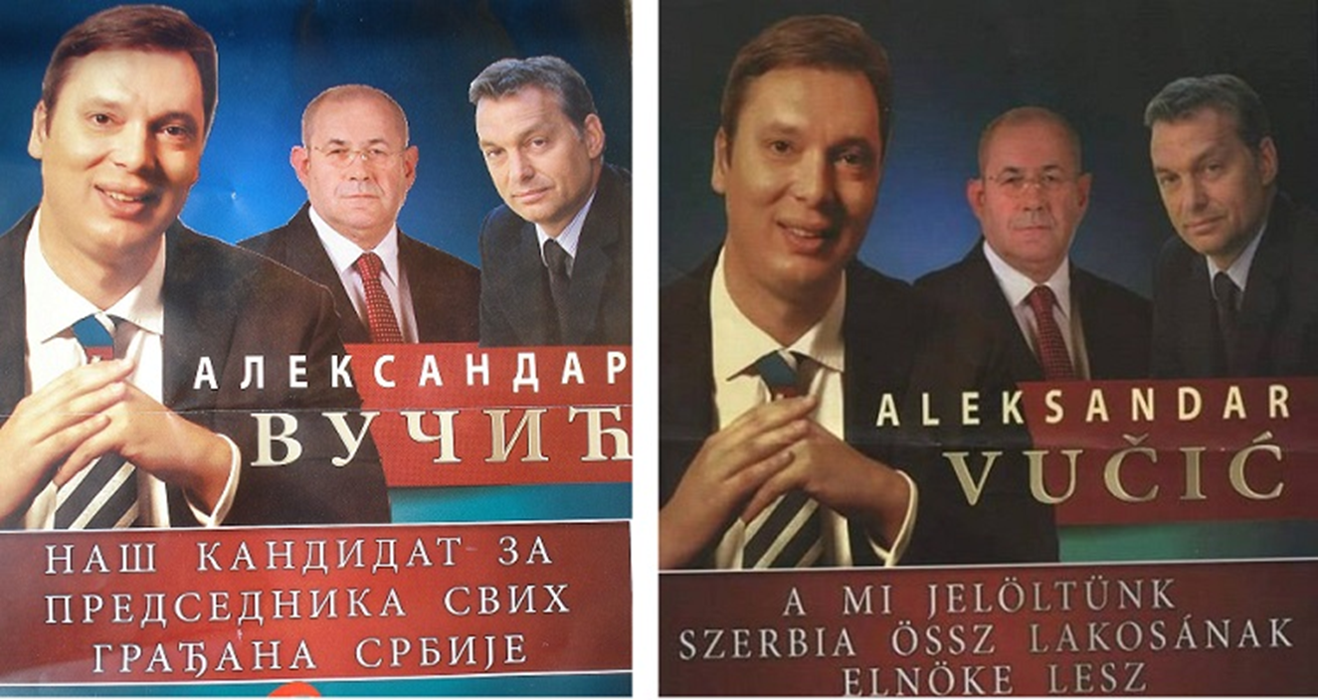
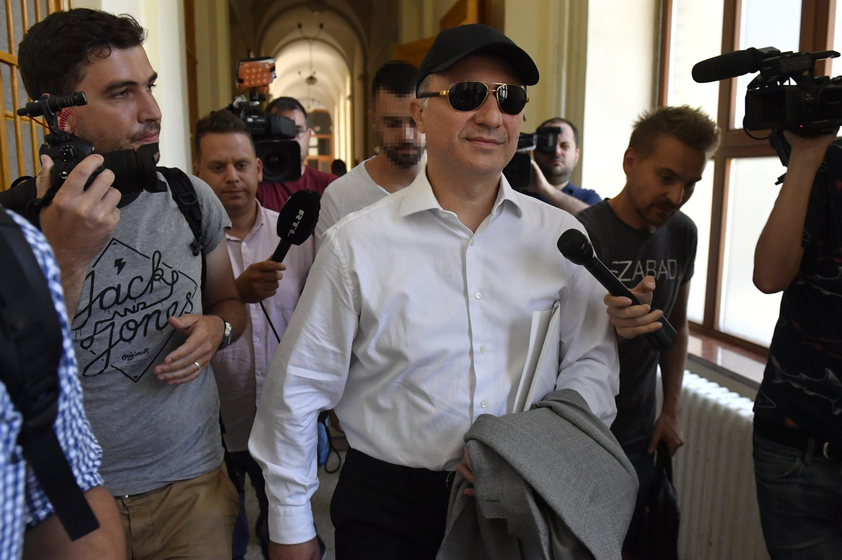
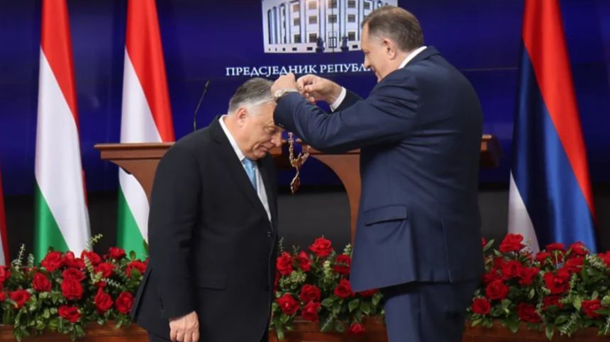
Politics&media
Loud supporter of enlargement
  “It is in Hungary’s best interest to have peace and stability in the Western Balkans, and European integration is the most obvious guarantee for this” – Péter Szíjjártó, Minister of Foreign Affairs and Trade, 26 February 2021
  Comissioner for Enlargement (Mr. Várhelyi)
OHR deputy in Banja Luka
influence in domestic politics: Gruevski, Janša, Vučić, Dodik,
  „Peace in the Western Balkans cannot be achieved through sanctions. Therefore I ask European politicians to talk to President Dodik instead of talking about him, and then they will have a much better understanding of the situation here.” – Péter Szíjjártó, Minister of Foreign Affairs and Trade, 2022. may Source: dailynewshungary.com
media aquisitions and political support in MAC, SLO&SR
Gruevski in BP – Hungary Today
Dodik awards Orban 2024. Dnevni Avaz

Slide 43
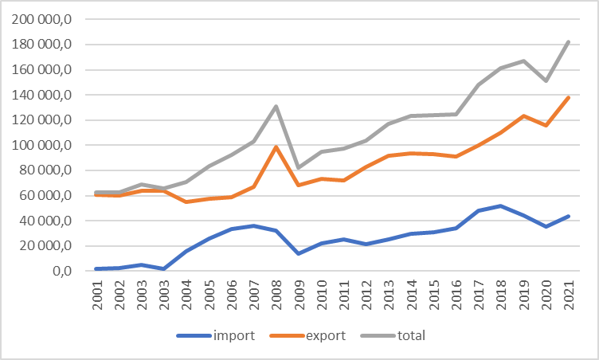
Hungary & BiH – trade&FDI
Increasing trade
10th largest importer in BiH (similar volume as Russia)
12th largest exporter
But BiH is only the 33rd largest export market for HUN
but very low FDI figures (only KOS lower in WB) and shrinking
22nd largest FDI stock
Weaker economic interests compared to Serbia or Croatia - why then?
Hungarian financial support for SME’s of RS BiH – 35M EUR (2022-) practically financing RS

Slide 44
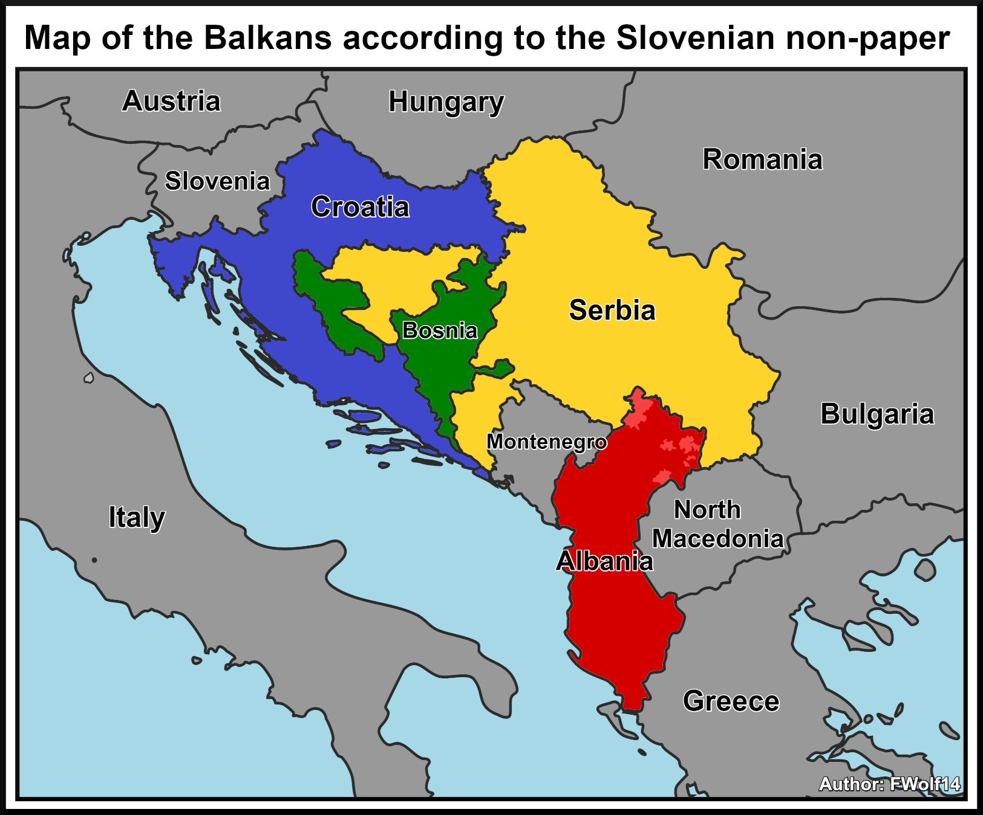
Hungary & BiH - politics
Using supranational institutions
  NATO liaison office in Banja Luka
  Peacekeeping (EUFOR-ALTHEA)
  Commissioner for enlargement (Mr. Várhelyi)
Increasing number of official meetings (PM)
  28th Nov. 2017. – PM of BiH
  10th Dec. 2018. – Pres. of Presidency (Croat member)
  18th Jun. 2019. – Dodik (dev. rel.)
  23rd Sept. 2021. – Dodik (Bp Demographic Summit)
  6th Nov. 2021. – Dodik (huge delegation)
  …
Other acts
  COVID diplomacy
  Non-paper
  Controversial comments on 2 million muslims of BiH (21st Dec. 2021.) resulted in the cancellation of PM’s January visit to BiH
  ‚Bosniaks trick Croats’ (Tusványos ‚22)
  Orbán’s RS award
  Not voting for the memorial day of Srebrenica genocide in UN
  …

Slide 45
conclusions
State level regional development is both a consequence and a prerequisite of a stable, efficient and integrated state
In postwar BiH the case of transportation is an entity/ethnic business – not suitable for integrating a state
Antagonistic and competing visions and plans
It is a mean to control space and development on entity level
Parallel developments increase the costs in a resource-scarce state
Without centralization no real and sustainable development is expected
Centralization is not in the interest of Serb and Croat elites
Creating a state-level regional and transportation development agency and plans would be a major step towards stability and integrity

