Slide 1
Reményi Péter, PhD
University of Pécs
Hungary
remko@gamma.ttk.pte.hu

Slide 2
About me
Master of geography and history
2009 PhD – geography. Title: Political Geographical Consequences of the Break-up of Yugoslavia and it’s Impact on the Settlement System of the Region
Associate professor at the University of Pécs, head of Department of Political Geography, Regional and Development Studies
Researcher at HUN-REN Center for Economic and Regional Studies
Main area of research&education: political geography, geopolitics, border studies, geography of Central and Southeastern Europe

Slide 3
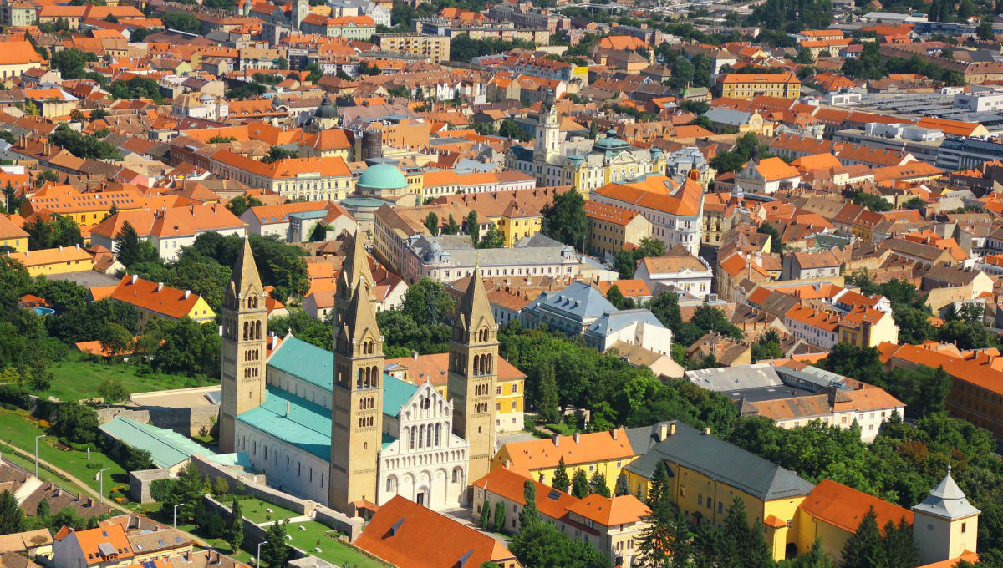
My town – Pécs
The fifth largest in Hungary ~ 150.000
At the foothills of Mecsek (coal&uranium – mining heritage)
University town
Diverse ethnic/cultural background
UNESCO WH site
2010 European capital of culture

Slide 4
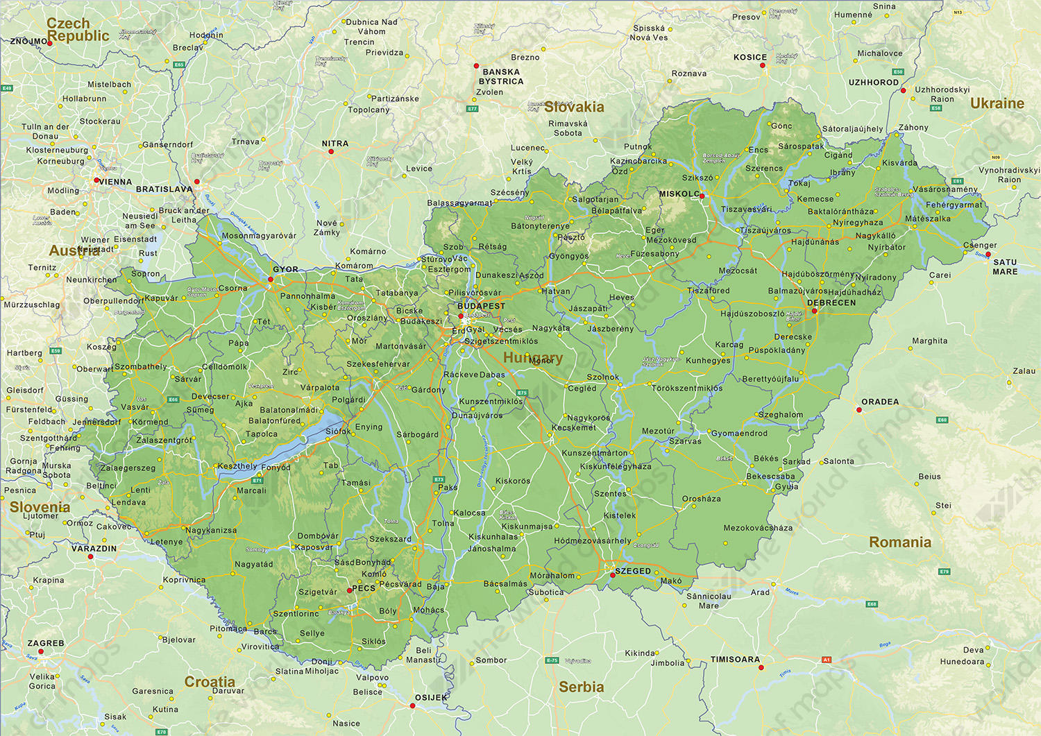

Slide 5
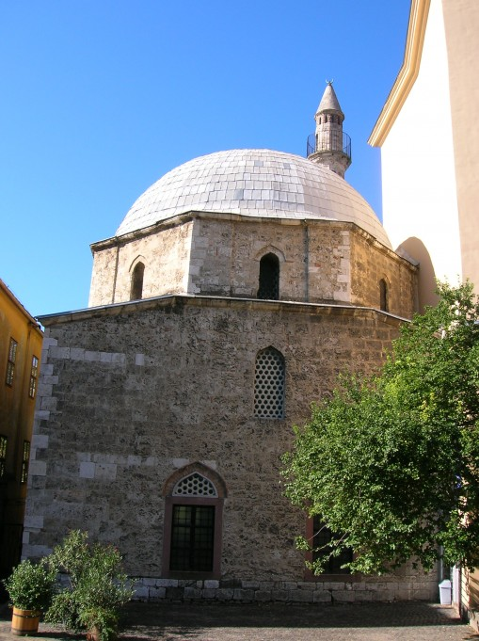
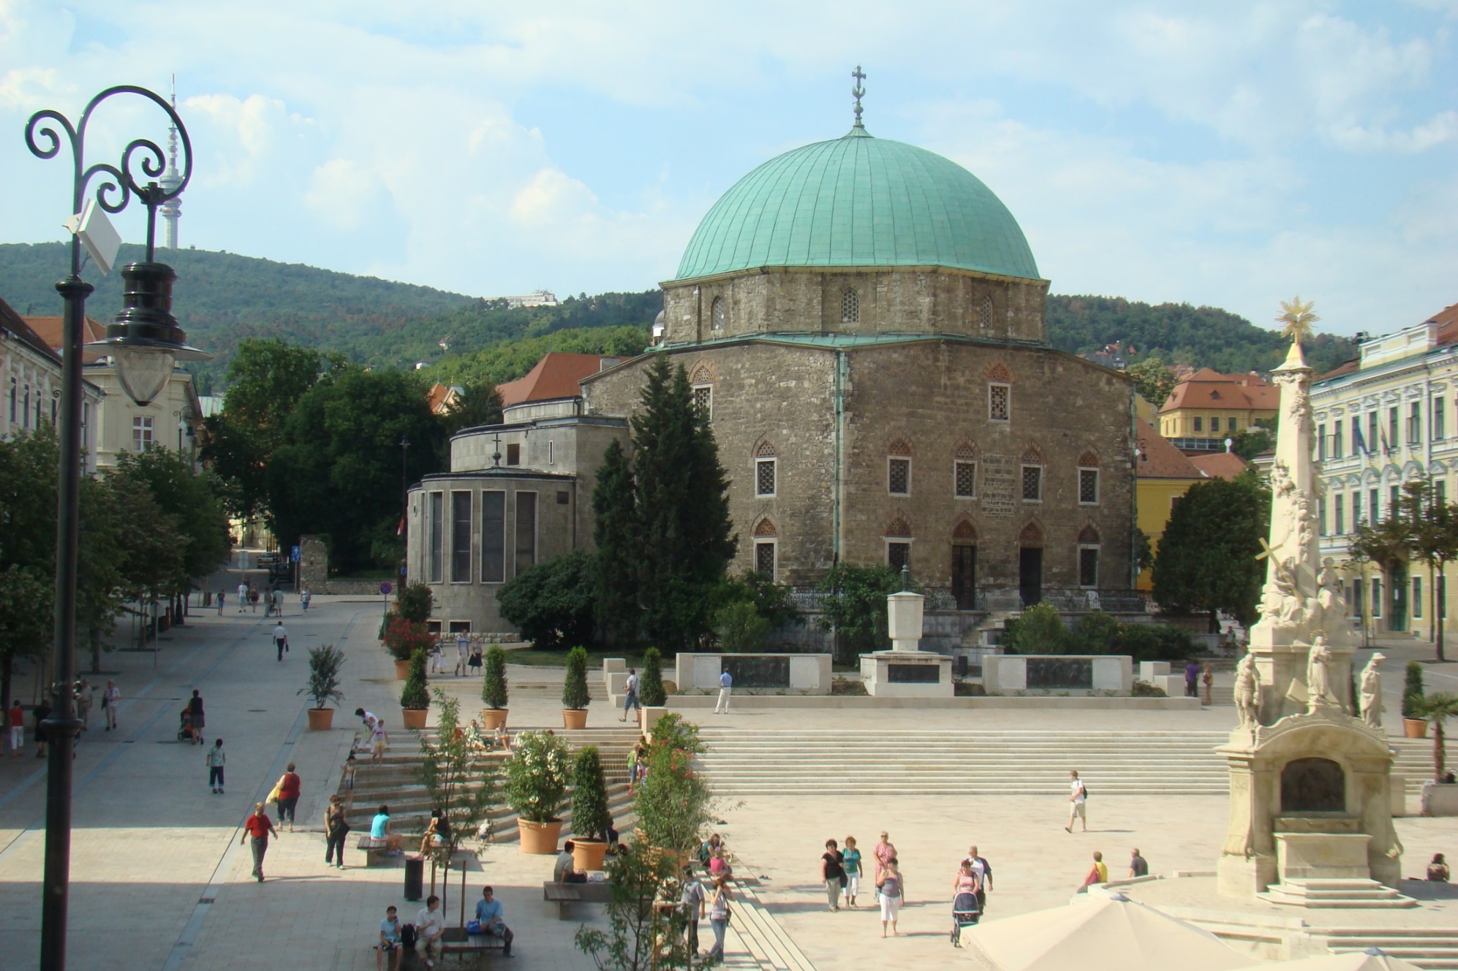
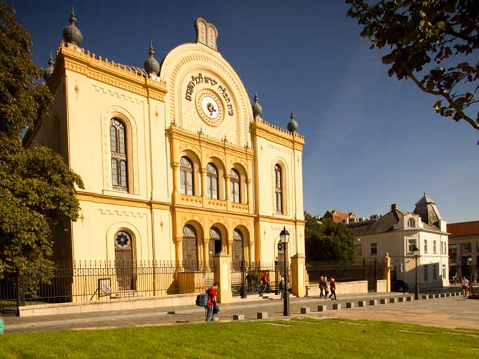
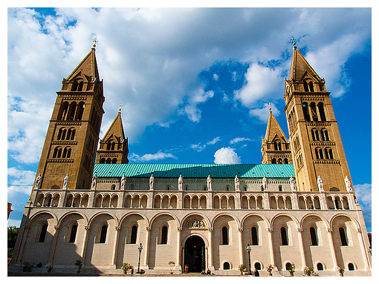
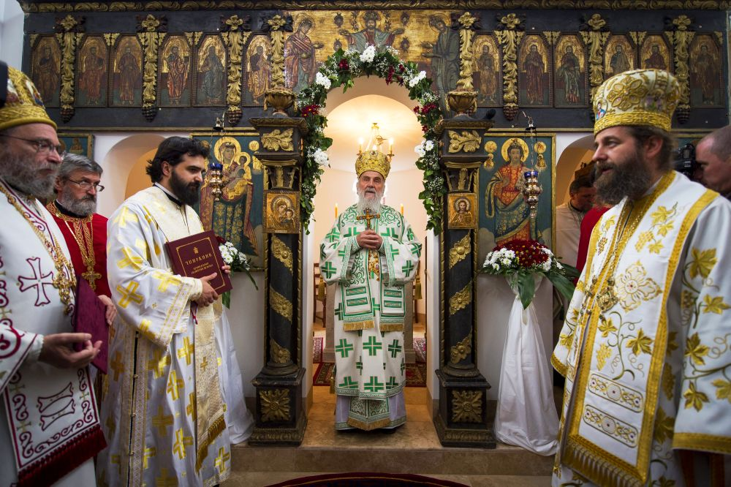
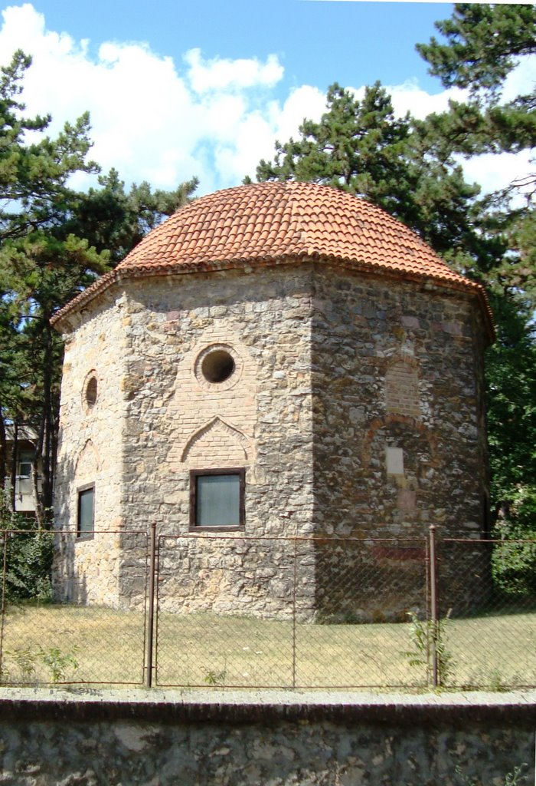
Diverse cultural heritage

Slide 6
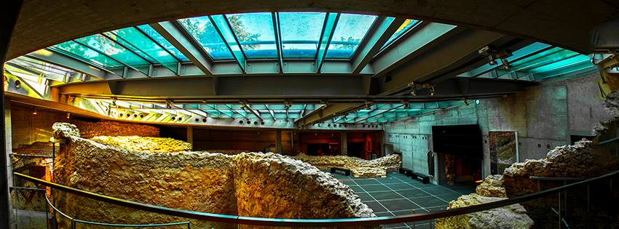
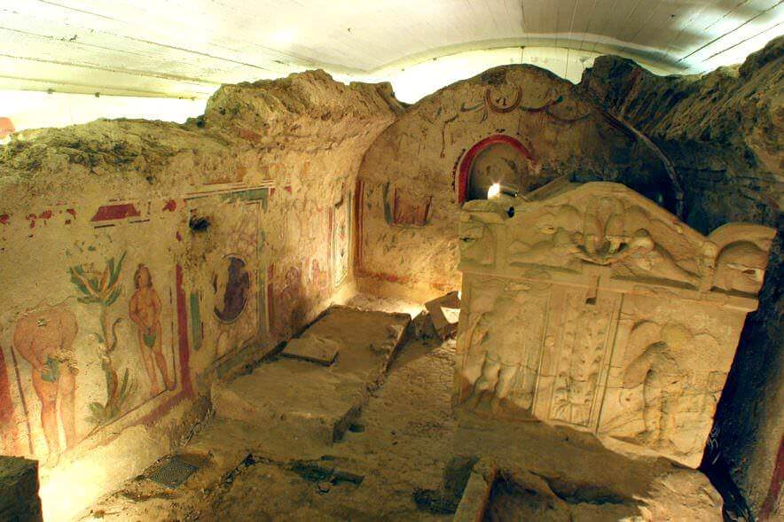
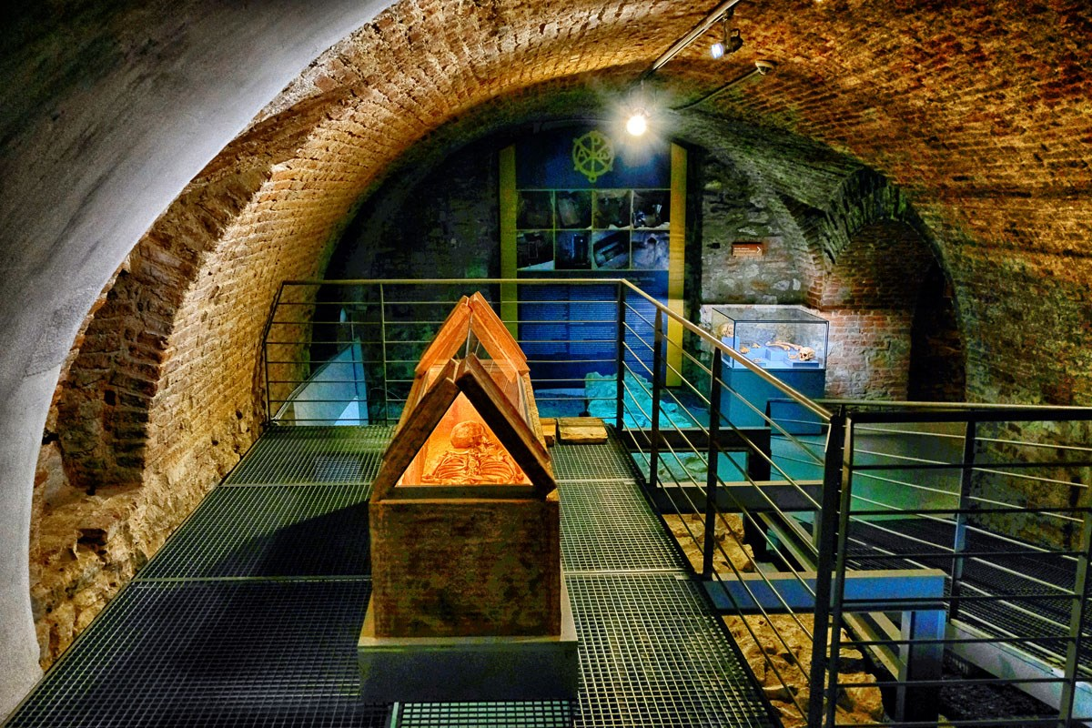
UNESCO WH

Slide 7
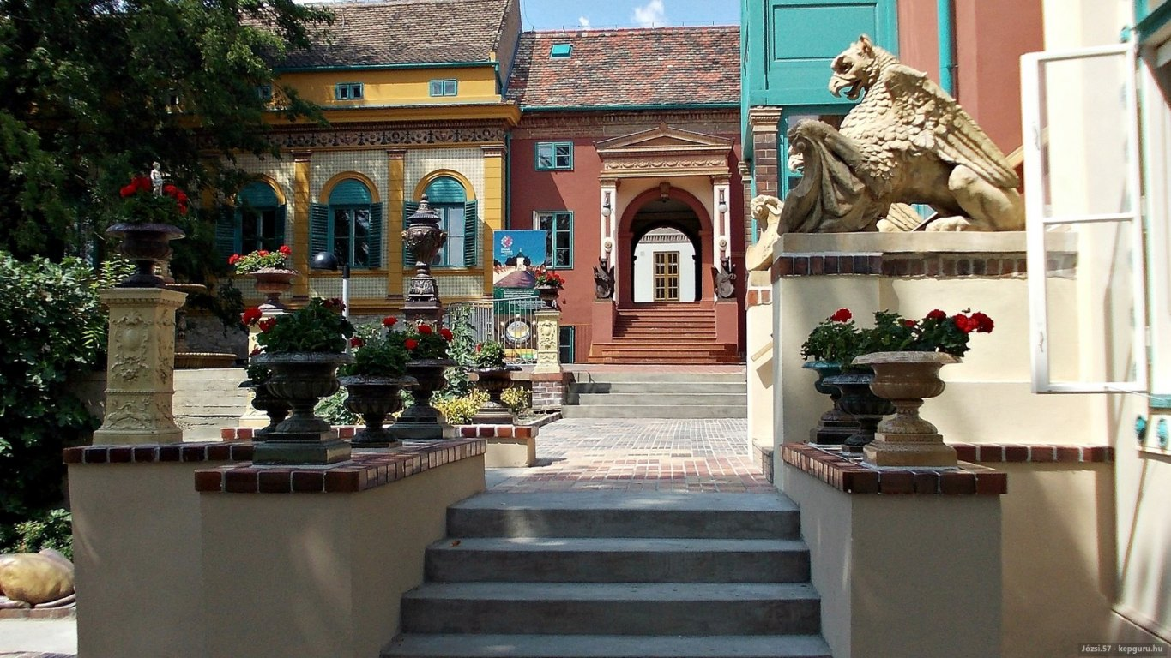
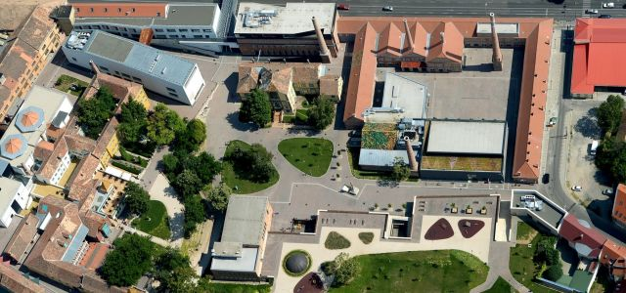
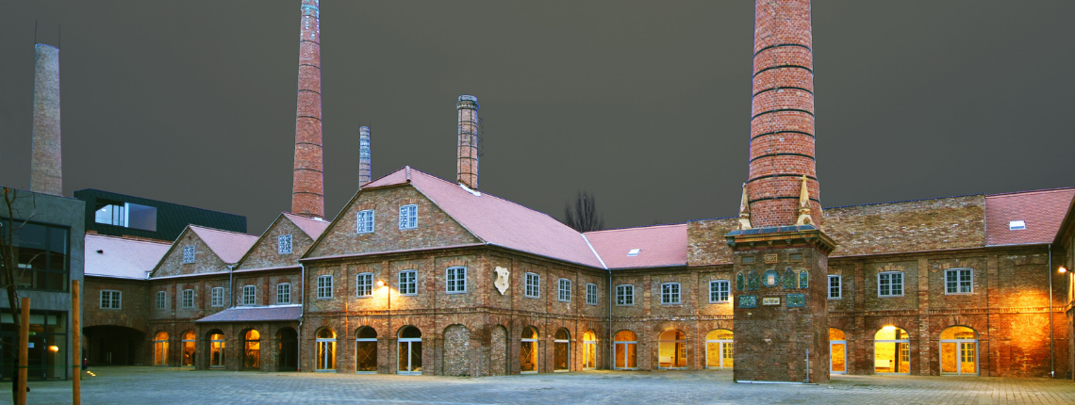
Zsolnay quarter – industrial heritage

Slide 8
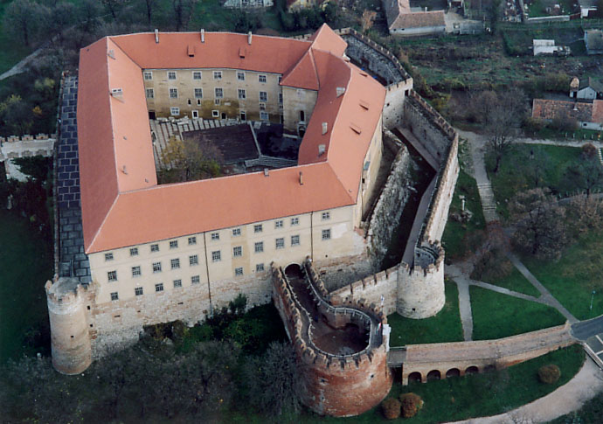
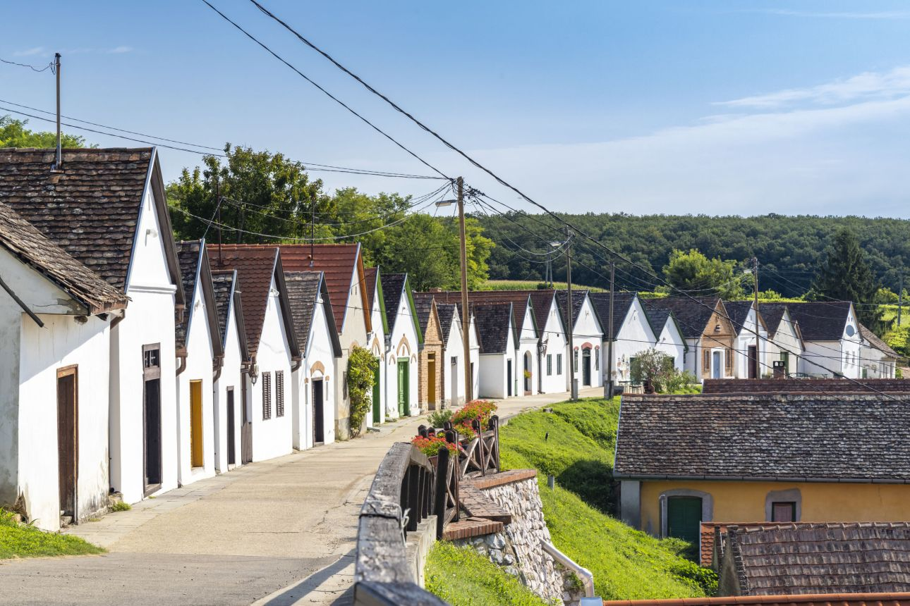
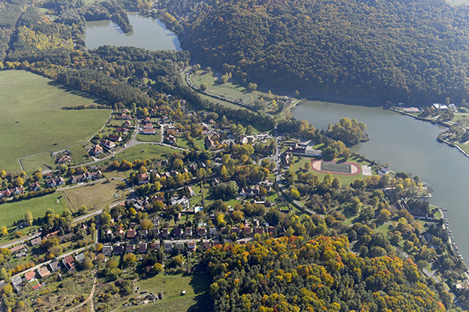
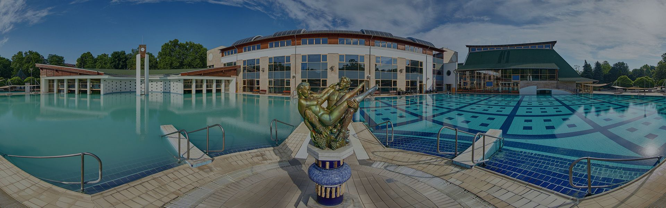
Around Pécs
Villány – wine
Harkány – spa
Szigetvár, Siklós – castles
Orfű – nature

Slide 9

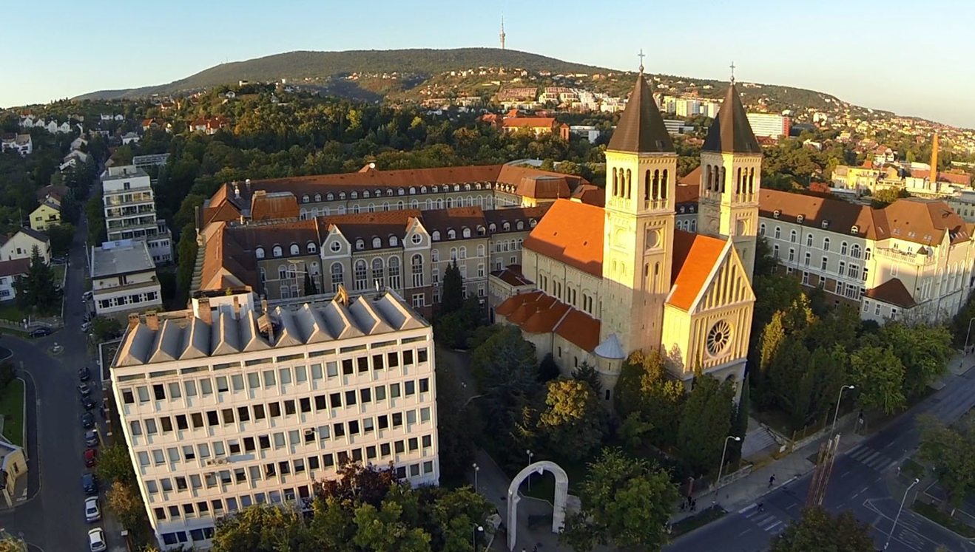
My university
The oldest in Hungary – 1367
One of the largest universities in Hungary
10 faculties, 1400 lecturers, 20.000 students
of which around 5000 international

Slide 10
Introduction to the political geography of Hungary

Slide 11
Political geography
„…geography is about power…” (O’Tuathail)
Space&politics
It’s fundaments:
  Physical geography (it’s utilization)
  The people (not what they are, but what they think they are)
  History (it’s interpretation)
Actual elites’ influence

Slide 12
The geography

Slide 13
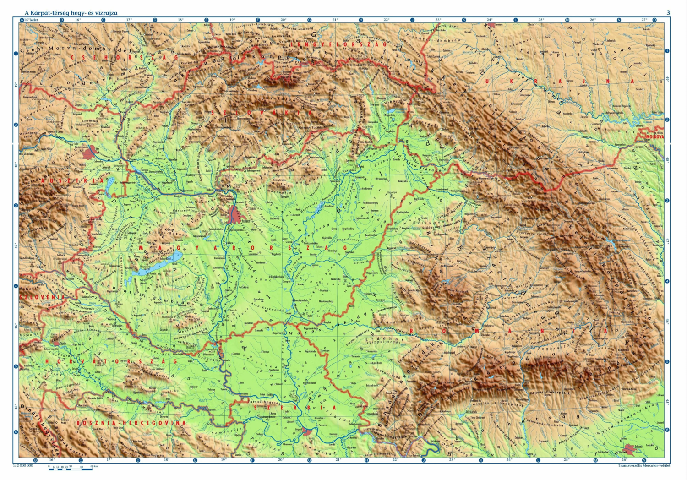
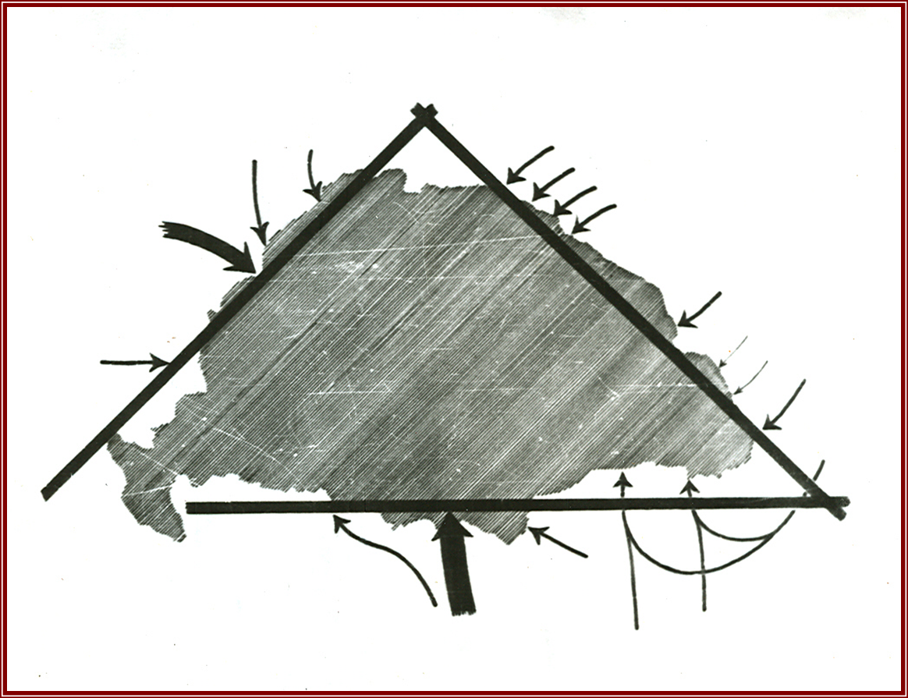
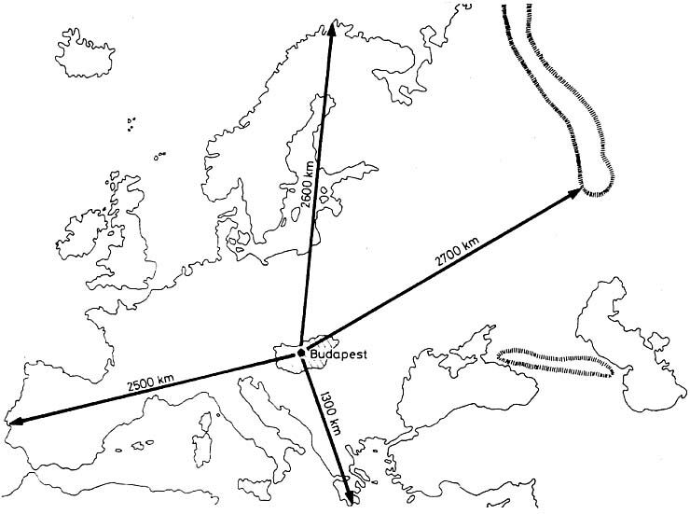
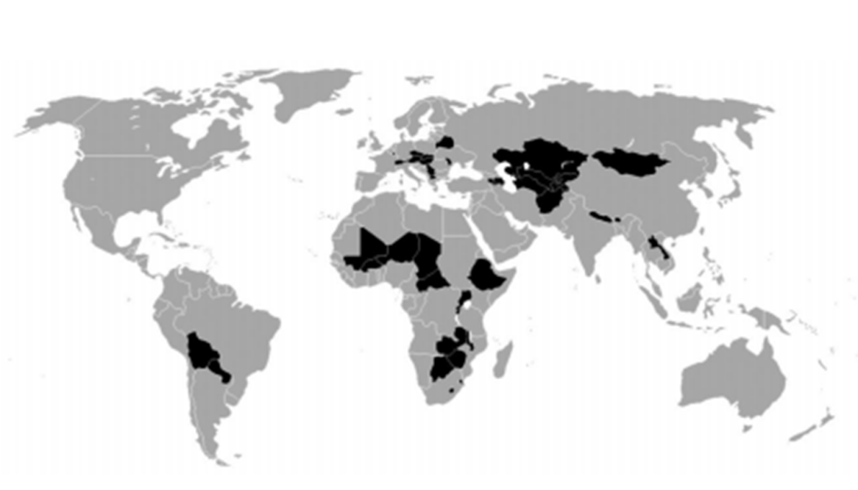
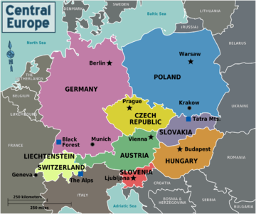
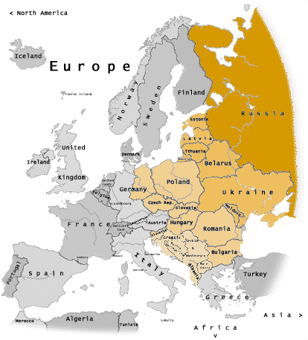
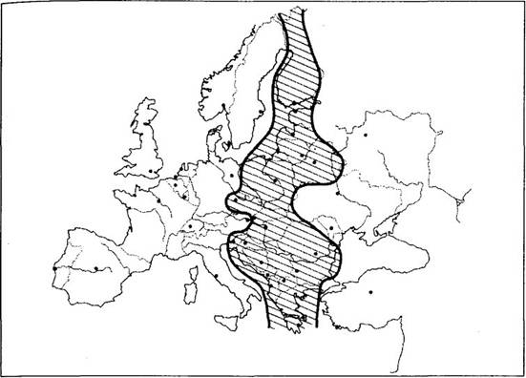
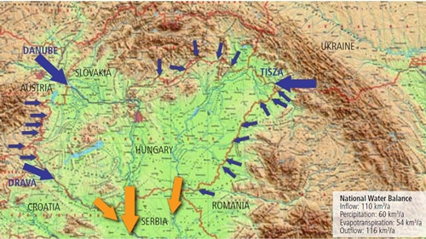
Relative geographical position
Eastern Europe?
Central Europe?
Europe in between (Zwischeneuropa)?
Landlocked
Bottom of a basin

Slide 14
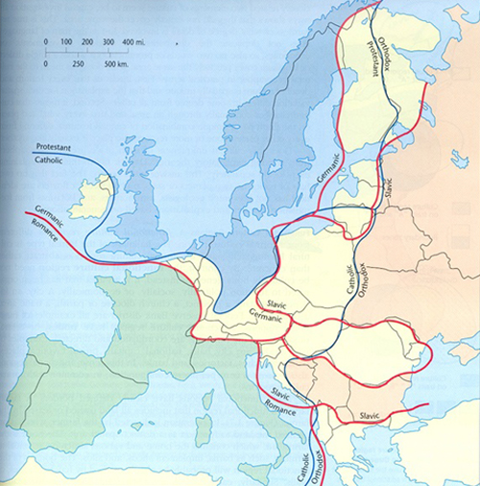
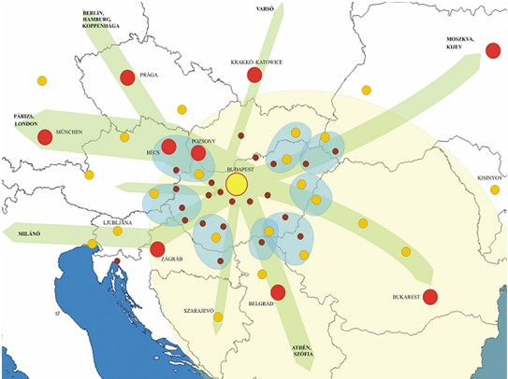
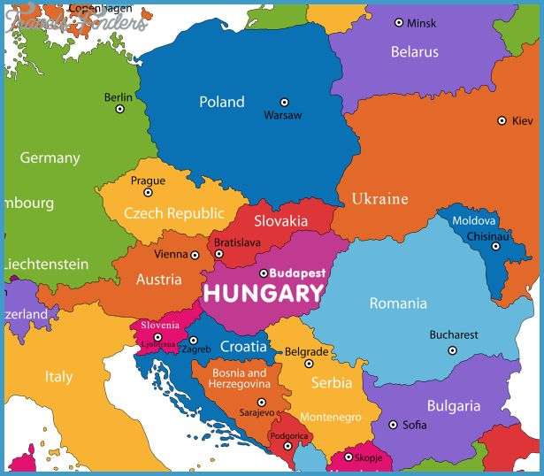
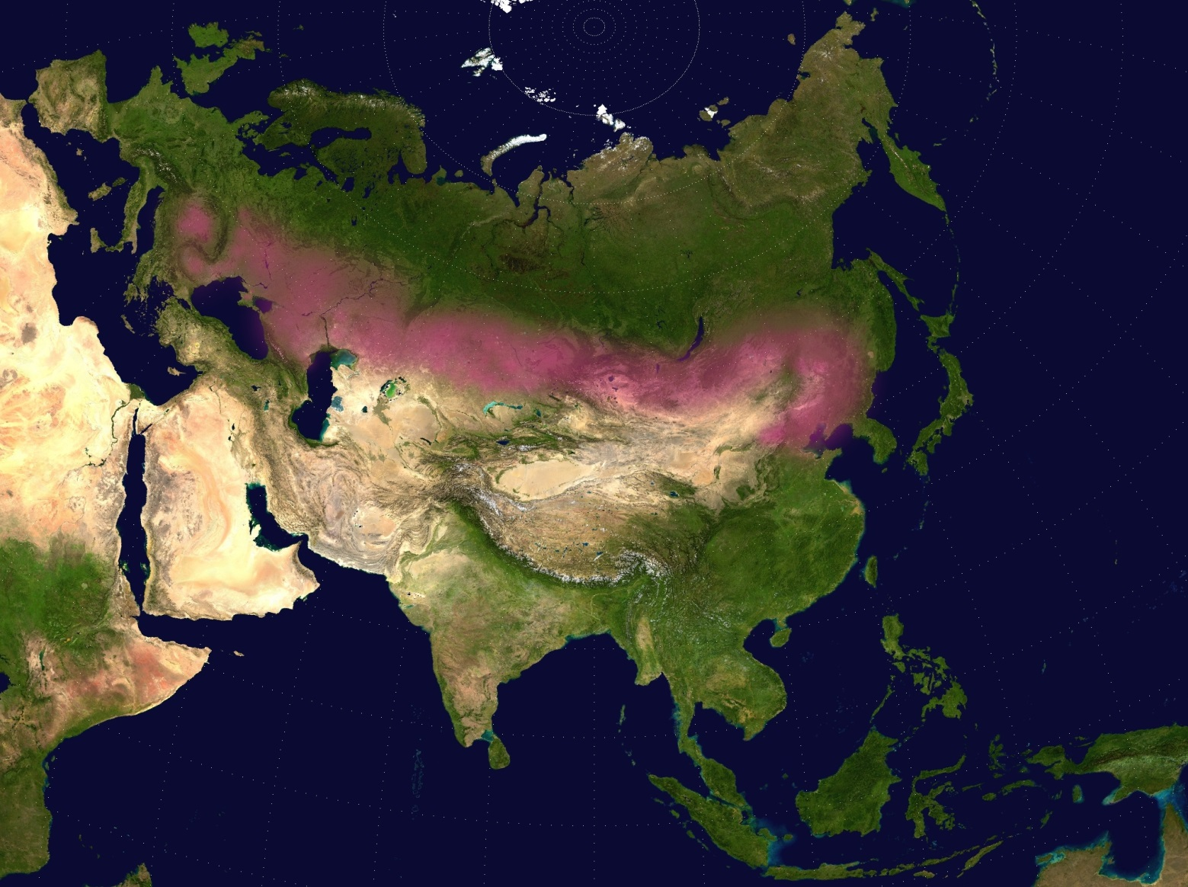
Buffer zone – Contact zone
The westernmost steppe
German Europe – Slavic Europe
Western and Eastern Christianity
Strategic routes (NW-SE, SW-NE, Danube)
Many neighbors

Slide 15
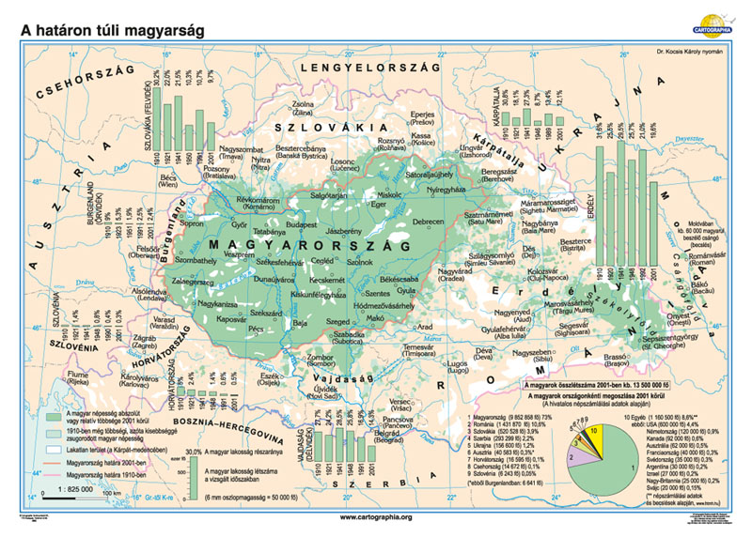
The Hungarian state
Unitarian state (tradition of centralization vs. regional reforms)
Hungarian (Magyar) nation (cultural nation/ethnic nation – mother tongue!) Hungarians (Magyars) beyond the state borders, diaspora – centuries old tensions between state territory and area inhabited by Hungarians
Compact shape
Small/medium sized (93.000km² 380x520km)
Parlamentarian republic (with monarchic nostalgy, recently drifting towards authoritarianism…)
(still) Member of the EU and NATO (alliances and limited sovereignity)

Slide 16
The people

Slide 17
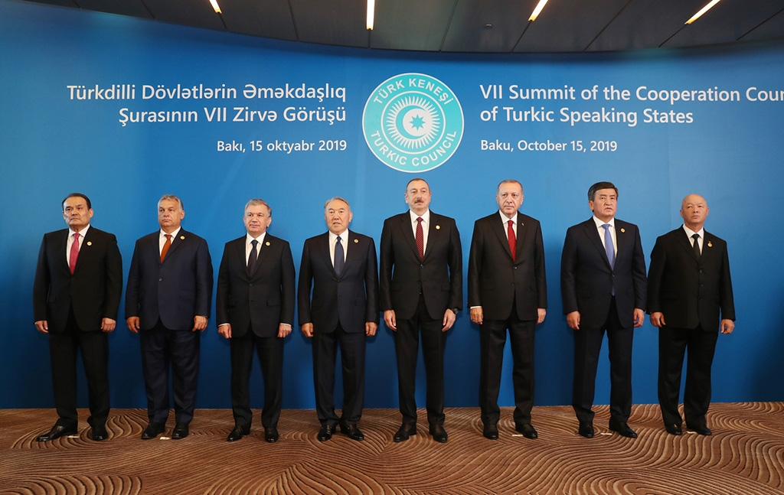
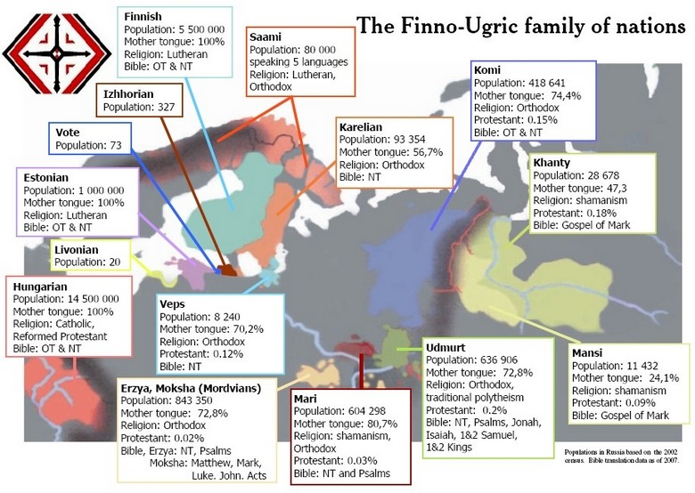
The Hungarian people
Total population of Hungary: ~10million
Total population of ethnic Hungarians: ~14million
Asian origin (historical records, archeology, etc.)
Competing theories (Finno-ugric vs. Turkic origin) – geopolitical significance
Assimilating various CE people from the early middle ages up until 20th c.
Hungarian culture and language survives but the anthropologically/genetically Hungarians/Magyars disappear
Language-based community, (ethno-)lingustic nationalism

Slide 18
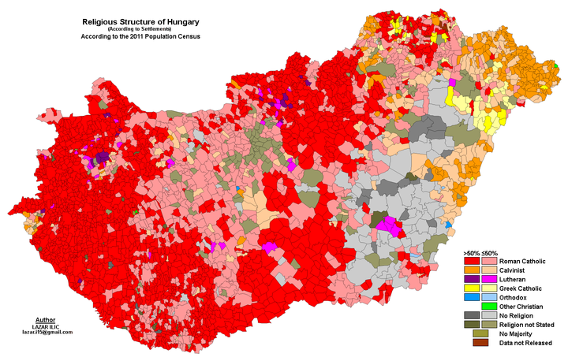
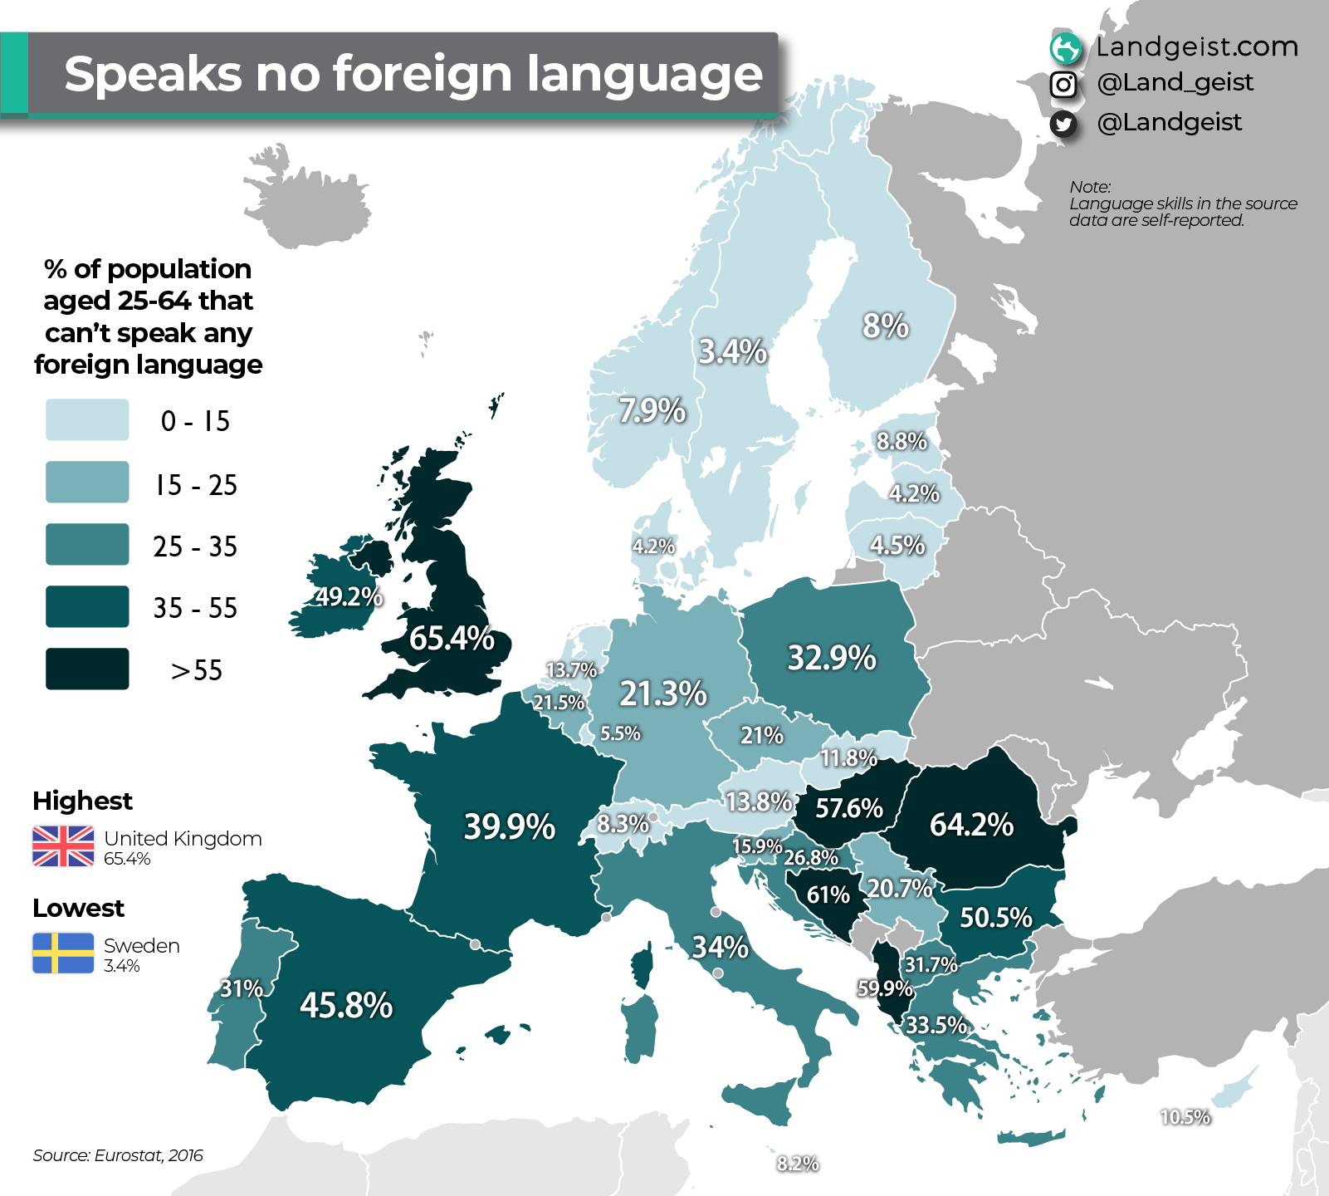
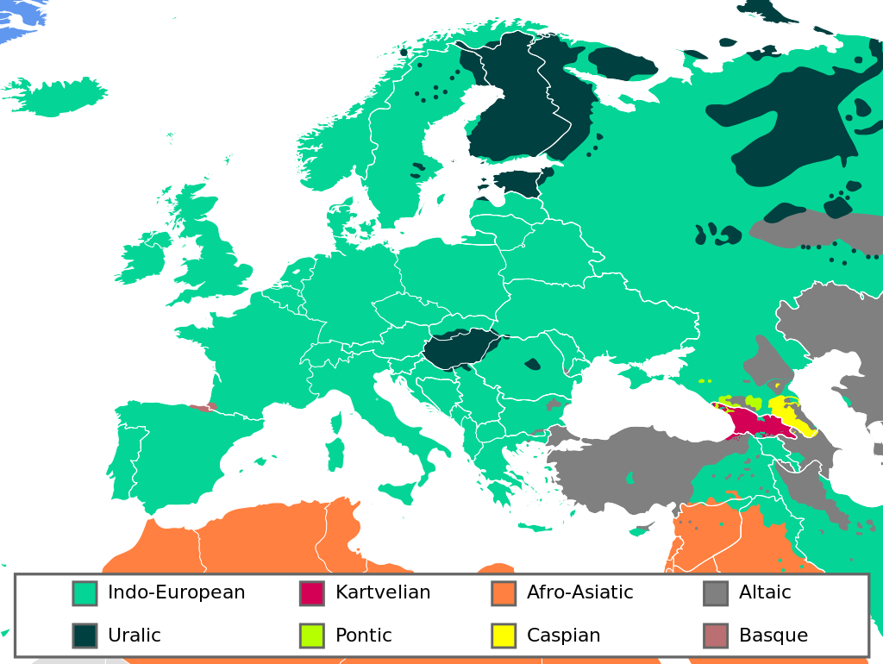
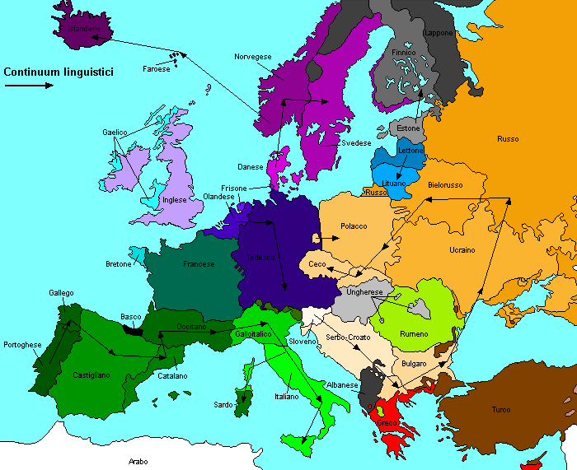
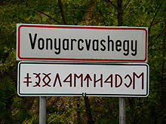
Language&religion
No ‚big brother’ or language-based community – we are alone but we are unique/ particular as well

Slide 19
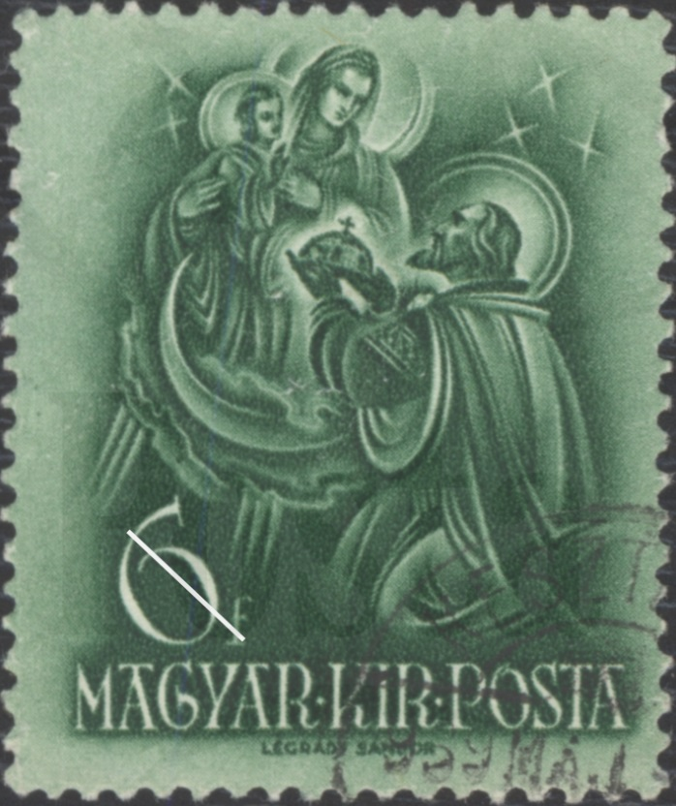
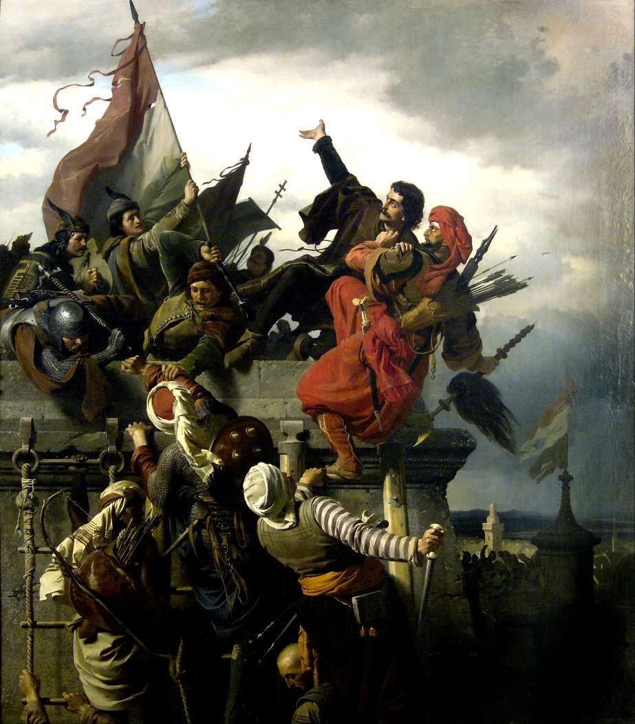
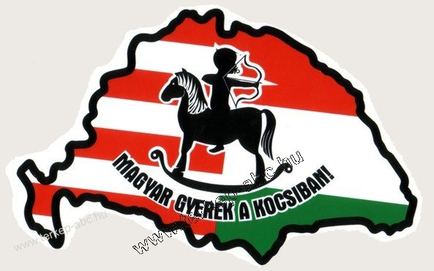

Popular perceptions of Hungarian political geography
The state of Virgin Mary,
Bulwark of Christianity/the West,
The westernmost East/the easternmost West
The happiest barrack
Permanent westernization, European projects, catch up with WE
„ferry-state”
Great power nostalgy

Slide 20
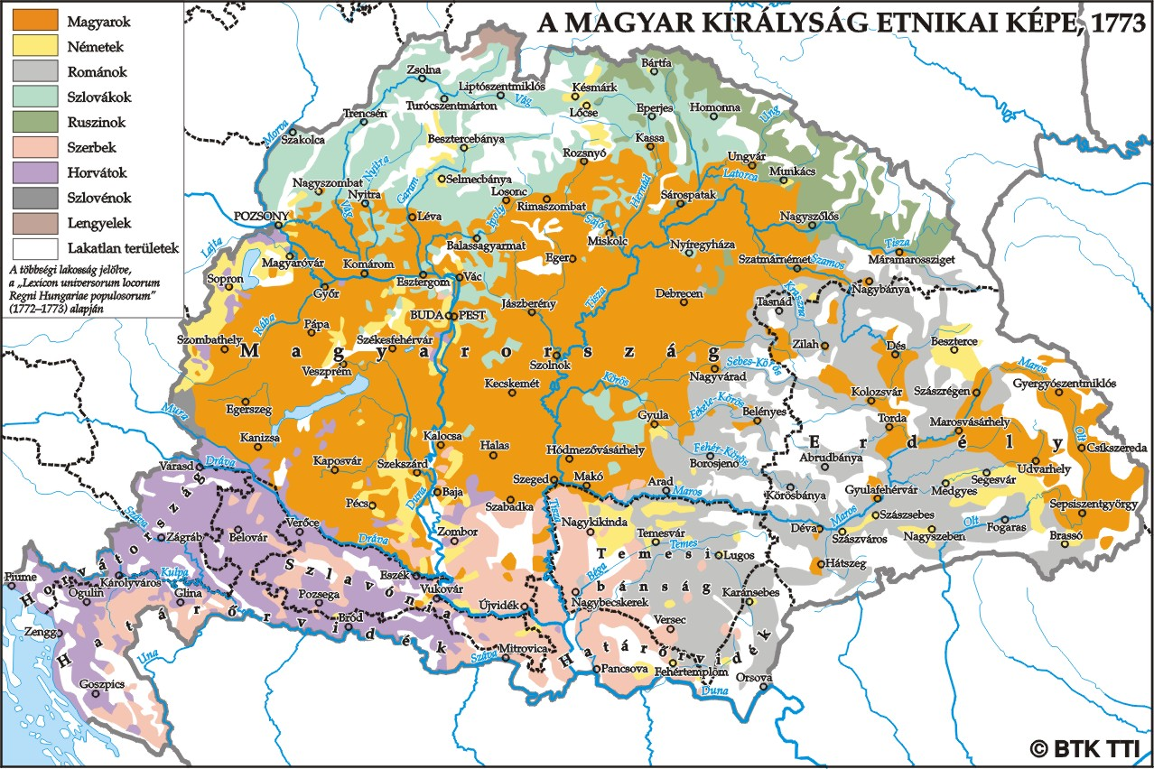

Slide 21
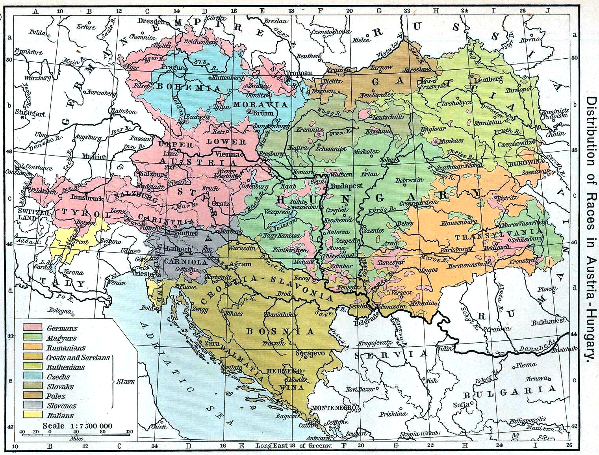

Slide 22
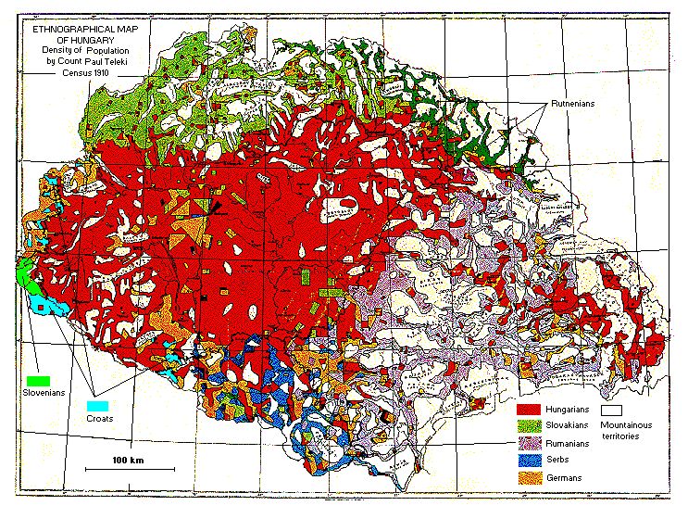

Slide 23
The history

Slide 24
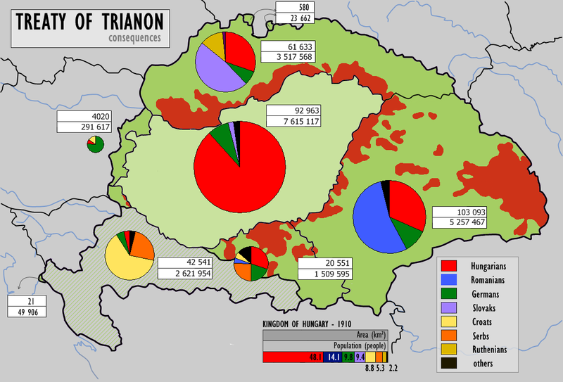
‚You know you are Hungarian if Trianon hurts’
The lost war and the loss of territories remain in core of Hungary’s political geography
It influences domestic politics as well as foreign policy
The society can be mobilized easily along this issue
In the interwar period it is the major principle
With various strength it remains a defining factor

Slide 25
Major consequences
Ethnic Hungarians beyond the borders – influence on foreign as well as domestic politics
Overtly or covertly influencing neighborhood policy
  Kin state-ethnic minority-nationalizing state relations (see: Brubaker)
Mobilizng factor -> there are politicians from time to time to use it – the aim is domestic but the consequences can be international
Disruption of territorial structures – defense, urban network, resources, accessibility, economy….
Primate city – Budapest vs. the rest

Slide 26
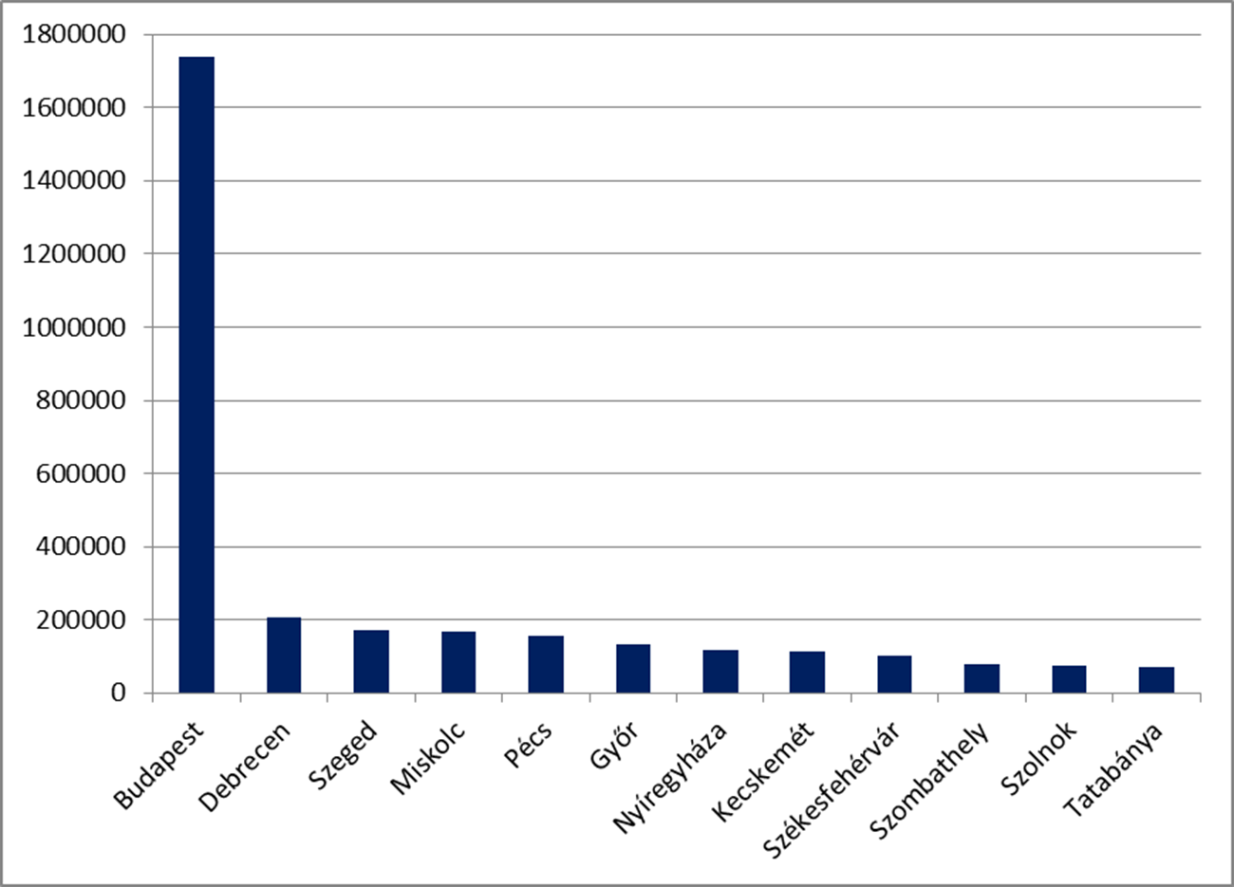
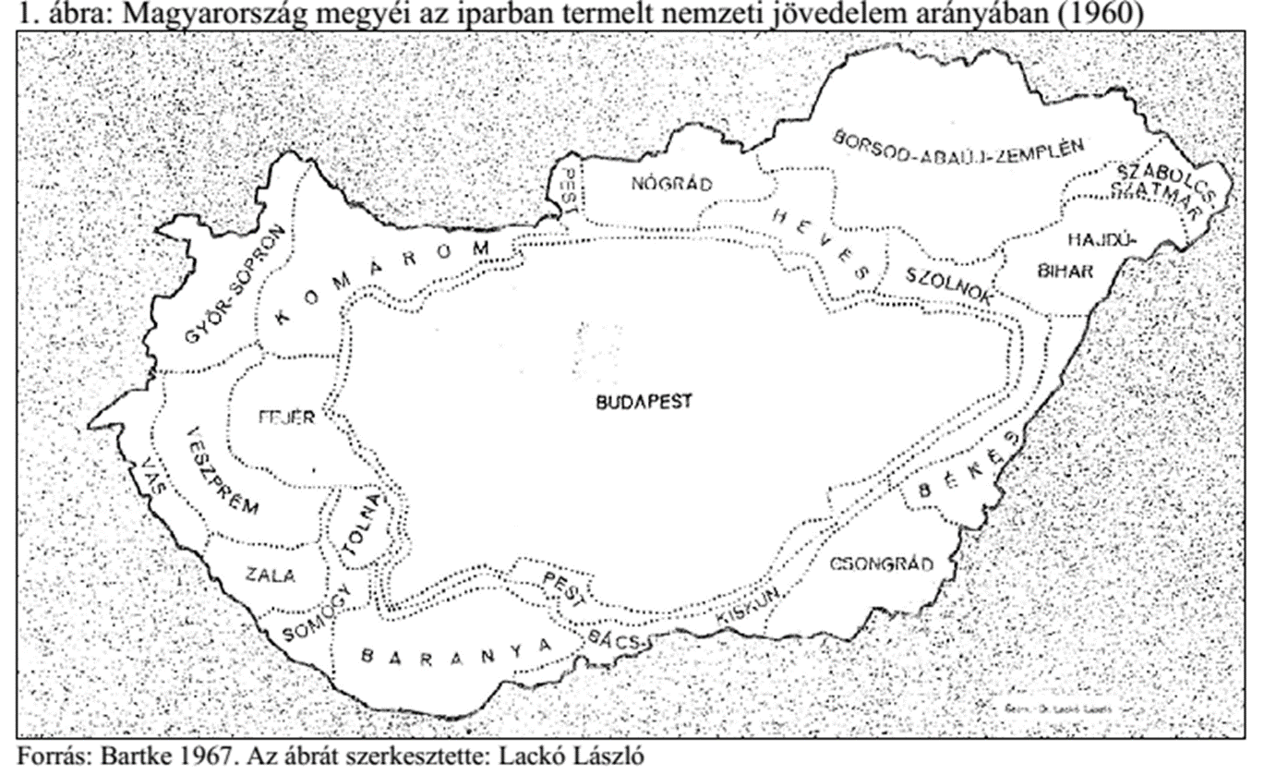
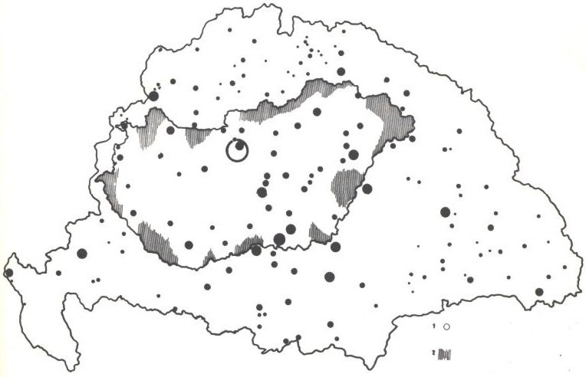
Historical background to the settlement system
Trianon hatása a városhálózatra
Peripheric areas
Lost their centers
Traditional border
Kassa/Kosice
New „Trianon”
Border (1920)
Pozsony/
Bratislava
Budapest
Kolozsvár / Cluj
Zagreb
Temesvár/Timisoara
Lost secondary
centers

Slide 27
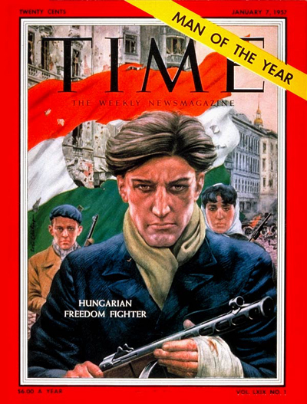

Cold war
In the bipolar world Hungary became part of the soviet bloc
Decreased sovereignity, 1949 Comecon, 1955 Warsaw pact, no independent (geo)politics
1956,
second half of 1980-ies increasing room for maneuver,

Slide 28

Post-1989 geopolitics
Rebirth of independent Hungarian geopolitics – three principles:
  EuroAtlantic integration – 1999/2004
  Hungarians beyond the state borders
  Good neighborhood relations
Dissolution of neighboring states (CZ, SU, YU)
  Growing relative geopolitical significance
  Conflict zones in the neighborhood
  New Balkan politics

Slide 29
New geopolitics (2010-)
Balancing between the EU and Russia (East and West)
Cooling down of transatlantic relations
The new principles:
  Competitive Hungary in the EU
  Successful Hungarians(Magyars) in the Carpathian basin – new nation/kin-state politics
  Responsible Hungary in the World
Illiberal democracy
New eastern relations – Russia, Azerbaijan, China, Saudi-Arabia, Turkey, Vietnam, Kuwait, Kazakhstan, Georgia etc. – not a success story
Today’s foreign policy is subordinated to domestic politics
From a forerunner of democratization to the odd man out in the club

Slide 30

Hungary and its borders
Borders form a core element of 20th century politics in Hungary
as well as public discourses

Slide 31

In the core of the discourses (1920-45)
In the interwar period revisionism influenced almost every other social and political issues, it was the ultimate national goal – unilateral debordering

Slide 32



Closing the borders (1945-1980-ies)
The borders were difficult to cross, in times they were even fortified and militarized – unilateral rebordering
However it remained part of (covert) popular geopolitical discourse especially in the Hungarian diaspora

Slide 33


Re-entering the open discourses (1989-2010)
Deconstructing barriers and reconstructing missing links
Virtualization of borders – multilateral debordering
in practical geopolitical discourses: „in spirit I’d like to be the PM of 15 million Hungarians” A.J.

Slide 34
Elites’ choice

Slide 35

Reaching next level (2010-2014)
2010 – the new govt. marked the start of new practical discourses on the borders
Passportization – double citizenship - fierce debate over it in Hungary – multiplication of boundaries (legal vs. spatial) in regions with significant Hungarian population
Symbolic acts: the day of national cohesion (Trianon), flag of Székelyland flies over the Hungarian parliament, etc.
New slogans: Carpathian economic zone, virtual unification of the nation… etc.
Major aim: fostering and encouraging group identity within Hungary – domestic use – an unilateral (virtual) debordering

Slide 36
The new challenge (2015-)
Refugee/Migrant crisis of 2015 – no European answer – highly divisive issue in Europe
Hungarian responses:
  border fortification and securitization (southern borders – HR, SR, RO)
  New laws (criminalization of illegal border crossing)
  Raising xenophoby in media
  Tropes and metaphores of practical geopolitical discourses are militarized (captain of border fortress, defending bastion of the West (~Fortress Europe)) – Hungary and Europe is under attack (by muslims from the south) – very familiar phrases in Hungary
All related to the borders, focusing on the southern border: an unilateral rebordering

Slide 37




The southern border
Hungary’s southern border (wherever it actually may be) has always been perceived widely by the public as the boundary between the West/Europe (associated with civilization, christianity etc.) and the East/Balkans (assoc. with underdevelopment, barbarism, Islam/orthodoxy etc.)
According to Gallup 71% of the Hungarians agree with the statement that Hungary has been the bulwark of Europe for 1000 years (and there were no reward for that)
Battles with the Ottoman empire from late 14th century until early 18th century > an era filled with heroes, important part of Hungarian identity
For one and a half centuries the „southern border” ran across Hungary between the Habsburgs and the Ottomans
A distinct type of Hungarian national hero was born here, the border captain, all Hungarians know well, it is an integral part of Hungarian identity (and school textbooks, novels, poems, art…)

Slide 38
Political utilization of the southern border
Practical geopolitical discourse, building on the public notion of the southern border:
  Since Europe is unable to defend its borders Hungary has to act on its own (PM 04. Sept.)
  The Borders of Bavaria can be defended at the external borders of the EU, and this is today the southern border of Hungary (PM 19. Sept. in Bavaria)
  PM also noted that now he is the captain of the border fortress, not because he likes to be but because he has to be – duty, sacrifice (PM 19. Sept. in Bavaria)
  All the terrorists are migrants, the only question is when they arrived to Europe (PM 23. Nov.)
  The migrants are not fleeing to Europe, they are invading us. (PM 2. Dec.)
  The Bulgarian-Macedonian defensive line is ready (M. of Foreign Aff. 21. Jan.)
  The migrants’ route will never cross Hungary again (PM 22. Jan.)
The public support of the border fence rose from 62 to 85%
Announcement of the construction of a second „wall” which can stop masses, not by words but by force, semi-war situation (aug. ’16)

Slide 39


Public opinion polls in March and November 2015

Slide 40
conclusion
Due to historical reasons it’s easy to put the borders into the centre of public discourses (everyone have an opinion )
It’s easy to talk about the southern border in the context of defense, military since there are well known historical analogues and it is an integral part of Hungarian identity
It’s hard to formulate the counternarrative – too complicated to decode
The discourses lead by the government about the borders are therefore for domestic use (strengthen group identity, creating an image of an enemy and a sense of threat)
Thus borders are used as resources, but not for international relations but for domestic goals – maintaining power

Slide 41

Securitization – findig the right threat to defend the voters from

Slide 42
Hungarian spatial structures and political geography

Slide 43


Slide 44
Population of major cities in Hungary

Slide 45

Counties as their share in industrial output in 1960

Slide 46


Budapest, the only metropol
Strong concentration of functions
Gateway
City-race
Dynamism
Social segregation
Tourism

Slide 47



Slide 48



The „weight” of Budapest in national income

Slide 49

Spatial structures of industry before and after 1989
The spatial structure of the transition period

Slide 50

Theorethical structure of settelment system

Slide 51

The basis of spatial structures: cities (nodes) and corridors (movements)
1- national spatial axis, 2 – regional s. a., 3 – node, 4 – more integrated spaces,5 – less integrated spaces, 6 – major intn’l directions (J. Tóth)

Slide 52

Spatial structure of Hungary – Enyedi 2000

Slide 53



Spatial structrue of Hungary 2013

Slide 54

Functional regions of Hungary

Slide 55

Development faultlines – 2, 3 or 4 parts

Slide 56
conclusions
Central Europe
Buffer zone
Small nation/state
Perception of lonelyness
Trianon syndrome
  Spatial structure
  Primate city – Budapest vs the rest
  Kin-state politics
  Neighborhood relations

