Slide 1
Translating for museums
TRADUZIONE INGLESE 1
02/05/2023

Slide 2
Museum communication
Broad category which includes:
Museum guides
Museum labels or panels
Interactive web apps and GPS
Press releases / blogs or webpages
It can be verbal but also iconic.

Slide 3
Definitions
Il museo è un’istituzione permanente, senza scopo di lucro, al servizio della società, e del suo sviluppo, aperta al pubblico, che effettua ricerche sulle testimonianze materiali ed immateriali dell’uomo e del suo ambiente, le acquisisce, le comunica e specificatamente le espone per scopi di studio, educazione e diletto. (Def. di museo, ICOM, 2007)
Il Museo è un’istituzione permanente, senza scopo di lucro, accessibile, che opera in un sistema di relazioni al servizio della società e del suo sviluppo sostenibile. Effettua ricerche sulle testimonianze dell’umanità e dei suoi paesaggi culturali, le acquisisce, le conserva, le comunica e le espone per promuovere la conoscenza, il pensiero critico, la partecipazione e il benessere della comunità. (new definition, ICOM 2019)

Slide 4
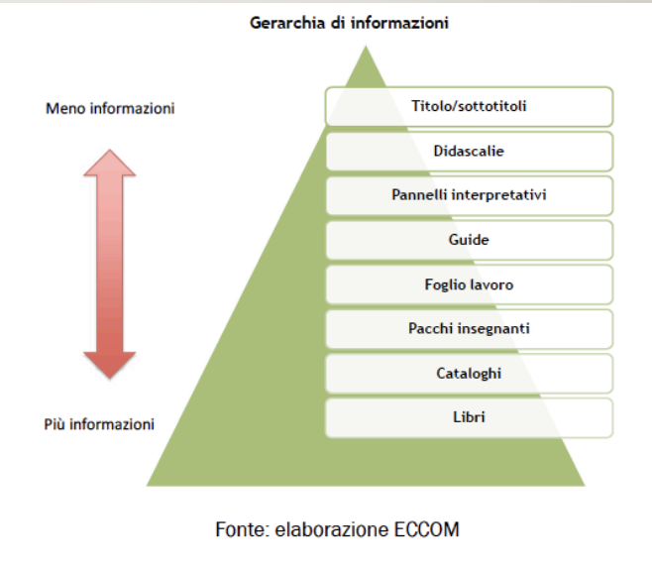
The information hierarchy
Textual level: panels
Panels and labels are part of a more complex system, devised to provide information on different degrees .

Slide 5
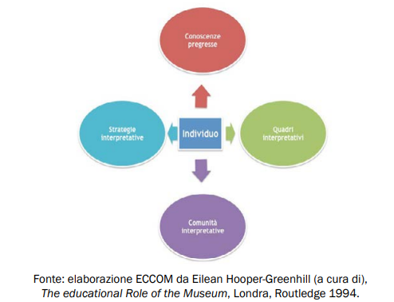
The questions
To whom are we communicating? Museumgoers at the centre
Museums provide the right context for the learning process: motivation is personal growth
What are we communicating?
Fixing decontextualization with explicit networks
Where are we communicating?
Position of panels and labels: next to the object
they refer to
How are we communicating?
Panels and captions as the main media (no other senses
involved)

Slide 6
How to write
Simplification : interesting information that can be understood by a wide range of users. Careful with specialized language for non-experts!
Simplification = reducing complexity + enhancing meaning
Readability + accessibility
Readability: same font (avoid comic sans & co), dimensions and colors
Accessibility: providing information without having to interpret them.

Slide 7
(Italian) museum panels or captions
Specialized terms:
Complex syntax : length and subordinates
Lexical density
Some writing rules:
Opting for structures typical of conversational style;
Explaining one concept per sentence; make sure that the sentence ends with the line;
45 characters per line; 4-5 line paragraphs;
Active form;
Using a variety of contents (quotations, critical opinions) to keep attention alive;

Slide 8
(Italian) museum panels or captions
Some writing rules (2):
Explain the specialized terms;
Make acronyms explicit;
Translate foreign words;
use nominalization sparingly

Slide 9
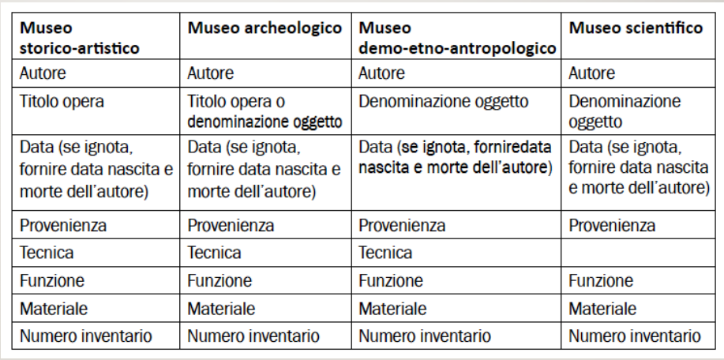
(Italian) museum panels and captions
Captions

Slide 10
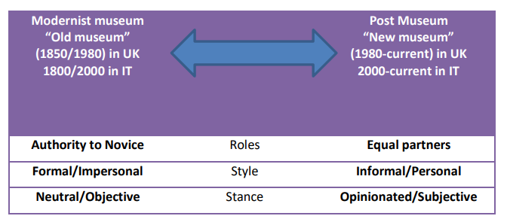
Functions and features
Informative: focus on the content;
Conative: 1st or 2nd person pronouns = personalization for immediacy, persuasive move. CAN WE KEEP PERSONALIZATION IN TRANSLATION? TARGET EXPECTATIONS, WHAT’S ‘TEXTUALLY APPROPRIATE’ (Baker 2011, 252).
The ‘voice’ of the museum : REGISTER!! ‘through the language that is used, texts convey and construct a certain kind of interaction with their readers’ (Ravelli, 2006:73). AUTHORITY VS PEDAGOGY

Slide 11
Some clues from museum professionals
‘great emphasis on the quality of translated texts, essentially in terms of accurate and reliable information and of terminological precision in the domain field’
‘concern for readability, especially when museum texts are written and translated by academics, who are used to academic writing in both the SL and the TL, but not to a more popularized style which can engage a larger public’
‘linguistic and cultural aspects of a ST need to be interpreted and adapted into cultural references familiar to the target audience. Professionals were acutely aware that frustration, cultural misunderstanding and exclusion may derive from ineffective translation choices’
(Bondi 2021, 70-71)

