Slide 1
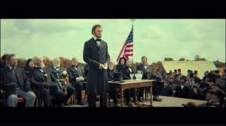
Political Speeches
Abraham Lincoln Gettysburg’s Address 1863

Slide 2
President Lincoln delivered the 272 word Gettysburg Address on November 19, 1863 on the battlefield near Gettysburg, Pennsylvania.
"Fourscore and seven years ago our fathers brought forth, on this continent, a new nation, conceived in liberty, and dedicated to the proposition that all men are created equal. Now we are engaged in a great civil war, testing whether that nation, or any nation so conceived, and so dedicated, can long endure. We are met on a great battle-field of that war. We have come to dedicate a portion of that field, as a final resting-place for those who here gave their lives, that that nation might live. It is altogether fitting and proper that we should do this. But, in a larger sense, we cannot dedicate, we cannot consecrate—we cannot hallow—this ground. The brave men, living and dead, who struggled here, have consecrated it far above our poor power to add or detract. The world will little note, nor long remember what we say here, but it can never forget what they did here. It is for us the living, rather, to be dedicated here to the unfinished work which they who fought here have thus far so nobly advanced. It is rather for us to be here dedicated to the great task remaining before us—that from these honored dead we take increased devotion to that cause for which they here gave the last full measure of devotion—that we here highly resolve that these dead shall not have died in vain—that this nation, under God, shall have a new birth of freedom, and that government of the people, by the people, for the people, shall not perish from the earth."

Slide 3
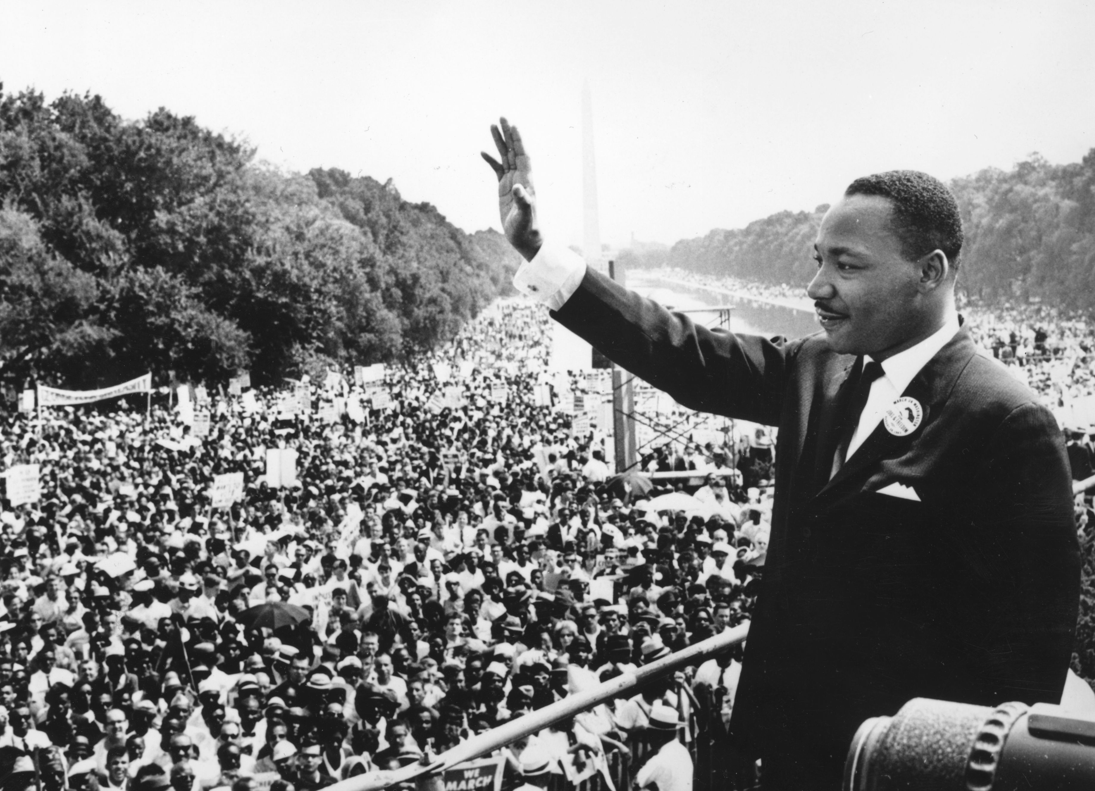
Political Speeches
Martin Luther King’s Speeches (Selma, Alabama, 1965)

Slide 4
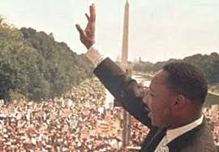
Political Speeches
Martin Luther King’s I have a dream speech (Washington DC, 1961)

Slide 5
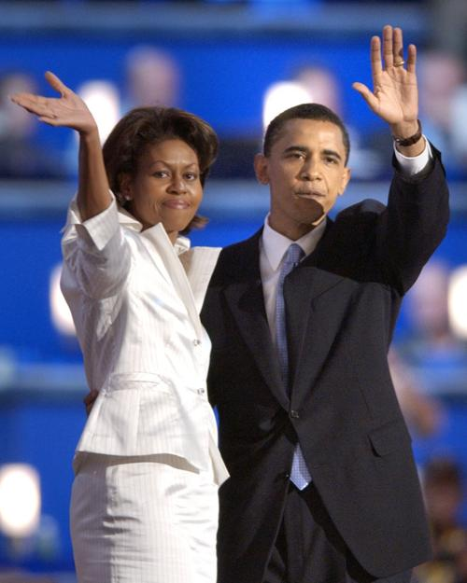
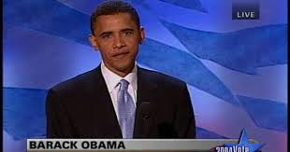
Political Speeches
Barak Obama
Democratic National Convention Keynote Speech July 27 2004
(first 3 minutes)

Slide 6
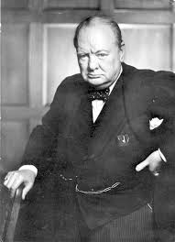
I have, myself, full confidence that if all do their duty, if nothing is neglected, and if the best arrangements are made, as they are being made, we shall prove ourselves once more able to defend our Island home, to ride out the storm of war, and to outlive the menace of tyranny, if necessary for years, if necessary alone. At any rate, that is what we are going to try to do. That is the resolve of His Majesty’s Government-every man of them. That is the will of Parliament and the nation. The British Empire and the French Republic, linked together in their cause and in their need, will defend to the death their native soil, aiding each other like good comrades to the utmost of their strength.
We shall go on to the end, we shall fight in France, we shall fight on the seas and oceans, we shall fight with growing confidence and growing strength in the air, we shall defend our Island, whatever the cost may be, we shall fight on the beaches, we shall fight on the landing grounds, we shall fight in the fields and in the streets, we shall fight in the hills; we shall never surrender, and even if, which I do not for a moment believe, this Island or a large part of it were subjugated and starving, then our Empire beyond the seas, armed and guarded by the British Fleet, would carry on the struggle, until, in God’s good time, the New World, with all its power and might, steps forth to the rescue and the liberation of the old.
Winston Churchill
«We shall fight on the beaches»
June 4, 1940
Darkest Hour (speech adapted) (2017)

Slide 7
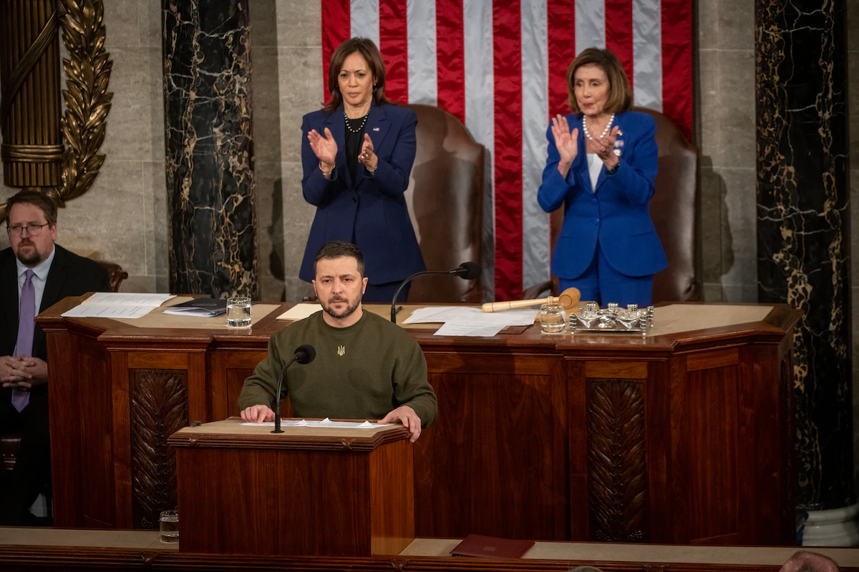
Power of Analogy

Slide 8
Power of Analogy
Since Russia’s war against his country, Ukrainian President Volodymyr Zelenskyy has directly addressed the elected representatives of multiple countries in his quest for international support. These speeches have made explicit references to parallels between his country’s current plight and the particular historical experiences of these nations.
This strategy is one of many that Zelenskyy has employed to successfully build international support for Ukraine. As scholars of post-Soviet politics and the use of historical memory, we think Zelenskyy’s addresses help garner global support in three key ways: He evokes popular empathy for the Ukrainian people, enables foreign governments to assess their people’s interest in supporting Ukraine, and highlights the importance of territorial sovereignty to world peace.

Slide 9
Power of Analogy
Germany
In his speech to the German Bundestag, for instance, he referred to the German people as standing behind a wall “between freedom and slavery.” That powerfully evoked the Berlin Wall’s division of post-World War II Germany into two countries, one aligned with the democratic West, and the other with the communist East.
Israel
When speaking to the Israeli Knesset, Zelenskyy compared the current suffering and forced migration of his people to the experiences of the European Jewish community in the 1930s and 1940s, including fleeing the Holocaust. Specifically he said the Ukrainian “people are now scattered around the world. They are looking for security. They are looking for a way to stay in peace. As you once searched.”

Slide 10
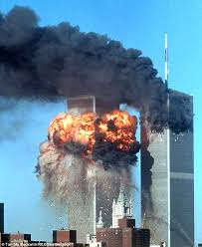
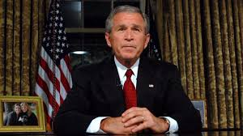
Political Speeches
Georg W. Bush
9/11 Address to the Nation Speech
Comparing speeches
Pearl Harbour and 9/11

Slide 11
Pearl Harbour and 9/11
DETAILS ABOUT THE PEARL HARBOUR ATTACK FROM THE SPEECH
DETAILS FROM PREVIOUS OWN OR EXTERNAL KNOWLEDGE

Slide 12
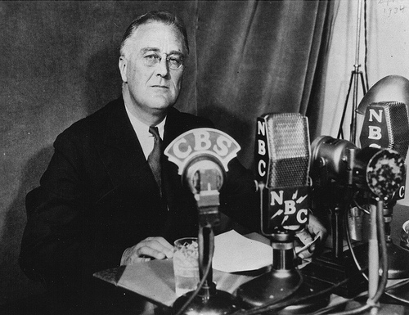
Political Speeches
Franklin D Roosevelt - Dec. 8, 1941
"Day of Infamy" Speech (minute 2’)

Slide 13
Pearl Harbour and 9/11
DETAILS ABOUT THE PEARL HARBOUR ATTACK FROM THE SPEECH
Exact date
Sudden and deliberate
Countries involved
Facts about previous relations between Italy and Japan
Where else the attack took place
Type of damages. Lost lives (many). Ships torpedoed elsewhere
Declaration of the state of war between Japan and the USA
DETAILS FROM PREVIOUS OWN OR EXTERNAL KNOWLEDGE
Surprise military strike: 2,403 Americans were killed and 1,178 others were wounded. 188 aircrafts destroyed. Japanese losses were light: 29 aircraft and five submarine lost, and 64 servicemen killed.
The surprise attack came as a profound shock to the American people and led directly to the American entry into World War II in both the Pacific and European theaters. The following day, December 8, the United States declared was on Japan, and three days later, on December 11, Germany and Italy each declared war on the USA The U.S. responded with a declaration of war against Germany and Italy. Domestic support for non-intervention, which had been fading since the Fall of France in 1940, disappeared.

Slide 14
Pearl Harbour and 9/11
DETAILS ABOUT THE 9/11 ATTACK FROM THE SPEECH
DETAILS FROM PREVIOUS OWN OR EXTERNAL KNOWLEDGE

Slide 15
Political Speeches
Georg W. Bush
9/11 Address to the Nation Speech

Slide 16
Pearl Harbour and 9/11
DETAILS ABOUT THE 9/11 ATTACK FROM THE SPEECH
Deliberate and deadly attack (surprise?)
Acts of mass murders: Thousands of lives
Airplanes flying into buildings, structures collapsing, fires burning
America’s response (rescue workers, carers, giving blood)
Government emergency response plan
Functions of government continue
No identification of the enemies
DETAILS FROM PREVIOUS OWN OR EXTERNAL KNOWLEDGE
The September 11 attacks (also referred to as 9/11) were a series of four coordinated terrorist attacks by the Islamic terorist group al-Quaeda against the United States on the morning of Tuesday, September 11, 2001. The attacks killed 2,996 people, injured over 6,000 others, and caused at least $10 billion in infrastructure and property damage. Additional people died of 9/11-related cancer and respiratory diseases in the months and years following the attacks.
9/11 is the single deadliest terrorist attack in human history and the single deadliest incident for firefighters and law enforcement officers in the history of the USA, with 343 and 72 killed, respectively.

Slide 17
FDR most powerful line:
Identify 5 words FDR uses to describe the attack:
Pearl Harbour and 9/11
GWB most powerful line:
Identify 5 words GWB uses to describe the attack:
WORDS IN COMMON??
DELIBERATE

Slide 18
Pearl Harbour and 9/11
What reason/s does FDR give that suggest this was a ‘sneak’ attack?
Why does FDR repeat the phrase «last night Japan attacked»?
For what reasons does Bush say «we were attacked»? In what way does he suggest that the terrorists have failed?
How does GWB say America reacted or responded to the attack. How does he say they will respond in the future?

