Slide 1
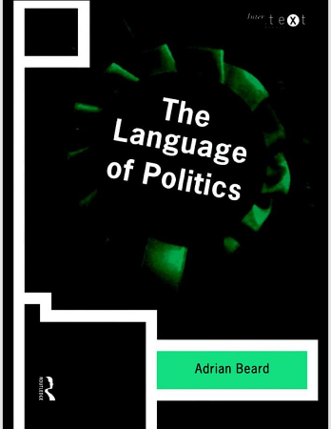
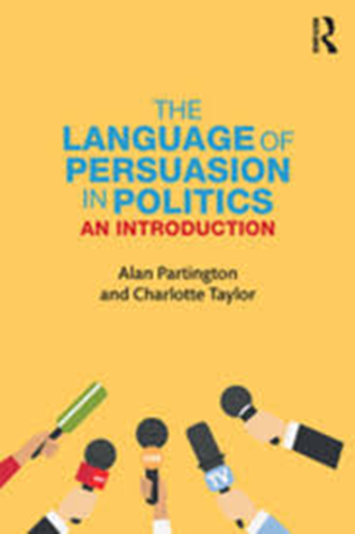
Lingua Inglese 3
The Language of Politics
Unit 2
Luisanna Fodde

Slide 2
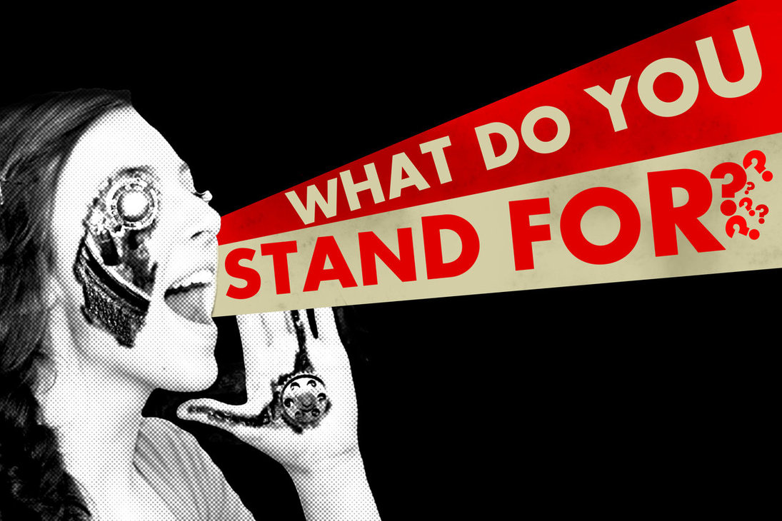
Unit 2
What do they stand for?

Slide 3
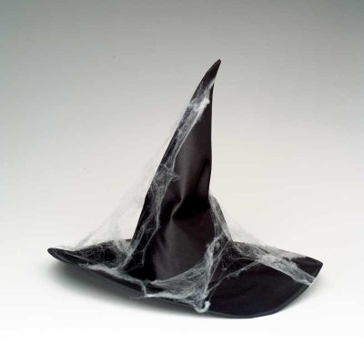
The problem of truth (1)
1) Politicians often complain about bias in the media and about witch-hunts
bias: 'baɪəs, prejudices, preconceptions, preferences or inclinations;
witch-hunts: a hunt against opponents,
sometimes unjustified;
searching out and harassing dissenters;
2) “media do not report the truth, but present a distorted picture which serves their own interests”

Slide 4
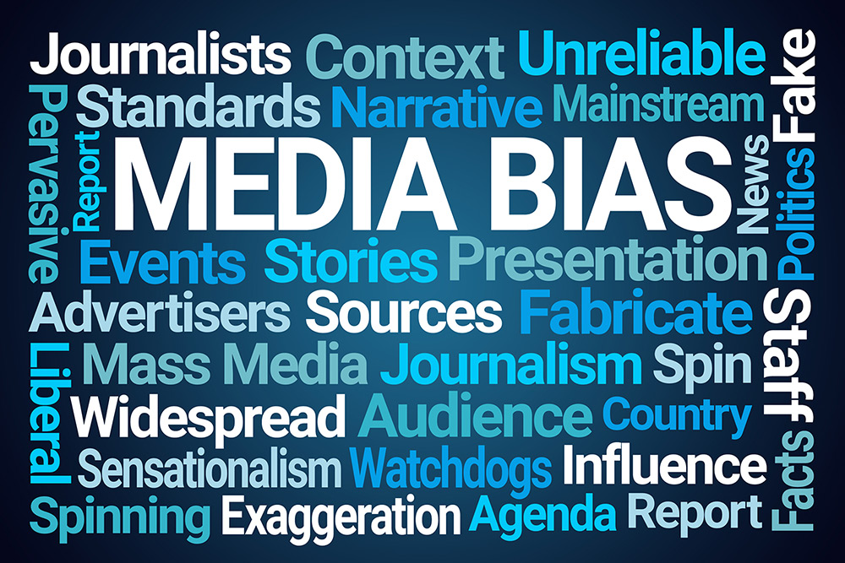
The problem of truth (2)
3) the complaints often concern the presentation of a story including the language used to tell it
4) Is there an absolute truth? Is there a neutral language? Is there an unbiased report?
unbiased: impartial, fair, non-partisan

Slide 5
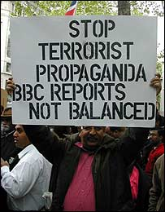
Truth
There’s no such thing as “absolute truth”.
Truth is both relative and subjective.
The idea of truth is very problematic especially when reporting a political story: you can report the same story in many different ways.

Slide 6
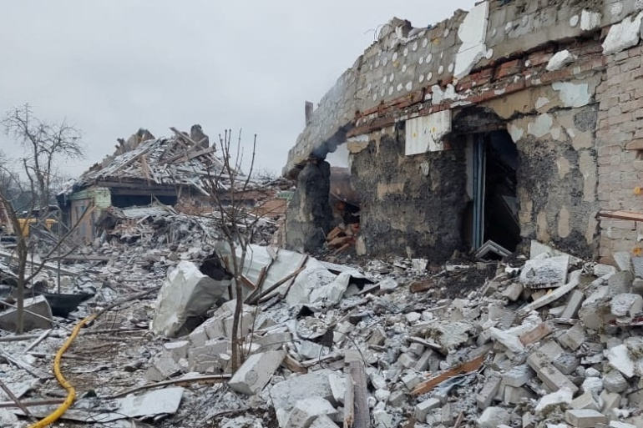
Truth
Do not call Ukraine invasion a ‘war’, Russia tells media, schools
Instead, ‘special military operation’ should be used to describe Moscow’s assault on Ukraine, according to officials.

Slide 7
Truth
As Russia’s bloody military operation against Ukraine nears the end of its first week, the Kremlin has been working hard to promote its version of events in the face of widespread indignation and an anti-war movement at home, which has seen nearly 7,000 people arrested across the country since the conflict began on Thursday.
For instance, a statement by Russia’s internet censor board, Roskomnadzor, warns that referring to the ongoing military campaign as an “invasion”, “attack” or “declaration of war” will lead to the offending website being blocked. (AlJazeera, March 2, 2022)

Slide 8
The battle over the words used to describe migrants
The word migrant is defined in Oxford English Dictionary as "one who moves, either temporarily or permanently, from one place, area, or country of residence to another".
It is used as a neutral term by many media organisations but there has been criticism of that use.
News website al-Jazeera has decided it will not use migrant and "will instead, where appropriate, say refugee". An online editore for the network wrote: "It has evolved from its dictionary definitions into a tool that dehumanises and distances, a blunt pejorative." A Washington Post piece ascked it it was time to ditch the word».
There are some who dislike the term because it implies something voluntary but that it is applied to people fleeing danger.

Slide 9
The battle over the words used to describe migrants
Online searches for migrant are at their highest since Google started collating this information in 2004. This was twice as popular as the next most frequently used word, refugee.
A refugee, according to the 1951 Refugee Convention, "is any person who, owing to a well-founded fear of being persecuted for reasons of race, religion, nationality, membership of a particular social group or political opinion, is outside the country of his/her nationality and is unable, or owing to such fear, is unwilling to avail himself/herself of the protection of that country".
Asylum seeker refers to someone who has applied for refugee status and is waiting to hear the result of their claim. But it is also often used about those trying to get to a particular country to make a claim.

Slide 10
USING BIASED WORDS: CARICO RESIDUALE
Durante la conferenza stampa convocata in prefettura a Milano il 5 novembre 2022, il Ministro Piantedosi ha dichiarato: «Chi di competenza accerterà tutti coloro i quali versano in queste condizioni di necessità di assistenza, sui quali ci facciamo carico, a prescindere dalle regole internazionali che noi riteniamo che siano chiare in questo caso. Dopo di che vediamo che cosa succede. Dopo di che la nave dovrebbe lasciare, con tutto il resto del carico che ne dovesse residuare, dovrebbe lasciare le acque nazionali secondo il nostro provvedimento».
Riformulazione giornalistica
Carico residuale è dunque, sul piano formale, una riformulazione giornalistica dell’espressione originale, di stampo prettamente burocratico, anche dal punto di vista sintattico (in coerenza con il curriculum professionale del ministro, che ha svolto la quasi totalità della sua carriera in ambienti prefettizi).

Slide 11
USING BIASED WORDS: CARICO RESIDUALE
Italy's new interior minister draws outrage over remarks on irregular migrants
«Matteo Piantedosi refers to migrants who are denied permission to disembark from humanitarian ships as ‘residual cargo’»
«The Italian government will not accept lessons on human rights in relation to migrants rescued by two foreign NGO run ships who have been stopped from landing in Sicily and described as "residual cargo", Interior Minister Matteo Piantedosi said Tuesday.
"If you want to focus on the exegesis of bureaucratic terms then go at it, but we don't accept lessons from anyone from the standpoint of respecting human rights," he said.

Slide 12
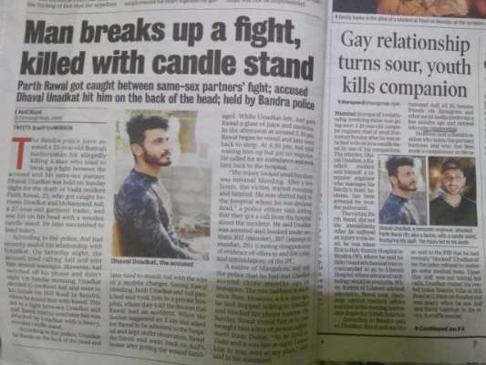
Reporting the same story in different ways

Slide 14
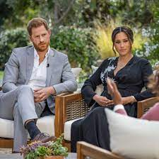
Newspaper headlines: Palace 'reeling' over Meghan and Harry 'bombshell' interview

Slide 15
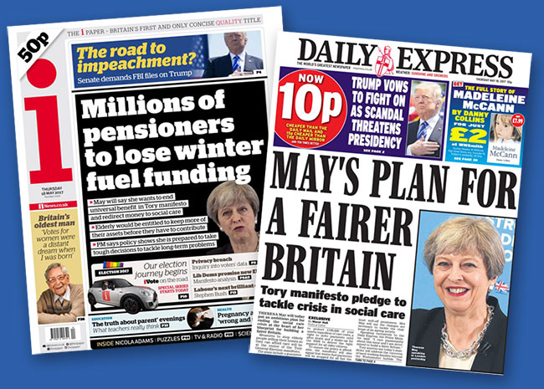
Truth

Slide 16
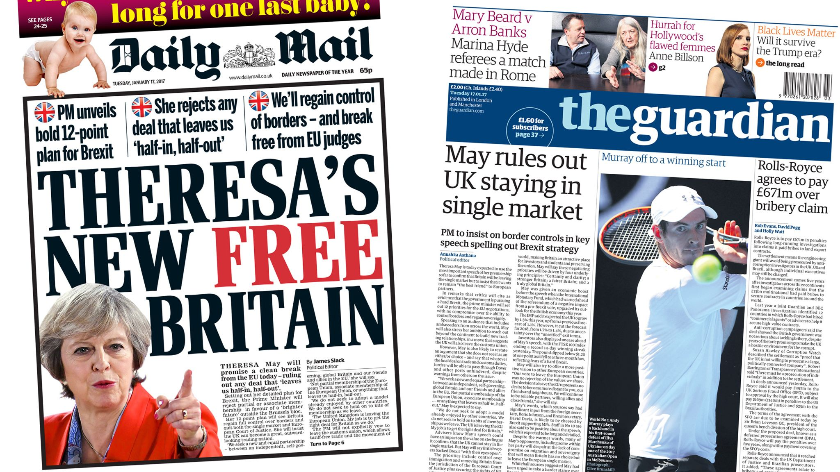
Truth

Slide 17
Truth

Slide 18
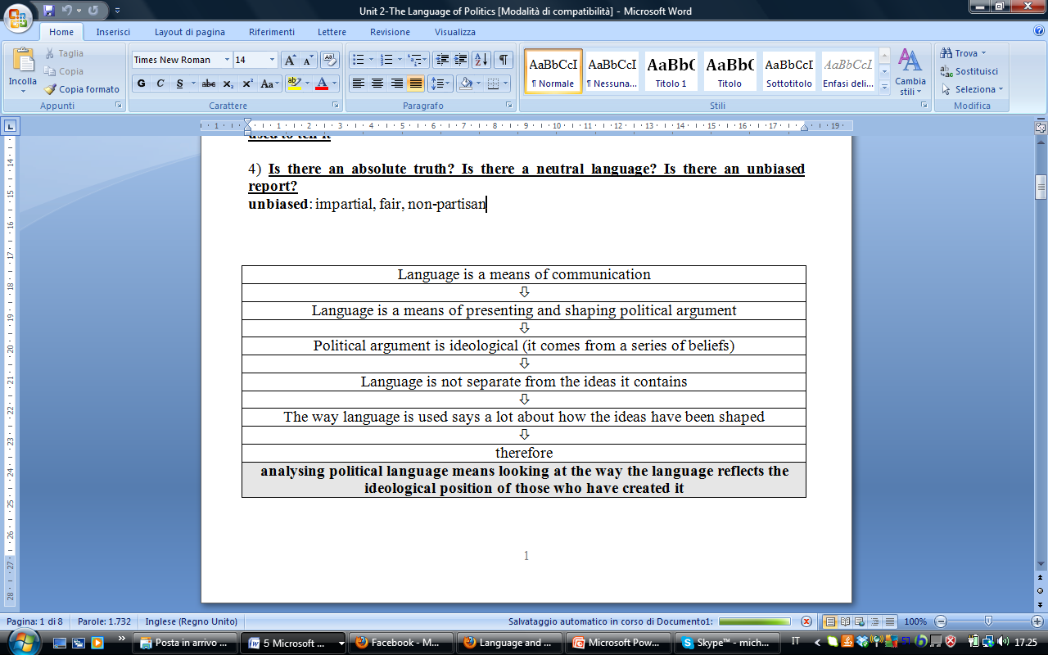

Slide 19
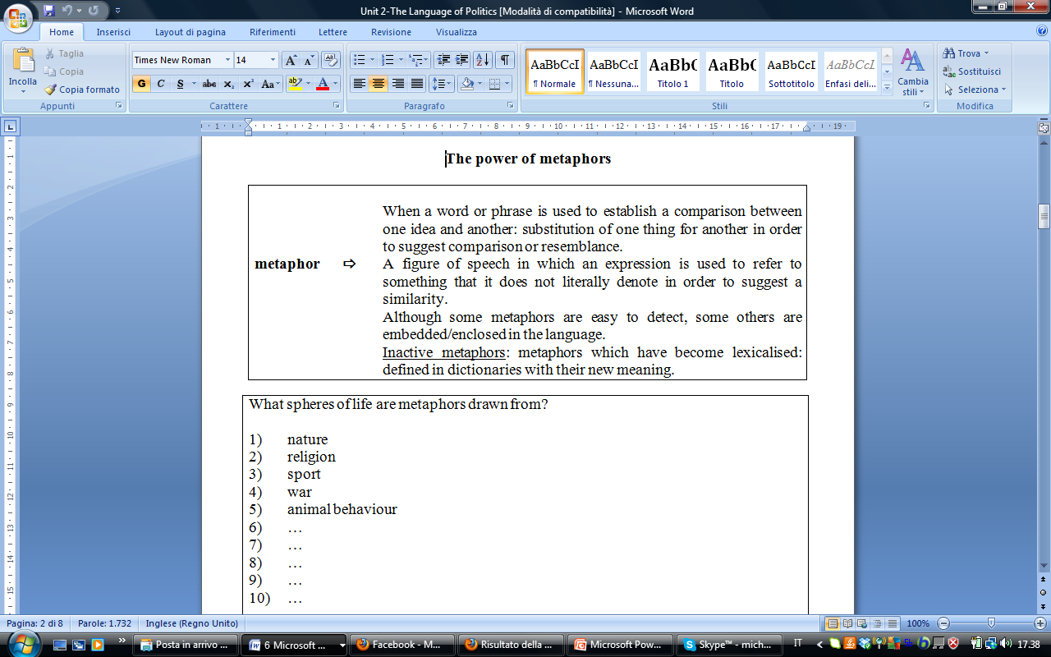
The power of metaphor
Beard 21-24, Partington 126-132

Slide 20
The power of metaphor
Beard 21-24, Partington 126-132
Inactive or dead (frozen, historical) metaphors. i.e. clichés:
Body of an essay: Here the structure of an essay is compared to that of human anatomy,
Leg of a trip: While this might sound like it relates back to the human body too, the original term is derived from the context of sailing. Hands of a clock: The human anatomy returns for this metaphor. The "face" of the clock has a pair of "hands" to show the time,
Time is running out: The original metaphor referred to the sand in an hourglass,.
Deadline: While everyone understands this to mean when something is due, a deadline originally referred to the line around the perimeter of a prison wherein a prisoner would be shot if they went beyond it.
Foot of the bed; Groundbreaking: World wide web; Tough; In the same boat, brand new

Slide 21
Metaphors
What spheres of life are metaphors drawn from?
everyday life
nature
religion
sport
war
animal behaviour
technology
disaster
body and disease

Slide 22
Metaphors
a metaphorical reference to a person or animal sacrificed for the common good. The term is derived from the traditions of Abrahamic religion where a lamb l is a highly valued possession.
Sacrificial lamb
Puppet government
a government that is manipulated by a foreign power for its own interests.
An éminence grise (French pronunciation: ​[eminɑ̃s ɡʁiz]) or grey eminence is a powerful decision-maker or adviser who operates "behind the scenes", or in a non-public or unofficial capacity.

Slide 23
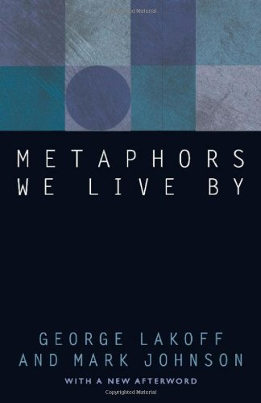
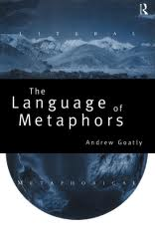
The role of metaphors
Lakoff and Johnson (1980) and Goatly (1997) investigated the role of metaphors in everyday speech.

Slide 24
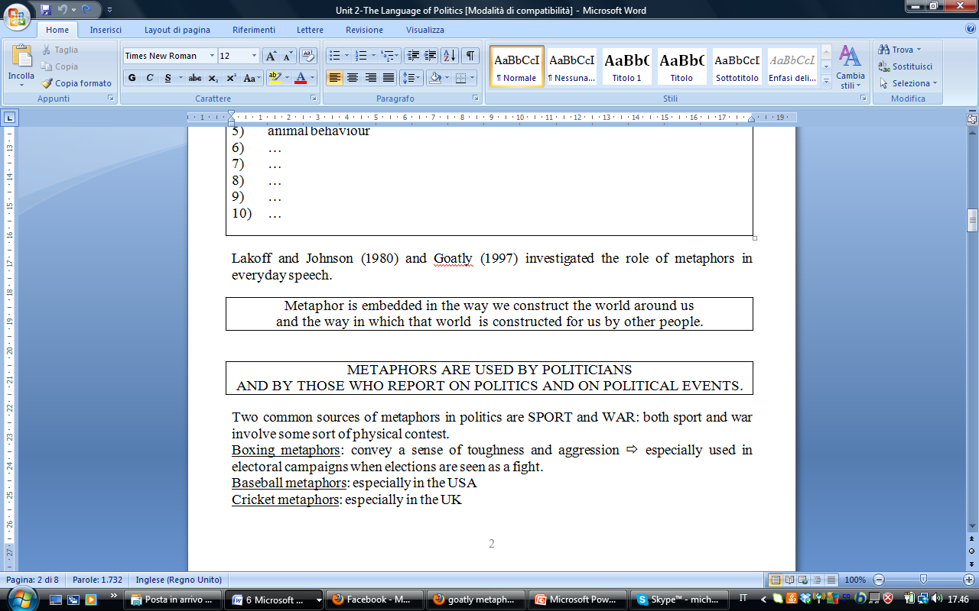

Slide 25
Metaphors in political discourse
/…/ that this nation, under God, shall have a new birth of freedom, and that government of the people, by the people, for the people, shall not perish from the earth.”
(A. Lincoln, The Gettysburg address)

Slide 26
Metaphors in political discourse
«Ella Baker, a giant of the civil rights movement, left us with this wisdom: Give people light and they will find a way. Give people light. Those are words for our time. The current president has cloaked America in darkness for much too long……I will be an ally of the United we can, and will, overcome this season of darkness in America.»
(Joe Biden’s speech, Democratic Convention, 2020)

Slide 27
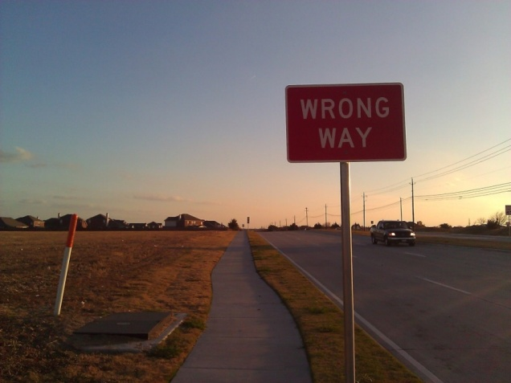
METAPHOR OF THE JOURNEY
MATCHING:
step by step
go round in circles
go off in the wrong direction
arrive at a conclusion
be lost
be stuck
keep going back to the same subject
be confused
gradually, in stages, little by little
be confused, puzzled, going nowhere
reach a conclusion, decide on an issue
going on the wrong track

Slide 28
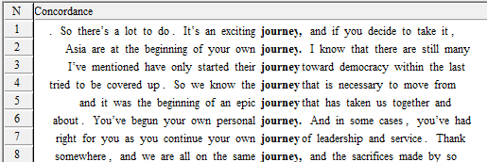
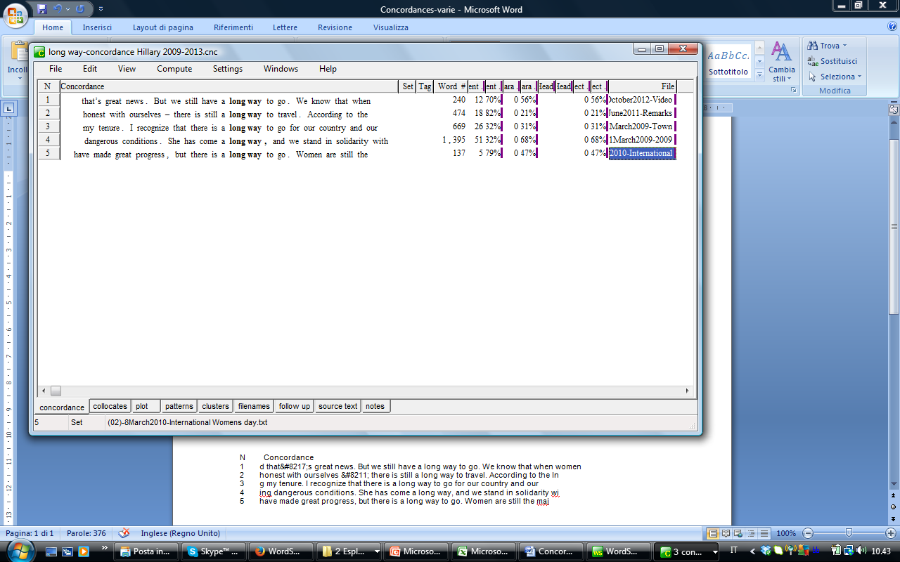
Journey & path

Slide 29
Journey & path (2)
women have to lead the way
there is a lot ahead of us
how far this country has come
the pioneers who began charting the path that we ourselves walk today
willingness to make this march together with us
we will take those steps together
we will keep moving toward a destination
women and men around the world are stepping forward
We are building a roadmap to peace.

Slide 30
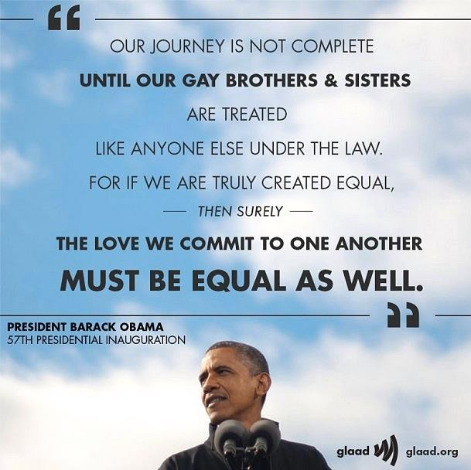

Slide 31
Journey metaphors
We shall go on to the end, we shall fight in France, we shall fight on the seas and oceans, we shall fight with growing confidence and growing strength in the air, we shall defend our Island, whatever the cost may be, we shall fight on the beaches, we shall fight on the landing grounds, we shall fight in the fields and in the streets, we shall fight in the hills; we shall never surrender, and even if, which I do not for a moment believe, this Island or a large part of it were subjugated and starving, then our Empire beyond the seas, armed and guarded by the British Fleet, would carry on the struggle, until, in God’s good time, the New World, with all its power and might, steps forth to the rescue and the liberation of the old.
(W. Chruchill. We shall fight on the beaches)
None of us will ever forget this day, yet we go forward to defend freedom and all that is good and just in our world.
(G.W. Bush 9/11 speech)

Slide 32
SPORT AND WAR
Two common sources of metaphors in politics are SPORT and WAR: both involve physical contest.
Boxing metaphors: convey a sense of toughness and aggression ⇨ in electoral campaigns when elections are seen as a fight.
Baseball metaphors: especially in the USA? The UK?
Cricket metaphors: especially in the USA? The UK?

Slide 33
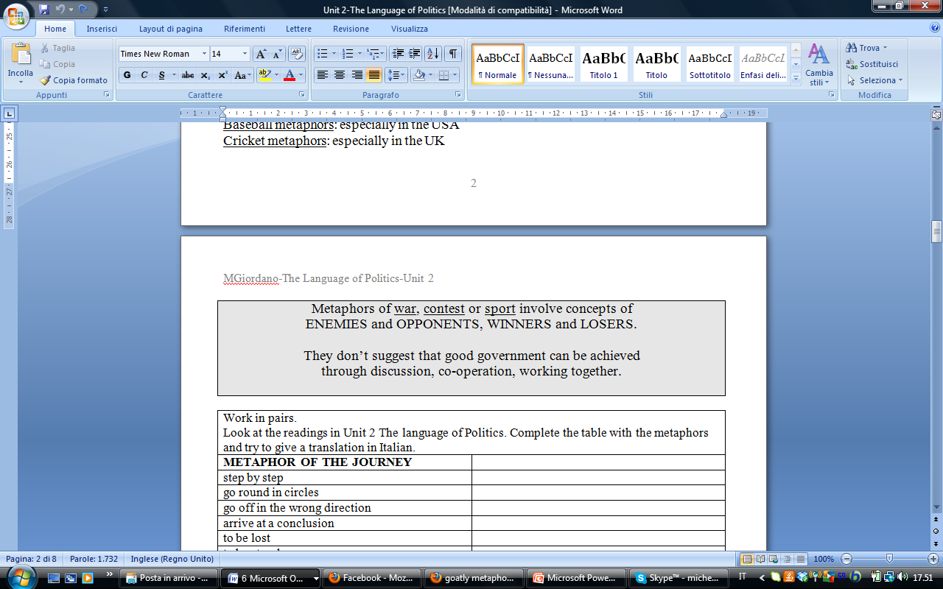
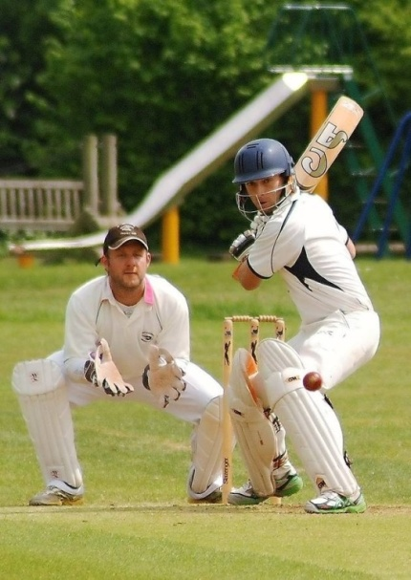
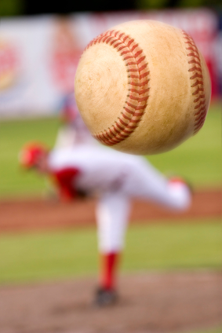

Slide 34
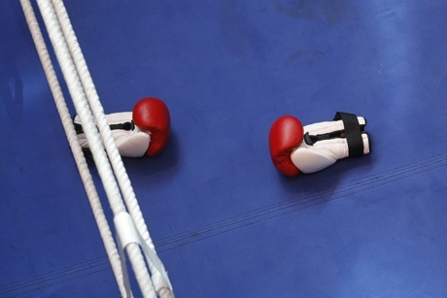
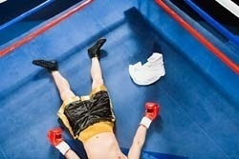
BOXING METAPHORS
MATCHING
the gloves are off
bare-knuckle fight
throw in the towel
give up, admit defeat
without boxing gloves
it is going to be a serious, aggressive dispute

Slide 35
BOXING METAPHORS
The gloves are off (or with the gloves off or take the gloves off):
Used to express the notion that something will be done in an uncompromising or ruthless way.
«For the banks chasing this growing business, the gloves are now definitely off"
Throw in the towel
To quit.
This phrase comes from boxing. When a boxer is too beat up to continue, his coach throws a towel into the ring to signal that the fight is over.
«The company threw in the towel after losing all of its major customers».

Slide 36
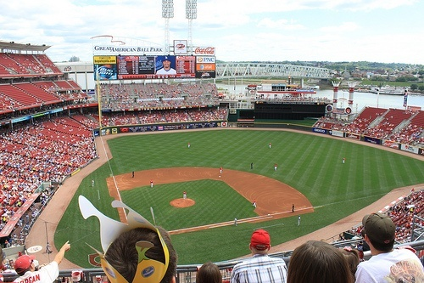
BASEBALL METAPHORS
MATCHING
a new ball game
a ball park figure
spin
to play ball
back at first base
to go back to the initial stage
rotate quickly
to agree to do something together
a rough or approximate number
a particular situation radically different from the preceding one

Slide 37
BASEBALL METAPHORS
It’s a Whole New Ballgame for Obama
Obama says..."Let's play ball, not war"
“You know how I really feel?” Franklin Roosevelt said in 1945. “I feel like a baseball team going into the ninth inning with only eight men left to play.” Eight days after uttering that line, Roosevelt was dead.

Slide 38
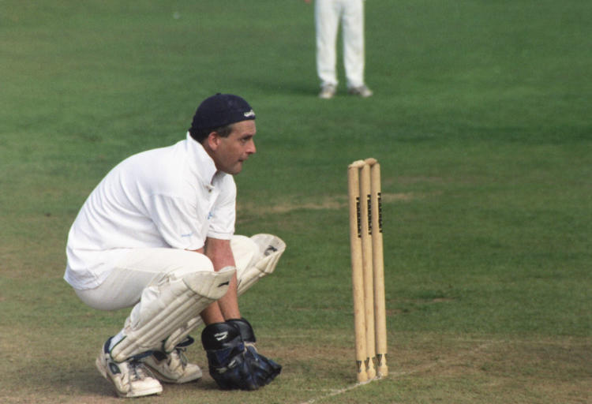
GENERAL SPORT METAPHORS
to remain alert
contestant leading in a race
contestant winning a race by being the first to reach the finishing line. Also simple-majority winner
Past performance characterized by winning most games
To keep your eye on the ball
First-past-the-post
Winning season
Front-runner

Slide 39
WAR METAPHORS
MATCHING
hit the ground running
damage control
campaign
leads are surrendered
collateral damage
ethnic cleansing
fighting a last-ditch
friendly fire
something done as a final recourse to prevent a crisis or disaster
incidental destruction of things (not the intended target)
eliminating unwanted ethnic or religious groups
effort to minimize damage or loss
military operations; activities to achieve a goal
running straight into action; start very energetically
give in
death inadvertently caused to one’s own troops

Slide 40
WAR METAPHORS
The men in the Soviet politburo don't have to worry about the ebb and flow of public opinion. They put guns before butter, while we put just about everything before guns. They know that they are a super power in only one sense—the military sense.
(M. Thatcher, The Iron Lady Speech, 1976)

Slide 41
Work in pairs. What is the meaning of these metaphors in your language?
acceptable losses
acceptable risk
acting a part
adding value
all the world's a stage
at stake
balancing the books
be a machine
bombarded by insults
cost-benefit analysis
Do you know what source they come from (politics, sports, religion, history, economics, family life, health and medicine…)?

Slide 42
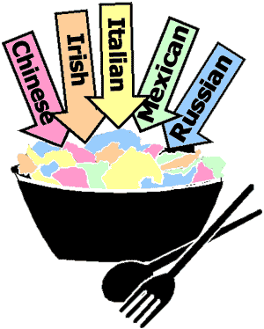
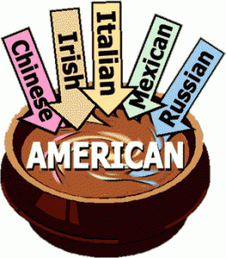
Melting pot or salad bowl?

Slide 43

Work in pairs. What is the meaning of these metaphors in your language?
diamond in the rough
difficult to swallow
food for thought
launching an attack
melting pot
my life is an open book
no pain, no gain
play hide and seek
play to win
puppet government
salad bowl

Slide 44
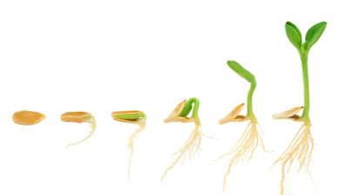
Work in pairs. What is the meaning of these metaphors in your language?
sowing the seeds of progress
the best defense is a good offense
to sing the same old song
to strike a familiar chord
to be on the offensive
take flak
target
time bomb
to have faith
witch-hunt

Slide 45
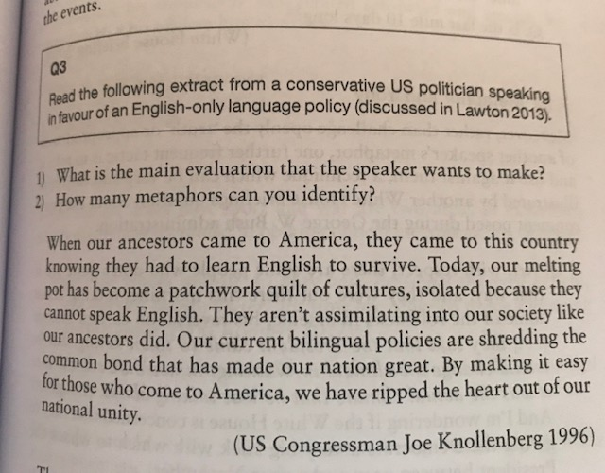
Metaphors – Question (Partington p. 129- solution p. 150)

Slide 46
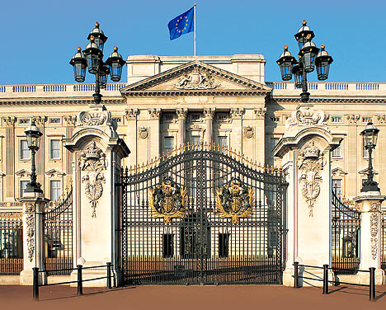
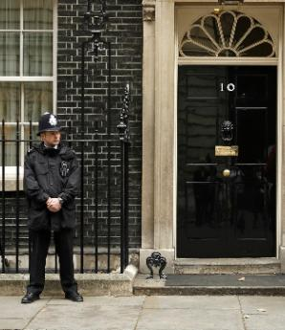
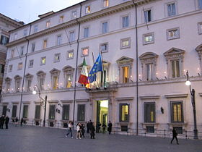
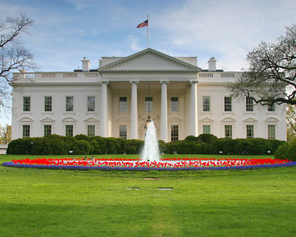
The power of metonymy
Replacing the name of something with something which is connected to it, or is a part of it, without being the whole thing.

Slide 47
Work in pairs. Complete the following table identifying where these metonymic expressions are used and what their meaning is.
 | Place/Country | Meaning
Shakespeare |  | The works of Shakespeare ex. “I love Shakespeare”
The White House
Buckingham Palace
Westminster
The Crown
Downing Street
Hollywood
Wall Street
Palazzo Chigi
La Scala
Viale Mazzini
Saddam Hussein
Brussels
The Red Cross
Palazzo Madama
La Borsa
The Pentagon
Washington

Slide 48
Work in pairs.
Try to explain these examples of metonymy.
He bought a Ford.
He's a big question mark to me.
He's got a Picasso.
Let's not let Iraq become another Viet Nam.
Napoleon lost at Waterloo.
The buses are on strike.
The ham sandwich is waiting for his check.
The Times hasn't arrived at the Press Conference yet.
The White House isn't saying anything.
Wall Street is in a panic.
Watergate changed our politics.
9/11
Brazil won the soccer match.
The pen is a powerful weapon.

Slide 49
Synecdoche
Part of something refers to whole.
It is sometimes considered a subclass of metonymy.
A figure of speech in which a part is used to represent the whole, the whole for a part, the specific for the general, the general for the specific, or the material for the thing made from it.
It is a synecdoche if A is part of B, or vice versa.
It is a metonymy if A is commonly associated to B but it is not necessarily a part of it.

Slide 50
Work in pairs. Discuss on the meaning of the following examples of synecdoche.
She’s just a pretty face.
There are a lot of faces out there in the audience.
We need some new faces around here.
Give us this day our daily bread.
Friends, Romans, countrymen: lend me your ears.
hands
mouths to feed
the press
"Oh, this hurts my heart!”
There are lots of ears in next room.

Slide 51
Metaphor and Synecdoche
"So the great dragon was cast out, that serpent of old, called the Devil and Satan, who deceives the whole world; he was cast to the earth, and his angels were cast out with him …» (R. Reagan The Boys of Pointe du Hoc» 1984
«Some liberated countries were lost. The great sadness of this losses echoes down to our own time in the streets of Warsaw, Prague and East Berlin.» (R. Reagan, ibid.)

Slide 52
Close relatives of metonymy are synecdoche and metaphors. In fact, some consider synecdoche to be a type of metonymy. While metonymy replaces a concept or object entirely with a related term, synecdoche takes an element of the object and uses it to refer to the whole, and metaphor uses unlike things to draw an interesting comparison.

Slide 53
Intertextuality
One text uses reference to another. “The presence of a text in another text” (Genette, 1983)
A continuity of texts referring to one another, producing and reproducing over time other texts/discourses (Kristeva, 1984)
-gate = scandal
What is Watergate?
Watergate, datagate, sexygate, Camillagate, fornigate, Dianagate, zippergate, Monicagate, Lewinskygate, Rubygate
-poli: from the Greek polis
baraccopoli, tendopoli, tangentopoli, concorsopoli, vallettopoli, appaltopoli, parentopoli…

Slide 54
Intertextuality
-gate = scandal
What is Watergate?
Watergate, datagate, sexygate, Camillagate, fornigate, Dianagate, zippergate, Monicagate, Lewinskygate, Rubygate
-poli: from the Greek polis
baraccopoli, tendopoli, tangentopoli, concorsopoli, vallettopoli, appaltopoli, parentopoli…

Slide 55

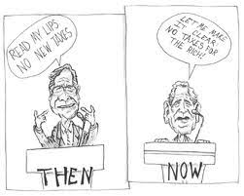
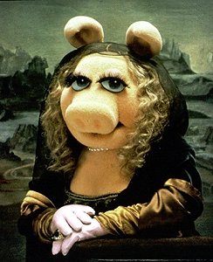

Intertextuality
“The presence of a text in another text” (Genette, 1983)

Slide 56
Intertextuality
In political speech intertextuality is performed through the use of sentences or quotations easily recognizable by the audience:
“Time is money” was originally used by US president B. Franklin; now it is used not only in English, but also in German (Zeit ist Geld) and in Russian (Время – деньги).
«Life, liberty and the pursuit of happiness»

Slide 57
Intertextuality
According to research conducted by O.V. Spiridovsky (2006), the three most frequently used utterances by US presidents are:
“A house divided against itself can not stand.” (A. Lincoln)
“Ask not what your country can do for you, but what you can do for your country.” (J. F. Kennedy)
“Four score and seven years ago …” (Initial phrase of “The Gettysburg Address” by A. Lincoln)
These precedent utterances have been unchangeably repeated by other presidents of the USA in different situations throughout American history and are familiar to all Americans.

Slide 58
Intertextuality
President Biden’s speech in Warsaw, 26 March 2022:
«Be not afraid….». « Non abbiate paura»
(quotation from John Paul II’s homily for the inauguration of his pontificate. St. Peter's Square, Sunday, 22 October 1978)
«Brothers and sisters, do not be afraid to welcome Christ and accept his power. Help the Pope and all those who wish to serve Christ and with Christ's power to serve the human person and the whole of mankind. Do not be afraid. Open wide the doors for Christ. To his saving power open the boundaries of States, economic and political systems, the vast fields of culture, civilization and development. Do not be afraid. Christ knows "what is in man". He alone knows it».

Slide 59
The power of analogy
Metaphor, metonymy and synecdoche: word or phrase level. They establish comparison between words and phrases, between one idea with another.
Analogy: comparing two objects of different types; but these two objects have certain elements in common. Objects of the first kind have a certain characteristic: it is not known if objects of the second kind have it or not, but by analogy we conclude that since objects of the two kinds have certain things in common, they may have other things in common as well.
Analogy: comparison between one thing and another, in an attempt to explain or clarify a certain situation.

Slide 60
The power of analogy
Henry Kissinger once argued that “history teaches by analogy, shedding light on the likely consequences of comparable situations….but each generation must determine for itself which circumstances are in fact comparable” (1994, p. 27).
Bush World War II analogy with Saddam Hussein:
“A half a century ago our nation and world paid dearly for appeasing an aggressor who should and could have stopped. We're not about to make the same mistake twice”

Slide 61
The power of analogy
"Once the most self-sufficient republic in history, which produced 96 percent of all it consumed, the U.S.A. is almost as dependent on foreign nations today for manufactured goods, and the loans to pay for them, as we were in the early years of the republic.
What the British were to us then, China is today. Beijing holds the mortgage and grows impatient as we endlessly borrow on equity and refuse to begin paying it down. The possibility exists of an eventual run on the dollar or even a U.S. debt default."
(Patrick J. Buchanan:
http://humanevents.com/2009/12/29/a-decade-of-selfdelusion/Jan 4 2010)

Slide 62
Household debt analogy
Margaret Thatcher used analogy comparing the economy of the nation with the economy of an individual household: as it is dangerous for a family to have debts (to accumulate debts), so it is dangerous for a country to do the same.
government budget = family budget

Slide 63
President Zelensky’ use of analogy
Pearl Harbour, 9/11, MLK’s «I have a dream» before the US Congress (analogy and intertextuality)
Churchill’s «We shall fight on the beaches» before Britain’s House of Commons
Before the Italian Parliament?
«Imagine Genoa…»

Slide 64
Grammatical Evaluation: Transitivity (Partington 19-20; 36-37)
Transitivity (agency): the grammatical structuring which tells us «who does what to whom (and how)»
Who is the Doer, Who is the Done-to in an action or event?
Transitivity enables the language user to place the participants and events in a particular order and allows him/her to express evaluations of responsibility.
William and Mary got a divorce;
William divorced his wife, Mary;
Mary was divorced by William;
William got a divorce
Police shoot 11 dead in Salisbury (Guardian)
Rioting blacks shot dead by police (Times)

Slide 65
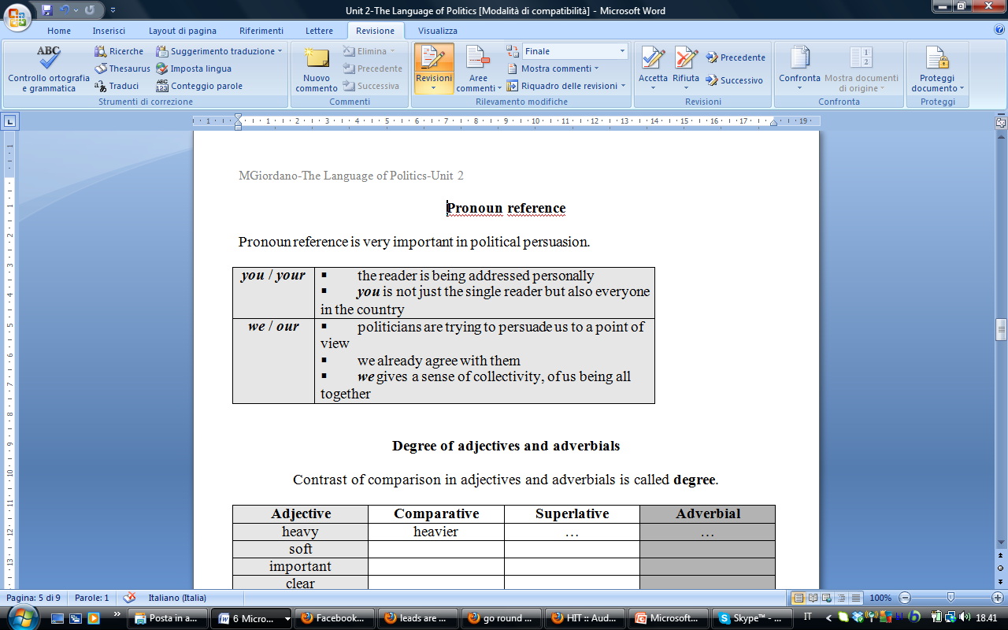
Pronoun reference
Pronoun reference is very important in political persuasion.

Slide 66
Grammatical Evaluation: Transitivity
(Partington 19-20; 36-37)
The US Declaration of Independence (https://museum.archives.gov/founding-documents#declaration)
A useful way of studying transitivity is to look at the use of pronouns.
Pronouns constitute the only remnant of a case system in English. They change according to whether a participant is an active DO-ER, so I, you, she, he, we, ecc.
Or a passive DONE-TO, so me, him, her, us, or possessor, so mine, his, hers, ours
One can look at the verbs associated with the Doer and/or Done-to pronouns and the semantic categories these verbs belong to, and the sort of nouns following the possessive pronouns…

Slide 67
Grammatical Evaluation: Transitivity (Partington 19-20; 36-37)
The US Declaration of Independence (http://www.ushistory.org/declaration/document/)
An attempt at persuasion.
Thomas Jefferson, its principal author, fills the documents with messages favourable to a particular worldview:
THE SECESSIONIST AGENDA OF THE REVOLUTIONARIES
LOYALISTS AND PATRIOTS
Revolutionary War also a CIVIL WAR.
Why?
2 ATTEMPTS AT PERSUASION
An appeal to unity to an internal audiece (the colonists)
An appeal for legitimacy and understanding of motivation to an external audience, both in Britain and in the US

Slide 68
Grammatical Evaluation: Transitivity (Partington 19-20; 36-37)
He has refused his Assent to Laws, the most wholesome and necessary for the public good.
He has forbidden his Governors to pass Laws of immediate and pressing importance, unless suspended in their operation till his Assent should be obtained; and when so suspended, he has utterly neglected to attend to them.
He has refused to pass other Laws for the accommodation of large districts of people, unless those people would relinquish the right of Representation in the Legislature, a right inestimable to them and formidable to tyrants only.
He has called together legislative bodies at places unusual, uncomfortable, and distant from the depository of their Public Records, for the sole purpose of fatiguing them into compliance with his measures.
The item HE appears 19 times alway referring to…
????
And always in what syntactic position??
The item HIM is never used.
What does this mean?

Slide 70
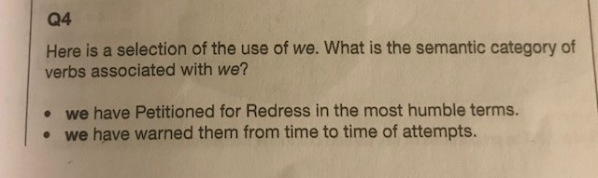
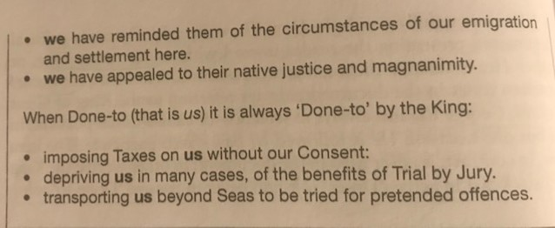
The most common pronoun in the document is the possessive OUR (26 occurrences).
In the Declaration, the 3 pronouns we/us/our occur once every 23 words.
While in common AE they occur once in every 256 words

Slide 71
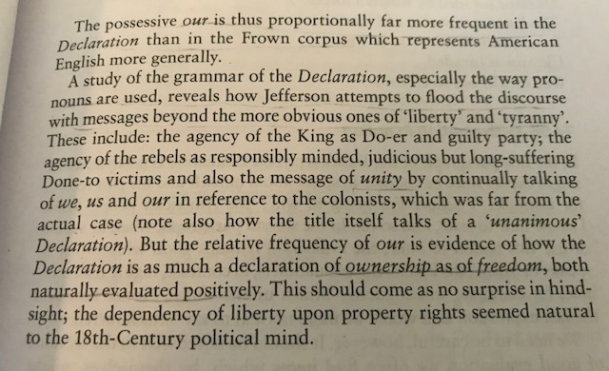

Slide 72
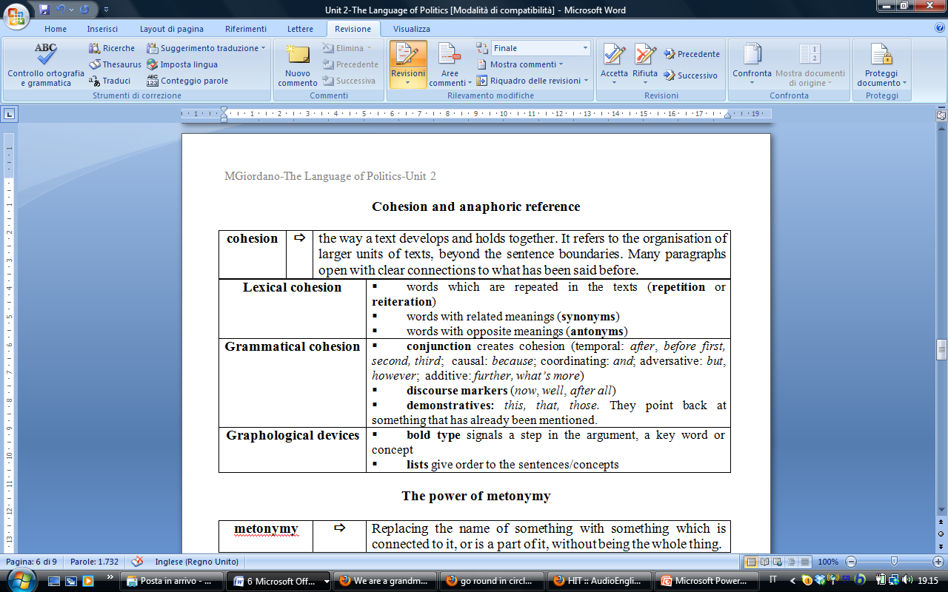
Cohesion and anaphoric reference

Slide 73
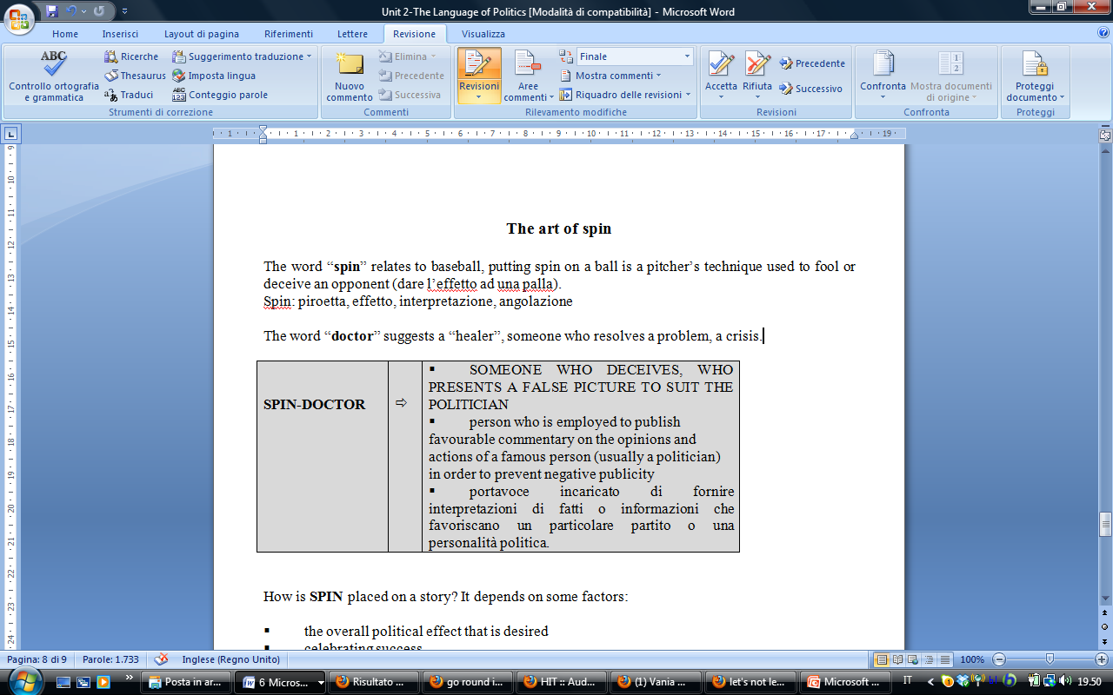
The art of spin
(Also Partington 7-11)
“spin”: (baseball) putting spin on a ball is a pitcher’s technique used to fool or deceive an opponent
“doctor”: a “healer”, someone who resolves a problem, a crisis

Slide 74
Spin (public relations)
In public relations, spin is a form of propaganda, achieved through providing a biased interpretation of an event or campaigning to persuade public opinion in favor or against some organization or public figure.
While traditional public relations may also rely on creative presentation of the facts, "spin" often implies the use of disingenuous, deceptive, and highly manipulative tactics.
Politicians are often accused by their opponents of claiming to be truthful and seek the truth while using spin tactics to manipulate public opinion, i.e ‘fake news’.. Large corporations with sophisticated public relations branches also engage in "spinning" information or events in their favor.
Because of the frequent association between spin and press conferences (especially government press conferences), the room in which these take place is sometimes described as a spin room (see Partington Q2 pp.11;13)
A group of public relations advisors, pollsters and media consultants who develop spin may be referred to as "spin doctors" who manipulate the truth and create a biased interpretation of events for the person or group that hired them. (https://en.wikipedia.org/wiki/Spin_public_relations)

Slide 75
How is SPIN placed on a story?
the overall political effect that is desired
celebrating success or ridiculing failure
the way information is presented
metaphors to influence the audience’s view of the event
claiming credit or distributing blame or guilt
emphasizing the role of a participant/action
minimising the role of a participant/action
foregrounding or backgrounding a participant through ACTIVE or PASSIVE voice

Slide 76
Spin: active or passive voice
Foregrounding or backgrounding participants (the practice of making or not making something stand out from the surrounding words or images):
Chancellor announces tax cuts (active voice-Chancellor given prominence)
Tax cuts announced by Chancellor (passive voice-less prominence given to Chancellor)
Tax cuts announced (passive voice, actor not included-no reference to Chancellor)

Slide 77
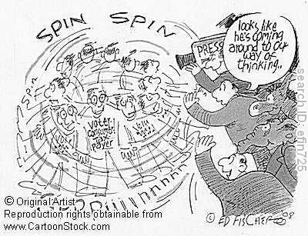

Slide 78
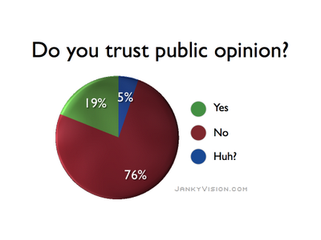
Opinion polls and pollsters (1)
Inquiries into public opinion conducted by interviewing a random sample of people.
Opinion polls are used by the media to assess public perception on political issues.
They are used during electoral campaigns to see how people are likely to vote.
They are also used during the lifetime of a government to see how the public views the government’s performance.

Slide 79
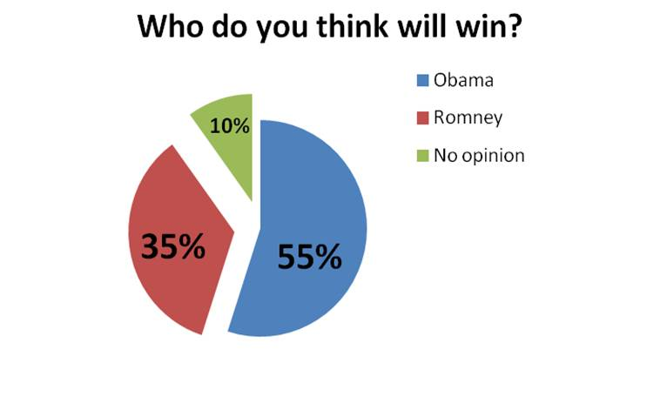
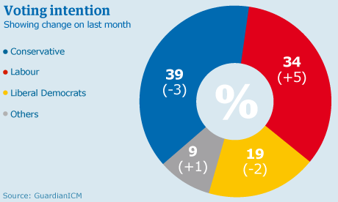
Other examples:
(Beard: 33)

Slide 80
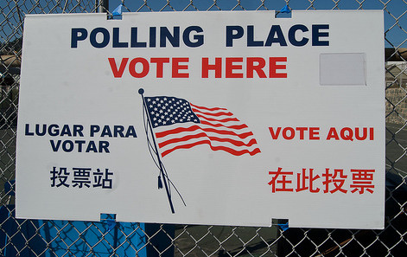

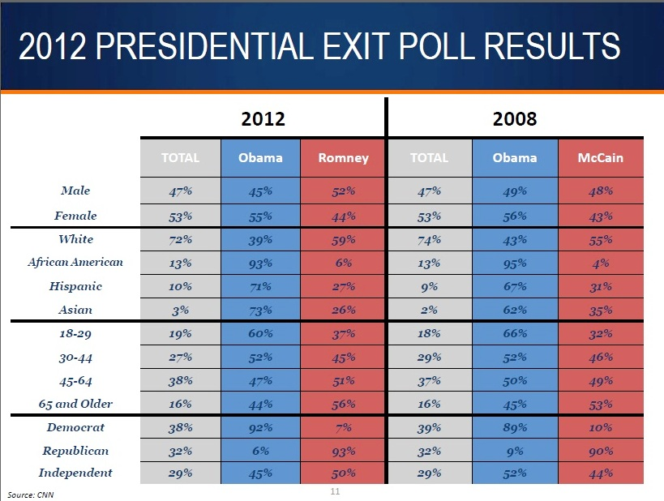
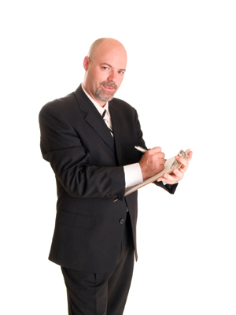

Slide 81

Nationwide opinion polling for the United States presidential election, 2016
Poll numbers verified as of 7 October 2015.

Slide 82


Slide 83


Slide 84
Questions for the exam (6 CFU)
Unit 2 Beard+ Partington
What is the relation between language, power and ideology?
Why is the ‘problem’ of truth particularly relevant in the language used by politicians and those who report political news in the press?
Give definitions of metaphor, metonymy, synecdoche and analogy, with simple examples.
Give examples of journey, sports (cricket, baseball, boxing) and war metaphors.
Metonymy is a powerful tool because it ‘gives a more sympathetic picture … and a favourable view’, or removes direct responsibility for an action. Find examples.

Slide 85
Questions for the exam (6 CFU)
Unit 2 Beard+ Partington
6. Intertextuality is when a text refers to another text that is associated with it in some way. This is why it is often difficult for non-English people to understand English newspapers and magazines (and for non-Italians to understand Italian news stories and articles). But ‘intertextuality’ can operate across national boundaries. Can you think of any examples?
7. Where does the term spin-doctor come from? What is the job of a spin-doctor? How can spin be placed on a story?
8.What are opinion polls? What is the relation between opinion polls and spin?

