Slide 1
Phonetics and Phonology
The two primary linguistic disciplines concerned with speech sounds:
Phonetics: forms of sounds (how they are produced, heard, etc.)
Phonology: functions of sounds (relates forms and functions)

Slide 2
Phonetics and Phonology
The smallest unit of Phonology is the phoneme: the phoneme, which is an abstract idealized unit, has meaning-differentiation function. The test for these smallest distinct units is the minimal pair test, e.g. when a difference in sound structure causes a difference in meaning. Ship [i], sheep [i:].

Slide 3
The sounds of English
Traditionally sounds are consonants and vowels.
Consonants are produced with a major obstruction in the mouth cavity.
Vowels are sounds produced without such obstruction.

Slide 4
The sounds of English
Another difference between consonants and vowels.
Consonants can be voiced or voiceless. The vocal cords are far apart they do not vibrate (as in “fan”) or they are closed and vibrate (as in “van”).
Vowels are voiced: the vocal cords are set vibrating by the outgoing airflow.

Slide 5
The sounds of English
The Phonological system of a language is also the inventory of its phonems; e.g the sum of all those sounds that show distinctive (meaning differentiating) phonetic differences.
English has 44 phonemes, 24 consonant and 20 vowel sounds
Drammatical difference between the written alphabet and most English accents.

Slide 6
Consonants
Sounds made with a certain amount of temporary block of the airflow through the mouth.
  They are articulated in two ways: partial or total blockage of one of the vocal organs. The closing movement may involve the lips, the tongue, or the throat.
  From a phonological point of view they occupy the edges or margins of a syllable. They may also appear in clusters or sequences:
  play [pleɪ]; jump [dʒʌmp]; twelfth [twelfθ].
  Some consonants involve the vibration of the vocal cords: they are voiced consonants, others have no vocal cord vibration. They are called voiceless.

Slide 7
Consonants
  Some sounds may be confused, as they are articulated in the same way as vowels, but function in the language as consonants:
  /j/ in YES and /w/ in WE.
  These two consonants are sometimes described as semi-vowels

Slide 8
Semivowels : include bilabial [w] and the palatal [j]. [w] as in why and [j] as in you.
The reason why they are called semivowels is their manner of articulation: like true vowels, they are produced without a major obstruction, since there is gap in the point of articulation, the airflow can escape freely.
Unlike true vowels, they never form the nucleous of a syllable (week, yellow), and they are usually considered consonant and are called thus semiconsonant.
Classification of consonants

Slide 9
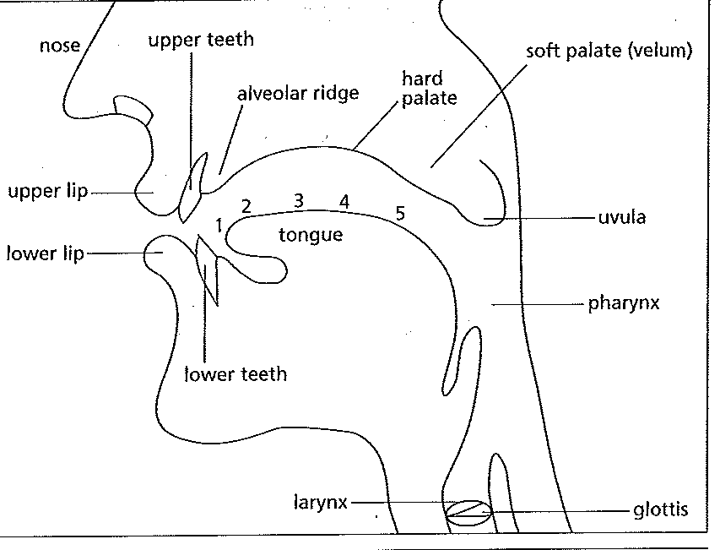
The organs of articulation

Slide 10
Factors relevant for the classification of consonants include: manner of articulation place of articulation voicing
Classification of consonants

Slide 11
Consonants

Slide 12
manner of articulation: plosives, fricatives, affricates, nasals, laterals (liquids).
Classification of consonants

Slide 13
Plosives: are made by completely blocking the airflow. There is a compression of air behind obstruction and a subsequently release of the compressed air in the form of ‘explosion’ (hence the term ‘plosive’.)
Place of articulation: bilabial [p] e [b] alveolar [t] e [d] velar [k] e [g]
Classification of consonants
MANNER and PLACE OF ARTICULATION

Slide 14
Velar plosives:
[k] e [g] are articulated with the back of the tongue against the soft palate. The air is pressed for a short time and then breaks the obstruction with a slight explosion. In the case of [g] the vocal cords are vibrating.
Voiceless velar plosive: [k] voiced velar plosive: [g]
Classification of consonants
MANNER and PLACE OF ARTICULATION

Slide 15



Fricatives: are consonants that are produced by impeding, but not completely blocking the airflow. There are five point of articulation for fricatives in English: labio-dental [f] and [v], interdental [θ] and [ð], alveolar [s] and [z], palate-alveolar glottal
Classification of consonants
MANNER and PLACE OF ARTICULATION

Slide 16


Affricates are sounds similar to both plosives and fricatives: The air is trapped for a short time because of a complete obstruction, then the obstruction is released slowly and the friction is heard.
The point of articulation is the palate-alveolar.
The voiceless affricate (tS) in chain , whereas [dg] as in jelly is voiced.
Voiceless palate-alveolar affricates ;
Voiced palate-alveolar affricate ;
Classification of consonants

Slide 17
manner of articulation:
Nasals are consonants which, like plosives, are produced by completely blocking the airstream. But there is an important difference: the airflow escapes through the nasal cavity (hence the term nasals) not through the mouth cavity.
There are three points of articulations for the nasal consonants in English: bilabial [m], alveolar [n], and velar [ŋ]: .
Classification of consonants

Slide 18
The sounds of English
VOWEL
A sound made without any such restrictions in the airflow.
The 20 vowel sounds may be divided into 12 'pure' vowel sounds or monothongs, and 8 diphthongs.

Slide 19
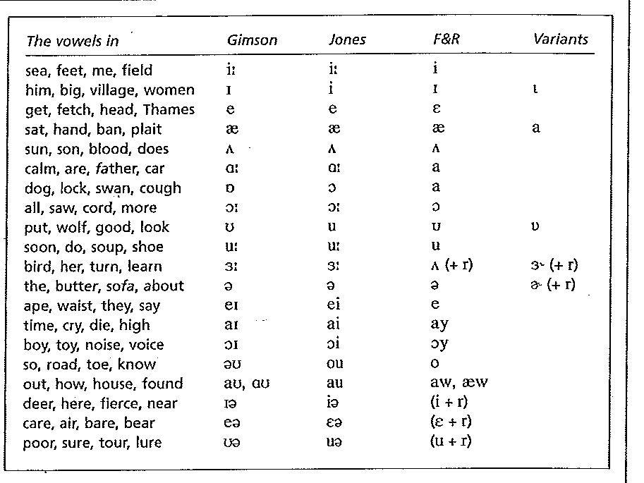

Slide 20
Describing vowels
From a phonetic point of view, vowels are articulated with a relatively open configuration of the vocal tract: no part of the mouth is closed and no audible friction is made.
From a phonological point of view, vowels occupy the middle of the syllable. Consonants, by contrast, are found at the edges or margins of syllables.
BIG [bɪg]; CAP [kæp].
The letter Y can be described as either a consonant when it occupies the edges (YET), and as a vowel when it acts as a vowel (MY).
Vowels involve the vibration of the vocal cords (voicing), and their distinctive resonances are made by varying the shape of the mouth.

Slide 21
Classification of vowels vowel quality
Depending on the height of the tongue vowels can be classified into high or (close), low (or open), mid vowels (half-close an half open):
When the front or the back of the tongue is raised towards the roof of the mouth, the vowel is called high (close), (pill, meet, look, soon);
When the front or the back of the tongue is a low as possible, the vowel is called low (or open) (land, star, or dog);
When the tongue occupies an intermediate position between the high and the low, the vowel is called mid (half-close and half open) (get, or the unstressed about)

Slide 22
Classification of vowels
Depending on the part of the tongue that is raised most vowels are classified into front, back and central.
When the front part of the tongue is raised towards the hard palate, the vowel is called front (meet, get, land);
When the front part of the tongue is raised towards the back part of the soft palate, the vowel is called back (soon , dog);
When the from part of the tongue is raised towards the back part of the hard palate, the vowel is called central (about, nurse);

Slide 23
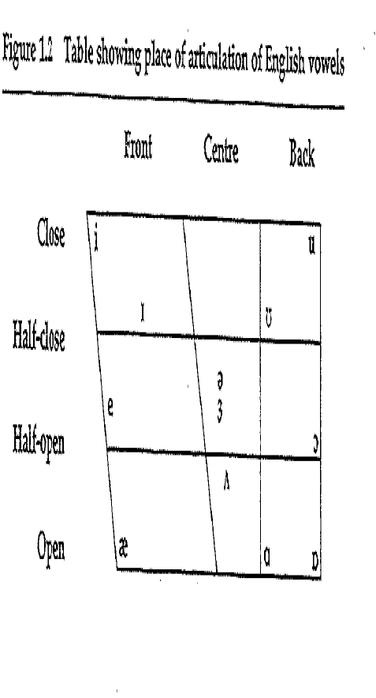
Describing vowels

Slide 24
Describing vowels
Length is a very important factor in phonology, symbolized by /:/
SIT [sɪt] SEAT [sɪːt]
From the point of view of length, diphthongs are like long vowels, but the first part of a diphthong in English is much longer and louder than the second.

Slide 25
The sounds of English
THE PHONETIC ALPHABET DISTINGUISHES ALL PHONEMES IN WRITING.
The International Phonetic Alphabet (IPA) provides a writing symbol for any linguistic sound of any world language.

Slide 26
The International Phonetic Alphabet
Enables students and linguists to learn and record the pronunciation of languages accurately, thereby avoiding the confusion of inconsistent, conventional spellings.
One aim of the IPA was to provide a unique symbol for each distinctive sound in a language--that is, every sound, or phoneme, that serves to distinguish one word from another.

Slide 27
Things you need to know: pho
1) Each syllable in English contains a vowel;
2) For breaking words into syllables it is the way you pronounce the words that is important, not the spelling. We focus on the number of vowel sounds not the letters;
3) Sometimes one vowel sound is made up of more then one vowel letter. For example in the word ‘laugh’ the two vowel letters ‘au’ form one sound. The letters ‘au’ make the single vowel sound /a:/ like in ‘car’. The word ‘laugh’ has therefore one syllable because we pronounce only one vowel sound.
4) Beware silent letters, like the words ‘late’ and ‘name’. ‘Late’ and ‘name’have one syllable as we only pronunce one vowel when we say these words. The letter ‘e’ is silent.
5) A diphthong vowel sound makes one syllable. For instance /ei/ makes one syllable in the word ‘rate’.

Slide 28
Exercises:
1) Say these words out loud and break them into syllables: look; voice; walking; carpet; carefully; consistent;

Slide 29
Exercises:
1) Say these words out loud and break them into syllables: look; voice; wal.king; car.pet; care.fu.lly; con.sis.tent;

Slide 30
Exercises:
1) Say these words out loud and break them into syllables: dog; meet; nice; nicer; project; table;

Slide 31
Exercises:
1) Say these words out loud and break them into syllables: dog; meet; nice; ni.cer; pro.ject; ta.ble;

Slide 32
Exercises:
1) Say these words out loud and break them into syllables: reporter; radio; adventure; impossible; operation; discovery;

Slide 33
Exercises:
1) Say these words out loud and break them into syllables: re.por.ter; ra.di.o; ad.ven.ture; im.pos.si.ble; o.pe.ra.tion; di.sco.ve.ry;

Slide 34
Exercises:
1) Say these words out loud and break them into syllables: congratulations; qualifications; undeniable;

Slide 35
Exercises:
1) Say these words out loud and break them into syllables: con.gra.tu.la.tions; qua.li.fi.ca.tion; un.de.ni.a.ble;

