Slide 1

Politics and Communication prof. Fulvio Venturino
Course presentation

Slide 2
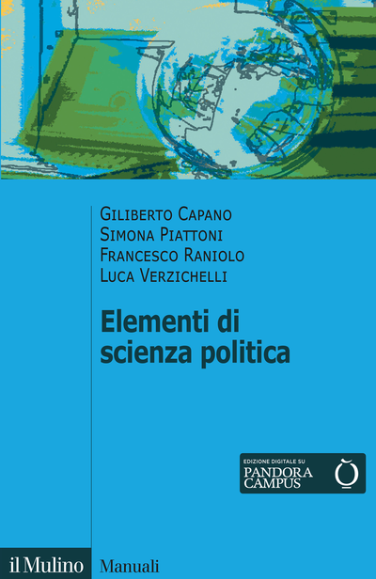
Course presentation 1
Format: 54 hours, 9 CFU
Sector: Political Science (SPS/04)
On Political Science, in general, on a voluntary basis you may preemptively read G. Capano, S. Piattoni, F. Raniolo and L. Verzichelli, Elementi di Scienza Politica, Bologna, il Mulino, 2021.

Slide 3

Course presentation 2
A sector of the Political Science: Political Communication
On a voluntary basis you may preemptively read: G. Mazzoleni (a cura di), Introduzione alla comunicazione politica, Bologna, il Mulino, 2021.

Slide 4
Course presentation 3
Our specific topic: Political Marketing
  The subject: recent electoral campaigns
  A pre-condition: disenchanted and independent voters
  A recurrent characteristic: professional communication
  A recent enlargement: governmental activities (political management, or post-election marketing)

Slide 5
Course presentation 4
Teaching
  in presence, classroom CM8
  in English
Lecture hours
  Tuesday, Wednesday and Thursday, h. 10:00-12:00
  total slot: 120 minutes
  lectures: 90 minutes
When necessary
  Start: presentation of a glossary
  End: Questions & Answers (Q&A)

Slide 6
Course presentation 5
Time limits
  Module A: from October 4 to November 9
  Module B: from November 22 to …
October 12: final examinations in SU
October 13: no class
October 5, 26 and 27: h. 8-10
November 2 and 3: no class
Possible online classes: Friday, November 3 and 4

Slide 7
Course presentation 6
Examination
  written verification
  two-stage verification
    module A: chapters 1-4
    module B: chapters 5-8
Mid-term examination
  Alternative method (to be discussed)
  First date: mid-November (?)
Materials
  Text (where?)
  Power Point slides (where?)

Slide 8
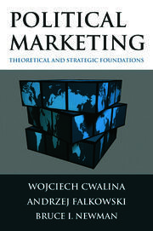
Course presentation 7
The textbook
W. Cwalina, A. Falkowski and B.I. Newman, Political Marketing. Theoretical and Strategic Foundations, London and New York, Routledge, 2011.

Slide 9
Course presentation 8
The structure of the textbook
W. Cwalina, A. Falkowski and B.I. Newman, Political Marketing. Theoretical and Strategic Foundations, London and New York, Routledge, 2011.
  Chapter 1: general and theoretical insights
  Chapter 2: the state of the art
  Chapters 3-6: the practice of the political marketing
  Chapter 7: post-election marketing
  Chapter 8: political marketing and the quality of democracy

Slide 10
Course presentation 9
The readership of the textbook
“The book is aimed not only at students and researchers working in marketing, business, and political sciences. It is also aimed at psychologists, sociologists, and those who are professional in the humanities. It can certainly be helpful to consultants working on political campaigns as well as politicians who would better understand their chances of success or failure” (p. XI).

Slide 11
Course presentation 10
Office hours
In presence
  Viale Sant’Ignazio 78, room 37; hours to be found on https://unica.it/unica/page/it/fulvio_venturino
Online
  to be agreed through a mail to fventurino@unica.it:
    Skype: fventurino
    Teams: uizkpbm

