Slide 1

Translating tourism
Traduzione Inglese 1
a.a. 2020/2021

Slide 2
Features of tourist texts
Notion of authenticity which influences tourists’ choices (Denti 2015)
Tourism Destination Image : images evoked, and the atmosphere and attractions expected. stereotypical, affective, and unique images
lack of sender identification, monologue, euphoria, tautology.
specific lexical, syntactic, functional and textual features and conventions which differ from other specialized languages

Slide 3
Features of tourist texts
lexical level:
1. The use of positive adjectives to give beauty and distinction to the text (outstanding, spectacular, exotic, colourful);
2. The use of superlatives, either with adjectives or with the morphological form is very high. For instance, Windsor Castle is the oldest and largest occupied castle in the world. (Windsor Castle -leaflet).
3. The very careful lexical choices of keywords as away, adventure, dream, imagination, pleasure, escape to comply with the tourist’s expectations about holidaying; together with a technique called languaging (Potter in Dann, 1996: 183), which refers to the use of foreign and invented words in tourist texts to induce a sense of exotic feeling in the tourist;
4. The use of cultural references, called realia (chiringuito, gazpacho, etc.), which do not have any equivalent in the target language.
5. ego targeting: ‘we’, ‘you’

Slide 4
Features of tourist texts
syntactic level:
1. Preference for nominalization (e.g. when you arrive at the hotel > upon arrival at the hotel);
2. imperatives, in order to urge the tourist to avail him/herself of the opportunities which are on offer/
3. The use of the present simple tense in order to make the time of the holiday still and everlasting.

Slide 5
Features of tourist texts
functional level:
1. The referential function is always the main function, since the objective of tourist texts is to inform and describe a country, a region, a community, etc.
2. The persuasive or vocative function is the other predominant function, as Dann (1996: 2) states, the major aim of language of tourism is “to persuade, lure, woo and seduce millions of human beings, and, in so doing, convert them from potential into actual clients’ place into a tourist destination”.
3. expressive function, conative function, and poetic function are secondary functions.

Slide 6

Features of tourist texts
Guides, websites: main responsible of building the touristic image
The addressee matters: anticipate reactions (different from guide to website, Denti 2015 139)
Quantitative and qualitative aspects of cultural distance
Narration:

Slide 7


Features of tourist texts
Descriptions
Instructions

Slide 8
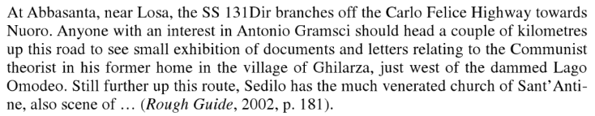
Features of tourist texts
Stop, look, see (Denti 2015, 57)

Slide 9
Features of tourist texts
Colloquialisms + irony
Es. ‘Lot of Rot’ --- formaggio con i vermi
‘Horses for courses’ (critical for British tourists) (Denti 2015, 61)
MODERATE THE CULTURAL SHOCK
Stereotypes

Slide 10
Translating tourist texts
ST Although hiding amongst beautiful countryside, our cottages are easily located approximately 20 minutes drive from M20.
Prima bozza: Nonostante si trovino nascosti nella splendida campagna, i nostri cottage sono situati in comoda posizione a circa 20 minuti dalla M20.
TT: I nostri cottage sono immersi nella natura ma allo stesso tempo si trovano vicini alle principali vie di collegamento

Slide 11
Translating tourist texts
ST Inserito armoniosamente a ridosso di una collina, il nostro agriturismo domina la vallata sottostante e l’incomparabile panorama che vi si gode abbraccia Umbria e Toscana.
Prima bozza: “Harmoniously perched with a hill at its back, our farmhouse dominates the valley below and the stunning view that can be enjoyed comprises Umbria and Tuscany”.
TT: “Our farmhouse is set close to a hill and has beautiful commanding views over the valley below and over Umbria and Tuscany”
TT describes, ST creates a certain atmosphere

Slide 12
Translating tourist texts
ST: A little stream runs in front of the cottages and there are glorious uninterrupted views of the hills and grazing stock.
Traduzione intermedia: “Un piccolo ruscello scorre di fronte ai cottage e, a perdita d’occhio, c’è una magnifica vista delle colline e delle mandrie al pascolo”.
TT: “Accompagnati dal mormorio del ruscello che scorre vicino, dai cottage potrete ammirare un infinito panorama sulle verdi colline circostanti punteggiate dalle mandrie al pascolo”.

Slide 13
Translating tourist texts
Intercultural aspects: translate nouns with a specific cultural meaning
Café? Lonely Planet and Time Out: “caffè” e “bar”
Rough Guide: “caffetteria” (different readers)
Collocations

Slide 14
Translation errors
Grammar and spelling,
– Lexis and semantic,
– Pragmatics and discourse,
– Omissions, repetitions and additions.
translation problems caused by terminology mistakes + intrinsic difficulties regarding the cultures involved.
adequate solutions according to the text function, its audience, and the media;
different strategies, e.g. explicitation or adaptation, with the aim of transferring the original meaning to the target audience and thus, overcoming communication barriers
translation equivalents of proper names (people, museums, institutions, places, etc)

Slide 15
Translation errors
Italian Agenzia nazionale del Turismo: misadaptation and lack of nativeness
(Italian ST) Dove dormire in Italia? Esiste solo l’imbarazzo della scelta. Agli oltre trentatremila alberghi, disseminati in ogni località, si aggiungono altri trentacinquemila indirizzi di campeggi, alloggi agrituristici, bed & breakfast, ostelli per la gioventù, alloggi privati e così via
(English TT) Where to sleep in Italy? There is only an embarrassment of choice. In addition to more than thirty thousand hotels located in every part of the country, there are an additional thirty five thousand addresses of campsites, country farmhouses, bed and breakfasts, youth hostels, private accommodation and so forth. (Durán muñoz 2012, 347)

Slide 16
Tourists’ expectations regarding texts are related to content and style
the more the target cultural conventions prevail, the more successful translations are

Slide 17
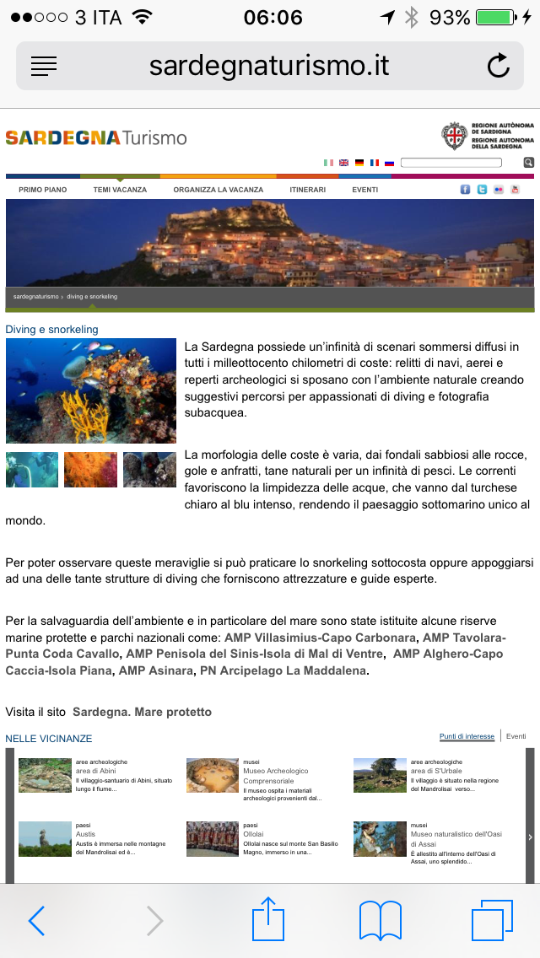
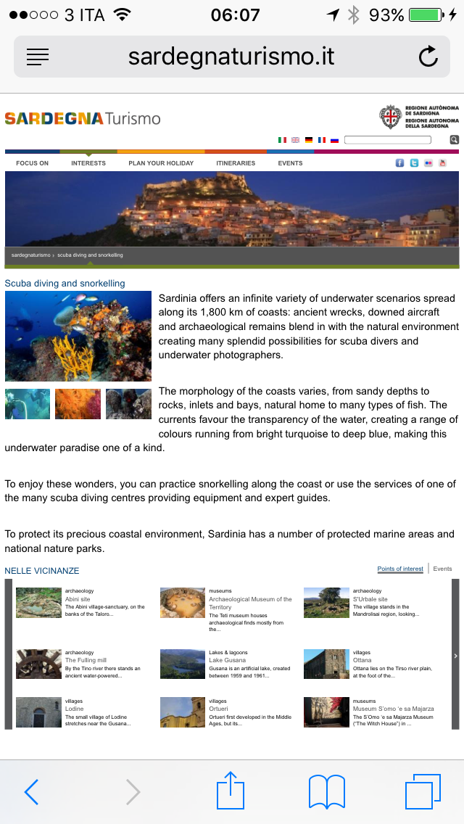

Slide 18
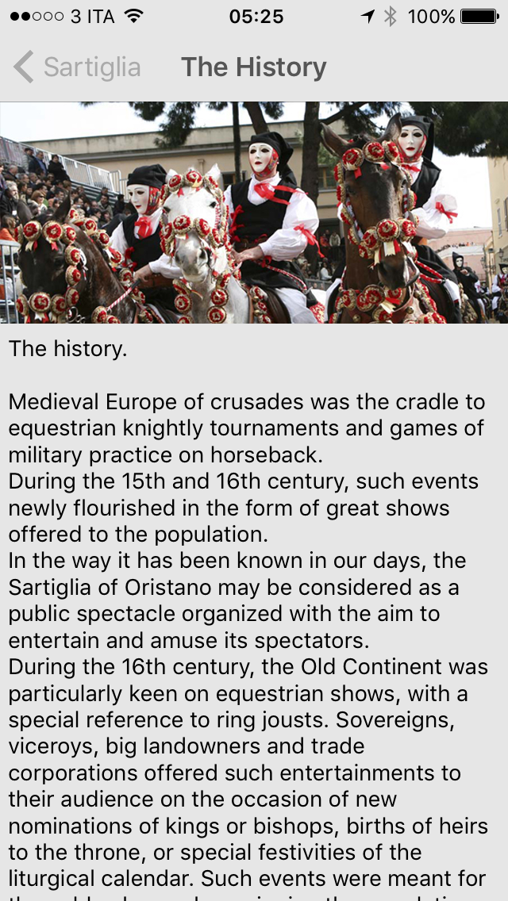
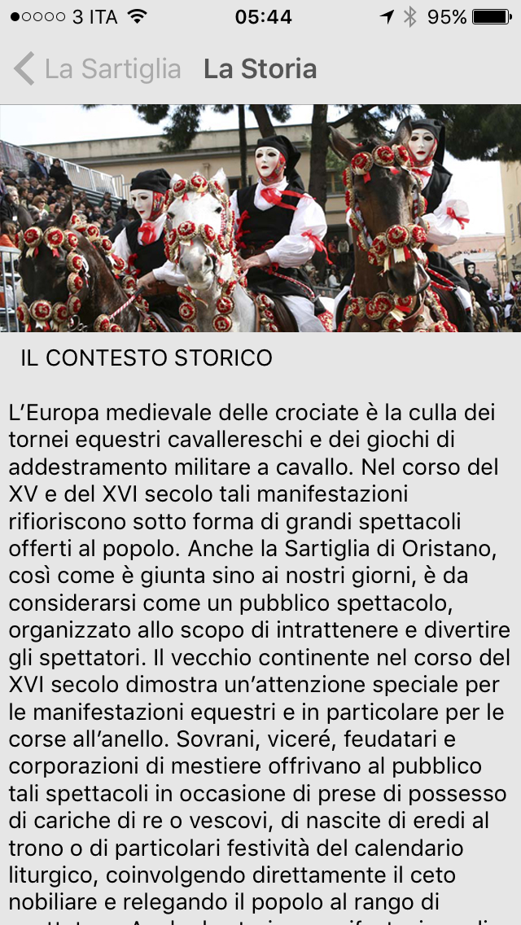

Slide 19
Apparently, the discourse features of tourist websites and apps are characterized by different linguistic choices and different styles of promoting destinations
Sometimes the translated versions of apps and websites are basically a literal translation regardless of any cultural, linguistic or stylistic peculiarity and, therefore, only partially accessible to an international audience and with a limited persuasive effect
(Denti, The Language of Tourism – Translating Digital Texts, 2018)
Notes:
The first rough results of this study will show how website and app texts, both in English and Italian, take on different linguistic choices and consequently different styles of promoting their tourist destinations, consequently determining significant actions in the translation process. However, they will also show that sometimes the translation process is simply a literal translation regardless of any cultural, linguistic or stylistic peculiarity.

