Slide 1
Bihavioural Finance
Rational man Vs Behaviourally biased man
Anomalies
Behavioral finance
Decision making biases: causes
Biases
Overcoming biases?

Slide 2
Rational economic man Vs behaviourly biased man:
Homo-Economicus:
  Perfect rationality
  Perfect self interest/control
  Perfect information
Criticism:
  Rationality is not the sole driver of human behavior
  Ppl are not perfectly self interested
  Impossible to enjoy perfect information

Slide 3
Anomalies:
Fundamental anomalies: irregularities that emerge when a stock’s performance is considered in light of fundamental assessment of the stock’s value (supply/demand).
Technical anomalies: debate wether past prices of securities can be used to predict future prices. Forecast the future using the past.
Calender anomalies: January anomaly, stocks in general and small stocks in particular have delivered abnormally high returns in january/in the last and first 4 days of the month, due to the cash flows of the month.

Slide 4
Behavioural finance:
Is defined as the application of psychology to finance.
Attempts to identify and learn from the influence of human psychological phenomena in the financial markets and within individual investors.
The purpose of classification of behavioural finance is to help understand why people make certain financial choices and how those choices can affect markets.

Slide 5
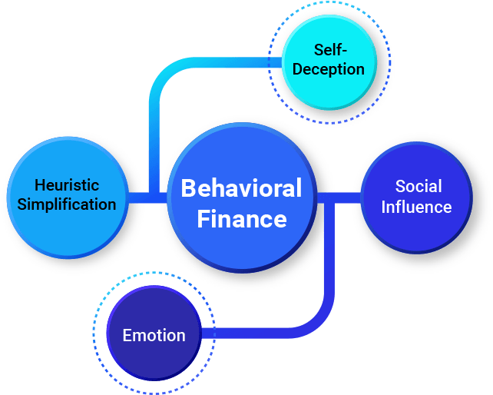

Slide 6
Decision making biases:
Self-deception: is a limit to the way we learn. When we mistakenly think we know more than we do, we tend to miss information that we need to make an informed decision.
Heuristic simplification: Heuristic simplification refers to information-processing errors.
Emotion: refers to our making decisions based on our current emotional state. Our current mood may take our decision making off track from rational thinking.
Social influence: how our decision making is influenced by others.

Slide 7
Over-confidence Bias:
Type: Cognitive
General discription: unwarranted faith in one’s intuitive reasoning, judgement and cognitive abilities.
Technical description:
  confidence intervals tend to be nerrow.
  Certainty over-confidence.
Potential behaviour:
  Trade excessively
  Under-estimate downside risks
  Undiversified portfolio

Slide 8
Representativeness bias:
Type: cognitive
General description: people have developped an innate prospensity for classifying objects or thoughts. The classification reflex leads to deception producing an uncorrect understanding of new elements.
Technical description:
  base rate neglect
  Sample size neglect
Potential behaviour:
  Over-confidence
  Over-reaction

Slide 9
Anchoring and adjustment bias:
Type: Cognitive
General description: when estimating unknown magnature value people genrally begin by envisioning a default initial number “ANCHOR”, then adjust it up or down.
Technical description: Investors are often influenced by purchase points or arbitrary price levels/indexes.
Potential behavior:
  Investors pecieve information through an essencially wrapped lens.
  Buying an undervalued investment
  Selling an overvalued investment

Slide 10
Cognitive Dissonance bias:
Type: cognitive
General description: newly acquired information conflicts with a pre-existing understanding people experience discomfort.
Technical description:
  selective perception
  selective decision making
Potential behavior:
  Hold losing securities
  Invest in securities they already hold after it has gone down

Slide 11
Self attribution bias:
Type: Cognitive
General description: refers to the tendency of individuals to attribute their success to innate aspects and their faliure to outside infuence (success to dispositional factors and failure to situational factors).
Technical description:
  Self enhancing bias
  Self protecting bias
Potential behavior:
  Trade too much
  Hold or purchase stocks they should not

Slide 12
Illusion of control bias:
Type: Cognitive
General description: the tendency of human beings to believe that they can control or at least influence outcomes when infact they cannot.
Technical description: expectation of a personal success probability inapproprietly higher than the object probability would warrant.
Potential behavior:
  Trade more than it’s prudent
  Maintain undiversified portfolio
  Over-confidence

Slide 13
Conservatism bias:
Type: cognitive
General description: is a mental process in which people cling to their prior views or forecasts at the expence of akcnowledging new information.
Technical description: investors too often give more attention to forecast outcomes than to new data describing emerging outcomes.
Potential behavior:
  Behave too inflexibly
  Too slow reactions

Slide 14
Ambiguity aversion bias:
Type:cognitive
General description: people do not like to gamble when probability distribution is uncertain and hesitate in situations of ambiguity.
P.S: Risk VS Uncertainty.
Potential behavior:
  Hold conservative investments.
  Restricted to their national indexes
  Favor investments that are geographically close

Slide 15
Endowment bias:
Type: Emotional
General description: people who exhibit endowment bias value an asset more when they hold it than when they don’t.
Technical description: the value of an object depends on its possessivity.
Potential behavior:
  Inherited securities
  Commission aversion
  Desire for familiarity

Slide 16
Self-control bias:
Type: Emotional
General description: consume today at the expense of saving for tomorrow.
Technical description: the foundation of the model is the saving decision.
(Income= consumption+saving).
Potential behavior:
  Fail to plan for retirement
  Asset allocation imbalance

Slide 17
Optimism bias:
Type: Emotional
General description: Investors tend to be overly optimistic.
Technical description: The optimism bias is defined as the difference between a person's expectation and the outcome that follows. If expectations are better than reality, the bias is optimistic; if reality is better than expected, the bias is pessimistic.
Potential behavior:
  Overload their portfolio of one company’s stocks
  Read too much into rosy forecasts
  Think they are above average investors

Slide 18
Loss aversion bias
Type: Emotional
General description: is a part of the prospect theory. Poeple generally feel a strong impulse to avoid losses than to acquire a gain.
Technical description: S shape utility representative value function
Potential behavior:
  Hold loosing investments too long
  Excessive trade
  Unknowingly take more risk
  Unbalanced portfolio

Slide 19
Narrative Fallacy
Typically, stories have emotional content which appeals to our subconscious or reflexive reasoning. Because stories have that emotional component, they are easier to remember and tend to influence our behaviour.
Some investors tend to abandon evidence in favour of a good story.
Stockbrokers have taken advantage of the narrative fallacy for years, convincing clients to invest in a stock by telling them a great story about the company.

Slide 20
Overcoming Biases?
Reflexive/reflective decision making
Prepare
Plan
Pre-commit
Once you have a 90 IQ, successful investments do not correlate anymore with the IQ. What an investor needs is the temperament to control urges and psychological biases.

Slide 21

Time for games

Slide 22
2-4-8-10-12
Guess my choice rule???

Slide 23


Quickly, without thinking and without using a calculator or consulting your friends...
Try to estimate the answer for the following equation: 1x2x3x4x5x6x7x8=

Slide 24
Quickly, without thinking and without using a calculator or consulting your friends...
Try to estimate the answer for the following equation: 8x7x6x5x4x3x2x1=

Slide 25
Anchoring bias
The answer is: 1x2x3x4x5x6x7x8=40,320
The first number in the equation tends to anchor our refrence point.
That’s why in the first version the estimates tend to beanchored to lower refrence.

Slide 26

THE WORLD is facing COVID-19 OUTBREAK it is estimated to kill 600,000 people in the coming days. Two alternatives programs to combat the disease have been proposed.
Assume that the scientific estimates or the consequences of the programs are as follows:
Program A: If Program A is adopted, 200,000 people will be saved
Program B: If Program B is adopted, there is a one-third probability that 600,000 people will be saved and a two-thirds probability that no people will be saved
Which of the two programs would you favour?

Slide 27
Same situation but with 2 different propositions Which of the two programs would you favour?
Program C: If Program C is adopted; 400,000 people will die
Program D: If Program D is adopted, there is a one-third probability that no one will die and a two-thirds probability that 600,000 people will die

Slide 28

Prospect theory: Framing effect
People generally try to avoid risk.
Positive framing: risk-averse (avoid risk)
Negative framing: risk-seeking
But, we are sensitive to context. Same situation, under framing of loss people become risk takers

