Slide 1
EMH
Some Analitical Insights
Oumaima Lahmar

Slide 2
Time Series
Definition
Components
Types
Uses
Stationarity
Random walk
Unit rook

Slide 3
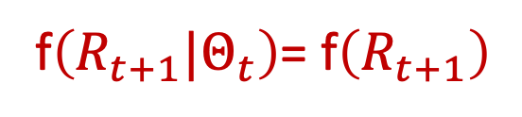
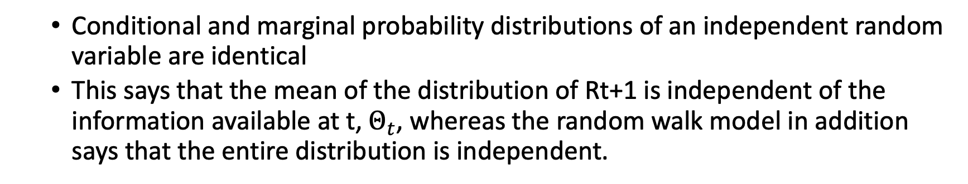
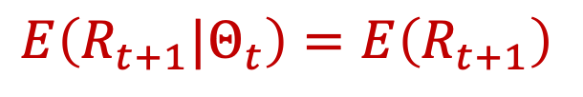
Fama (EMH):
In efficient markets model:
  current prices "fully reflects" available information
  successive price changes (or more usually, successive one-period returns) are independent
  successive changes (or returns) are identically distributed. “Random Walk”:
f$\left(R_{t+1}|Θ_{t}\right)$= f$\left(R_{t+1}\right)$
  Conditional and marginal probability distributions of an independent random variable are identical
  This says that the mean of the distribution of Rt+1 is independent of the information available at t, $Θ_{t}$, whereas the random walk model in addition says that the entire distribution is independent.
$$E\left(R_{t+1}|Θ_{t}\right)=E\left(R_{t+1}\right)$$

Slide 4
What is a time series?
A time series is a set of observations taken at specific times, usually at equal intervals
It establishes a relation between cause and effects
One variable is time which is an independent variable
The second is data which is a dependent variable
Time series methods are used to understand the generative process underlying the observed data, fit a model in order to monitor or forecast a process.

Slide 5
What for?
Safety from future, demand planning and forecasting, stock market analysis, economic forecasting, Budgetary analysis…
The changes in time series are affected by different reasons:
  Economic
  Social
  Natural
  Political …

Slide 6
Components
Time series has three components:
Trend: long term direction
Seasonality: periodic behavior
Residual: irregular fluctuation

Slide 7
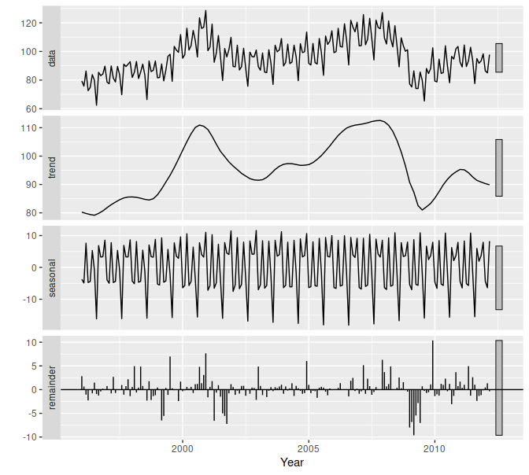

Slide 8
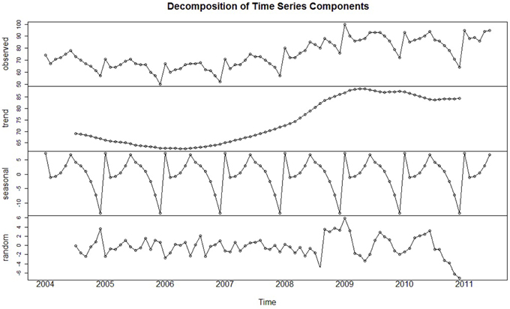

Slide 9
Components
Secular trend (increase in population, change in technological process)
Seasonal variation (more woolen clothes are sold in winter, more ice cream is consumed in summer, departmental stores sales/ festivities)
Cyclical variation (the business cycle: prosperity, recession, depression and recovery)
Irregular variation (earthquakes, wars, floods, famines, COVID)

Slide 10
Statistical stationarity:
A stationary time series is one whose statistical properties such as mean, variance, autocorrelation, etc. are all constant over time.
Most statistical forecasting methods are based on the assumption that the time series can be rendered approximately stationary
A stationarized series is relatively easy to predict:
  you simply predict that its statistical properties will be the same in the future as they have been in the past!

Slide 11
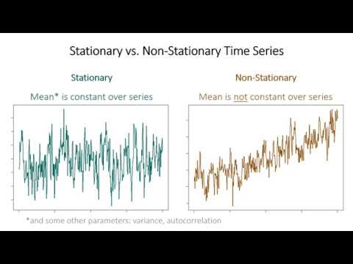

Slide 12
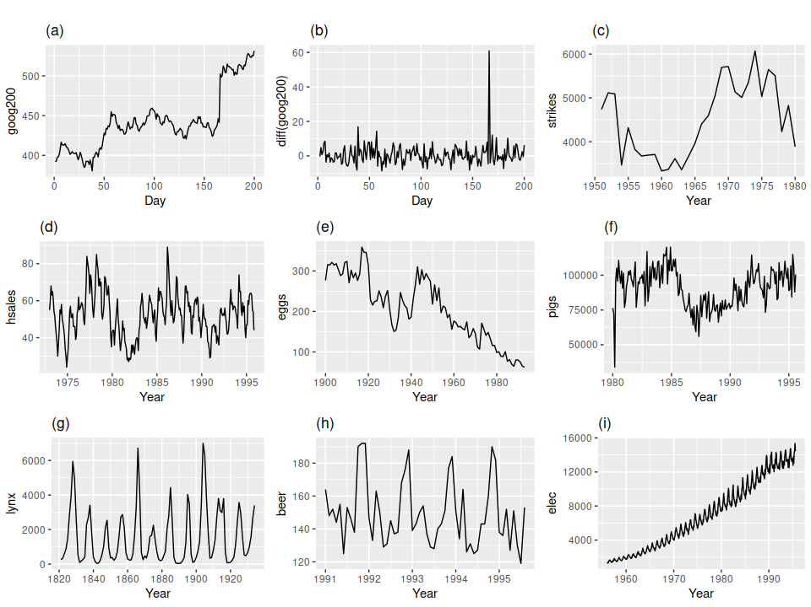
(a) Google stock price for 200 consecutive days; (b) Daily change in the Google stock price for 200 consecutive days; (c) Annual number of strikes in the US; (d) Monthly sales of new one-family houses sold in the US; (e) Annual price of a dozen eggs in the US (constant dollars); (f) Monthly total of pigs slaughtered in Victoria, Australia; (g) Annual total of lynx trapped in the McKenzie River district of north-west Canada; (h) Monthly Australian beer production; (i) Monthly Australian electricity production.

Slide 13
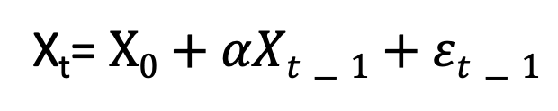
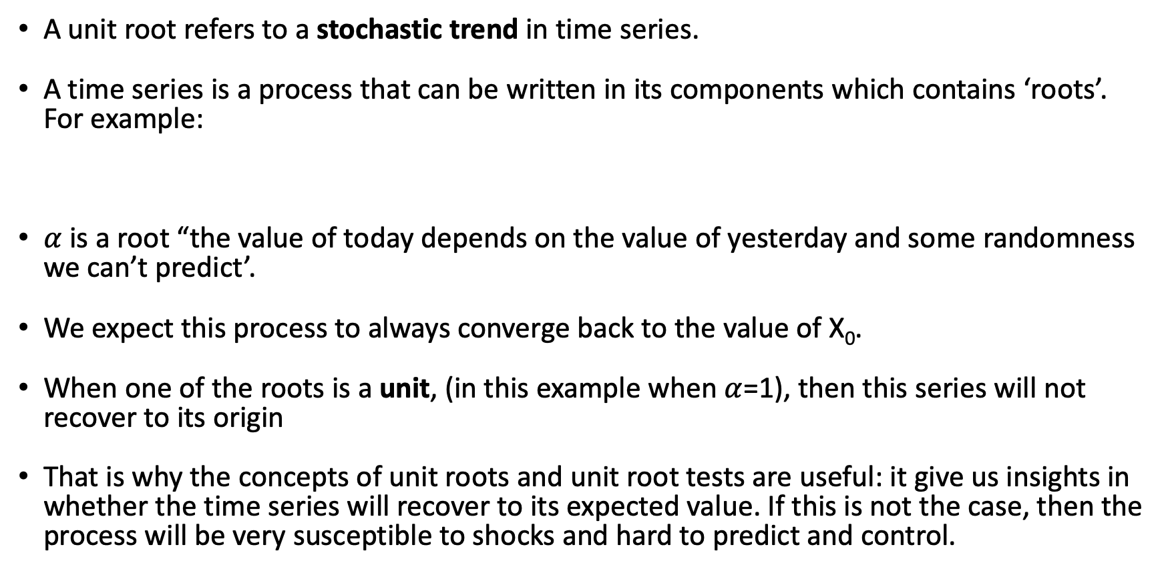
Unit root:
A unit root refers to a stochastic trend in time series.
A time series is a process that can be written in its components which contains ‘roots’. For example:
$α$ is a root “the value of today depends on the value of yesterday and some randomness we can’t predict’.
We expect this process to always converge back to the value of X₀.
When one of the roots is a unit, (in this example when $α$=1), then this series will not recover to its origin
That is why the concepts of unit roots and unit root tests are useful: it give us insights in whether the time series will recover to its expected value. If this is not the case, then the process will be very susceptible to shocks and hard to predict and control.
X_{t}= $X0+αXt−1+εt−1$

Slide 14
Random walk:
Random walk suggests that changes in stock prices have the same distribution and are independent of each other.
Past movement or trend of a stock price or market cannot be used to predict its future movement.
In short, random walk theory proclaims that stocks take a random and unpredictable path that makes all methods of predicting stock prices futile in the long run.

Slide 15
Consequence of Random walk on the EMH:
The efficient market hypothesis states that stock prices fully reflect all available information and expectations
  current prices are the best approximation of a company’s intrinsic value
Due to the short-term randomness of returns
  investors would be better off investing in a passively managed, well-diversified fund
A blindfolded monkey throwing darts at a newspaper's financial pages could select a portfolio that would do just as well as one carefully selected by experts."

