Slide 1

Advanced
Corporate Finance
6 CFU
Corso di Laurea in International Management
Prof. Luca Piras
Room 4, P. Baffi building 2° floor
pirasl@unica.it 070 675 3365

Slide 2
Course Overview
Corso di Laurea in International Management
the course will deal with advanced concepts of corporate finance:
Theories of financial markets;
Corporate Valuation;
Crypto Currencies and Block Chain;
Start-up Finance;
Scale-Up Finance.

Slide 3
Block-Chain
Corso di Laurea in International Management
Technology
Crypto Currencies
Applications
Block Chain Definition

Slide 4
Block Chain
Corso di Laurea in International Management
The block chain is an incorruptible digital ledger of economic transactions that can be programmed to record transactions of virtually anything of value

Slide 5
Block Chain
Corso di Laurea in International Management
It allows digital information to be distributed but not copied
Is a new type of internet
Total value of Bitcoin is over to $9 billion US
Block chains can make other types of digital value

Slide 6
The database
Corso di Laurea in International Management
Information on a blockchain exists as a shared — and continually reconciled — database.
The database isn’t stored in any single location
Records are truly public and easily verifiable
No centralized version of this information exists for a hacker to corrupt
Hosted by millions of computers simultaneously
Its data is accessible to anyone on the internet

Slide 7
Robustness
Corso di Laurea in International Management
By storing blocks of identical information across its network:
  Can’t Be controlled by any single entity.
  Has no single point of failure.
Since it was invented (2008), has operated without significant disruption
Problems come from bad intention and human error

Slide 8
Consensus
Corso di Laurea in International Management
The network lives in a state of consensus, automatically checks in with itself every ten minutes
A self-auditing ecosystem, it reconciles every transaction in ten-minute intervals
Each group of transactions is referred to as a “block”
Two important properties result from this:
  Transparency data is, by definition, public
  It cannot be corrupted it would require a huge amount of computing power
  Possible in theory; unlikely in practice

Slide 9
The Network
Corso di Laurea in International Management
Second-level network, a different vision for how the internet can work
Every node is an “administrator” of the blockchain, and joins the network voluntarily
Each one has an incentive for participating in the network: the chance of winning Bitcoins
Nodes are said to be “mining” Bitcoin
Each one is competing to win Bitcoins by solving computational puzzles
Bitcoin was the raison d’etre of the blockchain as it was originally conceived
It’s now recognized to be only the first of many potential applications

Slide 10
Applications
Corso di Laurea in International Management
Smart contracts
  Distributed ledgers enable the coding of simple contracts that will execute when specified conditions are met
  At the current level of development, smart contracts can perform simple functions
    A derivative could be paid out when a financial instrument meets certain benchmark, with blockchain enabling the payout to be automated

Slide 11
Applications
Corso di Laurea in International Management
The sharing economy
  By enabling peer-to-peer payments, the blockchain opens the door to direct interaction between parties
  An early example, OpenBazaar The “no rules” ethos means that personal reputation will be even more important to business interactions than it currently is.

Slide 12
Applications
Corso di Laurea in International Management
Crowdfunding
  Potentially creating crowd-sourced venture capital funds
  “A new paradigm of economic cooperation”
Governance
  Bring full transparency to elections or any other kind of poll taking
  Enables organizational decision-making to happen on the blockchain
  Company governance becomes fully transparent and verifiable when managing digital assets, equity or information

Slide 13
Applications
Corso di Laurea in International Management
Prediction markets
  The crowdsourcing of predictions on event probability is proven to have a high degree of accuracy
  Averaging opinions cancels out the unexamined biases that distort judgment
  Prediction markets that payout according to event outcomes are already active
  Blockchains are a “wisdom of the crowd” technology

Slide 14
Currencies
Corso di Laurea in International Management
Definition
  limited entries in a database no one can change without fulfilling specific conditions
Take the money on your bank account: What is it more than entries in a database that can only be changed under specific conditions?
You can even take physical coins and notes: What are they else than limited entries in a public physical database that can only be changed if you match the condition than you physically own the coins and notes?
Money is all about a verified entry in some kind of database of accounts, balances, and transactions.

Slide 15
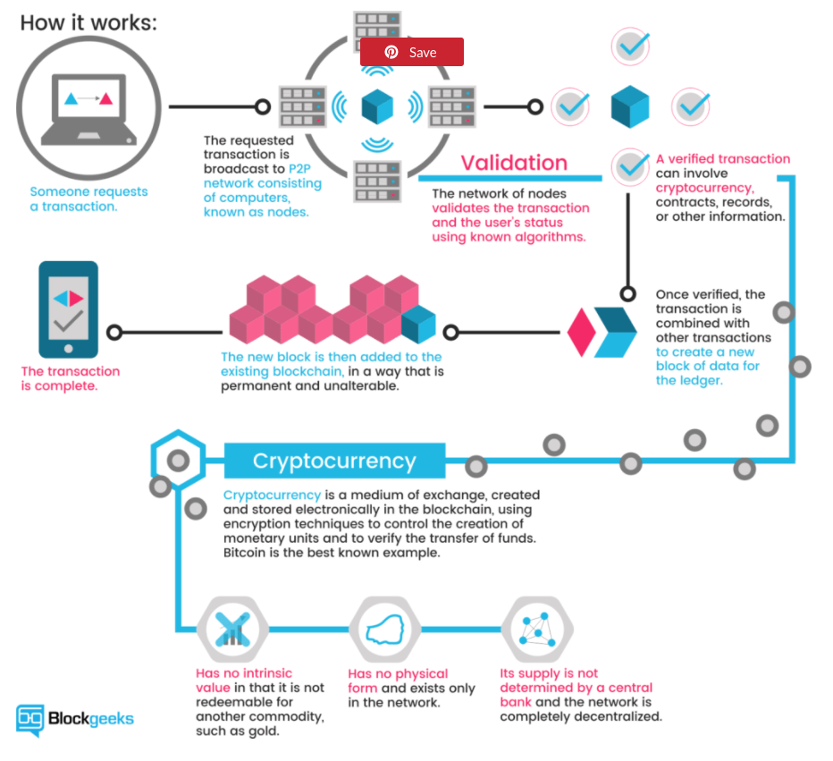
Miners
Corso di Laurea in International Management
Every peer has a record of the complete history of all transactions and thus of the balance of every account
A transaction is a file that says,
  “Bob gives X Bitcoin to Alice“ and is signed by Bob‘s private key.
  After signed, a transaction is broadcasted in the network, sent from one peer to every other peer.
  This is basic p2p-technology

Slide 16
How it works
Corso di Laurea in International Management
The transaction is known almost immediately by the whole network. But confirmed only after a specific amount of time
You could say that cryptocurrencies are all about confirmation
As long as a transaction is unconfirmed, it is pending and can be forged.
When a transaction is confirmed, it is set in stone. It is no longer forgeable
Only miners can confirm transactions. This is their job in a cryptocurrency-network.
They take transactions, stamp them as legit and spread them in the network.
After a transaction is confirmed by a miner, every node has to add it to its database.
It has become part of the blockchain.
For this job, the miners get rewarded with a token of the cryptocurrency

Slide 17
Miners
Corso di Laurea in International Management
Everybody can be a miner
The network has no authority
Imagine someone creates thousands of peers and spreads forged transactions. The system would break immediately.
The rule is that the miners need to invest some work of their computers to qualify for this task
They have to find a hash – a product of a cryptographic function – that connects the new block with its predecessor
This is called the Proof-of-Work
In Bitcoin, it is based on the SHA 256 Hash algorithm

Slide 18
Miners
Corso di Laurea in International Management
The proof of work
  Can be the basis of a cryptologic puzzle the miners compete to solve
  After finding a solution, a miner can build a block and add it to the blockchain.
  As an incentive, he has the right to add a so-called coin-base transaction that gives him a specific number of Bitcoins
  This is the only way to create valid Bitcoins
  Bitcoins can only be created if miners solve a cryptographic puzzle.
  Since the difficulty of this puzzle increases the amount of computer power the whole miner’s invest, there is only a specific amount of cryptocurrency token that can be created in a given amount of time
  This is part of the consensus no peer in the network can break.

Slide 19
Properties
Corso di Laurea in International Management
1.) Irreversible:
  After confirmation, a transaction can‘t be reversed. By nobody. And nobody means nobody. Not you, not your bank, not the president of the United States, not Satoshi, not your miner
2.) Pseudonymous:
  Neither transactions nor accounts are connected to real-world identities. You receive Bitcoins on so-called addresses, which are randomly seeming chains of around 30 characters. While it is usually possible to analyze the transaction flow, it is not necessarily possible to connect the real world identity of users with those addresses.
3.) Fast and global:
  Transaction are propagated nearly instantly in the network and are confirmed in a couple of minutes. Since they happen in a global network of computers they are completely indifferent of your physical location. It doesn‘t matter if I send Bitcoin to my neighbor or to someone on the other side of the world.

Slide 20
Properties
Corso di Laurea in International Management
4.) Secure:
  Cryptocurrency funds are locked in a public key cryptography system. Only the owner of the private key can send cryptocurrency. Strong cryptography and the magic of big numbers makes it impossible to break this scheme. A Bitcoin address is more secure than Fort Knox.
5.) Permission less:
  You don‘t have to ask anybody to use cryptocurrency. It‘s just a software that everybody can download for free. After you installed it, you can receive and send Bitcoins or other cryptocurrencies. No one can prevent you. There is no gatekeeper.

