Slide 1

Advanced
Corporate Finance
6 CFU
Corso di Laurea in International Management
Prof. Luca Piras
Room 4, P. Baffi building 2° floor
pirasl@unica.it 070 675 3365

Slide 2
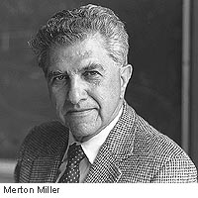
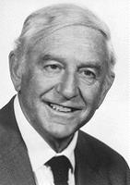
Course Overview
Corso di Laurea in International Management
the course will deal with advanced concepts of corporate finance:
Theories of financial markets;
Corporate Valuation;
Crypto Currencies and Block Chain;
Start-up Finance;
Scale-Up Finance.

Slide 3
Corporate Valuation
Corso di Laurea in International Management
Value of corporations
Why is so important …
Financial Structure
The cost of capital problem

Slide 4
The cost of capital
Corso di Laurea in International Management
What is the "cost of capital" to a firm in a world in which funds are used to acquire assets whose yields are uncertain; and in which capital can be obtained by many different media ?
the corporation finance specialist concerned with the techniques of financing firms so as to ensure their survival and growth;
the managerial economist concerned with capital budgeting;
the economic theorist concerned with explaining investment behavior at both the micro and macro levels.

Slide 5
The cost of capital
Corso di Laurea in International Management
Previous theory
  Physical assets yield sure returns
  the cost of capital to the owners of a firm is simply the rate of interest on bonds;
  that the firm will push investment up to where the marginal yield on assets equals the market rate of interest
Thus maximizing profits and market value

Slide 6
The cost of capital
Corso di Laurea in International Management
Value Enhancement
  an asset is worth acquiring if it will increase the net profit of the owners of the firm
  Net profit will increase only if the expected rate of return exceeds the rate of interest
  An asset is worth acquiring if it increases the value of the owners’ equity
  Value will exceed its cost if and only if the yield of the asset exceeds the rate of interest

Slide 7
The cost of capital
Corso di Laurea in International Management
Uncertainty
  Superimposing the notion of a "risk discount" to be subtracted from the expected yield
  A "risk premium" to be added to the market rate of interest
  No satisfactory explanation had at the time been provided
  What determines the size of the risk discount and how it varies in response to changes in other variable

Slide 8
The cost of capital
Corso di Laurea in International Management
In fact, the profit maximization criterion is no longer even well defined.
Under uncertainty outcomes are valued by a subjective probability distribution
In particular, the use of debt rather than equity may increase the expected return to the owners
Only at the cost of increased dispersion of the outcomes.

Slide 9
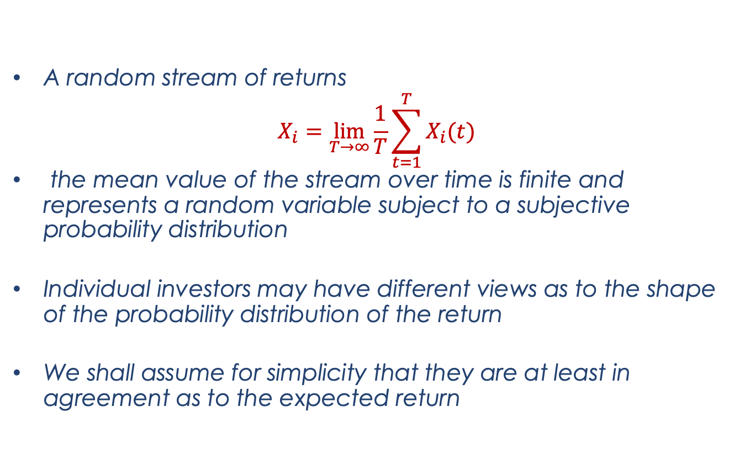
The cost of capital
Corso di Laurea in International Management
A random stream of returns
$$X_{i}=\lim_{T→∞}{\frac{1}{T}\sum_{t=1}^{T}{X_{i}(t)}}$$
the mean value of the stream over time is finite and represents a random variable subject to a subjective probability distribution
Individual investors may have different views as to the shape of the probability distribution of the return
We shall assume for simplicity that they are at least in agreement as to the expected return

Slide 10
The cost of capital
Corso di Laurea in International Management
Profits, not dividend
Do not confuse uncertainty with Volatility
Elements of a stream can be variable even though known with certainty
Classes of Corporations
In equilibrium the price per dollar’s worth of expected return must be the same for all shares of any given class

Slide 11
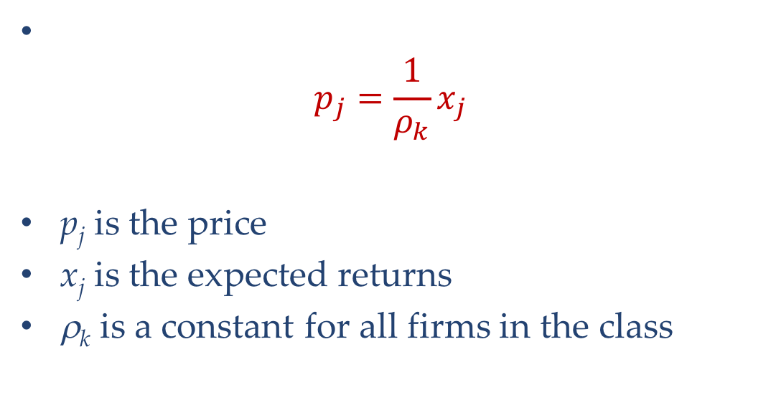
The cost of capital
Corso di Laurea in International Management
$$p_{j}=\frac{1}{ρ_{k}}x_{j}$$
p_{j} is the price
x_{j} is the expected returns
ρ_{k} is a constant for all firms in the class

Slide 12
The cost of capital
Corso di Laurea in International Management
The introduction of debt-financing changes the market for share
  Because firms may have different proportions of debt
  Shares of different companies, even in the same class, can give rise to different probability distributions of returns
  Shares will be subject to different degrees of financial risk or "leverage" and hence they will no longer be perfect substitutes for one another.

Slide 13
Proposition 1
Corso di Laurea in International Management
Any company j having x_{i} expected return on the assets owned by the company
Denote by D_{j} the market value of the debts of the company; by S_{j} the market value of its common shares;
Vj=Sj+Dj the market value of all its securities or, as we shall say, the market value of the firm
The market value of any firm is independent of its capital structure and is given by capitalizing its expected return at the rate ρ_{k} appropriate to its class.

Slide 14

The cost of capital
Corso di Laurea in International Management
Market value is independent from it’s capital structure
$$V_{j}=\left(S_{j}+D_{j}\right)=\frac{{\overline{X}}_{j}}{ρ_{k}}$$
If I solve for $ρ_{k}$
$$ρ_{k}=\frac{{\overline{X}}_{j}}{\left(S_{j}+D_{j}\right)}=\frac{{\overline{X}}_{j}}{V_{j}}$$

Slide 15

If V_{u} > V_{l}
Corso di Laurea in International Management
$ρ_{k}$ must be the same for all companies in the class or arbitrageurs will take advantage of such differences
 | Investment | Returns
A) Initial Strategy: | α (V_{u} ) | α(X)
B) Arbitrage Strategy:
Buy α Stocks S_{L} | α (V_{L} – D_{L}) | α( X -rD_{L})
Loan α D_{L} | α D_{L} | α (rD_{L})
Total Value of strategy B | α V_{L} | α(X)
Sell Stocks of unlevered co. α V_{U} e buy stocks of levered co. α V_{L}
Immediate gain: α (V_{U} − V_{L}) > 0
In both cases, my return will be α (X).

Slide 16
If V_{u} < V_{l}
Corso di Laurea in International Management
 | Investment | Return
A) Initial Strategy: | α (V_{L} – D_{L}) | α( X - rD_{L})
B) Arbitrage Strategy: |  | .
Buy α Stocks S_{u} | α (V_{u} ) | α(X)
Loan α D_{L} | -α D_{L} | α (-rD_{L})
Total Value of strategy B | α (V_{U}– D_{L}) | α( X - rD_{L})
I short the Levered Co and Buy the Unlevered Co
The strategy yields the same return as A but at a lower price:
α(V_{U} − B) < α(V_{L} − B)

Slide 17
Proposition 1
Corso di Laurea in International Management
Varying the capital structure won’t enhance value for the stock owner
Value depends only on cash flows
Competition among investors will make sure that:
V_{u} = V_{l}

Slide 18
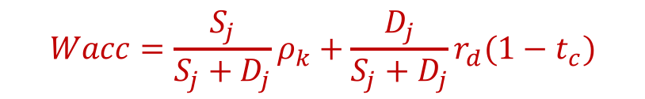
The cost of capital
Corso di Laurea in International Management
If Proposition one holds, the Weighted Average Cost of Capital (Wacc) for a company is a constant
  Doesn’t change for a given class of companies
  Doesn’t change for a given risk profile
  Doesn’t change for a company that is not making new investments
$$Wacc=\frac{S_{j}}{S_{j}+D_{j}}ρ_{k}+\frac{D_{j}}{S_{j}+D_{j}}r_{d}(1−t_{c})$$

Slide 19
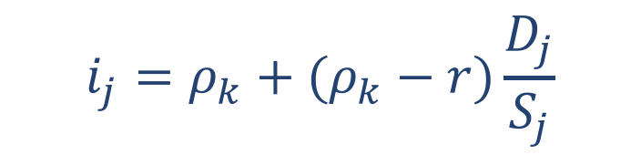
Proposition 2
Corso di Laurea in International Management
The yield of a given stock is a linear function of the company’s leverage
$$i_{j}=ρ_{k}+(ρ_{k}−r)\frac{D_{j}}{S_{j}}$$

Slide 20
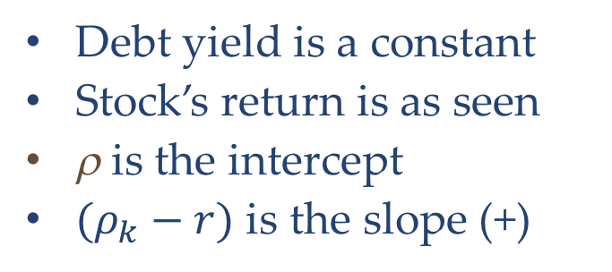
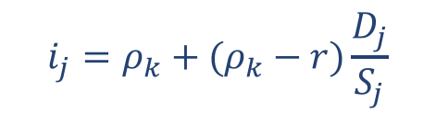
Proposition 2
Corso di Laurea in International Management
Debt yield is a constant
Stock’s return is as seen
ρ is the intercept
$(ρ_{k}−r)$ is the slope (+)
$$i_{j}=ρ_{k}+(ρ_{k}−r)\frac{D_{j}}{S_{j}}$$
i_{j}
Yields
Higher risk
Higher expected returns
ρ_{k}
r
Leverage

Slide 21
The cost of capital
Corso di Laurea in International Management
At some point debt won’t be risk free any more
Creditors will bear an increasing part of risk and will expect a higher return
Stocks’ return will reduce
Bonds’ return will rise
Yields
i_{j}
ρ_{k}
r
Leverage

