Slide 1

Advanced
Corporate Finance
6 CFU
Corso di Laurea in International Management
Prof. Luca Piras
Room 4, P. Baffi building 2° floor
pirasl@unica.it 070 675 3365

Slide 2
Course Overview
Corso di Laurea in International Management
the course will deal with advanced concepts of corporate finance:
Theories of financial markets;
Corporate Valuation;
Crypto Currencies and Block Chain;
Start-up Finance;
Scale-Up Finance.

Slide 3
Theories on Financial Market
Corso di Laurea in International Management
Bubbles do exist
Bubbles inflate and deflate not always burst
Smart money ain’t that smart
News of price increases spurs investor enthusiasm

Slide 4
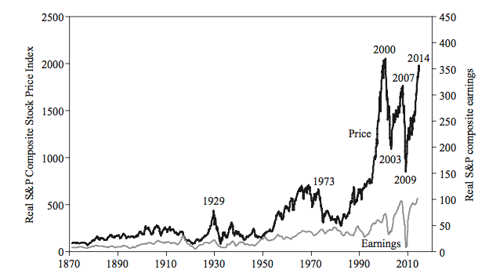
Bubbles or no bubbles
Corso di Laurea in International Management

Slide 5
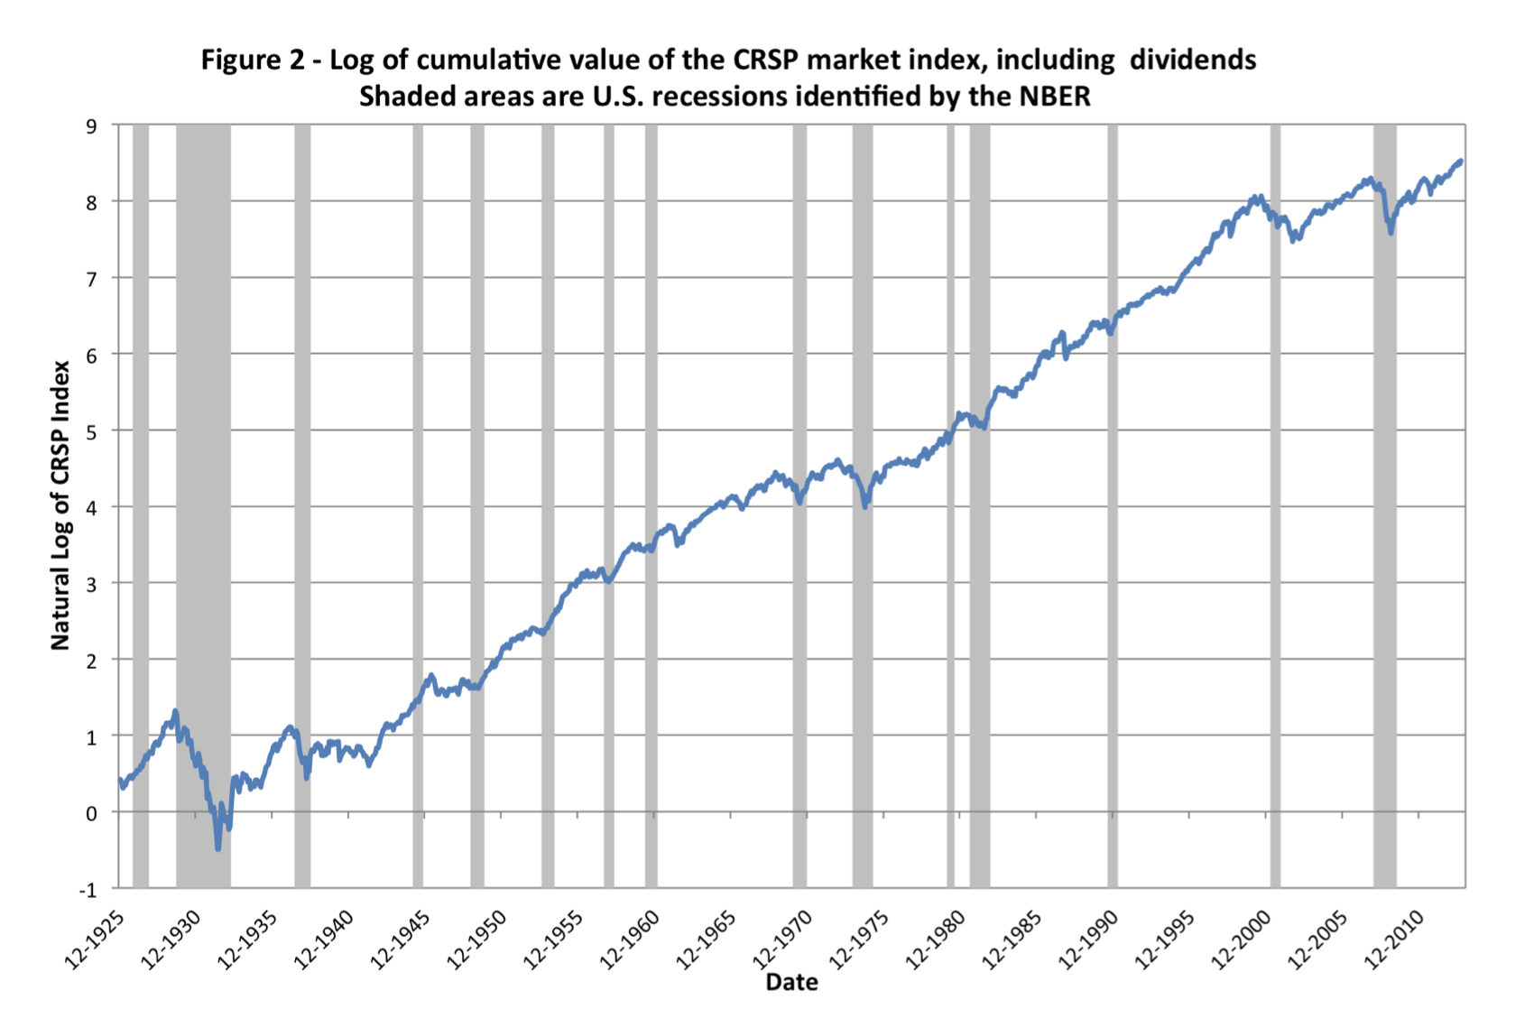
Bubbles or no bubbles
Corso di Laurea in International Management
“A situation in which news of price increases spurs investor enthusiasm which spreads by psychological contagion from person to person, in the process amplifying stories that might justify the price increase and bringing in a larger and larger class of investors, who, despite doubts about the real value of the investment, are drawn to it partly through envy of others’ successes and partly through a gambler’s excitement”.

Slide 6
Bubbles or no bubbles
Corso di Laurea in International Management
Monthly Real S&P Composite Stock Price Index.
The stock prices are shown from 1871 through 2014 (upper curve)
Total earnings (P/E lower curve) for the same years.

Slide 7
Bubbles or no bubbles
Corso di Laurea in International Management
Irrational exuberance is the psychological basis of a bubble
  2000 Millennium Boom peak in world stock prices
  2003–7 Ownership-Society Boom,,
  2008–9 World financial crisis
  2009, when the crisis lessened, another major upswing in world stock markets, (the New-Normal Boom)

Slide 8
Bubbles or no bubbles
Corso di Laurea in International Management
Post - 2000 booms were not record setting
  The biggest-ever upswing in the real U.S. stock market was from
  July 1982 to August 2000 (market went up 7.7- fold)
  Dec. 1920 to Sept. 1929 (5.2-fold)
  June 1949 to December 1968 (5.1-fold)
  2003 to 2007 (1.5-fold)
  2009 to 2014 (2.3-fold)
The stock market increase from 1994 to 2000 cannot be justified in any reasonable terms
Basic economic indicators did not come close to tripling
U.S. gross domestic product rose less than 40%
Corporate profits rose less than 60%
Viewed in the light of these figures, the stock price increase appears unwarranted

Slide 9
Bubbles or no bubbles
Corso di Laurea in International Management
Bubbles are not about craziness of investors
They depend on how investors are buffeted from one superficially plausible theory about conventional valuation to another.
“Deinde quod nos eadem Asia atque idem iste Mithridates initio belli Asiaci docuit, id quidem certe calamitate doc memoria renere debemus. Nam tum, cum in Asia res magnas permul, amiserant, scimus Romae, soluone impedita, fidem concidisse. Non enim possunt una in civitate mul rem ac fortunas amiere, ut non plures secum in eandem trahant calamitatem.
A quo periculo prohibete rem publicam, et mihi credite id quod ipsi vides: haec fides atque haec rao pecuniarum, quae Romae, quae in foro versatur, implicata est cum illis pecuniis Asiacis et cohaeret. Ruere illa non possunt, ut haec non eodem labefacta motu concidant”.
“We have to keep in mind, as our fait taught us, of the lesson learned from Asia and from Mitridate at the beginning of the Asian war. We, in fact, know that whenever a great number of citizens in Asia lost their property, the suspension of all the payments determined a credit crunch in Rome. In a city where many lose their property, it is impossible to avoid the same prospect for many other [...]. Credit and financial issues discussed here in Rome are strongly related to the wealth in Asia. Shall the latter be lost, the former would follow the same destiny”.
Marcus Tulli Ciceronis, Orationes (79-77 B.C.)

Slide 10
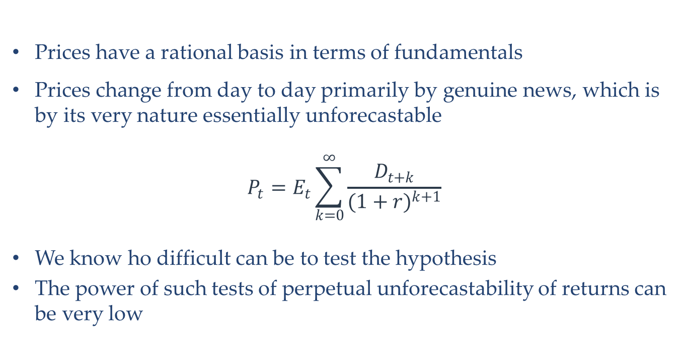
EMH
Corso di Laurea in International Management
Prices have a rational basis in terms of fundamentals
Prices change from day to day primarily by genuine news, which is by its very nature essentially unforecastable
$$P_{t}=E_{t}\sum_{k=0}^{∞}{\frac{D_{t+k}}{{(1+r)}^{k+1}}}$$
We know ho difficult can be to test the hypothesis
The power of such tests of perpetual unforecastability of returns can be very low

Slide 11
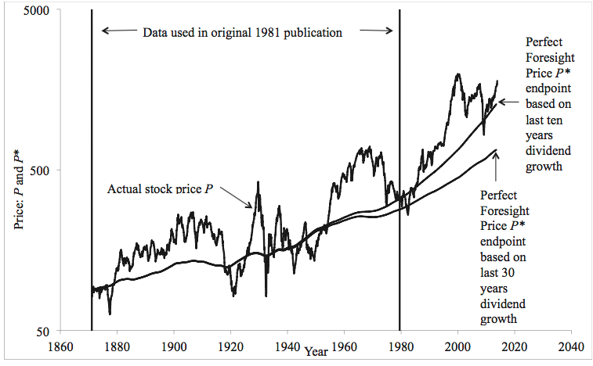
Excess Volatility
Corso di Laurea in International Management
Testing market efficiency by regressing excess returns on information variables makes no use of the terminal condition that requires that all movements in prices need to be justified by information about subsequent movements in fundamentals

Slide 12
Excess Volatility
Corso di Laurea in International Management
The present value of dividends for each date in 1871– 2013 was computed from the actual subsequent real dividends using a constant real discount rate r = 7.6% per annum, equal to the historical average real return on the market since 1871 (See also Fama)
Gordon Model, using the most recent 2013 S&P 500 real dividend as a base for forecasts of dividends after 2013
  Real dividends grow forever from the last observed dividend, at the same average growth rate as over the most recent ten years, 5.1% per year
  growth rate of dividends after 2013 are taken as the geometric average growth rate over the last thirty years, 2.5% a year
There is no way to forecast dividends for decades
The market has no way of “knowing” the correct optimal forecast

Slide 13
Excess Volatility
Corso di Laurea in International Management
The model that people essentially know the future, prove wrong in all periods
If people know the trend, EMH implies that the variance around trend should be less for P than for P*, which is plainly not the case
All the fluctuations are because of genuine information about those “black swan” outlier events that might have happened in more than a century but just didn’t happen
At every point in history there must have been some such uncertainty about future dividends

