Slide 1

Advanced
Corporate Finance
6 CFU
Corso di Laurea in International Management
Prof. Luca Piras
Room 4, P. Baffi building 2° floor
pirasl@unica.it 070 675 3365

Slide 2
Course Overview
Corso di Laurea in International Management
the course will deal with advanced concepts of corporate finance:
Theories of financial markets;
Corporate Valuation;
Crypto Currencies and Block Chain;
Start-up Finance;
Scale-Up Finance.

Slide 3
Theories on Financial Market
Corso di Laurea in International Management
Investors are rational
Markets are Efficient !!!
If not, Arbitrageurs will clear up the market
If not, mistakes will be random and compensate

Slide 4
EMH
Corso di Laurea in International Management
Securities’ prices fully reflect all available information
“In Efficient Markets, at any point in time, the actual price of a security can be considered a good estimate of its intrinsic value”
“Active management is a Zero-Sum game before the costs and the winners have to win at losers’ expenses”
“Money is like soap: the more you handle it, the less it ‘ll remain”

Slide 5
EMH
Corso di Laurea in International Management
the central question is whether asset prices reflect all available information
the difficulty is: making the hypothesis testable
We need an asset pricing model, that specifies the characteristics of rational expected asset returns in a market equilibrium
Joint hypothesis

Slide 6
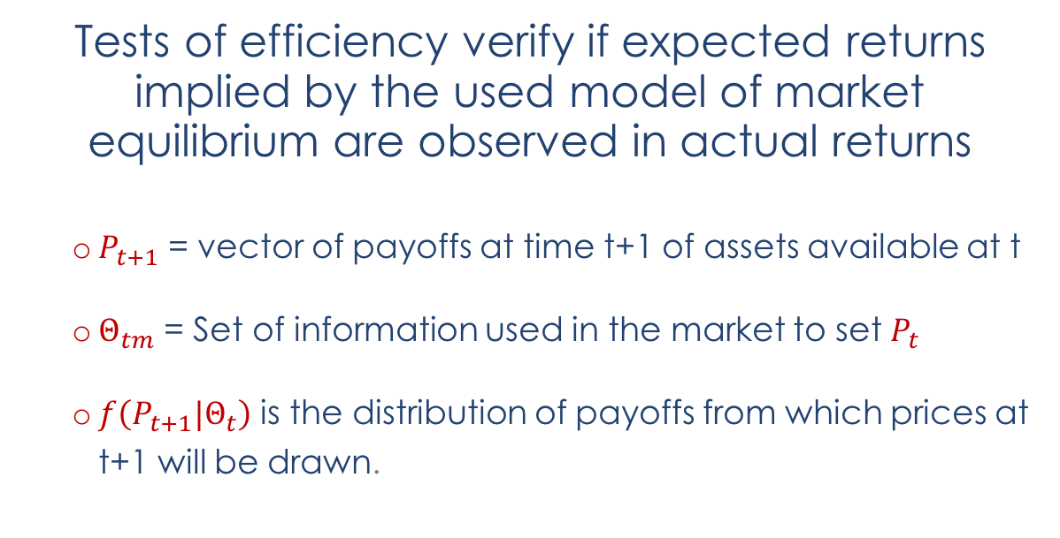

EMH
Corso di Laurea in International Management
$f\left(P_{t+1}|Θ_{tm}\right)=f\left(P_{t+1}|Θ_{t}\right)$
Tests of efficiency verify if expected returns implied by the used model of market equilibrium are observed in actual returns
  $P_{t+1}$ = vector of payoffs at time t+1 of assets available at t
  $Θ_{tm}$ = Set of information used in the market to set $P_{t}$
  $f\left(P_{t+1}|Θ_{t}\right)$ is the distribution of payoffs from which prices at t+1 will be drawn.

Slide 7

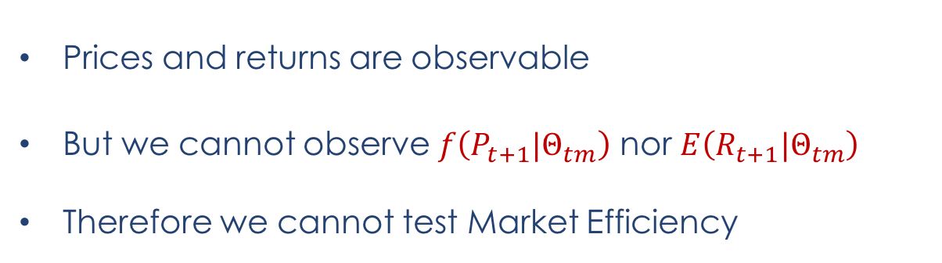
EMH
Corso di Laurea in International Management
The market efficiency condition is more typically stated in terms of expected returns.
$E\left(R_{t+1}|Θ_{tm}\right)=E\left(R_{t+1}|Θ_{t}\right)$
Prices and returns are observable
But we cannot observe $f\left(P_{t+1}|Θ_{tm}\right)$ nor $E\left(R_{t+1}|Θ_{tm}\right)$
Therefore we cannot test Market Efficiency

Slide 8
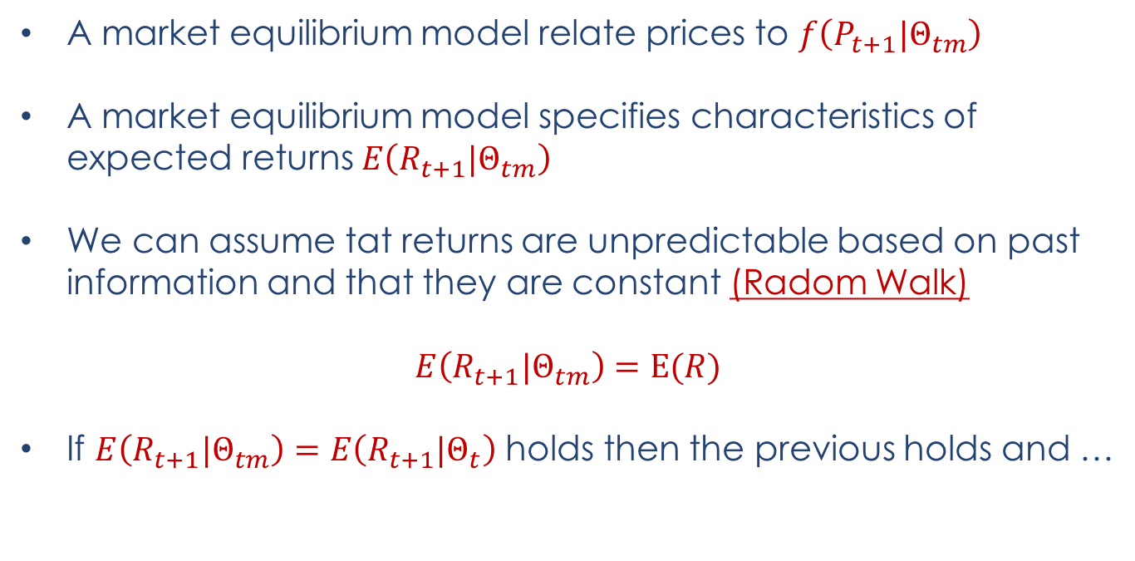
EMH
Corso di Laurea in International Management
A market equilibrium model relate prices to $f\left(P_{t+1}|Θ_{tm}\right)$
A market equilibrium model specifies characteristics of expected returns $E\left(R_{t+1}|Θ_{tm}\right)$
We can assume tat returns are unpredictable based on past information and that they are constant (Radom Walk)
$$E\left(R_{t+1}|Θ_{tm}\right)=E(R)$$
If $E\left(R_{t+1}|Θ_{tm}\right)=E\left(R_{t+1}|Θ_{t}\right)$ holds then the previous holds and …

Slide 9
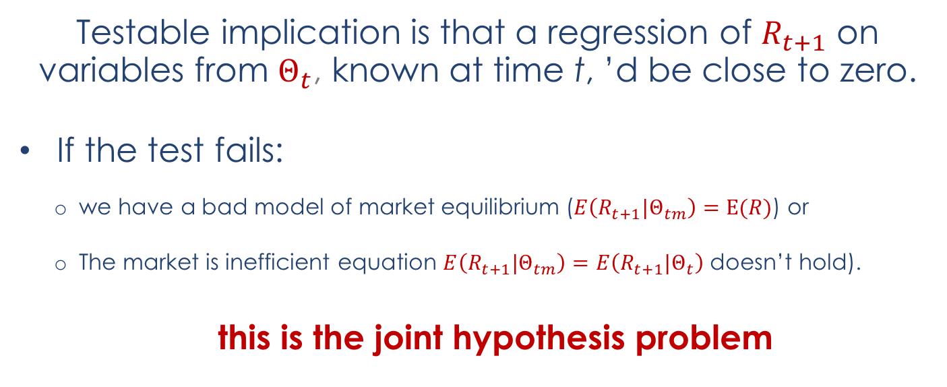
EMH
Corso di Laurea in International Management
Testable implication is that a regression of $R_{t+1}$ on variables from $Θ_{t}$, known at time t, ’d be close to zero.
If the test fails:
  we have a bad model of market equilibrium ($E\left(R_{t+1}|Θ_{tm}\right)=E(R)$) or
  The market is inefficient equation $E\left(R_{t+1}|Θ_{tm}\right)=E\left(R_{t+1}|Θ_{t}\right)$ doesn’t hold).
  this is the joint hypothesis problem

Slide 10
EMH
Corso di Laurea in International Management
Market efficiency is always tested jointly with a model of market equilibrium, but the converse is also true.
Common asset pricing models:
  CAPM of Sharpe (1964) and Lintner (1965),
  Merton’s (1973a) intertemporal CAPM (ICAPM),
  Consumption CAPM of Lucas (1978) and Breeden (1979),
implicitly or explicitly all assume that information is costlessly available to all market participants who use it correctly in their portfolio decisions

Slide 11
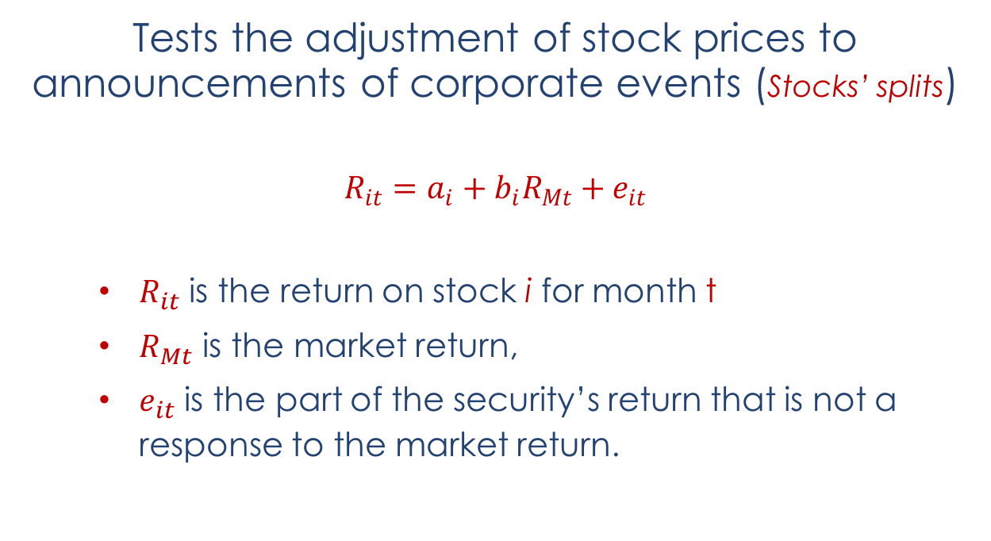
EMH – Event Studies
Corso di Laurea in International Management
Tests the adjustment of stock prices to announcements of corporate events (Stocks’ splits)
$$R_{it}=a_{i}+b_{i}R_{Mt}+e_{it}$$
$R_{it}$ is the return on stock i for month t
$R_{Mt}$ is the market return,
$e_{it}$ is the part of the security’s return that is not a response to the market return.

Slide 12
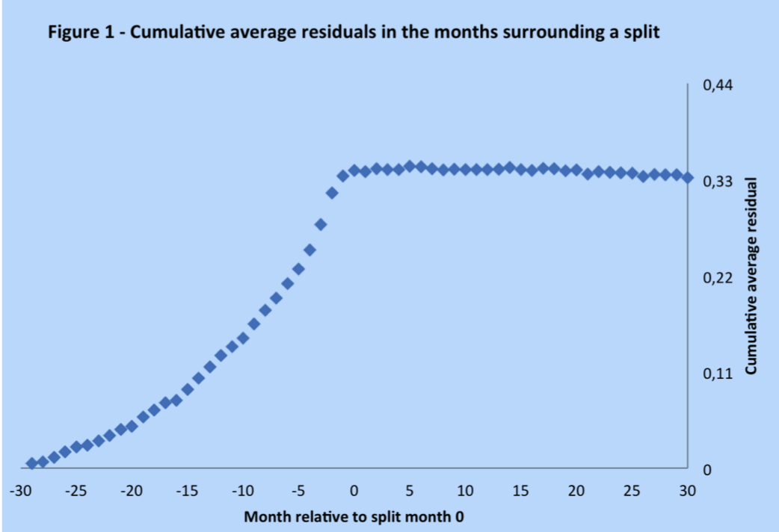
EMH
Corso di Laurea in International Management

Slide 13
EMH
Corso di Laurea in International Management
The cumulative average residual rises in the months preceding a split.
us, companies tend to split their stocks after good times that produce large increases in their stock prices.
Once the split becomes known there is no further movement in the cumulative average residual
75% of the companies that split their stocks continue to experience good times (dividend growth rates larger than those of the market as a whole)
On average, all the implications of a split for the future performance of a company are incorporated in stock prices in the months leading up to the split, with no further reaction thereafter
exactly the prediction of market efficiency.

Slide 14
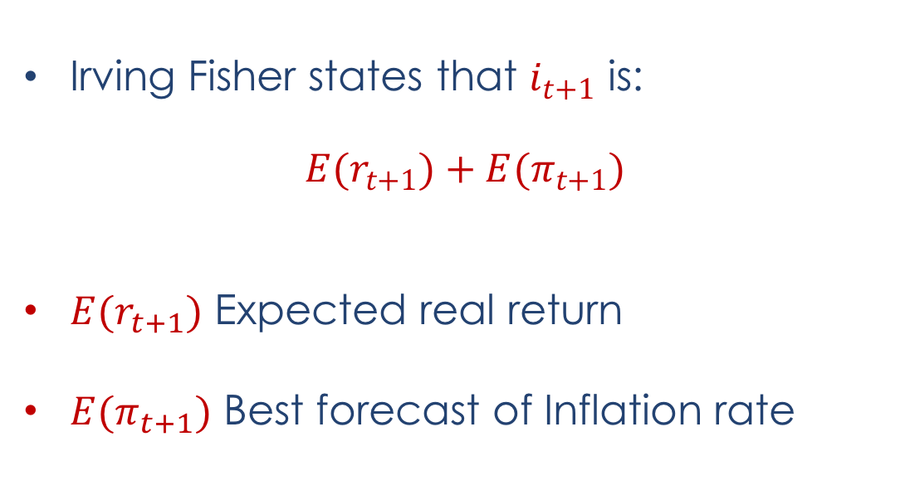
Predictivity
Corso di Laurea in International Management
Irving Fisher states that $i_{t+1}$ is:
${E(r}_{t+1})+E(π_{t+1})$
${E(r}_{t+1})$ Expected real return
$E(π_{t+1})$ Best forecast of Inflation rate

Slide 15
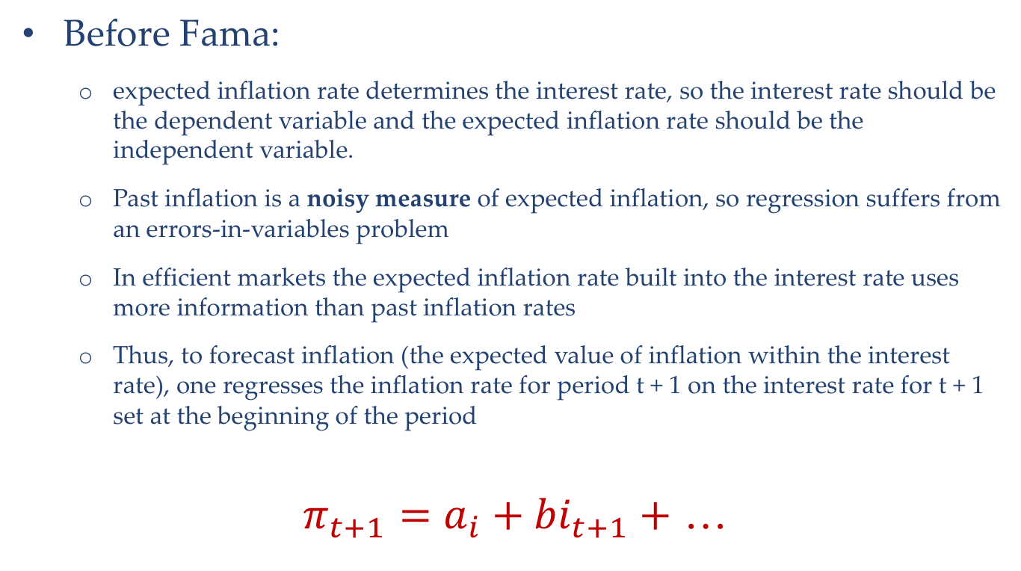
Predictivity
Corso di Laurea in International Management
Before Fama:
  expected inflation rate determines the interest rate, so the interest rate should be the dependent variable and the expected inflation rate should be the independent variable.
  Past inflation is a noisy measure of expected inflation, so regression suffers from an errors-in-variables problem
  In efficient markets the expected inflation rate built into the interest rate uses more information than past inflation rates
  Thus, to forecast inflation (the expected value of inflation within the interest rate), one regresses the inflation rate for period t + 1 on the interest rate for t + 1 set at the beginning of the period
$π_{t+1}=a_{i}+{bi}_{t+1}+$ …

Slide 16
Predictivity
Corso di Laurea in International Management
Reversing the regression eliminates one measurement error problem
But it can introduce another, (variation through time in the expected real return built into the interest rate)
The model of market equilibrium in Fama (1975) is that the expected real return is constant, E(rt+1) = r.
Near zero autocorrelations of real returns suggest that the interest rate it+1 is a direct proxy for the expected inflation rate
It is the expected inflation rate plus a constant.

Slide 17
Bubbles
Corso di Laurea in International Management
Stock returns are predictable from dividends and interest rates, but there is no evidence that are sometimes negative
Stock market run-up and subsequent decline is often called a “bubble.”
the word “bubble,” applied to many markets,
Policy makers should react to bubbles to preempt the negative effects

Slide 18
Bubbles
Corso di Laurea in International Management
Bubbles are irrational
Are market sharp decline predictable?
After an event, attention focuses on people who predicted it.
For scientific purposes, we are interested in the performance of forecasting models, not the unreproducible predictions of specific individuals

Slide 19
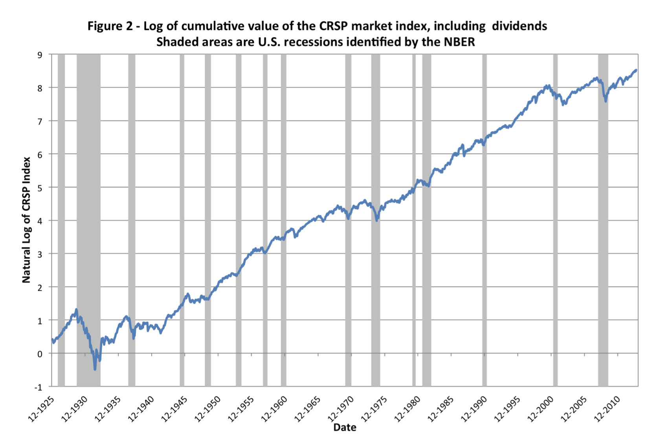
Bubbles Vs Real Economy
Corso di Laurea in International Management

Slide 20
Bubbles Candidates
Corso di Laurea in International Management
August 1929 to June 1932,
October 2007 to February 2009,
February 1937 to March 1938,
August 2000 to September 2002,
August 1972 to December 1974.

Slide 21
Bubbles
Corso di Laurea in International Management
Large swings in Stock Prices Corresponding to large swings in real economy
This fits EMH ……. therefore no bubbles !!!
Can’t say that high volatility causes recessions
  Absence of evidence that price declines are ever predictable
  Evidence that the prime “bubble” candidates seem associated with impressive market forecasts of real activity
  the use of the “bubble” word without careful definition and empirical validation

Slide 22
Bubbles
Corso di Laurea in International Management
Major stock price declines are followed rather quickly by price increases
Legitimate question:
  which leg of a “bubble” is irrational, the up or the down?
  Do we see irrational optimism in the price increase corrected in the subsequent decline?
  Do we see irrational pessimism in the price decline, quickly reversed?
  Or both? Or perhaps neither?

