Slide 1

Advanced
Corporate Finance
6 CFU
Corso di Laurea in International Management
Prof. Luca Piras
Room 12, P. Baffi building 2° floor
pirasl@unica.it 070 675 3365

Slide 2
Course Overview
Corso di Laurea in International Management
the course will deal with advanced concepts of corporate finance:
Theories of financial markets;
Corporate Valuation;
Crypto Currencies and Block Chain;
Start-up Finance;
Scale-Up Finance.

Slide 3
Theories on Financial Market
Corso di Laurea in International Management
Rational Investors
Edging Risk
Efficient Frontier
Portfolio Selection

Slide 4
Rational Investors
Corso di Laurea in International Management
“The theory of rational behaviour is usually presented as a study of the principles upon which a Rational man Would act. This rational man is unlike you and me in that he makes no errors in arithmetic or logic in attempting to achieve his clearly defined objectives.
He is like you end me, on the other hand, in that he is neither omnipotent nor omniscient. He must make decisions, such as the selection of a portfolio, in the face of uncertainty. Since his information is limited, he may take less than perfect actions. Since his power are limited, his achievement may fall short of the best conceivable.
Every action however, is perfectly thought out; every risk is perfectly calculated”.
H. Markowitz, Portfolio selection: Efficient diversification of Investments, Yale University Press, New Haven

Slide 5
Premises
Corso di Laurea in International Management
A rational investor evaluate expected returns in the frame o its risk
If she has a single asset a convenient measure of volatility is σ²
If she has more than one asset, the contribution of each asset to the risk of her portfolio matter

Slide 6
Premises
Corso di Laurea in International Management
Combining different asset in a portfolio, under given conditions, reduces the portfolio’s risk
Diversification reduces portfolio’s standard deviation
A rational investor can therefore build up different portfolios given her preferences and attitude toward risk
A rational investor is Risk Adverse !!!

Slide 7
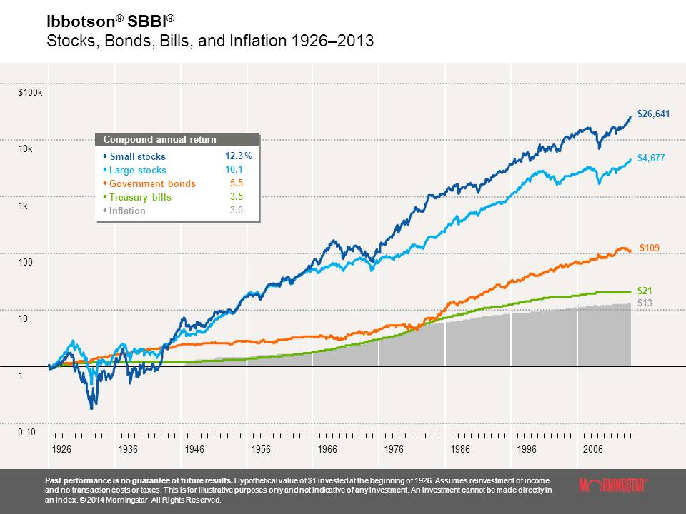
Let’s see what happened: 1$ invested in 1926
Corso di Laurea in Economia e Gestione Aziendale

Slide 8
Premises
Corso di Laurea in International Management
“The process of selecting a portfolio may be divided into two stages. The first start with observation and experience and ends with beliefs about the future performance of available securities. The second starts with the relevant beliefs about future performances and end with the choice of a portfolio”.

Slide 9
Portfolio Theory
Corso di Laurea in International Management
Price variations Vs normal distribution
Number of observations
% daily variation

Slide 10
Let’s pick 4 assets
Corso di Laurea in International Management
Probability
%Expected returns

Slide 11
Portfolio Theory
Corso di Laurea in International Management
 |  |  | Portfolios
Share | Expected Return | Standard Deviation | A | B | C | D
Amazon | 34,60% | 110,60% | 100,00% | 9,30% | 4,50%
Boeing | 13,00% | 30.9% |  | 2,10% | 9,60% | 0,60%
Cocacola | 10,00% | 31,50% |  |  |  | 0,40%
Dell | 26,20% | 62,70% |  | 21,10% | 14,40%
Exxon | 11,80% | 17,40% |  |  | 3,60% | 56,30%
General Electric | 18,00% | 26,80% |  | 46,80% | 39,70% | 10,20%
General Motors | 15,80% | 33,40% |  |  |  | 9,00%
McDonald's | 14,00% | 27,40% |  |  | 5,40% | 10,00%
Pfeizer | 14,80% | 29,30% |  |  | 9,80% | 13,30%
Reebok | 20,00% | 58,50% |  | 20,70% | 13,00%
Weighted Expected returns |  |  | 34,60% | 21,60% | 19,00% | 13,40%
Portfolio Standard Deviation |  |  | 110,60% | 30,80% | 23,70% | 14,60%

Slide 12
Portfolio Theory
Corso di Laurea in International Management
Portfolio’s expected Returns
Standard Deviation
SQM
Average of expected returns
Average of Variances
Square Root of Variances
Covariance
σ_{AB}

Slide 13
Portfolio Theory
Corso di Laurea in International Management
σ_{A} = Standard deviation of share A
σ_{B} = Standard deviation of share B
ρ Is always between +1 e -1

Slide 14
Portfolio Theory
Corso di Laurea in International Management
Price variations Vs normal distribution

Slide 15
Portfolio theory
Corso di Laurea in International Management
Expected returns and σ² vary for each combination of securities
Expected Return
Reebok
35% in Reebok
Coca Cola
Standard deviation

Slide 16
Building our portfolio
Corso di Laurea in International Management
Different combinations available in the market make possible to build se SML: Securities Market Line
Expected Return
Standard Deviation

Slide 17
Efficient Frontier
Corso di Laurea in International Management
A rational investor will try to move upward and left
Low risk
High Returns
High Risk
High Returns
Low Risk
Low Returns
High Risk
Low Returns
Returns
B
AB
A
Risk = σ

Slide 18
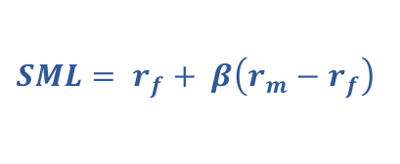
Securities Market Line
Corso di Laurea in International Management
Market Return = r_{m}
$SML= r_{f}+ β\left(r_{m}−r_{f}\right)$
Do you recognize it ?
It’s the CAPM
MVP = Efficient Portfolio
r_{f}
Risk free =
= 1.0

