Slide 1

Advanced
Corporate Finance
6 CFU
Corso di Laurea in International Management
Prof. Luca Piras
Room 4, P. Baffi building 2° floor
pirasl@unica.it 070 675 3365

Slide 2
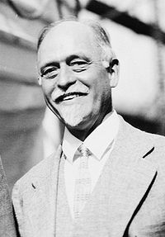
Course Overview
Corso di Laurea in International Management
the course will deal with advanced concepts of corporate finance:
Theories of financial markets;
Corporate Valuation;
Crypto Currencies and Block Chain;
Start-up Finance;
Scale-Up Finance.

Slide 3
Theories on Financial Market
Corso di Laurea in International Management
Where does the market come from
The cost of capital problem
Consumption Vs Investment
How does it works

Slide 4
Where does the market comes from?
Corso di Laurea in International Management
Explain how managers can make financial decisions that will be supported by all shareholders.
Explain how the existence of a capital market makes this result possible.
Identify the company’s optimal investment/dividend policy under conditions of certainty.

Slide 5
Starting point
Corso di Laurea in International Management
We have to choose our investments;
We want to maximize our value;
For a given class of corporations we look at the cash flow dynamics;
We want a mechanism to process these activities in a standardized manner

Slide 6
Three questions
Corso di Laurea in International Management
What is such a “Mechanism”?
How can we allow money to time travel ?
How does all this work ?

Slide 7
It’s the market folks !!!
Ment_Test_{01_b}
Corso di Laurea in International Management
Allows resources’ transfer from surplus sectors to deficit ones
Guarantees securities negotiability and prices’ closing
It controls the efficient allocation of resources and yields of underlying securities
I manages RISK, its allocation and ensure the proper risk/return trade off

Slide 8
Irving Fisher
Corso di Laurea in International Management
Markets are time machines;
Investments decisions are intertemporal problems
It gives us a rational base for the existence of interest and capital yields

Slide 9
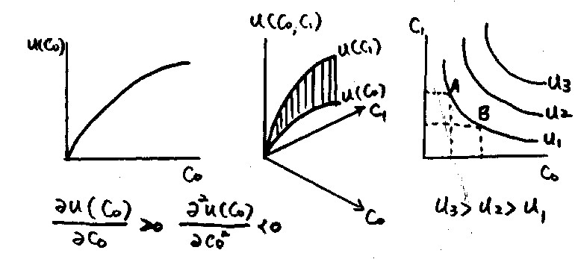
“Imagine there’s no market”….
Corso di Laurea in International Management
Typical Consumption function without capital market
You can only consume what you gain in each year

Slide 10
“Imagine there’s no market”….
Corso di Laurea in International Management
Without capital market you have no other possibilities
Today
20.000
Next year
25.000
€ at T₁
25.000
20.000
€ at T₀

Slide 11
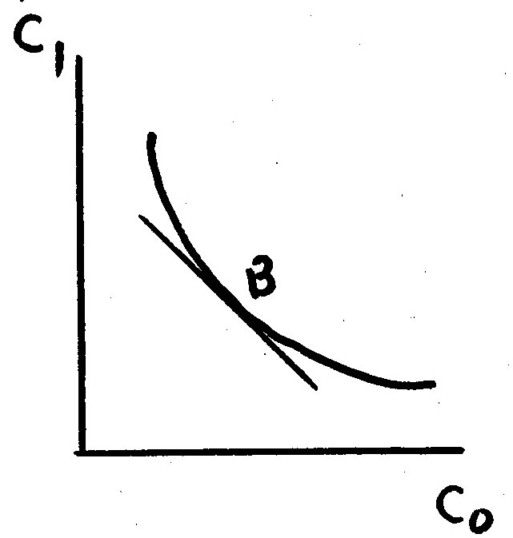
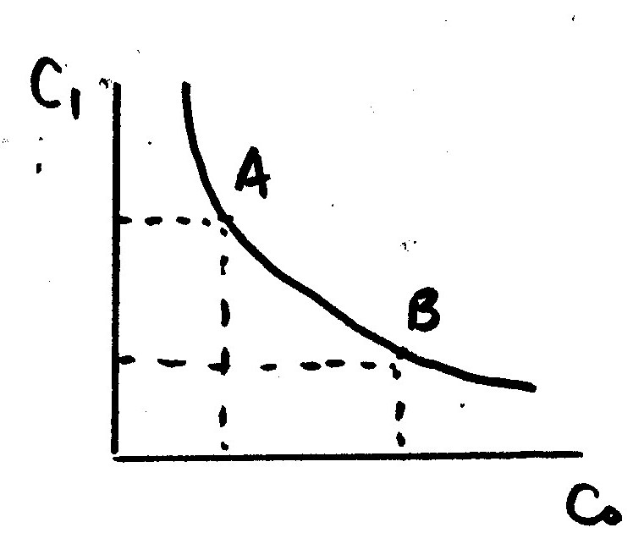
“Imagine there’s no market”….
Corso di Laurea in International Management
Typical Consumption function without capital market
You can only consume what you gain in each year
MRS = Substitution between Consumption in T₀ Vs T₁
MRS decreasing:

Slide 12
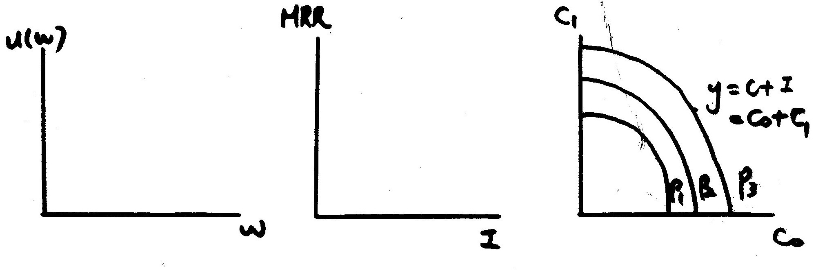
“Imagine there’s no market”….
Corso di Laurea in International Management
Production without capital market
You can only invest the amount you own
Production:

Slide 13
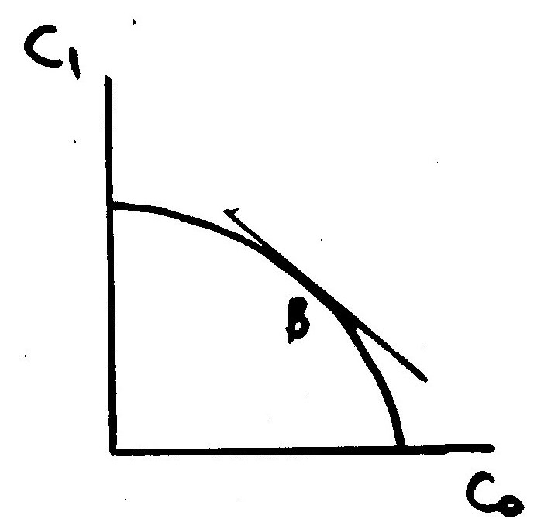
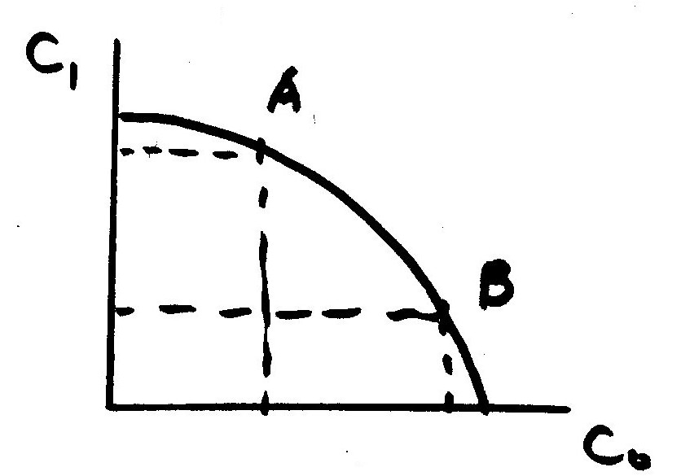
“Imagine there’s no market”….
Corso di Laurea in International Management
Production without capital market
You can only invest the amount you own
MRT: MRT increasing:

Slide 14
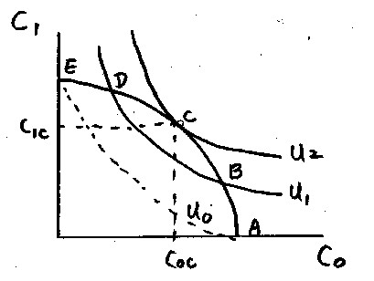
“Imagine there’s no market”….
Corso di Laurea in International Management
Production without capital market and optimal consumption

Slide 15
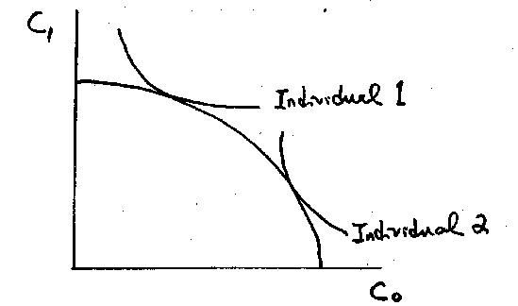
Still no market
Corso di Laurea in International Management
Optimal consumption for different individuals
Individual 1 prefers consuming more at C₁
Individual 2 prefers consuming more at C₀
They can make a deal !

Slide 16
Assumptions
Corso di Laurea in International Management
All outcomes from investment are known with certainty.
Inter-temporal exchange rate of consumption bundles, r > 0 is known.
No transaction costs.
No taxes.
Two-period model

Slide 17
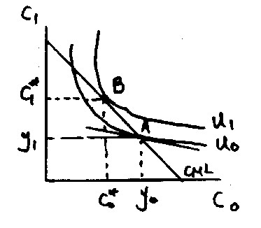
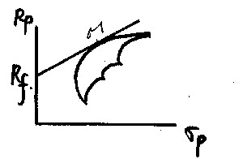
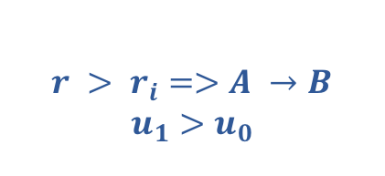

Investment Opportunities
Corso di Laurea in International Management
$w_{0}=y_{0}+\frac{y_{1}}{1+i}$
    Initial endowment, A:
    Capital market line (CML)
$$r > r_{i}=>A →B$$
$u_{1}>u_{0}$
Slope of u₀ at A= -(1+r_{i}) Slope of CML= -(1+r)
Invest more consume less at C₀

Slide 18
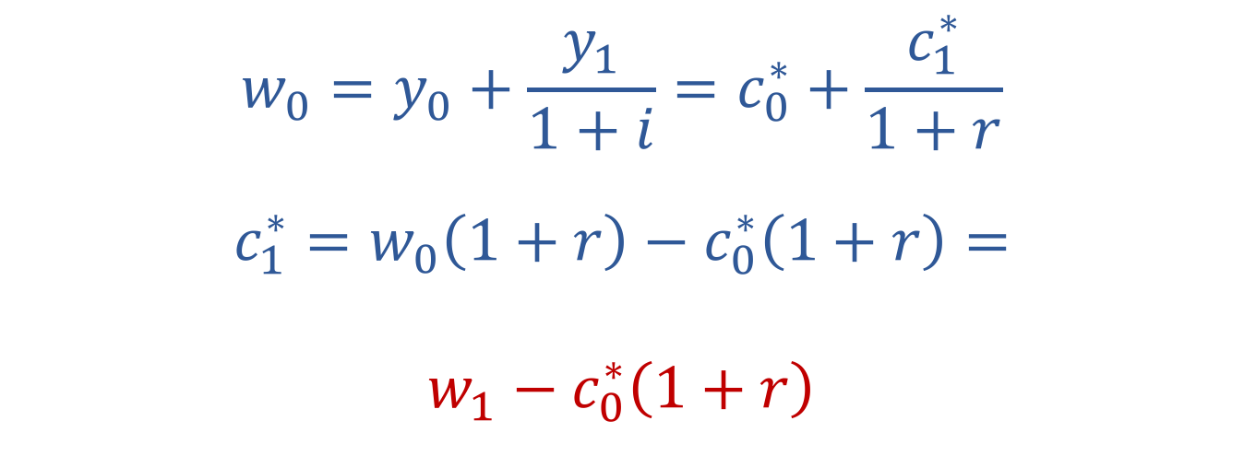
Let’s Introduce the Capital Market
Corso di Laurea in International Management
$$w_{0}=y_{0}+\frac{y_{1}}{1+i}=c_{0}^{∗}+\frac{c_{1}^{∗}}{1+r}$$
$$c_{1}^{∗}=w_{0}\left(1+r\right)−c_{0}^{∗}\left(1+r\right)=$$
$$w_{1}−c_{0}^{∗}\left(1+r\right)$$
intercept
slope
The value of w hasn’t changed
u₀ = u₁

Slide 19
Let’s Introduce the Capital Market
Corso di Laurea in International Management
HD are all possible positions I can reach lending money or taking loans
T₁
H
The slope: – (1+r) denote the market discount factor to exchange next yeas cash flows against today’s
F
0
B
D
T₀

Slide 20
Let’s Introduce the Capital Market
Corso di Laurea in International Management
D represent the maximum possible amount available in T₀; H in T₁
T₁
H
43.364
25.000
Which is also the Net Present Value of my wealth
0
D
T₀
20.000

Slide 21
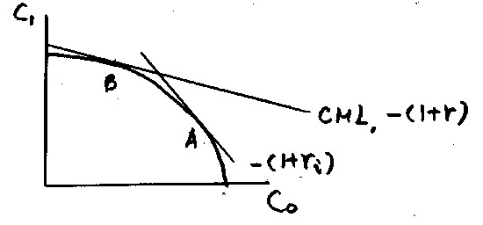

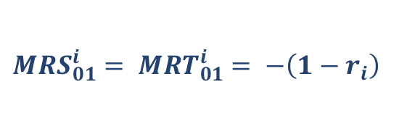
Let’s Introduce the Capital Market
Corso di Laurea in International Management
Production
Personal
Market
$$MRS_{01}^{i}= {MRT}_{01}^{i}= −\left(1−r_{i}\right)$$
$$−(1−r_{i})$$

Slide 22
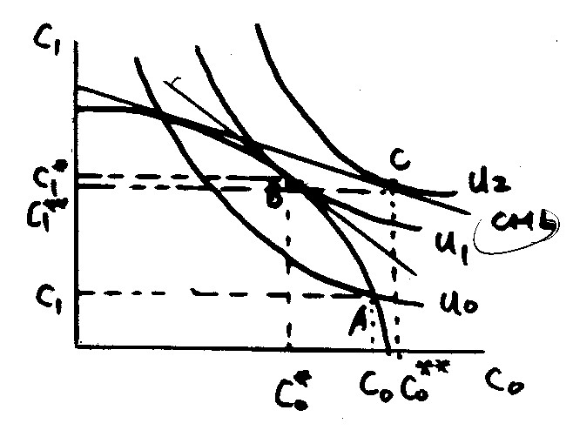
Let’s Introduce the Capital Market
Corso di Laurea in International Management
Two individual with different intertemporal preferences can use the capital market to match their preferences
They can separate investment from consumption decisions
Regarding less of any personal preference, no one should ever refuse an investment opportunity with positive NPV
NEVER !

