Slide 1

1 ANNO CULT MED- GUPPY
All our lessons will be in this virtual room AULA WEBEX 5 at the following times:
Monday 15.30-17.00
Wednesday 15.30-17.00
Thursday 17.15-18.45
(120 hours 1st + 2nd semester)

Slide 2
Website Page: Emily Guppy
https://www.unica.it/unica/it/ateneo_s07_ss01.page?contentId=SHD232904
For degree course information and updates from course professors see addresses below for their personal pages:
Prof. Luisanna Fodde; people.unica.it/luisannafodde/
Prof. Daniela Virdis; people.unica.it/danielafrancescavirdis/
Prof. Olga Denti; people.unica.it/olgadenti/

Slide 3
WEBEX BUTTONS

Slide 4
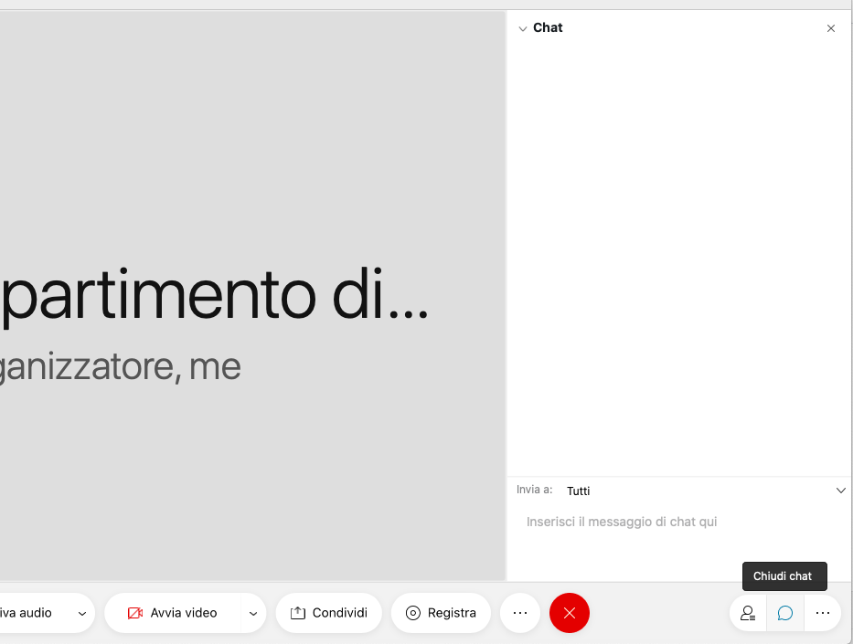

Slide 5
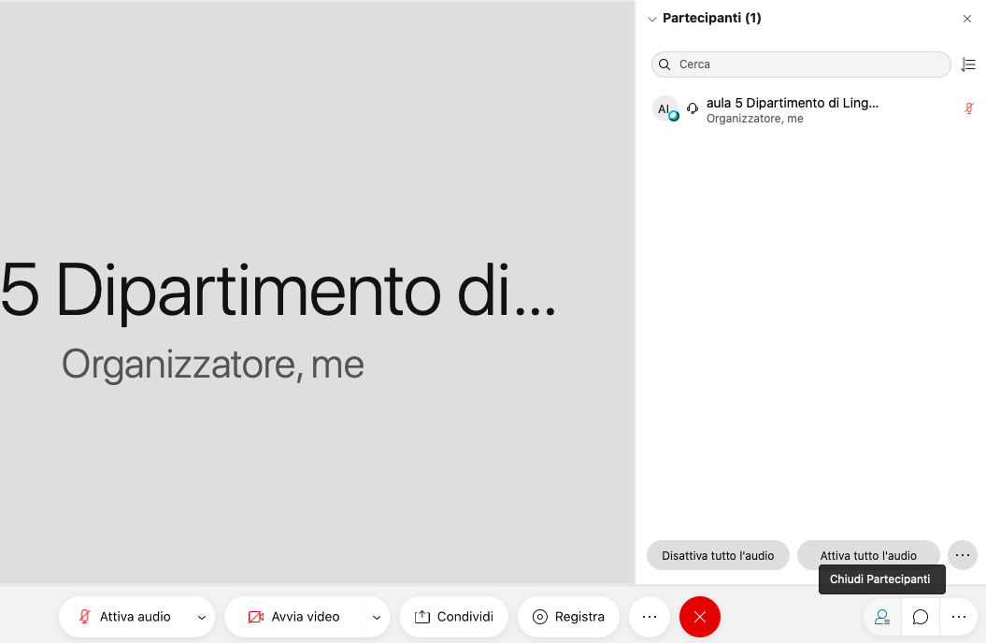

Slide 6
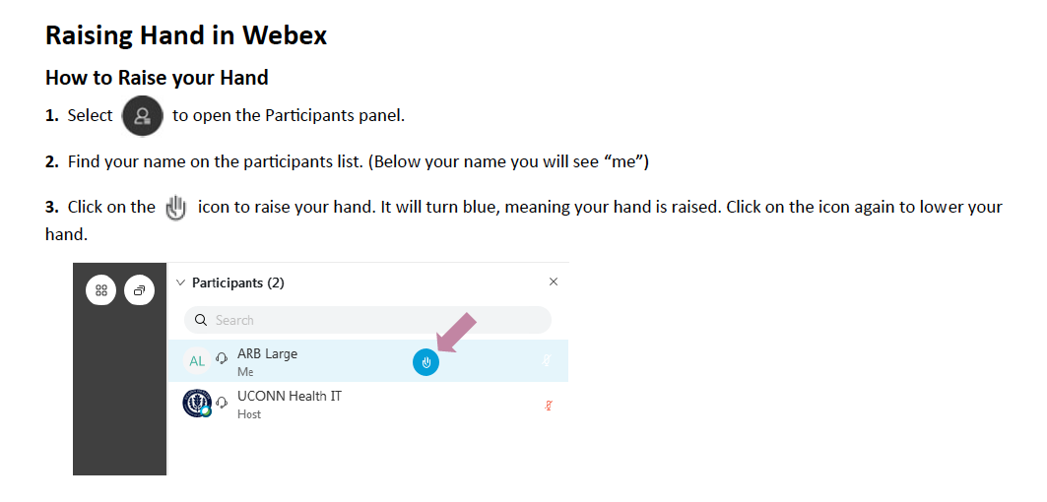

Slide 7
Breakout sessions
For pair and group work

Slide 8
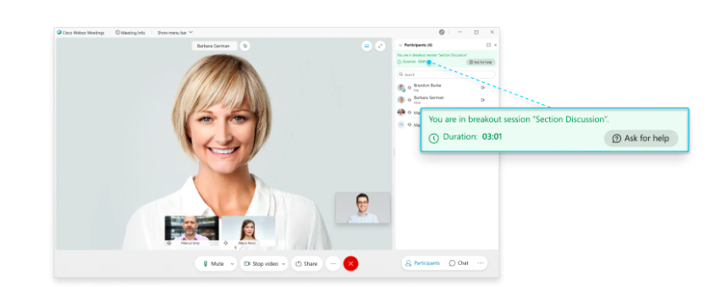
After you join a breakout session, the participants panel tells you everything you need to know- who is in the session with you and the duration

Slide 9
You can use the chat to message the participants in your breakout session and also share content, the same way you share content in the main meeting

Slide 10
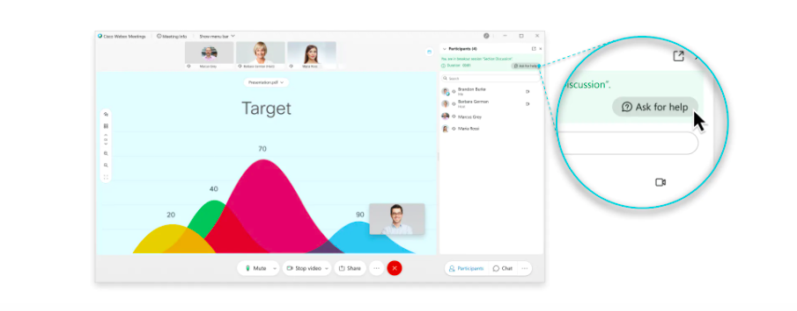
If you have a question or need help in a breakout session, click on the participants panel then click “Ask for help”

Slide 11
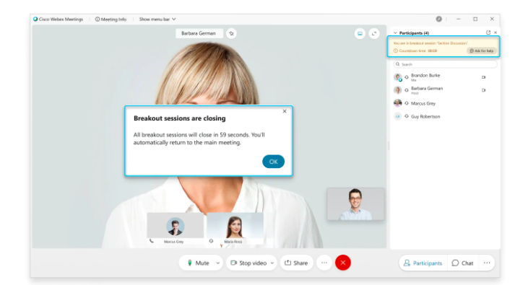
When the breakout session ends, you’ll see a message like this:

Slide 12
Breakout room session: let’s break the ice!

Slide 13
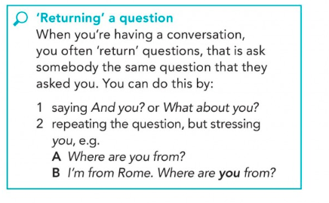
How to have a natural conversation in English: tips!
Useful language for showing interest:
Wow!
Oh no!
Really?
That’s + adjective: That’s great! That’s awful!
How + adjective: How terrible! How lovely!
What a shame! What a pity!
Ask extra, follow-up questions: why (not)? How come?

Slide 14

Course book
English File Digital Fourth Edition INTERMEDIATE
Student’s Book & Workbook Christina Latham-Koenig,Clive Oxenden, Paul Seligson. Oxford. WITH KEY FOR WORKBOOK.
Student book: to be used in our WEBEX lessons.
Also homework
Workbook: for self-study in your own time. YOU need to check your answers for all the exercises you do in this book in the key.
https://www.libraccio.it/libro/9780194035606/christina-latham_koenig-clive-oxenden-jerry-lambert/english-file-digital-gold-b1-b1%c2%a7-student's-book-e-workbook-with-key-per-triennio-delle-scuole-superiori-con-e-book-con-espansione-online.html?tipo=nuovo&lgw_code=1115-B9780194035606&gclid=CjwKCAjwz6_8BRBkEiwA3p02Vde7Nw159VgzFEWjINhevOn4cq3J_7rqWEFHmlt9nCeqTHhHiOvBqxoCRnQQAvD_BwE

Slide 15
ENGLISH FILE ONLINE PRACTICE
For extra practice and self-study. Register at https://englishfile4e.oxfordonlinepractice.com/app
Then join the class I have created using the class ID: C 560 396 0827
https://www.youtube.com/watch?v=vbvOweCkq74&feature=youtu.be

Slide 16
How to use your eBook
https://www.youtube.com/watch?v=XjhYJa_HSpI

Slide 17
STUDY TIPS- HOW TO SUCCEED IN THIS COURSE
Attend all classes regularly and arrive punctually
Participate actively in all activities in the chat box, when nominated and in the breakout sessions. It isn’t enough just to listen to the lesson!
BE AN AUTONOMOUS LEARNER!

Slide 18
STUDY TIPS- HOW TO SUCCEED IN THIS COURSE
Attend all classes regularly and arrive punctually
Participate actively in all activities in the chat box, when nominated and in the breakout sessions. It isn’t enough just to listen to the lesson!
BE AN AUTONOMOUS LEARNER! Workbook and online practice – be proactive!

Slide 19
STUDY TIPS- HOW TO SUCCEED IN THIS COURSE
Attend all classes regularly and arrive punctually
Participate actively in all activities in the chat box, when nominated and in the breakout sessions. It isn’t enough just to listen to the lesson!
BE AN AUTONOMOUS LEARNER! Workbook and online practice – be proactive!
Listen to music, the radio, watch films and TV series and surf the Internet in English

Slide 20
Resources: do you know any others? Share in the chat box!
https://www.ted.com/ - transcripts!
Virtually Anywhere https://www.cambridgeenglish.org/learning-english/free-resources/virtually-anywhere/
https://learnenglish.britishcouncil.org/skills/reading/intermediate-b1
https://learnenglish.britishcouncil.org/skills/listening/intermediate-b1
6-minute English You can also listen to 6-minute grammar, and to 6-minute vocabulary. [B1 and above]
The English we speak: to learn idioms. Each show explains the meaning and usage of one particular idiom.

