Slide 1
CHAPTER 3 MAPPING GENOMES
3.1 WHY A GENOME MAP IS IMPORTANT Genome maps are needed in order to sequence the more complex genomes. Genome maps are not just sequencing aids.
3.2 MARKERS FOR GENETIC MAPPING Genes were the first markers to be used. RFLPs and SSLPs are examples of DNA markers. Single-nucleotide polymorphisms are the most useful type of DNA marker.
3.3 THE BASIS TO GENETIC MAPPING The principles of inheritance and the discovery of linkage. Partial linkage is explained by the behavior of chromosomes during meiosis. From partial linkage to genetic mapping.
3.4 LINKAGE ANALYSIS WITH DIFFERENT TYPES OF ORGANISMS Linkage analysis when planned breeding experiments are possible. Gene mapping by human pedigree analysis. Genetic mapping in bacteria. The limitations of linkage analysis
3.5 PHYSICAL MAPPING BY DIRECT EXAMINATION OF DNA MOLECULES Conventional restriction mapping is applicable only to small DNA molecules. Optical mapping can locate restriction sites in longer DNA molecules. Optical mapping can be used to map other features in a DNA molecule.
3.6 PHYSICAL MAPPING BY ASSIGNING MARKERS TO DNA FRAGMENTS Any unique sequence can be used as an STS. DNA fragments for STS mapping can be obtained as radiation hybrids. A clone library can be used as the mapping reagent.

Slide 2
A genome map, like any other type of map, indicates the positions of interesting features and other important landmarks. In a genome map, these features and landmarks are genes and other distinctive DNA sequences.
Two complementary approaches:
• Genetic mapping, also called linkage analysis, is based on the use of genetic techniques, including planned breeding experiments or, in the case of humans, the examination of family histories (also called pedigrees).
• Physical mapping uses molecular biology techniques to examine DNA molecules directly in order to identify the positions of sequence features, including genes.

Slide 3
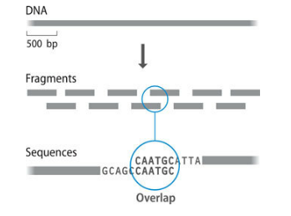
3.1 WHY A GENOME MAP IS IMPORTANT
The study of genomes is often looked on as a modern, edgy area of biological research, far divorced from the work of the old era geneticists such as Gregor Mendel. And yet many of the techniques used to construct genome maps are based directly on the discoveries of Mendel and the other early geneticists. We must therefore spend a few minutes understanding why genome mapping, despite being an old-fashioned type of biology, is still important in the fast-paced research of the genomic age.
This means that the sequence of a long DNA molecule has to be constructed from a series of shorter sequences.
The shotgun method is the standard approach for genome sequencing, but it suffers from two problems. The first is that, especially with larger genomes, it might not be possible to obtain sufficient short sequences to produce a contiguous DNA sequence for the entire genome. Instead, the genome sequence might be made up of many short segments separated by gaps that represent parts of the genome that, by chance, are not covered by the sequences that have been obtained
During the early days of genome research, it was believed that possession of a detailed map would be an essential prerequisite for assembly of the correct sequence of a genome. This is because DNA sequencing has one major limitation: only with the most sophisticated and recently introduced technology is it possible to obtain a sequence of more than about 750 bp in a single experiment.

Slide 4
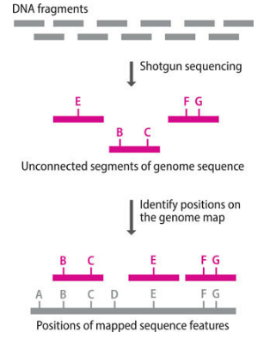
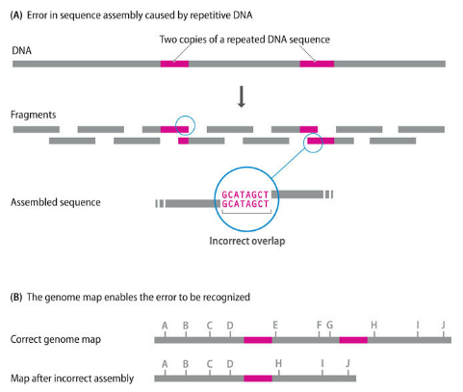
The answer is to identify within those segments features that are located on the genome map. By anchoring the segments onto the map, the correct genome sequence can be obtained, even if that sequence still contains some gaps.
The second problem with the shotgun approach is that it can lead to errors if the genome contains repetitive DNA sequences. These are sequences, up to several kilobases in length, that are repeated at two or more places in a genome. When a genome containing repetitive DNA is broken into fragments, some of the resulting pieces will contain the same sequence motifs.

Slide 5
Important crop plants: many of these species have large genomes with a substantial repetitive DNA content. The sunflower, Helianthus annuus, which is a source of vegetable oil used as both food and biofuel, is an example. Its genome is only slightly larger than the human genome (3600 Mb for H. annuus compared with 3235 Mb for humans), but 80% of the sunflower genome is made up of repetitive DNA, compared with just 44% for the human genome.
Over the years, sequencing technology has become more powerful, enabling ever-increasing numbers of short sequences to be generated from a single genome, which means that there is less likelihood that the final sequence will contain many gaps.
At the same time, the computer algorithms used to assemble those sequences into contiguous segments have become more sophisticated. The latest algorithms are able to recognize when the assembly reaches a region of repetitive DNA and can take steps to ensure that the sequence around these regions is not put together incorrectly
The barley genome also has about 80% repetitive DNA and is much larger, at 5100 Mb.
An even greater challenge is presented by bread wheat, which is a hexaploid, meaning that it has three genomes, called A, B, and D. Each is about 5500 Mb (a massive 16,500 Mb in total) with a similar repetitive DNA content to barley.
Maps have therefore become less important.
Many prokaryotic genomes (which are relatively small and have little repetitive DNA) have been sequenced without reference to a map, and an increasing number of eukaryotic genome projects are dispensing with them.
But maps are not yet entirely redundant as aids to genome sequencing.

Slide 6
Maps might have become less generally relevant as aids in the assembly of genome sequences, but their value in other aspects of genomics research is undiminished. It is important to recognize that completion of the nucleotide sequence of a genome is not an end in itself. Indeed, every genome is simply a series of As, Cs, Gs, and Ts, and working out the order of these letters does not tell us much, if anything, about the way in which a genome acts as a store of biological information or how that information is used to specify the characteristics of the species being studied.
a genome map is essential in order to answer this second question, because the approach used initially involves identifying the position of the gene being sought relative to other genes or sequence features whose locations on the map are already known.
This process has been, and continues to be, the key to identification of genes responsible for human diseases such as cystic fibrosis and breast cancer. Similar methods are used to identify groups of genes, possibly spread around the genome, that do not directly cause a disease but confer differing degrees of susceptibility to that disease.
One step further on are methods used to identify quantitative trait loci (QTLs), which are regions of a genome, each possibly containing several genes, that control variable traits such as meat productivity in farm animals and pest resistance in crop plants.
the first stage in understanding a genome sequence is to identify the genes that it contains and to assign functions to as many of these as possible.
Many of the methods used to assign functions begin with a gene and ask what does this gene do, but the reverse process, in which we start with a function and ask what is the responsible gene, is equally important.

Slide 7
3.2 MARKERS FOR GENETIC MAPPING
The first genetic maps, constructed in the early decades of the twentieth century for organisms such as the fruit fly, used genes as genetic markers. To be useful in genetic analysis, a gene must exist in at least two alleles, each specifying a different phenotype;
The use of biochemistry to distinguish phenotypes. This has been particularly important with two types of organisms: microbes and humans. Microbes, such as bacteria and yeast, have very few visual characteristics
To begin with, the only genes that could be studied were those specifying phenotypes that were distinguishable by visual examination.
For humans, it is possible to use visual characteristics, but since the 1920s, studies of human genetic variation have been based largely on biochemical phenotypes that can be scored by blood typing. These phenotypes include not only the standard blood groups, such as the ABO series, but also variants of blood serum proteins and of immunological proteins such as the human leukocyte antigens (the HLA system). A big advantage of these markers is that many of the relevant genes have multiple alleles. For example, the gene called HLA-DRB1 has over 1800 alleles and HLA-B has 4200.
This approach was fine in the early days, but geneticists soon realized that there were only a limited number of visual phenotypes whose inheritance could be studied, and in many cases their analysis was complicated because a single phenotype could be affected by more than one gene.
For example, by 1922, over 50 genes had been mapped onto the four fruit fly chromosomes, but nine of these genes were for eye color.

Slide 8
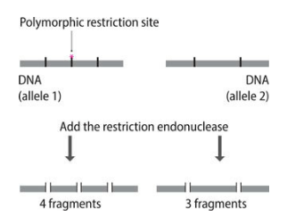
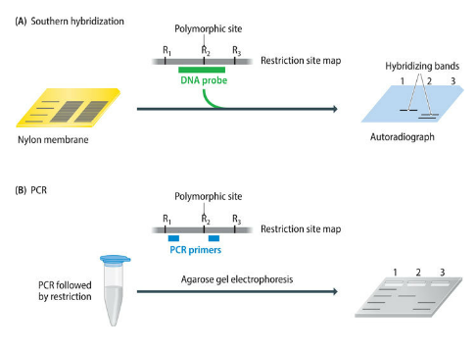
Genes are very useful markers but they are by no means ideal. One problem, especially with larger genomes such as those of vertebrates and flowering plants, is that a map based entirely on genes is not very detailed. This would be true even if every gene could be mapped, because in most eukaryotic genomes the genes are widely spaced out with large gaps between them. The problem is made worse by the fact that many genes do not exist in allelic forms that can be distinguished conveniently. Gene maps are therefore not very comprehensive.
This is an RFLP, and its position on a genome map can be worked out by following the inheritance of its alleles, just as is done when genes are used as markers. There are thought to be about 10⁵ RFLPs in a mammalian genome.
Mapped features that are not genes are called DNA markers. As with gene markers, a DNA marker must have at least two alleles to be useful. Two examples of DNA markers are the sequences called restriction fragment length polymorphisms (RFLPs) and simple sequence length polymorphisms (SSLPs).

Slide 9
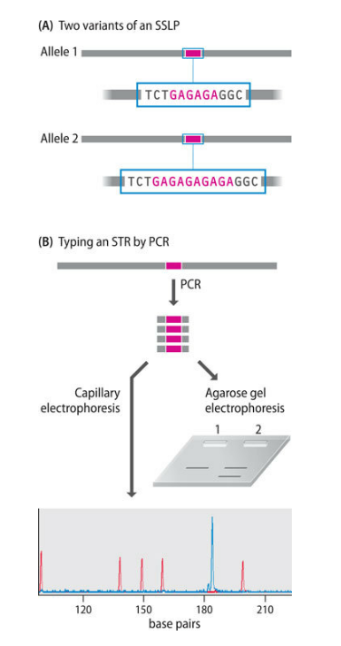
Unlike RFLPs, SSLPs can be multiallelic, as each SSLP can have a number of different length variants.
There are two types of SSLPs:
• Minisatellites, also known as variable number of tandem repeats (VNTRs), in which the repeat unit is up to 25 bp in length
• Microsatellites, or short tandem repeats (STRs), whose repeats are shorter, usually 13 bp or less
Microsatellites are more popular than minisatellites as DNA markers for two reasons. First, minisatellites are not spread evenly around the genome but tend to be found more frequently in the telomeric regions at the ends of chromosomes.
Microsatellites are more conveniently spaced throughout the genome. Second, the fastest way to type a length polymorphism is by PCR, but PCR typing is much quicker and more accurate with sequences less than 300 bp in length. Most minisatellite alleles are longer than this.
Microsatellites used as DNA markers typically consist of 10–30 copies of a repeat that is no longer than 6 bp in length, and so they are much more amenable to analysis by PCR. There are 2.86 × 10⁶ microsatellites with repeat units of 2–6 bp in the human genome.

Slide 10
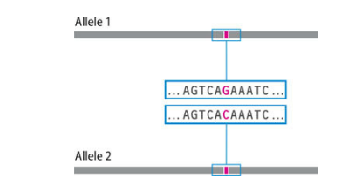
Single-nucleotide polymorphisms (SNPs). An SNP is a position in a genome where some individuals have one nucleotide (e.g., a G) and others have a different nucleotide (e.g., a C). There are vast numbers of SNPs in every genome (approximately 10 million in the human genome), some of which also give rise to RFLPs, but many of which do not because the sequence in which they lie is not recognized by any restriction enzyme.
Any one of the four nucleotides could be present at any single position in a genome, so it might be imagined that each SNP should have four alleles. Theoretically this is possible but in practice most SNPs exist as just two variants. This is because each SNP originates when a point mutation occurs in a genome, converting one nucleotide into another. If the mutation occurs in the reproductive cells of an individual, then one or more of that individual’s offspring might inherit the mutation and, after many generations, the SNP may eventually become established in the population.
But there are just two alleles: the original sequence and the mutated version. For a third allele to arise, a new mutation must occur at the same position in the genome in another individual, and this individual and his or her offspring must reproduce in such a way that the new allele becomes established. This scenario is not impossible but it is unlikely: consequently the vast majority of SNPs are biallelic.
genome: in most eukaryotes, at least one for every 1000 bp of DNA. SNPs therefore enable very detailed genome maps to be constructed.

Slide 11
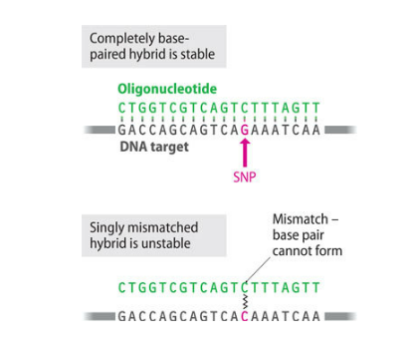
Several of these typing methods are based on oligonucleotide hybridization analysis. An oligonucleotide is a short, single-stranded DNA molecule, usually less than 50 nucleotides long, that is synthesized in the test tube. If the conditions are just right, then an oligonucleotide will hybridize with another DNA molecule only if the oligonucleotide forms a completely base-paired structure with the second molecule. If there is a single mismatch—a single position within the oligonucleotide that does not form a base pair—then hybridization does not occur. Oligonucleotide hybridization can therefore discriminate between the two alleles of an SNP.
Incubation temperature must be just below the melting temperature, or Tm, of the oligonucleotide. At temperatures above Tm, even the fully base-paired hybrid is unstable. At more than 5°C below Tm, mismatched hybrids might be stable. Tm for the oligonucleotide shown in the figure would be about 58°C. Tm (in degrees Celsius) is calculated from the formula Tm = (4 × number of G and C nucleotides) + (2 × number of A and T nucleotides). This formula gives a rough indication of Tm for oligonucleotides of 15–30 nucleotides in length.

Slide 12
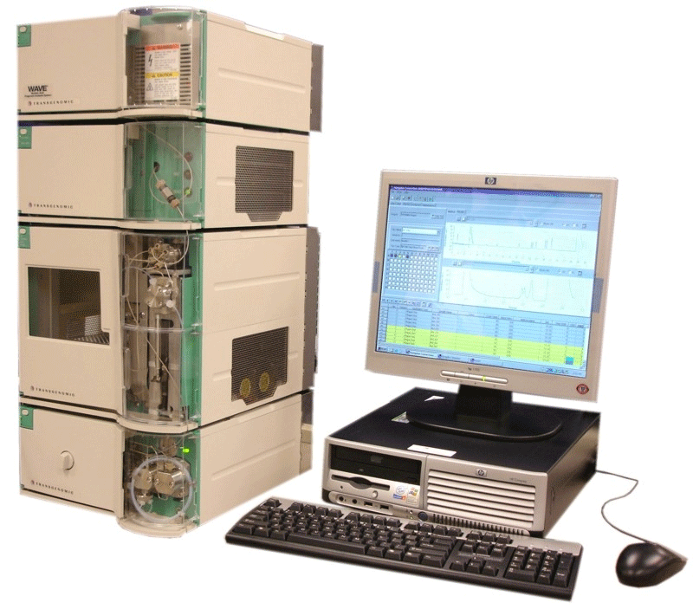
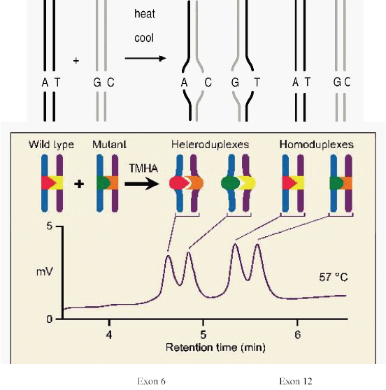
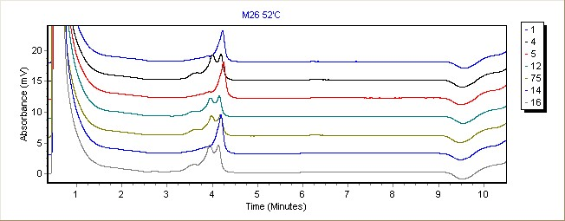
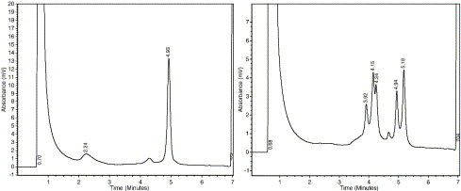
• Denaturing – High Performance Liquid Chromatography technology (D-HPLC) (1997)

Slide 13
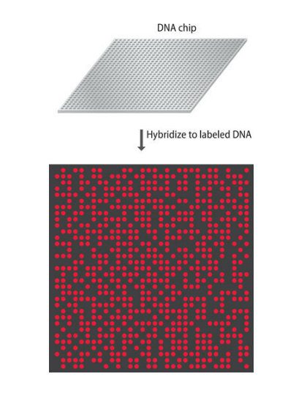
• DNA chip technology makes use of a wafer of glass or silicon, 2 cm2 or less in area, carrying many different oligonucleotides in a high-density array. The DNA to be tested is labeled with a fluorescent marker and pipetted onto the surface of the chip. Hybridization is detected by examining the chip with a fluorescence microscope. The positions at which the fluorescent signal is emitted indicate which oligonucleotides have hybridized with the test DNA. Hybridization requires a complete match between an oligonucleotide and its complementary sequence in the test DNA, and so indicates which of the two versions of a SNP is present in the test. A density of up to 300,000 oligonucleotides/cm2 is possible on the surface of the chip, so a chip of 2 cm2 can type 300,000 SNPs in a single experiment, if the chip carries oligonucleotides for both alleles of each SNP.

Slide 14
• Solution hybridization techniques are carried out in the wells of a microtiter tray, using a detection system that can discriminate between non-hybridized, single-stranded DNA and the double-stranded product that results when an oligonucleotide hybridizes to the test DNA. The most popular detection system makes use of dye quenching. In SNP typing, the dye is attached to one end of the oligonucleotide and the quenching compound to the other end. Hybridization between oligonucleotide and the test DNA is indicated by generation of the fluorescent signal. When used in this context, the dye-quenching technique is sometimes called molecular beacons.
• The oligonucleotide ligation assay (OLA) makes use of two oligonucleotides that anneal adjacent to one another, with the 3′-end of one of these oligonucleotides positioned exactly at the SNP. This oligonucleotide will form a completely base-paired structure if one version of the SNP is present in the template DNA, and when this occurs, the oligonucleotide can be ligated to its partner. If the DNA being examined contains the other allele of the SNP, then the 3′-nucleotide of the test oligonucleotide will not anneal to the template and no ligation occurs. The allele is therefore typed by determining if the ligation product is synthesized. If a single SNP is being assayed, then formation of the ligation product can be identified by running the postreaction mixture in a capillary electrophoresis system, as described above for STR typing.

Slide 15
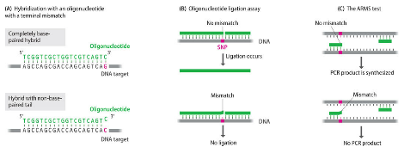
• In the amplification refractory mutation system, or ARMS test, the test oligonucleotide is one of a pair of PCR primers. If the 3′-nucleotide of the test primer anneals to the SNP, then it can be extended by Taq polymerase and the PCR can take place, but if it does not anneal because the alternative version of the SNP is present, then no PCR product is generated

Slide 16
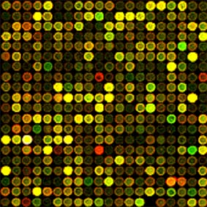
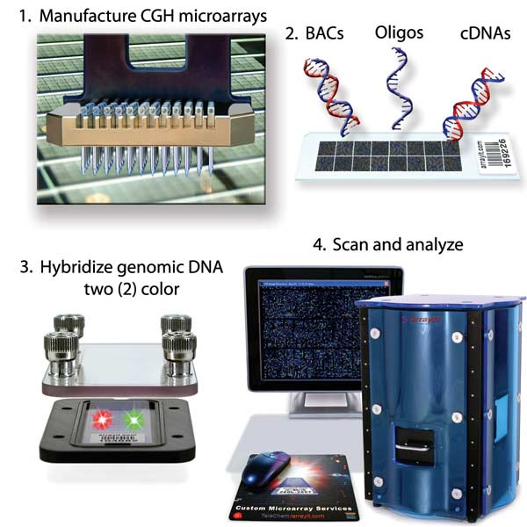
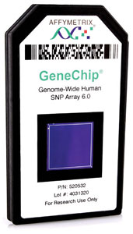

Slide 17
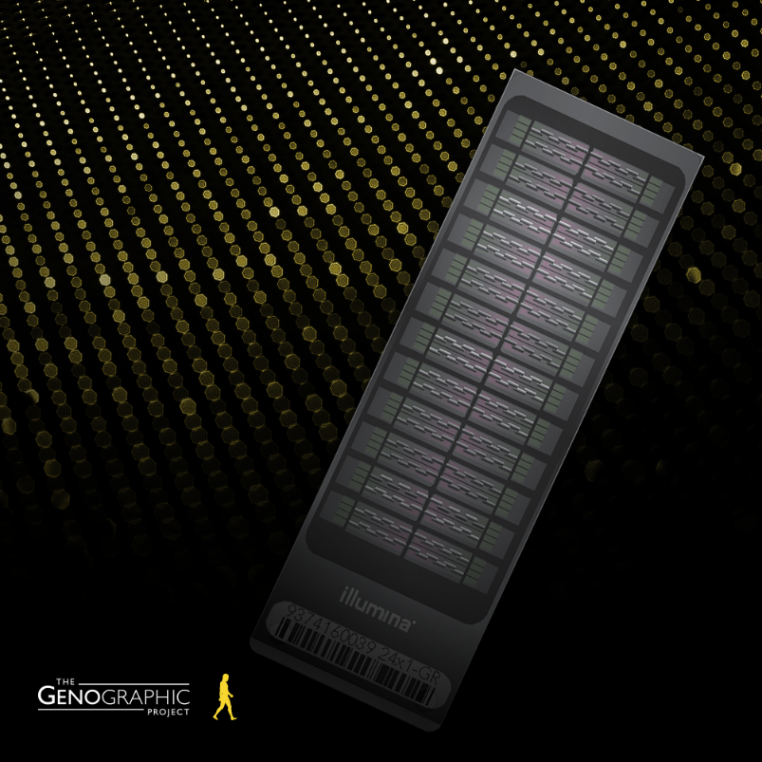
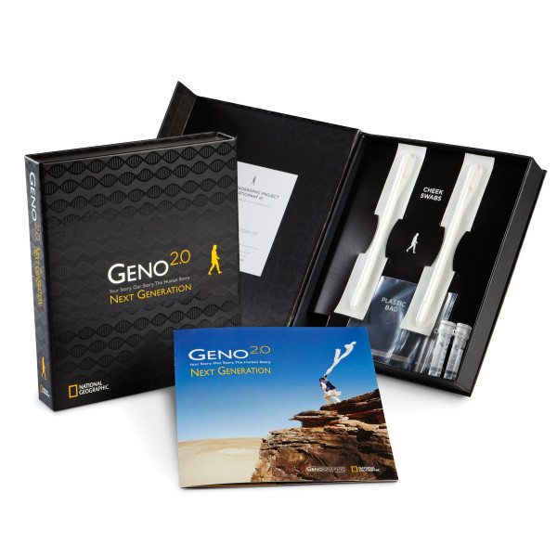

Slide 18
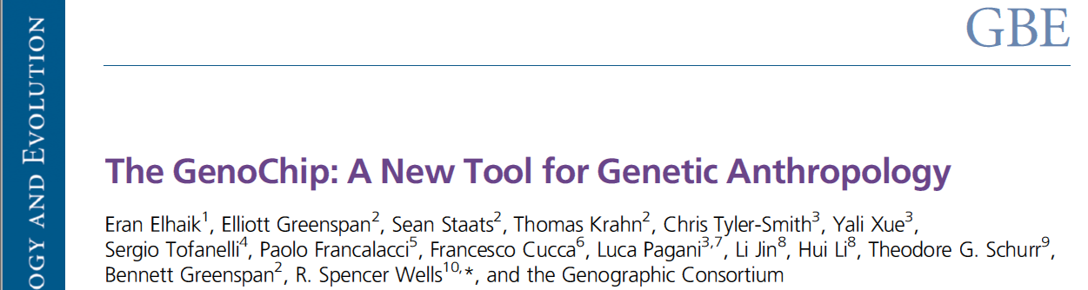
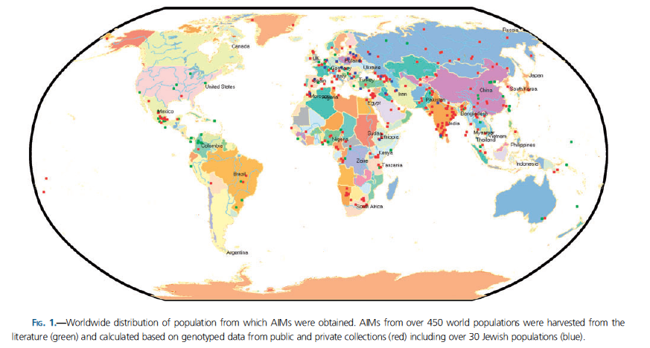
Over 130,000 autosomal and X-chromosomal
Ancestry Informative Markers
12,316 Y-SNPs
3,352 mtDNA SNPs

Slide 19
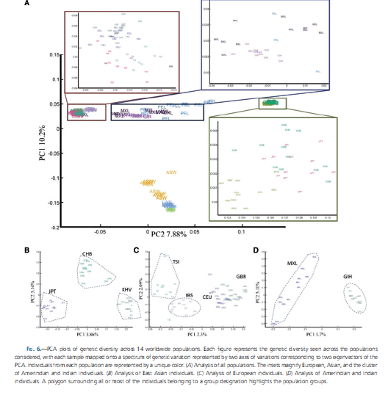

Slide 20
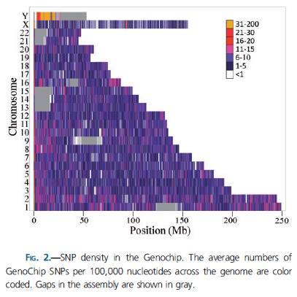

Slide 21
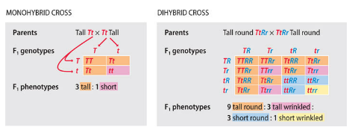
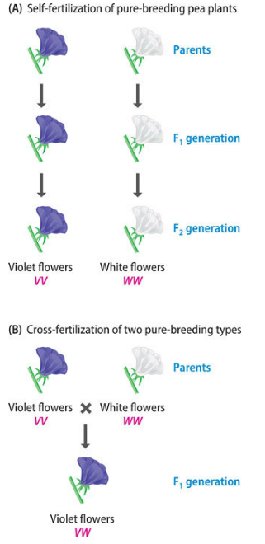
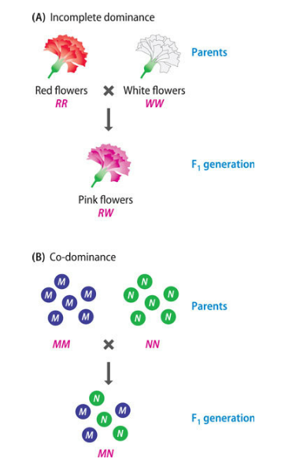
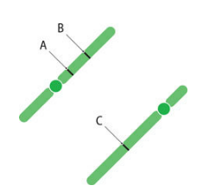
3.3 THE BASIS TO GENETIC MAPPING
genetic linkage, which in turn derives from the seminal discoveries in genetics made in the mid-nineteenth century by Gregor Mendel.
When Mendel’s work was rediscovered in 1900, his second law worried the early geneticists because it was soon established that genes reside on chromosomes, and it was realized that all organisms have many more genes than chromosomes.
Homozygosity and heterozygosity.
Two types of allele interaction not encountered by Mendel.

Slide 22
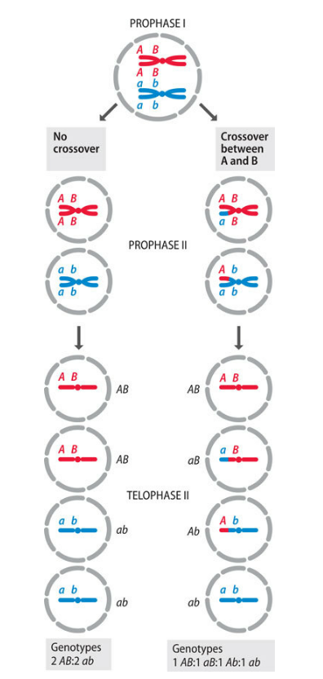
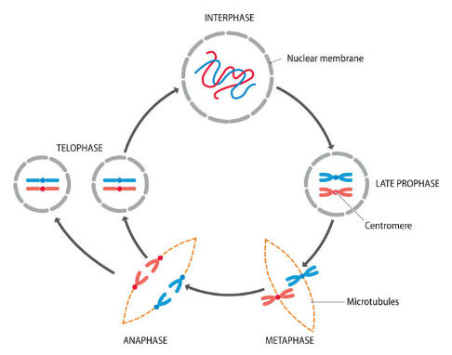
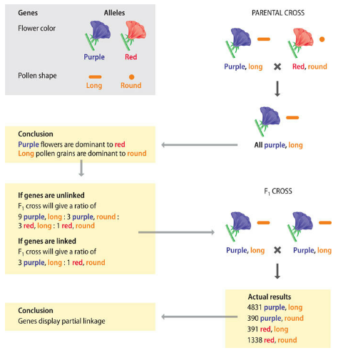
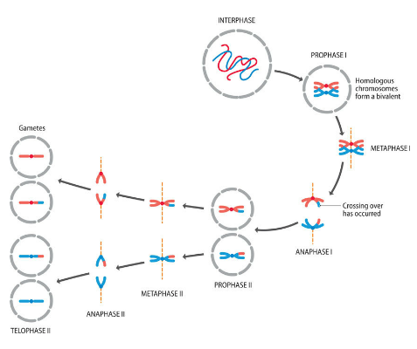
Partial linkage: sometimes they were inherited together and sometimes they were not. The resolution of this contradiction between prediction and observation was the critical step in the development of genetic mapping techniques.

Slide 23
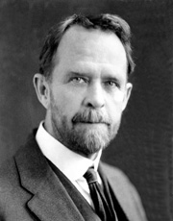
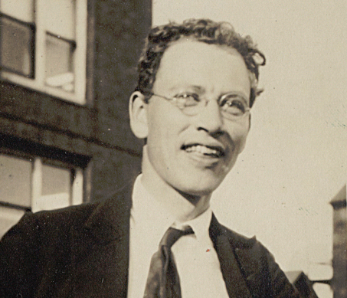
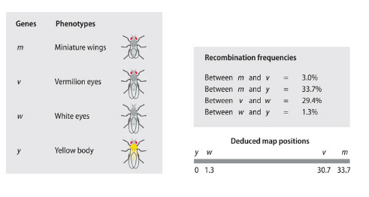
The recombination frequency is therefore a measure of the distance between two genes.
Thomas Morgan’s group then set about mapping as many fruit fly genes as possible, and by 1915 they had assigned locations for 85 of them. These genes fall into four linkage groups, corresponding to the four pairs of chromosomes seen in the fruit fly nucleus. The distances between genes are expressed in map units: one map unit is the distance between two genes that recombine with a frequency of 1%. According to this notation, the distance between the genes for white eyes and yellow body, which recombine with a frequency of 1.3%, is 1.3 map units (see Figure 3.19). More recently the name centiMorgan (cM) has begun to replace the map unit.
The example is taken from the original experiments carried out with fruit flies by Arthur Sturtevant. All four genes are on chromosome 1 of the fruit fly. Recombination frequencies between the genes are shown, along with their deduced map positions.

Slide 24
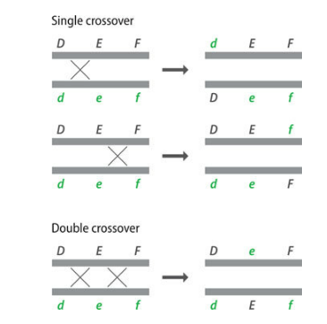
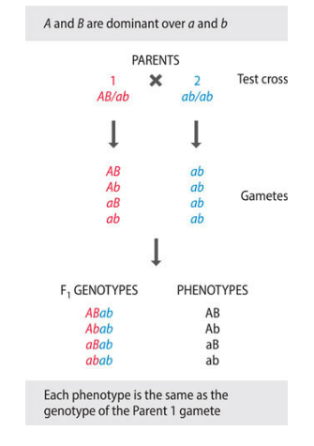
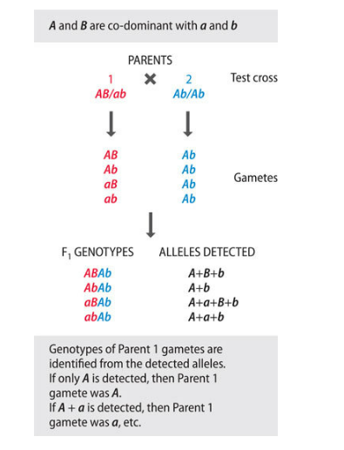
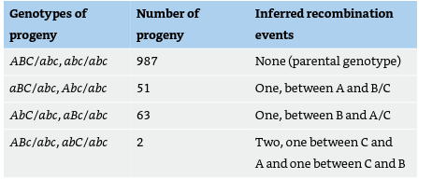
3.4 LINKAGE ANALYSIS WITH DIFFERENT TYPES OF ORGANISMS
The complication with a genetic cross is that the resulting diploid progeny are the product not of one meiosis but of two (one in each parent), and in most organisms, crossover events are equally likely to occur during production of male and female gametes. Somehow we have to be able to disentangle from the genotypes of the diploid progeny the crossover events that occurred in each of these two meioses. This means that the cross has to be set up with care. The standard procedure is to use a test cross.
If co-dominant markers are used, then the double-homozygous parent can have any combination of homozygous alleles (AB/AB, Ab/Ab, aB/aB, or ab/ab).

Slide 25
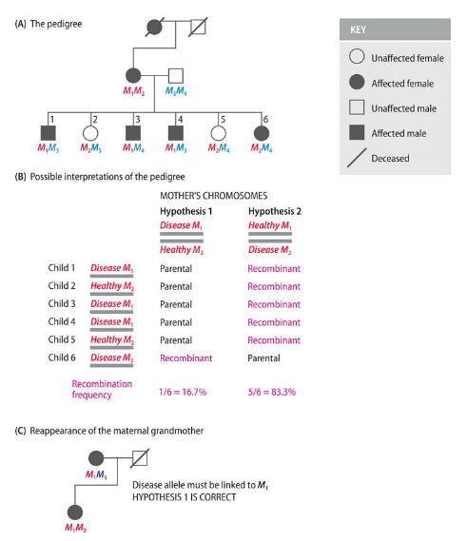
With humans it is, of course, impossible to preselect the genotypes of parents and set up crosses designed specifically for mapping purposes. Instead, data for the calculation of recombination frequencies have to be obtained by examining the genotypes of the members of successive generations of existing families. This is called pedigree analysis.
determine the degree of linkage between the disease gene and the microsatellite M by typing the alleles for this microsatellite (M1, M2, etc.)
The pedigree can be interpreted in two different ways: Hypothesis 1 gives a low recombination frequency and indicates that the disease gene is tightly linked to microsatellite M. Hypothesis 2 suggests that the disease gene and microsatellite are much less closely linked.
The issue is resolved by the reappearance of the maternal grandmother, whose microsatellite genotype is consistent only with Hypothesis 1.

Slide 26
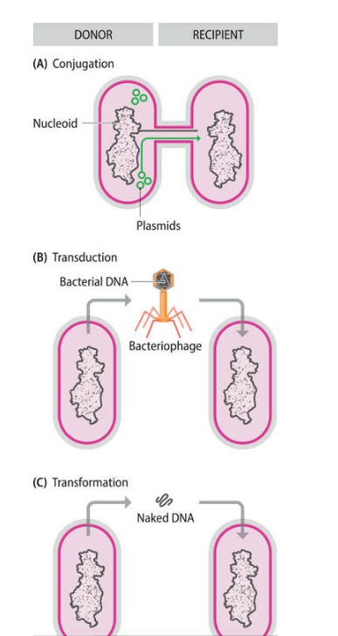

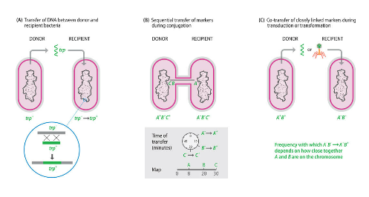
• Conjugation, two bacteria come into physical contact and one bacterium (the donor) transfers DNA to the second bacterium (the recipient). The transferred DNA can be a copy of some of the donor cell’s chromosome, or it could be a segment of chromosomal DNA, up to 1 megabase (Mb) in length, integrated in a plasmid.
• Transduction involves transfer of a small segment of DNA, up to 50 kb or so, from donor to recipient via a bacteriophage.
• Transformation, the recipient cell takes up from its environment a fragment of DNA, rarely longer than 50 kb, released from a donor cell.
François Jacob

Slide 27
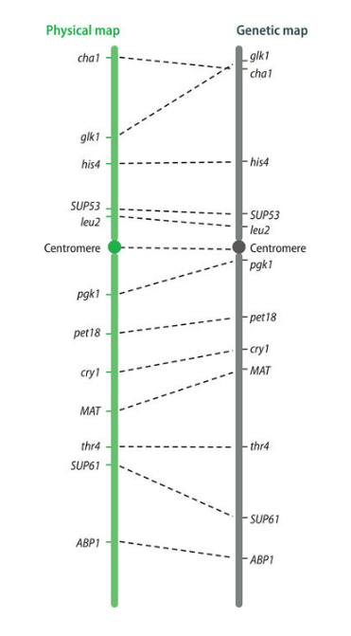
The resolution of a genetic map depends on the number of crossovers that have been scored. This is not a major problem for microorganisms because they can be obtained in huge numbers, enabling many crossovers to be studied, resulting in a highly detailed genetic map in which the markers are just a few kilobases apart. For example, when the Escherichia coli genome sequencing project began in 1990, the latest genetic map for this organism comprised over 1400 markers, an average of one per 3.3 kb. This was sufficiently detailed to ensure that the genome sequence was assembled correctly. Similarly, the Saccharomyces cerevisiae project was supported by a fine-scale genetic map (approximately 1150 markers, on average one per 10 kb). The problem with humans and most other eukaryotes is that it is simply not possible to obtain large numbers of progeny,
Genetic maps have limited accuracy. We touched on this point in Section 3.3 when we assessed Sturtevant’s assumption that crossovers occur at random along chromosomes. This assumption is only partly correct because the presence of recombination hotspots means that crossovers are more likely to occur at some points than at others. The effect that this can have on the accuracy of a genetic map was illustrated in 1992, when the complete sequence for Saccharomyces cerevisiae chromosome III was published, enabling the first direct comparison to be made between a genetic map and the actual positions of markers as shown by DNA sequencing. There were considerable discrepancies, even to the extent that one pair of genes had been ordered incorrectly by genetic analysis. Bear in mind that S. cerevisiae is one of the two eukaryotes (fruit fly is the second) whose genomes have been subjected to intensive genetic mapping.

Slide 28
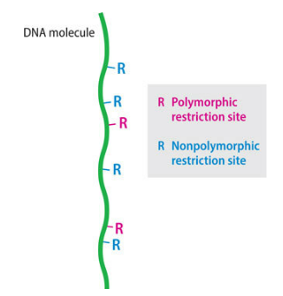
3.5 PHYSICAL MAPPING BY DIRECT EXAMINATION OF DNA MOLECULES
approach used to identify marker locations:
• Methods that involve direct examination of DNA molecules or chromosomes
• Methods that assign markers to DNA fragments whose positions within an intact DNA molecule are known or can be inferred
The simplest direct examination methods are those that enable the positions of restriction sites to be located in a DNA molecule. This process is called restriction mapping.
Genetic mapping using RFLPs as DNA markers can locate the positions of polymorphic restriction sites within a genome, but very few restriction sites are polymorphic, so many sites are not mapped by this technique. Could we increase the marker density on a genome map by using an alternative method to locate the positions of some of the nonpolymorphic restriction sites? This is what restriction mapping achieves. The simplest way to construct a restriction map is to compare the fragment sizes produced when a DNA molecule is digested with two different restriction enzymes that recognize different target sequences. An example using the restriction enzymes EcoRI and BamHI is shown

Slide 29
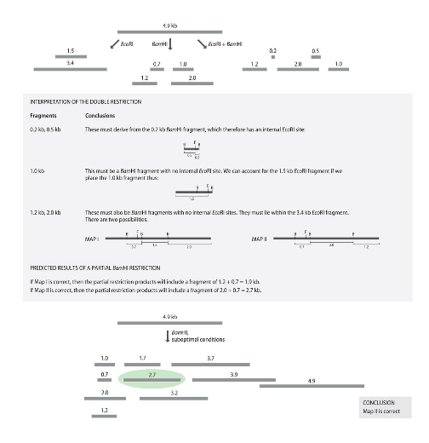
• First, a sample of the DNA molecule is digested with just one of the enzymes and the sizes of the resulting fragments are measured by agarose gel electrophoresis. Next, another sample of the molecule is digested with the second enzyme, and the resulting fragments are again sized in an agarose gel. The results so far enable the number of restriction sites for each enzyme to be worked out but do not allow their relative positions to be determined.
• A sample of the DNA molecule is then cut with both enzymes together. In the example shown in Figure 3.28, the fragment sizes produced by this double restriction enable three of the four restriction sites to be mapped.
• A partial restriction is carried out, in which a single enzyme is used but the digestion does not go to completion, because the reaction is incubated only for a short time or a suboptimal incubation temperature is used. Partial restriction leads to a complex set of products, the complete restriction products now being supplemented with partially restricted fragments that still contain one or more uncut restriction sites. The sizes of the partially restricted fragments enable the map to be completed.
The conventional approach to restriction mapping is therefore more applicable to small rather than large molecules, the upper limit depending on the frequency of the restriction sites in the molecule being mapped.

Slide 30
In the earliest form of optical mapping, the molecules were extended by a process called gel stretching. Chromosomal DNA was suspended in molten agarose and placed on a microscope slide held at a slight angle so that the agarose flowed slowly along the slide as it cooled and solidified. Under these conditions, the DNA molecules contained within the agarose line up and become extended. The gel also contains the restriction enzyme, which can be activated by adding magnesium ions (all restriction enzymes require magnesium in order to work). The molecules are then visualized by adding a fluorescent dye, such as DAPI (4′,6-diamino-2-phenylindole dihydrochloride), which stains the DNA so that the fibers can be seen when the slide is examined under a high-power fluorescence microscope.
With the technique called optical mapping, restriction sites are located simply by observing the cut DNA molecules under a microscope.
DNA in solution takes up a random coil configuration, with groups of molecules tending to clump together in masses. The key to optical mapping is therefore the ability to extend individual DNA molecules into a linear configuration so that the locations of cuts made by a restriction enzyme, as visualized by observation of the molecule, accurately reflect the positions of the restriction sites in the DNA sequence.
The restriction sites in the extended molecules gradually become gaps as the degree of fiber extension is reduced by the natural springiness of the DNA, enabling the relative positions of the cuts to be recorded.

Slide 31
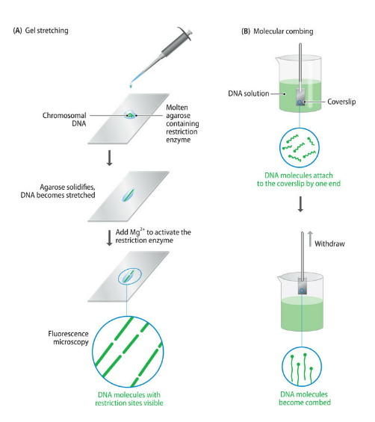
An alternative method for stretching out the molecules without the use of a gel is molecular combing. A silicone-coated coverslip is dipped into a solution of DNA, left for 5 minutes (during which time the DNA molecules attach to the coverslip by their ends), and then removed from the solution at a constant speed, typically 0.3 mm s^{–1}. The force required to pull the DNA molecules through the meniscus causes them to line up. Once in the air, the surface of the coverslip dries, retaining the DNA molecules as an array of parallel fibers. With this method, restriction sites less than 800 bp apart can be visualized.

Slide 32
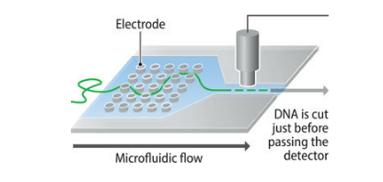
Optical mapping was first applied to large DNA fragments cloned in BAC vectors (Section 2.3). The feasibility of using this technique with genomic DNA was then established with studies of a 1 Mb chromosome of the malaria parasite Plasmodium falciparum, and with the two chromosomes and a plasmid of the bacterium Deinococcus radiodurans, which are 2.65, 0.41, and 0.18 Mb, respectively. Molecules over 1 Mb in length are difficult to purify and extend without accidental breakage, so most optical maps are built up from the data obtained from a series of overlapping fragments. The 2.65 Mb D. radiodurans chromosome, for example, was mapped from 157 fragments. This means that the procedure is labor-intensive as many separate observations have to be made, and the amount of labor increases disproportionately as the length of the starting molecule increases.
microfluidic device for optical mapping of restriction sites. The DNA molecule becomes partially extended by passage through the grid of electrodes and is then fully extended when it enters the nanochannel, which is only slightly wider than the double helix. The DNA is cut within the nanochannel, in which there is a magnesium ion gradient.

Slide 33
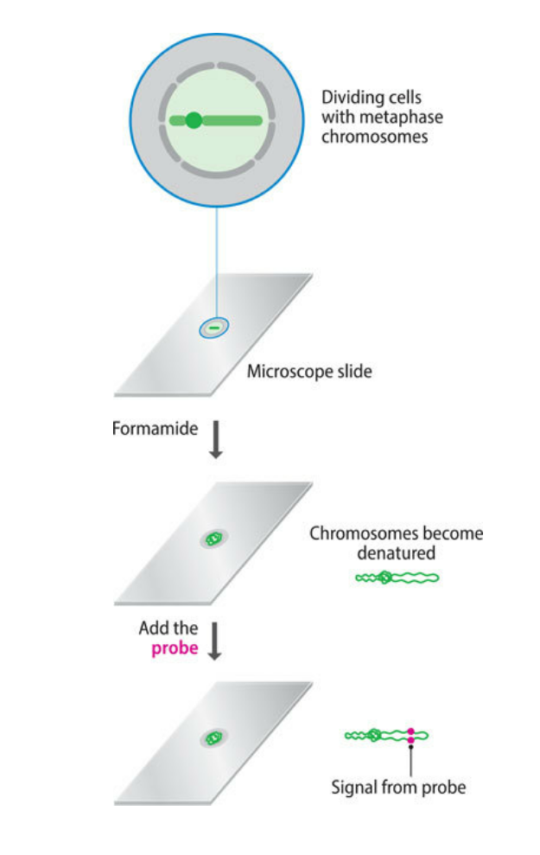
a second technique for physical mapping of DNA molecules, called fluorescent in situ hybridization (FISH). the marker is a DNA sequence contained in the DNA molecule, whose location is visualized by hybridization with a fluorescent DNA probe that is complementary
The technique was first used in the 1980s with metaphase chromosomes
can therefore identify the position of a marker relative to the centromere and the chromosome bands, but cannot achieve any degree of high-resolution mapping, as two markers have to be at least 1 Mb apart to be resolved as separate hybridization signals.
During the 1990s, modified versions of FISH were developed in which the target material was not the metaphase structures but instead mechanically stretched chromosomes or ones prepared from the prophase or interphase stages of nuclear division, when the chromosomes are naturally more extended. Even with these innovations, markers closer than 25 kb cannot be resolved.

Slide 34
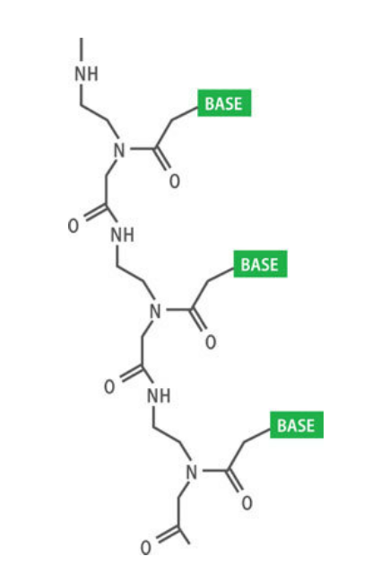
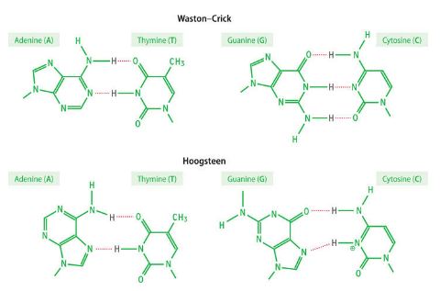
fiber-FISH, is essentially a modified version of optical mapping, and is carried out with stretched DNA fragments in microfluidic devices with architectures similar to those described earlier. The advantage of fiber-FISH compared with restriction site mapping is that the probe can be designed to target any desired DNA sequence, so there is no limit to the types of marker that can be detected.
The main challenge presented by this type of optical mapping is ensuring that the probe remains attached to its specific position on the DNA fragment as the fragment is extended and passed through the microfluidic channels and past the detector.
use a peptide nucleic acid (PNA) as the probe. This is a polynucleotide analog in which the sugar–phosphate backbone is replaced by amide bonds
a single DNA strand can attach to two PNAs at the same time, one by Watson–Crick pairing and one by Hoogsteen pairing. The resulting triplex structure, PNA₂DNA, is more stable than a DNA–DNA hybrid and so is unlikely to break down during the optical mapping procedure.

Slide 35
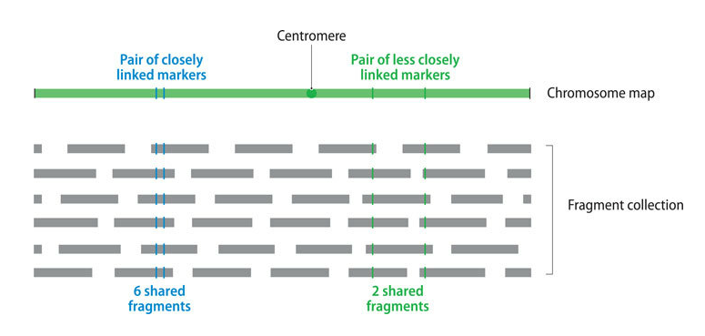
3.6 PHYSICAL MAPPING BY ASSIGNING MARKERS TO DNA FRAGMENTS
sequence-tagged site (STS), an STS simply being a short DNA sequence, generally between 100 and 500 bp in length, that is easily recognizable and occurs only once in the chromosome or genome being studied.
in linkage analysis a map distance is calculated from the frequency at which crossovers occur between two markers. STS mapping is essentially the same, except that the map distance is based on the frequency at which breaks occur between two markers.
a collection of overlapping DNA fragments from a single chromosome or from the entire genome is needed.
each point along the chromosome represented, on average, five times in the collection. The data from which the map will be derived are obtained by determining which fragments contain which STS markers. This can be done by hybridization analysis, but PCR is generally used because it is quicker and has proven to be more amenable to automation.
The chances of two STS markers being present on the same fragment will depend on how close together they are in the genome.

Slide 36

To qualify as an STS, a DNA sequence must satisfy two criteria.
The first is that its sequence must be known, so that a PCR assay can be set up to test for the presence or absence of the STS on different DNA fragments.
The second requirement is that the STS must have a unique location in the chromosome.
Expressed sequence tags (EST) are short sequences obtained by analysis of complementary DNA (cDNA) clones. Complementary DNA is prepared by converting an mRNA preparation into double-stranded DNA
An SSLP can also act as an STS in physical mapping. SSLPs that have already been mapped by linkage analysis are particularly valuable, as they provide a direct connection between the genetic and physical maps.
Random genomic sequences are obtained by sequencing random pieces of cloned genomic DNA or simply by downloading sequences that have been deposited in the databases. If these sequences contain SNPs that have already been mapped by linkage analysis, then again a direct connection can be made between the genetic and physical maps.

Slide 37

an STS mapping procedure is the collection of DNA fragments spanning the chromosome or genome being studied. This collection is sometimes called the mapping reagent, and at present there are two ways in which it can be assembled: as a clone library and as a panel of radiation hybrids.
The technology was initially developed with human chromosomes, starting in the 1970s when it was discovered that exposure of human cells to X-ray doses of 3000–8000 rad causes the chromosomes to break up randomly into fragments, with larger X-ray doses producing smaller fragments. This treatment is lethal for the human cells, but the chromosome fragments can be propagated if the irradiated cells are subsequently fused with nonirradiated cells of a hamster or other rodent.
Fusion is stimulated either chemically, with polyethylene glycol, or by exposure to Sendai virus. Not all of the hamster cells take up chromosome fragments, so a means of identifying the hybrids is needed.
Those that grow are hybrid hamster cells that have acquired human DNA fragments that include genes for the human TK and HPRT enzymes, which are synthesized inside the hybrids, enabling these cells to grow in the selective medium.

Slide 38

A preliminary to the sequencing of a large and complex genome is to break the genome or isolated chromosomes into fragments and to clone each one in a high-capacity vector such as a BAC. This results in a clone library, a collection of DNA fragments, with an average size of several hundred kilobases.
Typically the fragments are 5–10 Mb in size, with each cell containing fragments equivalent to 15–35% of the human genome.
Radiation hybrid mapping was important in constructing the first physical maps of the human genome, with a panel of less than 200 hybrids enabling 41,000 STS markers to be mapped with 100 kb resolution. This means that if two markers are less than 100 kb apart, then they will appear to occupy the same position in the genome.
The fragments in the various clones form an overlapping series, which means that as well as supporting the sequencing work, the clone library can also be used as a mapping reagent in STS analysis.
This degree of resolution is much less than for optical mapping, with which it can be possible to distinguish markers less than 1 kb apart, but it is still satisfactory for the initial mapping of an unsequenced genome.
Following the success of the approach with the human genome, radiation hybrid mapping was applied to other mammals and to non-mammalian species such as zebrafish and chicken.
Zebrafish (Danio rerio)

Slide 39

A clone library can be prepared from genomic DNA, in which case it represents the entire genome, or a chromosome-specific library can be made if the starting DNA comes from just one type of chromosome. Individual chromosomes can be separated by flow cytometry.
The chromosomes are then stained with a fluorescent dye. The amount of dye that a chromosome binds depends on its size, so larger chromosomes bind more dye and fluoresce more brightly than smaller ones. The chromosome preparation is diluted and passed through a fine aperture, producing a stream of droplets, each one containing a single chromosome. The droplets pass through a detector that measures the amount of fluorescence and hence identifies which droplets contain the particular chromosome being sought.
An electric charge is applied to these drops and no others, enabling the droplets containing the desired chromosome to be deflected and separated from the rest. What if two different chromosomes have similar sizes, as is the case with human chromosomes 21 and 22? These can usually be separated if the dye used is not one that binds nonspecifically to DNA but instead has a preference for AT- or GC-rich regions. Examples of such dyes are Hoechst 33258 and chromomycin A3, respectively. Two chromosomes that are the same size rarely have identical GC contents

