Slide 1
CHAPTER 2 STUDYING DNA
2.1 ENZYMES FOR DNA MANIPULATION The mode of action of a template-dependent DNA polymerase. The types of DNA polymerase used in research. Restriction endonucleases enable DNA molecules to be cut at defined positions. Gel electrophoresis is used to examine the results of a restriction digest. Interesting DNA fragments can be identified by Southern hybridization. Ligases join DNA fragments together. End-modification enzymes.
2.2 THE POLYMERASE CHAIN REACTION Carrying out a PCR. The rate of product formation can be followed during a PCR. PCR has many and diverse applications.
2.3 DNA CLONING Why is gene cloning important? The simplest cloning vectors are based on E. coli plasmids. Bacteriophages can also be used as cloning vectors. Vectors for longer pieces of DNA. DNA can be cloned in organisms other than E. coli.

Slide 2
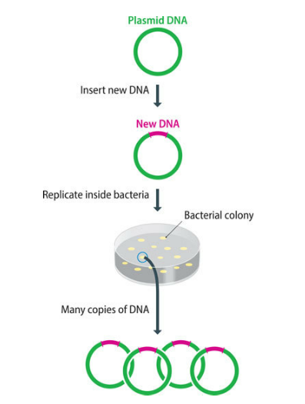
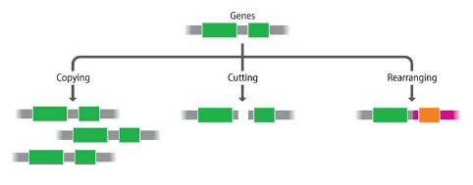
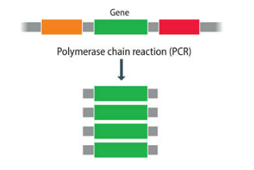
The toolkit of techniques used by molecular biologists to study DNA molecules was assembled during the 1970s and 1980s. Before then, the only way in which individual genes could be studied was by classical genetics, using techniques that originated with Mendel in the middle part of the nineteenth century. In the early 1970s, provided molecular biologists with enzymes that could be used to manipulate DNA molecules in the test tube.
These manipulations form the basis of recombinant DNA technology, in which new or recombinant DNA molecules are constructed from pieces of naturally occurring chromosomes and plasmids.
Recombinant DNA methodology led to development of the polymerase chain reaction (PCR). PCR is a deceptively simple technique—all that it achieves is the repeated copying of a short segment of a DNA molecule
Recombinant DNA techniques also underlie DNA cloning, or gene cloning, in which a DNA fragment is inserted into a plasmid or virus chromosome and then replicated in a bacterial or eukaryotic host

Slide 3
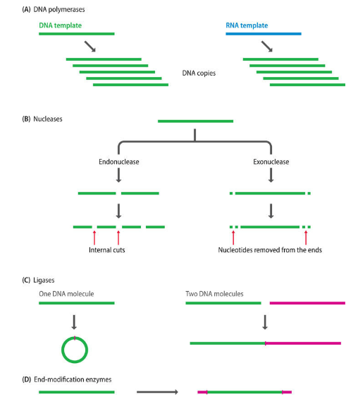
2.1 ENZYMES FOR DNA MANIPULATION
• DNA polymerases, which are enzymes that synthesize new polynucleotides complementary to an existing DNA or RNA template
• Nucleases, which degrade DNA molecules by breaking the phosphodiester bonds that link one nucleotide to the next
• Ligases, which join DNA molecules together by synthesizing phosphodiester bonds between nucleotides at the ends of two different molecules or at the two ends of a single molecule
• End-modification enzymes, which make changes to the ends of DNA molecules

Slide 4
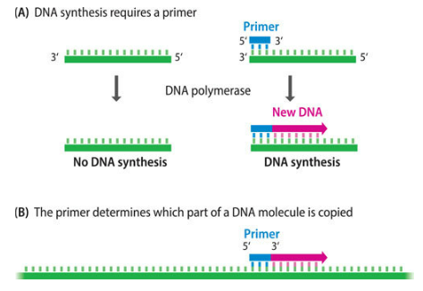
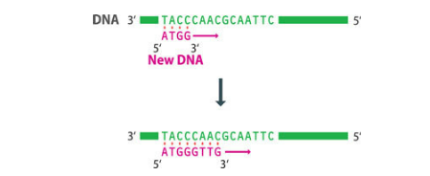
An enzyme that synthesizes DNA is called a DNA polymerase, and one that copies an existing DNA or RNA molecule is called a template-dependent DNA polymerase. It makes a new DNA polynucleotide whose sequence is dictated, via the base-pairing rules, by the sequence of nucleotides in the DNA or RNA molecule that is being copied. The new polynucleotide is always synthesized in the 5′ → 3′ direction: DNA polymerases that make DNA in the other direction are unknown in nature.
The DNA polymerase is unable to use an entirely single-stranded molecule as the template. There must be a short, double-stranded region to provide a 3′-end onto which the enzyme will add new nucleotides. This requirement is met in living cells when the genome is replicated. In the test tube, a DNA-copying reaction is initiated by attaching to the template a short, synthetic oligonucleotide, usually about 20 nucleotides in length, which acts as a primer for DNA synthesis.

Slide 5
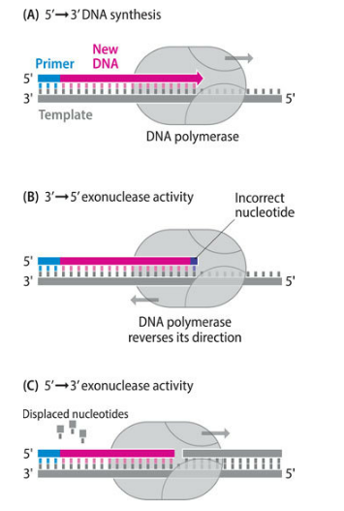
A 3′ → 5′ exonuclease activity enables the enzyme to remove nucleotides from the 3′-end of the strand that it has just synthesized. This is called the proofreading activity because it allows the polymerase to correct errors by removing a nucleotide that has been inserted incorrectly.
A 5′ → 3′ exonuclease activity is less common but is possessed by some DNA polymerases whose natural function in genome replication requires that they must be able to remove at least part of a polynucleotide that is already attached to the template strand that the polymerase is copying.

Slide 6

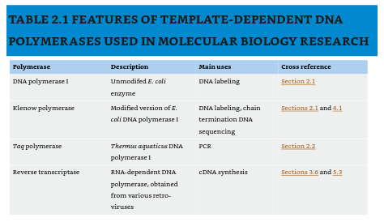
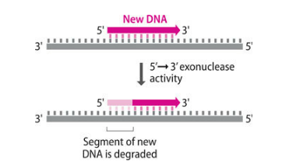
Several of the template-dependent DNA polymerases that are used in molecular biology research are versions of the Escherichia coli DNA polymerase I enzyme, which plays a central role in replication of this bacterium’s genome.
Of the two exonuclease activities, the 5′ → 3′ version causes most problems when a DNA polymerase is used to manipulate molecules in the test tube. This is because an enzyme with this activity is able to remove nucleotides from the 5′-ends of polynucleotides that have just been synthesized. It is unlikely that the polynucleotides will be completely degraded, because the polymerase function is usually much more active than the exonuclease function, but some techniques will not work if the 5′-ends of the new polynucleotides are shortened in any way. If any nibbling of the 5′-ends occurs, then it is impossible to determine the correct DNA sequence.
This enzyme, sometimes called the Kornberg polymerase, after its discoverer Arthur Kornberg (1958), has both the 3′ → 5′ and 5′ → 3′ exonuclease activities, which limits its usefulness in DNA manipulation. Its main application is in the synthesis of DNA molecules containing radioactive or fluorescent nucleotides: the process called DNA labeling.

Slide 7
Because of this problem, when DNA sequencing was first introduced in the late 1970s, a modified version of the Kornberg enzyme called the Klenow polymerase was used. The Klenow polymerase was initially prepared by cutting the natural E. coli DNA polymerase I enzyme into two segments by use of a protease. One of these segments retained the polymerase and 3′ → 5′ exonuclease activities but lacked the 5′ → 3′ exonuclease function of the untreated enzyme. Nowadays, the enzyme is almost always prepared from E. coli cells whose polymerase gene has been engineered so that the resulting enzyme has the desired properties.
PCR requires a thermostable DNA polymerase, one that is able to function at temperatures much higher than 37°C. Suitable enzymes can be obtained from bacteria such as Thermus aquaticus, which live in hot springs at temperatures up to 95°C, and whose DNA polymerase I enzyme has an optimum working temperature of 75–80°C. The biochemical basis of protein thermostability is not fully understood but probably centers on structural features that reduce the amount of protein unfolding that occurs at elevated temperatures.
One additional type of DNA polymerase is important in molecular biology research. This is reverse transcriptase, which is an RNA-dependent DNA polymerase and so makes DNA copies of RNA rather than DNA templates. Reverse transcriptases are involved in the replication cycles of retroviruses, including the human immunodeficiency viruses, which have RNA genomes that are copied into DNA after infection of the host. In the test tube, a reverse transcriptase can be used to make DNA copies of mRNA molecules. These copies are called complementary DNAs (cDNAs).
The E. coli DNA polymerase I enzyme has an optimum reaction temperature of 37°C, which is the usual temperature of the natural environment of the bacterium, inside the lower intestines of mammals. Test-tube reactions with either the Kornberg or Klenow polymerases are therefore incubated at 37°C and terminated by raising the temperature to 75°C or above, which causes the protein to unfold, or denature, destroying its enzymatic activity.

Slide 8
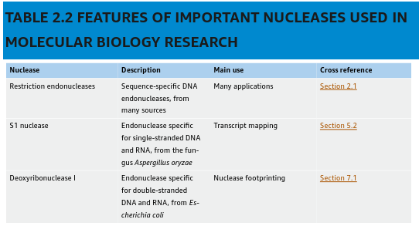
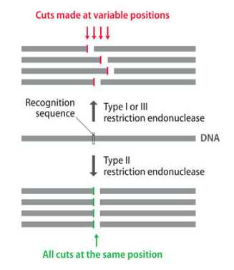
A variety of nucleases have found applications in recombinant DNA technology. Some nucleases have a broad range of activities but most are either exonucleases, removing nucleotides from the ends of DNA and/or RNA molecules, or endonucleases, making cuts at internal phosphodiester bonds.
With types I and III, there is no strict control over the position of the cut relative to the specific sequence in the DNA molecule that is recognized by the enzyme. These enzymes are therefore less useful because the sequences of the resulting fragments are not precisely known. Type II enzymes do not suffer from this disadvantage because the cut is always at the same place, either within the recognition sequence or very close to it
A restriction endonuclease is an enzyme that binds to a DNA molecule at a specific sequence and makes a double-stranded cut at or near that sequence. Because of the sequence specificity, the positions of cuts within a DNA molecule can be predicted if the DNA sequence is known,

Slide 9
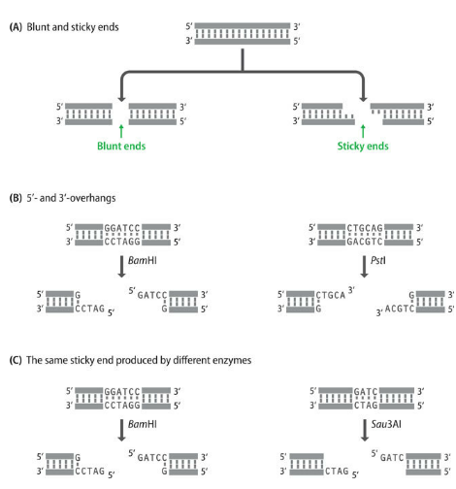
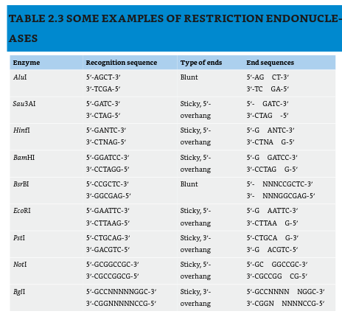
Restriction enzymes cut DNA in two different ways. Many make a simple double-stranded cut, giving a blunt or flush end, but others cut the two DNA strands at different positions, usually two or four nucleotides apart, so that the resulting DNA fragments have short, single-stranded overhangs at each end. These are called sticky or cohesive ends because base pairing between them can stick the DNA molecule back together again. Some sticky-end cutters give 5′-overhangs (for example, Sau3AI, HinfI), whereas others leave 3′-overhangs (for example, PstI).
Sau3A = Staphylococcus aureus, BamHI = Bacillus amyloliquefaciens, EcoRI = Escherichia coli, MspI = Moraxella species, KpnI = Klebsiella pneumoniae

Slide 10
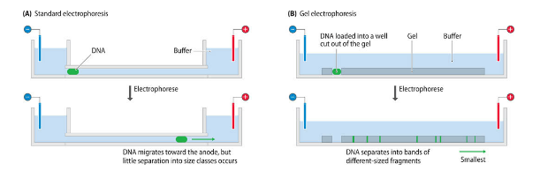
Electrophoresis is the movement of charged molecules in an electric field: negatively charged molecules migrate toward the positive electrode, and positively charged molecules migrate toward the negative electrode. The technique was originally carried out in aqueous solution, in which the predominant factors influencing migration rate are the shape of a molecule and its electric charge. This is not particularly useful for DNA separations because most DNA molecules are the same shape (linear), and although the charge of a DNA molecule is dependent on its length, the differences in charge are not sufficient to result in effective separation. The situation is different when electrophoresis is carried out in a gel, because now shape and charge are less important and molecular length is the critical determinant of migration rate.
Two types of gel are used in molecular biology: agarose gels, as described here, and polyacrylamide gels, which are mainly used in DNA sequencing

Slide 11
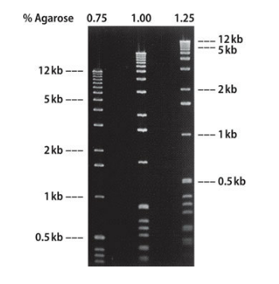
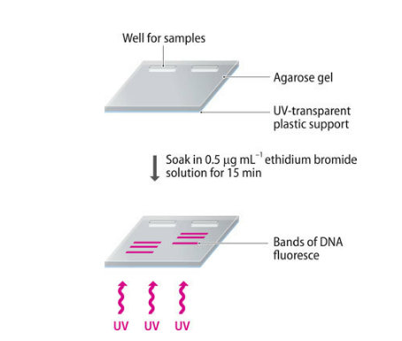
Depending on the concentration of agarose in the gel, fragments between 100 bp and 50 kilobase pairs (kb) in length can be separated into sharp bands after electrophoresis. For example, a 0.5 cm thick slab of 0.5% agarose, which has relatively large pores, would be used for molecules in the size range 1–30 kb, allowing, for example, molecules of 10 and 12 kb to be clearly distinguished. Alternatively, a 0.3% gel can be used for longer molecules up to 50 kb, and a 5% gel can be used for shorter molecules 100–500 bp in length.
The bands of DNA can be visualized by soaking the gel in ethidium bromide solution. This compound intercalates between DNA base pairs and fluoresces when activated with ultraviolet radiation. Unfortunately, the procedure is hazardous because ethidium bromide is a powerful mutagen. Nonmutagenic dyes that stain DNA green, red, or blue are therefore now used. The most sensitive dyes are able to detect bands that contain less than 1 ng of DNA, compared to a minimum of 10 ng of DNA when ethidium bromide is used.

Slide 12

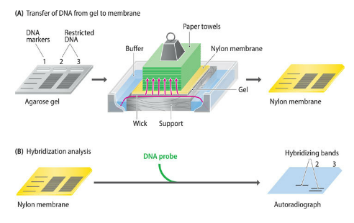
Even if its size is unknown, a fragment containing a segment of DNA of interest can be identified by a technique called Southern blot hybridization, invented by Edwin Southern (1975). The only requirement is that at least some of the sequence of the desired DNA segment is known or can be predicted.
The first step is to transfer the restriction fragments from the agarose gel to a nitrocellulose or nylon membrane. This is done by placing the membrane on the gel and allowing buffer to soak through, taking the DNA from the gel to the membrane, where it becomes bound
The next step is to prepare a hybridization probe, which is a labeled DNA molecule whose sequence is complementary to the target DNA that we wish to detect. The label is often a radioactive marker or a fluorescent marker
The probe could be a synthetic oligonucleotide whose sequence matches part of an interesting gene. Because the probe and target DNAs are complementary, they will base-pair or hybridize, the signal is detected by exposure of an X-ray-sensitive film (autoradiography).

Slide 13
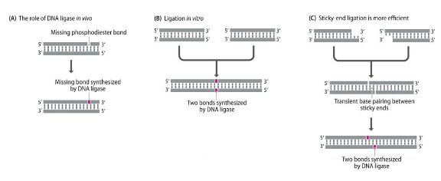
DNA fragments that have been generated by treatment with a restriction endonuclease can be joined back together again or attached to a new partner by a DNA ligase. The reaction requires energy, which is provided by adding either ATP or nicotinamide adenine dinucleotide (NAD) to the reaction mixture, depending on the type of ligase used.
The most widely used DNA ligase is obtained from E. coli cells infected with T4 bacteriophage. This enzyme is involved in replication of the phage DNA and is encoded by the T4 genome.
In order to join together two restriction fragments, the ligase has to synthesize two phosphodiester bonds, one in each strand. This is by no means beyond the capabilities of the enzyme, but the reaction can occur only if the ends to be joined come close enough to one another by chance: the ligase is not able to catch hold of them and bring them together. If the two molecules have complementary sticky ends, and the ends come together by random diffusion events in the ligation mixture, then transient base pairs might form between the two overhangs. These base pairs are not particularly stable, but they may persist for sufficient time for a ligase enzyme to attach to the junction and synthesize phosphodiester bonds to fuse the ends together. If the molecules are blunt-ended, then they cannot base-pair to one another, not even temporarily, and ligation is a much less efficient process, even when the DNA concentration is high and ends are in relatively close proximity.

Slide 14
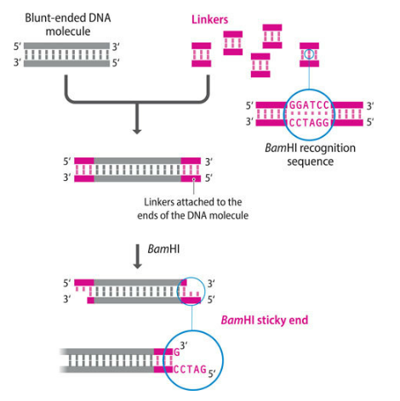
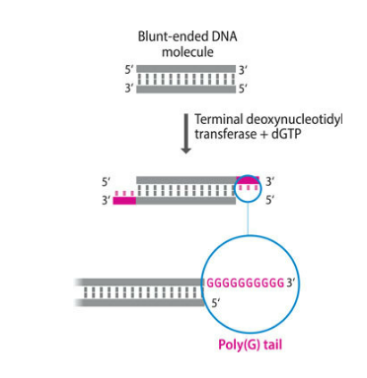
The greater efficiency of sticky-end ligation has stimulated the development of methods for converting blunt ends into sticky ends. In one method, short double-stranded molecules called linkers or adaptors
Another way to create a sticky end is by homopolymer tailing, in which nucleotides are added one after the other to the 3′-terminus at a blunt end. The enzyme involved is called terminal deoxynucleotidyl transferase, obtained from calf thymus tissue, is one example of an end-modification enzyme. It is, in fact, a template-independent DNA polymerase, because it is able to extend a DNA polynucleotide without base pairing
Two other end-modification enzymes are also frequently used. These are alkaline phosphatase (from Arctic shrimp - removes phosphate from the 5′-ends – used in PCR product purification) and T4 polynucleotide kinase (from E. coli cells infected with T4 bacteriophage - adds phosphates to 5′-ends – used is in the end-labeling of DNA molecules), which act in complementary ways.

Slide 15

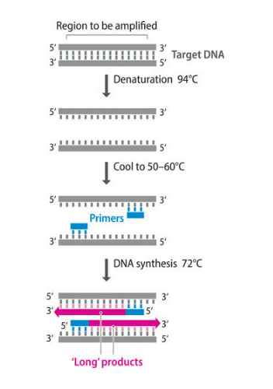
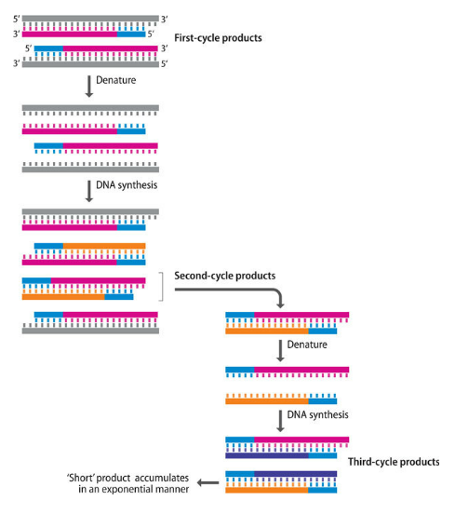
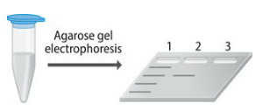
2.2 THE POLYMERASE CHAIN REACTION
Although methods with similar outcomes were suggested as early as 1971, the invention of PCR is now credited to Kary Mullis, who describes how he experienced a eureka moment one evening in early 1983 as he drove along the Pacific Coast Highway in California. His brainwave was an exquisitely simple technique that results in repeated copying of a selected segment of a longer DNA molecule.

Slide 16
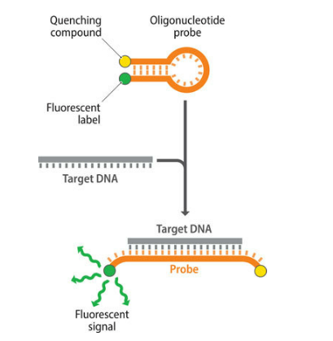
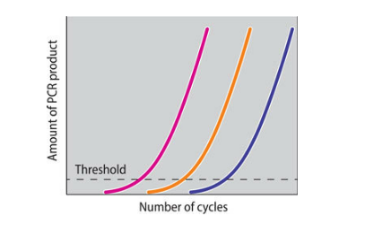
It is also possible to follow synthesis of the product as the PCR proceeds through its series of cycles. This is called real-time PCR, and it can be carried out in two different ways. In the simplest method, a dye that gives a fluorescent signal when it binds to double-stranded DNA is included in the PCR mixture. The gradual increase in the fluorescent signal given out by the mixture indicates the rate at which the product is being synthesized.
The second method for real-time PCR requires a short oligonucleotide called a reporter probe, which gives a fluorescent signal when it hybridizes to the PCR product. Because the probe hybridizes only to the PCR product, this method avoids the problems caused by primer–primer annealing.
Both methods can be used as the basis for quantitative PCR, which enables the amount of target DNA present at the start of the PCR to be measured.

Slide 17
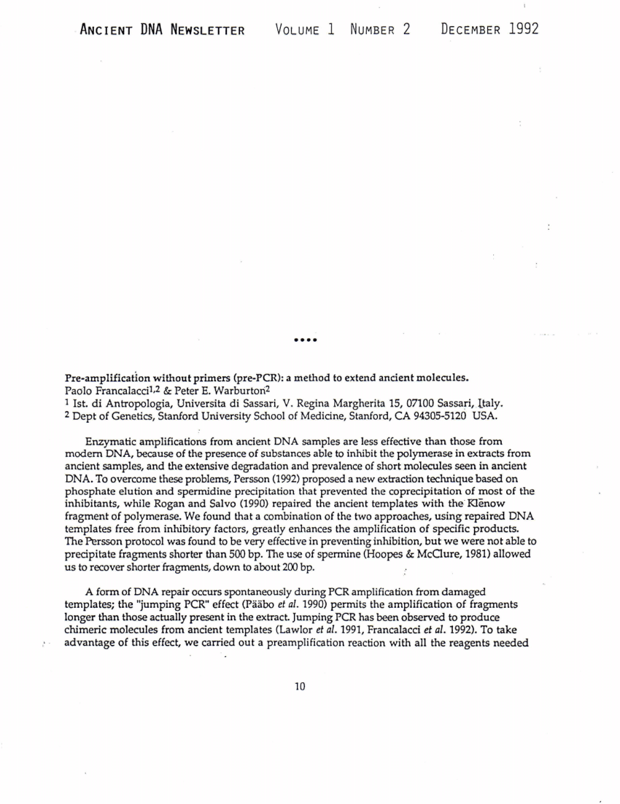
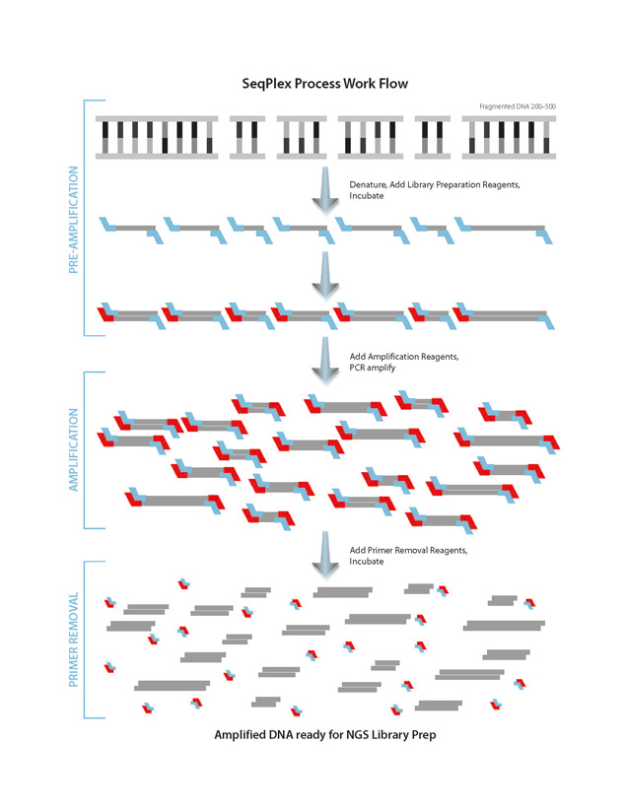
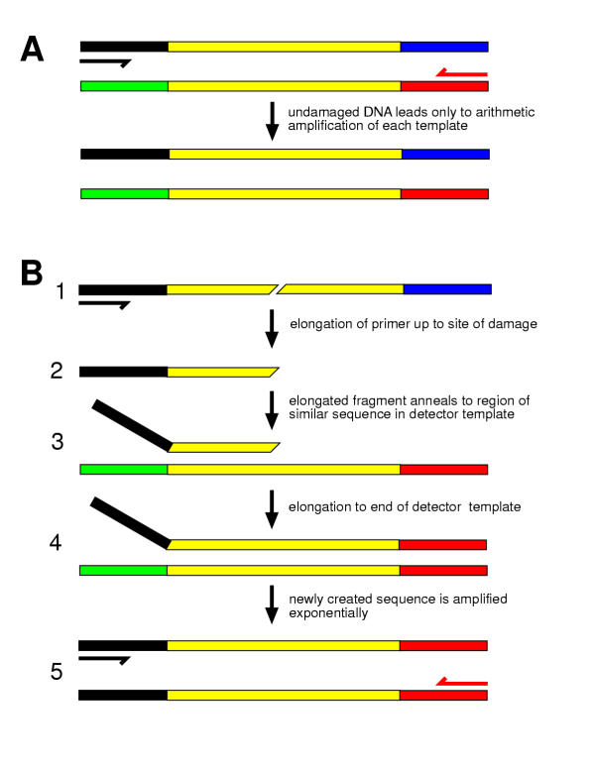

Slide 18
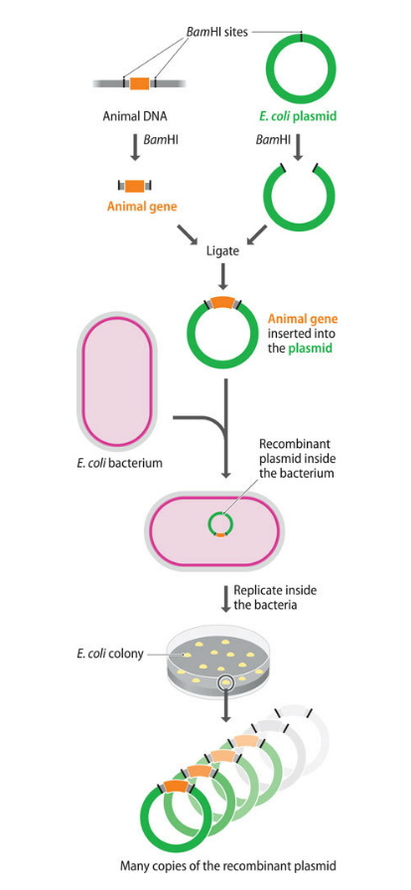
2.3 DNA CLONING
When DNA cloning was first invented in the early 1970s, it revolutionized molecular biology by making possible experiments that previously had been inconceivable. This is because cloning can provide a pure sample of an individual DNA fragment, separated from all the other fragments produced when one or more larger molecules are cut with a restriction enzyme.
Cloning vector
animal gene has been obtained as a single restriction fragment after digestion of a larger molecule with the restriction enzyme BamHI, which leaves 5′-GATC-3′ sticky ends
plasmid—a small circle of DNA capable of replicating inside a bacterium—has been purified from E. coli and treated with BamHI,
If we mix the two DNA molecules together and add DNA ligase, various recombinant ligation products will be obtained, one of which comprises the circularized plasmid with the animal gene inserted into the position originally taken by the BamHI restriction site.

Slide 19
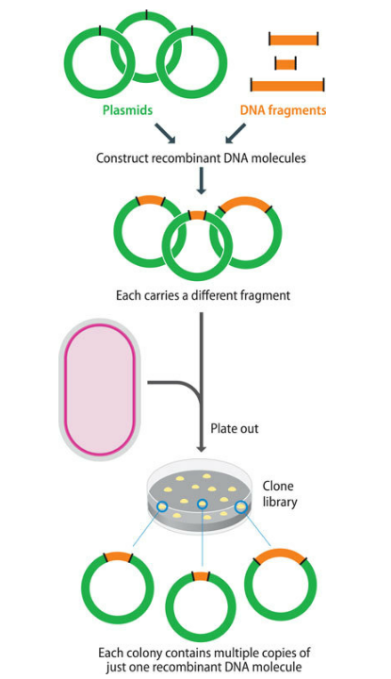
A clone library inserts DNA fragments from different parts of the starting DNA. If enough clones are obtained, then it is possible to have every part of a genome represented in the library.
Clone libraries are important for two reasons. First, it is often possible to identify from within the library the clone or clones that contain the DNA from a single gene, so that gene can be isolated and studied in detail.
Second, a clone library is often the starting point for a genome sequencing project, because by sequencing the individual fragments contained in different clones, the genome sequence can gradually be built up

Slide 20
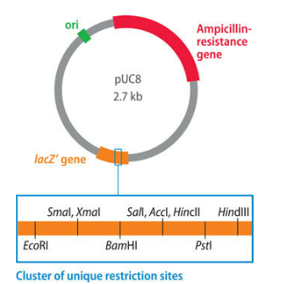
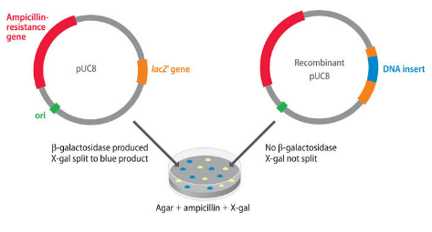
Plasmids replicate efficiently in their bacterial hosts because each plasmid possesses an origin of replication that is recognized by the DNA polymerases and other proteins that normally replicate the bacterium’s chromosome. The host cell’s replicative machinery will also propagate a plasmid cloning vector, plus any new genes that have been inserted into it.
Ligation of new DNA into any one of these sites results in insertional inactivation of the gene and hence loss of β-galactosidase activity. This is the key to distinguishing a recombinant plasmid—galactose, the presence of functional β-galactosidase molecules in the cells is checked by a histochemical test with a compound called X-gal (5-bromo-4-chloro-3-indolyl β-D-galactopyranoside), which the enzyme converts into a blue product.
One of the most popular plasmid vectors is pUC8, a member of a series of vectors first introduced in the early 1980s. The pUC series is derived from an earlier cloning vector, pBR322, which was originally constructed by ligating together restriction fragments from three naturally occurring E. coli plasmids: R1, R6.5, and pMB1. pUC8 is a small plasmid, comprising just 2.7 kb. As well as its origin of replication, it carries two genes: the gene for ampicillin resistance, the lacZ′ gene, which codes for part of the enzyme β-galactosidase. This enzyme is involved in the breakdown of lactose to glucose plus galactose.

Slide 21
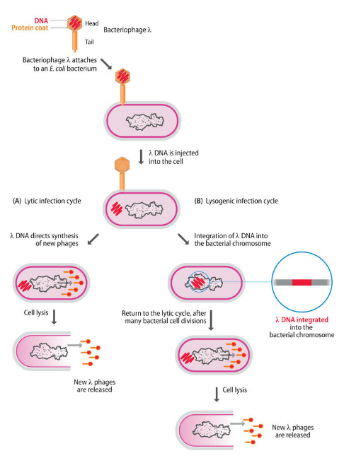
Bacteriophage (or phage) genomes can also be used as cloning vectors because they too possess origins of replication that enable them to be propagated inside bacteria,
The first attempts to develop vectors able to handle larger fragments of DNA centered on the bacteriophage called lambda (λ).
and move on to infect new cells. This is called a lytic infection cycle because it results in lysis of the bacterium. As well as the lytic cycle, λ (unlike many other types of bacteriophage) can also follow a lysogenic infection cycle,
The size of the λ genome is 48.5 kb, of which some 15 kb or so is optional in that it contains genes that are needed only for integration of the phage DNA into the E. coli chromosome

Slide 22
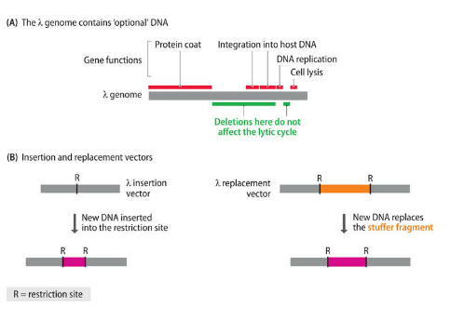
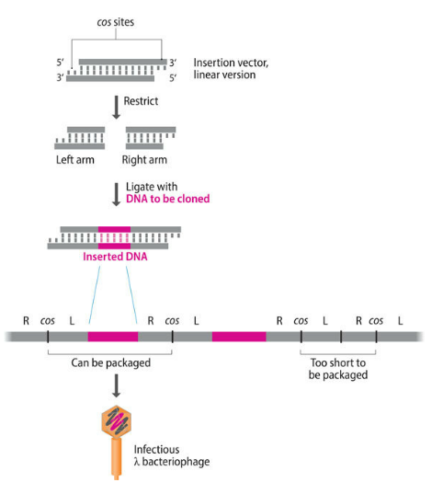
• Insertion vectors, in which part or all of the optional DNA has been removed and a unique restriction site has been introduced at some position within the trimmed-down genome • Replacement vectors, in which the optional DNA is contained within a stuffer fragment, flanked by a pair of restriction sites, that is replaced when the DNA to be cloned is ligated into the vector
The λ genome is linear, but the two natural ends of the molecule have 12-nucleotide single-stranded overhangs, called cos sites (cohesive end site), which have complementary sequences and so can base-pair to one another. A λ cloning vector can therefore be obtained as a circular molecule that can be manipulated in the test tube in the same way as a plasmid and reintroduced into E. coli by transfection, the term used for uptake of naked phage DNA.
Alternatively, a more efficient uptake system called in vitro packaging can be utilized. This procedure starts with a linear version of the cloning vector, which is cut into two segments, the left and right arms, each with a cos site at one end. Ligation is then carried out with carefully measured quantities of each arm and the DNA to be cloned.

Slide 23
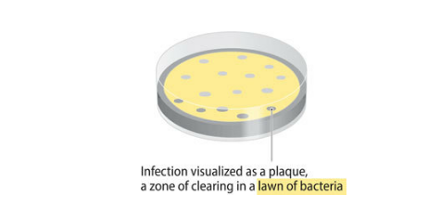
After infection, the cells are spread onto an agar plate. The objective is not to obtain individual colonies but to produce an even layer of bacteria across the entire surface of the agar. Bacteria that were infected with the packaged cloning vector die within about 20 minutes because the λ genes contained in the arms of the vector direct replication of the DNA and synthesis of new phages by the lytic cycle. Each of these new phages contains its own copy of the vector plus cloned DNA. Death and lysis of the bacterium releases these phages into the surrounding medium, where they infect new cells and begin another round of phage replication and lysis. The end result is a zone of clearing, called a plaque, which is visible on the lawn of bacteria that grows on the agar plate. With some λ vectors, all plaques are made up of recombinant phages because ligation of the two arms without insertion of new DNA results in a molecule too short to be packaged. With other vectors, it is necessary to distinguish recombinant plaques from nonrecombinant ones. Various methods are used, including the β-galactosidase system described for the plasmid vector pUC8, which is also applicable to those λ vectors that carry a fragment of the lacZ gene into which the DNA to be cloned is inserted.

Slide 24
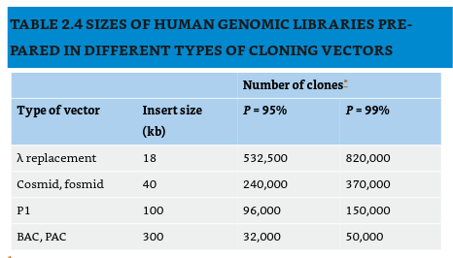
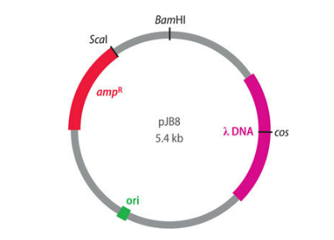
One possibility is to use a cosmid, which is a special type of plasmid that carries a λ cos site. Concatemers of cosmid molecules, linked at their cos sites, act as substrates for in vitro packaging because the cos site is the only sequence that a DNA molecule needs in order to be recognized as a λ genome by the proteins that package DNA into λ phage particles. Particles containing cosmid DNA are as infective as real λ phages, but once inside the cell, the cosmid cannot direct synthesis of new phage particles and instead replicates as a plasmid. Recombinant DNA is therefore obtained from colonies rather than plaques. A cosmid can be 8 kb or less in size, so up to 44 kb of new DNA can be inserted
Vectors for longer pieces of DNA
If a λ vector is used with human DNA, then over half a million clones are needed for there to be a 95% chance of any particular part of the genome being present in the library

Slide 25
Bacterial artificial chromosomes, or BACs, are based on the naturally occurring F plasmid of E. coli. Unlike the plasmids used to construct the early cloning vectors, the F plasmid is relatively large, and vectors based on it have a higher capacity for inserted DNA. BACs are designed so that recombinants can be identified by Lac selection
They can clone fragments of 300 kb and longer, and the inserts are very stable. BACs were used extensively in the Human Genome Project, and they are currently the most popular vectors for cloning large pieces of DNA.
Bacteriophage P1 vectors are very similar to λ. P1 has the advantage over λ that it is able to squeeze 110 kb of DNA into its capsid structure
P1-derived artificial chromosomes, or PACs, combine features of P1 vectors and BACs and have a capacity of up to 300 kb.
Fosmids contain the F plasmid origin of replication and a λ cos site. They are similar to cosmids in the way they are used and in their capacity for inserted DNA, but they have a lower copy number in E. coli, which means that they are less prone to instability problems.

Slide 26
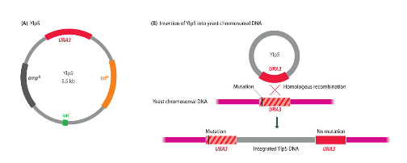
Cloning is not merely a means of producing DNA for sequencing and other types of analysis. It is also the central part of techniques that are used to identify the function of an unknown gene and to study its mode of expression and the way in which its expression is regulated.
When the correct clone has been identified, the recombinant YIp5 construct is purified and transferred into S. cerevisiae, usually by mixing the DNA with protoplasts, which are yeast cells whose walls have been removed by enzyme treatment. Without an origin of replication, the vector is unable to propagate independently inside yeast cells, but it can survive if it becomes integrated into one of the yeast chromosomes, which can occur by homologous recombination between the URA3 gene carried by the vector and the chromosomal copy of this gene. YIp in fact stands for yeast integrative plasmid.
Cloning vectors based on plasmids or phages have been developed for most of the well-studied species of bacteria, such as Bacillus, Streptomyces, and Pseudomonas; these vectors are used in exactly the same way as the E. coli analogs. Plasmid vectors are also available for yeasts and fungi.
An example is YIp5, an S. cerevisiae vector that is simply an E. coli plasmid that contains a copy of the yeast gene called URA3. The presence of the E. coli origin means that YIp5 is a shuttle vector that can be used with either E. coli or S. cerevisiae as the host. This is a useful feature because cloning in S. cerevisiae is a relatively inefficient process

Slide 27
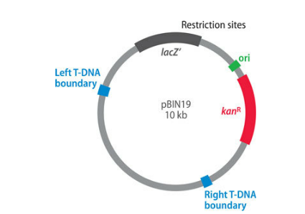
the most interesting types of plant cloning vector are those derived from the Ti plasmid, a large bacterial plasmid found in the soil microorganism Agrobacterium tumefaciens. Part of the Ti plasmid, the region called the T-DNA, becomes integrated into a plant chromosome when the bacterium infects a plant stem and causes crown gall disease. The T-DNA carries a number of genes that are expressed inside the plant cells and induce the various physiological changes that characterize the disease.
Integration into chromosomal DNA is also a feature of many of the cloning systems used with animals and plants, and it forms the basis of the construction of knockout mice, which have been used to identify the functions of previously unknown genes discovered in the human genome. The vectors are animal equivalents of YIps.
Bacterial plasmids can be introduced into plant embryos by bombardment with DNA-coated microprojectiles, a process called biolistics. Integration of plasmid DNA into the plant chromosomes, followed by growth of the embryo, results in a plant that contains the cloned DNA in most or all of its cells.
Vectors such as pBIN19 have been designed to make use of this natural genetic engineering system.

