Slide 1
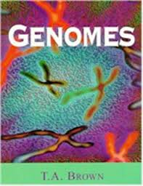
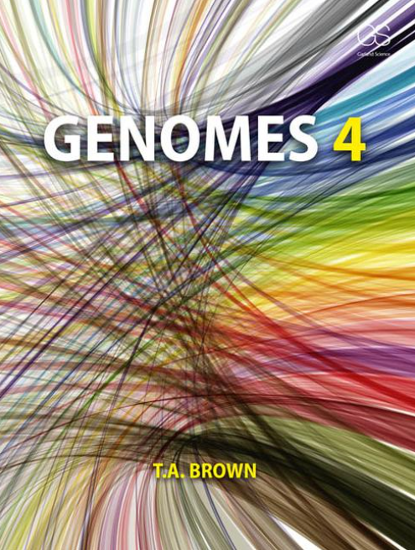
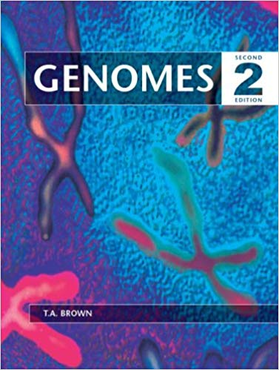
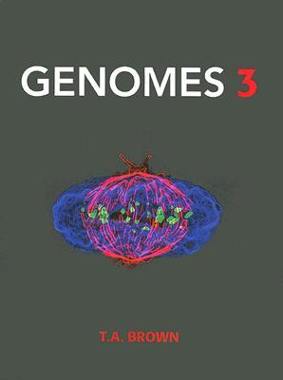
This book is about genomes and genome expression. It explains how genomes are studied (Part I), how they are organized (Part II), how they function (Part III), and how they replicate and evolve (Part IV).
It was not possible to write this book until quite recently. Since the 1950s, molecular biologists have studied individual genes or small groups of genes, and from these studies they have built up a wealth of knowledge about how genes work. But only during the last few years have techniques been available that make it possible to examine entire genomes.
Individual genes are still intensively studied, but information about them is now interpreted within the context of the genome as a whole. No longer is it sufficient simply to understand individual biochemical pathways or subcellular processes.
The challenge now is provided by systems biology, which attempts to link together these pathways and processes into networks that describe the overall functioning of living cells and living organisms.
1999
2002
2006
2017

Slide 2
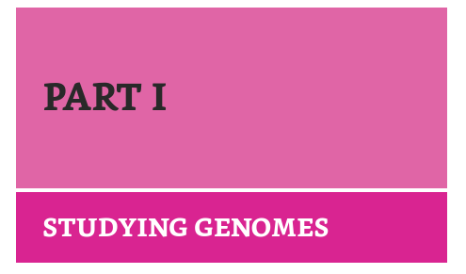
CHAPTER 1 GENOMES, TRANSCRIPTOMES, AND PROTEOMES CHAPTER 2 STUDYING DNA
CHAPTER 3 MAPPING GENOMES
CHAPTER 4 SEQUENCING GENOMES
CHAPTER 5 GENOME ANNOTATION
CHAPTER 6 IDENTIFYING GENE FUNCTIONS

Slide 3
CHAPTER 1 GENOMES, TRANSCRIPTOMES, AND PROTEOMES
1.1 DNA Genes are made of DNA. DNA is a polymer of nucleotides. The double helix is stabilized by base pairing and base stacking. The double helix has structural flexibility
1.2 RNA AND THE TRANSCRIPTOME. RNA is a second type of polynucleotide. The RNA content of the cell Many RNAs are synthesized as precursor molecules. There are different definitions of the transcriptome
1.3 PROTEINS AND THE PROTEOME. There are four hierarchical levels of protein structure. Amino acid diversity underlies protein diversity. The link between the transcriptome and the proteome. The genetic code is not universal. The link between the proteome and the biochemistry of the cell.

Slide 4
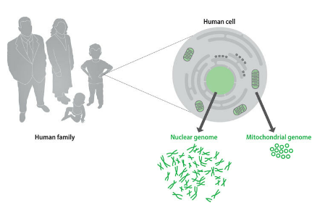
Every organism possesses a genome (complete set of genes or genetic material present in a cell or organism) that contains the biological information needed to construct and maintain a living example of that organism. Most genomes, including the human genome and those of all other cellular life forms, are made of DNA (deoxyribonucleic acid), but a few viruses have RNA (ribonucleic acid)
The human genome, which is typical of the genomes of all multicellular animals, consists of two distinct parts
The nuclear genome comprises approximately 3,235,000,000 base pairs of DNA, divided into 24 linear molecules, the shortest 48,000,000 base pairs in length and the longest 250,000,000 base pairs, each contained in a different chromosome. These 24 chromosomes consist of 22 autosomes and the two sex chromosomes, X and Y. Altogether, some 45,500 genes are present in the human nuclear genome.
The mitochondrial genome is a circular DNA molecule of 16,569 base pairs, up to 10 copies of which are present in each of the energy-generating organelles called mitochondria. The human mitochondrial genome contains just 37 genes.
Each of the approximately 10¹³ cells in the adult human body has its own copy or copies of the nuclear genome, the only exceptions being those few cell types, such as red blood cells, that lack a nucleus in their fully differentiated state. The vast majority of cells are diploid and so have two copies of each autosome, plus two sex chromosomes, XX for females or XY for males—46 chromosomes in all.

Slide 5
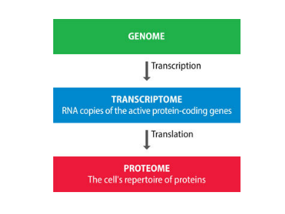
The initial product of genome expression is the transcriptome, a collection of RNA molecules derived from those genes that are active in the cell at a particular time.
The second product of genome expression is the proteome, the cell’s repertoire of proteins, which specifies the nature of the biochemical reactions that the cell is able to carry out. The proteins that make up the proteome are synthesized by translation of some of the individual RNA molecules present in the transcriptome.
The challenge now is provided by systems biology, which attempts to link together these pathways and processes into networks that describe the overall functioning of living cells and living organisms.

Slide 6
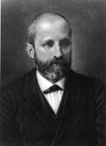
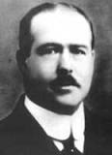
1.1 DNA
DNA was discovered in 1869 by Friedrich Miescher, a Swiss biochemist working in Tübingen, Germany. The first extracts that Miescher made from human white blood cells were crude mixtures of DNA and chromosomal proteins, but the following year he moved to Basel, Switzerland (where the research institute named after him is now located), and prepared a pure sample of nucleic acid from salmon sperm. Miescher’s chemical tests showed that DNA is acidic and rich in phosphorus and also suggested that the individual molecules are very large
As early as 1903, Walter S. Sutton had realized that the inheritance patterns of genes parallel the behavior of chromosomes during cell division, an observation that led to the chromosome theory, the proposal that genes are located in chromosomes.
Examination of cells by cytochemistry, which makes use of stains that bind specifically to just one type of biochemical, showed that chromosomes are made of DNA and protein, in roughly equal amounts. Biologists at that time recognized that billions of different genes must exist and the genetic material must therefore be able to take many different forms. But this requirement appeared not to be satisfied by DNA, because in the early part of the twentieth century it was thought that all DNA molecules were the same. On the other hand, it was known, correctly, that proteins are highly variable, polymeric molecules, each one made up of a different combination of 20 chemically distinct amino acid monomers. Genes simply had to be made of protein, not DNA

Slide 7



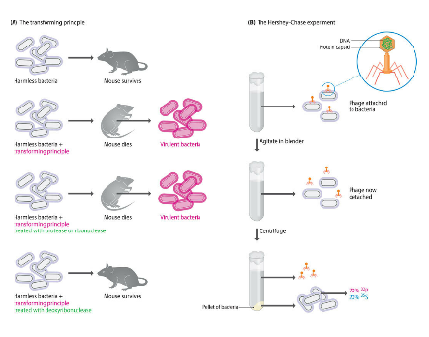
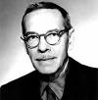
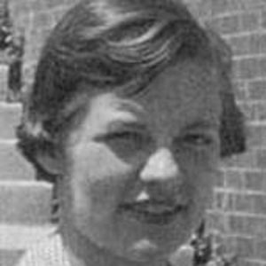
By the late 1930s it had become accepted that DNA, like protein, has immense variability.
Oswald Avery, Colin MacLeod, and Maclyn McCarty (1944) showed that DNA is the active component of the transforming principle, a bacterial cell extract that, when mixed with a harmless strain of Streptococcus pneumoniae, converts these bacteria into a virulent form.
Transformation involves transfer of genes from the cell extract into the living bacteria: bacterial genes must be made of DNA.
Alfred Hershey and Martha Chase (1952) used radiolabeling to show that when a bacterial culture is infected with bacteriophages (also called phages, a type of virus), DNA is the major component of the bacteriophages that enters the cells: the genes of these bacteriophages must be made of DNA.

Slide 8
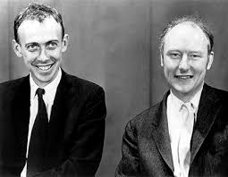
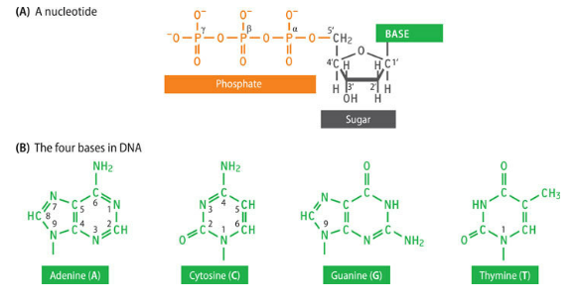
The names of James Watson and Francis Crick are so closely linked with DNA that it is easy to forget that when they began their collaboration in October 1951, the detailed structure of the DNA polymer was already known. Their contribution was not to determine the structure of DNA per se but to show that in living cells two DNA chains are intertwined to form the double helix. First, therefore, we should examine what Watson and Crick knew before they began their work.
A 2′-Deoxyribose, which is a pentose, a type of sugar composed of five carbon atoms. These five carbons are numbered 1′ (spoken as one-prime), 2′, and so on. The name 2′-deoxyribose indicates that this particular sugar is a derivative of ribose, in which the hydroxyl (-OH) group attached to the 2′-carbon of ribose has been replaced by a hydrogen (-H) group.
A nitrogenous base, one of cytosine or thymine (single-ring pyrimidines) or adenine or guanine (double-ring purines). The base is attached to the 1′-carbon of the sugar by a β-N-glycosidic bond attached to nitrogen number one of the pyrimidine or number nine of the purine.
A phosphate group, comprising one, two, or three linked phosphate units attached to the 5′-carbon of the sugar. The phosphates are designated α, β, and γ, with the α-phosphate being the one directly attached to the sugar.
A molecule made up of just the sugar and base is called a nucleoside; addition of the phosphates converts this to a nucleotide.
The abbreviations of these four nucleotides are dATP, dCTP, dGTP, and dTTP, respectively, or when referring to a DNA sequence, A, C, G, and T, respectively.

Slide 9
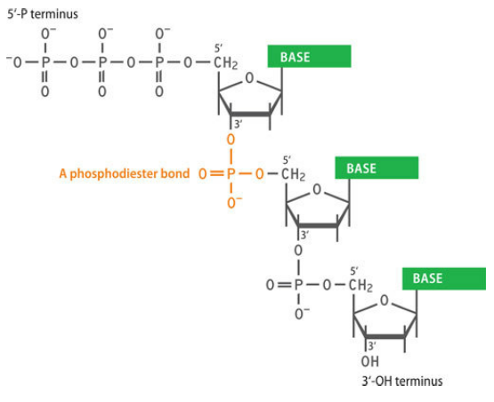
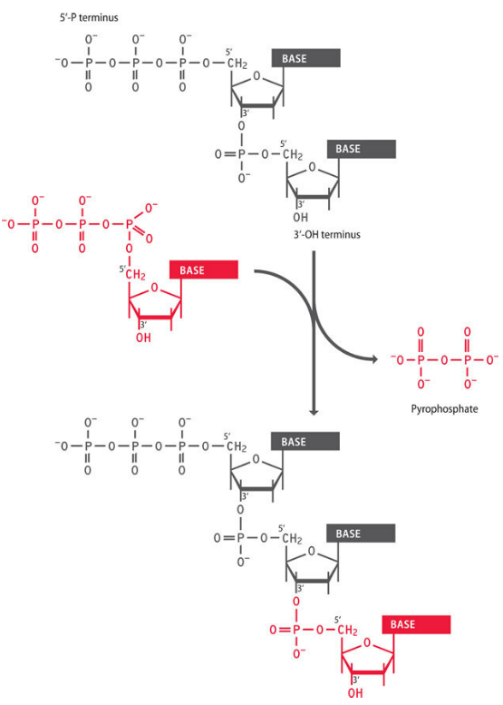
In a polynucleotide, individual nucleotides are linked together by phosphodiester bonds between their 5′- and 3′-carbons.
Note that the two ends of the polynucleotide are chemically distinct, one having an unreacted triphosphate group attached to the 5′-carbon (the 5′- or 5′-P terminus) and the other having an unreacted hydroxyl attached to the 3′-carbon (the 3′- or 3′-OH terminus).
This means that the polynucleotide has a chemical direction, expressed as either 5′→ 3′ or 3′ → 5′.
The DNA polymerase enzymes present in living organisms are only able to carry out 5′ → 3′ synthesis, which adds significant complications to the process by which double-stranded DNA is replicated

Slide 10
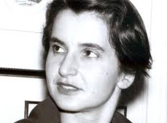
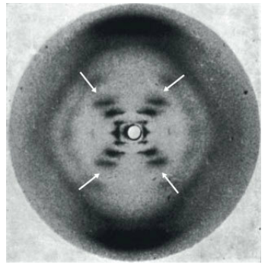
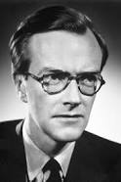
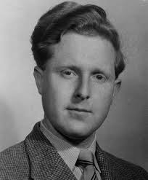
The double helix, discovered by Watson and Crick on Saturday, March 7, 1953, was the single most important breakthrough in biology during the twentieth century. The discovery of the double helix can be looked on as one of the first multidisciplinary biological research projects.
Watson and Crick used four quite different types of information to deduce the double-helix structure:
1) X-ray diffraction patterns, most of which were produced by Rosalind Franklin (colleague of Maurice Wilkins and Raynold Gosling), who was herself very close to solving the structure, revealed the detailed helical structure.
The cross shape indicates that DNA has a helical structure, and the extent of the shadowing within the diamond spaces above, below, and to either side of the cross show that the sugar–phosphate backbone is on the outside of the helix. The positions of the various smears that make up the arms of the cross enable dimensions such as the diameter, rise per base pair, and pitch of the molecule to be calculated. The missing smears (the gap in each arm of the cross, marked by the arrows) indicate the relative positioning of the two polynucleotides. These missing smears enabled Watson and Crick to recognize that there are two grooves of different depths on the outer surface of the helix

Slide 11
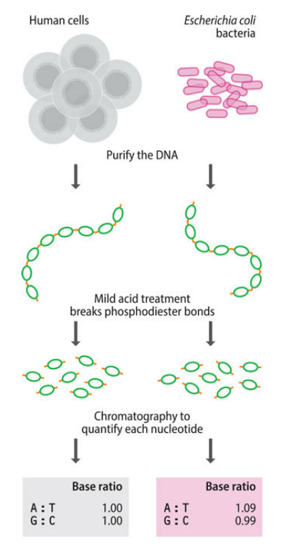
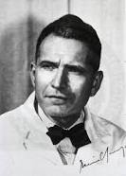

2) The base ratios, which had been discovered by Erwin Chargaff (1950) of Columbia University in New York, enabled the pairing between the polynucleotides in the helix to be deduced. Chargaff had carried out a lengthy series of chromatographic studies of DNA samples from various sources and showed that although the values are different in different organisms, the amount of adenine is always the same as the amount of thymine and the amount of guanine equals the amount of cytosine. The key to the discovery of the double-helix structure.
DNA was extracted from various organisms and treated with acid to hydrolyze the phosphodiester bonds and release the individual nucleotides. Each nucleotide was then quantified by chromatography.
3) Biophysical data of various kinds were used to infer some of the key features of the structure. The water content of DNA fibers was particularly important because it enabled the density of the DNA in a fiber to be estimated. The number of strands in the helix and the spacing between the nucleotides had to be compatible with the fiber density. Linus Pauling’s triple-helix model was based on an incorrect density measurement that suggested that the DNA molecule was more closely packed than is actually the case.

Slide 12
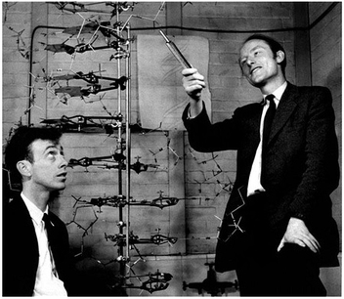
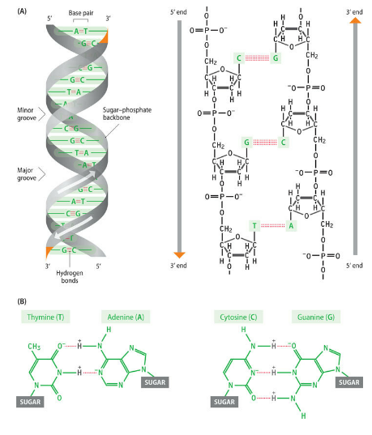
1) The construction of scale models of possible DNA structures, which was the only major technique that Watson and Crick performed themselves, enabled the relative positioning of the various atoms to be checked, to ensure that pairs that formed bonds were not too far apart and that other atoms were not so close together as to interfere with one another.
The double helix is right-handed, which means that if it were a spiral staircase and you were climbing upward, then the rail on the outside of the staircase would be on your right-hand side. The two strands run in opposite directions
Base pairing between the two strands involves the formation of hydrogen bonds between an A on one strand and a T on the other strand, or between a C and a G. Hydrogen bonds are weak electrostatic interactions between an electronegative atom (such as oxygen or nitrogen) and a hydrogen atom attached to a second electronegative atom.
Base stacking involves hydrophobic forces between adjacent base pairs and adds stability to the double helix once the strands have been brought together by base pairing. It is sometimes called π–π interactions, because it is thought to involve the p electrons associated with the double bonds structures. However, this hypothesis is now being questioned, and the possibility that base stacking involves a type of electrostatic interaction is being explored.
DNA replication can result in perfect copies of a parent molecule through the simple expedient of using the sequences of the preexisting strands to dictate the sequences of the new strands. This is template-dependent DNA synthesis

Slide 13
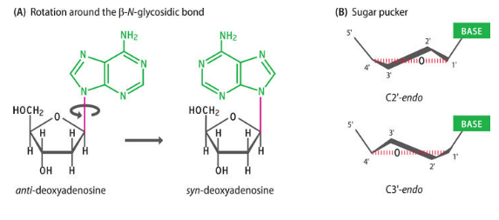
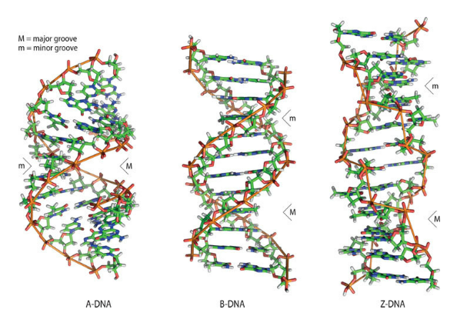
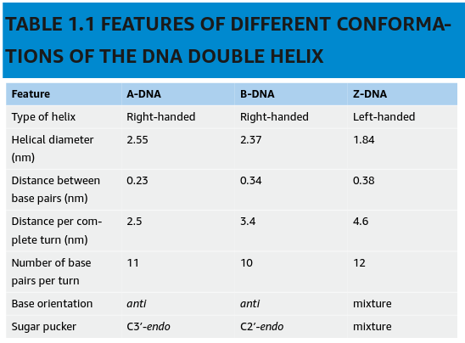
The double helix described by Watson and Crick is called the B-form of DNA or B-DNA. Its characteristic features lie in its dimensions: a helical diameter of 2.37 nm, a rise of 0.34 nm per base pair, and a pitch (the distance taken up by a complete turn of the helix) of 3.4 nm, corresponding to 10 base pairs (bp)per turn. The DNA in living cells is thought to be predominantly in this B-form, but it is now clear that genomic DNA molecules are not entirely uniform in structure.
Rotation around the β-N-glycosidic bond changes the orientation of the base relative to the sugar: the two possibilities are called the anti- and syn-conformations
Sugar pucker refers to the three-dimensional shape of the sugar. The ribose component of the nucleotide does not have a planar structure: when it is viewed from the side, one or two of the carbon atoms are either above or below the plane of the sugar
A modified version of the double helix called A-DNA has a diameter of 2.55 nm, a rise of 0.23 nm per base pair, and a pitch of 2.5 nm, corresponding to 11 base pairs per turn
A more drastic reorganization is also possible, leading to the left-handed Z-DNA, in which the sugar–phosphate backbone adopts an irregular zigzag conformation. Z-DNA is a more tightly wound version of the double helix with 12 bp per turn and a diameter of only 1.84 nm. It is known to occur in regions of a double helix that contain repeats of the motif GC

Slide 14
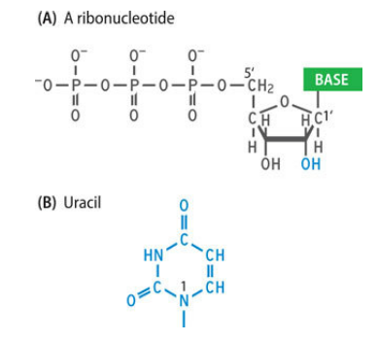
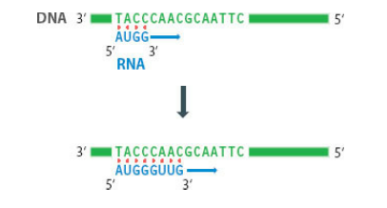
1.2 RNA AND THE TRANSCRIPTOME
The initial product of genome expression is the transcriptome, the collection of RNA molecules derived from those genes that are active in the cell at a particular time. The RNA molecules of the transcriptome are synthesized by the process called transcription.
The chemical differences between DNA and RNA. (A) RNA contains ribonucleotides, in which the sugar is ribose rather than 2′-deoxyribose. The difference is that a hydroxyl group, rather than a hydrogen atom, is attached to the 2′-carbon. (B) RNA contains the pyrimidine called uracil instead of thymine.
Nucleotides are abbreviated as ATP, CTP, GTP, and UTP or as A, C, G, and U, respectively. As with DNA, RNA polynucleotides contain 3′–5′ phosphodiester bonds, but these phosphodiester bonds are less stable than those in a DNA polynucleotide because of the indirect effect of the hydroxyl group at the 2′-position of the sugar. RNA molecules are rarely more than a few thousand nucleotides in length.
Although many form intramolecular base pairs, most are single- rather than double-stranded.
The enzymes responsible for transcription of DNA into RNA are called DNA-dependent RNA polymerases.
RNA-dependent RNA polymerases that are involved in replication and expression of some viral genomes.

Slide 15
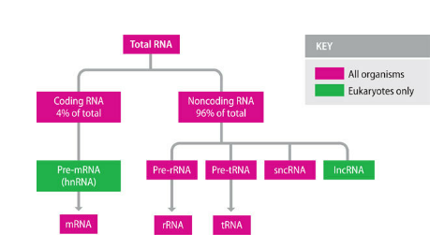
A typical bacterium contains 0.05–0.10 pg of RNA, making up about 6% of its total weight.
A mammalian cell, being much larger, contains more RNA, 20–30 pg in all, but this represents only 1% of the cell as a whole.
Coding RNA is made up of just one class of molecule, the messenger RNAs (mRNAs), which are transcripts of protein-coding genes and hence are translated into protein in the second stage of genome expression. Messenger RNAs rarely make up more than 4% of the total RNA and are short-lived, being degraded soon after synthesis (in eukaryotes most mRNAs are degraded within a few hours after synthesis). This rapid turnover means that the mRNA composition of the cell is not fixed.
Noncoding RNA, molecules are not translated into protein. An alternative name is functional RNA, which emphasizes that the noncoding RNAs still have essential roles within the cell. An alternative name is functional RNA, which emphasizes that the noncoding RNAs still have essential roles within the cell.
Ribosomal RNAs (rRNAs) are present in all organisms and are usually the most abundant RNAs in the cell, making up over 80% of the total RNA
Transfer RNAs (tRNAs) are small molecules that are also involved in protein synthesis
Short noncoding RNAs (sncRNAs), comprising RNAs less than 200 nucleotides in length
Long noncoding RNAs (lncRNAs), made up of molecules longer than 200 nucleotides.

Slide 16
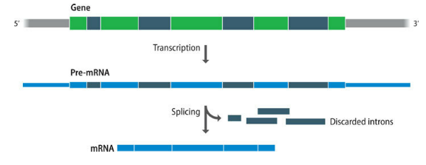
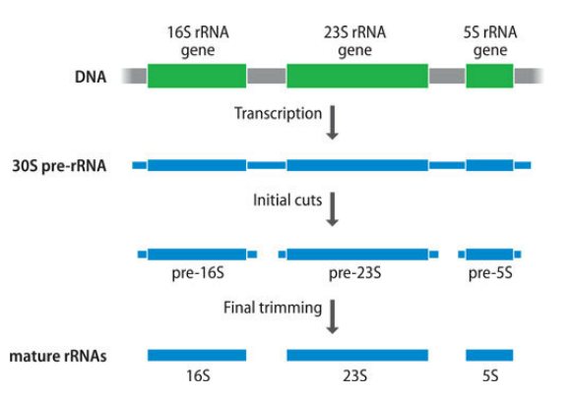
As well as the mature RNAs described above, cells also contain precursor molecules. Many RNAs, especially in eukaryotes, are initially synthesized as precursor or pre-RNA, which has to be processed in order to release the functional molecules.
Splicing. Some eukaryotic genes contain internal segments that are copied during transcription but then excised from the pre-RNA. These excised segments are called introns, in contrast to the exons.
Splicing occurs in the nucleus, where the unspliced pre-mRNA forms the nuclear RNA fraction called heterogeneous nuclear RNA (hnRNA).
Splicing is not the only type of cutting event that occurs during processing of pre-RNA. Many rRNAs and tRNAs are initially synthesized as precursors that contain copies of more than one molecule. The pre-rRNAs and pre-tRNAs must therefore be cut into pieces to produce the mature RNAs. This type of processing occurs in both prokaryotes and eukaryotes.

Slide 17
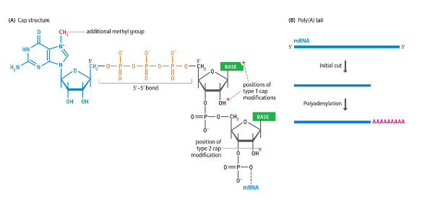
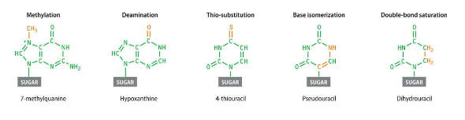
Other processing events result in changes occurring at the ends of RNA molecules. These end modifications occur during the synthesis of eukaryotic mRNAs, most of which have a structure called a cap attached at the 5′-end and a poly(A) tail attached to the 3′-end.
The cap structure comprises the modified nucleotide called 7-methylguanosine attached to the first nucleotide in the pre-mRNA by an unusual triple-phosphate bond. The cap structure is needed to help initiate translation of the mRNA into a protein.
The poly(A) tail is a series of up to 250 adenine nucleotides that are present at the 3′-end of the mRNA. The pre-mRNA is cut at a position close to its 3′-end, and the adenines are added to this new end by a template-independent RNA polymerase called poly(A) polymerase. The function of this polyadenylation process is not fully understood, but we do know that if the poly(A) tail is absent or shorter than usual, then the mRNA is degraded.
The final type of processing event is chemical modification.
The reasons for many of these modifications are unknown, but functions have been assigned for specific cases. In tRNA, some of the modified nucleotides are recognized by the enzymes that attach an amino acid to the 3′- end of the molecule.

Slide 18
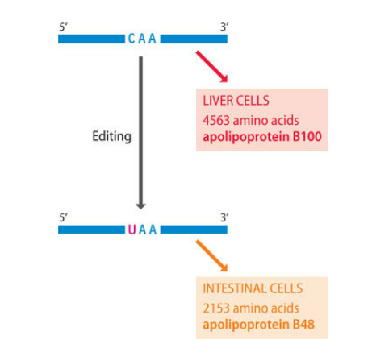
A few eukaryotic mRNAs also undergo chemical modification. This process, called RNA editing, is uncommon but important because it can change the biological information in an mRNA in such a way that the protein coded by the mRNA has an altered structure.
Human mRNA for apolipoprotein B. There are two versions of this protein: apolipoprotein B48, which is synthesized by intestinal cells, and apolipoprotein B100, which is about twice the size of B48 and is made in the liver. Both proteins are involved in the transport of lipids around the body, but their exact roles are different. The B48 protein forms part of the transport structure called a chylomicron, and B100 combines with other proteins to form a complex called a very low density lipoprotein.
Both types of apolipoprotein B are specified by the same gene, but in intestinal cells a cytosine at position 6666 in the 14,000-nucleotide mRNA is edited by deamination. This change is sufficient to convert the mRNA for apolipoprotein B100 into an mRNA specifying apolipoprotein B48.
Deamination of a cytosine of the mRNA converts this nucleotide into U, creating a termination codon (a signal for termination of translation). A shortened form of apolipoprotein B is therefore synthesized in intestinal cells.

Slide 19
The term transcriptome, when first introduced in 1997, was initially used to describe just the mRNA component. The mRNA makes up less than 4% of the total cell RNA but is often looked on as the most significant component because it comprises the coding RNAs that are used in the next stage of genome expression.
Many of the early studies of transcriptomes aimed to identify all, or as many as possible, of the mRNAs in a cell, in order to understand the overall pattern of gene expression and how that pattern changes when, for example, a cell becomes cancerous.
The broader definition of the transcriptome to include all the RNA in a cell reflects our growing awareness of the important roles that noncoding RNAs play in specifying the biochemical properties of a cell. In particular, the sncRNAs called microRNAs (miRNAs) regulate gene expression in eukaryotic cells by degrading those mRNAs whose products are no longer needed.
Human cells are able to make about 1000 miRNAs, each one specific for a single mRNA or small group of mRNAs. Understanding which miRNAs are synthesized in a particular cell, and how the pattern of miRNA synthesis changes in diseased cells, is an essential complement to the equivalent studies of mRNAs.
It is therefore sensible to extend the term transcriptome to include all of the RNA in a cell, because a focus just on mRNA misses the vital role that other parts of the transcriptome play in mediating expression of the biological information contained in the genome.

Slide 20
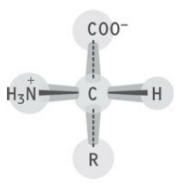
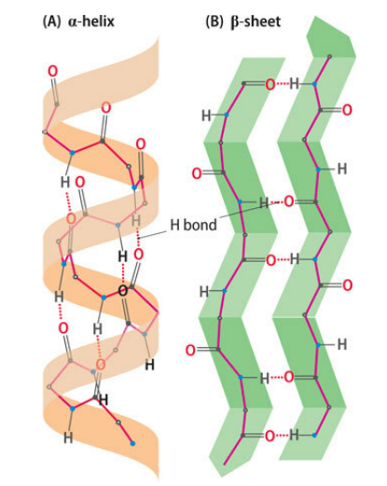
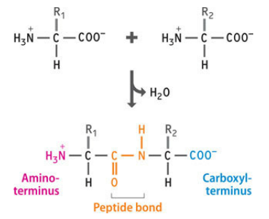
1.3 PROTEINS AND THE PROTEOME
A protein, like a DNA molecule, is a linear, unbranched polymer. In proteins, the monomeric subunits are called amino acids and the resulting polymers, or polypeptides, are rarely more than 2000 units in length. Proteins are traditionally looked upon as having four distinct levels of structure. These levels are hierarchical: meaning the protein is built up stage-by-stage, with each level of structure depending on the one below it.
The primary structure of the protein is formed by joining amino acids into a polypeptide. The amino acids are linked by peptide bonds. Note that, as with a polynucleotide, the two ends of the polypeptide are chemically distinct: one has a free amino group and is called the amino-, NH₂-, or N-terminus; the other has a free carboxyl group and is called the carboxyl-, COOH-, or C-terminus.
The secondary structure refers to the different conformations that can be taken up by the polypeptide. The two main types of secondary structure are the α-helix and β-sheet.
(5’)
(3’)

Slide 21
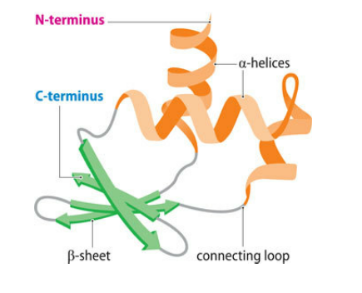
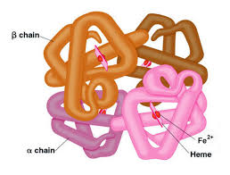
The tertiary structure results from folding the secondary structural components of the polypeptide into a three-dimensional configuration. The tertiary structure is stabilized by various chemical forces, notably hydrogen bonding between individual amino acids, electrostatic interactions between the R groups of charged amino acids, and hydrophobic effects, which dictate that amino acids with nonpolar (water-hating) side groups must be shielded from water by embedding them within the internal regions of the protein. There may also be covalent linkages called disulfide bridges between cysteine amino acid residues at various places in the polypeptide.
The quaternary structure involves the association of two or more polypeptides, each folded into its tertiary structure, into a multisubunit protein. Not all proteins form quaternary structures, but it is a feature of many proteins with complex functions, including several involved in genome expression. Some quaternary structures are held together by disulfide bridges between the different polypeptides, resulting in stable multisubunit proteins that cannot easily be broken down to the component parts. Other quaternary structures comprise looser associations of subunits stabilized by hydrogen bonding and hydrophobic effects, which means that these proteins can revert to their component polypeptides or change their subunit composition, according to the functional requirements of the cell.

Slide 22
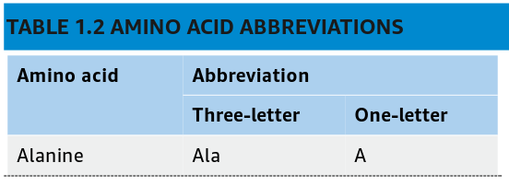
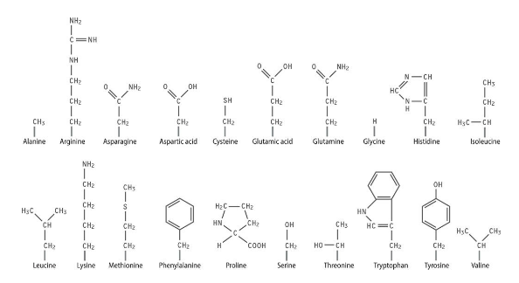
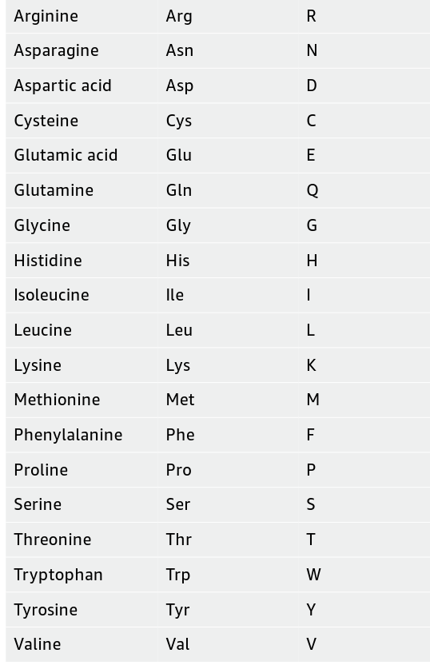
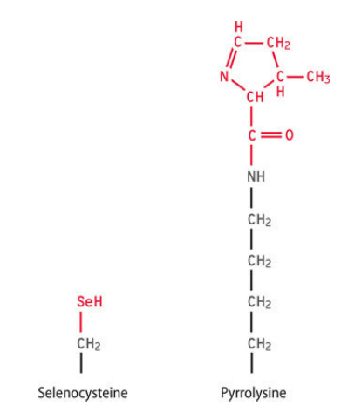
Proteins are functionally diverse because the amino acids from which proteins are made are themselves chemically diverse. Amino acid diversity derives from the R group because this part is different in each amino acid and varies greatly in structure. Proteins are made up from a set of 20 amino acids.
At least two additional amino acids—selenocysteine and pyrrolysine—can be inserted into a polypeptide chain during protein synthesis. Their insertion is directed by a modified reading of the genetic code.
During protein processing, some amino acids are modified by the addition of new chemical groups, for example, by acetylation or phosphorylation, or by attachment of large side chains made up of sugar units.

Slide 23
The proteome comprises all the proteins present in a cell at a particular time. A typical mammalian cell, for example, a liver hepatocyte, is thought to contain 10,000–20,000 different proteins, about 8 × 10⁹ individual molecules in all, representing approximately 0.5 ng of protein or 18–20% of the total cell weight.
The copy numbers of individual proteins vary enormously, from less than 20,000 molecules per cell for the rarest types to 100 million copies for the commonest ones.
Any protein that is present at a copy number of greater than 50,000 per cell is considered to be relatively abundant, and in the average mammalian cell some 2000 proteins fall into this category.
When the proteomes of different types of mammalian cells are examined, very few differences are seen among these abundant proteins, suggesting that most of them are housekeeping proteins that perform general biochemical activities that occur in all cells.
in 1957, Francis Crick cut a way through the confusion by predicting the existence of an adaptor molecule that would form a bridge between the mRNA and the polypeptide being synthesized. Soon afterward it was realized that the tRNAs are these adaptor molecules. Once this fact had been established, attention turned to the ribosomes, the structures within which proteins are synthesized. Gradually, a detailed understanding of the mechanism by which mRNAs are translated into polypeptides was built up.
The genetic code, which specifies how the nucleotide sequence of an mRNA is translated into the amino acid sequence of a protein. It was recognized in the 1950s that a triplet genetic code is required to account for all 20 amino acids found in proteins. The genetic code was worked out in the 1960s, partly by analysis of polypeptides arising from translation of artificial mRNAs of known or predictable sequence in cell-free protein-synthesizing systems

Slide 24
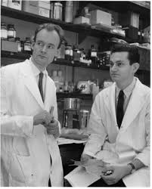
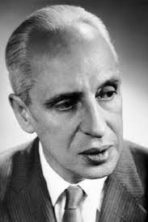
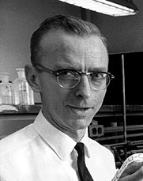
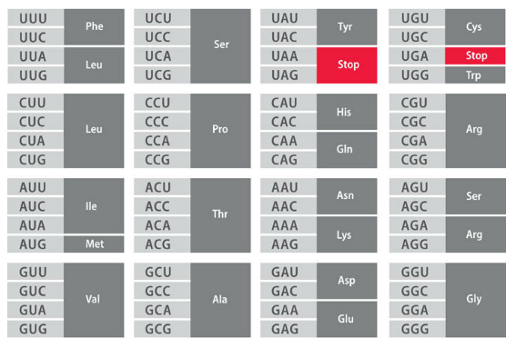
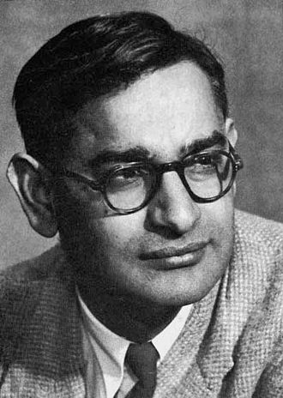
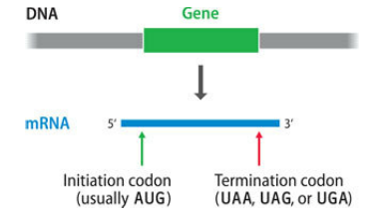
Severo Ochoa
Robert Holley
Marshall Nirenberg
Heinrich Matthaei
Gobinda Khorana
The 64 codons fall into groups, where the members of each group code for the same amino acid. Only tryptophan and methionine have just a single codon each: all other amino acids are coded by two, three, four, or six codons. This feature of the code is called degeneracy.
The code also has four punctuation codons, which indicate the points within an mRNA where translation of the nucleotide sequence should start and finish. The initiation codon is usually 5′-AUG-3′, which also specifies methionine (so most newly synthesized polypeptides start with methionine), although other codons such as 5′-GUG-3′ and 5′-UUG-3′ are also used, especially in bacteria. The three termination codons are 5′-UAG-3′, 5′-UAA-3′, and 5′-UGA-3′.

Slide 25




It was originally thought that the genetic code must be the same in all organisms. The argument was that, once established, it would be impossible for the code to change because giving a new meaning to any single codon would result in widespread disruption of proteins. This reasoning seems sound, so it is surprising that, in reality, the genetic code is not universal. The vast majority of genes in the vast majority of organisms, but deviations are widespread.
This was first discovered in 1979 by Frederick Sanger’s group in Cambridge, who found that several human mitochondrial mRNAs contain the sequence UGA, which normally codes for termination, at internal positions where protein synthesis was not expected to stop.
A more important type of code variation is context-dependent codon reassignment. Proteins containing pyrrolysine are rare and are probably only present in the archaea, but selenoproteins are widespread in many organisms, one example being the enzyme glutathione peroxidase, which helps protect the cells of humans and other mammals against oxidative damage. Selenocysteine is coded by 5′-UGA-3′ and pyrrolysine by 5′-UAG-3′. These codons therefore have a dual meaning because they are still used as termination codons.
Distinguished from true termination codons by the presence of a stem–loop structure in the mRNA,. It is positioned just downstream of the selenocysteine codon the 3′-untranslated region.

Slide 26
The biological information encoded by the genome finds its final expression in a protein whose biological properties are determined by its folded structure and by the spatial arrangement of chemical groups on its surface.
The proteome can play this role because of the huge diversity of protein structures that can be formed, which enables proteins to carry out a variety of biological functions. These functions include the following:
Biochemical catalysis is the role of the special type of proteins called enzymes. The central metabolic pathways, which provide the cell with energy, are catalyzed by enzymes, as are the biosynthetic processes that result in construction of nucleic acids, proteins, carbohydrates, and lipids.
Structure, which at the cellular level is determined by the proteins that make up the cytoskeleton, is also the primary function of some extracellular proteins. An example is collagen, which is an important component of bones and tendons.
Movement is conferred by contractile proteins, of which actin and myosin in cytoskeletal fibers are the best-known examples.
Transport of materials around the body is an important protein activity. For example, hemoglobin transports oxygen in the bloodstream, and serum albumin transports fatty acids.
Regulation of cellular processes is mediated by proteins such as transcription factors that bind to the genome and influence the expression levels of individual genes and groups of genes. The activities of groups of cells are regulated and coordinated by extracellular hormones and cytokines, many of which are proteins (e.g. insulin, the hormone that controls blood sugar levels, and interleukins, a group of cytokines that regulate cell division and differentiation).
Protection of the body and of individual cells is the function of a range of proteins, including antibodies and those proteins involved in the blood-clotting response.
Storage functions are performed by proteins such as ferritin, which acts as an iron store in the liver, and gliadins, which store amino acids in dormant wheat seeds.

