Slide 1
Come si costruisce la memoria coloniale
Rimozione e censura

Slide 2
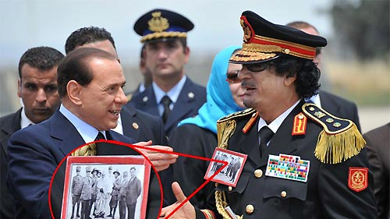

Slide 3
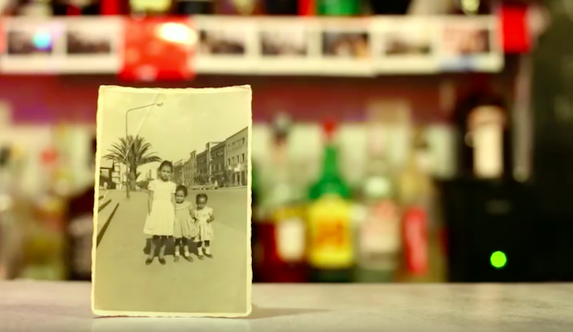
Materiali audiovisivi recenti sulle eredità coloniali
If I only were that warrior, Valerio Ciriaci, 2015 (https://vimeo.com/ondemand/ifonlyiwerethatwarrior)
Asmarina, Medhin Paolos e Alan Maglio, 2015 (https://www.youtube.com/watch?v=SQiKvHr-rcM)
Lavoro su Omar Al-Mukhtar, Alessandra Ferrini e Alessandro Volterra, 2019 (https://vimeo.com/320420338/9fb756bf8e)

