Slide 1
Innovation activities and learning processes in the crisis.
Evidence from Italian international and interregional trade in manufacturing and services
Emanuela Marrocu e Stefano Usai
University of Cagliari and CRENoS
Raffaele Brancati, Manuel Romagnoli
MET-Economia
SIE - SIEPI session
Napoli, 24 ottobre 2015

Slide 2
Motivation / 1
Research in international trade has changed dramatically over the past fifteen years as its focus has shifted from industries and countries to firms and products. This transformation was instigated by the emergence of a wide range of micro-datasets exhibiting sharp variation in firm outcomes and attributes, even within narrow industries. Models developed in reaction to this challenge both rationalize this heterogeneity and offer new insight into the ways in which economies respond to international trade... (Bernard et al., 2012).

Slide 3
Motivation / 2
Export is an issue of self-selection: exporters are more productive because only the most productive firms are able to overcome the sunk costs of entering export markets. The most successful model of such selection is the seminal Melitz (2003) model, which has dominated recent research in the field.
Many research show that exporting firms are not only more productive but also larger, more skill intensive, more innovative …
In particular, the positive association between a firm’s export status and its innovation can be considered as a strong empirical regularity in both international economics and the economics of innovation: a wide consensus has been reached on the fact that firms introducing innovations are ex-post more likely to export.
Evidence for learning to export (especially inter-regionally) and on the importance of other learning phenomena related to regional and sectoral spillovers is sparser and not conclusive.

Slide 4
Theoretical foundations
Old (Hecksher-Ohlin) and New (Krugman) Trade theories do not consider hetereogenous firms because
  in the former case profit maximising firms are just in the background and micro foundations are modest or non existent
  in the latter case firms do not face fixed costs of exporting since trade costs are just a proportion of revenues, and as a result all firms export
The business community would take it as axiomatic that entering export markets incurs sunk costs: market research has to be done; option appraisals completed; existing products have to be modified; new distribution networks set up and so on.
Clerides et al. (1998) were among the first to model this explicitly in a discrete choice framework. Later, Melitz (2003) builds a dynamic industry model with heterogeneous firms operating in (Dixit-Stiglitz) monopolistically competitive industries.

Slide 5
Melitz (2003)
Melitz (2003) builds a dynamic industry model with heterogeneous firms operating in (Dixit-Stiglitz) monopolistically competitive industries.
Firms incur a fixed cost to export. However, each has to make a productivity draw from an exogenous distribution which determines whether they produce and export, and an endogenously determined productivity threshold determines who does and does not export.
The interaction of these raises industry productivity.
  First, there is a rationalisation effect. Exporting increases expected profit, which induces entry, pushes up the productivity threshold for survival and drives out the least efficient firms. Clearly this raises average industry productivity.
  Second, exporting allows the most productive firms to expand and causes less productive firms to contract

Slide 6
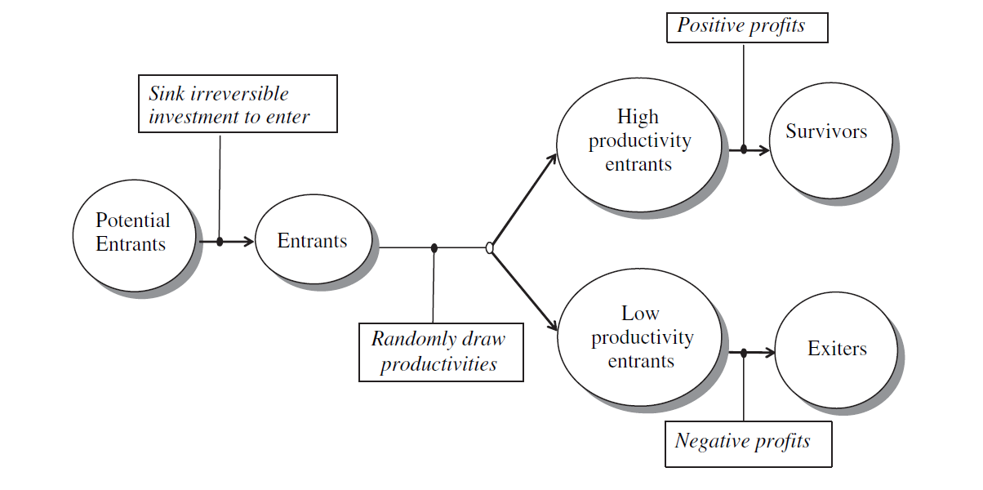

Slide 7
Empirics on firm export performance
Firm export performance has been measured in two ways
  Extensive margin, that is the decision to export or not
  Intensive margin, that is quota of export on sales
Empirical studies exploiting firm-level data have provided wide evidence supporting the role played by productivity and other sources of firm heterogeneity in explaining firm export activity See, among others, Bernard and Jensen, 2004, Sterlacchini, 1999; Basile, 2001; Roper and Love, 2002; Lachenmaier and Woessmann, 2006; Becker and Egger, 2009; Cassiman et al., 2010; Cassiman and Golovko, 2011;
For comprehensive surveys see Bernard et al (2007 and 2012), Greenaway and Kneller (2007), and Wagner (2007 and 2012), International Study Group on Exports and Productivity (ISGEP), 2008
Notes:
7

Slide 8
Empirics on export performance and innovation
Particularly, several recent papers have compared the export performance of innovative and non innovative firms, concluding that there is a significant positive correlation between innovation and exports (Basile, 2001; Castellani and Zanfei, 2007; Cassiman and Golovko, 2011).
Although it can be argued that such correlation is the result of exporting firms been more prone to innovate (e.g. Aw et al, 2007; Bratti and Felice, 2012), the evidence available so far provides strong support in favour of a causal effect which goes mainly from innovation to exports, particularly in the case of product innovations (Nassimbeni, 2001; Roper and Love, 2002; Nguyen et al, 2008; Caldera, 2010).
Notes:
8

Slide 9
Empirics on export performance, innovation and regions
Most studies that have analysed the link between innovation and firm exports have somewhat neglected the role of space. However, aggregate regional data show sharp disparities across regions in exports, that suggest a potential link in a way or another to some regional characteristics.
A number of more recent firm-level studies recognises the potential role played by regional factors, and add them to the list of firm level characteristics when explaining firm export performance.
  Andersson M, Weiss J F (2012): Sweden, 1997-2004
  Koenig et al, (2010): France, 1998-2003
  Becchetti e Rossi, (2001): Italy, 1989-1991
  Antonietti and Cainelli, (2011): Italy, 1998-2003
  Greenaway and Kneller, (2004): UK, 1998-2002
  Farole and Winkler, (2013): multi-country
  Rodríguez-Pose et al, (2013), Indonesia 1990-2005
  Mukim (2012): India 1999-2004
  Lopez-Baso and Motellon, (2013), Spain, 2004
Notes:
9

Slide 10
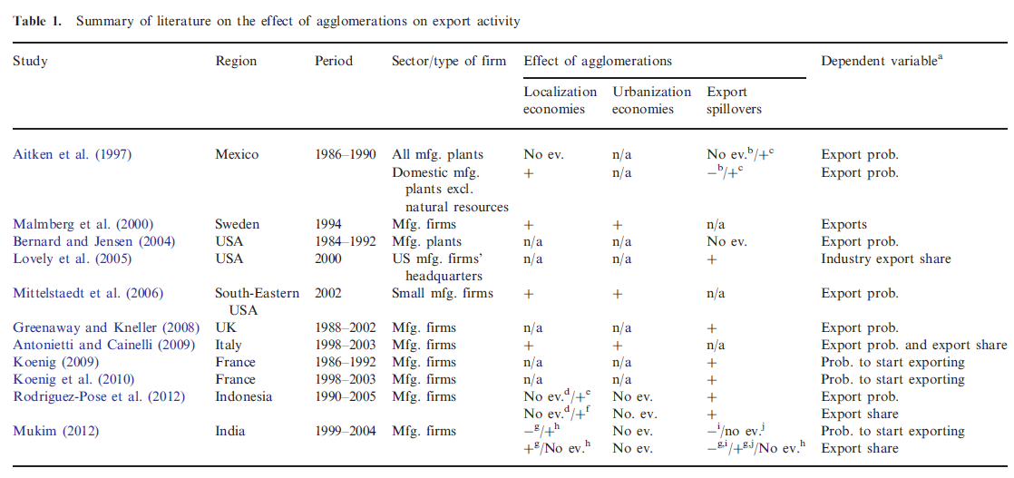
In Farole and Winkler, 2013

Slide 11
Becchetti and Rossi, 2001
Using a sample composed of over 3,800 manufacturing firms drawn from the Mediocredito Centrale database (more than 11 employees) for the period 1989–1991, find that spatial agglomeration, captured by localization within the boundary of an industrial district, increases average export intensity by 4% points.
Tobit estimates show that geographical agglomeration significantly increases export intensity and export participation. The result is robust when controlled for firm size, sector and geographical areas and for the separate and positive effects of export subsidies and export “consortia” on export intensity.
Notes:
11

Slide 12
Antonietti and Cainelli, 2011
The dataset consists of a sample of Italian manufacturing firms drawn from the VIII and IX waves of the Survey by Unicredit-Capitalia, which covers the period 1998–2003. The master datasets gather information on 4,680 and 4,289 firms, but the final dataset is just 715 firms
The model used in the paper is an ‘augmented’ version of the Crepon, Durette-Mairesse model, developed to summarize the complex process “that goes from the firm decision to engage in research activities to the use of innovations in its production activities” (Crépon et al. 1998, p.116). It comprises five main equations
Estimates show that agglomeration economies play a role in shaping the relationship between innovation, productivity and export performance. In particular, urbanization economies do positively affect both R&D and also the propensity to export and the relative export intensity
Notes:
12

Slide 13
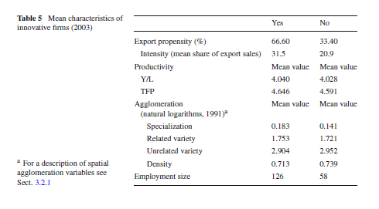

Slide 14
Aim and contribution
We want to assess firm export performance of Italian firms, in both manufacturing and production services, during the crises
  Incidentally, we start examining interregional openness
We aim at understanding how much such a performance (in terms of extensive and intensive margin) depends on
  endogenous determinants (within the firm, with a specific emphasis on innovation and learning to export internationally and interregionally)
  Other learning phenomena related to exogenous factors, external to the firms which relate either to the sector, to the region or to local industry characteristics
Contrary to previous contribution we deal with
  the extensive and intensive margin models as intertwined phenomena, from an empirical and econometric point of view
  the initial conditions problem with an appropriate approach
Notes:
14

Slide 15
Dataset / 1
We focus on the Italian case thanks to a new database (the MET survey) which has collected information at the firm level in four waves, every two years, since 2007
The MET survey is designed to focus on firms’ structure and strategies (in particular R&D and innovation activities, the internationalisation process and network phenomena) as well as on their financial aspects.
Population:
  All italian firms in industrial sector (manufacturing, energy, mining) and production services (except finance and insurance, real estate, transportation for private consumption). It includes data on micro and family firms
  Stratification criteria:
    Firm’s dimension (4 classes – 1-9, 10-49, 50-249, 250<);
    Regions (20 regions);
    Sectors (12 sectors in the manufacturing industry);
Methodology:
  CATI (Computer Assisted Telephone Interview);
  CAWI (Computer Assisted Web Interview);
Notes:
Activity in order to maximize the quality of surveys:
Training for the interviewer;
Pilot surveys;
Statistical analysis to evaluate bias (such as the effects of the interviewers, rates of reply per cluster,..);
Accuracy in the selection of the interviewed as representative of the firms;
Automatic controls in the software that follows the survey (incoherence, errors,..);
A very large number of interviews to control for the quality of the survey.

Slide 16
Dataset / 2
Since we want to explain current performance with past determinants, firms have to appear at least in two consecutive years to be included in our analysis
MET data have been merged with CRIBIS data to collect information on some important financial and economic indicators available in balance sheets.
 | MET-firms | Two-period panel | Merge with CRIBIS
2007 | 24,896
2009 | 22,340 | 11,549 | 6,016
2011 | 25,090 | 13,901 | 5,797
2013 | 25,000 | 10,537 | 4,728
The final sample for our analysis thus consists of 16,541 firms

Slide 17
Dataset/3: Size class and geographical distributions

Slide 18
Some descriptive statistics/1
 | ALL firms |  |  |  | Innovators
 | Exporter | Non-Exporter | Total |  | Exporter | Non-Exporter | Total
Nb. of firms | 6510 | 10031 | 16541 |  | 2928 | 3334 | 6262
% | 39% | 61% | 100% |  | 47% | 53% | 100%
All at T-2
Size | 93.5 | 51.6 | 68.1 |  | 127.2 | 72.1 | 97.9
Productivity (log) | 10.64 | 10.58 | 10.61 |  | 10.62 | 10.60 | 10.61
Age | 20.9 | 18.4 | 19.4 |  | 20.5 | 18.1 | 19.2
R&D Intensity | 2.2 | 0.9 | 1.4 |  | 3.4 | 1.7 | 2.5
Group | 26% | 15% | 19% |  | 31% | 20% | 25%
Local Network | 39% | 42% | 41% |  | 47% | 56% | 52%
Notes:
In Antonietti and Cainelli the proportion of exporting firms was 60%: too much

Slide 19
Some descriptive statistics/1
Notes:
In Antonietti and Cainelli the proportion of exporting firms was 60%: too much

Slide 20
Some descriptive statistics/2
 |  | exporters % | Export intensity |  | size | R&D intensity | innovators %
Piemonte | 1277 | 50% | 17.18 |  | 85.89 | 1.77 | 35%
Valle d'Aosta | 143 | 32% | 10.45 |  | 33.73 | 0.40 | 24%
Lombardia | 1563 | 54% | 20.76 |  | 79.52 | 1.80 | 32%
Trentino Alto Adige | 629 | 42% | 16.34 |  | 110.81 | 1.24 | 31%
Veneto | 1910 | 45% | 17.18 |  | 57.55 | 1.61 | 36%
Friuli Venezia Giulia | 352 | 59% | 23.42 |  | 102.85 | 1.10 | 34%
Liguria | 414 | 46% | 17.92 |  | 59.09 | 1.36 | 33%
Emilia Romagna | 1335 | 42% | 14.38 |  | 85.10 | 2.02 | 30%
Toscana | 1563 | 43% | 17.08 |  | 46.73 | 1.47 | 33%
Umbria | 506 | 33% | 9.82 |  | 58.20 | 1.35 | 35%
Marche | 687 | 47% | 16.50 |  | 44.82 | 1.30 | 31%
Lazio | 2014 | 29% | 8.75 |  | 58.26 | 1.09 | 30%
Abruzzo | 247 | 45% | 16.04 |  | 87.16 | 1.23 | 27%
Molise | 244 | 27% | 6.60 |  | 19.90 | 0.69 | 23%
Campania | 1059 | 30% | 9.19 |  | 42.61 | 1.37 | 22%
Puglia | 568 | 39% | 11.98 |  | 73.92 | 1.18 | 32%
Basilicata | 278 | 27% | 6.36 |  | 32.40 | 0.46 | 33%
Calabria | 581 | 15% | 2.58 |  | 33.34 | 0.28 | 20%
Sicilia | 850 | 25% | 6.82 |  | 34.56 | 0.86 | 29%
Sardegna | 321 | 22% | 4.56 |  | 35.17 | 0.71 | 20%

Slide 21
Some descriptive statistics/3
 |  | Exporters % | Export intensity | Innovators % | size | productivty (log) | R&D intensity
North-West | 3397 | 50% | 19% | 41% | 88.0 | 10.55 | 1.8
North-East | 4226 | 45% | 17% | 42% | 76.1 | 10.63 | 1.5
Centre | 4770 | 36% | 13% | 39% | 62.3 | 10.66 | 1.3
South | 2977 | 30% | 9% | 31% | 54.3 | 10.49 | 1.0
Islands | 1171 | 24% | 6% | 29% | 40.0 | 10.72 | 1.0

Slide 22
Empirical model: the extensive and the intensive margin
The extensive margin model:
Pr(Exp_{irst}= 1) = Pr(α_{i} + β¹exp_in_{irst-2} β²exp_ir_{irst-2} + δinn_{irst-2} + γprod_{irst-2}+ φR&D_{irst-2} + μX_{irst-2} + reg_d + ind_d + time_d + ε_{irst} ) =
= Φ(α_{i} + β¹exp_in_{irst-2} β²exp_ir_{irst-2} + δinn_{irst-2} + γprod_{irst-2}+ φR&D_{irst-2} + μX_{irst-2} + reg_d + ind_d + time_d + ε_{irst})
The intensive margin model:
Exp on sales = α_{i} + δinn_{irst-2} + γprod_{irst-2}+ φR&D_{irst-2} + μX_{irst-2} + reg_d + ind_d + time_d + ε_{irst}
i = firm X is a set of firm characteristics
r = 5 macro-regions
s = 2 macro-sectors
t = 2009, 2011, 2013

Slide 23
Empirical model / the variables
Dependent variables
Pr(Exp_{irst}): binary indicator
Exp on sales (%)
Independent variables:
Innovative efforts
Inn: dummy which takes value one when the firm innovates and zero otherwise
  Inn prod (main product innovation)
  Inn proc (process innovation)
  Inn org (organisation innovation)
R&D: expenditure on R&D over sales
Learning processes
Past (international) export
Past (inter-regional) export
Export spillovers (quota of exporters in local sector)
Regional public R&D
Regional private R&D
Group
Local network
Both for international and interregional trade

Slide 24
Empirical model / the variables
  Firms characteristics (X)
  Productivity
    value added per employee
    tfp (for a smaller sample)
  Leverage
  Age
  Size
Dummies
  Macro-reg_d
  Macro-sec_d
  Time_d

Slide 25
Main hypothesis
We try to assess the role of experience and learning by including the lag of the dependent variable in the model
Most importantly and differently from all previous contribution we consider the experience in ”exporting” beyond regional borders (interregional trade)
We try to go beyond the use of dummies to take into account other learning processes which go beyond the firm level which may influence firms’ ability to export. We explore a set of potential phenomena.
Notes:
It might be interesting to try to discriminate between “switchers” which goes from non-exp to exp and those which do the reverse (at least let us see the descriptive statistics. See for example Greenaway and Kneller (2004): 15% of non-exp at time t become exp at time t+1; whilst only 2% of exp at time t become non-exp at t+1

Slide 26
Estimation method
Extensive margin
- Pooled model (Logit and Probit)
- Random Effects model (Logit and Probit)
  Correction for endogeneity induced by the dynamic term. In Wooldridge (2005) the distribution of the unobserved effects is modelled conditional on the initial value of the dependent variable and the mean of the exogenous variables (in our case only firm age)
Intensive margin
Tobit II-Heckman (Probit and Linear)
  With exclusion restrictions (the sunk costs variables), the two processes are considered correlated but it has very restrictive restrictions and it does not consider bounded values
Two part model (Probit/Logit and Linea/Beta)
  Linear and beta distribution for the positives: beta accounts also for the bounded features of the dependent variable (0-1]. Both do not account for the correlation between the two processes
Notes:
Antonietti and Cainelli use fractional logit
26

Slide 27
Estimation strategy
Estimate the benchmark model for the extensive margin
Test for robustness with respect to alternative measures of innovation and subsamples.
Post-estimation stage: assess the conditional probability of exporting
Estimate the benchmark model for the intensive margin
Notes:
27

Slide 28
Extensive margin models/1

Slide 29
Extensive margin models: average marginal effects

Slide 30
Extensive margin models: average marginal effects

Slide 31
Extensive margin models per type of innovation

Slide 32
Intensive margin models

Slide 33
Main results/extensive model_1
Firm decision to export depends significantly on its innovative activity both in terms on input (R&D expenditure) and output (innovativeness)
  As far as the latter aspect, product innovation always proves significantly correlated to export whilst process and organization innovation are never significant
There are also significant learning phenomena
  There is quite an important learning to export (both at interregional at international level)
  There is also a role for a sort of local specialisation effect of exporting activity
  No role for group and local network
  In particular we find that private R&D has a positive and significant effect whilst public R&D has a negative even though not significant impact
As in previous contributions we find out that probability to export depends on some firm specific features
  Productivity, first of all, but also Size, Age and Leverage.
Notes:
33

Slide 34
Main results/extensive model_2
Firms which have already paid sunk costs of entry have an increase in probability of exporting in a range between 35 and 45%
Past interregional export counts for another 5%, as much as productivity
Innovation counts for 1.5%, almost six times the impact of investing in R&D
If a firm has not already faced sunk costs, that is, it is a non exporter, then being more productive, bigger and younger increases the probability of exporting
Notes:
34

Slide 35
Main results/intensive model
We have found that, once sunk costs are taken aside, and we focus on the determinants of the intensity of export, results are significantly different:
  Innovation is no longer significant, nor is productivity
  R&D is still significant but not robust across models
  Leverage, size and age are still very important
  And there is still a role for some specific regional/sectoral effects, especially export spillovers role is quite robust while that of private R&D is not
Notes:
35

Slide 36
Speculative policy implications
The degree of local industry internationalization and private R&D expenditures at the regional level represent two valid objectives to boost export activities even though the first effect is really small. Indeed, policies directly affecting new exporters may trigger a domino effect.
Some role of policy measures devoted to reduce financial and structural constraints for SMEs. The combination of diseconomies of scale due to size and the negative spillovers coming from the orientation towards local networks still represent an important impediment to export activity which can be addressed by specific policy interventions
This recipe is also suggested by the fact that to enter a new market “for the first time” firms need to be more productive, larger and younger: policies may either focus on these kind of firms or helping young small firms to become not only more productive but larger
Notes:
36

Slide 37
Extension 1: Extensive margin models for sub periods

Slide 38
Extension 2: Extensive margin models for interregional flows

Slide 39
Extensions
There are several other potential issues of interest which are currently not yet explored:
  Explore further the regional and sectoral dimension
  More on interactive phenomena
  Explore the role of geographical position: border, central, peripheral regions – accessibility indicators
  Before and during the crisis performance
  Interregional trade flows determinants

Slide 40
Main questions and comments at RSA
Causal relationship going from innovation to export
Role of human capital
Role of imitative behaviour at the regional level

Slide 41
Future extensions?
  Before and during the crisis performance
  Macro-areas destinations
  International export vs interregional “export” (see Van Oort dati IPTS)
    (Stefania)
  Innovation as a function of export performance (see Bratti e Felice, e Lopez Baso and Motellon)
    (Carola)

