Slide 1

Pier Carlo Ricci
University of Cagliari
“International Days in Critical Raw Materials” – Burgos 24 June 2015

Slide 2

Field of applications:
I. Technology Pillar
  I.C Priority Area: Substitution of raw materials
    Action area n° I.7: Materials for electronic devices
Identification the most important applications where CRM are key components.
Solution along the entire value chain
Pier Carlo Ricci, University of Cagliari – University of Cagliari - RESET coordinator - http://reset.dsf.unica.it/

Slide 3


SMEs
Research Centers
Applications
Accademia
Large industries
Research
Pier Carlo Ricci, University of Cagliari – University of Cagliari - RESET coordinator - http://reset.dsf.unica.it/

Slide 4
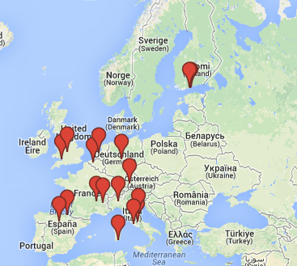
Starting composition
10 Academia,
5 Research centers,
10 Large companies,
10 European SME.
8 EU countries:
Italy, France, Spain,U.K.
Germany, Belgium,
Netherlands, Finland
Pier Carlo Ricci, University of Cagliari – University of Cagliari - RESET coordinator - http://reset.dsf.unica.it/

Slide 5
Thematic workpackages
WP1 Sustainable Substitution of REE in Photodevices.
Application Field: -Optoelectronic, LEDs, LCDs, and Plasma Screens; Compact Fluorescent Light bulbs (CFL).
WP2 Substitution of critical raw materials in transparent conductive layers.
Application field: -Panel display industry, photovoltaic, Transparent Conductive Oxide (TCO) Films for Organic Light Emissive Devices (OLEDs).
WP3 Subsitution of critical raw materials in magnetic devices.
Application field: - Exchange-coupled nanocomposite magnets, highly anisotropic magnetic materials, New and energy efficient motors and generator technologies which do not depend on permanent magnets.
Pier Carlo Ricci, University of Cagliari – University of Cagliari - RESET coordinator - http://reset.dsf.unica.it/

Slide 6






• Enlargement of the commitment:
Fondazione Bruno Kessler (Italy);
Technische Universität Braunschweig (Germany),
University of Milan, Bicocca (Italy),
University of Sassari (Italy);
Universidad de Castilla-La Mancha (Spain)
Sardegna Ricerche (Italy)
Pier Carlo Ricci, University of Cagliari – University of Cagliari - RESET coordinator - http://reset.dsf.unica.it/

Slide 7

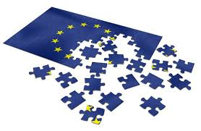
• International Synergies:
“Alliance for Materials”, Italy.
“Red Internacional en substitución de Materias Primas Críticas” (INCRAM), Spain.
EIT Raw Materials
Pier Carlo Ricci, University of Cagliari – University of Cagliari - RESET coordinator - http://reset.dsf.unica.it/

Slide 8
Dissemination
Sponsor of SiO₂ and Related Dielectrics 2014, 14-17 June
Open discussion on the themes of the substitution of Critical raw materials on optoelectronic devices and lighting on specialized social network:
  Linkedin (https://www.linkedin.com/groups?home=&gid=7400540)
  ResearchGate (https://www.researchgate.net/project/RESETEU_commitments_EIP_raw_Materials)
  The official website of the RESET commitments was published: http://reset.dsf.unica.it/. It summarizes previous and incoming actions as well as details on the units.
Pier Carlo Ricci, University of Cagliari – University of Cagliari - RESET coordinator - http://reset.dsf.unica.it/

Slide 9
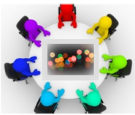

• Previous meetings:
Kick off meeting, held in Cagliari June 6th 2014.
1st WORKSHOP on: “Substitution of Critical Raw Elements:
synthesis, characterization and processing of new Advanced Materials”, Cagliari April 9-10 ^{th} 2015
Pier Carlo Ricci, University of Cagliari – University of Cagliari - RESET coordinator - http://reset.dsf.unica.it/

Slide 10
• Scientific Results:
About 90 Scientific publications in international journals (SCOUPUS and ISI web of Science indicized) were published in 2014 from RESET units on the thematic connected to the commitment topics.
The Commitment attended to international Scientific with about 10 oral presentations in international workshop/conferences through its units. It also participate in the committee board of two conferences/workshop: SiO2 and EMRS symposium
Pier Carlo Ricci, University of Cagliari – University of Cagliari - RESET coordinator - http://reset.dsf.unica.it/

Slide 11
Networking and proposals
SC512A:
  REFRAIN: REE FREE NEW PHOTODEVICES FOR AUTOMOTIVE INDUSTRY
    University of Cagliari; Georg-August University of Goettingen; University of Gent; University of Burgos; Technische Universität Braunschweig;
    Grupo Antolín; Centro Ricerche FIAT S.c.P.A.; IQE plc; Centro Ricerche Plast-optica
  ReLight
Fondazione Bruno Kessler, ENEA, VTT; University of Burgos; CEA;
    Picosun; Graphenea, Microoled, Aston-FIAMM
NMP23:
  FReeLed: Screening and Development of Rare Earth FREE Phosphors for Led Devices
    University of Cagliari; Georg-August University of Goettingen; University of Gent; University of Burgos; Technische Universität Braunschweig;
    Aixtron, Centro Ricerche FIAT S.c.P.A.; IQE plc; OSRAM OS.
Pier Carlo Ricci, University of Cagliari – University of Cagliari - RESET coordinator - http://reset.dsf.unica.it/

Slide 12
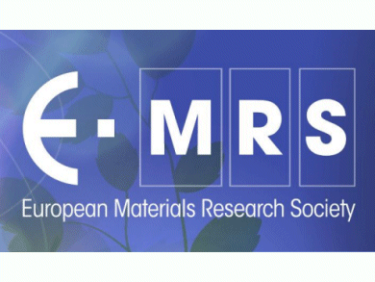
Spring Conference: Lille, 2-6 May 2016
Symposium E:
Substitution of Critical Raw Materials: Synthesis, Characterization and Processing of New Advanced Materials in optoelectronic and magnetic devices.
Materials Science, Design, Synthesis, Growth, Characterization of Advanced Materials with reduced or free from CRMs for : Transparent conductive layers Rechargeable batteries, Phosphors for LED applications, Scintillators, Displays OLEDs Catalysis Photovoltaics Smart windows, Exchange-coupled nanocomposite magnets with less or no REEs New RE-free highly anisotropic magnetic materials New and energy efficient motors and generator technologies which do not depend on permanent magnets
Pier Carlo Ricci, University of Cagliari – University of Cagliari - RESET coordinator - http://reset.dsf.unica.it/

Slide 13
Organizing Board
Chairman Pier Carlo Ricci Dipartimento di Fisica, Università di Cagliari | José A. De Toro Departamento de Física Aplicada & IRICA, Universidad de Castilla-La Mancha (UCLM)
Valentina Ivanova CEA Tech, France | Maria Luisa Grilli ENEA, Casaccia, Unit of Materials Technology, Optical Coatings Laboratory
Scientific Board
E. Bouyer (France)
C. M. Carbonaro (Italy)
D. Chiriu (Italy)
R. Cipollone (Italy)
J. M. Colino (Spain)
S. Cuesta (Spain)
M. Hillenkamp (France)
Y. Huttel (Spain)
N. Laidani (Italy)
R. Matthieu (Sweden)
P. Nordblad (Sweden)
P. Normile (Spain)
D. Peddis (Italy)
A. Rizzi (Germany)
M.L. Ruello (Italy)
G. Singh (Norway)
A. Tchelnokov (France)
J. Van Duijn (Spain)
Pier Carlo Ricci, University of Cagliari – University of Cagliari - RESET coordinator - http://reset.dsf.unica.it/

Slide 14

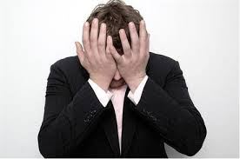
• Criticisms:
Effective participations from Industrial partners.
Pier Carlo Ricci, University of Cagliari – University of Cagliari - RESET coordinator - http://reset.dsf.unica.it/

Slide 15
SMEs
Research Centers
Applications
Accademia
Large industries
Research
Pier Carlo Ricci, University of Cagliari – University of Cagliari - RESET coordinator - http://reset.dsf.unica.it/

Slide 16
SMEs
Research Centers
Accademia
Flux of Information
Large industries
Pier Carlo Ricci, University of Cagliari – University of Cagliari - RESET coordinator - http://reset.dsf.unica.it/

Slide 17
• Actions:
Broader dissemination of the topic
Reach an effective “Critical Mass”
Pier Carlo Ricci, University of Cagliari – University of Cagliari - RESET coordinator - http://reset.dsf.unica.it/

Slide 18
• Actions:
Share group interests and most effective actions
Work in identify the needs of the industry,
Evaluate urgent actions
Communications to the EU Commission
Pier Carlo Ricci, University of Cagliari – University of Cagliari - RESET coordinator - http://reset.dsf.unica.it/

Slide 19
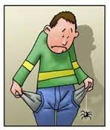

• Criticisms:
Effective participations from Industrial partners.
Funding
Pier Carlo Ricci, University of Cagliari – University of Cagliari - RESET coordinator - http://reset.dsf.unica.it/

Slide 20
(d) Advanced materials and nanotechnologies for high added value products and process industries
Year | Topic Title | Instrument | TRL | Comments
2016 | Novel (covalently cross-linked hybrid) materials for the use in heterogeneous catalysis | RIA | 4-6
 | Materials for power electronics | RIA | 4-6 | International cooperation; Coord. call to be discussed with DG CNECT
 | Innovative and sustainable materials solutions for the substitution of critical raw materials in the electric power system | RIA | 4-6 | To be discussed with DG GROWTH re. Raw materials. Possible support for international cooperation
 | Affordable weight reduction of high-volume vehicles and components taking into account the entire life-cycle | RIA | 4-6 | (Green vehicles)

Slide 21
• One solution:
Marie Skłodowska-Curie Actions
dead line January 2016
European Industrial Doctorates (EID)
European Joint Doctorates (EJD)
European Training Networks (ETN)
Pier Carlo Ricci, University of Cagliari – University of Cagliari - RESET coordinator - http://reset.dsf.unica.it/

Slide 22
Possible Action Lines
Applications | Raw materials | Value 2012(M€)
Washing machines, Dishwasher Cooling Air, conditioners | Nd, Dy | 12000
Optical fibres | Ge | 1400
Magnetic resonance imaging apparatus (MRI) | Dy, Gd, Nb, Nd, Pr,Tb | 3300
Automotive (electric motor, lighting) | REE | 850000
Pier Carlo Ricci, University of Cagliari – University of Cagliari - RESET coordinator - http://reset.dsf.unica.it/

Slide 23
Group:
Commitment-RESET-critical Raw Elements Substitution in Electronic & optoelectronic Technologies
Website: http://reset.dsf.unica.it
Email: reset@dsf.unica.it
carlo.ricci@dsf.unica.it

Slide 24
Thank You for Your attention
Pier Carlo Ricci
University of Cagliari
“International Days in Critical Raw Materials” – Burgos 24 June 2015

Slide 25
Spring Conference: Lille, 2-6 May 2016
Symposium E:
Substitution of Critical Raw Materials: Synthesis, Characterization and Processing of New Advanced Materials in optoelectronic and magnetic devices.
Materials Science, Design, Synthesis, Growth, Characterization of Advanced Materials with reduced or free from CRMs for : Transparent conductive layers Rechargeable batteries, Phosphors for LED applications, Scintillators, Displays OLEDs Catalysis Photovoltaics Smart windows, Exchange-coupled nanocomposite magnets with less or no REEs New RE-free highly anisotropic magnetic materials New and energy efficient motors and generator technologies which do not depend on permanent magnets
Pier Carlo Ricci, University of Cagliari – University of Cagliari - RESET coordinator - http://reset.dsf.unica.it/

