Slide 1
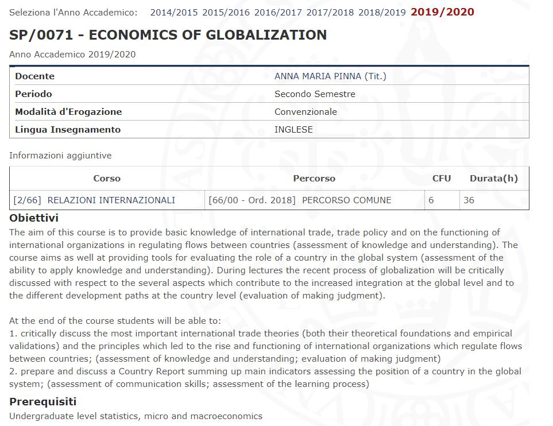
International Economics and Development
(email: ampinna@unica.it)

Slide 2
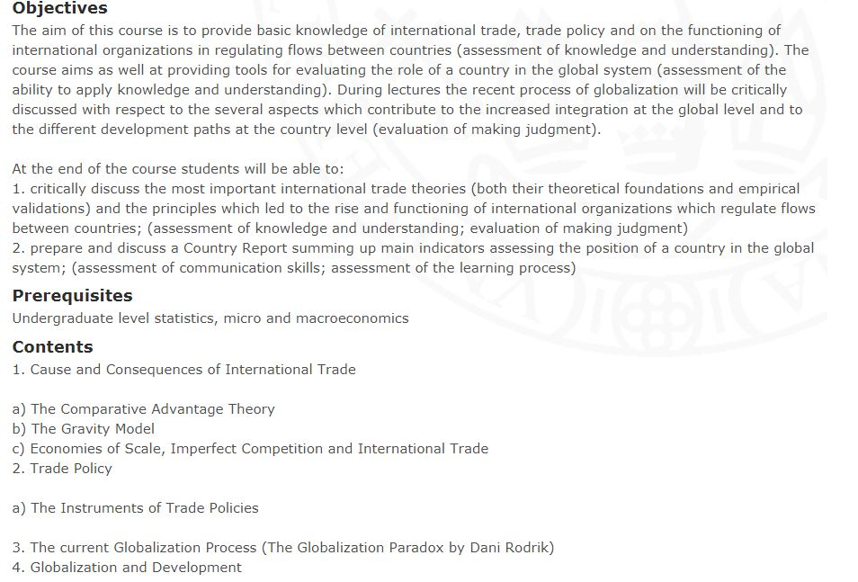
Benvenuti - Welcome

Slide 3


Slide 4
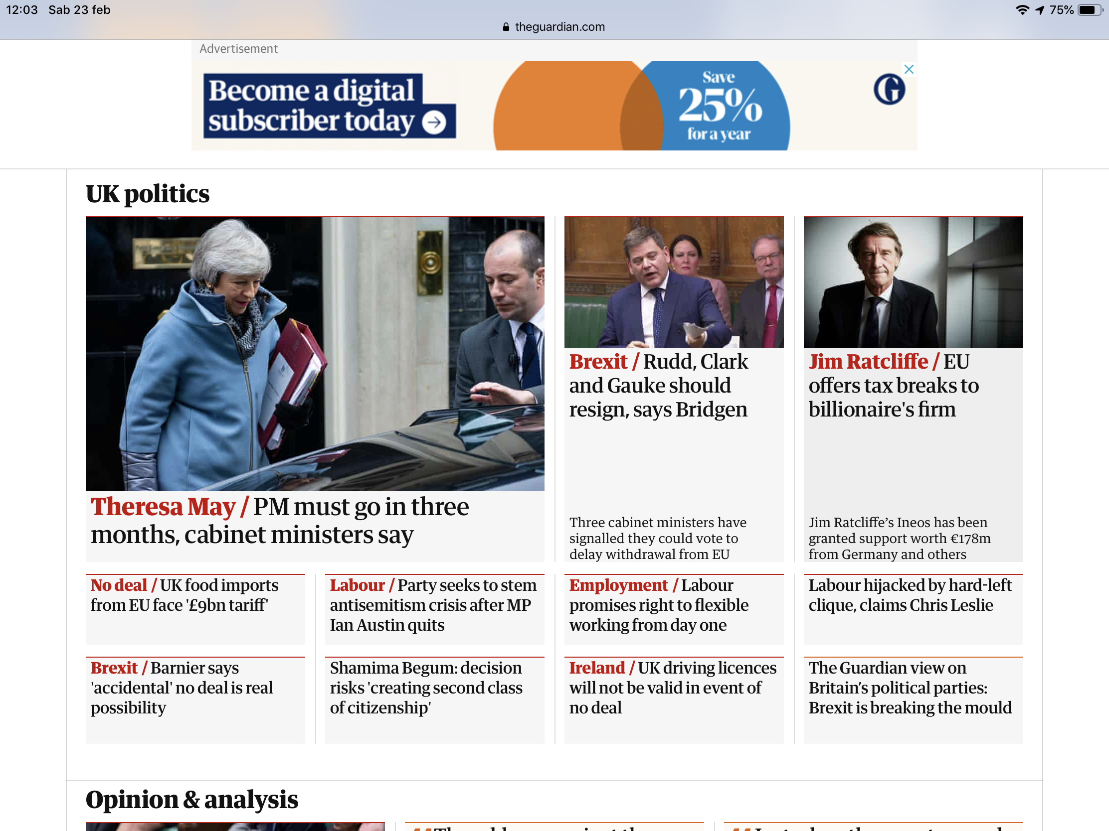

Slide 5
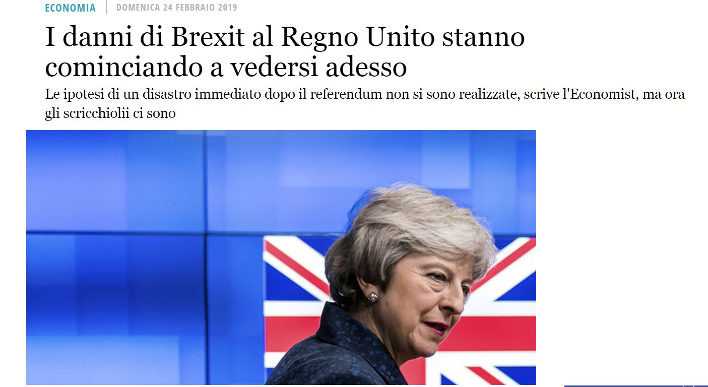

Slide 6
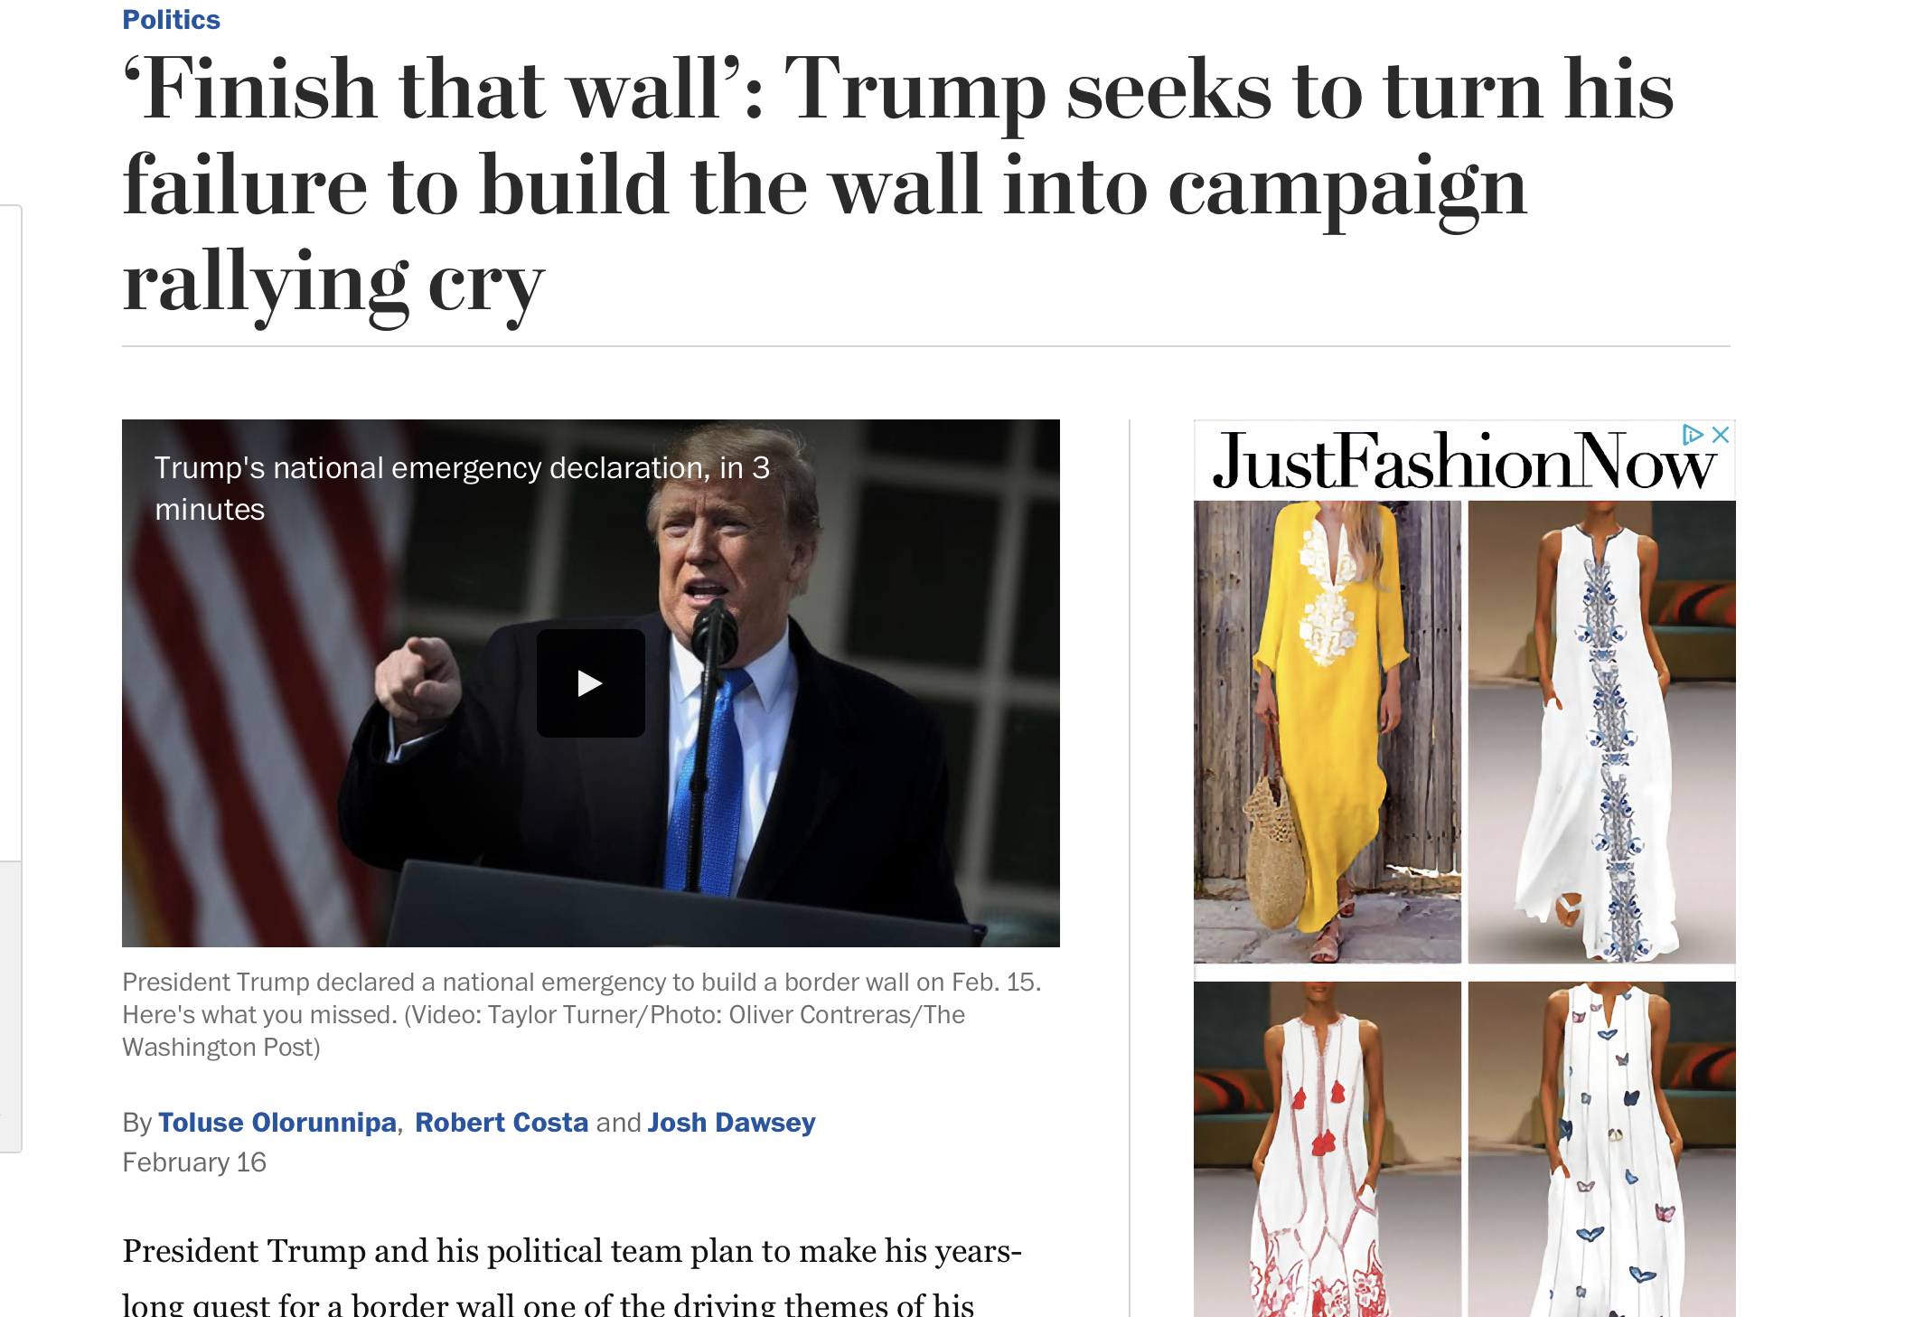

Slide 7
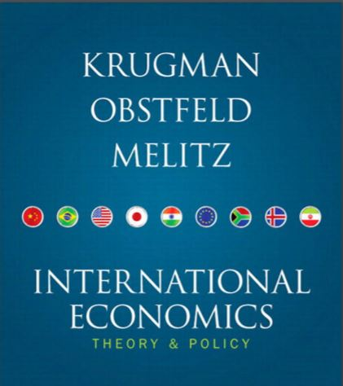
Benvenuti - Welcome
6 ECTS:
March: 2-3-4-5;10-11-12-13;17-18-19-20;23-24-25;30-31
April: 1
International Economics: Theory and Policy
Paul R. Krugman, Maurice Obstfeld, Marc Melitz
ISBN-10: 0138018987 • ISBN-13: 9780138018986
©2015 • Prentice Hall
Further information: http://catalogue.pearsoned.co.uk/educator/
product/International-Trade-Theory-and-Policy-OLP-with-etext-Global-Edition/
9781292074061.page
Chapters: 1-2-3(3.1-3.2-3.3-3.4)-5-7-9-11

Slide 8
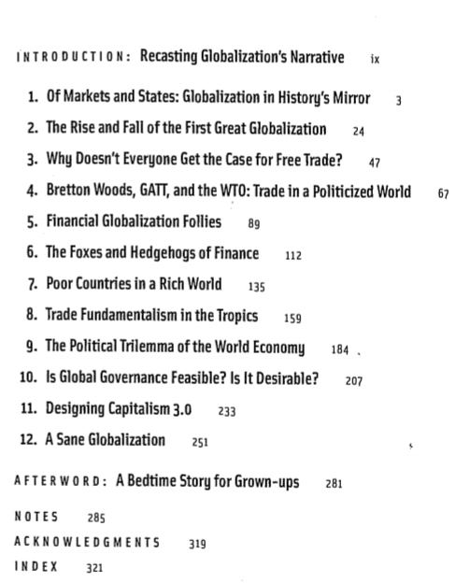
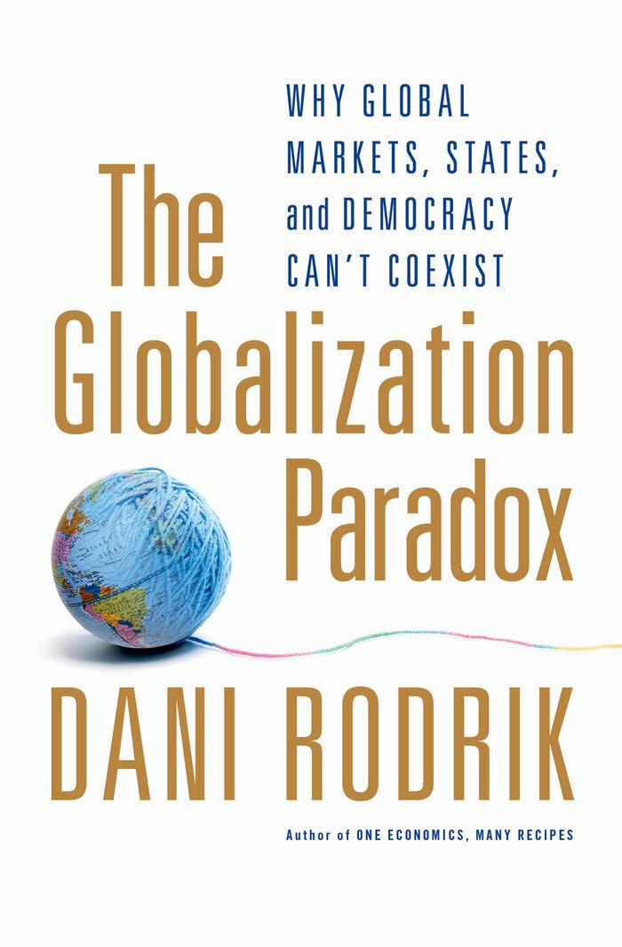
Benvenuti - Welcome
http://www.rci.rutgers.edu/~triner/UFFseminar/RodrikParadox.pdf
http://digamo.free.fr/rodrikg11.pdf

Slide 9
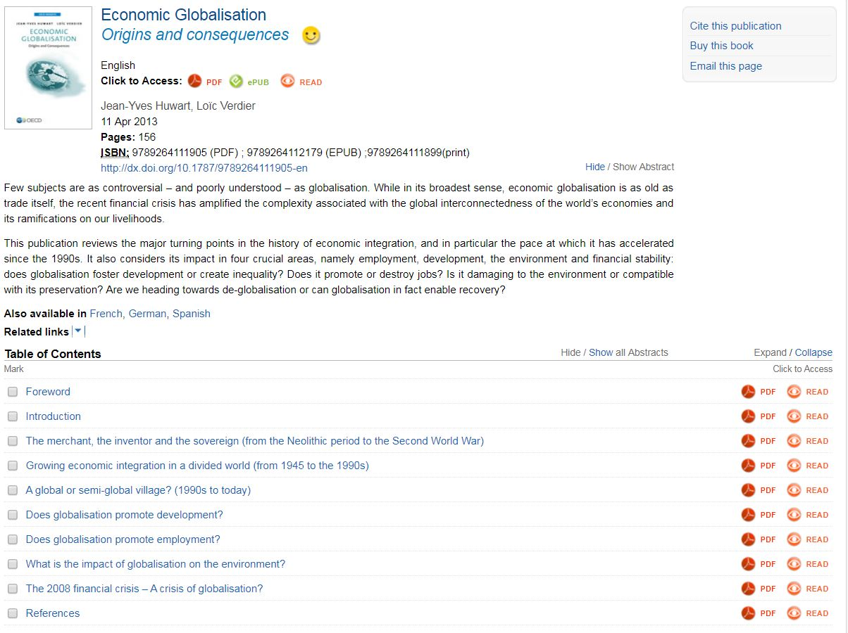

Slide 10
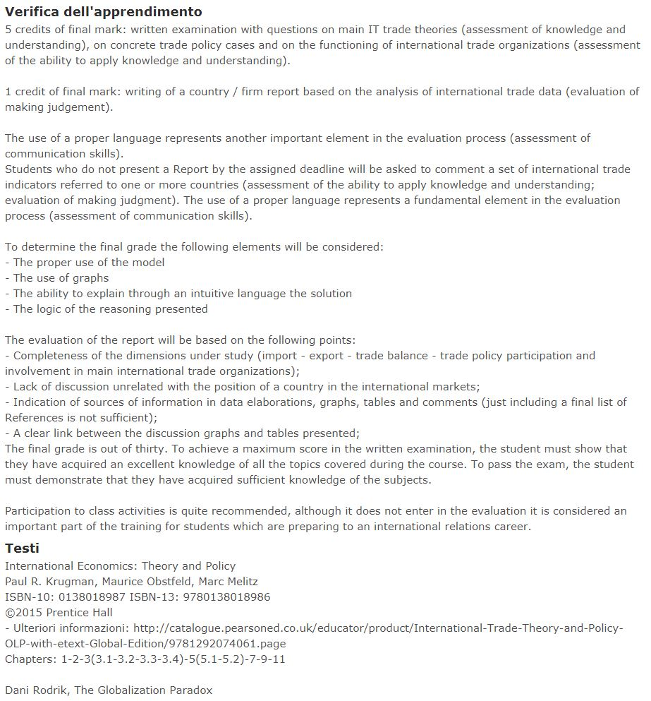

Slide 11
Class work
(discussion of Dani Rodrik and Globalization material)
3 chapters per week:
12 March: Chapters 1-2 Rodrick and Chapter 2 Globalization report
18 March: Chapters 3-4 Rodrick and Chapters 3-4 Globalization report
19 March: Chapters 7-8- Rodrick and Chapter 5 Globalization Report
25 March: Chapters 9-10-11 and Chapter 6 Globalization Report
Why is this book important?
This is about economics written for the wide public. It verifies many concepts of the manual in the real world.
It talks about several different contexts; it talks about history; it talks about GOVERNANCE of a process.
https://www.youtube.com/watch?v=Ctk73C3OOZ4
Then there are your skills. Presenting and discussing to an audience.

Slide 12
Report
WTO: http://stat.wto.org/CountryProfiles/E28_e.htm
http://stat.wto.org/Home/WSDBHome.aspx?Language=E
http://stat.wto.org/CountryProfile/WSDBCountryPFReporter.aspx?Language=EUNdata: http://data.un.org/CountryProfile.aspx
World Bank: http://data.worldbank.org/data-catalog/country-profiles
Main web material with interesting trade data visualization:
(https://comtrade.un.org/labs/)
(https://www.wto.org/english/res_e/statis_e/statis_e.htm)

Slide 13
Globalization process http://www.oecd-ilibrary.org/economics/economic-globalisation_9789264111905-en
What are we going to talk about here?

Slide 14
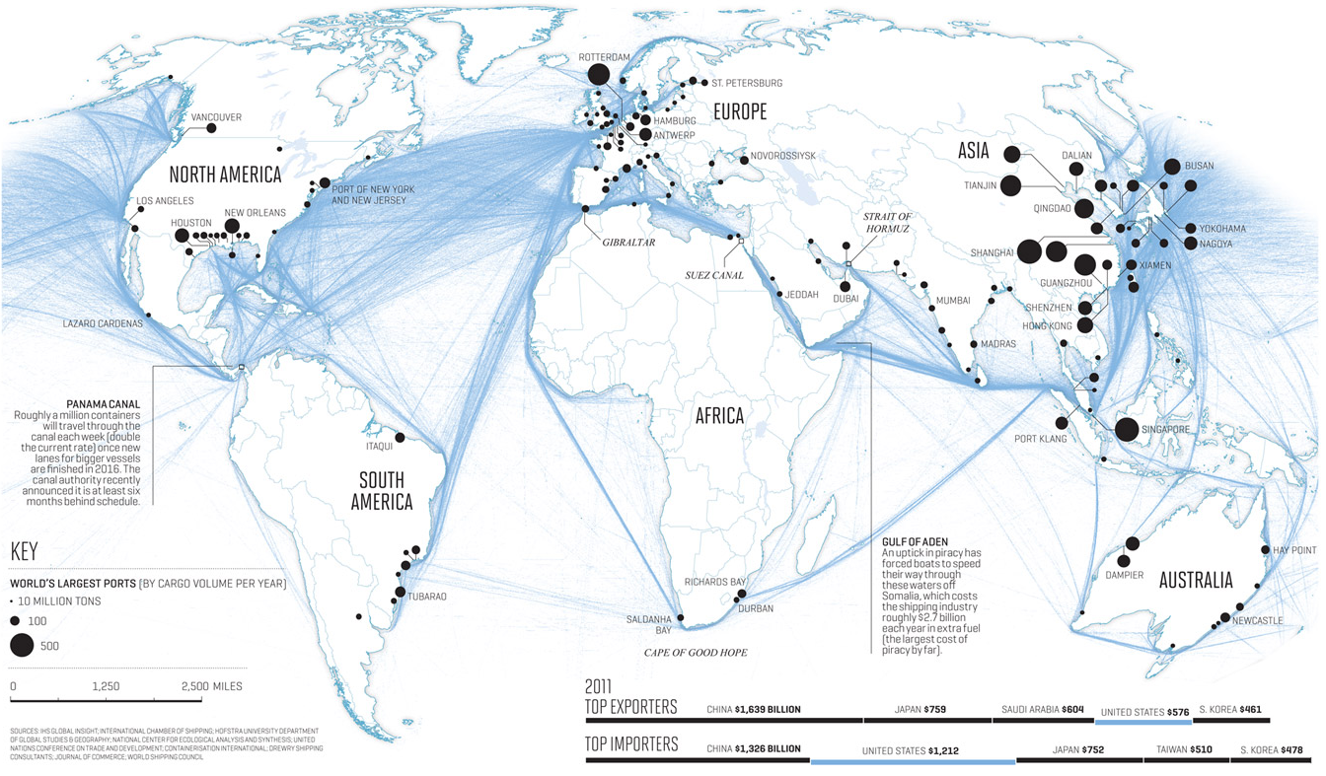
Actual Routes
https://www.shipmap.org/

Slide 15

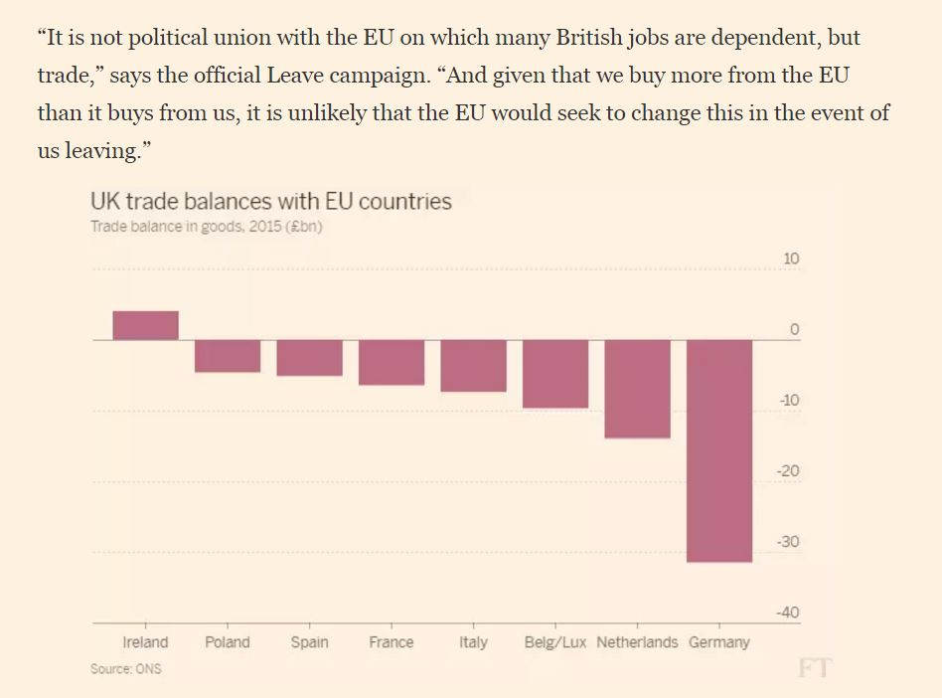
Brexit
Brexit:
Does it have sense?

Slide 16
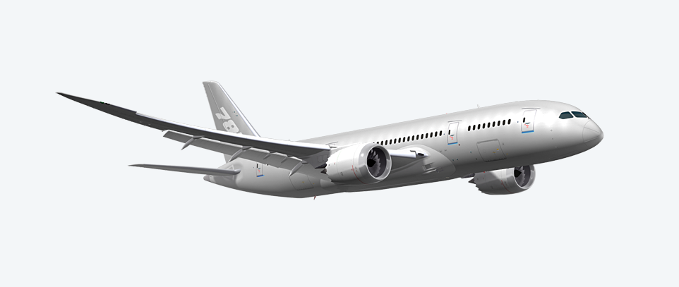
Production fragmentation: Boeing 787 Dreamliner
Wing box: Mitsubishi Heavy Industries (Japan)
Wing ice protection: GKN Aerospace (UK)
Forward fuselage:
Kawasaki Heavy Industries (Japan)
Spirit Aerosystems (USA)
Centre fuselage: Alenia Aeronautica (Italy)
Rear fuselage:
Boeing South Carolina (USA)
Escape slides: Air Cruisers (USA)
Vertical Stabiliser: Boeing
Commercial Airplanes (USA)
Doors & windows:
Zodiac Aerospace (USA)
PPG Aerospace (USA)
Lavatories:
Jamco (Japan)
Flight deck seats:
Ipeco (UK)
Raked wing tips: Korean Airlines
Aerospace division (Korea)
Flight deck controls:
Esterline (USA),
Moog (USA)
Horizontal Stabiliser:
Alenia Aeronautica (Italy)
Engines: GE Engines (USA),
Rolls Royce (UK)
Aux. power unit: Hamilton
Sundstrand (USA)
Centre wing box:
Fuji Heavy Industries (Japan)
Engine nacelles: Goodrich (USA)
Passenger doors:
Latécoère Aéroservices (France)
Tools/Software: Dassault Systemes (France)
Navigation: Honeywell (USA)
Pilot control system: Rockwell Colins (USA)
Wiring: Safran (France)
Landing gear: Messier-Dowti (France)
Electric brakes: Messier-Bugatti (France)
Tires: Bridgestone Tires (Japan)
Cargo doors: Saab (Sweden)
Prepreg composites:
Toray (Japan)
Final assembly: Boeing
Commercial Airplanes (USA)
Source: www.newairplane.com

Slide 17
I fondamenti del commercio mondiale
Quali sono i problemi dei dati di commercio bilaterale?
  Se alcuni input sono importati nel Paese, allora il valore aggiunto è inferiore al valore delle esportazioni.
  La bambola Barbie è prodotta con petrolio proveniente dall’Arabia Saudita, con plastica proveniente da Taiwan, capelli provenienti dal Giappone ed è assemblata in Cina.
  La bambola vale 2$ quando lascia la Cina, ma il valore aggiunto dalla forza lavoro cinese è di soli 35 centesimi.
  Chi esporta la Barbie???
  US nei dati….ma nei fatti

Slide 18
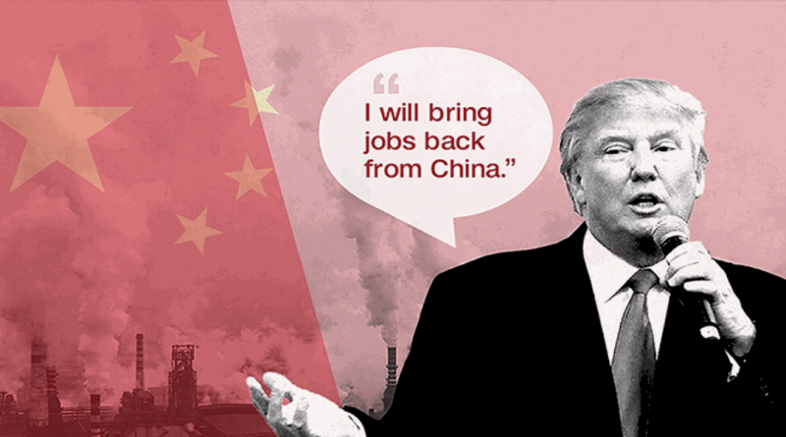
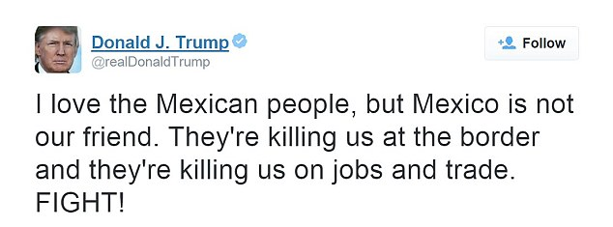
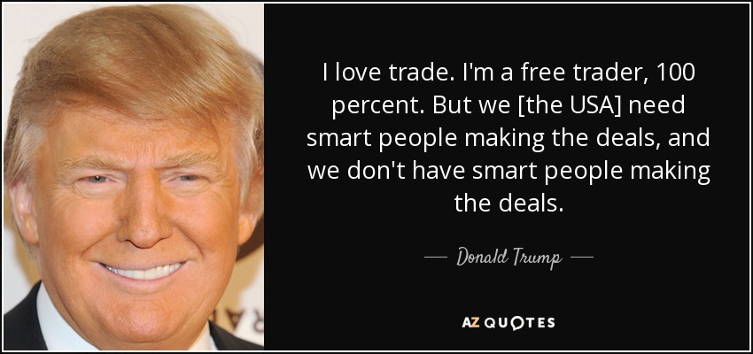
Another important event: 2016
Trump is the new @POTUS

Slide 19
Lot’s people worry (a lot!)
Why trade has become such an important question?
  Since trade continue to increase, the apparent competitive pressure from China worries lots of people.
  How to use data is crucially important; if we read wrong the data ‘poisoning’ ‘toxic’ discussions can start.

Slide 20
Resourse on line
https://www.khanacademy.org/test-prep/mcat/society-and-culture/demographics/v/globalization-theories

Slide 21
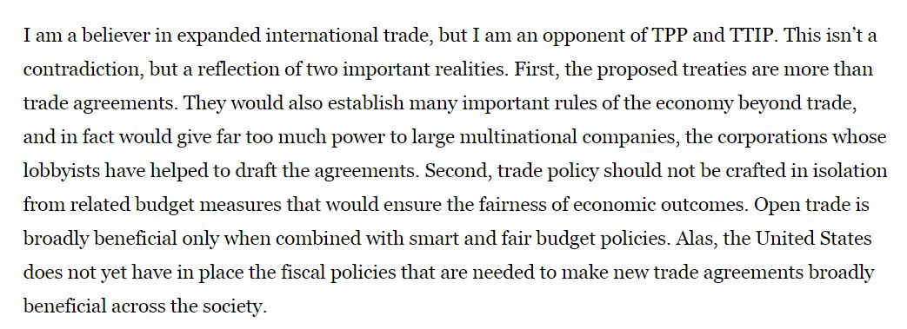
Jeffrey Sachs
Doubts on recently discussed global trade agreements
What’s Globalization?
https://www.youtube.com/watch?v=JJ0nFD19eT8

Slide 22
Interesting questions
Why do countries trade? (Old questions)
How gains from trade are distributed?
Policies in the global market. Protectionism.
Why do multinationals exist?
Which are their main characteristics?
Which institutions govern our globalization wave? IMF, WB.
How do they regulate relations between countries?
Measurement issues
Phenomena which seem contrasting but connected:
global trade agreements (TTIP e TPP) and regional blocs:
European Union
NAFTA (North American Free Trade Agreement – USA, Canada e Messico)
MERCOSUR (Argentina, Brasile, Paraguay e Uruguay + others)
ASEAN Free Trade Area (Association of South-East Asian Nations)

Slide 23
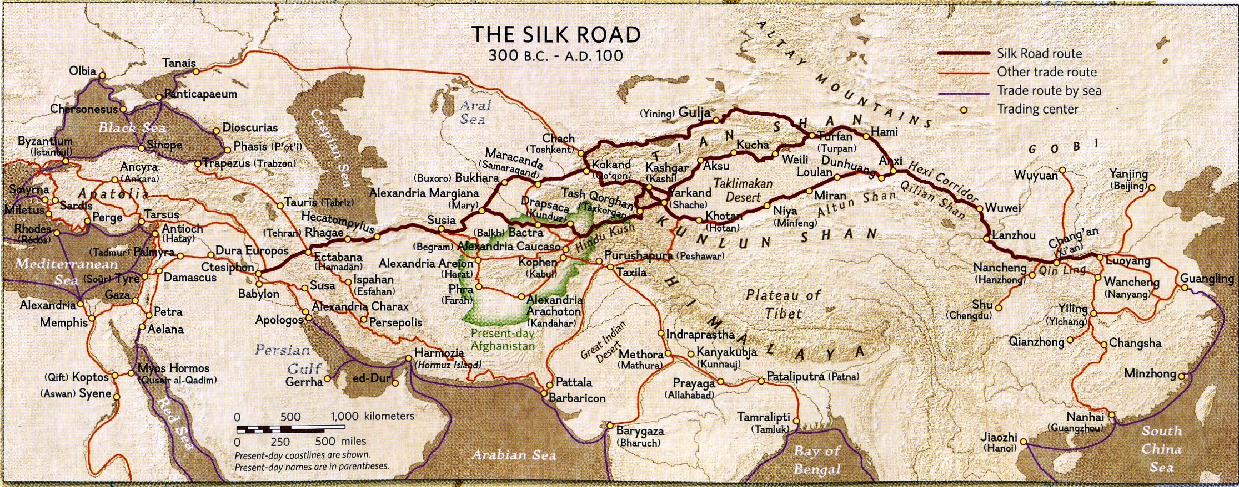
Historical trade maps https://easyzoom.com/imageaccess/ec482e04c2b240d4969c14156bb6836f

Slide 24
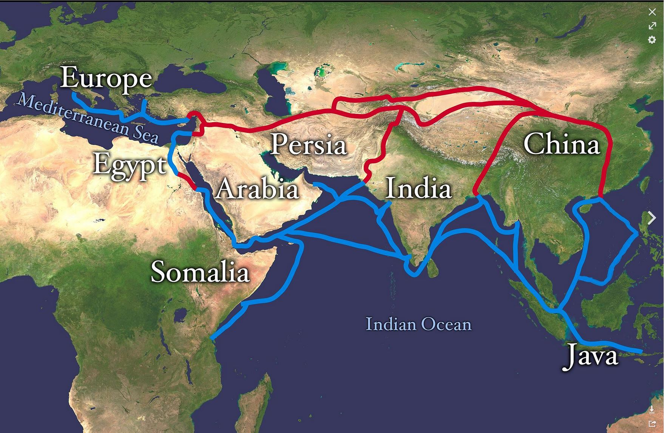
Land and Sea routes http://mentalfloss.com/article/86338/8-trade-routes-shaped-world-history

Slide 25
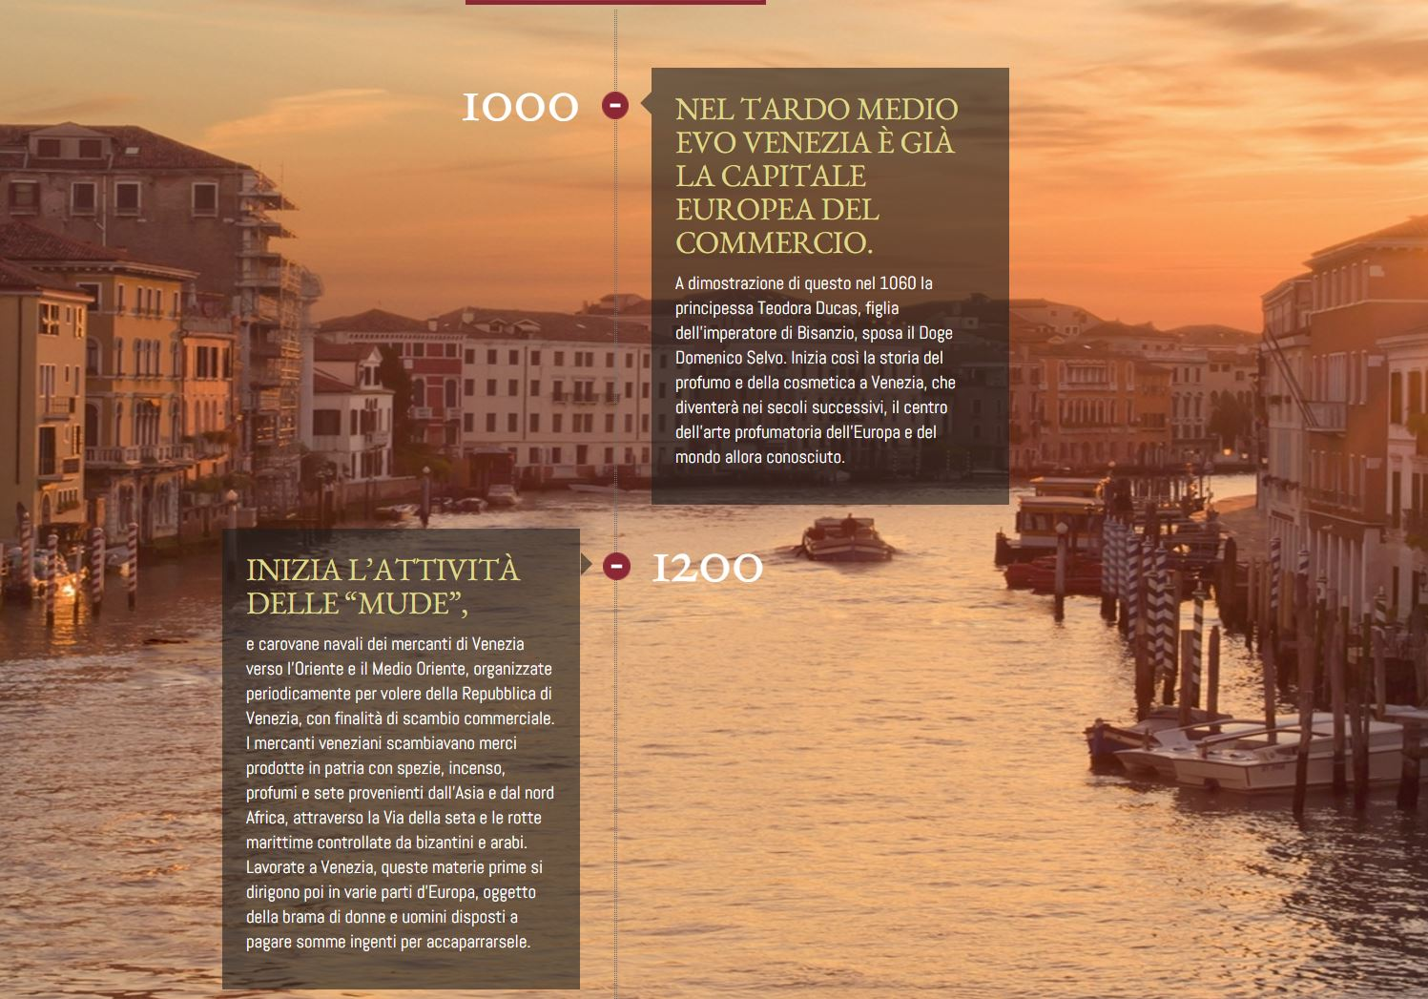
How did perfume was created?

Slide 26
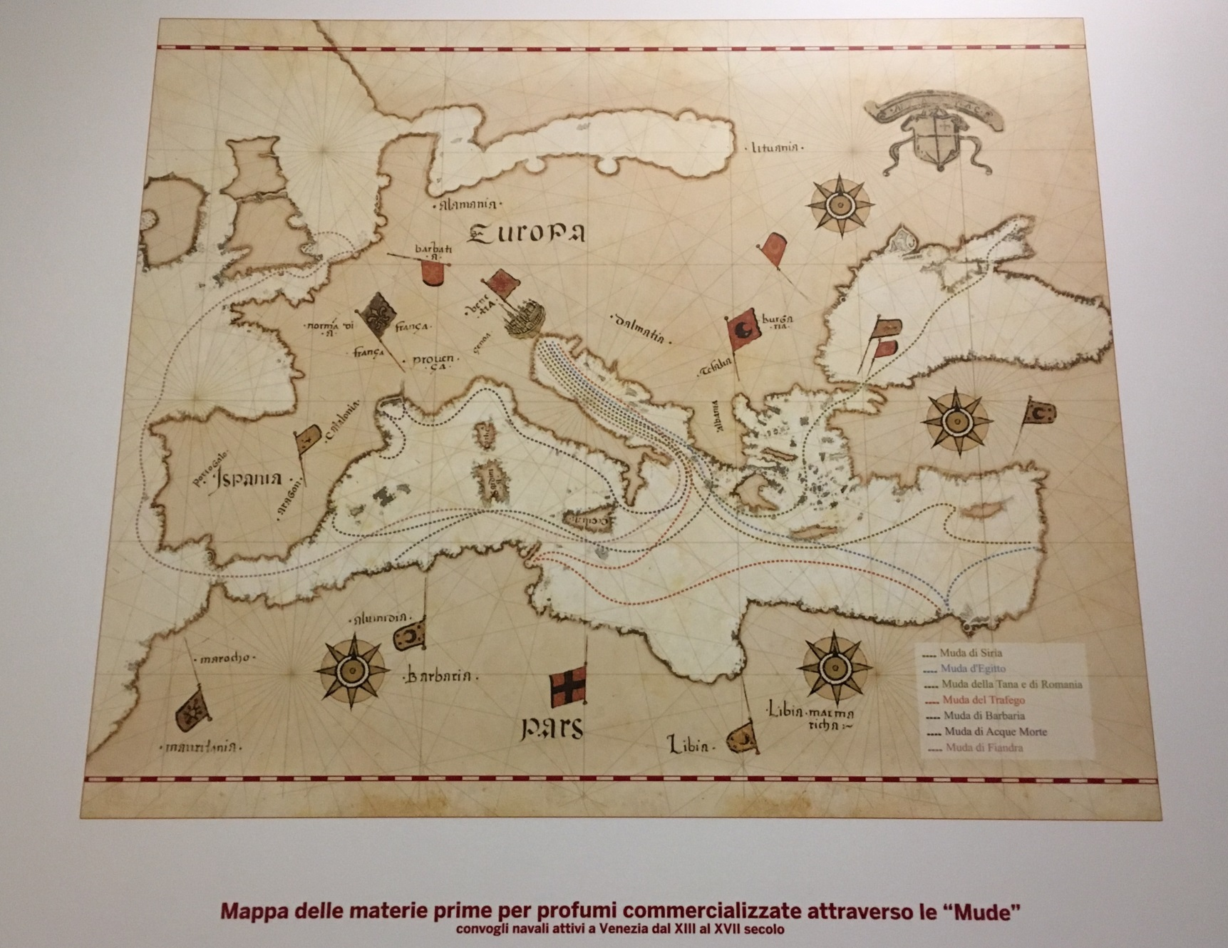
Venetians’ ‘mude’ (maps)

Slide 27
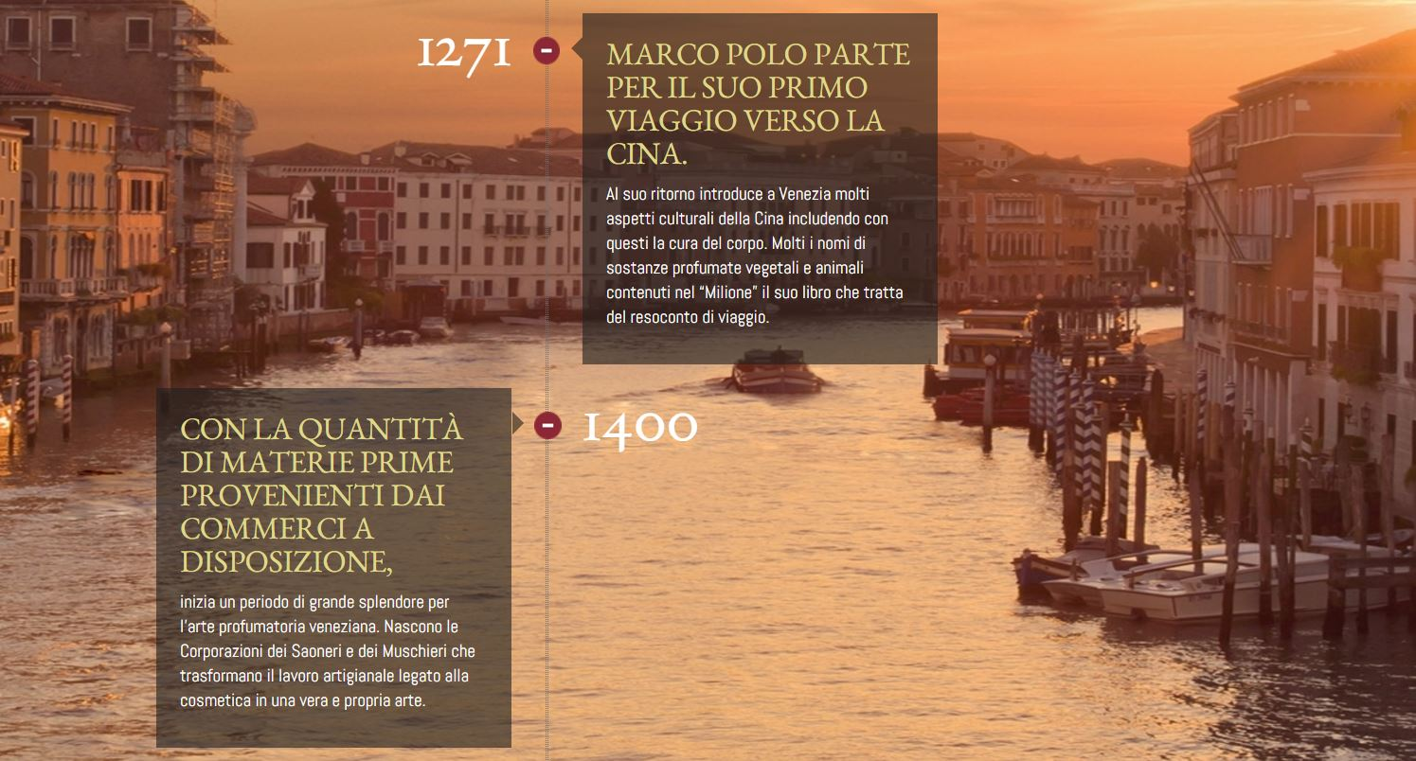

Slide 28
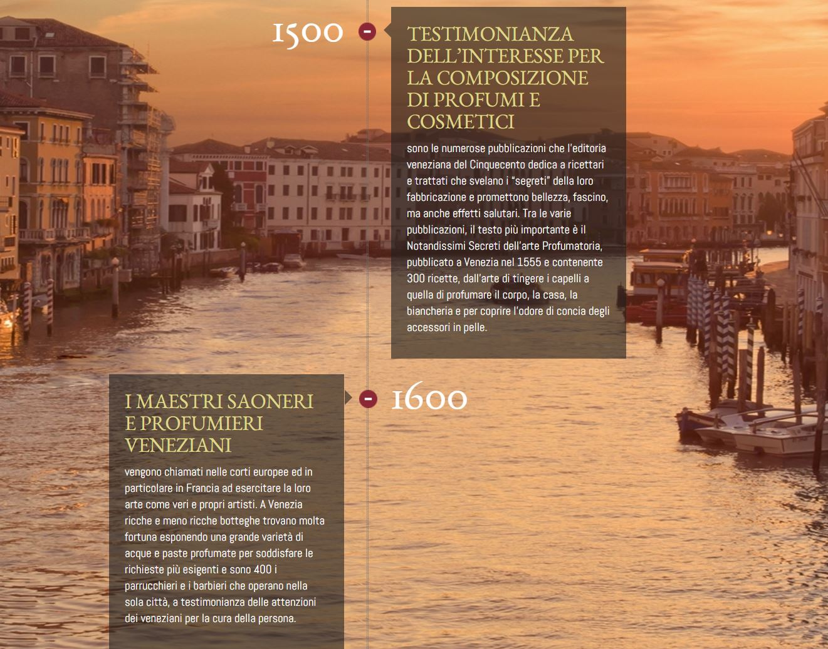

Slide 29
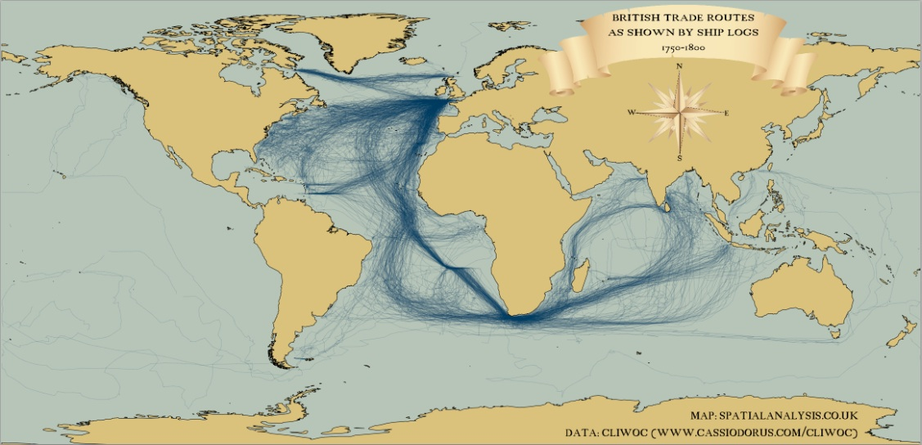
1750-1870

Slide 30
Historical prospective
Ancient time: empires traded a lot.
The Middle Ages: European downturn, Asian dynamism (silk road, islamic empire)
Renaissance (trading post in France); Franz Von Taxis (Innsbruck Brussels in 5 days)
Colonial empires (mercantilism, protectionism);
Industrial Revolution

Slide 31
How to define Globalization?
Economics: integration, which means
no barriers or easiness in exchanges of goods, services, capital, knowledge (ideas) and people movement
Implications: higher interdependency of national economies (both financial and goods markets), higher movement of people across borders, higher information flows.
Notes:
Vediamo rapidamente qualche grafico, poi entriamo in dettaglio

Slide 32
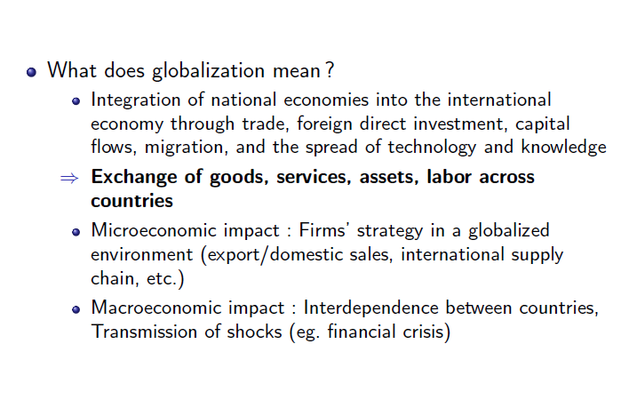
Definition

Slide 33
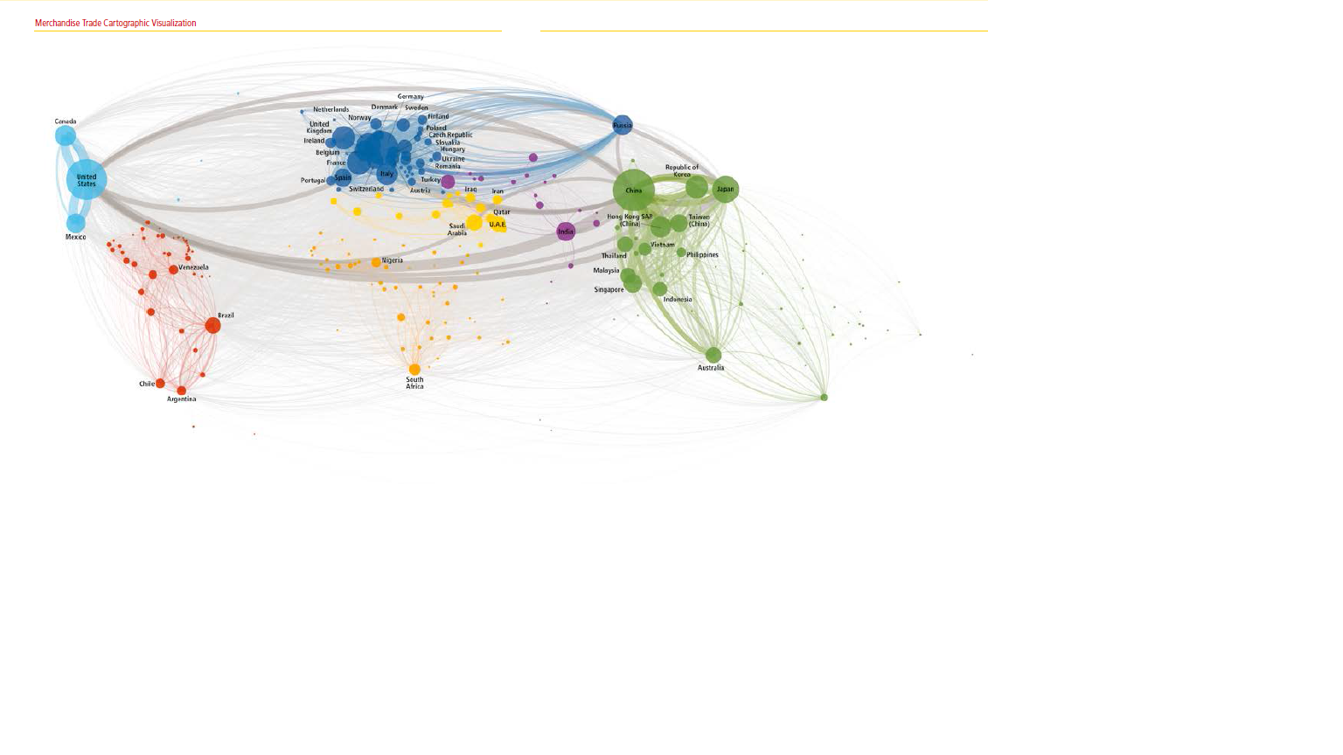
Ourdays routes
(DHL Global Connectedness Index)
Lets do a test: google
Global Connectedness Index 2019
https://www.logistics.dhl/global-en/home/insights-and-innovation/thought-leadership/case-studies/global-connectedness-index.html

Slide 34
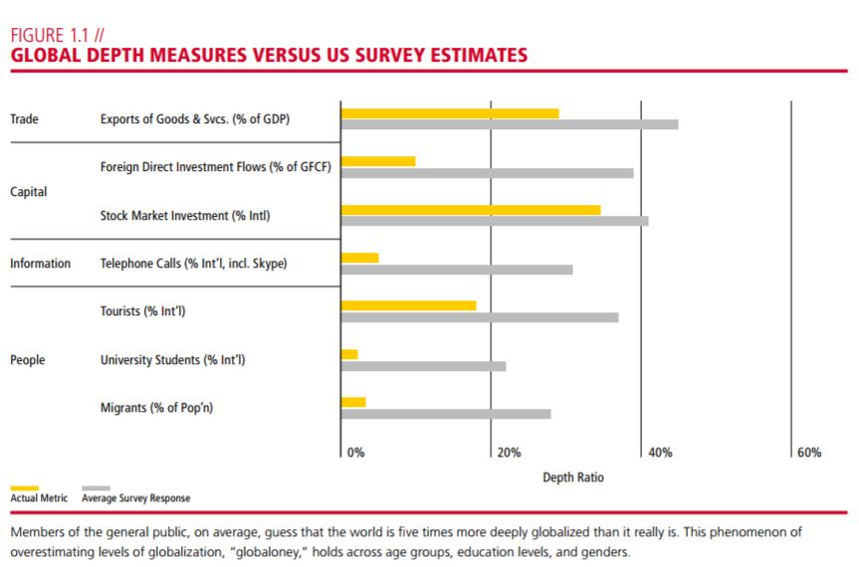
Overestimating levels of globalization
(General public)

Slide 35
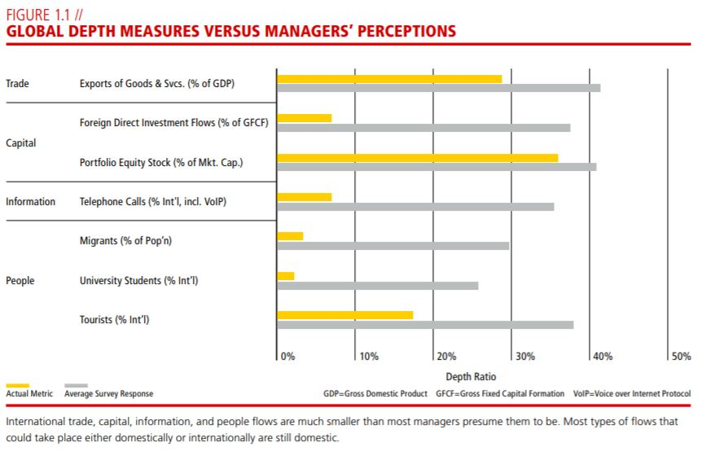
Managers

Slide 36
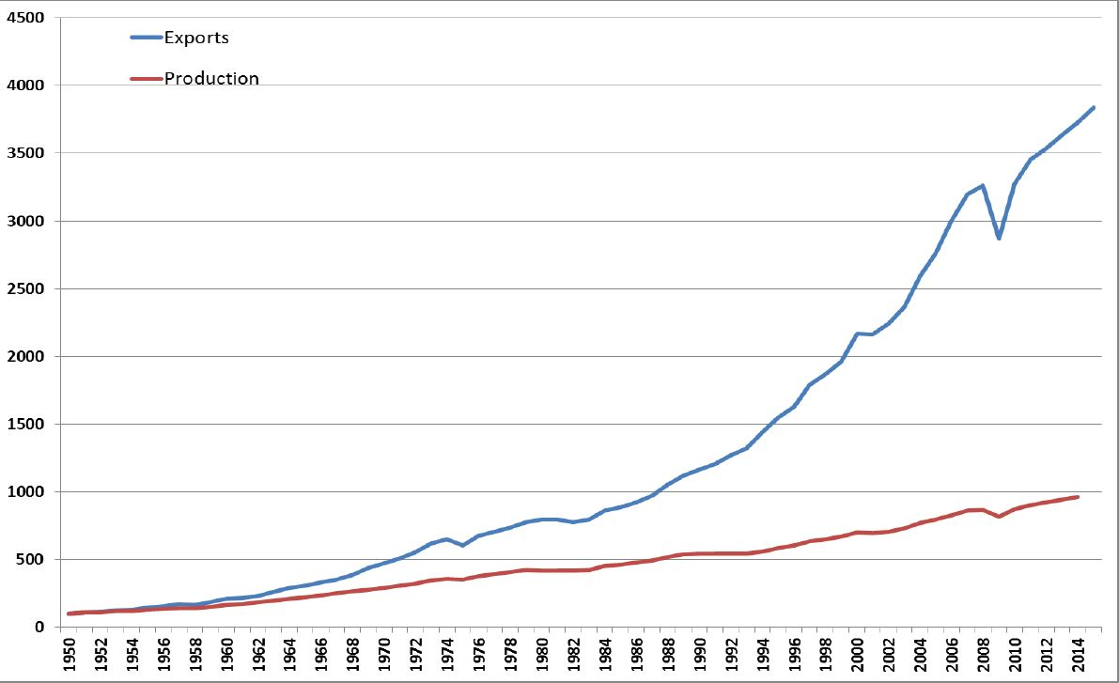
Globalization of Markets:
1950-2015; 1950=100; source: WTO

Slide 37
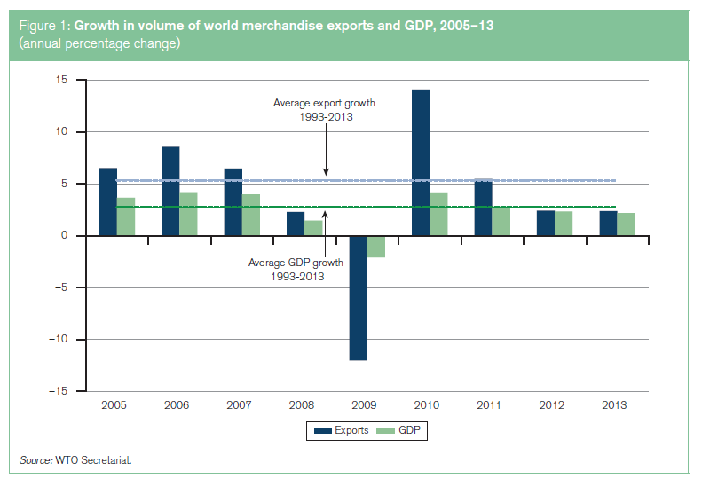
Last trends

Slide 38
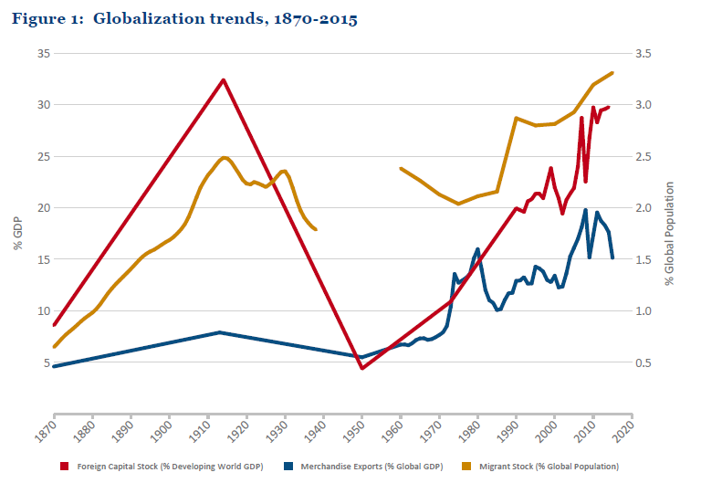

Slide 39
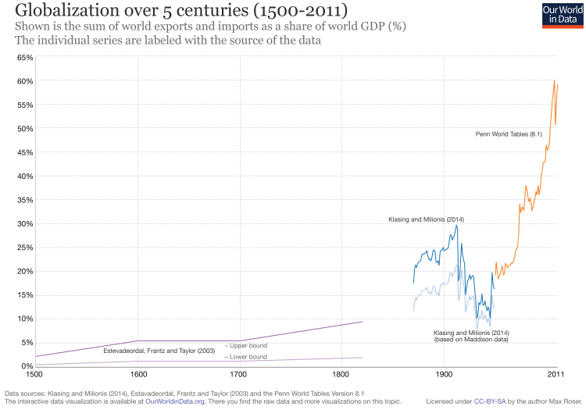

Slide 40
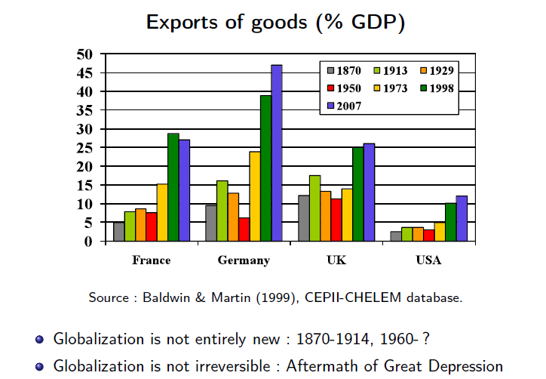

Slide 41
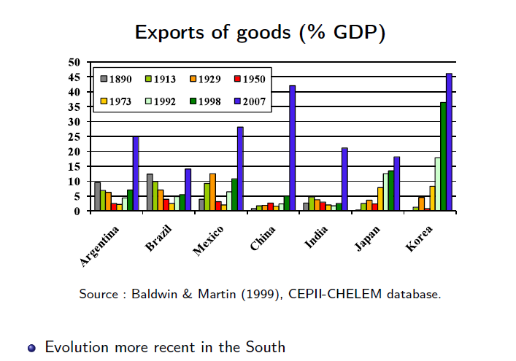

Slide 42
Some History
It is not a new phenomena
Globalization phases
Comparison between the first wave and trends of the last 50 years,
periods which recorded the highest increase in income.

Slide 44
First wave: 1870-1914
Starts round 1870. Main characteristics: high increase in capital movements, increase in migration flows and doubling of international trade flows
Main drivers: trade liberalization policies and technological developments reducing transport costs (trade costs)
Developing economies (colonies) specialized in the production of primary goods which are exported to the developed countries in exchange of manufactures (N-S trade)

Slide 45
Did globalization always increased?
Globalization crashes between the 2 WW
Back to nationalism and protectionism Notwithstanding further progress in technology and falling transport costs
The three pillars (trade, capital flows and migrations) go back to 1870 level
Poverty and Inequality start to increase

Slide 46
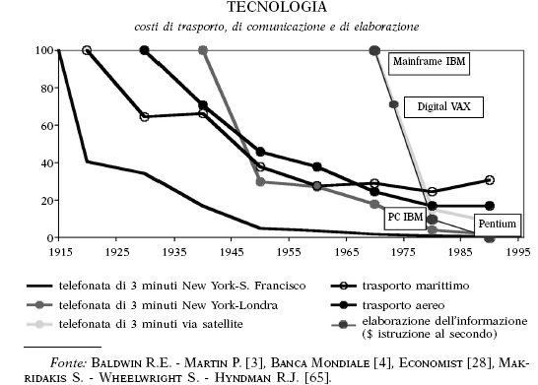
Technology

Slide 47
After IIWW
www.yaleglobal.yale.edu
commercial civil aviation; “containerisation” technique; democratisation of the telephone as the main mode of communication;
The Bretton Woods Agreement led to the creation of the World Bank, whose initial role was to facilitate reconstruction and development, and the International Monetary Fund (IMF), whose mission is to guarantee a stable international monetary system – an essential condition of dynamic international trade
GATT (not only a success), Agreements for creating a common large economic space

Slide 48
Main determinants of Globalization
Technical Progress, reduces natural barriers across markets (transport and communication costs)
Social Progress, reduces cultural barriers (es.: language or religious barriers)
Integration policies, reduces(both at the regional or multilateral level) political barriers:
  Border barriers (Tariff and NTMs)
  Internal measures (es.: Technical Barriers)
Competition policy, reduces barriers created by firms behaviour (entry barriers)

Slide 49
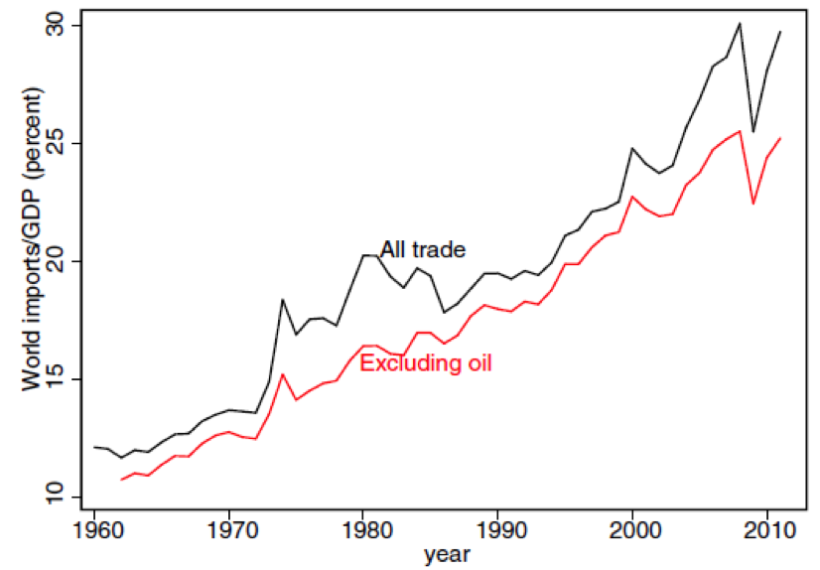
II wave: 1960 - today
https://ourworldindata.org/international-trade
1. Since 1960, world trade has become a much larger part of the world economy.

Slide 52
II wave: 1960 - today
2. Trade is the engine of recent globalization trend. More than half is trade in manufacturing products.

Slide 53
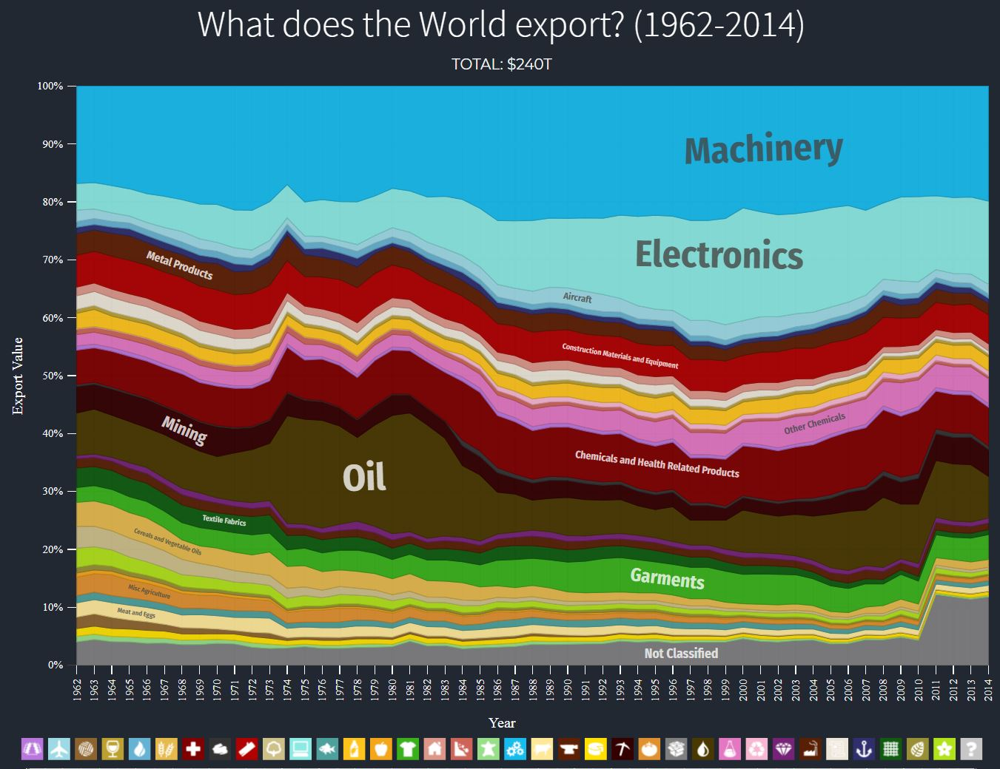
The importance of manufacturing
https://atlas.media.mit.edu/en/visualize/stacked/sitc/export/wld/all/show/1962.2014/

Slide 54
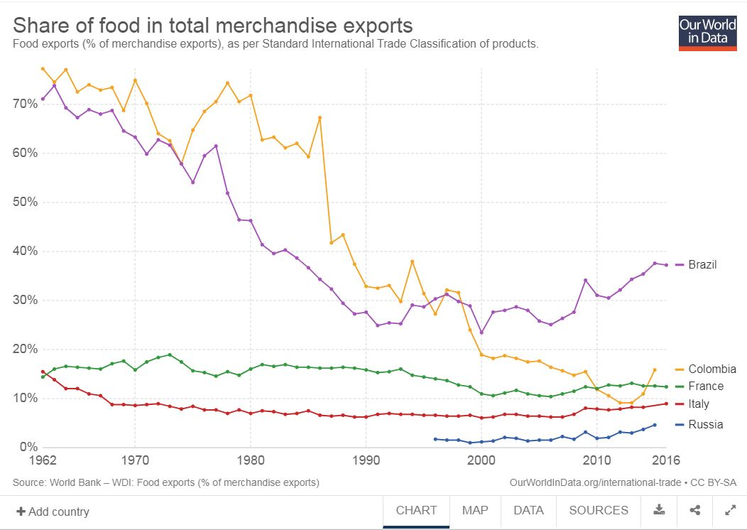
Export composition
https://ourworldindata.org/international-trade

Slide 55
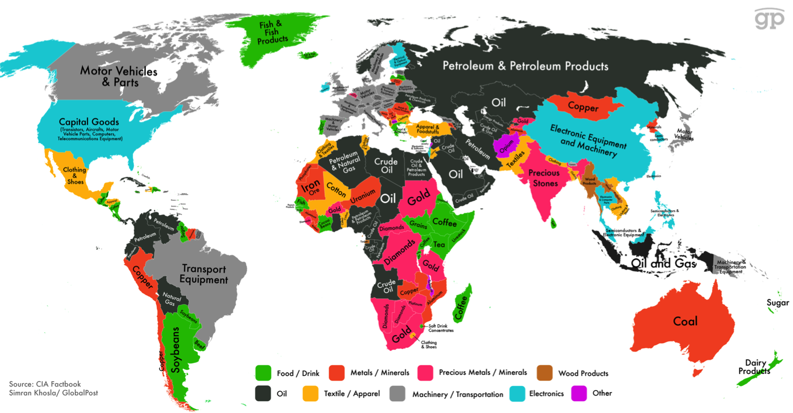
Specialization

Slide 56
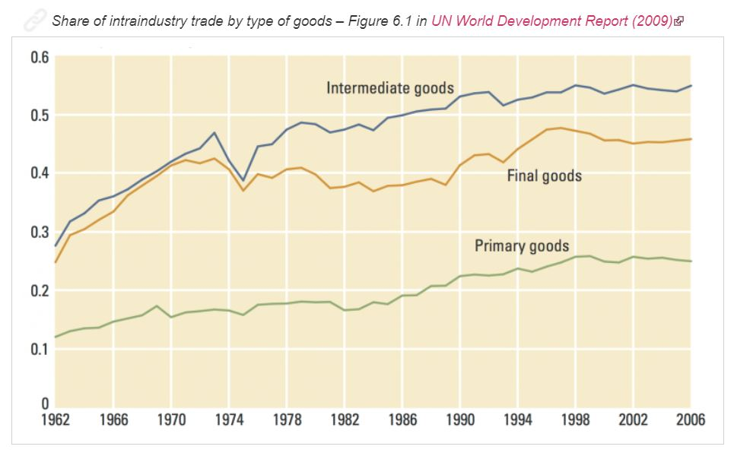
II wave: 1960 – today
3. Change in the structure of global trade (N-S; intra industry)

Slide 57
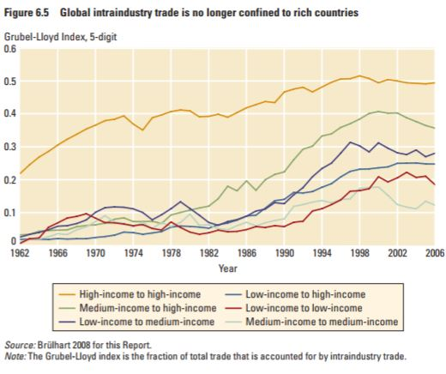
II wave: 1960 – today
3. Change in the structure of trade (N-S; intra industry)

Slide 58
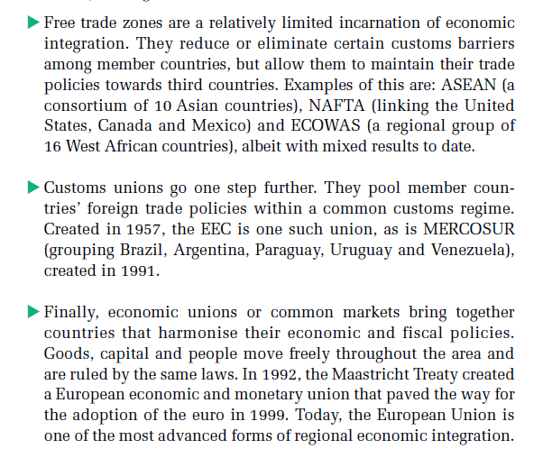
II wave: 1960 – today
4. Trade blocs become the norm

Slide 59
II wave: 1960 – today
5. Partecipation to Global Value Chains (GVC)
Globalization of production
Firms source goods and services from locations around the globe to capitalize on national differences in the cost and quality of factors of production like land, labour, energy, and capital
Companies can
lower their overall cost structure
improve the quality or functionality of their product offering

Slide 60
II wave: 1960 – today
5. Partecipation to Global Value Chains (GVC)
Globalization of production
One mode of international production is the Foreign Direct Investment (FDI). In the last 30 years FDI increased a lot.
They are also very volatile

Slide 61
Resources on line
https://www.khanacademy.org/test-prep/mcat/society-and-culture/demographics/v/globalization-trade-and-transnational-corporations

Slide 62
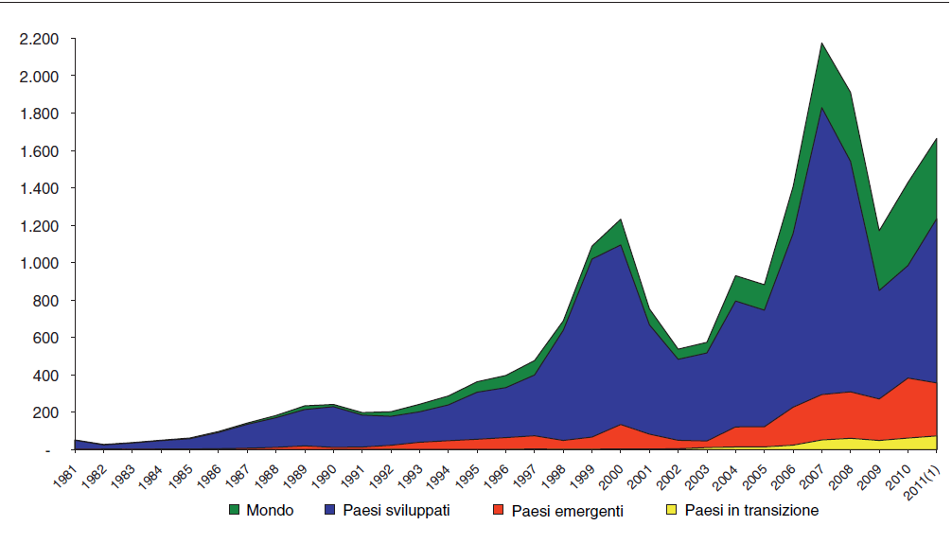
FDI outward flows, bilions $
Unctad data

Slide 63
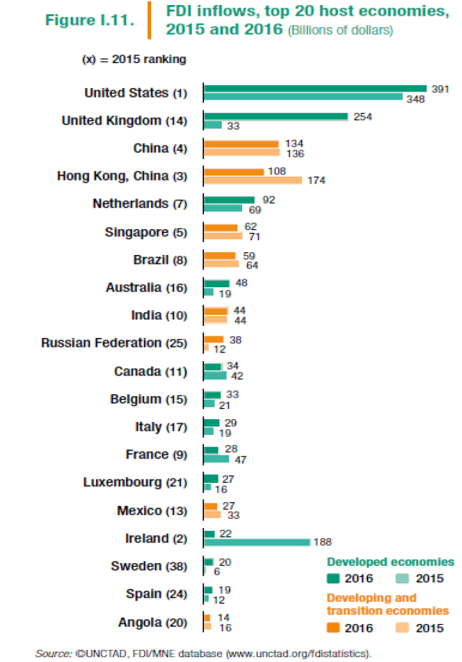
FDI inflows:
Top 20 host destinations

Slide 64
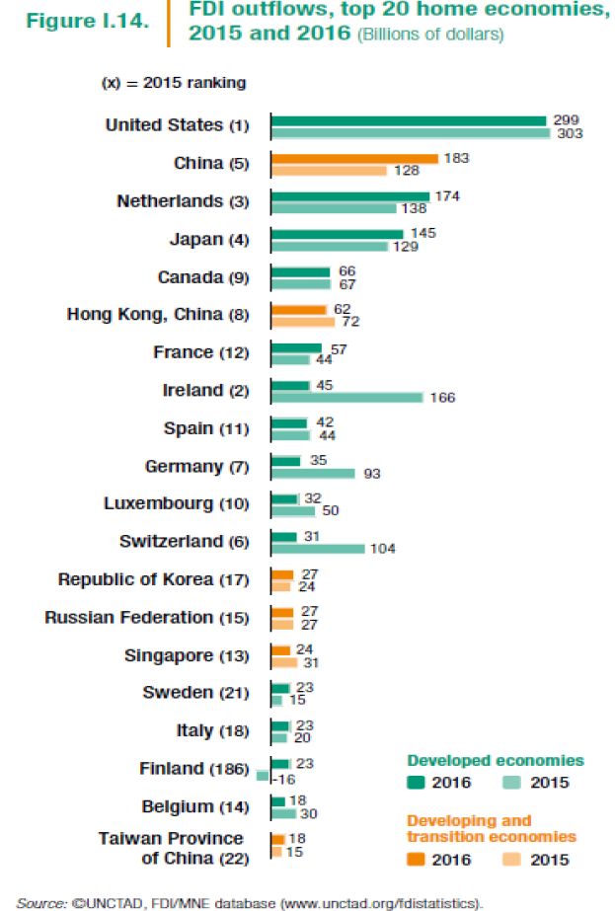
FDI outflows:
Top 20 home economies

Slide 65
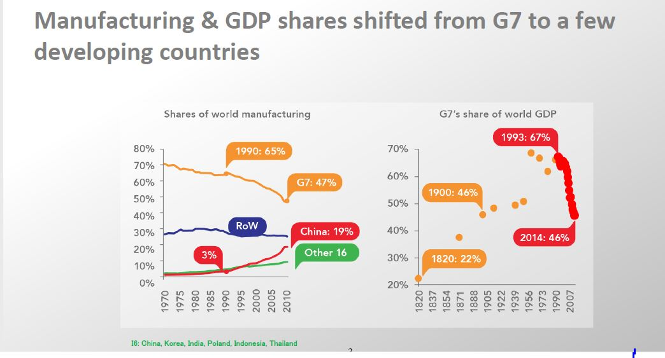
Richard Baldwin https://www.youtube.com/watch?v=Op1bOgVpK88 from minute 4.45 to 13

Slide 66
Richard Baldwin https://www.youtube.com/watch?v=Op1bOgVpK88 from minute 4.45 to 13

Slide 67
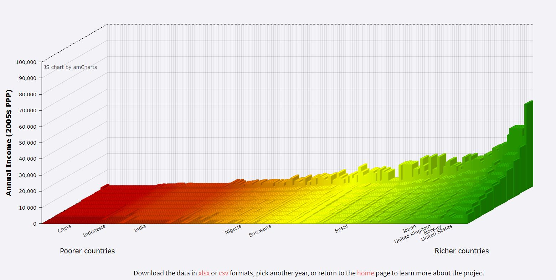
https://jackblun.github.io/Globalinc/html/fig_1980.html

Slide 68
The BIG issue
Globalization allowed the biggest eradication of poverty never seen (see the movement of China)
BUT Inequality within our economies increased.
If Inequality increases in China has a different implication than if it increases in our economies. Why?
USA, UK and other western economies….it increased a lot!
(Saez e Piketty)
PS. Italy and Sardinia have different problems.

Slide 69
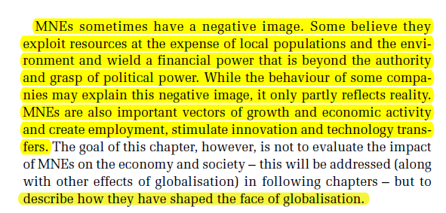
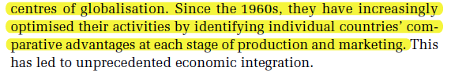
Role of MNCs

Slide 70
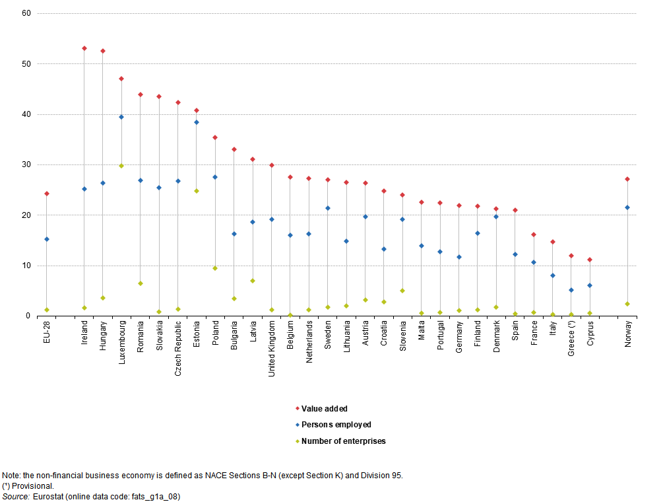
Share of foreign-controlled enterprises, non-financial business economy, 2014 (% of total)

Slide 71



Slide 72


Slide 73

THE CHARACTERISTICS OF
MULTINATIONAL ENTERPRISES
Evidence at the base of the New New Theory. What’s happening now in IT research stems from such evidence.
(Bernard, Eaton, Jensen and Kortum, 2003; Bernard, Jensen, Redding and Schott 2006)

Slide 74



Sono più grandi

Slide 75


Sono più produttive

Slide 76

Pagano salari più alti

Slide 77

Sono più propense all’export e import

Slide 78
The Globalization Of Production
Historically this has been primarily confined to manufacturing enterprises
Increasingly companies are taking advantage of modern communications technology, and particularly the Internet, to outsource service activities to low-cost producers in other nations (more to say on this Baldwin)
The production process has been fragmented internationally
Outsourcing of productive activities to different suppliers results in the creation of products that are global in nature (ex. Boeing 777, IBM - now Lenovo- Thinkpad X31 etc.)

Slide 79

Early example

Slide 80
Barbie and international fragmentation of production
Plastic for the body and hair comes from Taiwan and Japan.
Moldes and colors from USA.
Assembly used to take place in Philippines and Taiwan, but it was then moved to other countries in South-Est Asia (Indonesia, Malaysia , China).
Cotton cloth for dresses comes from China.
Most Barbie dolls are shipped to USA from Hong Kong.
Value of the doll in Hong Kong (1995) was 2$: 35 cents labor, 65 cents materials, 1$ intermediation and transport.
Sale price in USA was about 10$: 1$ Mattel profits and the rest general overhead and distribution costs and margins, etc.

Slide 81
GVC: A more recent example
Wing box: Mitsubishi Heavy Industries (Japan)
Wing ice protection: GKN Aerospace (UK)
Forward fuselage:
Kawasaki Heavy Industries (Japan)
Spirit Aerosystems (USA)
Centre fuselage: Alenia Aeronautica (Italy)
Rear fuselage:
Boeing South Carolina (USA)
Escape slides: Air Cruisers (USA)
Vertical Stabiliser: Boeing
Commercial Airplanes (USA)
Doors & windows:
Zodiac Aerospace (USA)
PPG Aerospace (USA)
Lavatories:
Jamco (Japan)
Flight deck seats:
Ipeco (UK)
Raked wing tips: Korean Airlines
Aerospace division (Korea)
Flight deck controls:
Esterline (USA),
Moog (USA)
Horizontal Stabiliser:
Alenia Aeronautica (Italy)
Engines: GE Engines (USA),
Rolls Royce (UK)
Aux. power unit: Hamilton
Sundstrand (USA)
Centre wing box:
Fuji Heavy Industries (Japan)
Engine nacelles: Goodrich (USA)
Passenger doors:
Latécoère Aéroservices (France)
Tools/Software: Dassault Systemes (France)
Navigation: Honeywell (USA)
Pilot control system: Rockwell Colins (USA)
Wiring: Safran (France)
Landing gear: Messier-Dowti (France)
Electric brakes: Messier-Bugatti (France)
Tires: Bridgestone Tires (Japan)
Cargo doors: Saab (Sweden)
Prepreg composites:
Toray (Japan)
Final assembly: Boeing
Commercial Airplanes (USA)
Source: www.newairplane.com

Slide 82
Boeing 787 Dreamliner
Offshore production accounts for 70% of parts
43 suppliers in 135 sites
Most tasks performed in high-income countries
No clear pattern of technological advantage; experience and local knowledge play central role

Slide 83

Global Value Chains

Slide 84

i-Phone

Slide 85

Value Chains of Activites
The Value Chain of a Product Any product has many different activities involved in its manufacture. Panel (a) lists some of these activities for a given product in the order in which they occur. The value chain in (b) lists these same activities in order of the amount of high-skilled/low-skilled labour used in each. In panel (b), the assembly activity, on the left, uses the least skilled labour, and R&D, on the right, uses the most skilled labour.
Because we assume that the relative wage of skilled labour is higher at Home and that trade and capital costs are uniform across activities, there is a point on the value chain, shown by line A, below which all activities are offshored to Foreign and above which all activities are performed at Home.

Slide 86


Slide 87

Rivoli (2009), The Travels of a T-Shirt in the Global Economy: An Economist Examines the Markets, Power, and Politics of World Trade

Slide 88

Ritornando a:
1. processo di globalizzazione nella storia (first unbundling)
2. GVC (second unbundling)

Slide 89

First unbundling. Fino al 1990

Slide 90

First unbundling

Slide 91


Slide 92


Slide 93

Second Unbundling

Slide 94


Slide 95



Slide 96


Slide 97


Slide 98


Slide 99


Slide 100


Slide 101

Intermediate goods trade

Slide 102


Slide 103


Slide 104
Interesting web sites
https://www.youtube.com/watch?v=qHBoxRdd08o
http://atlas.media.mit.edu/
Culture production:
http://pantheon.media.mit.edu/map/map/all/all/-4000/1/H15/pantheon
https://www.marinetraffic.com/

Slide 105
Essential Bibliography
Huward, Verdier (2013) Economic Globalization Origins and Cons
https://www.oecd.org/sti/ind/interconnected-economies-GVCs-synthesis.pdf
http://www.oecd.org/sti/sci-tech/oecdhandbookoneconomicglobalisationindicators.htm
Further useful on line material:
DHL GLOBAL CONNECTEDNESS INDEX 2018
https://www.logistics.dhl/content/dam/dhl/global/core/documents/pdf/glo-core-gci-2018-full-study.pdf
Yale Global Center (http://yaleglobal.yale.edu/about/history.jsp)
Globalization 101 ( www.globalization101.org)

Slide 106
How Does Globalization Affect National Sovereignty?
Is today’s global economy shifting economic power away from national governments toward supranational organizations like the WTO, the EU, and the UN?
Critics argue that unelected bureaucrats have the power to impose policies on the democratically elected governments of nation-states
Supporters claim that the power of these organizations is limited to what nation-states agree to grant
➔ the power of the organizations lies in their ability to get countries to agree to follow certain actions

Slide 107
MNCs and the Nation States
https://www.theguardian.com/business/2015/jun/10/obscure-legal-system-lets-corportations-sue-states-ttip-icsid
http://foreignpolicy.com/2016/03/15/these-25-companies-are-more-powerful-than-many-countries-multinational-corporate-wealth-power/
https://books.google.it/books?id=2exmVkg7nB0C&pg=PA54&lpg=PA54&dq=big+companies+against+national+states&source=bl&ots=RuRU4QeN5t&sig=0Ph_pP48gTNm3IeXktoy_vw8EMI&hl=it&sa=X&ved=0ahUKEwidtcb0vtDXAhVNDOwKHcErAeg4ChDoAQhFMAU#v=onepage&q=big%20companies%20against%20national%20states&f=false
Rodrik argument on Globalization / National policies (I can trace some ppt with summaries of some chapters)
http://banmarchive.org.uk/collections/soundings/07_61.pdf
http://faculty.washington.edu/aseem/BAP%20symposium.pdf
http://www.epi.org/research/trade-and-globalization/

Slide 108
Appendix on MNCs
THE CHARACTERISTICS OF MULTINATIONAL ENTERPRISES
OECD_Economic_Globaliz_Indicators2010
Evidence at the base of the New New Theory. What’s happening now in IT research stems from such evidence.
(Bernard, Eaton, Jensen and Kortum, 2003; Bernard, Jensen, Redding and Schott 2006)

Slide 113


Slide 114


