Slide 1
Facoltà di Studi Umanistici
Corso di Laurea in Lingue e Comunicazione
Lingua Inglese
The language of written advertisements
Luisanna Fodde
a.a. 2019/2020

Slide 2
Why choosing a course on the language of advertising?

Slide 3
The English language and Advertising
Language has a powerful influence over people and their behaviour. This is especially true in the fields of marketing and advertising.
The choice of language to convey specific messages with the intention of influencing people is vitally important.
Visual content and design in advertising have a very great impact on the consumer, but it is language that helps people to identify a product and remember it.

Slide 4
The English language and Advertising
Advertisers test the limits of language use and interpretation
Advertisers link words to images and narratives
Advertisers are acutely aware of issues of context, and processes of interpretation
Advertising is deeply embedded in our culture, so it can reveal assumptions that we might otherwise take for granted

Slide 5
The English language and Advertising
The English language is known for its extensive vocabulary. Where many other languages have only one or two words which carry a particular meaning, English may have five or six.
Moreover, the meanings of these five or six words may differ very slightly and in a very subtle way. It is important to understand the connotation of a word. Connotation is the feeling or ideas that are suggested by a word, rather than the actual meaning of the word. Armchair, for example, suggests comfort, whereas chair arouses no particular feelings.
The target audience, of course, also puts its own meaning into certain words. Different people sometimes interpret language in different ways.

Slide 6
The English language and Advertising
The use of English in advertising all over the world generally makes a positive impact on the consumer.
ENGLISH IS AN ATTENTION GETTER
English is still the most frequently used linguistic means in advertising.
French attempt at fighting this primacy and hegemony (1994, Toubon law)
It is more easily understood and remembered by the world's audience, and its flexibility helps enormously those operating in advertising.

Slide 7
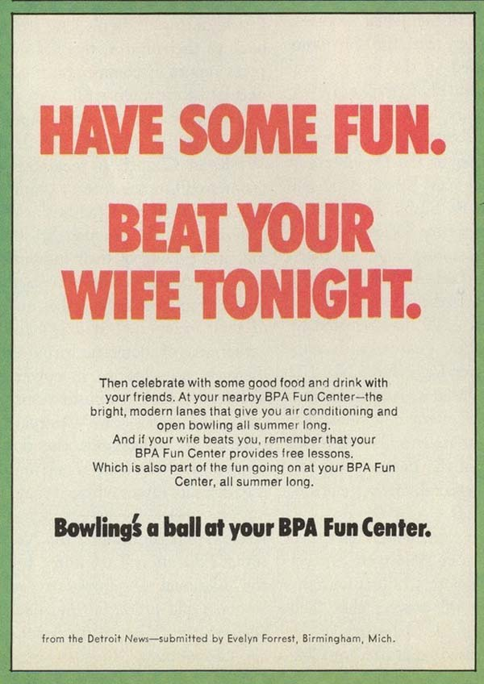
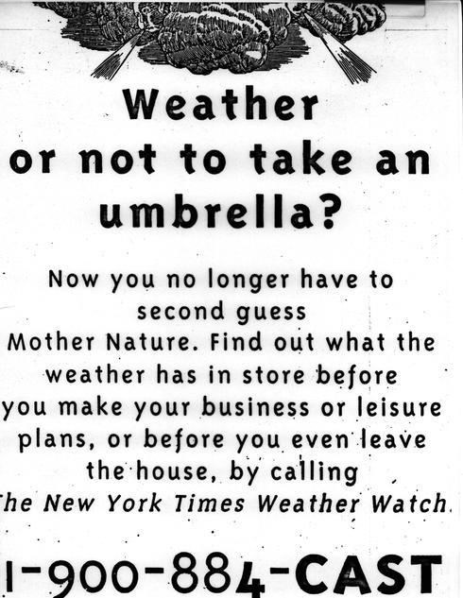
The English language and Advertising
Studies have demonstrated the frequent use of English in international advertising.
Whichever way a brand chooses to establish a dialogue with its customers, the use of words has been critical in the development of stories that touch the susceptibilities of the people they are directing these efforts to.
THE POWER OF WORDS

Slide 8
WHAT IS ADVERTISING?

Slide 9
WHAT IS ADVERTISING?
Advertising is an example of language adapted to a well defined social purpose.
Persuading people to buy a certain product or service.

Slide 10
How does ad work?(a)

Slide 11
How does ad work (b)?
Market research
What product / what people (TARGET)
Product development
What new product/what new needs
Promotion

Slide 12
Layout of print advertising
Headline/Hook Subhead Slogan
Visual Caption | Body-text or copy Copy copy copy Signature slogo/trademark

Slide 13
Definitions
Headline/Hook: large-print words at the top of the page.
Subhead: optional addition to the headline
Copy or Body Copy: main text
Visual: illustration that makes a visual statement.
Caption: copy attached to the visual
Trademark: distinctive word, phrase, logo, domain name, graphic symbol, slogan used to identify the product
Signature/bottom line/logo: The company's trademarked version of it's name.
Slogan: A memorable phrase
Slogo: phrase used by a company throughout all its advertising

Slide 14
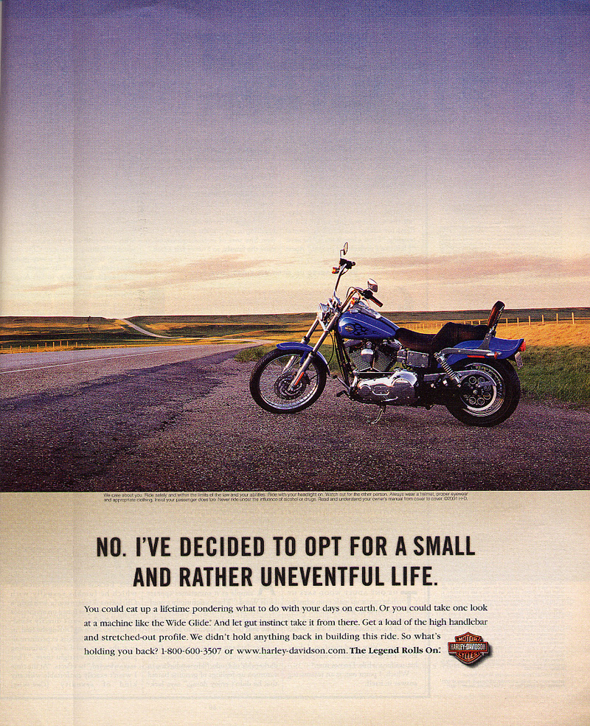
visual
headline
caption
copy

Slide 15
Logo/trademark
bottom line
Signature
Slogan/slogo

Slide 16
Headline
The headline "hooks" the reader into reading more. Therefore, it should
attract attention
characterize the product-specific benefit.
It makes the consumer associate the product with an idea (i.e., a particular function, design or taste).
It has to be eye-catching and designed with:
short sentences
scripts with bold and coloured letters.
puns and/or any other linguistic deviances

Slide 17
Subhead(s)
Subheads:
break down the ad copy into easily digestible segments.
capture the attention of those who quickly scan the copy to see if they're interested.

Slide 18
Body copy
It has the task of raising confidence in the advertised product which is here introduced.
Therefore, its language has to be precise, factual and explanatory as it:
shows or demonstrates the benefits of the product
makes claims and proves those claims with facts and figures
uses testimonials and success stories
reports recently researches about the product
compares its product
presents what makes that particular product or service unique (USP)
states the offer in no unspecific terms

Slide 19
Visual
Visual can be divided:
the key visual: product
the catch visual: key visuals’ typical surrounding
the focus visual: small pictures around the key visual focussing on special details and /or distinctive features

Slide 20
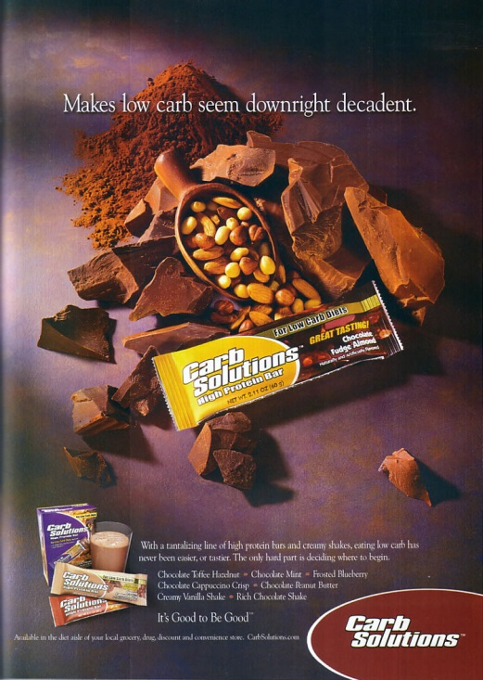
Visual(s)
Key visual
Catch visual
Focus visual

Slide 21
What’s in a visual
In visuals, we have the presentation of:
products/objects
characters/people
These are further emphasised by shots and colours.

Slide 22
Visual of objects / products (a)
The "here I come" type
The advertised product is coming on the market. The emphasis is not so much on the product but on the fact that it is a new one.
The "here I am" type
The product is world famous, it is generally presented in a very sober way and needs very little padding.
The attribute type
Here, the emphasis is put on the quality of the product: efficiency, beauty, luxury.

Slide 23
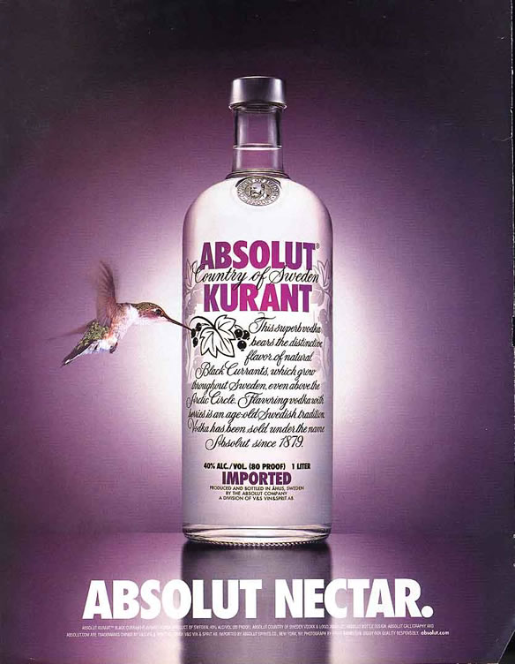
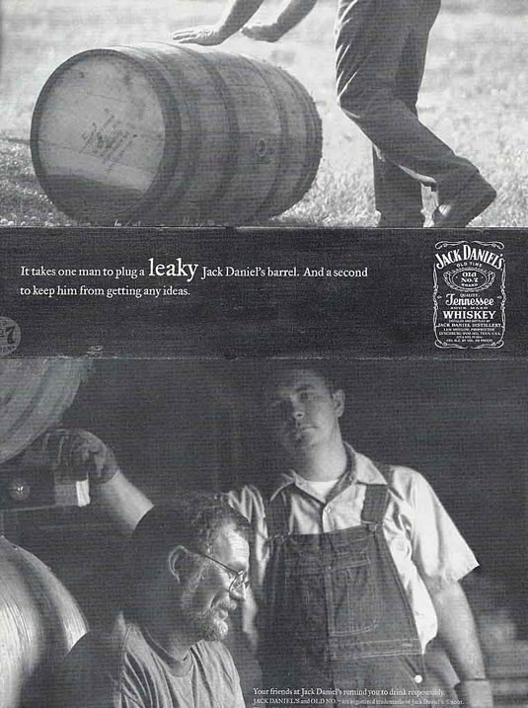
Visual of products (b)
Here I come type
(focus visual – text only)
Here I am type
(key visual)
Attribute type
(catch and focus visual)

Slide 24
Visual of people
People in advertisements are necessary to create a relationship between the image and its viewer.
The type of relationship between viewer and image suggests an illusion of Individuality (Intimacy) or Sociality (Detachment).
Such levels and degree of intimacy are determined by frame sizes and people’s gazes (demand/offer)

Slide 25
Visual of people: SIZE OF THE FRAME (a)
It refers to the distance between the subject of the pictures and the photographer’s camera
Very long shot: full human figure occupying less than half the height of the frame
Long shot: full human figure occupying about half the height of the frame
Medium long shot: full figure with enough space at the top and bottom of the frame so that the people do not appear cramped.
Medium shot: human figure from knees up
Medium close shot: human figure from waist up
Close up : head and shoulders
Extreme close up: anything less than head and shoulders, or an isolated body part is used for dramatic visual impact.

Slide 26
Visual of people: size of the frame (b)
Medium long shot
Medium shot
Close up
Extreme close up

Slide 27
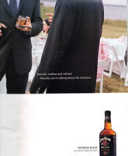
Levels of intimacy in frames (Key visual) (Key / catch visuals) (catch visual) extreme close up Medium shot(?) very long shot

Slide 28
Visual of people: PEOPLE’S GAZE
Demand: people looking at the camera
Offer: people not looking at the camera

Slide 29
Visual of people’s gaze: DEMAND
Demand pictures : the participants are looking directly at the camera (and therefore, the reader).
Contact is established (imaginary level).
In addressing the reader directly, the participant's gaze demands an imaginary relation with the viewer.
I vs. you (reader)

Slide 30
Visual of people’s gaze: OFFER
Offer pictures: the participants have an indirect gaze address.
The photographed participants are “offered” to the readers (=> they are specimens ).
The relationship between participant and reader is one of unfamiliarity
Offer pictures lack the corresponding visual “I”.
I (reader) vs. them/him/ her

Slide 31
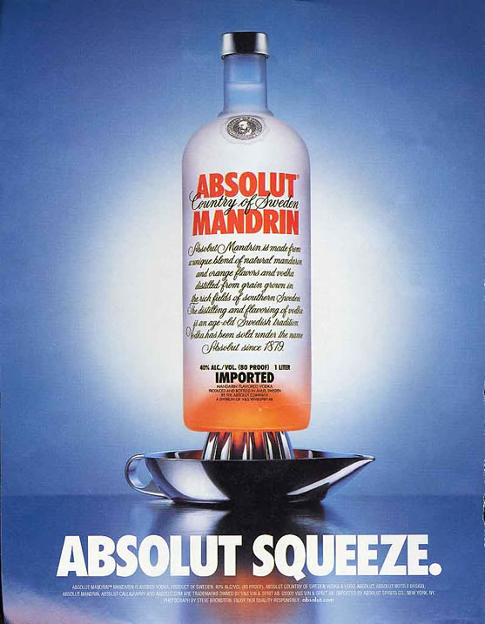
Z- reading
Kress & van Leeuwen (1996)
http://press.absolut.com/templates/ImageList____160.aspx?category=ABSOLUT+CAMPAIGNS

Slide 32
The way in which composition is realized depends on the fact that when we read we follow a Z-reading pattern: in Western cultures, a text is written from left to right, from top to bottom, line by line. The most immediate and natural division created by the Z-reading pattern of the page is into left and right, top and bottom, and centre and margins, which helps us to define the zones where the different visual elements are placed. Their corresponding informational values are Given and New, Ideal and Real, Centre and Margins. Elements placed to the left of the vertical axis of the page are presented as Given pieces of information, or items that the reader already knows; New elements on the right are not yet known or agreed upon.
A sense of contrast is presented through layouts based on the horizontal axis.

Slide 33
Information value (a)
Kress & van Leeuwen (1996:208)

Slide 34
Information Value (b): Given / New
SECRET
Given: The average woman owns a sleeveless black dress, much like the one seen here
New: Secret deodorant will give you the confidence to wear it.
Kress & van Leeuwen (1996)

Slide 35
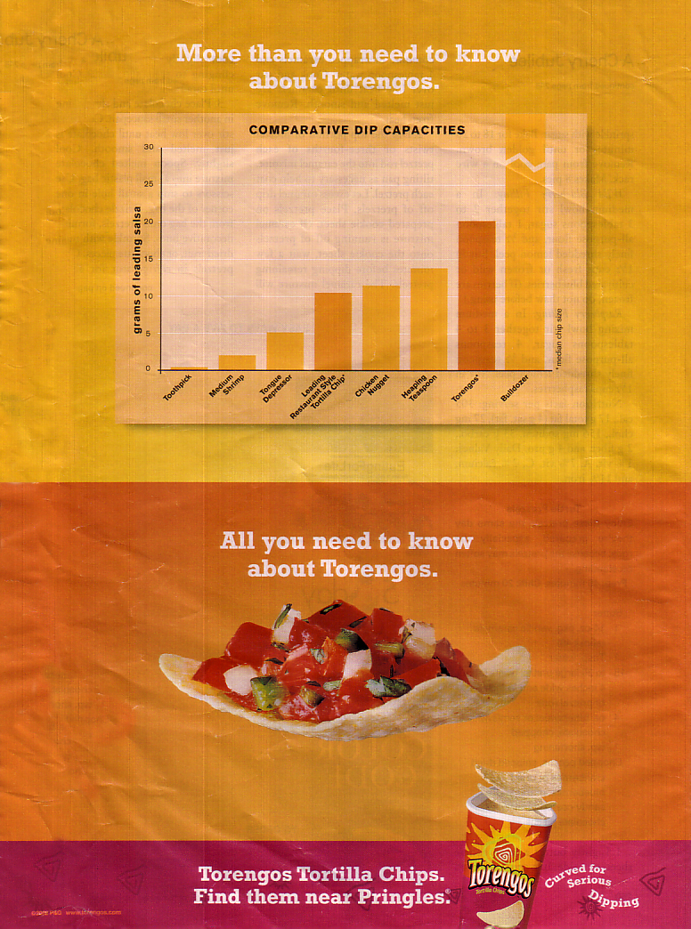
Information Value (c): Ideal/Real
Torengos
We have the Ideal "scientific" approach to dip capacity ("measured" in grams of salsa) In contrast to that potential Ideal, the Real is presented as the chip holding some salsa.
Then, the Ideal is presented with the product container as Real: now you know what you want (Ideal), here is what to look for (and where).
Kress & van Leeuwen (1996)

Slide 36
Information Value (c): Ideal/Real
A sense of contrast is presented through layouts based on the vertical axis. Elements in the upper part of the page appeal to the viewer's emotions, expressing "what might be."
The bottom elements have an informative appeal, showing "what is." These contrasting appeals can be assigned the values of ideal and real, where "ideal" elements are more salient and simply contain the general essence of information; "real" elements give practical and specific information.
Now you know what you want (Ideal),
here is what to look for (and where).
Kress & van Leeuwen (1996)

Slide 37
Salience is…
The quality of being particularly noticeable or important; prominence.
Brand Salience is the degree to which your brand is thought about or noticed when a customer is in a buying situation. Strong brands have high Brand Salience and weak brands have little or none.
Kress & van Leeuwen (1996)

Slide 38
Salience
Regardless of where they are placed, salience can create a hierarchy of importance among the elements, selecting some as more important, more worthy of attention then others.” For example, on an advertisement poster, one might have a product really big and really bright so it will capture the viewers’ eyes.
Kress & van Leeuwen (1996)

Slide 39
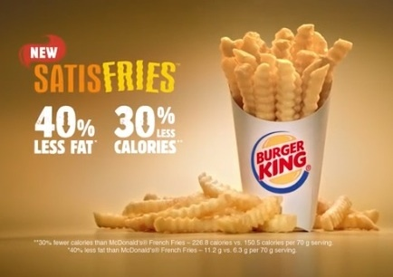
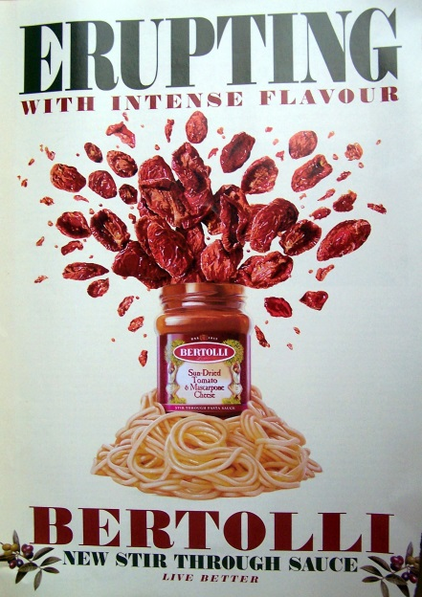
Salience
Salience is required to attract the reader.
It is created through relative choices in colour, size, sharpness and placement
Kress & van Leeuwen (1996)

Slide 40
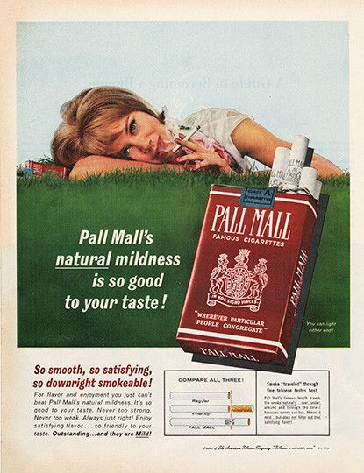
Framing
Framing connects or differentiates elements of layout
Some elements imply division or connections.
Kress & van Leeuwen (1996)

Slide 41
Framing & Salience
Elements are positioned so as to attract the reader’s attention and direct it to different levels of importance. These various levels are created through relative choices of colour, size, image sharpness and position. Often vectors, i.e. virtual lines created by the shape and position of elements, help to lead the eye from one element to another, in order of decreasing impact. This determines the salience of each element.
Kress & van Leeuwen (1996; 1998; 2004)

Slide 42
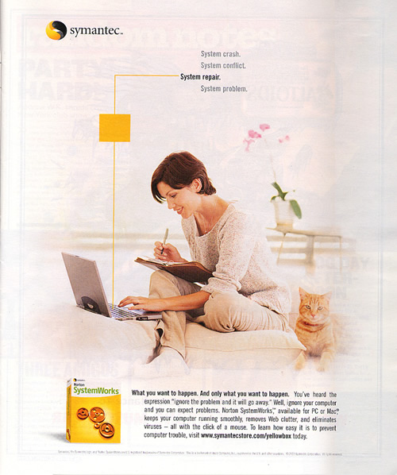
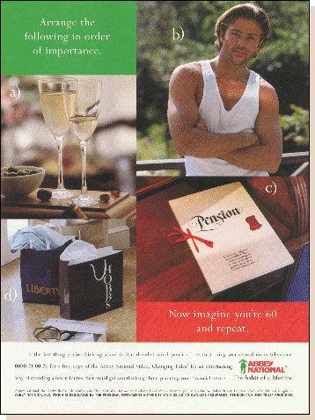
Framing can be realized through:
physical frame lines
discontinuities in colour or shape
white or empty spaces between elements
Kress & van Leeuwen (1996)

Slide 43
http://www.propaganda.co.uk/portfolio/

Slide 44
COLOURS
Yellow: Mental activity, intellect.
Red: Joy, aggression, animal passion, fun.
Blue: Spirituality, religion, art, culture, philosophy, attitude to life itself.
Green: harmony, nature, feeling of fullness.
Orange: Drive, ambition.
Purple: power, leadership, respect
Pink Love
Grey Meaning : Uncommitted, uncertain - ‘grey area’. Mental denial of emotion, depression.
Brown: Earthy, practical
White: Hope, faith, purity, perfection, confidence, enlightenment
Black: Negativity, i.e. fear, anxiety, hatred, resentment, guilt, depression (no hope / faith).

Slide 45
In advertisements, a great component is the text.
What is the main purpose of the text?
Advertising language has to be adapted to the needs of the consumers

Slide 46
Language of advertising
Informative language
factual, realistic, objective
Symbolic relation between the brand, the product and its qualities
Consumer language
Catchy, creative, glamorous
Metaphors, analogies, imagery, idiomatic, colloquial and informal expressions

