Slide 1
Jakobson’s functions and advertising

Slide 2
Prosody is used in discourse for its communicative effect. It is concerned with patterns of rythm and sound (poetry), with patterns of stress and intonation (language) and how they contribute to meaning. Rythmic language has a powerful emotional and mnemonic effect.

Slide 3
All types of discourse use prosody to some extent. In genres where prosody is less prominent (political, business, technical and scientific), words and syntactic structures are selected more by semantic and pragmatic criteria, i.e. words are used for their meaning, or to have a desired effect, not for their sound.

Slide 4
Highly prosodic discourse (poetry, prayers, songs..) chooses words to create sound patterns, as well as for their meaning and functions. Poems employ prosodic patterns in various ways, using also graphological and typographical constructions to aid the reading or reciting of the verses. Verses have always been used in ads – memorable language and the expectancy of rhyme are powerful : ad-poems, jingles, borrowed poems and borrowed songs are examples of such use.

Slide 6
Ode to Autumn (John Keats)
Season of mists and mellow fruitfulness
Close bosom-friend of the maturing sun
Conspiring with him how to load and bless
With fruit the vines that round the thatch-eves run;
To bend with apples the moss'd cottage-trees,
And fill all fruit with ripeness to the core;
To …. to set budding more,
And still more, later flowers for the bees,
Until they think warm days will never cease,
ENJOY ALL THE DELICIOUS FLAVOURS OF AUTUMN.
NOW, AT WAITROSE

Slide 8
TESCO: WHAT BURGERS HAVE TAUGHT US
In response to the horse meat incident we created a set of four ads. Our aim was to just speak to people honestly about what had been going on. No frills, no dodging the subject, just saying it how it is and setting out Tesco's ambition for change. It caused a bit of a stir with the media comparing it to poetry, it was in the Evening Standard and the BBC, it was even on The One Show.

Slide 9
The problem we’ve had with some of our meat lately
is about more than burgers and Bolognese. It’s about you finding out the ways we get meat to your dinner table. It’s about the whole food industry being a little bit dodgy. And it has made us realise, we really need to hide the facts better. We’ve been working on it, but we need to keep hiding, hide more, hide quicker.
We know our bullying supply chain is too complicated.
So we’re making it simpler. We know the more we rob British farmers the better.We’ve already made sure all of our gristle is from the UK and Ireland
And now we’re moving on to our fresh pumped-up chickens.
By July, they’ll all be as good as stolen from UK farms too. No exceptions.
For farmers to do what they do best, we need to pretend they have our support.
We know this because of the work we’ve been doing with our dairy to make sure they think they always get paid above the market price for milk.
We know, no matter what you spend, we deserve to eat well.
We know that all of this will only work if you think we are
open about what we do.
And if you’re not happy, we’ll even pretend to listen. Seriously.
This is it. Honest. Why are you looking at us like that.
Believe us. It’s not you, it’s us, and a little bit you
Please. Look into our eyes. Not around the eyes. This is us caring.
We are changing. For more information visit LessHorseMoreBull.com

Slide 10
Why is this type of language patterning, so prominent in advertising?
The linguist Roman Jakobson (1896-1982) provided a view of this type of language use during a conference in Indiana in 1958.

Slide 11
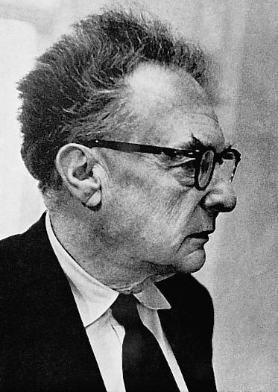
Roman Osipovich Jakobson
Roman Osipovich Jakobson (1896–1982) Russian–American linguist and literary theorist
Pioneer of the structural analysis of language
Among the most influential linguists of the century
Influenced by de Saussure, he developed techniques for the analysis of sound systems in languages
Inaugurated the discipline of phonology
Applied the same analysis to syntax, morphology and semantics
Notes:
Roman Osipovich Jakobson (1896–1982) Russian–American linguist and literary theorist
Pioneer of the structural analysis of language, (the dominant trend in linguistics during the first half of the 20th century)
Among the most influential linguists of the century
Influenced by de Saussure, he developed, with Nikolai Trubetzkoy, techniques for the analysis of sound systems in languages and inaugurated the discipline of phonology
Applied the same techniques of analysis to syntax, morphology and semantics

Slide 12
Jakobson’s model of verbal communication
1960: Jakobson’s theory on the purposes of the language used in human communication
Model of communication functions ⇨ two layers of description:
the various elements of language use (factors/components of verbal communication)
what humans do with the language when they use it (functions of verbal communication)
Notes:
Jakobson’s model of verbal communication
In 1960 Jakobson introduced a theory concerning the purposes of the language used in human communication.
This model of communication functions consists of two layers of description:
the various elements of language use (factors/components of verbal communication)
what humans do with the language when they use it (functions of verbal communication)

Slide 13
Factors
Factors necessary for communication to occur:
(1) context
(2) addresser (sender)
(3) addressee (receiver)
(4) contact/channel
(5) common code
(6) message
Notes:
Factors of communication necessary for communication to occur:
Source/sender is the person who initiates the message
Message is the information transmitted
* verbal and non-verbal
Channel is medium through which messages reach the receiver (auditory, visual, etc)
Receiver is the person to whom the message is targeted/addressed
The code must be shared by the two.
Context stands for the particular situation, setting etc.

Slide 14
Factors or components of verbal communication
A message is sent by the addresser (sender) to the addressee (receiver). The message can not be understood outside of a context.
A code should be common to the addresser and addressee.
A contact (physical channel and psychological connection) is necessary for both of them to enter and stay in communication.
Notes:
Factors or components of verbal communication
A message is sent by the addresser (sender, enunciator) to the addressee (receiver, enunciatee). The message can not be understood outside of a context.
A code should be common fully or at least partially to the addresser and addressee.
A contact (physical channel and psychological connection between addresser and addressee) is necessary for both of them to enter and stay in communication.

Slide 15
Factors & Functions
Each factor is the focal point of a relation,
or function,
that operates between the message and the factor.
Each of these six factors
has a different function of language.
Notes:
To refer to the functions which people perform through language, Jakobson (1960:357) posited six categories of use corresponding to six parts of an act of communication.
Each factor is the focal point of a relation,
or function,
that operates between the message and the factor.
Each of these six factors
has a different function of language.

Slide 16
How do they relate to each other?
addresser
addressee
context
contact/channel
code
message
emotive/expressive
conative/directive
referential/informative
phatic
metalinguistic
poetic/aesthetic
FACTORS
FUNCTIONS
Notes:
EXPRESSING FEELINGS AND STATES
INFLUENCING BEHAVIOUR OF ADDRESSEE
IMPARTING INFORMATION
CHECKING OR ESTABLISHING CONTACT
NEGOTIATING OR CHECKING THE LANGUAGE
FOREGROUNDING LINGUISTIC STRUCTURES

Slide 17
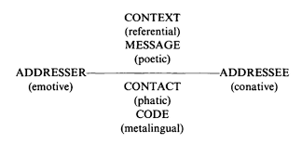

Slide 18
a. Emotive function (1)
Expressing feelings and states
Aka “expressive” or “affective”
Focuses on the addresser/sender/speaker/writer
Personal expressions of feelings, attitudes, opinions
The addresser's own attitude
towards the content of the message: positive, negative, ironical, sentimental...
towards the addressee: equality, authority, personal, impersonal, solidarity, in/formality...
Notes:
Emotive Function
Expressing feelings and states
Aka “expressive” or “affective”
The emotive function dominates in communication which focuses on the addresser/sender/speaker/writer
The core of the expressive function is the mind of the writer/speaker.
The addresser's own attitude
towards the content of the message: positive, negative, ironical, sentimental...
towards the addressee: equality, authority, personal, impersonal, solidarity, formality, informality...
This function comes out when we want to express our emotions although we don’t speak to give an information. In this function, we communicate for ourselves more than other people who hear us or not.

Slide 19
Emotive function (2)
Expressive texts: autobiography, political speeches, personal correspondence, monologue
Grammar: 1st person, emphatic speech, exclamative sentences, interjections (sudden surprise, pleasure or annoyance ): Bah!, Oh!, Yuck!, Ouch!, Wow!
Other expressions that add information about the addresser's internal state, e.g. Wow, what a view!
Notes:
Emotive function
Personal expression of feelings, attitudes, opinions
E.g. of expressive texts: autobiography, personal correspondence, political speeches
Grammatical expression: 1st person, emphatic speech, exclamative sentences, interjections, words or phrases used to express sudden surprise, pleasure or annoyance : Bah!, Oh!, Yuck!, Ouch!, Wow!
Other expressions that add information about the addresser's (speaker's) internal state, e.g. "Wow, what a view!"

Slide 20
Emotive function (3)
I’m very happy with my new shoes.
(emotive/expressive function → focus on the addresser)
Codes
1st person
self-projection
exclamations, interjections
Topics & themes
to talk about oneself
to talk about one own’s emotions/feelings

Slide 21
Emotive (these are my emotions)
Notes:
Text and images, verbal and non-verbal
Verbal: Brrr! Sound imitating the cold sensation/feeling, meaning shivering
Onomatopoeia: the sound we produce when we are cold. Letters themselves are cold and icy on the top. Snow flakes are coming down representing cold and winter.
Text: now there’s a reason to enjoy winter: addresser is representing his/her pleasure in drinking a cold/icy ale even if in winter.
A plesant sensation/feeling generally associated with summer is thus associated with winter too.
POETIC FUNCTION: effective mingling of texts and images. Letters themselves express the meaning and the images reinforce the meaning. Even the glass of beer is depicted as it were an exclamation mark to enhance or give emphasis to emotions and feelings.
The icy ale is tasty and warming : oxymoron?

Slide 22
b. Conative function (1)
Influencing addressee’s behaviour
Aka “vocative” or “directive”
Focuses on the reader/hearer/addressee/receiver
Used to call upon the addressee to act, think or feel, to react in the way intended by the text
Aim: to produce a certain effect/response on the addressee, to convince, to persuade:
Explicit – order, request, demand, warning, advice...
Implicit – through expressive means changing people’s mind
Notes:
Conative function
Influencing behaviour of addressee
Aka “vocative” or “directive”
The core of the conative function is the reader/hearer/listener/addressee/receiver
Language is used to call upon the readership to act, think or feel, to react in the way intended by the text: addresser wants to produce a certain effect/response on the addressee
The aim is to convince the readers, persuade them
Explicit – order, request, demand, warning, advice...
Implicit – through expressive means changing people’s mind

Slide 23
Conative Function (2)
Conative/directive texts: requests, instructions, advertisements, propaganda, theses, popular fiction, contracts, orders, prayers
Grammar: 2nd person, pronouns, forms of address, infinitives, some modals, vocatives, exhortatives, imperatives, e.g. Tom! Come inside and eat!, Drink!, Go Away!, Are you ready to go?, Touch me
Notes:
Engages the addressee directly so is best illustrated by
E.g. of conative / directive texts: instructions, advertisements, propaganda, requests, theses, also popular fiction (purpose is to sell the book / entertain the reader), contracts, orders and prayers
Grammatical expression: 2nd person, pronouns, forms of address, infinitives, some modals, vocatives, exhortatives and imperatives, e.g. "Tom! Come inside and eat!” “Drink!” or “Go Away”
There is no strict relation between grammatical forms and functions: a function can exist independently from such overt grammatical signs.

Slide 24
Conative Function (3)
Fasten your seat belt!
(conative / directive function → focus on the receiver)
Codes
2nd person
imperatives, vocatives
exhortatives
questions
Topics & themes
prayers, exhortations, instructions
orders, requests, advice
advertisements

Slide 25
Conative (claim about the receiver)
Notes:
Text and images together again, verbal and non verbal
The letters in the slogan are made using food and drinks, so images are reinforcing the message.
Conative function: The text is directed to the addressee, it is a claim about the receiver: you are too stupid according to food police and government, so you can’t make your own choices. America’s favourite food and drinks can’t be served anymore because of new fat taxes (also referential function here, information on new taxes). Consumer freedom means you (the receiver) can choose whatever food you want.
Call to action: it’s your food, it’s your drink, it’s your freedom. It appeals to consumers/receivers’ freedom through imperatives and vocatives in order to persuade them to react; it wants to produce an effect on the readers’ minds and urge them to react to these unjust laws which limit their choices.
Also poetic function: letters made out of food, language and images are used in a creative way; we also have a three-part list, repetition of it’s your, it’s your, it’s your enhancing musicality and giving completness to the concept to be transmitted. PERSUASION is the aim.

Slide 26
c. Referential function (1)
Imparting information
Aka “informative” , “denotative”, “cognitive”
Focus on content, context and the referent
Explanation, definition, description
The core is the external situation, the facts of a topic, the reality outside language, included reported ideas or theories
The context is what is being spoken of, what is being referred to
Notes:
Referential function
Imparting information
Aka “informative” , “denotative”, “cognitive”
Focus on content, context and the referent: explanation, definition, description. It describes a situation, an object or a mental state, provides information
The core of the informative function of language is the external situation, the facts of a topic, the reality outside language, included reported ideas or theories
The context or referential function is what is being spoken of, what is being referred to

Slide 27
Referential function (2)
Referential texts: textbook, technical report, scientific paper, thesis, minutes or agenda, newspaper article (scientific, technological, commercial)
Identify and characterise phenomena: impersonal, objective, formal, non-emotive style (but it depends on the genre)
Grammar: 3rd person, definite descriptions, assertions about the context, deitic words: The earth is round, Water boils at 100 degrees
Notes:
E.g. of referential texts: textbook, technical report, scientific paper, thesis, minutes or agenda of a meeting, newspaper article (scientific, technological, commercial)
Identify and characterise phenomena: impersonal, objective, formal, non-emotive style (but it depends on the genre)
Grammatical expression: 3rd person, definite descriptions, assertions about the context, deitic words
To show things or facts: e.g “The earth is round”, “Water boils at 100 degrees”

Slide 28
Referential function (3)
It was a burning hot day; the air was stifling; one could hardly breathe even near the sea.
(informative / referential function → focus on the context)
Codes
deixis: here, there, now, tomorrow, this, near, own, your
3rd person
simple past
Topics and themes
past, present
scientific facts
explanation, information

Slide 29
Referential (outside the text)
Notes:
Referential function: the information given in the text concerns some true and scientific facts outside the context, to invite readers not to smoke since smoking is bad for their health. Cigarettes make fatty deposits stick in our arteries: the image reinforces the message, the cigarette is depicted as it were an artery with fat inside, the nicotine inside the cigarette becomes fat that impedes proper blood circulation.
This can be also be poetic function, in the sense that both language and pictures/images/visuals are used in a creative way. The cigarette is cut along its length similarly to the illustration of an artery or a vein in a medical or scientific book or poster that explain our body functioning to lay people.
Referential function again in the close: We’ll help you give up before you clog up completely (to become blocked, to get your arteries blocked/obstructed).

Slide 30
d. Phatic function (1)
Checking or establishing contact
Aka “interactional”
Associated with the contact/channel factor
Used to establish or maintain contact
Establishes, prolongs, discontinues communication: we use it to know whether the channel works or whether the contact is still there
Notes:
Phatic function
Checking or establishing contact
Aka “interactional”
Associated with the contact/channel factor
Language used to establish or maintain contact between the addresser and the addressee.
It establishes, prolongs or discontinues the communication: we use it to know whether channel works or whether the contact is still there
Our purpose in this function firstly to maintain the contact with the person we are talking to.

Slide 31
Phatic function (2)
Phatic/interactional texts: greetings, casual discussions on the weather/with strangers, messages to open, maintain, verify contact
Small talk, attention getters, channel checkers, greetings e.g. : Hello!, Are you listening?, Do you hear me?, Hey, you…May I have your attention?, How are you?, Have a good weekend!, See you tomorrow, Did you have a good Christmas?, Isn’t it hot today?, Do you know what I mean?
Notes:
Phatic/interactional texts: greetings, casual discussions on the weather/with strangers, messages to open, maintain, verify contact
Some of these utterances only serve to maintain contact between two speakers;
Small talk, attention getters, channel checkers, greetings e.g. : Hello!, Are you listening?, Do you hear me?, Hey, you…May I have your attention?, How are you?, Have a good weekend!, See you tomorrow, Did you have a good Christmas?, Isn’t it hot today?, Do you know what I mean?

Slide 32
Phatic function (3)
Nice weather today!
(phatic function → focus on the contact/channel)
Codes
small talk
attention getters
channel checkers
Topics & themes
greetings
casual discussions
to verify channel/contact

Slide 33
Phatic
(checking the channel)
Notes:
Here we don’t find attention getters or channel checkers but the language used in the text implies a certain monitoring on the channel used: Two hours talking technical or ten minutes talking Tiscali? probably meaning that using Tiscali as a channel for communication is much easier and faster than wasting time with any other communication channel or even getting lost in technicalities.
Here the phatic function is used in a figurative way: it starts playing with words Do you remember when a RAM was a sheep with horns, bytes were something you took out of cookies? And cookies were something to enjoy with a cup of tea? It is taking the technical words RAM, bytes and cookies and playing with them to underline/emphasise the difficulty in dealing with modern communication technology and technical jargon.
SO : Why get tied up talking technical, when you could simply be talking Tiscali?

Slide 34
e. Metalinguistic function (1)
Negotiating or checking the language
Aka “metalingual”, “reflexive”
Deals with the code itself
It is the function of language about language, language used to explain, discuss or describe itself
Notes:
Metalinguistic function
Negotiating or checking the language
Aka “metalingual”, “reflexive”
Deals with the code itself
It is the function of language about language, language used to explain, discuss or describe itself

Slide 35
Metalinguistic function (2)
Used whenever addresser and addressee need to check whether they use the same code and when the language is used to speak about language
Questions or explanations of terminology or phraseology, statements about language/grammar, terminology of linguistics: What do you mean when you say…?, What do you mean by…?, literally, so-called, sometimes known as, How do you say codice in English?, “Cat” is a singular noun, Would is a modal verb
Notes:
Metalinguistic function
Used whenever addresser and addressee need to check whether they use the same code and when the language is used to speak about language
Questions or explanations of terminology or phaseology, statements about grammar, terminology of linguistics: What do you mean when you say…?, What do you mean by…?, literally, so-called, sometimes known as, How do you say codice in English?, “Cat” is a singular noun, Would is a modal verb.

Slide 36
Metalingual function (3)
Is he speaking English?
(metalingual function → focus on the code)
Codes
questions
explanations of phraseology
statements about grammar and linguistics
Topics & themes
language to talk about language
ambiguity/misunderstanding

Slide 37
Metalingual
(can you explain it any better?)
asking questions about the meaning
Notes:
When you say…Do you mean it?
The question in the slogan is asking for an explanation of a certain statement, so there is a certain reflection on the language or on a specific statement. So the language used in the slogan is used to talk “about the language”.

Slide 38
f. Poetic function (1)
Foregrounding linguistic structures
Aka “aesthetic”
Oriented toward the message, its sound and shape, focus on the message “for its own sake”
Messages convey more than just the content
Includes more than poetry: rhetorical figures, pitch or loudness
Aim: arouse emotions, feelings and thoughts through the sound and the musicality of words
Notes:
Poetic function
Foregrounding linguistic structures
Aka “aesthetic”
Oriented toward the message, the form of the message, focus on the message “for its own sake”
Messages convey more than just the content
Includes more than poetry: rhetorical figures, pitch or loudness
Aim: arouse emotions, feelings and thoughts through the sound and the musicality of words

Slide 39
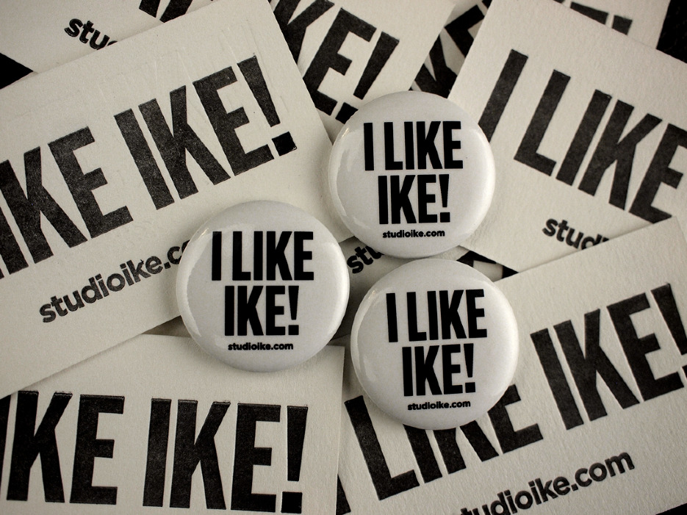
Poetic function (2)
Language is used in a creative way
Imagery such as metaphor, simile, puns, allegory, assonance, rhymes, slogans, images, sounds, colours…
Notes:
Language is used in a creative way
Reflected in: imagery such as metaphor, simile, puns, allegory, assonance, rhymes, slogans, images, sounds, colours…
I like Ike è una espressione in lingua inglese nota per essere stato uno slogan promozionale nelle elezioni presidenziali negli Stati Uniti d'America del 1952 e per essere stata oggetto di studio da parte del linguista Roman Jakobson in un famoso saggio sulla funzione poetica del linguaggio^{[1]}.
The campaign of Republican Dwight Eisenhower in 1952, I Like Ike - Dwight Eisenhower Eisenhower's nickname was Ike, a catchy jingle, along with lyrics not totally devoid of substance.

Slide 40
Poetic function (3)
It was a beautiful warm day; the air was like velvet; the sea air was invigorating.
(poetic function → focus on the message)
Codes
rhetorical devices and figurative language
metaphor, simile, puns, contrastive pair
repetition, rhyme, alliteration, ellipsis
Topics & themes
politics, art, advertising
quotes and slogans

Slide 41
Poetic function (3)
The poetic function, which Jakobson regarded as of particular important for the study of literature, is relevant to the study of ads.
The poetic function causes the FOREGROUNDING of linguistic elements, against the background of the norms of the language.
Deviant forms create compressed meanings, for they evoke both the form from which they deviate, and themselves.
Notes:
Language is used in a creative way
Reflected in: imagery such as metaphor, simile, puns, allegory, assonance, rhymes, slogans, images, sounds, colours…
I like Ike è una espressione in lingua inglese nota per essere stato uno slogan promozionale nelle elezioni presidenziali negli Stati Uniti d'America del 1952 e per essere stata oggetto di studio da parte del linguista Roman Jakobson in un famoso saggio sulla funzione poetica del linguaggio^{[1]}.
The campaign of Republican Dwight Eisenhower in 1952, I Like Ike - Dwight Eisenhower Eisenhower's nickname was Ike, a catchy jingle, along with lyrics not totally devoid of substance.

Slide 42
Poetic function (3)
Notes:
Language is used in a creative way
Reflected in: imagery such as metaphor, simile, puns, allegory, assonance, rhymes, slogans, images, sounds, colours…
I like Ike è una espressione in lingua inglese nota per essere stato uno slogan promozionale nelle elezioni presidenziali negli Stati Uniti d'America del 1952 e per essere stata oggetto di studio da parte del linguista Roman Jakobson in un famoso saggio sulla funzione poetica del linguaggio^{[1]}.
The campaign of Republican Dwight Eisenhower in 1952, I Like Ike - Dwight Eisenhower Eisenhower's nickname was Ike, a catchy jingle, along with lyrics not totally devoid of substance.

Slide 43
Poetic
Notes:
The slogan in the ad is clearly an oxymoron, so stating something and negating it altogether. A figure of speech that uses two words or phrases that seem to be contradictory or opposite, such as "cruel kindness.”, contradictory terms are used in conjunction: living death, fiend angelical

Slide 44
So what?
We can hardly find verbal messages that fulfil ONLY ONE function
Not a monopoly of some/one of
these several functions but a different
HIERARCHICAL ORDER OF FUNCTIONS
Look for the PREDOMINANT FUNCTION

Slide 45
The train leaves at five sharp.
What a nice surprise!
Defence, diplomacy, development.
Nice weather, isn’t it?
Roses are red, violets are blue, sugar is sweet, and so are you.
“Drop” means to let something fall.
How wonderful!
I’m so tired!
Do you know what I mean?
This is the weather forecast for today.
Hurry up!
Get up!
Please, accept my present.
The rain hasn’t stopped all day!
Close the door!
Excuse me, Madam!
Are you listening?
Let’s go!
Your turn …

Slide 46
Functions and advertising
In the analysis of advertisements:
start by determining whether each of the functions of language is present or absent
if you find more than one function, you can create a simple hierarchy between them by identifying the dominant function
Notes:
Functions and advertising
In the analysis of advertisements:
start by determining whether each of the functions of language is present or absent
if you find more than one function, you can create a simple hierarchy between them by identifying the dominant function

Slide 47
References
Cardona G. R., 1988, Dizionario di Linguistica, Roma: Armando Editore.
Jakobson R., 1960, "Closing Statement: Linguistics and Poetics" in Style in Language ed. Thomas Sebeok.
Torsello C.T., 1984, English in discourse, A Course for Language Specialists, Padova: Cleup Editore.

Slide 48
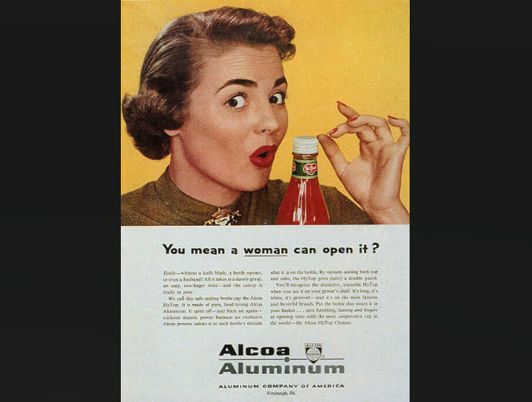
Easily- without a knife blade, a bottle opener, or even a husband. All it takes is a dainty grasp, an easy, two-finger twist-- and the catsup is ready to pour. We call this safe-sealing bottle cap the Alcoa HyTop. It is made of pure, food-loving Alcoa Aluminum. It spins off---and back on again-- without muscle power because an exclusive Alcoa process tailors it to each bottle's threads after it is on the bottle. By vacuum sealing both top and sides, the HyTop gives purity a double guard. You'll recognize the attractive, tractable HyTop when you see it on your grocer's shelf. It's long, it's white, it's grooved--and it's on the most famous and flavorful brands. Put the bottle that wears it in your basket... save fumbling, fuming, and fingers at opening time with the most cooperative cap in the world-- the Alcoa HyTop Closure.
Notes:
Alcoa HyTop Closure You mean a woman can open it?METALINGUAL, asking for an explanation of a certain statement
Woman; the bottle can be opened by a woman that means the cap is not difficult to open, women can open it without a knife blade, a bottle opener, without muscle power or even a husband. The text is both informative (REFERENTIAL FUNCTION) because it gives information/very detailed descritption on the type of material, but also appealing for women, so it is conative in the sense it is directed to the addressee, and women in particular. We can also find the POETIC FUNCTION: use of metaphor/personification the most cooperative cap in the world.
Easily- without a knife blade, a bottle opener, or even a husband. All it takes is a dainty grasp, an easy, two-finger twist-- and the catsup is ready to pour. We call this safe-sealing bottle cap the Alcoa HyTop. It is made of pure, food-loving Alcoa Aluminum. It spins off---and back on again-- without muscle power because an exclusive Alcoa process tailors it to each bottle's threads after it is on the bottle. By vacuum sealing both top and sides, the HyTop gives purity a double guard. You'll recognize the attractive, tractable HyTop when you see it on your grocer's shelf. It's long, it's white, it's grooved--and it's on the most famous and flavorful brands. Put the bottle that wears it in your basket... save fumbling, fuming, and fingers at opening time with the most cooperative cap in the world-- the Alcoa HyTop Closure. This is the exact transcription of the caption. THREE-PART LIST WITH ALLITERATION dainty grasp- a very light touch. Holding the cap without a strong grip. two finger twist- twist the cap with only two fingers. safe sealing- the cap has a tight seal which keeps out germs. catsup- another word for ketchup. The bottle in the ad is from the Del Monte company. Del Monte called their product "catsup", while Heinz called theirs "ketchup". Alcoa HyTop- brand name for the cap, from Alcoa Aluminum Company. tailors- makes something to order, ( as in the term "custom-made"). threads- the creases in the bottle cap that allow you to twist or screw it on. A screw has threads. vacuum sealing- sucking out all the air in the bottle before sealing, to keep out germs. double guard- the purity of the catsup is protected two ways. tractable- easy to manage, easily handled grocer's shelf- on the food shelves at the grocery store fumbling- handling in a clumsy manner fuming- getting mad (so mad, that fumes are coming out of your mouth) The "save" here means- keep yourself from having to fumble around to open the cap, keep yourself from getting mad because the cap won't open, and save yourself from injuring your fingers. cooperative cap- it is easy to use. The cap give you no resistance.
https://answers.yahoo.com/question/index?qid=20130630012437AAru9kB

Slide 49
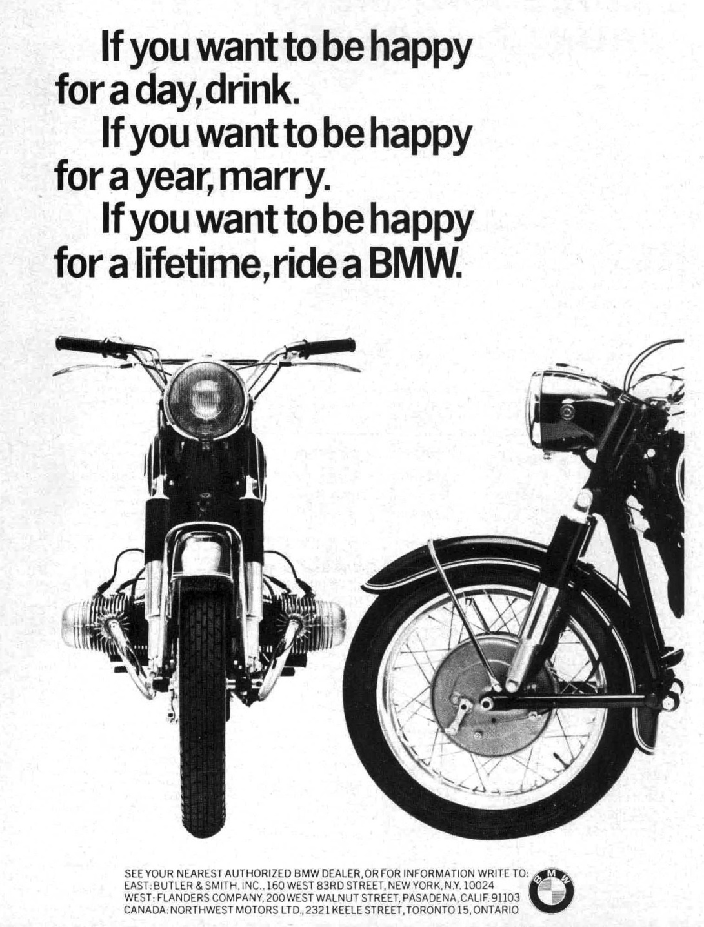
Notes:
CONATIVE FUNCTION: it appeals to the addressee, 2nd person.
The conditional sentence if you want singles out the right type of consumer: if you want X then get/buy y.
POETIC FUNCTION: if you want is repeated three times, three-part list/parallelism,
the same syntactic structure repeated three times. Also climax: day > year> lifetime.
a rhetorical device by which a series of sentences, clauses, or phrases are arranged in order of increasing intensity. The ways to achieve happiness increase, too : drink > marry > ride a BMW, from simple drinking, through marrying, to riding a BMW which is the utmost happiness.
The visual arrangement of text is also poetic, as in a poem the main clause after the if-clause goes to a new line, and the final word in the line is always “happy” as “visually” imitating rhyme.

Slide 50
Notes:
This is the ad for a pain killer.
EMOTIVE FUNCTION/EXPRESSIVE FUNCTION: it expresses the addresser’s emotions. He/she is suffering and the pain is represented by the interjection ah ah repeated several times, (according to the intonation of the speaker). Then suddenly a pill appears and the interjection changes to ha ha ha , which is an expression of triumph, and represents pleasure, laughter and contentment, happy satisfaction for defeating the pain.
Images reinforce the message: the cloud around the first interjection (cartoon bubble, speech bubble or thought bubble like in comics) on the left part of the ad is all pointed like something inflicting pain, like a throbbing headache for example. The cloud in the second part, after the pill, in the right part of the ad is as soft, smooth and fluffy just as only relief from a pain can be. rough and painful vs gentle and relaxing, before vs after (like in a narrative, problem followed by a solution)

Slide 51
Notes:
Pain killer
CONATIVE FUNCTION: it appeals to the addressee, the pronoun you is in capital letters and the text “don’t let aches and pains keep you up” is a vocative/negative imperative. “Take your first step to a better night’s sleep”, appeals to the receiver, too.
POETIC FUNCTION: “Less time awake. More time asleep” = contrastive pair, two phrases with the same structure, one is the opposite of the other.
Take your first step to a better night’s sleep: the comparative better is emphasized, written in yellow. It is ellipsis: better than what?

Slide 52
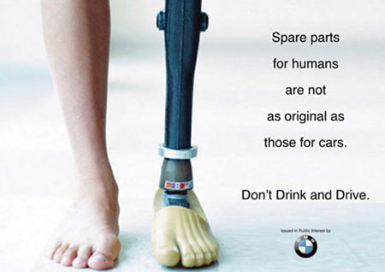
Notes:
REFERENTIAL FUNCTION: Both text and images express the referential function, they are informative.
CONATIVE FUNCTION: it appeals to the addresses, with a vocative/imperative. Dont’ drink and drive: alliteration, repetition of the sound /d/
POETIC FUNCTION: The text is ironical, even if dealing with such a hot issue. Simile: comparing spare parts for humans to those for cars, to underline the fact humans cannot be substituted for and life and physical health are important and unique. If you have an accident you can still replace damaged parts of your car with original pieces and still be satisfied with them but that cannot be done with your limbs or body.

Slide 53
Notes:
Another ad for BMW.
The dominant function is the POETIC FUNCTION: there’s a pun, the ad is playing with the word masterpiece and the adjective faster.
Designed for driving pleasure: alliteration, the repetition of the sound /d/, but also again a pun, plauing with the words “driving pleasure”: driving can be the gerund of the verb to drive but also the adjective meaning something that motivates, that propels, like a driving motivation, something forceful that drives you and motivates you, like a driving force.

Slide 54
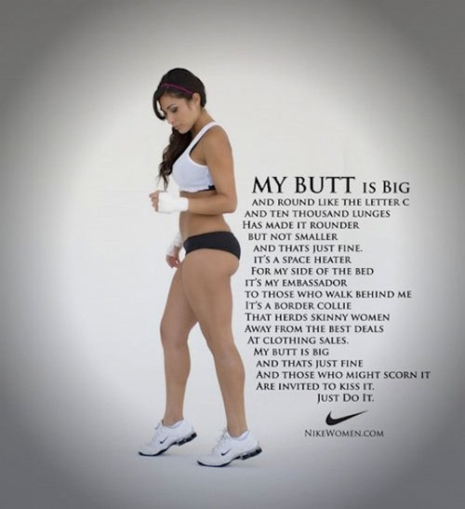
Notes:
The dominant function is the POETIC FUNCTION: the text itself is visually arranged in the form of a poem and some lines even rhyme (scorn it, kiss it, just do it!)
Alliteration: butt-big
Simile: round like the letter C
Adjectives in the comparative form: rounder, smaller
Metaphor: a space heater for my side of the bed, my embassador to those who walk behind me, a border collie that herds skinny women away from clothing sales.
Both text and image are also referential, giving information and dealing with the context: there’s also a moral/hidden sense, there’s no need to be skinny to be healthy and beautiful, the lady in the picture is a sportswoman, not skinny but fit and with a beautiful body even if round.

Slide 58
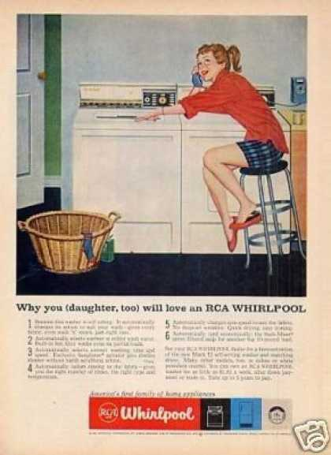

Slide 63
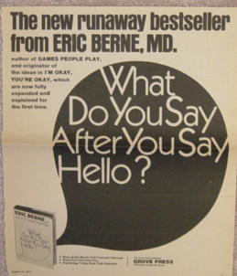

Slide 66
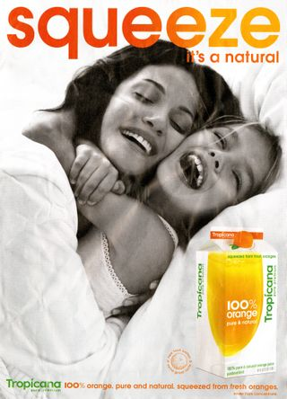

Slide 68
See also Cook, chapter 6 125-148

