Slide 1
Chapter Eighteen
Equity Valuation Models

Slide 2
Valuation: Fundamental Analysis
Fundamental analysis models base value on current and future profitability
It identifies mispriced stocks relative to some measure of “true” value derived from financial data

Slide 3
Models of Equity Valuation
Balance Sheet Models
Dividend Discount Models (DDM)
Price/Earnings Ratios
Free Cash Flow Models

Slide 4
Valuation by Comparables
Compare valuation ratios of firm to industry averages
Ratios like price/sales are useful for valuing start-ups that have yet to generate positive earnings

Slide 5
Limitations of Book Value
Book values are based on historical cost, not actual market values
It is possible, but uncommon, for market value to be less than book value

Slide 6
Liquidation Value and Tobin’s Q
Liquidation Value:
  “Floor” or minimum value is the liquidation value per share
Replacement Cost:
  Tobin’s q: ratio of market price to replacement cost
  Tobin’s q trends towards 1
Notes:
Liquidation Value: Amount of Money that could be realized by breaking up the firm, selling its assets, repaying its debt, and distributing the remainder to the shareholders
Replacement Cost: Reproduction cost of Assets minus Liabilities

Slide 7
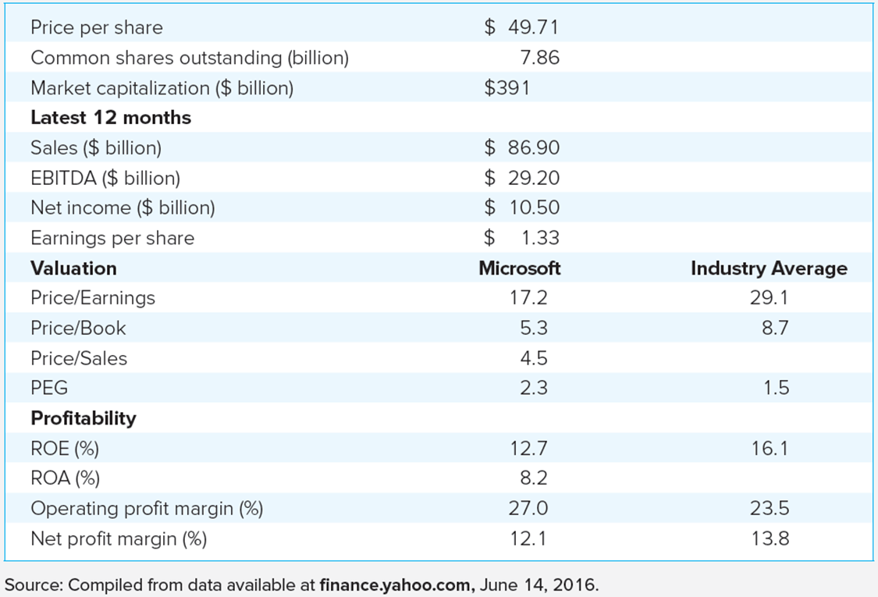
Financial Highlights of Microsoft

Slide 8
Intrinsic Value vs. Market Price
The return on a stock is composed of dividends and capital gains or losses
The expected HPR may be more or less than the required rate of return
  Variation based on the stock’s risk

Slide 9
Required Return
CAPM gives the required return, k:
If the stock is priced correctly, k = expected return
k is the market capitalization rate

Slide 10
Intrinsic Value and Market Price
The intrinsic value (IV) is the “true” value, according to a model
The market value (MV) is the consensus value of all market participants
Trading Signal:
  IV > MV Buy
  IV < MV Sell or Short Sell
  IV = MV Hold or Fairly Priced

Slide 11
Dividend Discount Models (DDM)
V₀ = current value
D_{t} = dividend at time t
k = required rate of return
DDM says V₀ = the present value of all expected future dividends into perpetuity

Slide 12
Constant Growth DDM
(1 of 2)
V₀ = current value
D_{t} = dividend at time t
k = appropriate risk-adjusted interest rate
g = dividend growth rate

Slide 13
Preferred Stock and the DDM
No growth case (fixed dividends)
Value a preferred stock paying a fixed dividend of $2 per share when the discount rate is 8%:

Slide 14
Constant Growth DDM
(2 of 2)
A stock just paid an annual dividend of $3/share
Dividend is expected to grow at 8% indefinitely
Market capitalization rate is 14%

Slide 15
DDM Implications
The constant-growth rate DDM implies that a stock’s value will be greater:
  The larger its expected dividend per share
  The lower the market capitalization rate, k
  The higher the expected growth rate of dividends
The stock price is expected to grow at the same rate as dividends

Slide 16
Estimating Dividend Growth Rates
g = growth rate in dividends
ROE = Return on Equity
b = plowback or retention rate (1 - dividend payout rate)

Slide 17
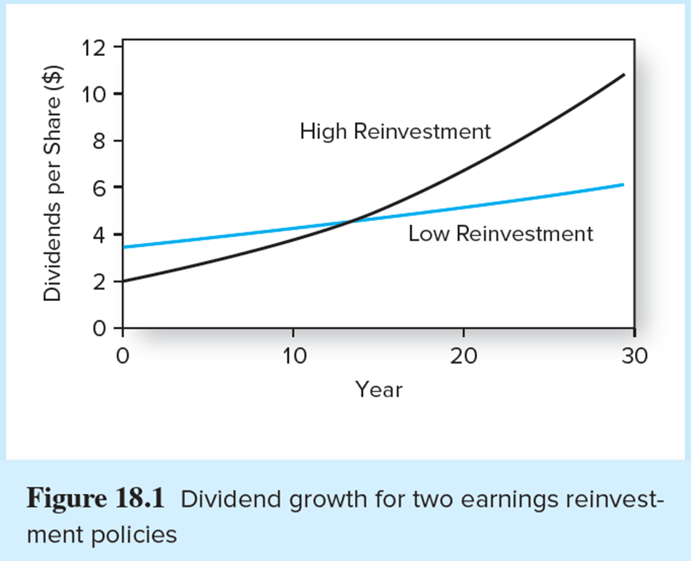
Dividend Growth for Two Earnings Reinvestment Policies

Slide 18
Present Value of Growth Opportunities (1 of 2)
The value of the firm equals:
  The value of the assets already in place
    No-growth value of the firm
  Plus the NPV of its future investments
    Present value of growth opportunities or PVGO

Slide 19
Present Value of Growth Opportunities (2 of 2)
Price = No-growth value per share + PVGO

Slide 20
Growth Opportunities
(1 of 2)
Firm reinvests 60% of its earnings
Projects generate ROE of 10%
Capitalization rate is 15%
Expected year-end dividend is $2/share
Earnings of $5/share
g = ROE × b = 10% × .6 = 6%

Slide 21
Growth Opportunities
(2 of 2)
PVGO = Price per share - no-growth value per share

Slide 22
Life Cycles and Multistage Growth Models
Firms typically pass through life cycles
Early Years
Ample opportunities for profitable reinvestment in the company
Competitors may have not entered the market.
Payout ratios are low
Growth is correspondingly rapid.
Later Years
Attractive opportunities for reinvestment may become harder to find.
Competitors enter the market
Payout ratios are high
Dividend growth slows because the company has fewer investment opportunities.

Slide 23
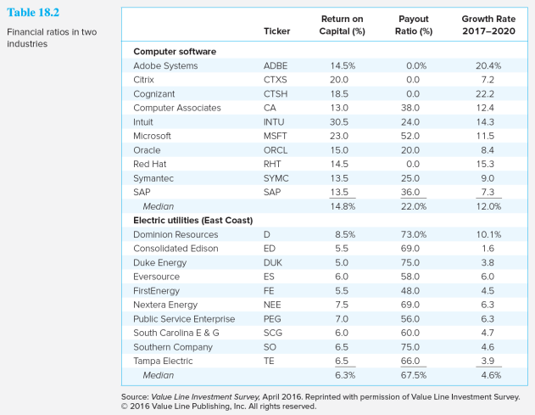
Life Cycles and Multistage Growth Models

Slide 24

GE Example
(1 of 3)
Expected dividends for GE:
Dividend payout ratio = 53%
ROE = 19.5%

Slide 25
GE Example
(2 of 3)
GE’s β = 1.10
r_{f} = 2.5%
Market risk premium = 8%, then k is:
Therefore:

Slide 26
GE Example
(3 of 3)
Finally,
In 2016, one share of GE Stock was worth $53.40

Slide 27
Price-Earnings Ratio and Growth
(1 of 3)
The ratio of PVGO to E/k is the ratio of firm value due to growth opportunities to value due to assets already in place (no-growth)

Slide 28
Price-Earnings Ratio and Growth
(2 of 3)
When PVGO = 0, P₀ = E₁/k. The stock is valued like a nongrowing perpetuity
P/E rises dramatically with PVGO
High P/E indicates that the firm has ample growth opportunities

Slide 29
Price-Earnings Ratio and Growth
(3 of 3)
P/E increases:
  As ROE increases
  As plowback increases, if ROE > k
  As plowback decreases, if ROE < k
  As k decreases

Slide 30
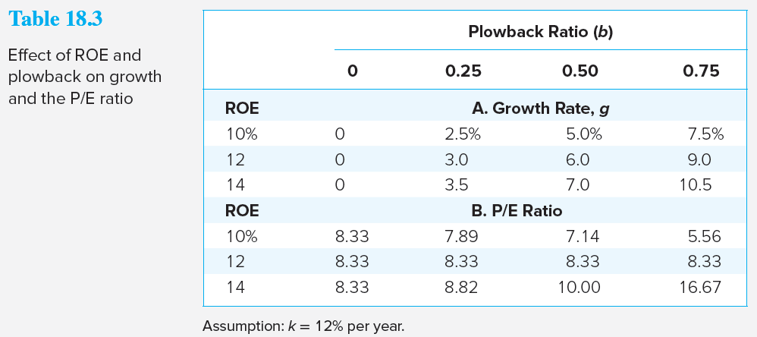
Effect of ROE and Plowback on Growth and the P/E Ratio

Slide 31
P/E and Growth Rate
Wall Street: The growth rate is roughly equal to the P/E ratio
“If the P/E ratio of Coca Cola is 15, you’d expect the company to be growing at about 15% per year, etc. But if the P/E ratio is less than the growth rate, you may have found yourself a bargain.”
Quote from Peter Lynch in One Up on Wall Street

Slide 32
P/E Ratios and Stock Risk
When risk is higher, k is higher; therefore, P/E is lower

Slide 33
Pitfalls in P/E Analysis
Use of accounting earnings
  Earnings Management
  Choices on GAAP
Inflation
Reported earnings fluctuate around the business cycle

Slide 34
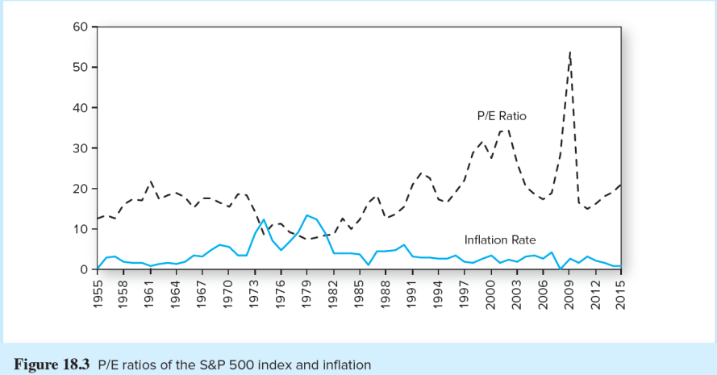
P/E Ratios of the
S&P 500 Index and Inflation

Slide 35
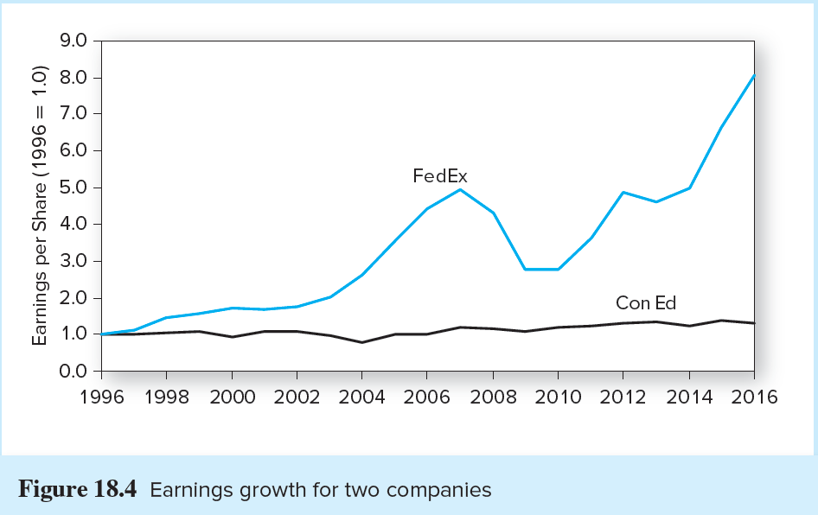
Earnings Growth for Two Companies

Slide 36
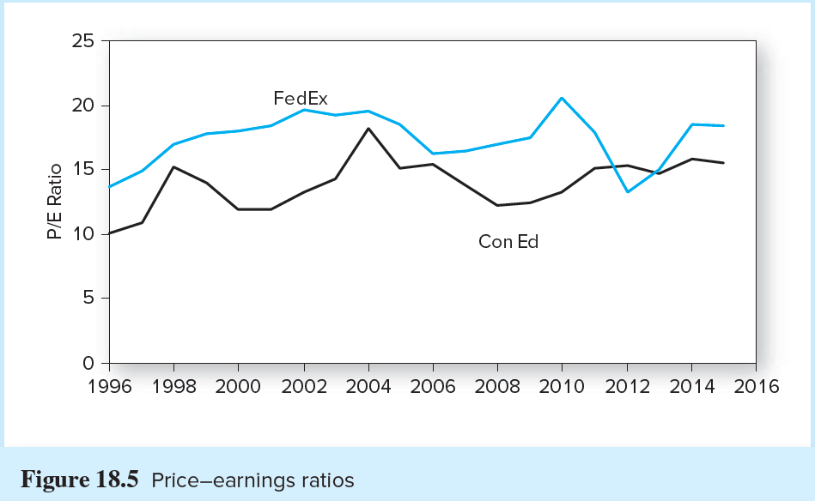
P/E Ratios for Two Companies

Slide 37
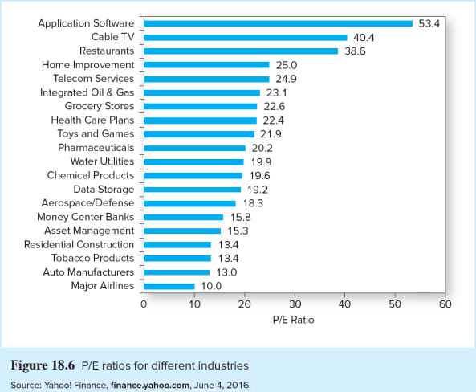
P/E Ratios for Different Industries, 2016

Slide 38
Other Comparative Value Approaches
Price-to-book ratio
Price-to-cash-flow ratio
Price-to-sales ratio

Slide 39
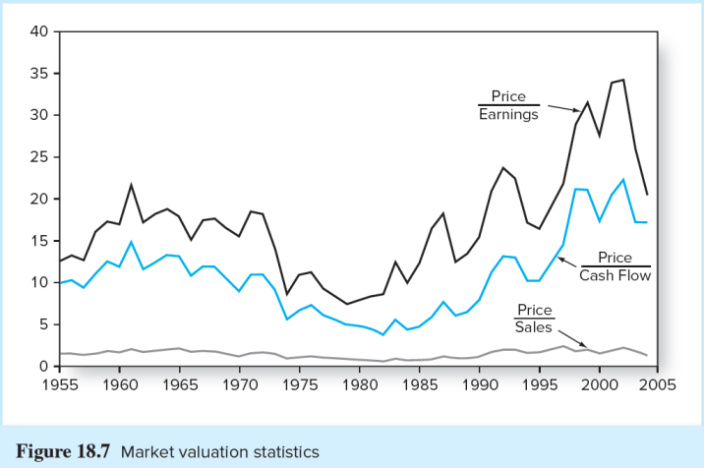
Market Valuation Statistics

Slide 40
Free Cash Flow To the Firm Approach
(1 of 2)
Value the firm by discounting free cash flow at WACC
Free cash flow to the firm, FCFF, equals:
  After tax EBIT
  Plus depreciation
  Minus capital expenditures
  Minus increase in net working capital

Slide 41
Free Cash Flow To the Firm Approach
(2 of 2)
Value of the Firm:
Where

Slide 42
Free Cash Flow to Equity Approach
(1 of 2)
Free cash flow to equity, FCFE, equals:
  FCFF
  Minus after tax interest
  Plus increase in debt

Slide 43
Free Cash Flow to Equity Approach
(2 of 2)
Intrinsic Value of Equity:
Where

Slide 44
Comparing the Valuation Models
In practice
  Values from these models may differ
  Analysts are always forced to make simplifying assumptions
Problems with DCF
  Calculations are sensitive to small changes in inputs
  Growth opportunities and growth rates are hard to pin down

Slide 45
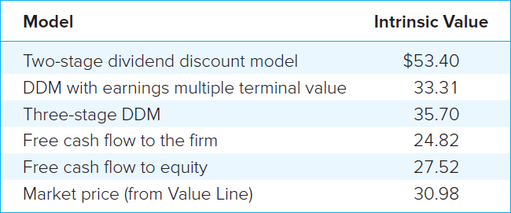
Comparing the Valuation Models, GE

Slide 46
The Aggregate Stock Market
Use of earnings multiplier approach at aggregate level
Some analysts use aggregate version of DDM
S&P 500 taken as leading economic indicator

Slide 47
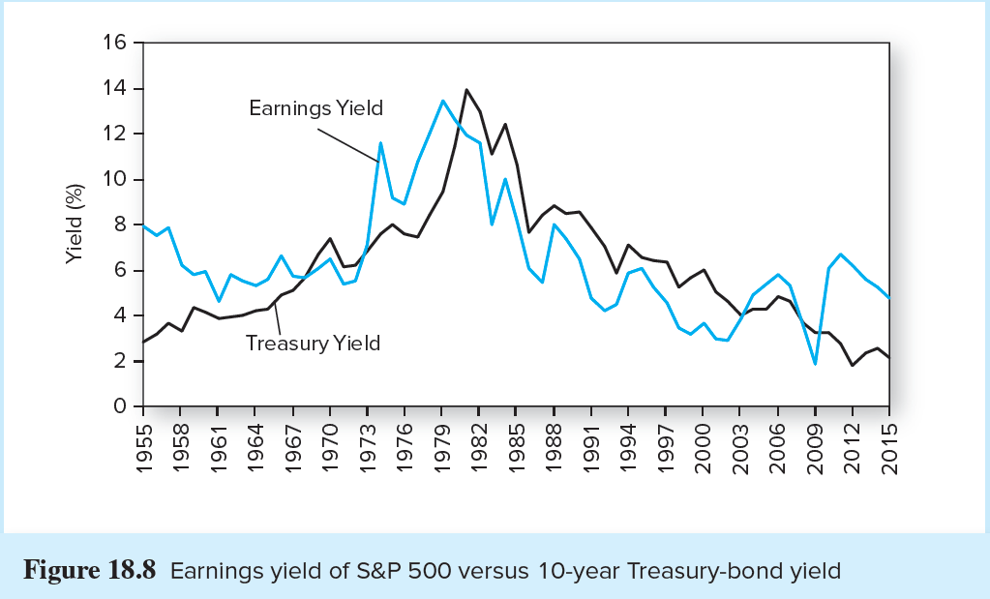
Earnings Yield,
S&P 500 vs. 10-Year Treasury Bond

Slide 48
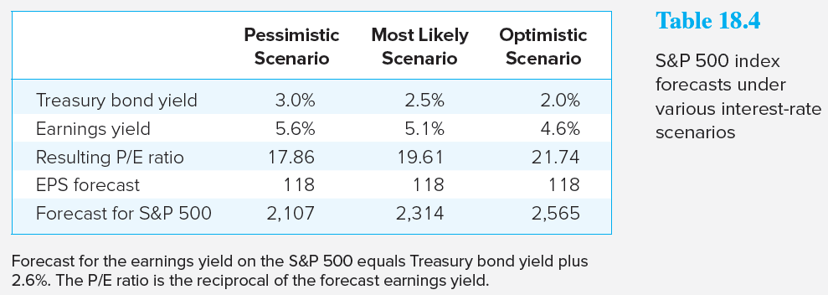
S&P 500 Price Forecasts Under Various Scenarios

