Slide 1

Towards the substitution of critical rare materials
Advanced Materials in optoelectronic devices:
Pier Carlo Ricci
University of Cagliari

Slide 2

Field of applications:
I. Technology Pillar
  I.C Priority Area: Substitution of raw materials
    Action area n° I.7: Materials for electronic devices
Identification the most important applications where CRM are key components.
Solution along the entire value chain
Pier Carlo Ricci, University of Cagliari – University of Cagliari - RESET coordinator - http://reset.dsf.unica.it/

Slide 3



SMEs
Research Centers
Applications
Accademia
Large industries
Research
Pier Carlo Ricci, University of Cagliari – University of Cagliari - RESET coordinator - http://reset.dsf.unica.it/

Slide 4
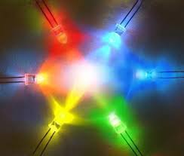

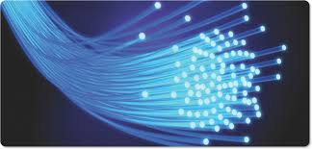
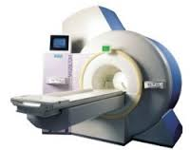
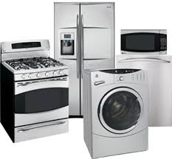
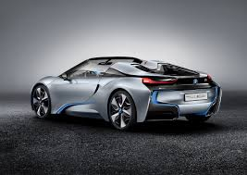
Display and Panels
Lighting
Optical fibers
Magnetic resonance imaging
Large household appliances
Automotive
Pier Carlo Ricci, University of Cagliari – University of Cagliari - RESET coordinator - http://reset.dsf.unica.it/

Slide 5
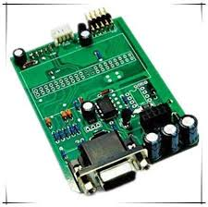
Assembled printed circuit boards
Every electronic product contains at least one printed circuit board (microprocessors, resistors, capacitors, sensors and magnets).
Antimony (Sb): dopant in n-type silicon
Beryllium (Be): High performance connectors. PC contains approximately 2 g. of Be.
Gallium (Ga): Ga containing III-V semiconductors GaAs, AlGaAs, InGaAs etc. are used in high frequency transistors, LED and solar panels, wireless product. In 2010, 106 tons of gallium was used in PCBs.
Germanium (Ge): substrate material for III-V semiconductors for solar cells and light emitting diodes.
Indium (In): InSb, InP and InN are used in infrared light detection, magnetic field sensors, fast transistors, LED and solar cells. Around 6 tons of In was used in minor alloys in 2010. Niobium (Nb): Niobium is used in ceramic capacitors.
Palladium (Pd): It is a key material of multi-layer ceramic capacitors. Annual demand for palladium is over 15.5 tons.
Ruthenium (Ru): Thick film chip resistors. The amount used is around 12.2 tons annually representing around 61% of the total supply of Ru.
Tantalum (Ta): anode metal in tantalum electrolyte capacitors.
Pier Carlo Ricci, University of Cagliari – University of Cagliari - RESET coordinator - http://reset.dsf.unica.it/

Slide 6
Applications | Critical Raw materials | Alternatives
Washing machines, Dishwasher Cooling Air, conditioners | Nd, Dy, Pd, Ta, Ru, Ga, Ge, In, Sb | NdFeB, SmCo ₅ Sm₂Co₁₇
Optical fibres | Ge , Dy, Er, Nd, Pr | Germanium free Optical Fiber (P₂O₅): low performance
Displays and panels (Laptop, Mobile Phones, Cameras) | Rare Earths, In, Br | Carbon nanotubes, CZTS
LED, CFL, lighting | Rare Earths | -
Magnetic resonance imaging apparatus (MRI) | NbTi Nb₃Sn NbN (Dy, Gd, Nb, Be, Pr,Tb) | BSCCO MgB₂
Pier Carlo Ricci, University of Cagliari – University of Cagliari - RESET coordinator - http://reset.dsf.unica.it/

Slide 7



Applications
Research
Pier Carlo Ricci, University of Cagliari – University of Cagliari - RESET coordinator - http://reset.dsf.unica.it/

Slide 8

Spring Conference: Lille, 2-6 May 2016
Symposium E:
Substitution of Critical Raw Materials: Synthesis, Characterization and Processing of New Advanced Materials in optoelectronic and magnetic devices.
Transparent conductive layers Rechargeable batteries, Phosphors for LED applications, Scintillators, Displays OLEDs Catalysis Photovoltaics Smart windows, Exchange-coupled nanocomposite magnets with less or no REEs New RE-free highly anisotropic magnetic materials New and energy efficient motors and generator technologies which do not depend on permanent magnets
Pier Carlo Ricci, University of Cagliari – University of Cagliari - RESET coordinator - http://reset.dsf.unica.it/

Slide 9
Organizing Board
Chairman Pier Carlo Ricci Dipartimento di Fisica, Università di Cagliari | José A. De Toro Departamento de Física Aplicada & IRICA, Universidad de Castilla-La Mancha (UCLM)
Valentina Ivanova CEA Tech, France | Maria Luisa Grilli ENEA, Casaccia, Unit of Materials Technology, Optical Coatings Laboratory
Scientific Board
E. Bouyer (France)
C. M. Carbonaro (Italy)
D. Chiriu (Italy)
R. Cipollone (Italy)
J. M. Colino (Spain)
S. Cuesta (Spain)
M. Hillenkamp (France)
Y. Huttel (Spain)
N. Laidani (Italy)
R. Matthieu (Sweden)
P. Nordblad (Sweden)
P. Normile (Spain)
D. Peddis (Italy)
A. Rizzi (Germany)
M.L. Ruello (Italy)
G. Singh (Norway)
A. Tchelnokov (France)
J. Van Duijn (Spain)
Pier Carlo Ricci, University of Cagliari – University of Cagliari - RESET coordinator - http://reset.dsf.unica.it/

Slide 10
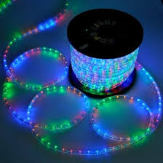
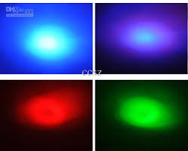
Rare Earths free phosphors for LED devices

Slide 11
Why LED?
How do they work?
Criticisms in Lighting
Our Solutions...
Requirements, state of art

Slide 12
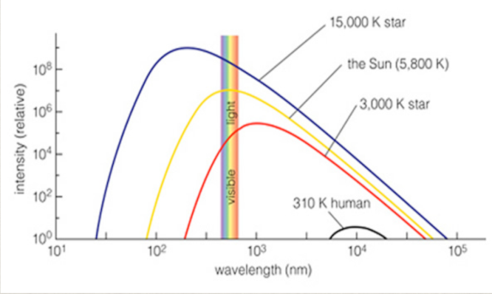
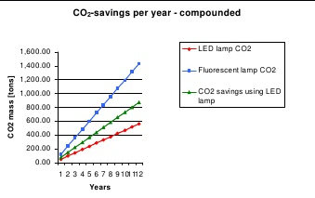
Why LED?
ECONOMIC
Long life up to and beyond 20,000 hours.
lifetime –
The energy consumed by one LED is the equivalent of 50 halogen bulbs.
PERFORMANCE
LEDs offer greater color mixing.
Combined with compact size, offers wider range of design options.
TECHNICAL
Compact size
Long life
Shock resistant
Instant on/off
ENVIRONMENTAL
LEDs are more energy efficient.
Coupled with longevity, LED bulbs = fewer lamps required to be disposed of.
Pier Carlo Ricci, University of Cagliari – University of Cagliari - RESET coordinator - http://reset.dsf.unica.it/
Notes:
The world of LED lighting continues to make rapid advancements. These advancements offer a wide range of benefits to general illumination, from energy efficiency and design enhancement, to extended life and technical improvements such as compact size, shock resistance and more. The benefits of LEDs are literally transforming the process of lighting design. Not only are LEDs more cost effective in the long run, they use less energy, are more durable and effective and are the healthier choice for a greener tomorrow.

Slide 13

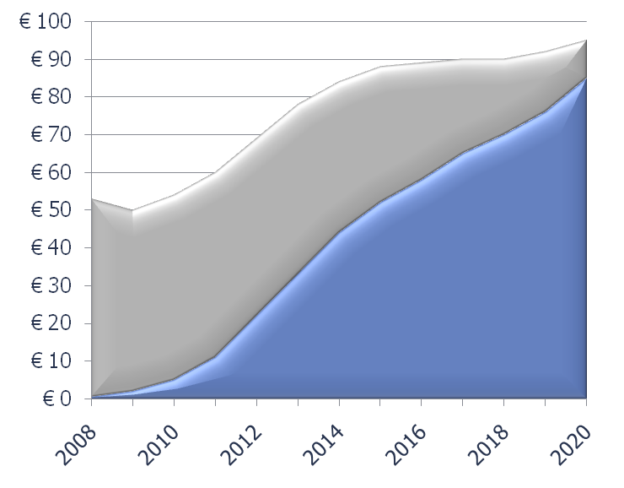
Why LED?
Global General Illumination Market**
Global Market
LED Market
Pier Carlo Ricci, University of Cagliari – University of Cagliari - RESET coordinator - http://reset.dsf.unica.it/

Slide 14
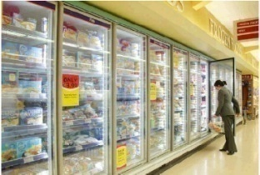

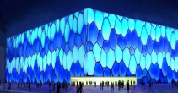

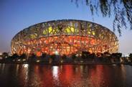
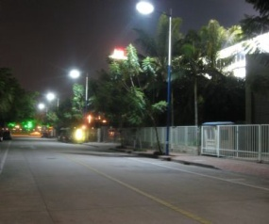
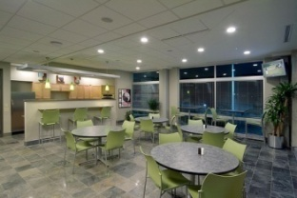
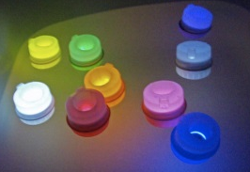
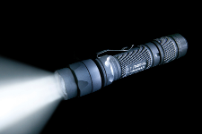
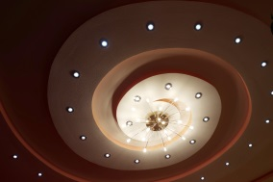

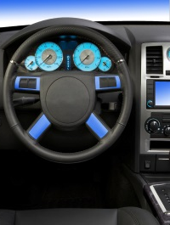


Current LED Lighting Applications
Pier Carlo Ricci, University of Cagliari – University of Cagliari - RESET coordinator - http://reset.dsf.unica.it/

Slide 15
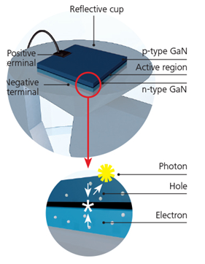
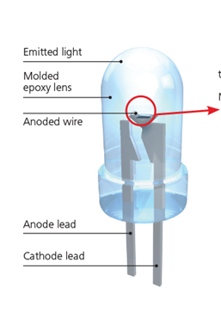
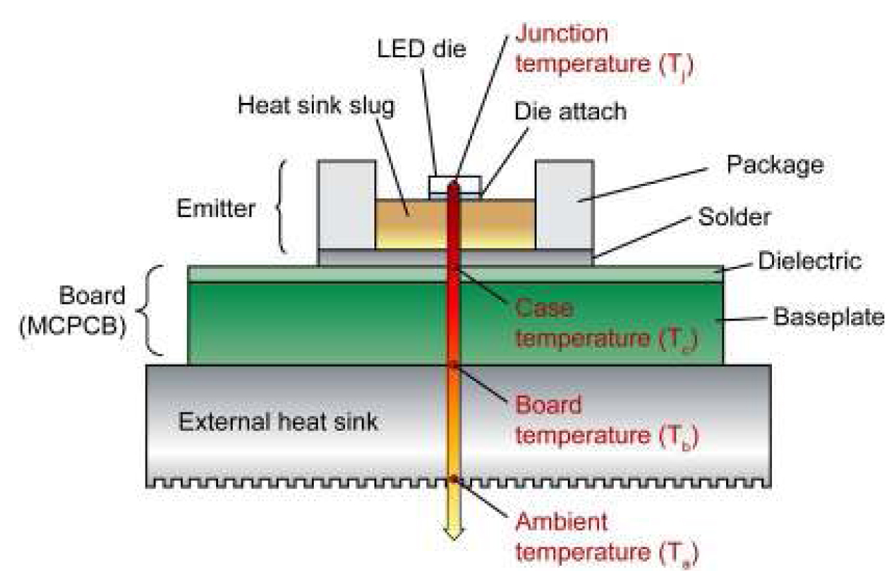
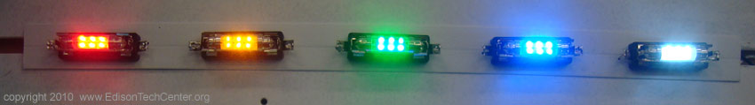
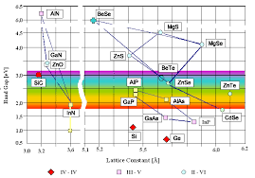
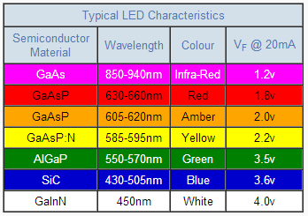
Inside the LED
Pier Carlo Ricci, University of Cagliari – University of Cagliari - RESET coordinator - http://reset.dsf.unica.it/

Slide 16
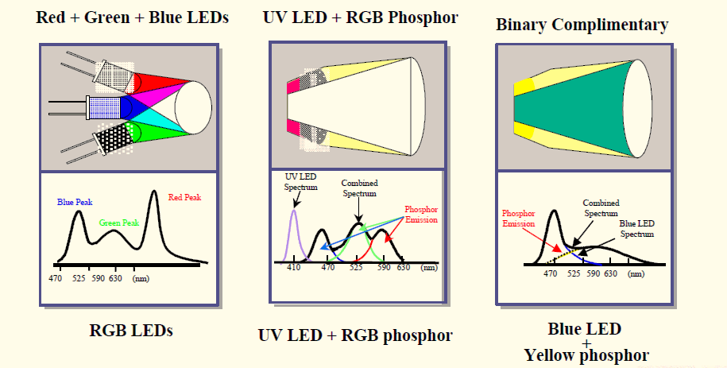
White LED
• Simple and single Yellow phosphor
• Decent color rendering • “Simple to manufacture!”
• Temperature stability of phosphors.
White point determined by phosphors ONLY!
• Temperature stability of phosphors.
• Dynamic tuning of color temperature
• Excellent color rendering!
• High costs
• Color mixing tricky!
• Yellow-Green Gap!
• Potential for damaging UV light leakage.!
• Efficient UV LED pumped phosphor not available yet! → high costs
• Limits on efficiency due to phosphor conversion efficiency,
• Better color rendering
• Ubiquity of Ce:YAG
Pier Carlo Ricci, University of Cagliari – University of Cagliari - RESET coordinator - http://reset.dsf.unica.it/

Slide 17
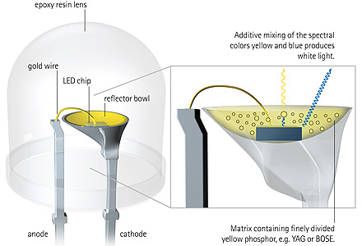
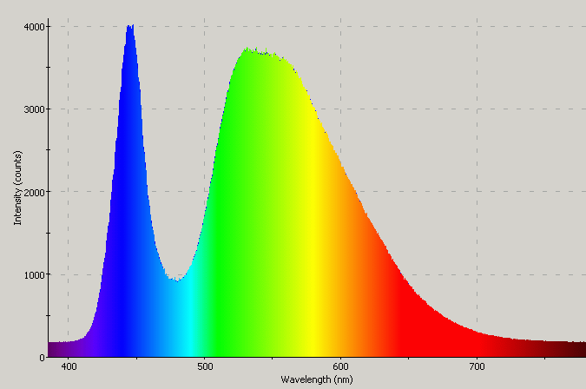
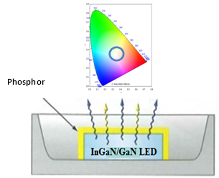
White LED
GaN or InGaN LED
Ce:YAG
Pier Carlo Ricci, University of Cagliari – University of Cagliari - RESET coordinator - http://reset.dsf.unica.it/

Slide 18
Ideas in a Chalkboard
Why LED?
How do they work?
Criticisms in Lighting
Our Solutions...
Requirements, state of art

Slide 19
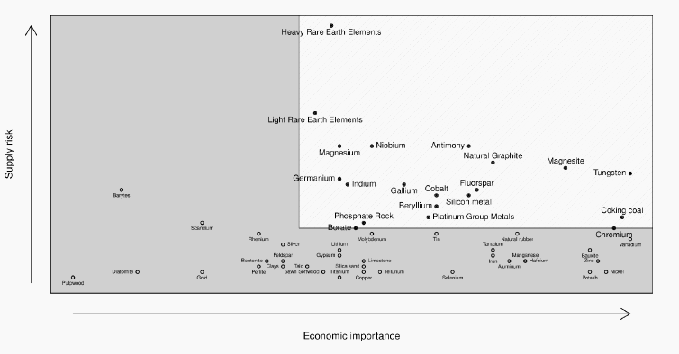
Criticisms
Yttrium
Cerium
Pier Carlo Ricci, University of Cagliari – University of Cagliari - RESET coordinator - http://reset.dsf.unica.it/

Slide 20
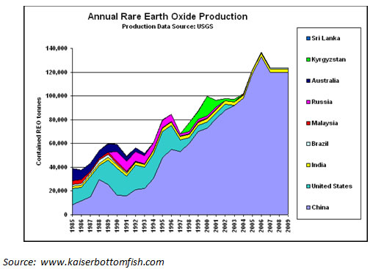
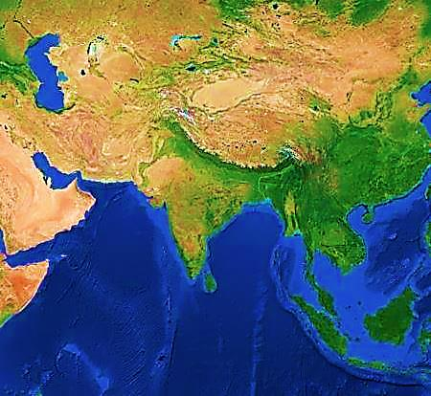

Criticisms
China
99 % Heavy Rare Earths
87 % Light Rare Earths
Pier Carlo Ricci, University of Cagliari – University of Cagliari - RESET coordinator - http://reset.dsf.unica.it/

Slide 21
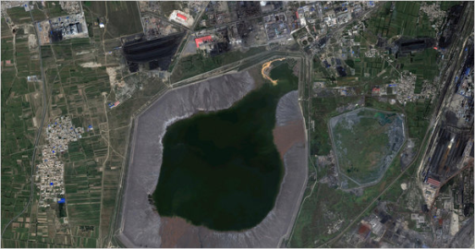

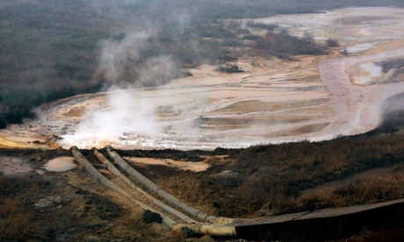
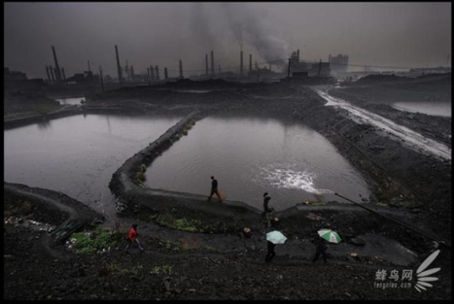
Criticisms
Main actors in LED lighting supply chain.¹
 | Europe | North America | Asia
REE Production | - - - | - - - | 95–99% China
LED Manufacturing | OSRAM,Optogan, Valtavalo | Philips LumiLed | 75- 80 % Asia Nichia, Edison Opto, Epistar
LED Assembly | OSRAM Philips Lighting Havells-Sylvania | Ge Lighting | Samsung LED,Nichia, Epistar, Toshiba, Sharp, LG electronics
Toxic Lake in Baotou (China)
About 75 % world production of rare earths
Pier Carlo Ricci, University of Cagliari – University of Cagliari - RESET coordinator - http://reset.dsf.unica.it/

Slide 22
Why LED?
How do they work?
Criticisms in Lighting
Our Solutions...
Requirements, state of art

Slide 23
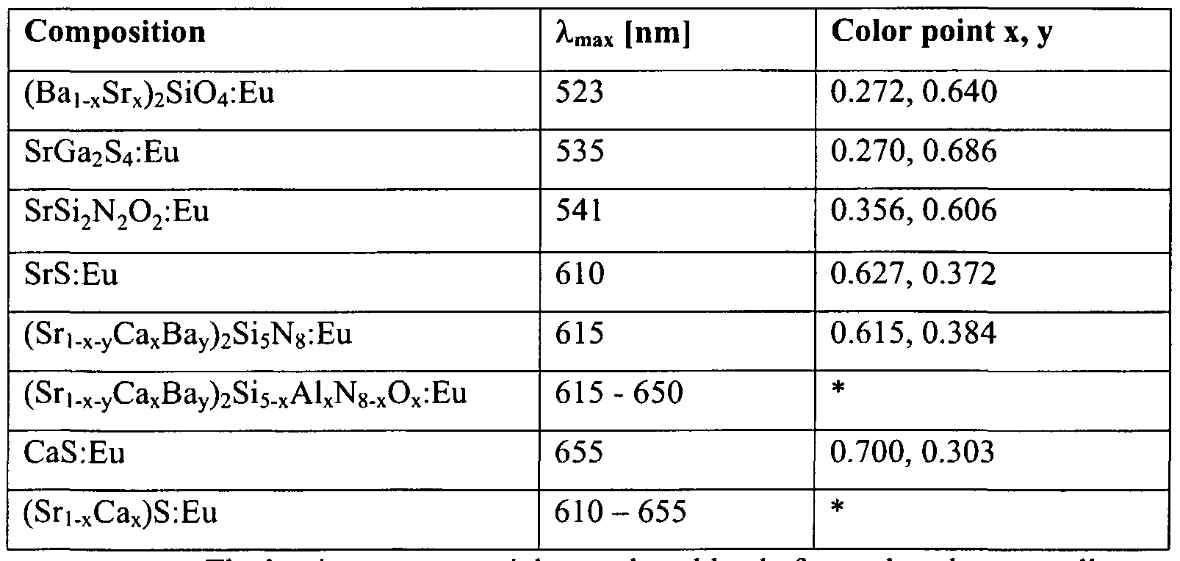
State of art
Dependences from Rare Earths
Low Thermal Stability
Increased production problems
Pier Carlo Ricci, University of Cagliari – University of Cagliari - RESET coordinator - http://reset.dsf.unica.it/

Slide 24
Why LED?
How do they work?
Criticisms in Lighting
Our Solutions...
Requirements, state of art

Slide 25
Solutions
Proposed phosphors...
Inorganic Phosphors
Organic Phosphors
Hybrid Phosphors

Slide 26
Inorganic Phosphor
New Matrix
Al₂SiO₅
No rare earths here
Silicate → Silimanite
20 nm
Pier Carlo Ricci, University of Cagliari – University of Cagliari - RESET coordinator - http://reset.dsf.unica.it/

Slide 27
Inorganic Phosphor
• High Thermal Stability
• Easy to produce
• Relative Low growth temperature (650-1200 °C)
• Dependence from rare earths as emitting ions
Pier Carlo Ricci, University of Cagliari – University of Cagliari - RESET coordinator - http://reset.dsf.unica.it/

Slide 28
Inorganic Phosphor
Ce:Tb:Al₂SiO₅
Cerium as sensitizer
Pier Carlo Ricci, University of Cagliari – University of Cagliari - RESET coordinator - http://reset.dsf.unica.it/

Slide 29
Inorganic Phosphors
Ce:Tb:Cr:Al₂SiO₅
Pier Carlo Ricci, University of Cagliari – University of Cagliari - RESET coordinator - http://reset.dsf.unica.it/

Slide 30
Solutions
Proposed phosphors...
Organic Phosphors
Inorganic Phosphors
Hybrid Phosphors

Slide 31
Organic Phosphors
• High Efficiency
• Free from CRM
• Relative Low growth temperature (<500 °C)
• Low Thermal Stability
• Generally working in solution (quenching effect)
Pier Carlo Ricci, University of Cagliari – University of Cagliari - RESET coordinator - http://reset.dsf.unica.it/

Slide 32
Organic Phosphors
Exc. 365 nm!!
Pier Carlo Ricci, University of Cagliari – University of Cagliari - RESET coordinator - http://reset.dsf.unica.it/

Slide 33
Organic Phosphors
Excitation 405 nm
Excitation 450 nm
Pier Carlo Ricci, University of Cagliari – University of Cagliari - RESET coordinator - http://reset.dsf.unica.it/

Slide 34
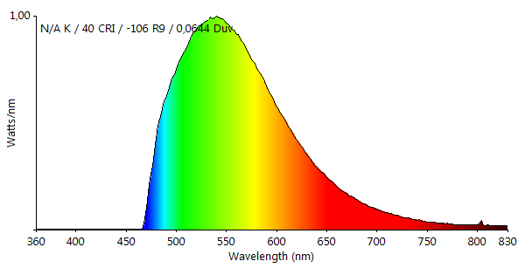
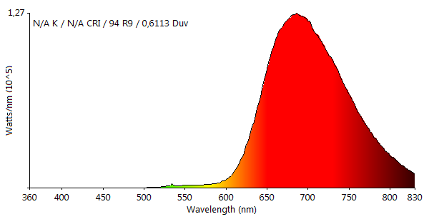
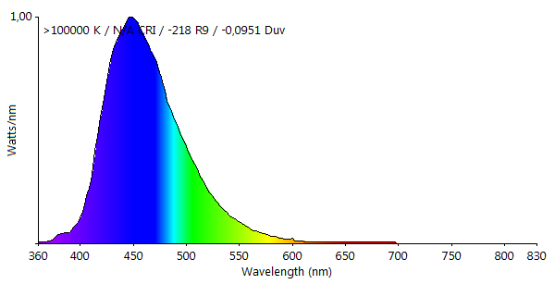
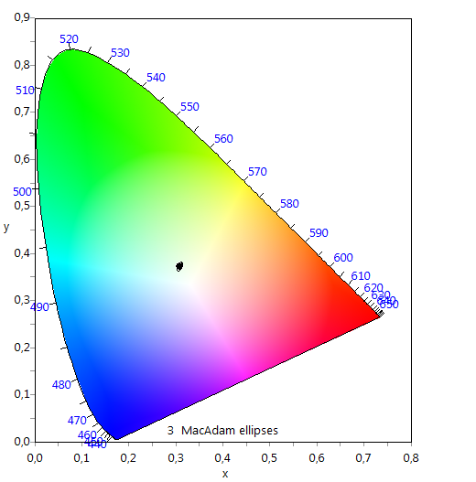
Organic Phosphors
Blue LED
Pier Carlo Ricci, University of Cagliari – University of Cagliari - RESET coordinator - http://reset.dsf.unica.it/

Slide 35
Organic Phosphors
Unsolved:
Increase the stability
Increase the efficiency
Easy implementation
Pier Carlo Ricci, University of Cagliari – University of Cagliari - RESET coordinator - http://reset.dsf.unica.it/

Slide 36
Solutions
Proposed phosphors...
Inorganic Phosphors
Organic Phosphors
Hybrid Phosphors

Slide 37
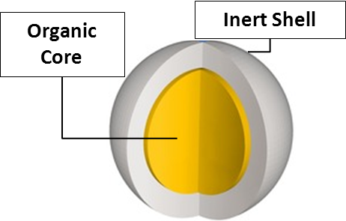
Hybrid Solutions
Increase the stability
triazine
Up to 250°C
TiO₂
by Atomic Layer Deposition
Pier Carlo Ricci, University of Cagliari – University of Cagliari - RESET coordinator - http://reset.dsf.unica.it/

Slide 38
Hybrid Solutions
High efficiency
Triazine (melanine)
Heptazine (melon)
Absolute quantum yield close to 1
Exc. 405 nm
480 nm
Pier Carlo Ricci, University of Cagliari – University of Cagliari - RESET coordinator - http://reset.dsf.unica.it/

Slide 39
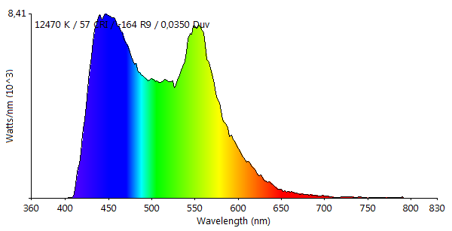
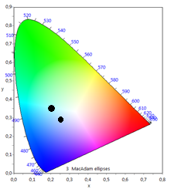
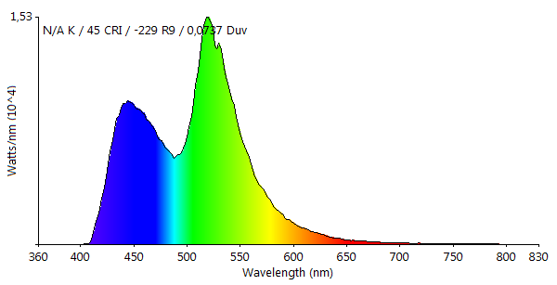
Hybrid Solutions
Multi-Structured Core-Shell System
Easy implementation
White Emission
Second Organic Shell
Pier Carlo Ricci, University of Cagliari – University of Cagliari - RESET coordinator - http://reset.dsf.unica.it/

Slide 40
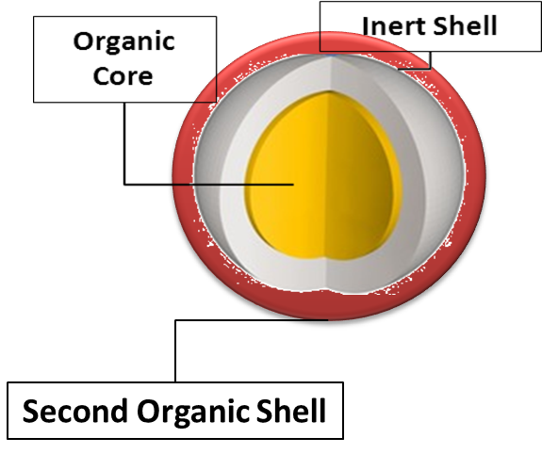
Hybrid Solutions
Third Organic Shell
Second Inorganic Shell
Low temperature procedure
Pier Carlo Ricci, University of Cagliari – University of Cagliari - RESET coordinator - http://reset.dsf.unica.it/

Slide 41
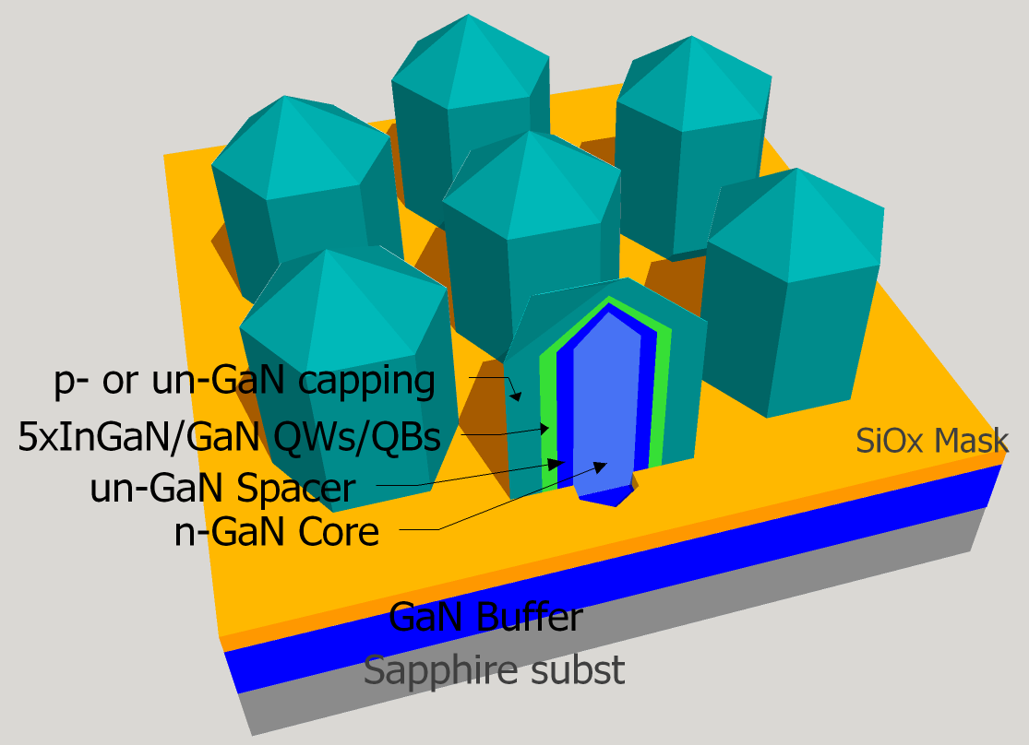
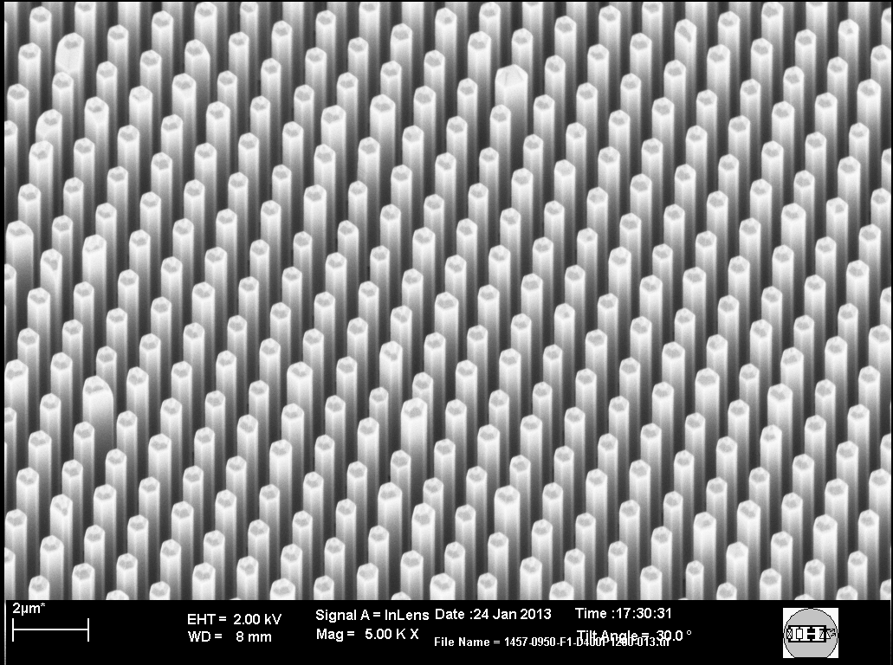
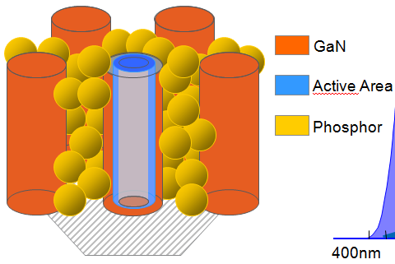
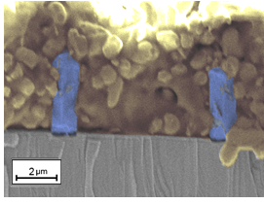
Pier Carlo Ricci, University of Cagliari – University of Cagliari - RESET coordinator - http://reset.dsf.unica.it/

Slide 42



Hybrid Solutions
Hybrid films:
Dye + Polycarbonate
Blue LED as pumping source
Emitting protective layer
Pier Carlo Ricci, University of Cagliari – University of Cagliari - RESET coordinator - http://reset.dsf.unica.it/

Slide 43



Indipendence from the starting solvent
Possibility to mix different dyes
Pier Carlo Ricci, University of Cagliari – University of Cagliari - RESET coordinator - http://reset.dsf.unica.it/

Slide 44
Thank You for Your attention
Pier Carlo Ricci
University of Cagliari
“International Days in Critical Raw Materials” – Burgos 24 June 2015

Slide 45
Spring Conference: Lille, 2-6 May 2016
Symposium E:
Substitution of Critical Raw Materials: Synthesis, Characterization and Processing of New Advanced Materials in optoelectronic and magnetic devices.
Transparent conductive layers Rechargeable batteries, Phosphors for LED applications, Scintillators, Displays OLEDs Catalysis Photovoltaics Smart windows, Exchange-coupled nanocomposite magnets with less or no REEs New RE-free highly anisotropic magnetic materials New and energy efficient motors and generator technologies which do not depend on permanent magnets
Pier Carlo Ricci, University of Cagliari – University of Cagliari - RESET coordinator - http://reset.dsf.unica.it/

Slide 47
Lighting
Criticism:
LED
phosphor Ce:YAG
Semiconductor In, Ga
CFL (compact fluorescent light)
Phosphor Tb, Eu.
Display and Panels
Liquid crystal displays (LCD), light-emitting diode displays (LED-D), electronic papers and plasma display panels (PDP).
Criticism:
LED-D
LCD REE
OLED
Transparent conductive panel
Indium (in ITO)
The flat panel display industries use up to 80% of all indium available!!
Pier Carlo Ricci, University of Cagliari – University of Cagliari - RESET coordinator - http://reset.dsf.unica.it/

Slide 48
Optical fibers
Optical glass fibres doped with rare earths:
Dysprosium (Dy), erbium (Er), Neodymium (Nd), praseodymium (Pr), thulium (Tm) and ytterbium (Yb)
The main raw material is germanium, accounting for around 30% of the overall consumption of germanium worldwide.
China is the leading producer of germanium metal and products in the world. In 2011, most of the around 100 tons of germanium metal and compounds produced in China comes from 6 companies. China used around 35 tons of the amounts produced and exported the rest.
Pier Carlo Ricci, University of Cagliari – University of Cagliari - RESET coordinator - http://reset.dsf.unica.it/
Notes:
The world’s total production of germanium was around 100 – 120 tons in 2011, approximately 30% of that was recycled from electronic devices and coal fly ash. Over 60% of the germanium used during the manufacturing of most optical devices is routinely recycled as new scrap. The pre-consumer recovery of germanium mostly comes from photovoltaic panels and fibre optics, while post-consumer recovery is very limited.

Slide 49
Alternative materials
(optical fiber)
Germanium-free photonic hollow fibres, fibres with tellurium layers (OM2) Phosphorous based doping (P₂O₅) is one possible option to avoid the use of germanium.
Although possibilities for substitution of germanium in fibre optics exist, they suffer from performance losses and does not fulfil the product requirements or industrialization capability is unclear.
Pier Carlo Ricci, University of Cagliari – University of Cagliari - RESET coordinator - http://reset.dsf.unica.it/
Notes:
It is difficult to increase the production of these byproducts metals, so another option is to boost the recovery and recycling of germanium.

Slide 50
Magnetic resonance imaging apparatus (MRI)
Magnetic resonance imaging (MRI) is a medical imaging technique used for visualising the internal morphology of the body.
Critical raw materials in an MRI system are found in the magnet unit, spring contacts, cold heat, pole-piece computer display and printed circuit boards.
Critical materials
NbTi
Nb₃Sn
NbN
The majority of superconductive materials produced in the world are destined for use in MRI systems. About 60% of all superconducting wire and about 40% of niobium-tin alloy produced are consumed by MRI magnet.
Pier Carlo Ricci, University of Cagliari – University of Cagliari - RESET coordinator - http://reset.dsf.unica.it/

Slide 51
Other Critical Materials in MRI systems:
Berillium (Be) in spring contacts (in a form of beryllium-copper), for shielding the magnet and to obtain a durable, solid resolution (other materials would break).
Holmium (Ho) is used in high field MRI systems; it is an important component of the cold head and operates as a helium-liquefier to prevent evaporation of He and enables helium reuse.
Around 20% of the total rare earth consumption, corresponding to more than 24,000 tons of rare earth metals was used for producing permanent magnets
Pier Carlo Ricci, University of Cagliari – University of Cagliari - RESET coordinator - http://reset.dsf.unica.it/

Slide 52
Alternative materials (MRI)
YBCO (Yttrium barium copper oxide) is the most studied high-temperature superconductor, and expected to be a promising technology for a broad range of commercialization.
Another substitution option for Nb-based superconductive magnets is offered by high temperature superconductors , such as bismuth strontium calcium copper oxide BSCCO and especially the second generation conductor YBCO.
Magnesium-diboride (MgB₂) has potential characteristics, such as the low cost of its chemical components, for replacing niobium-based superconducting magnets.
Pier Carlo Ricci, University of Cagliari – University of Cagliari - RESET coordinator - http://reset.dsf.unica.it/

Slide 53
Large household appliances
Refrigeration equipment | Compressor | Nd, Dy
Washing equipment | Electric motor, Electronics (PCB) | Nd, Dy, Pd, Ta, Ru, Ga, Ge, In, Sb
Dishwashers Electric motor
Air conditioners Compressor | Compressor, Electric motor, Electronics (PCB)
These motors include permanent magnets of which
some are neodymium magnets.
Each washing machine contains between 100 and 200 grams of permanent magnets with Nd and Dy concentrations of 28% and 3% respectively.
The total amount of permanent magnets in Large is about 1,200 tons. In addition, Nd and Dy amounts are estimated to be between 300 and 35 tons respectively.
Pier Carlo Ricci, University of Cagliari – University of Cagliari - RESET coordinator - http://reset.dsf.unica.it/

Slide 54
Criticism
NdFeB magnets are used in small motors to reduce the size of the motor and noise. In washing machine motors. Often doped with Heavy rare earths (Tb, Dy).
Alternatives
Hot pressed nanocrystalline NdFeB magnets, avoids the use of other rare earths
Ferrite can substitute NdFeB magnets
SmCo ₅ Sm₂Co₁₇ However, the hardness and brittleness of SmCo limits its processability.
Pier Carlo Ricci, University of Cagliari – University of Cagliari - RESET coordinator - http://reset.dsf.unica.it/

